Slide 1
Asynchronous Programming
callbacks, futures, coroutines, generators
https://github.com/tylerjohnhaden - Tyler Haden

Slide 2
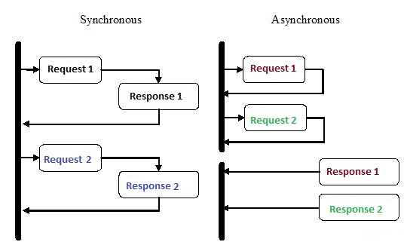

What is async?
Parallel
Not Parallelism

Slide 3
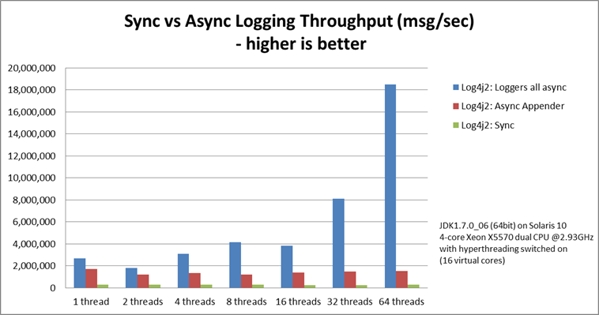
What is async?
Fast/
Ligtweight

Slide 4
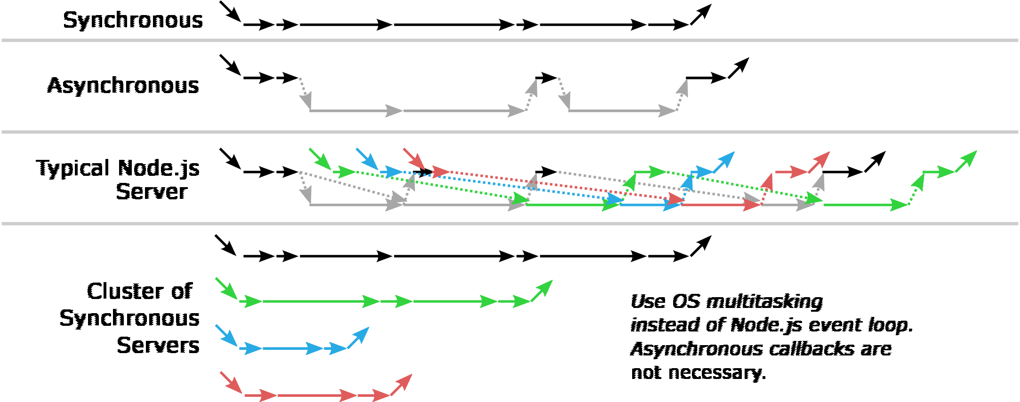
What is async?
Sometimes Fast
Async cannot speed up CPU bound programs

Slide 5
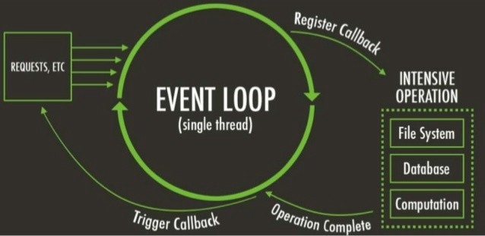
Async event loop

Slide 6
Callbacks -> Callback Hell -> Promise/Futures
*Javascript (ES6/Node)

Slide 7
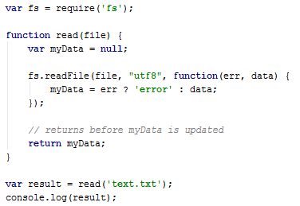
Callbacks
Javascript has built in asynchronous functionality. Many use cases would hurt responsiveness and availability if they were blocking the main thread of execution.
null

Slide 8
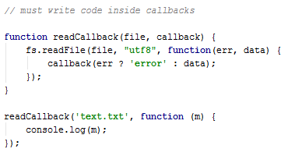
Callbacks
Callbacks are the go to solution to enforce proper order of execution. You must pass in a function that gets called once the IO (async) process is complete.
“text”

Slide 9
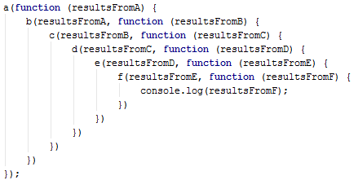
Callback Hell
Callbacks lead to complex code, with deeply nested function definitions. Hard to read code can be avoided by using wrappers like promises.
Flat is better than nested. - Tim Peters, Zen of Python

Slide 10
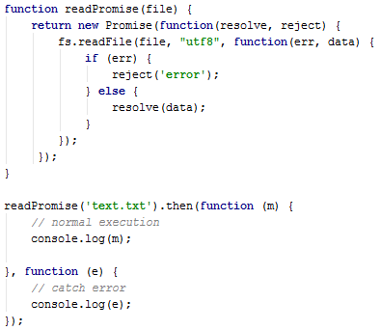
Promise/Futures
ES6 Promise Api
A Promise object is essentially a wrapper of callbacks and built in error handling. “It represents the eventual completion (or failure) of an asynchronous operation, and its resulting value.” - MDN Docs

Slide 11
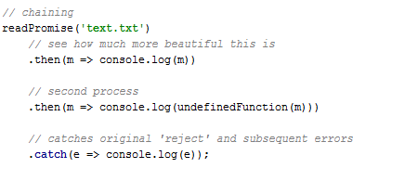
Promise/Futures
Promises allow you to write synchronous looking code while still utilizing async. This results in a cleaner and more intuitive code base.
It also makes error handling look like traditional code, with leads to less mistakes when catching errors.

Slide 12
Generators -> Coroutines -> “Async/Await” Syntax
*Python 3.5+

Slide 13
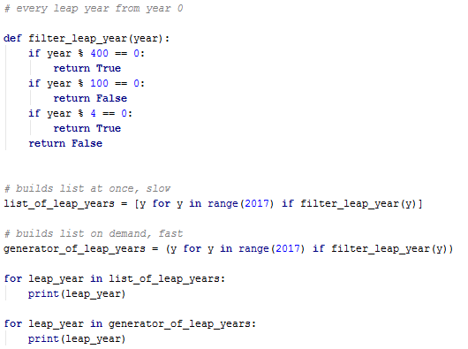
Generators
Generators are borrowed from functional languages. Python has them baked into the standard library, i.e. “range”, “__iter__”.
They can be used to minimize the heap required to store lists of objects that can be generated dynamically.

Slide 14
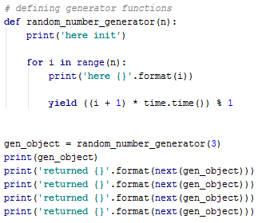
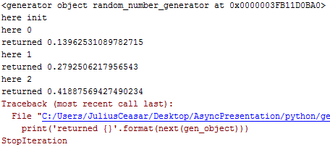
Generators
You can define your own generators by using “yield” instead of “return”. Python automatically knows to make this function a generator.
The state of this function’s execution (stack) is stored in memory until another “next” is called.

Slide 15
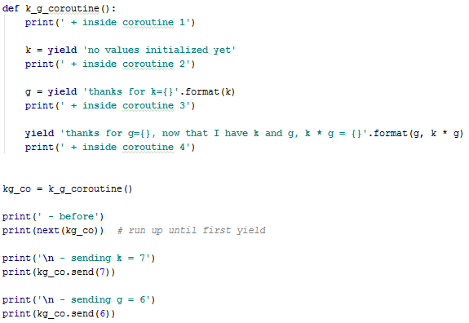
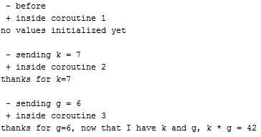
Coroutines
A coroutine is a generator that you pass in data throughout it’s lifetime.
“Yield” allows the stack to ‘pause’ until another piece of data is passed in.

Slide 16
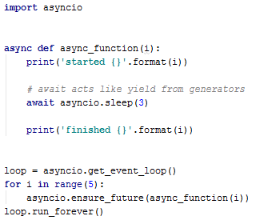
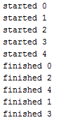
Async / Await
“Await” is syntactic sugar for “yield”. However the function is still essentially a coroutine.
The event loop is Python’s way of letting the developer have access to the underlying async framework. Some languages abstract this away.
3 second delay

Slide 17
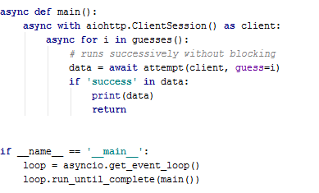
Async for IO

Slide 18
The End
Async is better for IO heavy applications
Async programming requires extra work to enforce proper execution
Application level languages have ways to make async programming easier with wrappers and syntactic sugar
Questions?

Slide 19
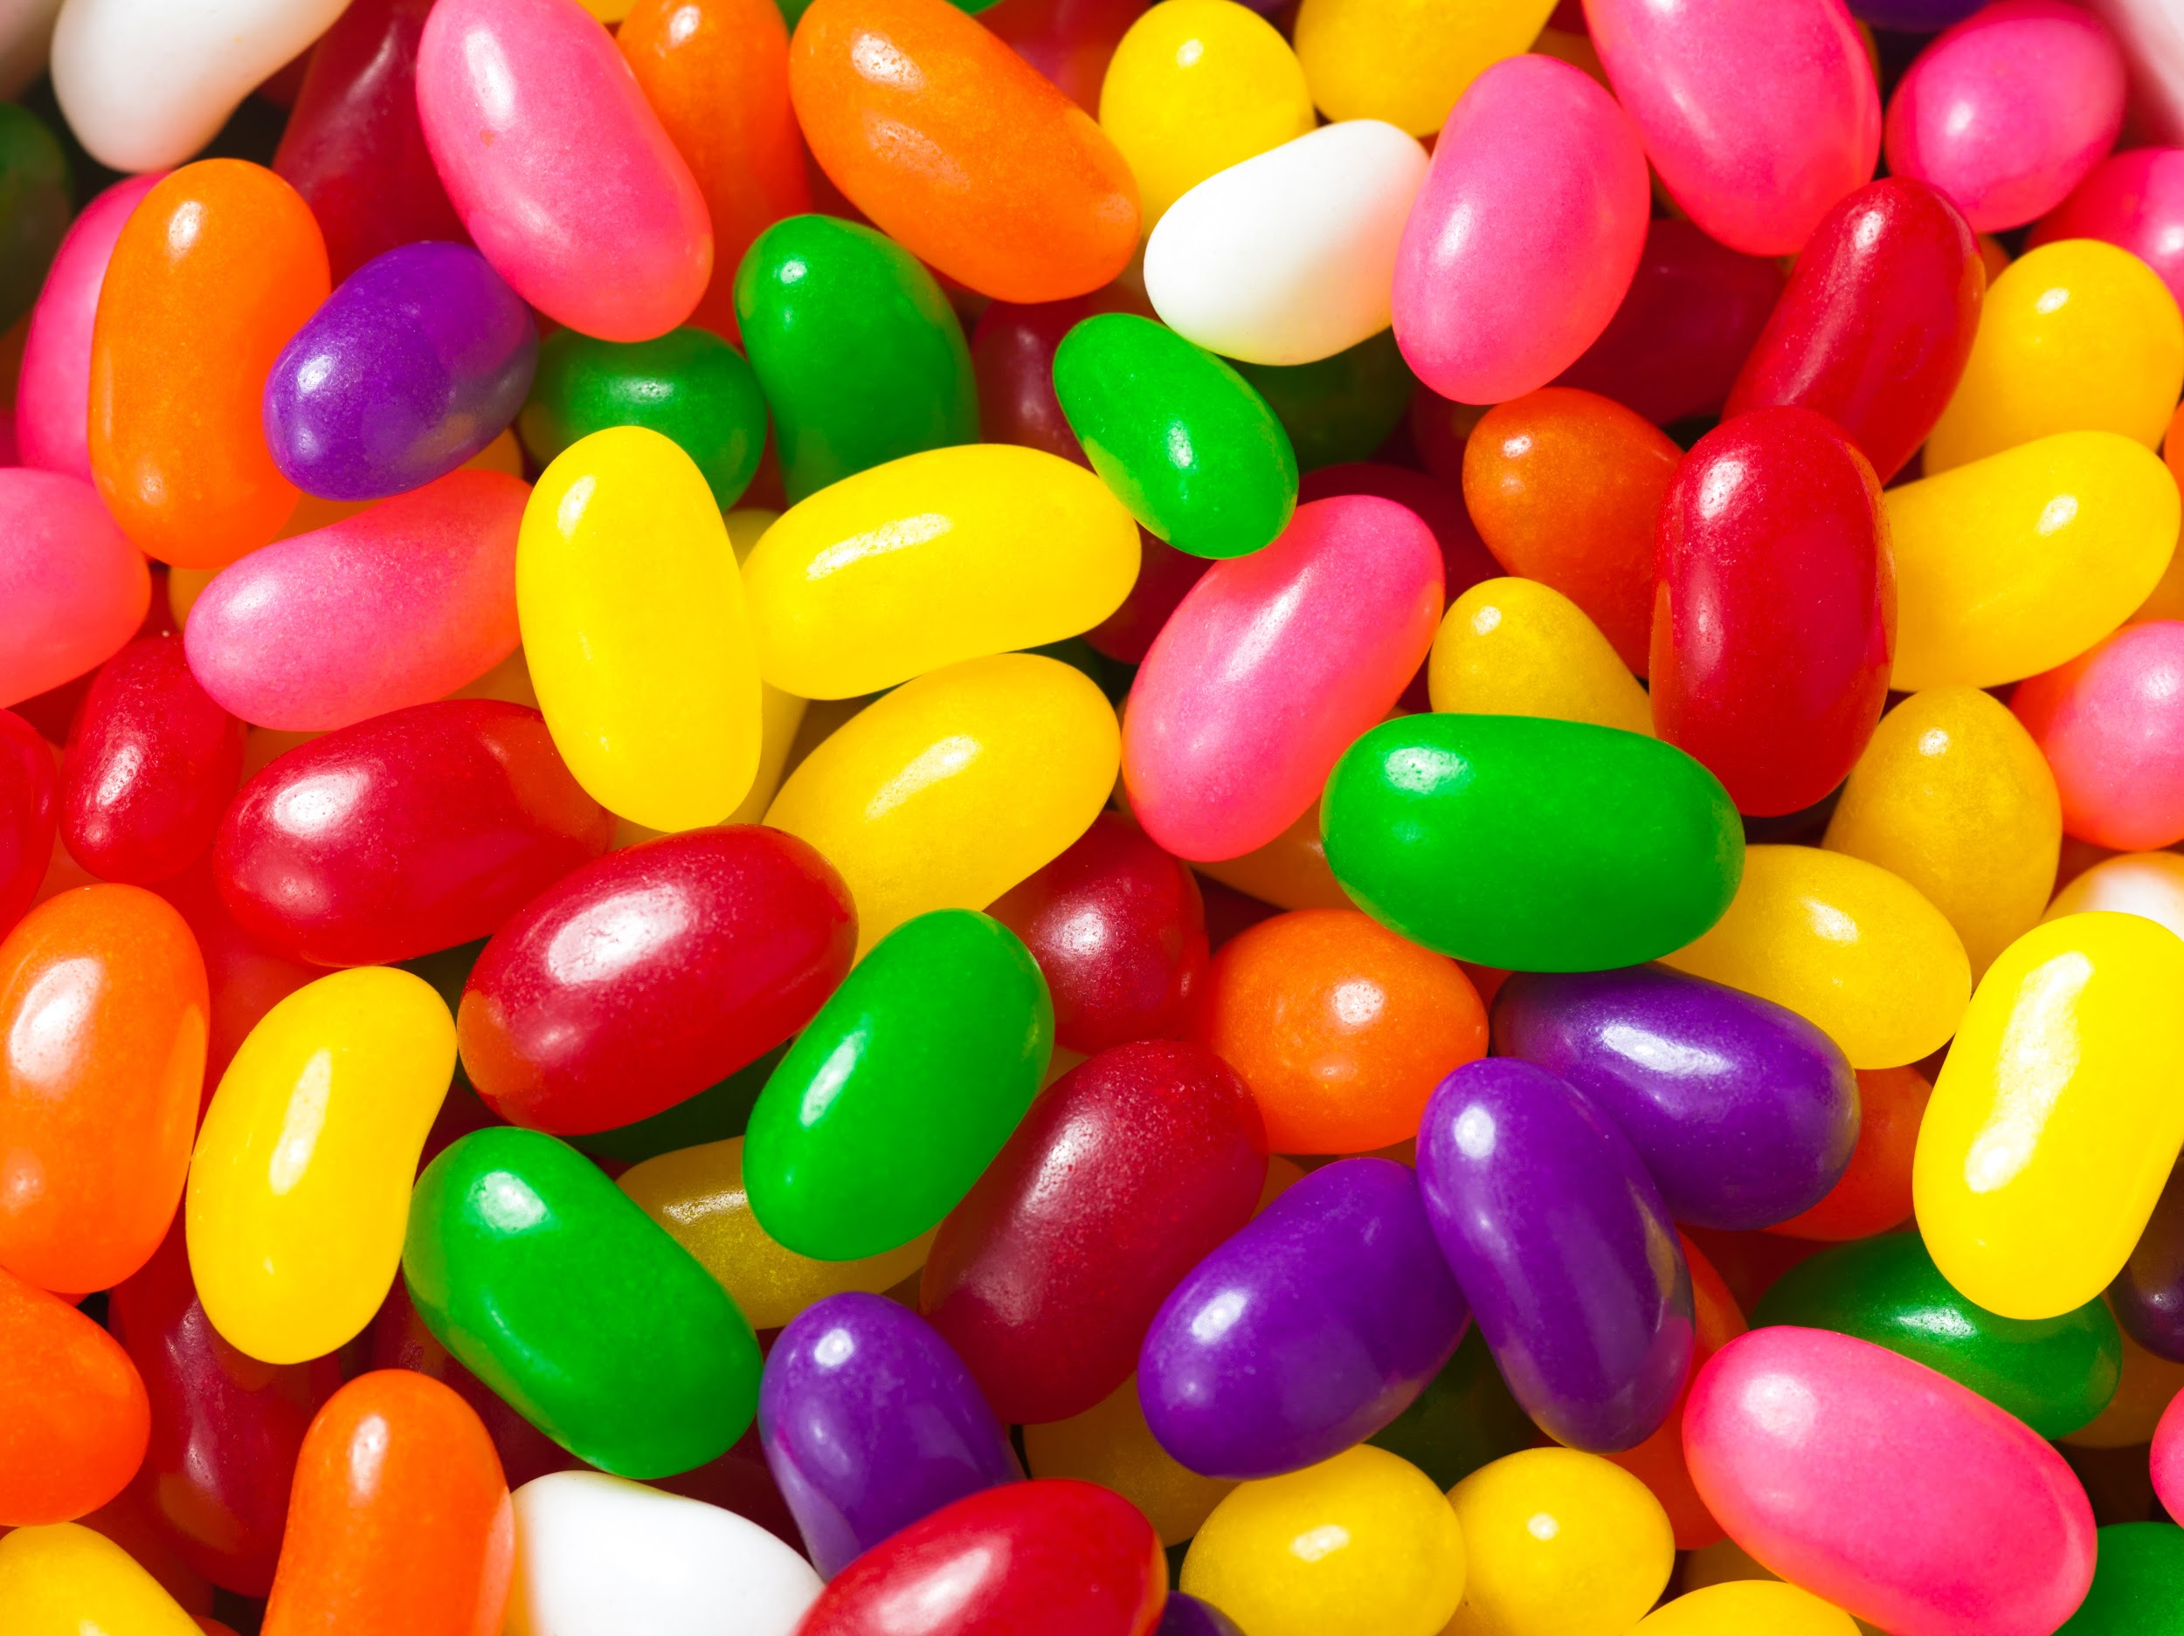
Ref:
https://www.python.org/dev/peps/pep-0020/
https://developer.mozilla.org/en-US/docs/Web/JavaScript/Reference/Global_Objects/Promise
http://callbackhell.com/
https://docs.python.org/3/library/asyncio.html
https://docs.python.org/3/library/asyncio-task.html

