Slide 1
Asynchronous Programming
callbacks, futures, coroutines, generators
Tyler Haden

Slide 2
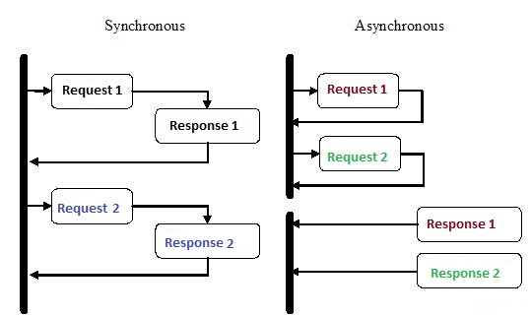

What is async?
Parallel
Not Concurrency

Slide 3
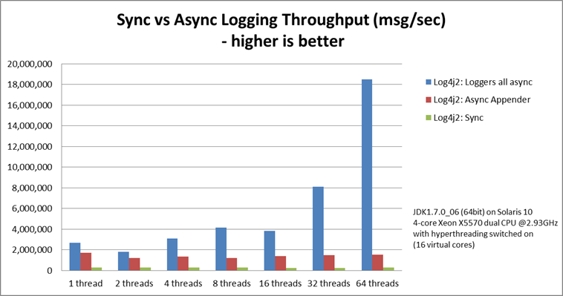
What is async?
Fast

Slide 4
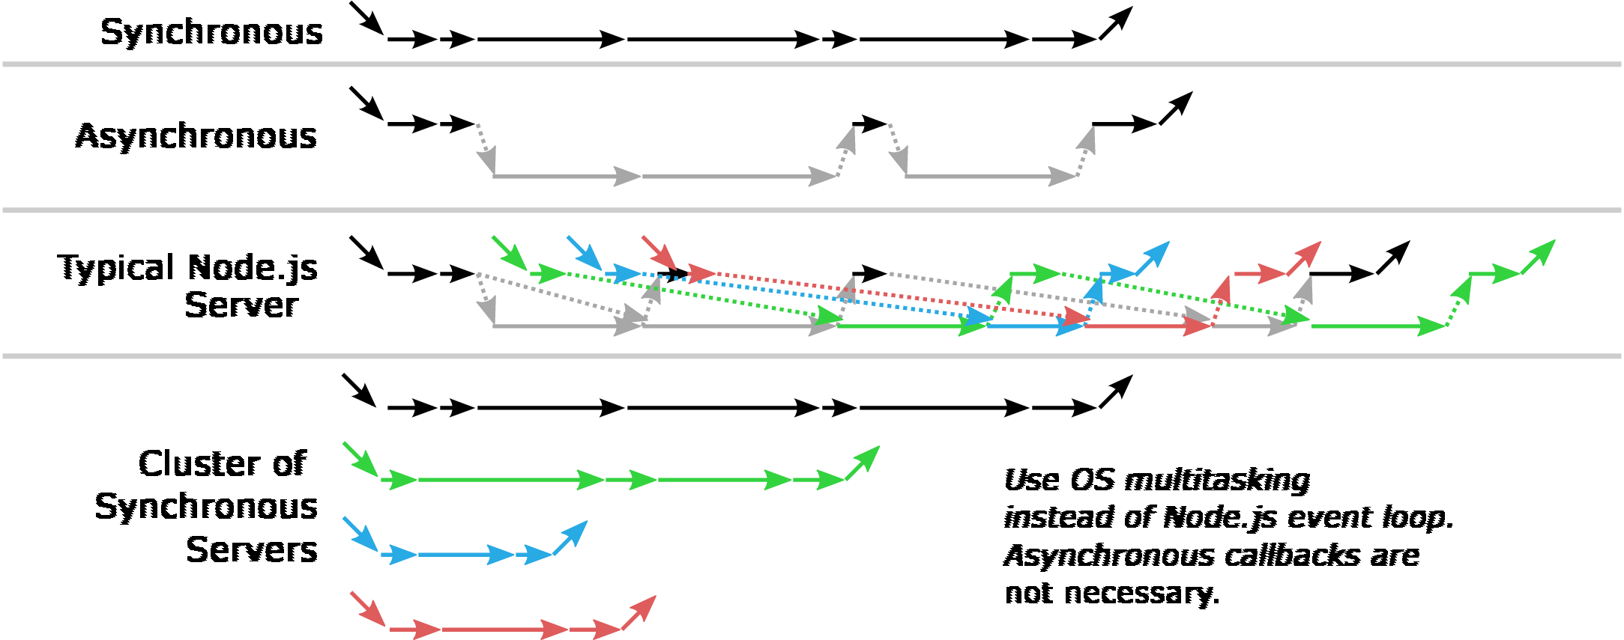
What is async?
Sometimes Fast
Async cannot speed up CPU bound programs

Slide 5
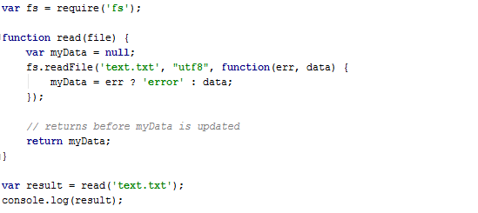
Callbacks
null

Slide 6
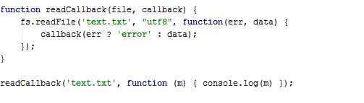
Callbacks
“text”

Slide 7
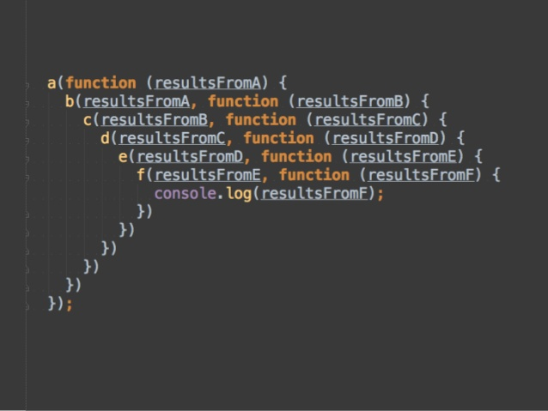
Callback Hell

Slide 8
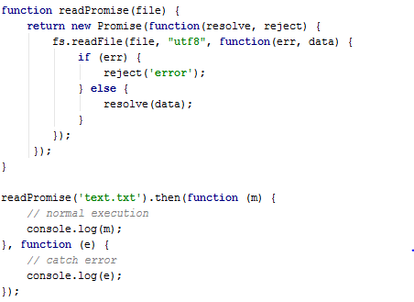
Promises / Futures
Just more callback headache?

Slide 9
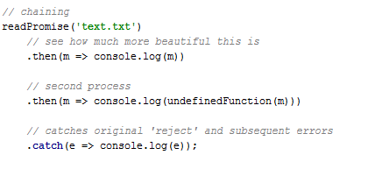
Promises / Futures

Slide 10
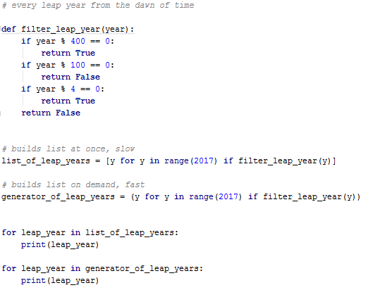
Generators

Slide 11
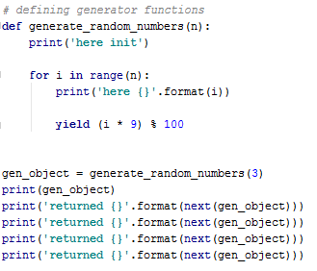
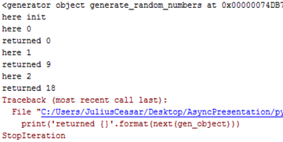
Generators

Slide 12
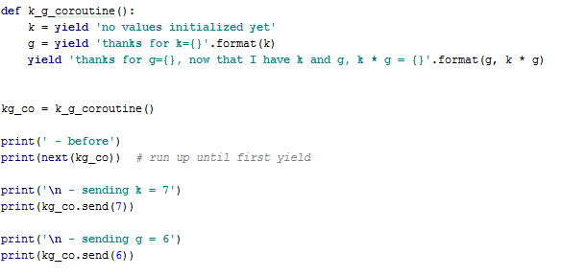
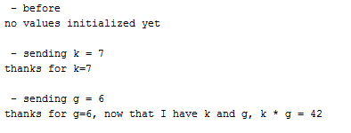
Coroutines

Slide 13
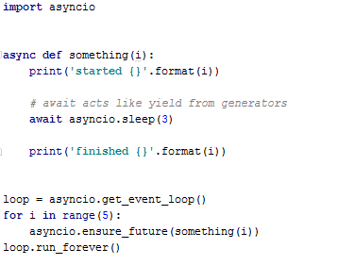
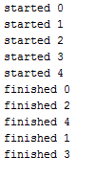
Async / Await

Slide 14
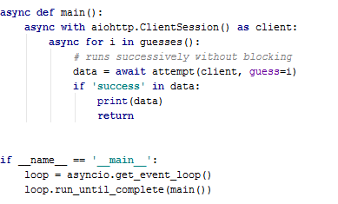
Async for IO

Slide 15
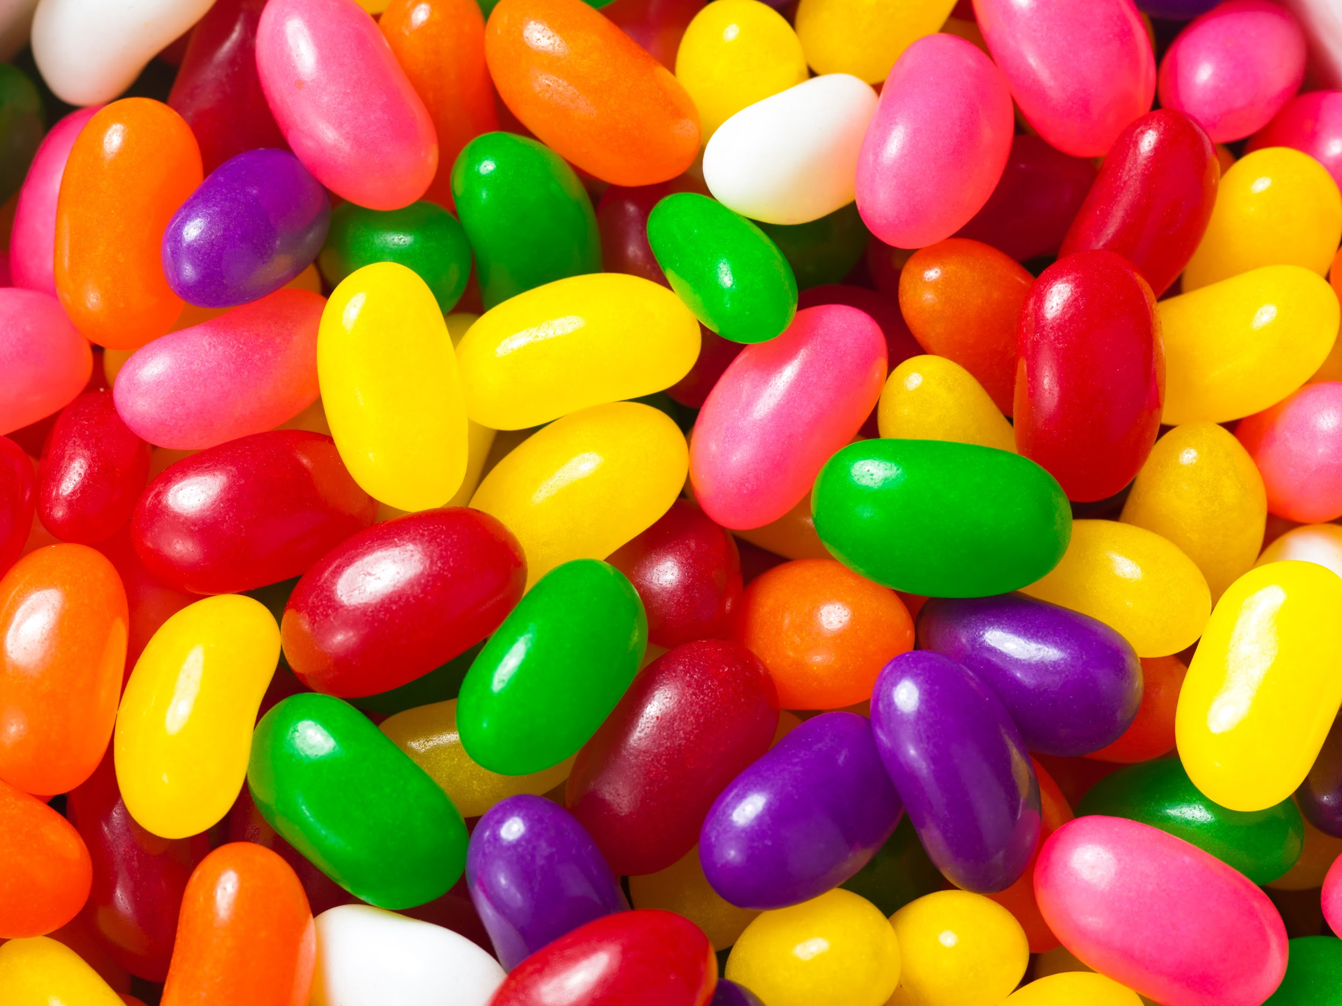
The end

