Slide 1
Logistic Regression Final Project
By: Tyler Klink

Slide 2
Dataset Summary
Dataset: Toyota Used Cars Market Insights – Kaggle
Rows (Used Cars) - 6,738
Original Columns (9): price, year, mileage, fuel type, transmission, engine size, mpg, tax, model
Engineered Columns (2): Age (newest year − car year), High Price (1 if price > median, 0 otherwise)

Slide 3
Research Question
Research Question: Can we predict whether a Toyota vehicle is priced above or below the median price based on mileage, age, fuel type, transmission, and other features?
Target Variable: ”High Price” (Price > Median Price)
Binary (0 = Price < Median Price, 1 = Price > Median Price)

Slide 4

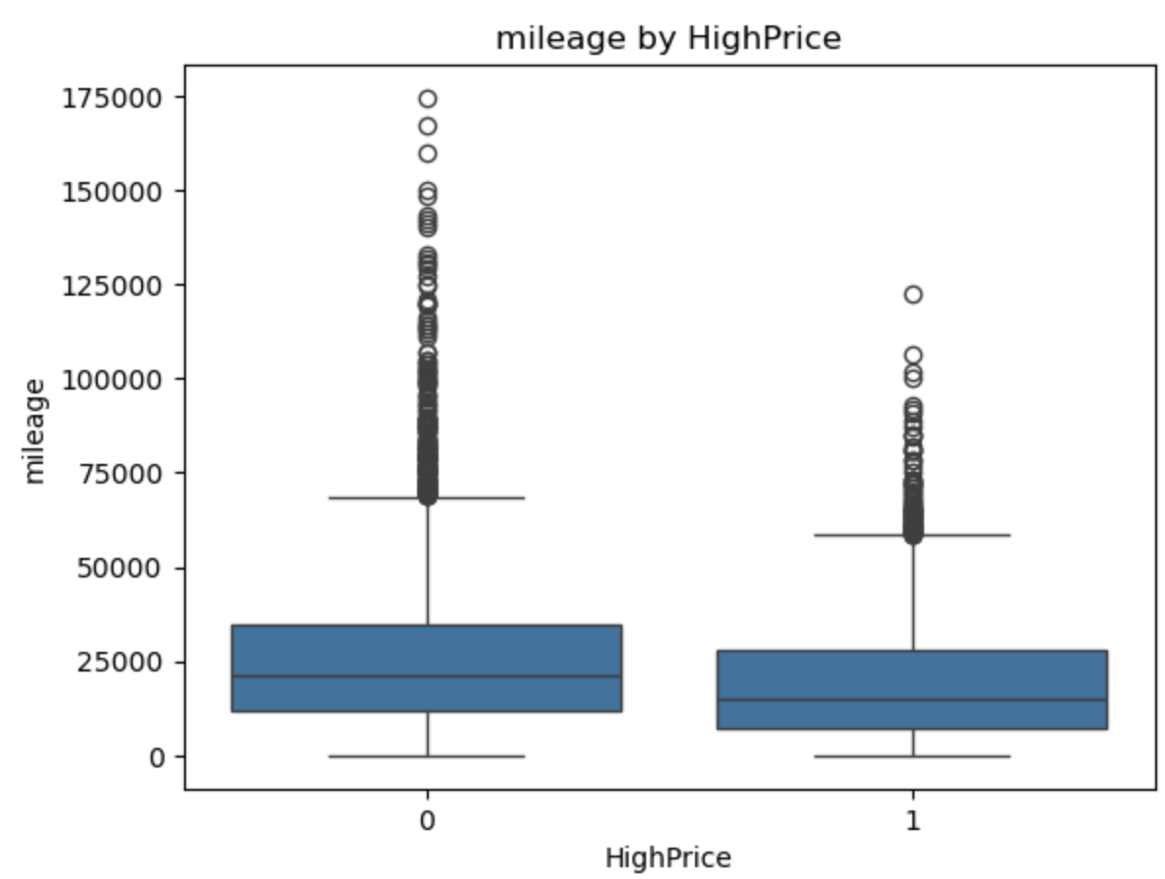
Python EDA
High price cars tend to have lower mileage

Slide 5
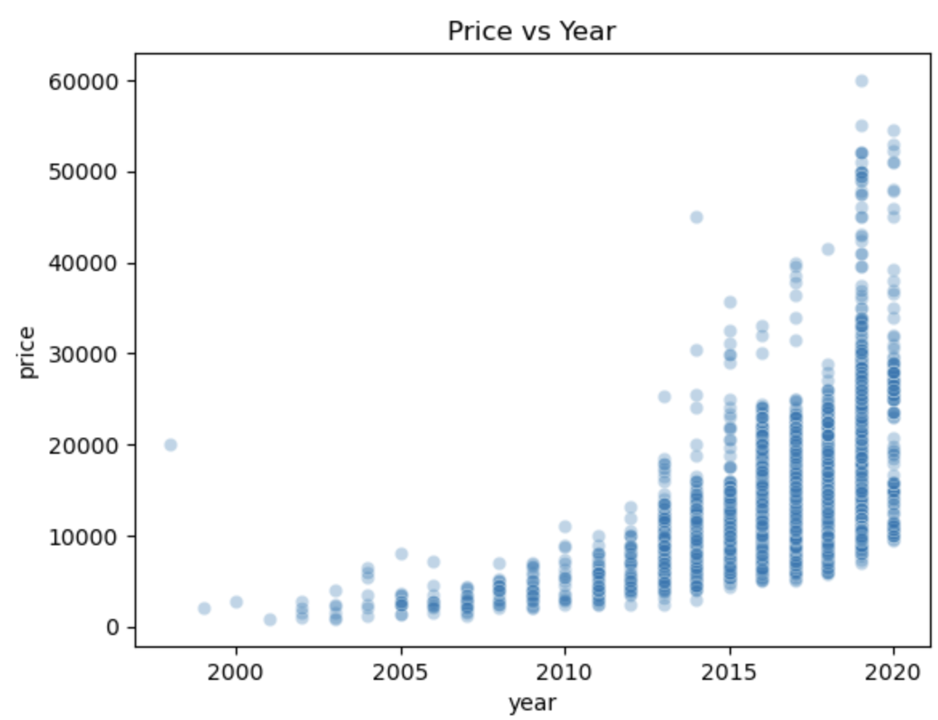
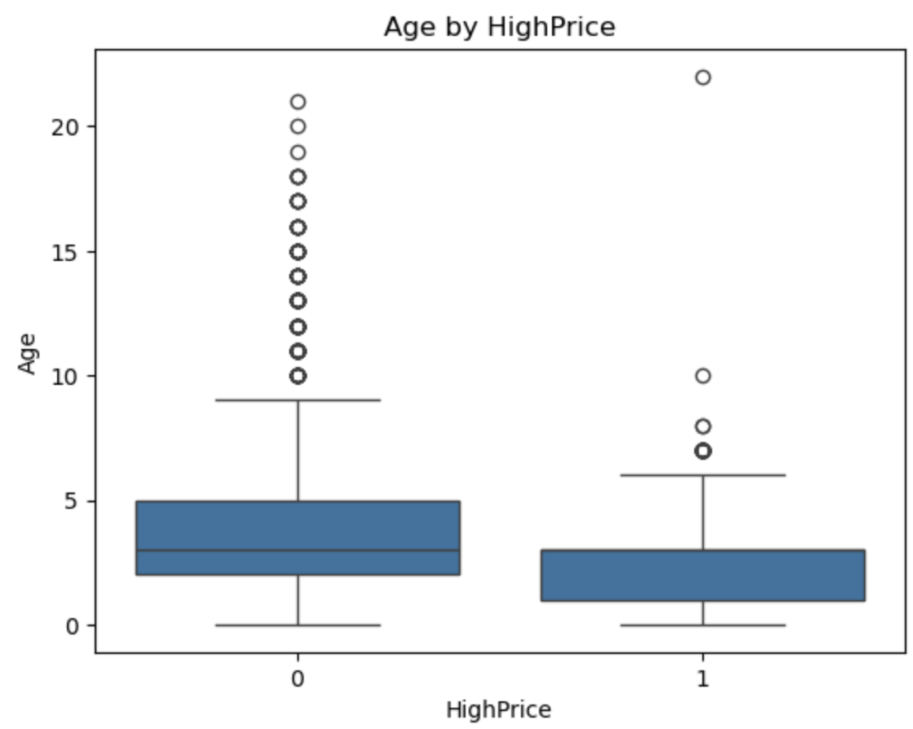
Python Eda
Newer vehicles are more likely to be high-priced

Slide 6
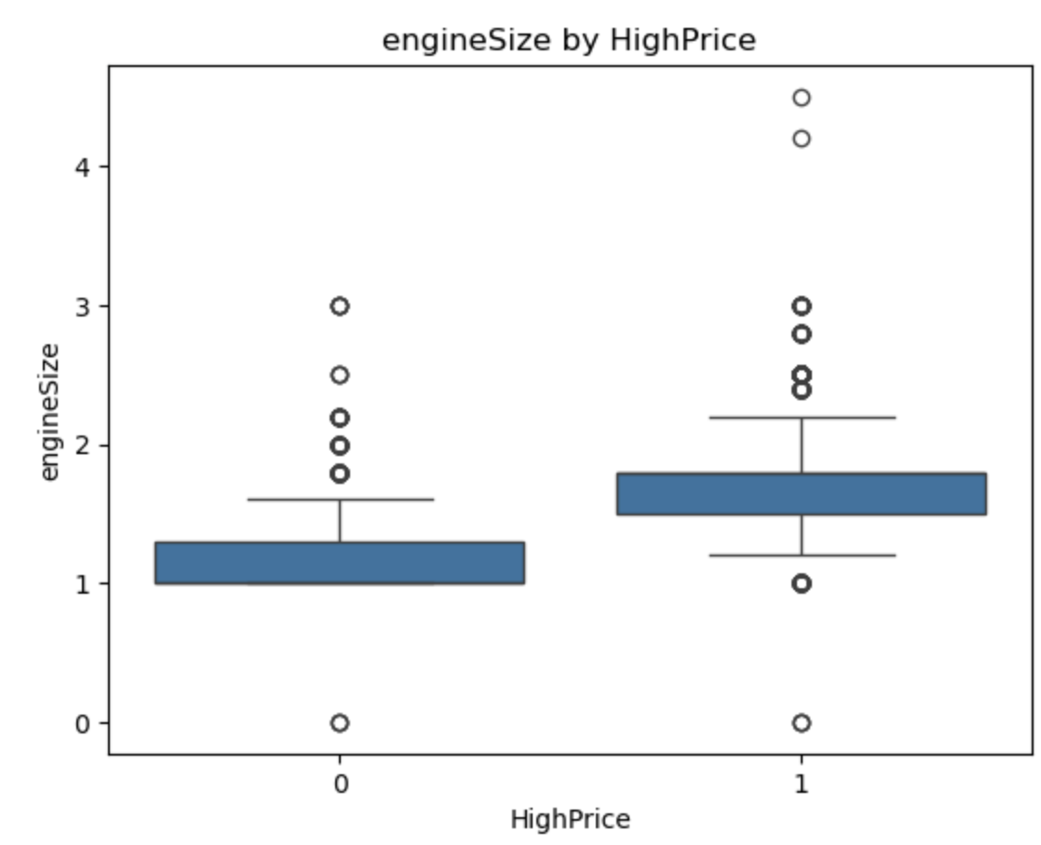
Python EDA
Larger engine size is associated with higher prices

Slide 7
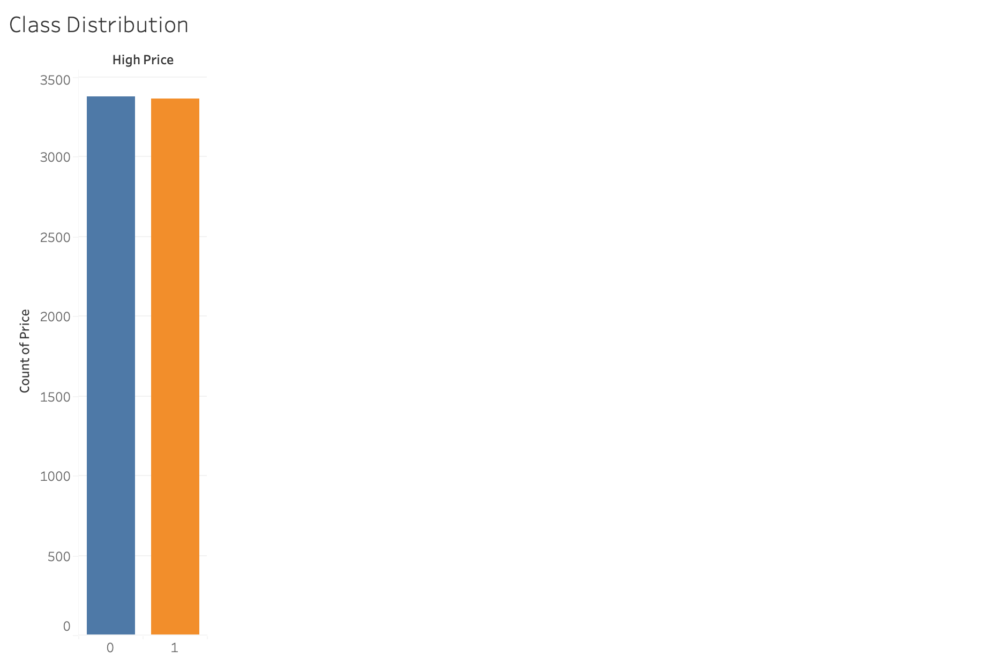
Tableau Dashboards
High Price Count: 3,363
Low Price Count: 3,375

Slide 8
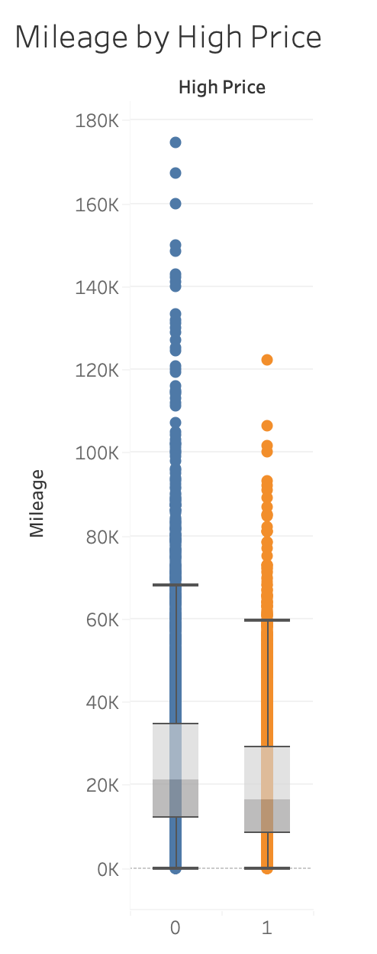
Tableau Dashboards
Mileage Increase ➔ Price Decrease

Slide 9
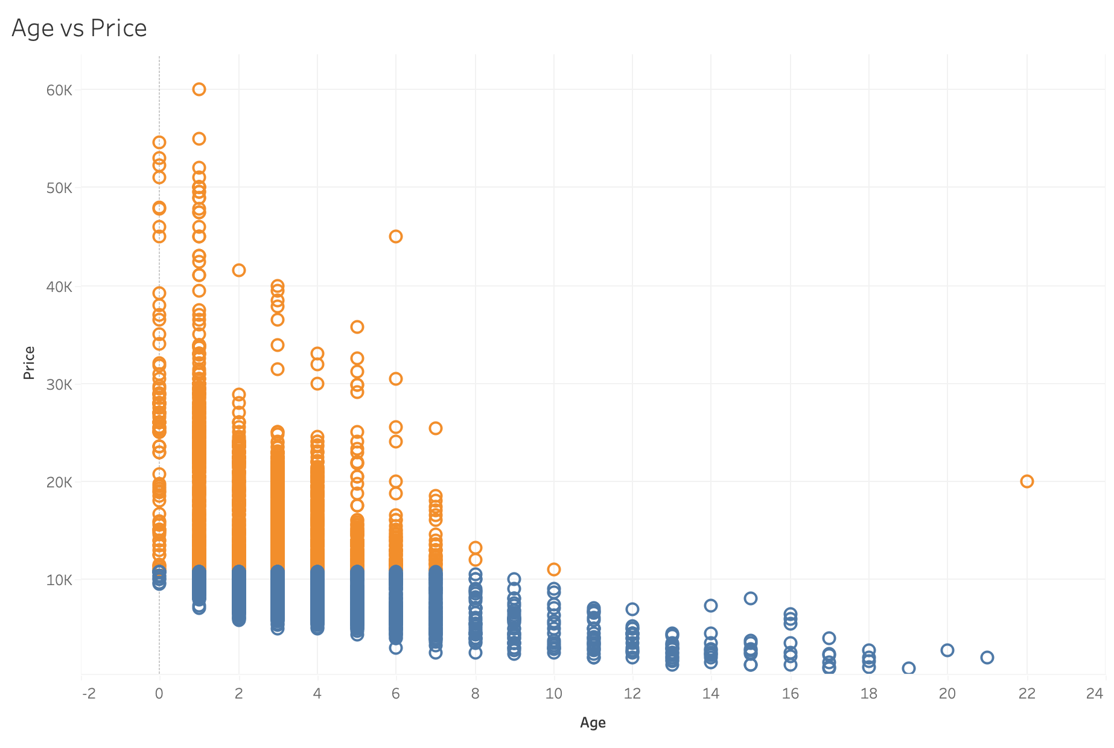
Tableau Dashboards
Age Increase ➔ Price Decrease

Slide 10
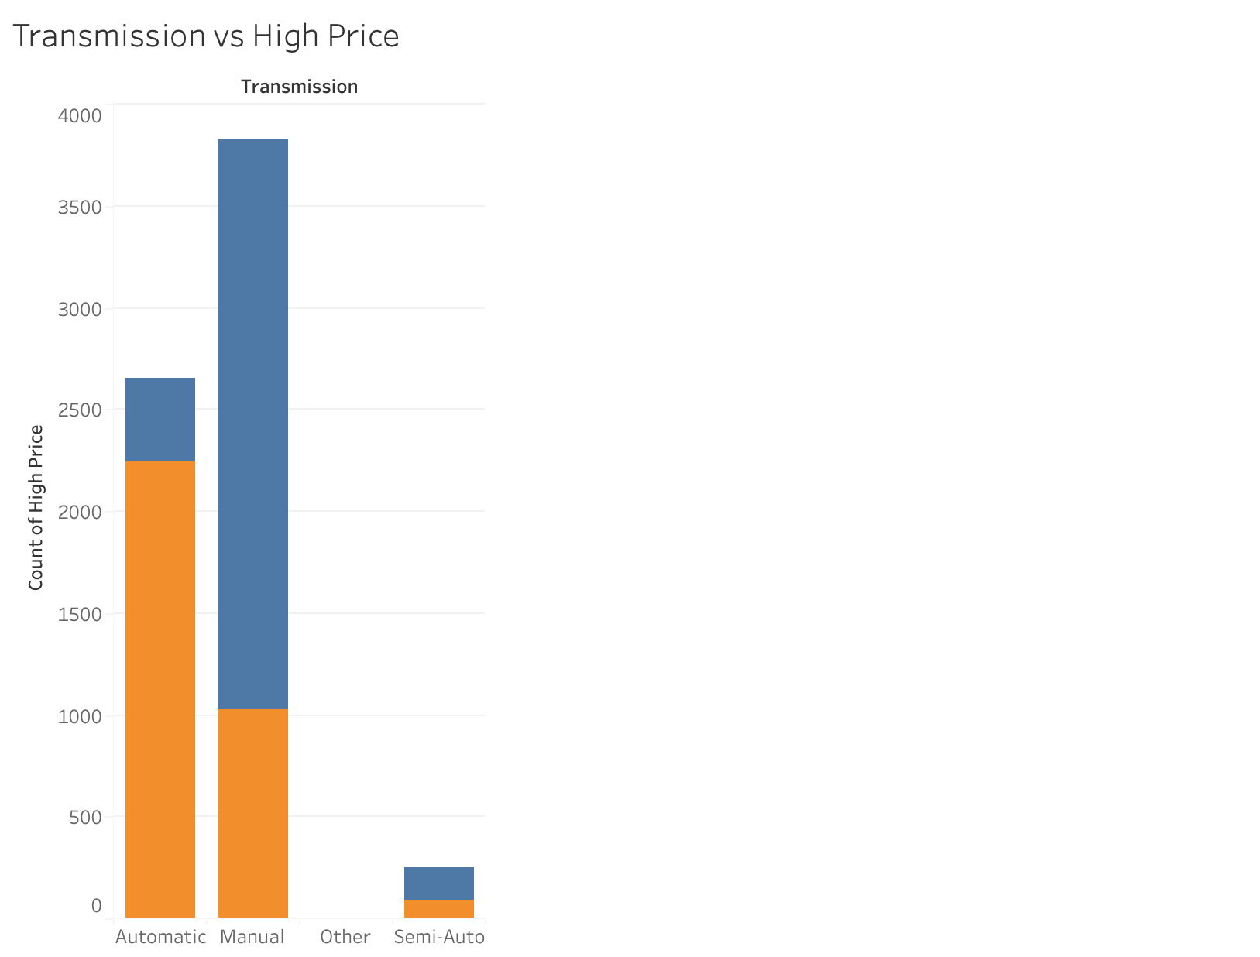
Tableau Dashboards
Automatic Transmission ➔ Price Increase
Manual Transmission ➔ Price Decrease

Slide 11
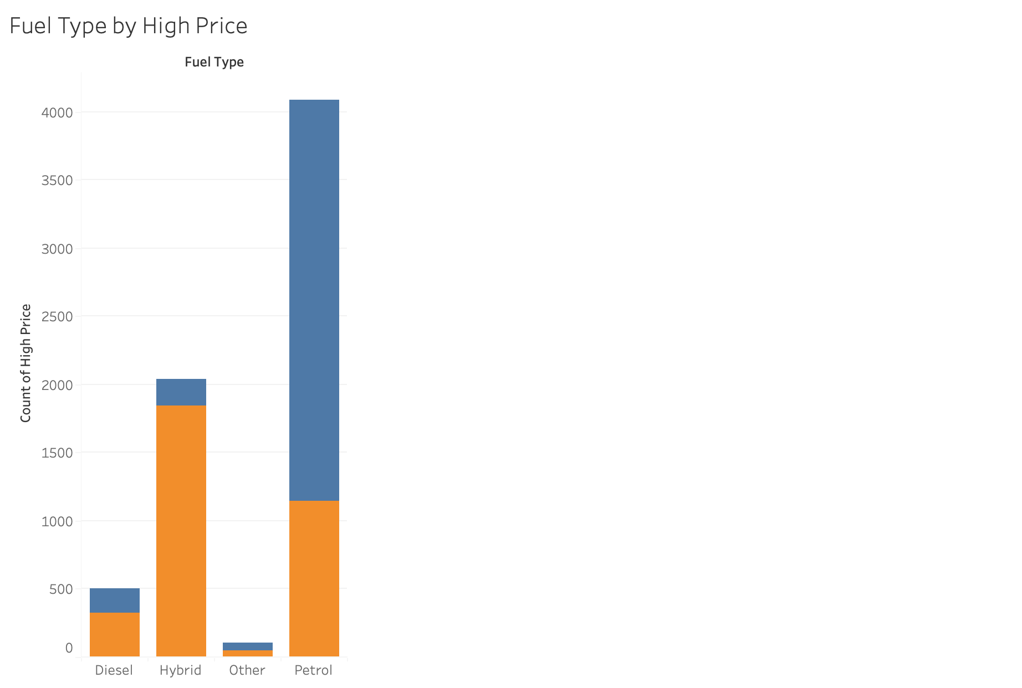
Tableau Dashboards
Hybrid and Diesel Fuel ➔ Price Increase
Petrol ➔ Price Decrease

Slide 12
Model Training Summary
To prepare the data for modeling, missing values were removed and all relevant variables were organized into numerical form. The data was split into training and testing sets, with 75% of the data used to train the model and 25% used to evaluate its performance.
A logistic regression model was then trained to classify vehicles as either priced above or below the median. This model was chosen because it is well-suited for binary classification problems and provides interpretable results.

Slide 13
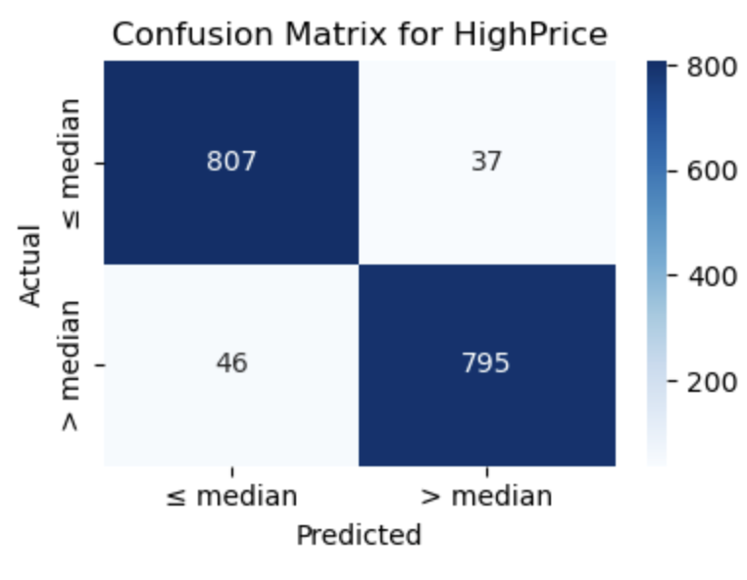
Confusion matrix + metrics
Model performance was evaluated using a confusion matrix and standard classification metrics. The confusion matrix shows how many vehicles were correctly and incorrectly classified as high-price or low-price. Most predictions fall along the diagonal of the matrix, indicating strong overall performance.
The model achieved an accuracy of approximately 87% to 90%, with balanced precision and recall across both classes. This indicates that the model performs consistently and does not favor one price category over the other.

Slide 14
Key Insights
Vehicles with lower mileage were significantly more likely to be priced above the median, indicating that mileage is a strong indicator of vehicle value.
Newer vehicles were much more likely to fall into the high-price category, showing a clear relationship between age and price.
Cars with larger engine sizes tended to be priced higher, suggesting that engine capacity contributes positively to market value.
Vehicles with automatic or semi-automatic transmissions were more commonly classified as high-priced compared to manual transmissions.
Hybrid fuel types were more likely to appear in the high-price category, reflecting market preferences for fuel efficiency and newer technology

Slide 15
Conclusion
Vehicle characteristics can be used to reliably predict whether a Toyota is priced above or below the median market price.
Mileage and vehicle age were the most influential factors, with newer cars and lower-mileage vehicles more likely to be high-priced.
Logistic regression proved to be an effective and interpretable method for this classification task.
The model’s results were consistent with both the exploratory data analysis and real-world expectations of the used car market.

