Slide 1

Exploring and Modeling Education & Career Success
Analyzing Factors Influencing Career Outcomes
Tyler Leech

Slide 2
Objectives
Understand key factors influencing education & career success
Build predictive models for outcomes such as current job level

Slide 3
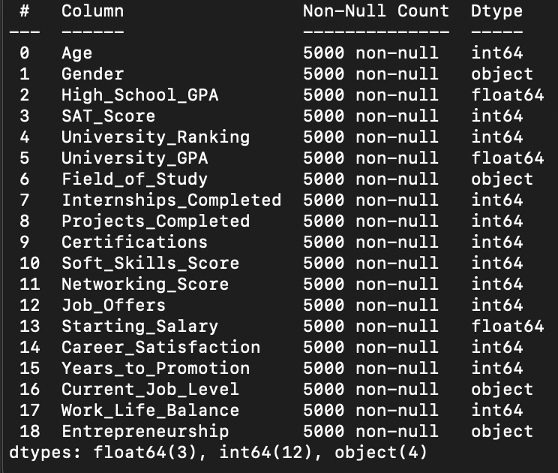
Dataset
Key features: Age, High School GPA, SAT Score, University performance metrics, Internship/Project data, Job Offers, Starting Salary, and categorical variables like Gender and Current Job Level

Slide 4
Exploratory data analysis

Slide 5
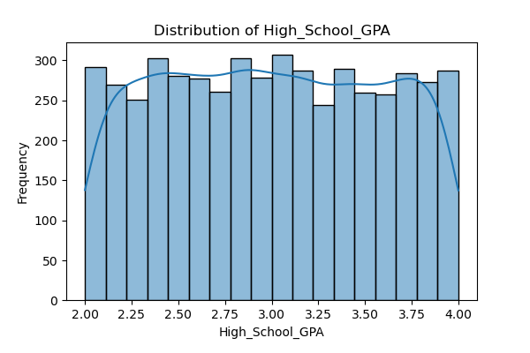
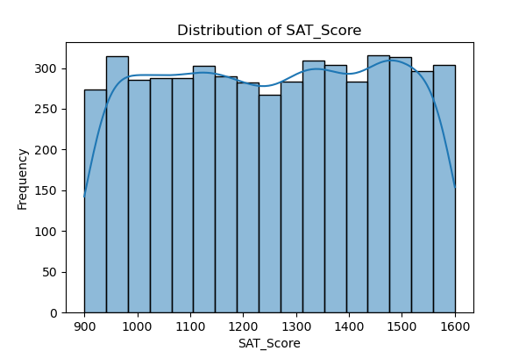
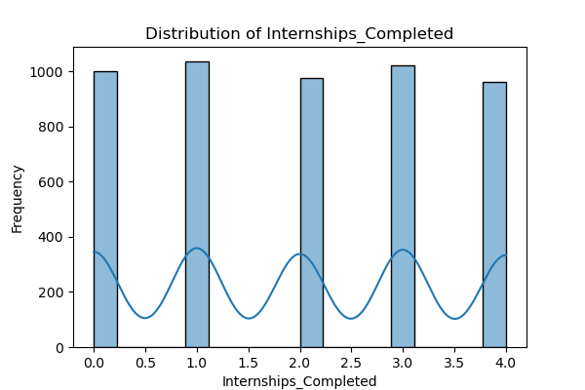
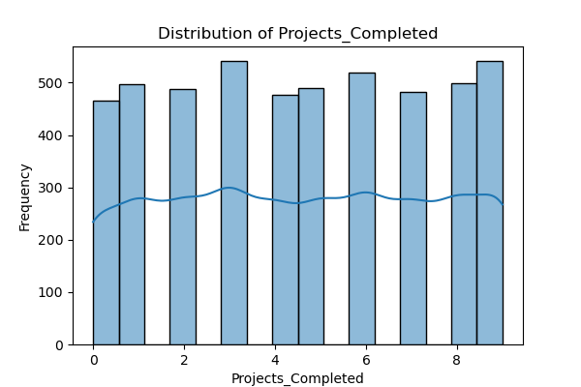
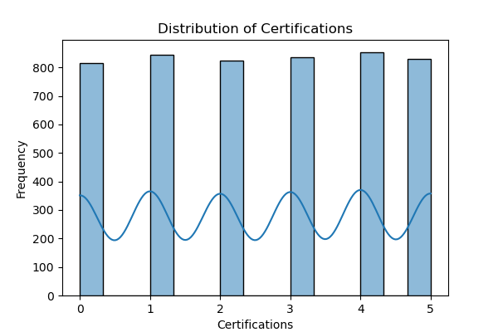
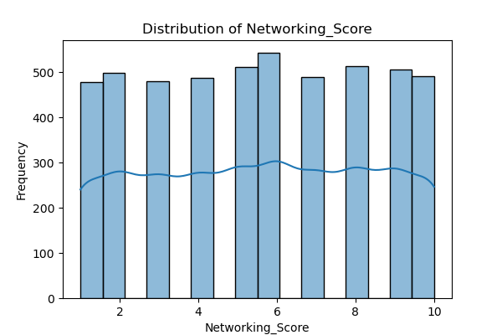
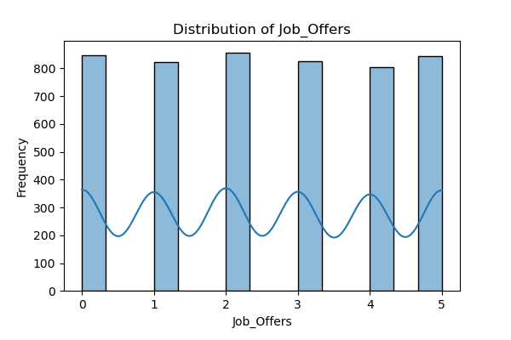
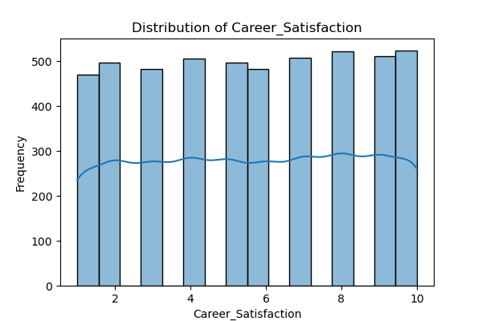
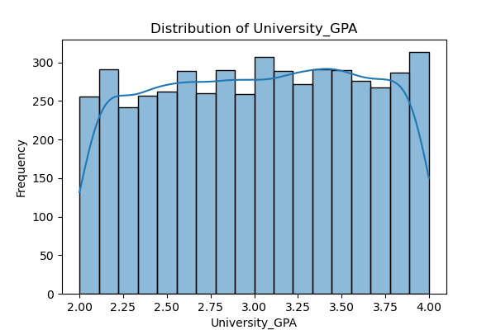
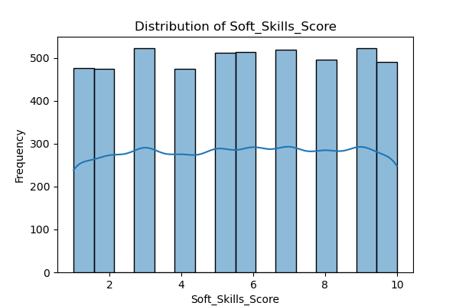
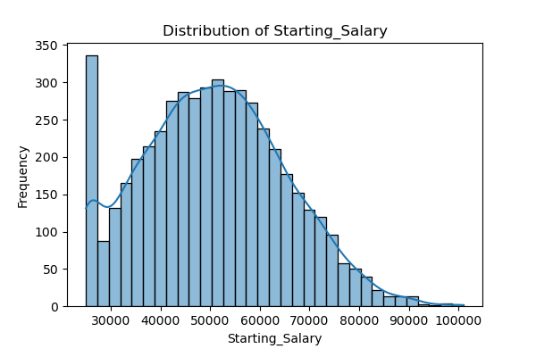
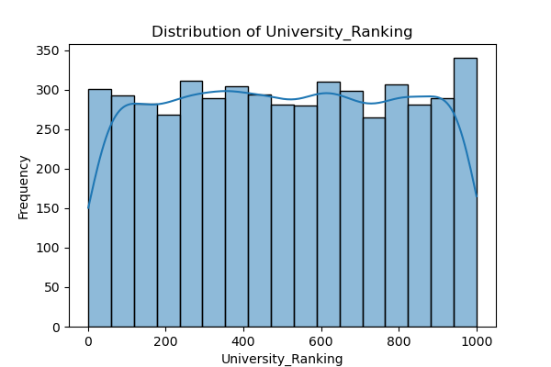
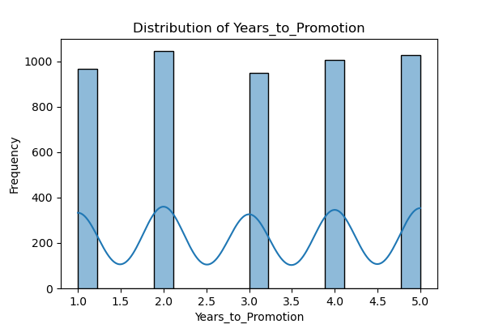
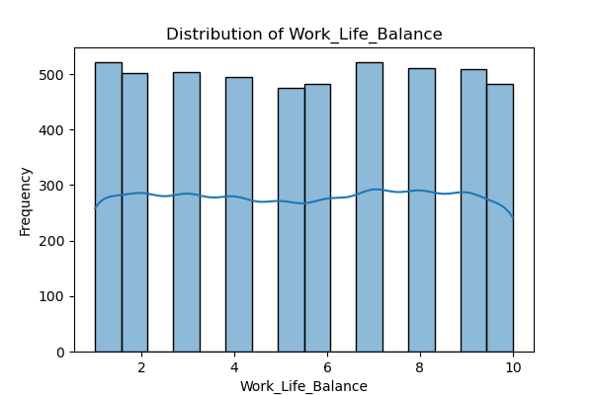

Slide 6
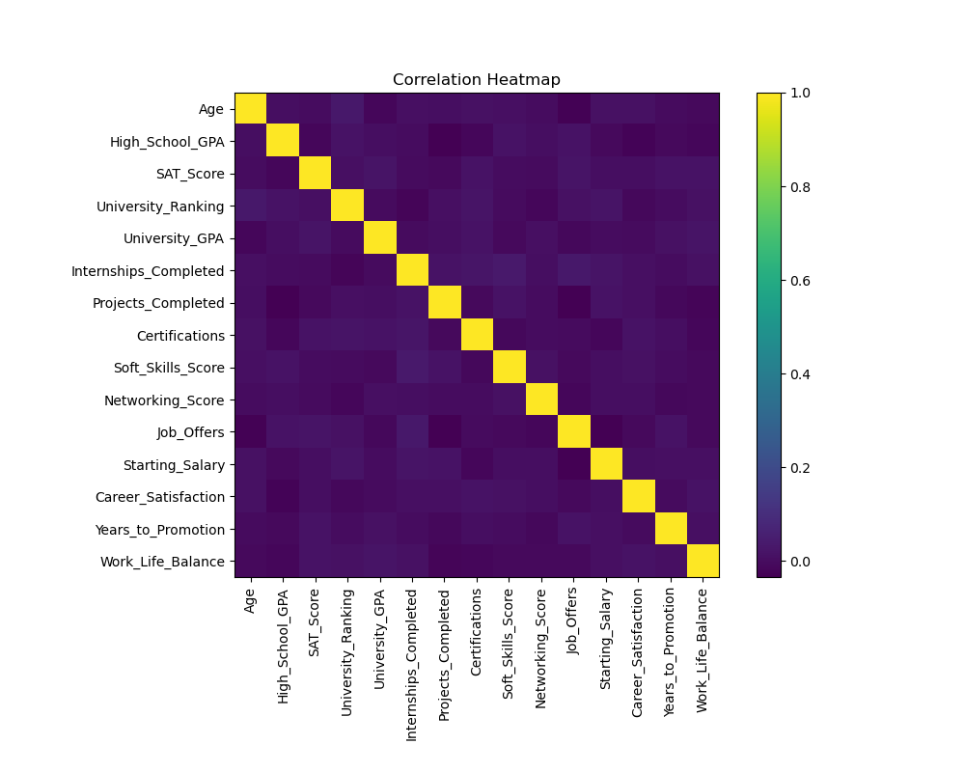

Slide 7
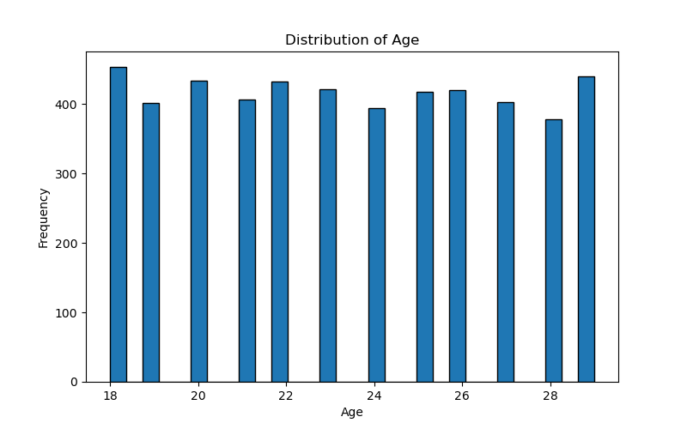
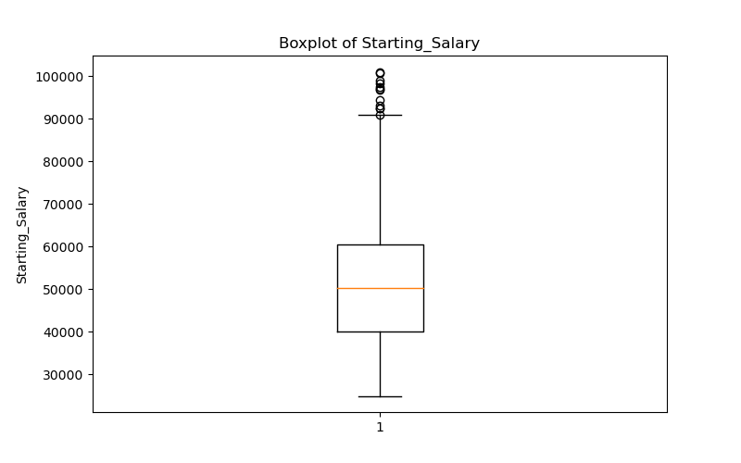

Slide 8
Data preprocessing
Handling missing values and removing duplicates
Dataset was clean
Outlier Removal
Starting_Salary
Encoding categorical features
One-hot encoding
Feature scaling with RobustScaler

Slide 9

Modeling & Analysis

Slide 10
Modeling Approach
Baseline: Gaussian Naïve Bayes
Sophisticated: Gradient Boosting Classifier

Slide 11
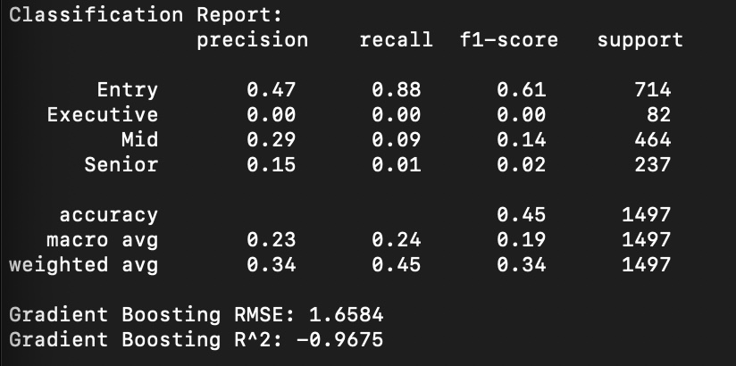
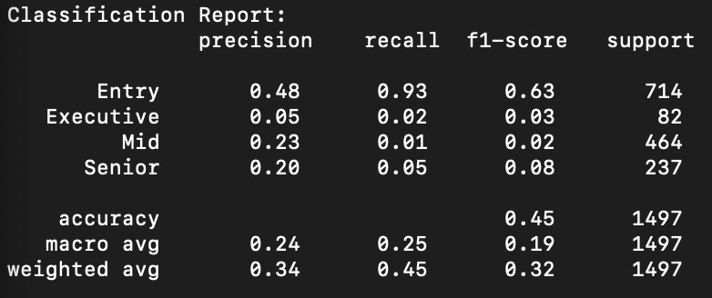
Classification

Slide 12
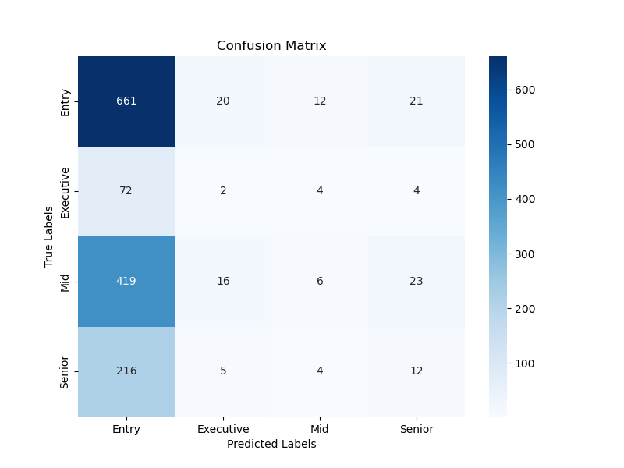
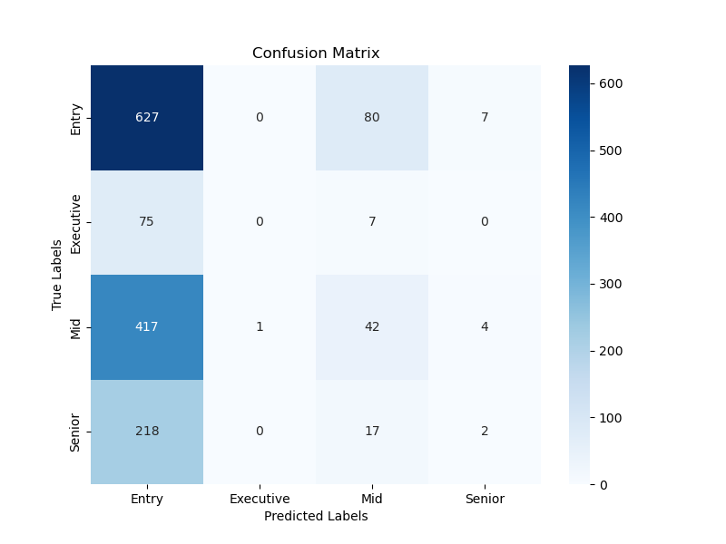
Model Evaluation

Slide 13
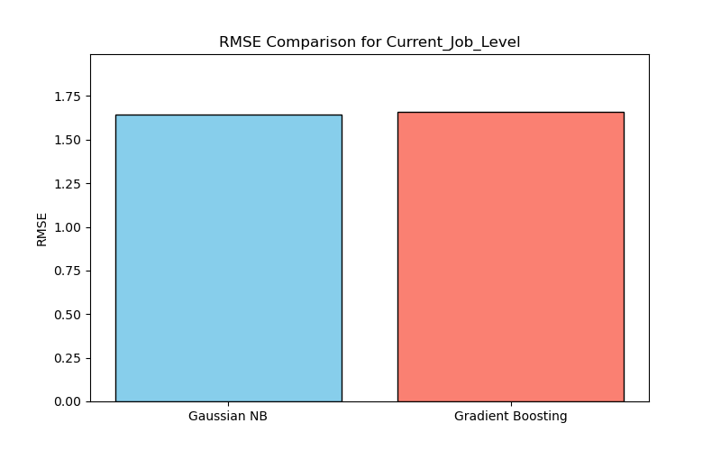
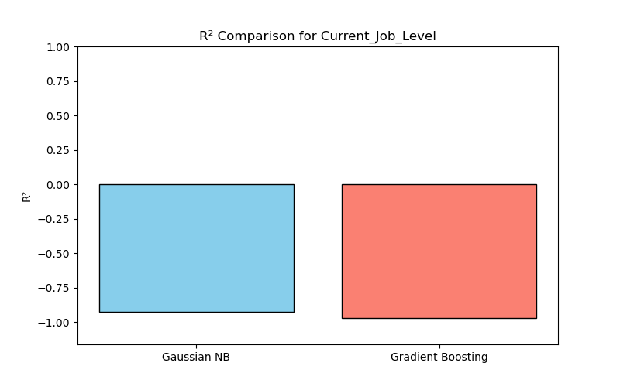
Model Comparisons
1.6412
1.6584
-0.9269
-0.9675

Slide 14

Limitations & Challenges
Limited variability
Capturing complex career success dynamics
Possible data quality or feature relevance issues

Slide 15
Fixes
Further feature engineering
Exploring additional models
Additional validation techniques
Practical implications

