Slide 1


Applying Kernel Change Point Algorithms to Financial Markets
CIISE
M.A.Sc Thesis Defence
August 2020
By
Tyler Manning-Dahan
Supervised By
Dr. Jia Yuan Yu

Slide 2
Presentation Roadmap
Introduction
Kernel Change Point Detection
Application to Financial Market Liquidity
Conclusion

Slide 3

Part I:
Introduction

Slide 4

Motivation
Data is processed non-stop
Part of more and more everyday apps
Monitoring tools need real-time analysis

Slide 5
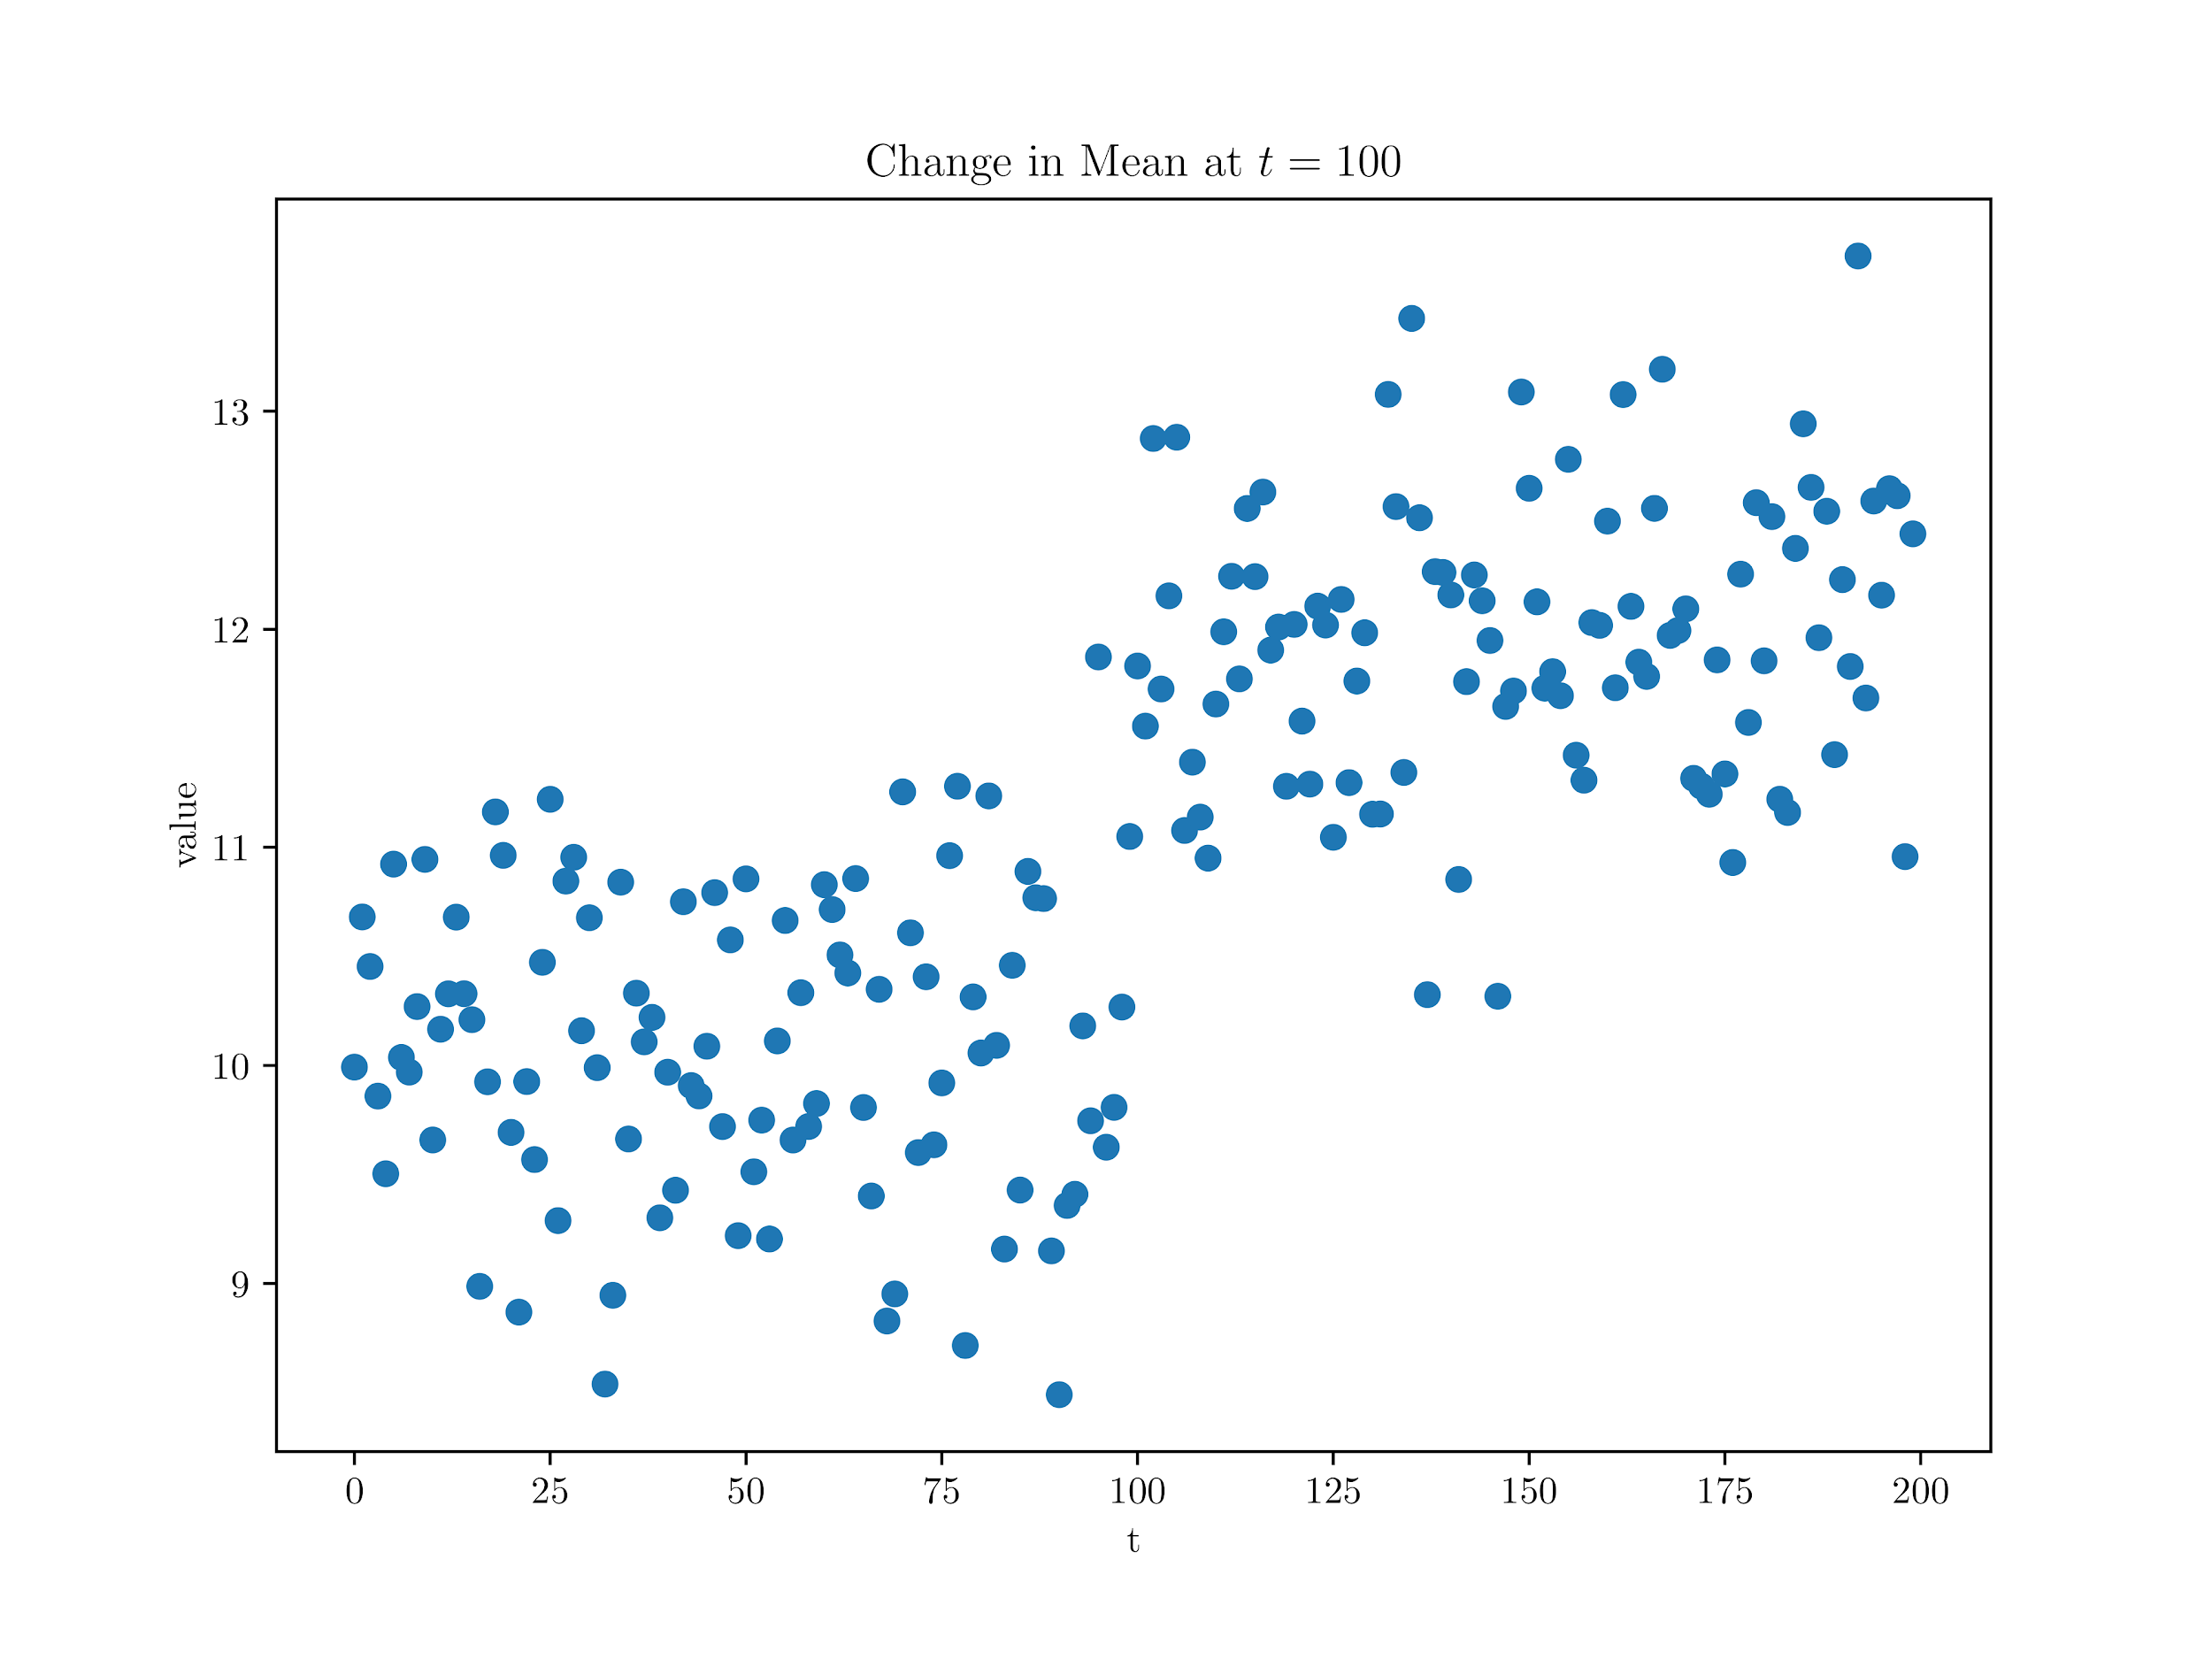
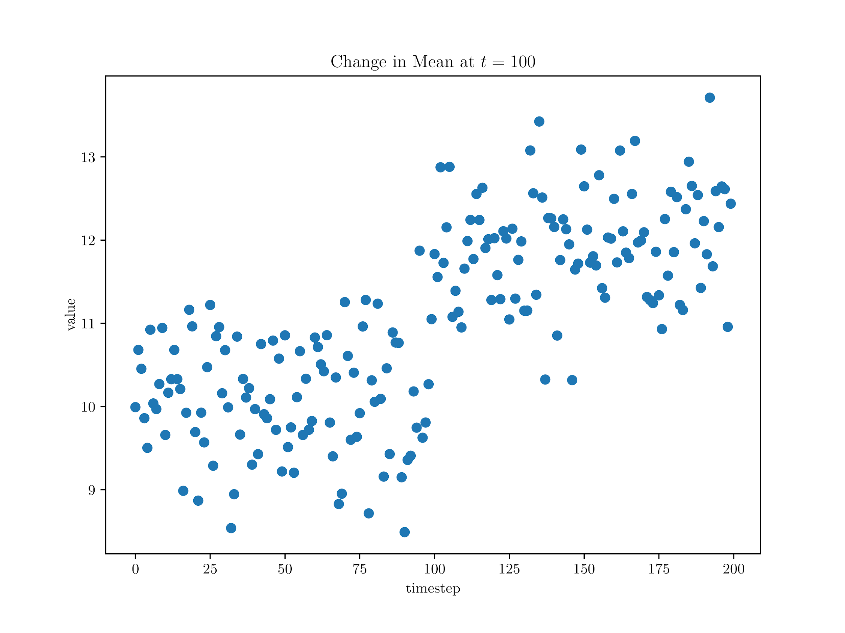
Motivation
Goal is to determine when the change point occurs as the data is observed

Slide 6
Motivation
How to determine if a signal changes?
→ Store data offline → apply some supervised learning methods
But this could be too slow or impractical in certain applications…..
→ Need to respond to data changes in real-time quickly and reliably!

Slide 7
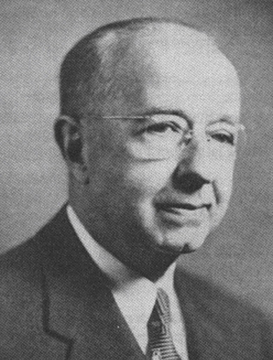
Motivation
“Data have no meaning apart from their context.” - W. Shewhart
Idea: Analyze data as you observe them in a statistical manner [1]
Online Change Point Detection

Slide 8
Background
What is online change point detection?
Statistically identify points in time where time series distribution has changed
Techniques are online as opposed to offline
Emphasis is on speed to detection
But must be balanced with false alarms
What kind of signal changes can we detect:
Mean
Variance
Other higher-order moments in a distribution
Previous distribution ≠ New distribution

Slide 9
Background
General Procedure:
Determine what statistical change to detect
Create a statistic that encapsulates the change
Compare the statistic to a threshold
Classic Algorithms:
Shewart Control Chart
CUSUM [2]
EWMA [3]

Slide 10
Background
What characteristics do we want in an online algorithm?
1. Non-parametric
2. Can detect any kind of change in distribution
3. Can apply to different data structures
Online Kernel Change Point Detection

Slide 11
Part II:
Online Kernel Change Point Detection

Slide 12
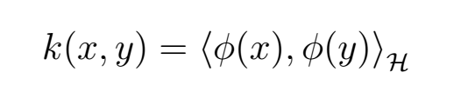
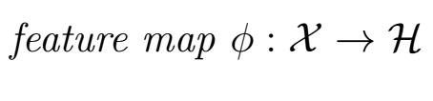
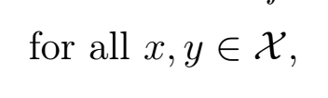
Kernel Change Point Detection
Central Idea:
Use kernel functions to map data to a new feature space where distinguishing between the data samples will be more evident.
Idea: Compare previous data (X) with incoming data (Y) in this new feature space.
As long as suitable kernel can be applied to the data, then this method can be used
→ can apply to different data structures [4]

Slide 13
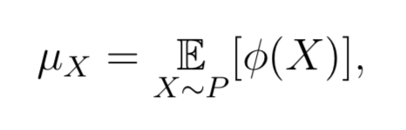
Kernel Change Point Detection
What do we have available to us?
X ∼ P
Y ∼ Q
How exactly to map to new feature space?
→ Kernel Mean Embedding [5]
Can be interpreted as a distribution being mapped to its expected feature map in the RKHS

Slide 14
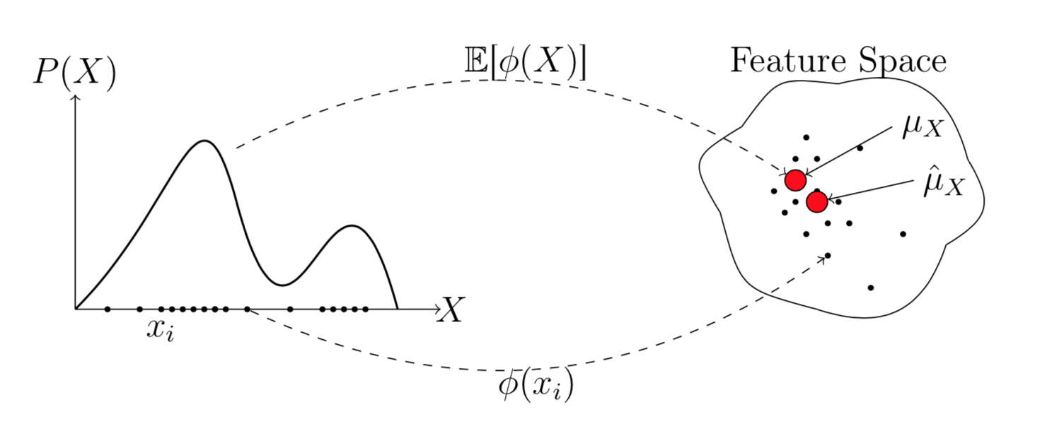
Kernel Change Point Detection
Kernel Mean Embedding
[6]

Slide 15
Kernel Change Point Detection
Idea: Compare the Kernel Mean Embeddings of two samples to see if they are “close” to each other indicating the samples are the “same”.
Create a statistic around this idea called the
Maximum Mean Discrepancy: [5]

Slide 16
Kernel Change Point Detection
If kernel is a characteristic kernel then:
MMD(P, Q) = 0 if and only if P = Q
Implies:
Can detect if any two samples are different
→ any change in distribution
No assumptions on the distribution of the data samples
→ non-parametric
Caveat: Theoretically true, but empirically this is never exact

Slide 17
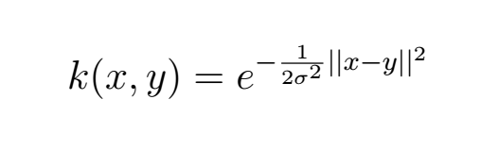
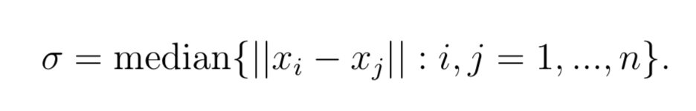
Kernel Change Point Detection
Which kernel to use?
How to selection the bandwidth?

Slide 18
Novel Bandwidth Selection
Most kernel change point techniques use the Gaussian kernel [7]
Selecting its bandwidth hyperparameter is done by:
Median Heuristic
Empirically works well [8]
Our Idea:
Running efficient online median algorithm to calculate the median heuristic
Bandwidth adapts to most recent data

Slide 19
Synthetic Experiments
Algorithms tested:
NEWMA (kernelized EWMA) [9]
Scan-B (kernelized control chart) [10]
Kernel CUSUM (KCUSUM)* [11]
→ Could not reliably test, excluded from experiments
Experiment Design
Test several types of change points (mean, variance, etc.)
Run each experiment as a continuous data stream with 500 change points
Evaluate each algorithm across a range of thresholds and metrics

Slide 20
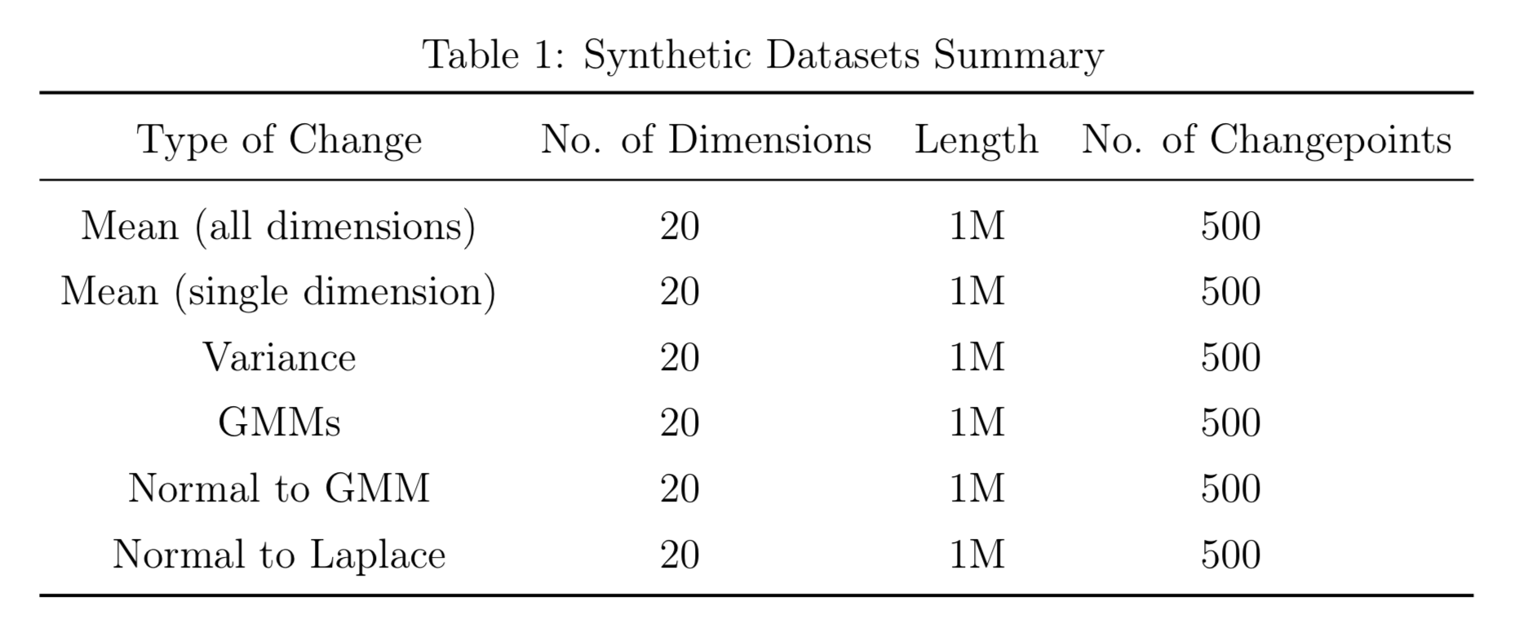
Synthetic Experiments

Slide 21
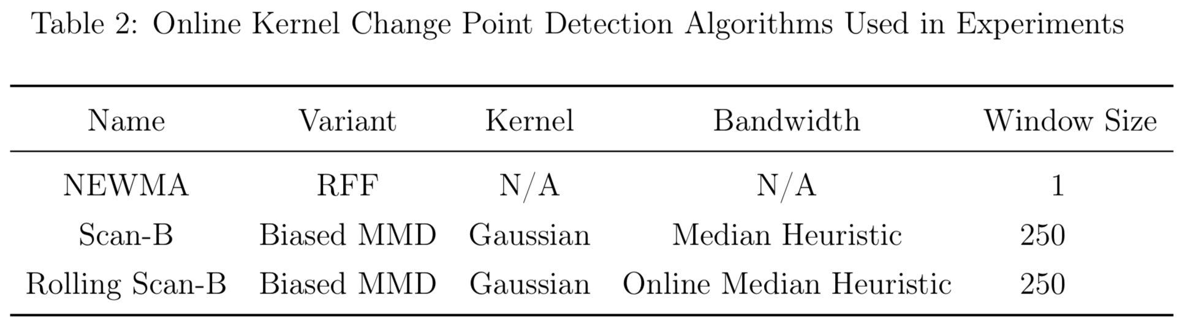
Synthetic Experiments
Evaluation Metrics:
EDD (time)
False Alarms (%)
Missed Detections (%)

Slide 22
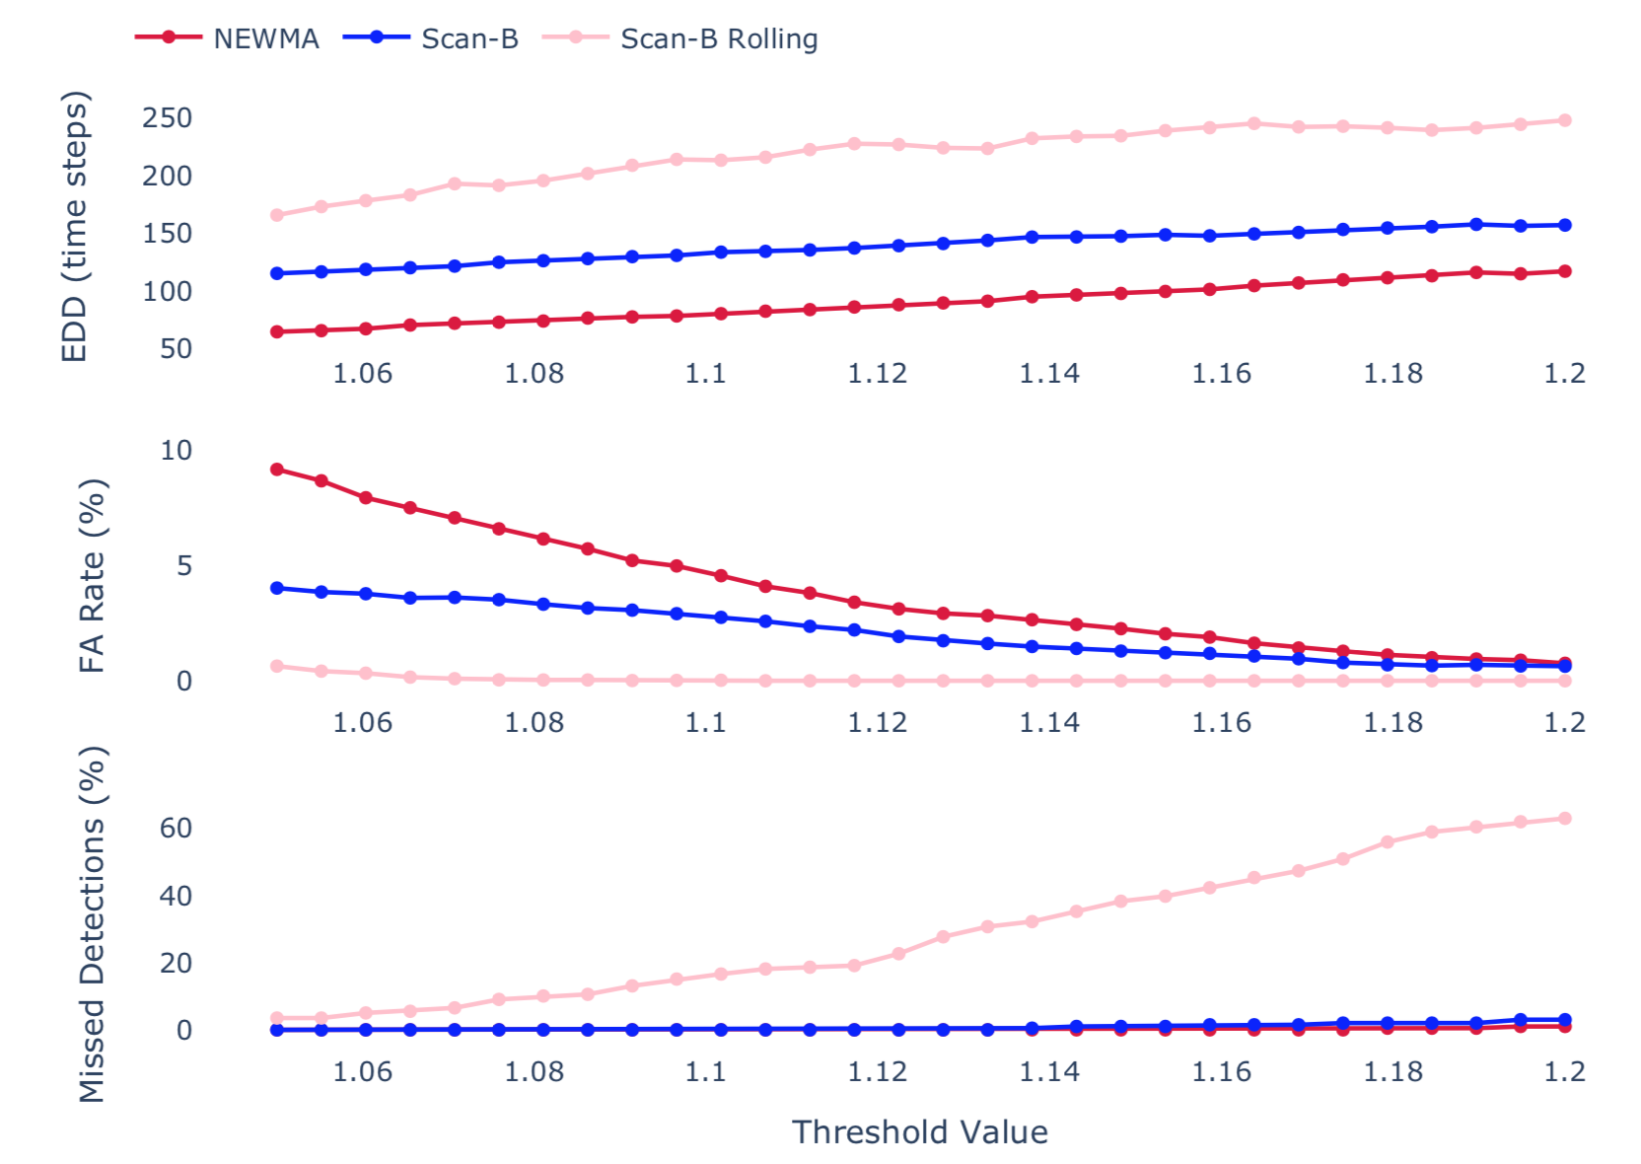
Synthetic Results
Evaluation graphs for Gaussian mixture model change points

Slide 23
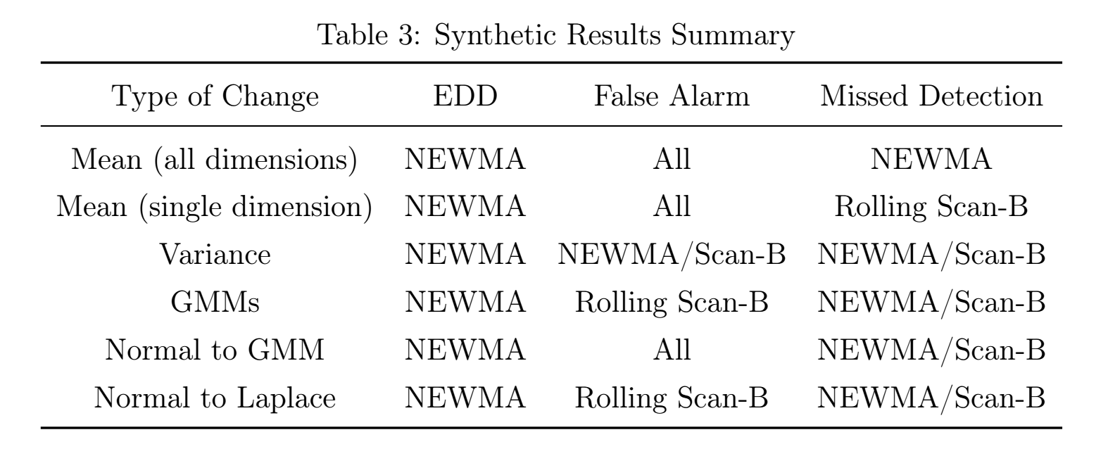
Synthetic Results
NEWMA is overall best algorithm with this setup

Slide 24
Synthetic Results
Use case for online bandwidth update of kernel:
Introduce drift into mean shifts
Results:
Equivalent false alarm & missed detection rates
EDD is ≈5% better on average across all thresholds

Slide 25
Part III:
Application to Real Data

Slide 26
Financial Data
What is market liquidity?
Amount of shares / lots / contracts per price for a market.
Idea: Find change points in intraday market liquidity
Identify key moments during day that indicate significant changes in the market

Slide 27
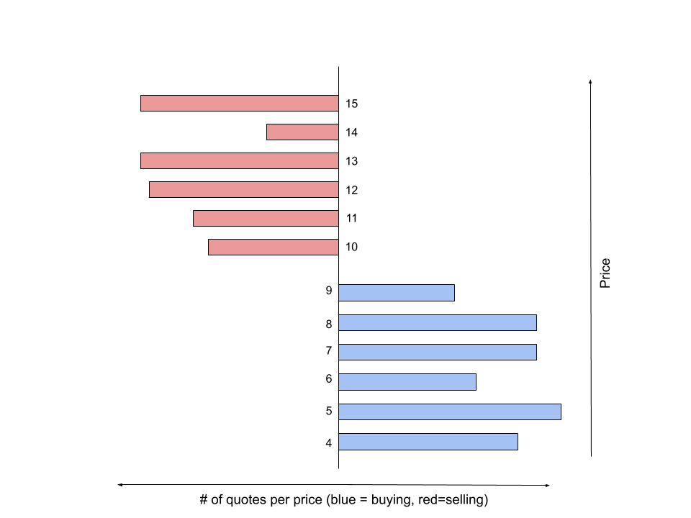
Example Limit Order Book @ t=0

Slide 28
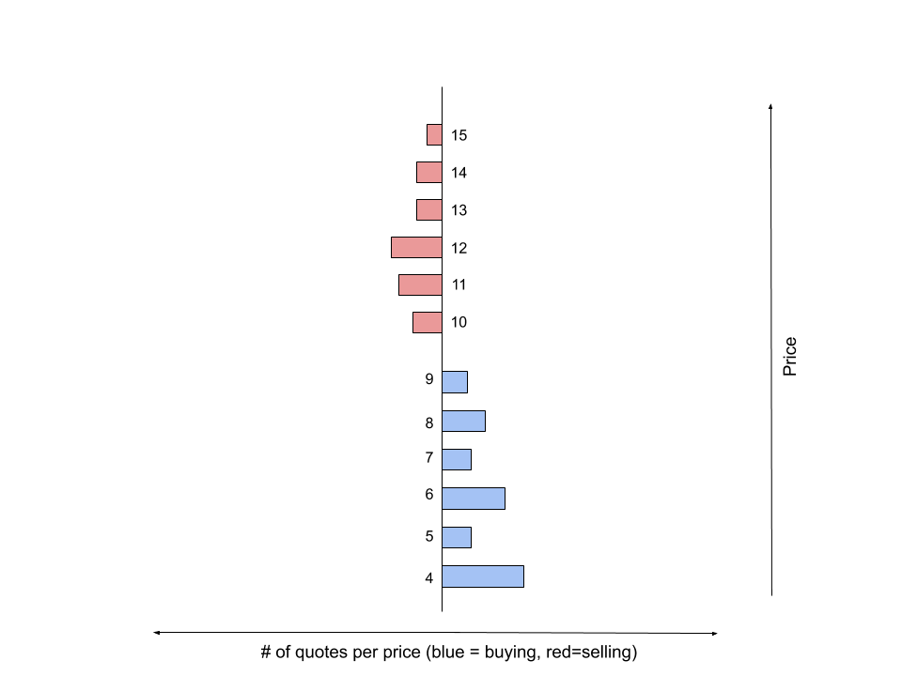
Example Limit Order Book @ t=1

Slide 29

Market Liquidity Dataset Construction
Look at futures data on the Chicago Mercantile Exchange (CME)
Look at 5 different asset classes:
S&P 500
US 10 Year Treasury Bond
Euro FX
Crude Oil
Gold
Sample data every 10 sec from Jan 1 2020 to April 24 2020
Look at the top 20 price levels only

Slide 30
Application to Market Liquidity
Based on synthetic experiments, use the best kernel change point detection algorithm:
→ NEWMA algorithm
How to evaluate performance on real data?
No ground truth change points available
Not obvious what threshold should be
EDA: see how NEWMA statistic compares to data

Slide 31
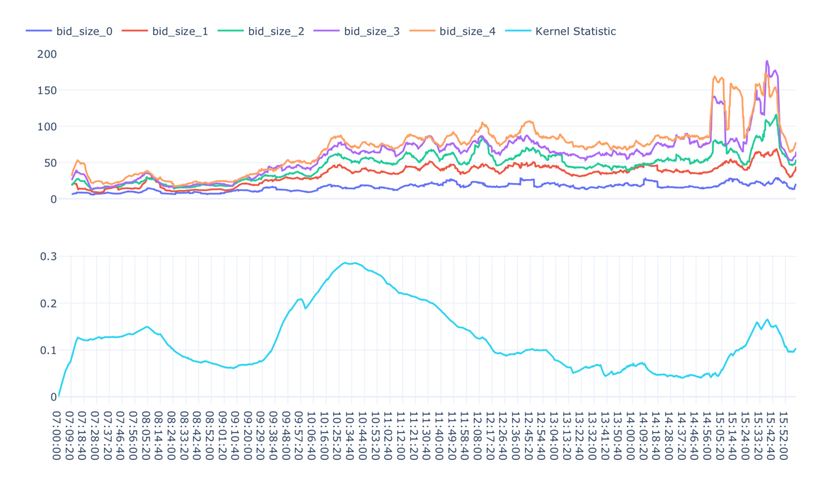
Market Liquidity Results
ES on April 1, 2020

Slide 32
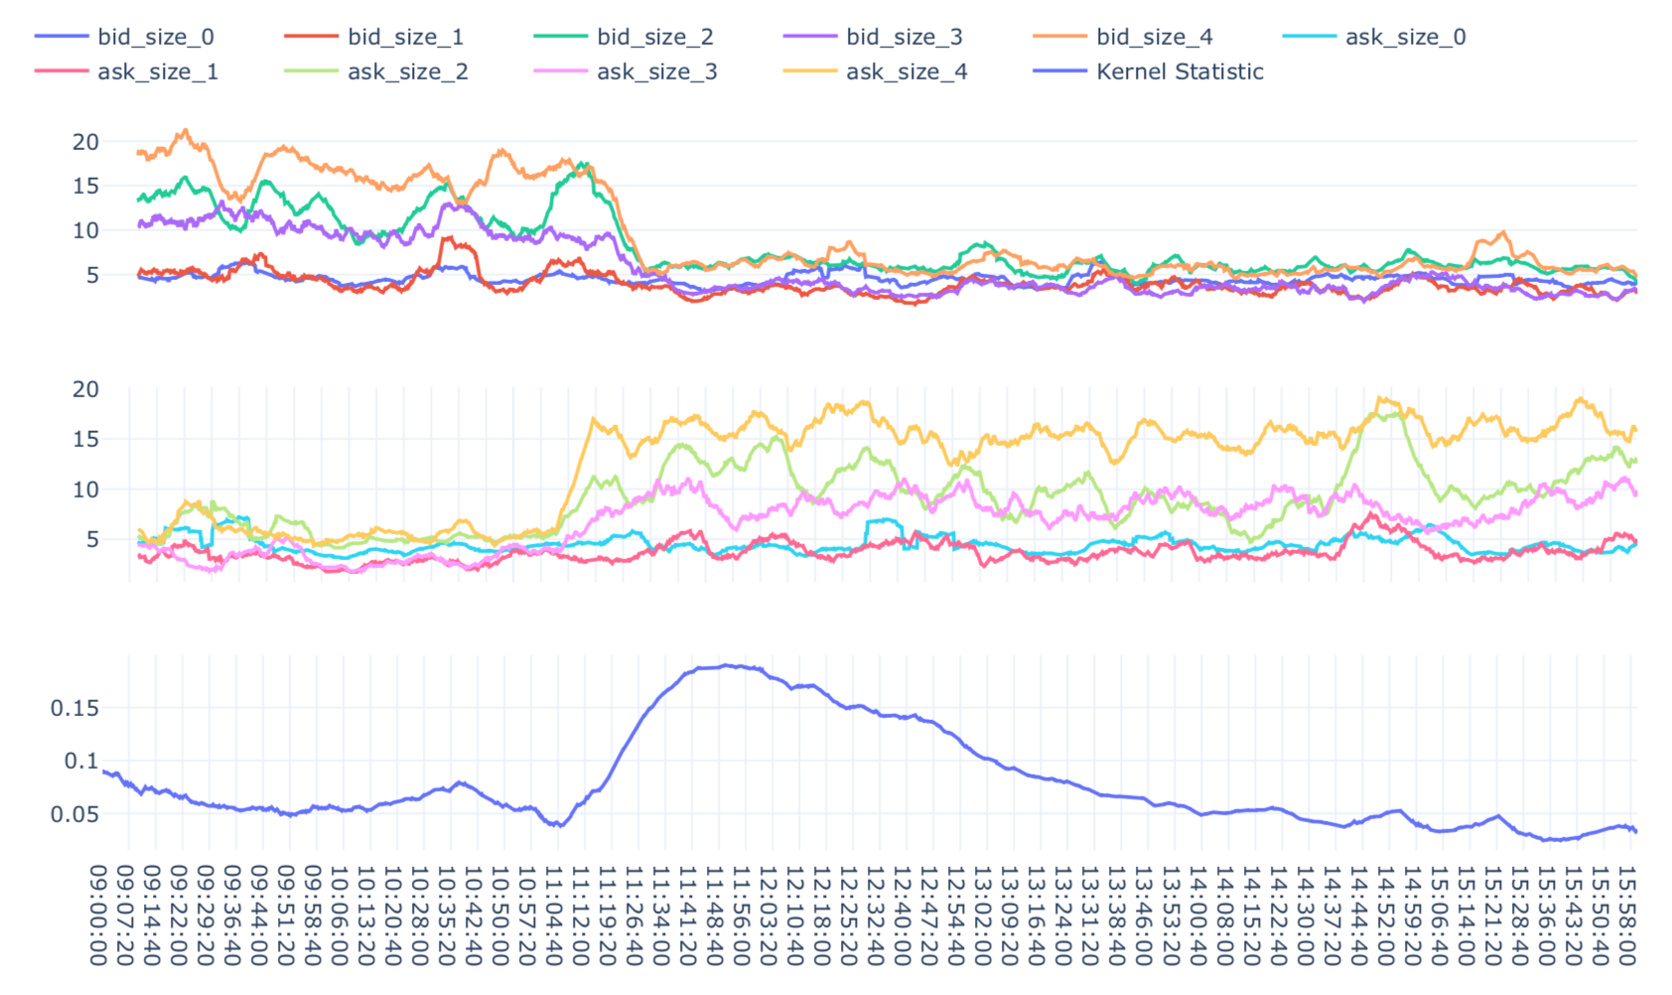
Market Liquidity Results
Euro FX on March 16, 2020

Slide 33
Part IV:
Closing

Slide 34
Thesis Summary / Future Work
Contributions
Online Gaussian kernel bandwidth update for MMD statistic
Synthetic experiments across wide range of distributions
Kernel change point detection on financial liquidity data
Future Work
Develop theory around online bandwidth & more use cases
Formalize framework for evaluating online change point models
Better method for analyzing the performance on real market data and possibly compare market liquidity change points to offline methods

Slide 35
Q & A

Slide 36
References
Walter Andrew Shewhart. Economic control of quality of manufactured product. ASQ Quality Press, 1931
Ewan S Page. Continuous inspection schemes. Biometrika, 41(1/2):100–115, 1954.
SW Roberts. Control chart tests based on geometric moving averages. Techno- metrics, 1(3):239–250, 1959.
dfdf
Alex Smola, Arthur Gretton, Le Song, and Bernhard Schölkopf. A hilbert space embedding for distributions. In International Conference on Algorithmic Learning Theory, pages 13–31. Springer, 2007.
Le Song, Kenji Fukumizu, and Arthur Gretton. Kernel embeddings of conditional distributions: A unified kernel framework for nonparametric inference in graphical models. IEEE Signal Processing Magazine, 30(4):98–111, 2013.

Slide 37
References (cont.)
7. Kenji Fukumizu, Arthur Gretton, Gert R Lanckriet, Bernhard Schölkopf, and Bharath K Sriperumbudur. Kernel choice and classifiability for rkhs embeddings of probability distributions. In Advances in neural information processing systems, pages 1750–1758, 2009.
8. Damien Garreau, Wittawat Jitkrittum, and Motonobu Kanagawa. Large sample analysis of the median heuristic. arXiv preprint arXiv:1707.07269, 2017.
9. Nicolas Keriven, Damien Garreau, and Iacopo Poli. Newma: a new method for scalable model-free online change-point detection. IEEE Transactions on Signal Processing, 2020.
10. Shuang Li, Yao Xie, Hanjun Dai, and Le Song. M-statistic for kernel change- point detection. In Advances in Neural Information Processing Systems, pages 3366–3374, 2015.
11. Thomas Flynn and Shinjae Yoo. Change detection with the kernel cumulative sum algorithm. In 2019 IEEE 58th Conference on Decision and Control (CDC), pages 6092–6099. IEEE, 2019.

Slide 38
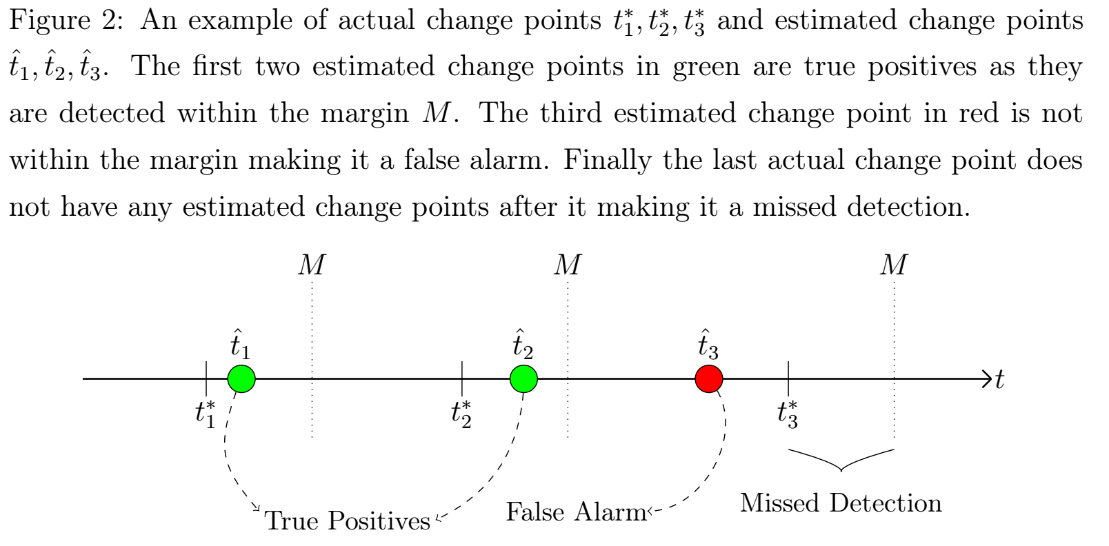
Supplemental Material

Slide 39
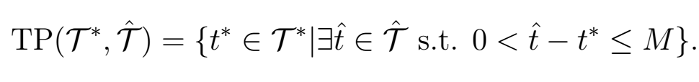
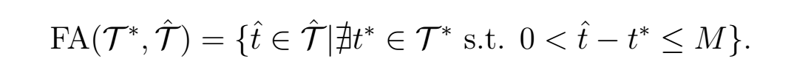
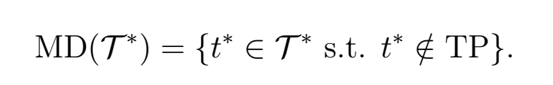
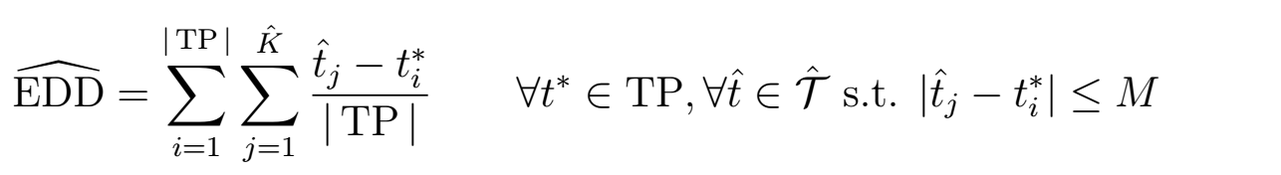
Supplemental Material

