Slide 1
The Solution
Lincoln Software Architecture meetup

Slide 2
Definitions – Identifying the problems
Current Architecture
Time and State
Distributed Systems

Slide 3
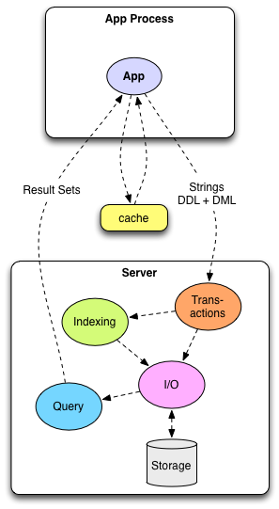
Current Architecture
Database is doing too many things

Slide 4

Time and State
Do things really change?
Or are changes additional information (facts) that happen over a sequence of time?
FACTS never change. They are immutable.
UPDATE in place is BAD.
Forces the database to take on too much responsibility.

Slide 5
Distributed Systems
A series of network coordinated servers/nodes that can share request load
Can scale on demand ("Horizontal Scaling / Scale Out")
Reads separated from writes
Data is consistent within version of database
Timestamped transactions
Single Transactor for writes
Peers made aware of newer versions of db as writes occur
Free to query latest or a specific version
Caches "warmed" to calls from region
No need to hit storage if you have local copy of db
Peers can be specialized for certain roles (Catalog / Analytics)

Slide 6
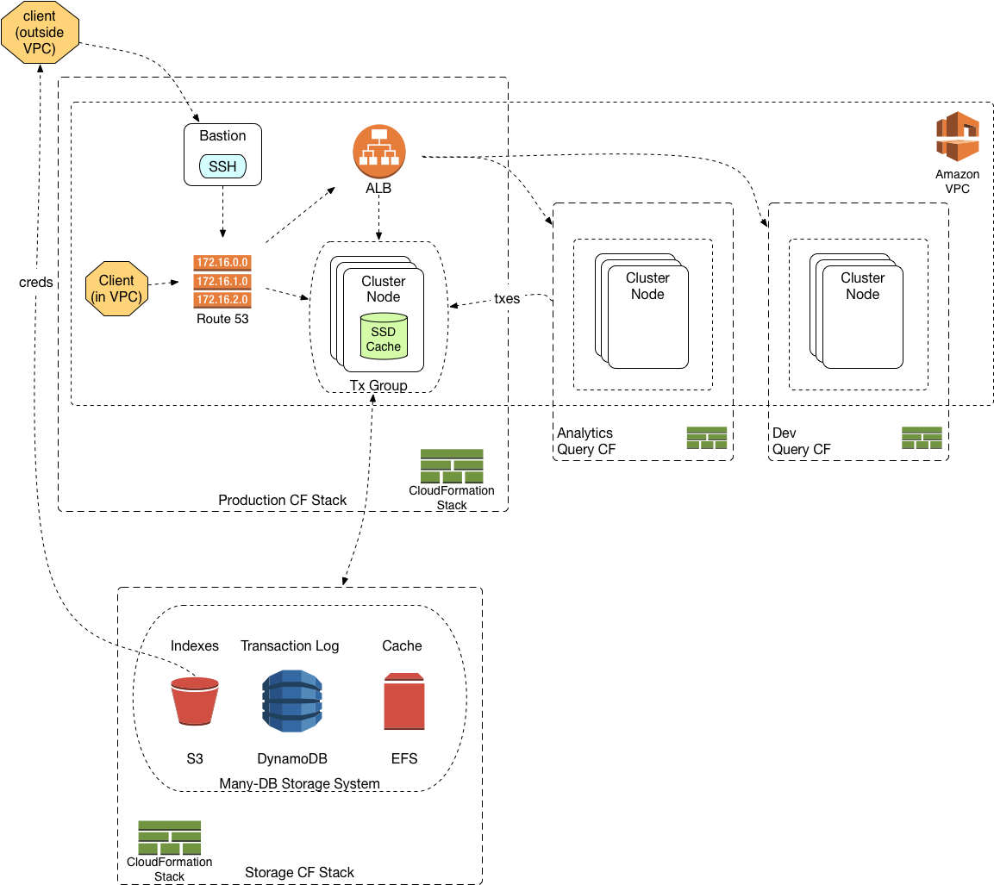
The Solution

Slide 7
Questions

