Slide 1


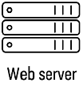
Certificate
Authority
Certificate
Authority
Certificate
Authority
Validate
Client P12
Validate
Server P12
Validate
Server P12
Server
CSR
Server
P12
Client
CSR
Client
P12
Server
CSR
Server
P12
TLS
m-TLS

