Slide 1
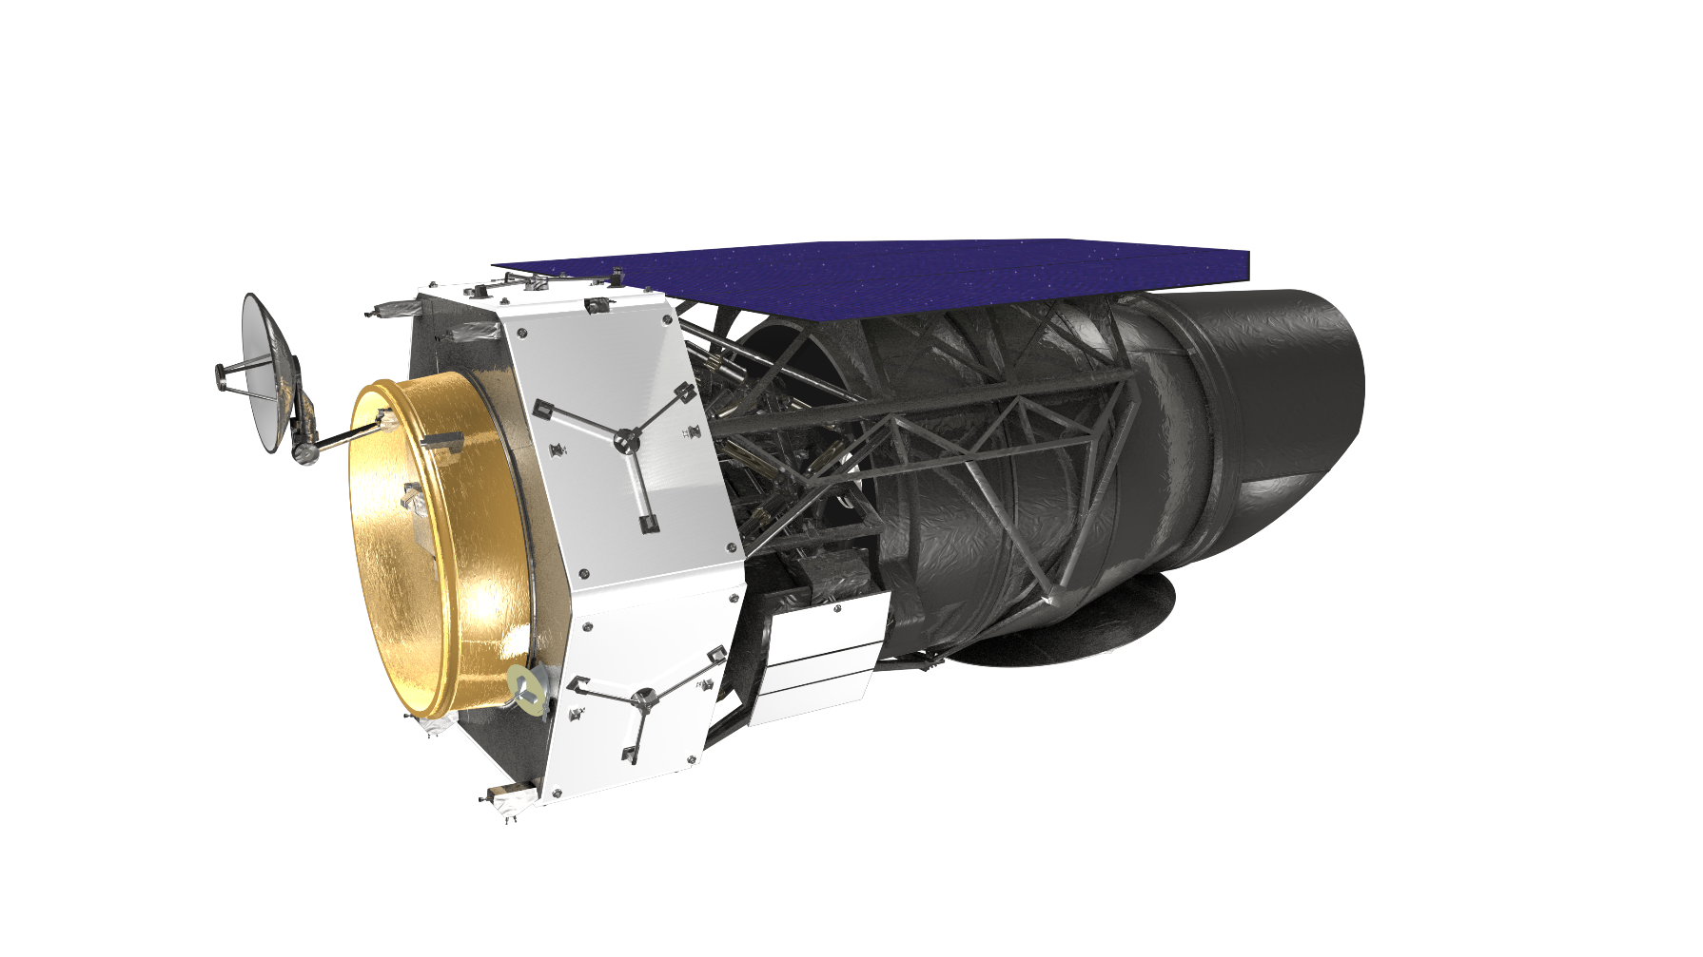
IMPipeline: An Integrated STOP modeling pipeline for the WFIRST coronagraph
ASME Verification and Validation Symposium
May 4 2017
Navtej Saini, Kevin Anderson, Zensheu Chang, Gary Gutt, Bijan Nemati
NASA JPL, California Institute of Technology, Pasadena, California
© 2017 California Institute of Technology. Government sponsorship acknowledged.

Slide 2
Talk Outline
Introduction and Motivation
Fundamentals of STOP Analysis
WFIRST Integrated Modeling Pipeline
Verification and Validation of STOP Model
Preliminary Results
Future Work

Slide 3
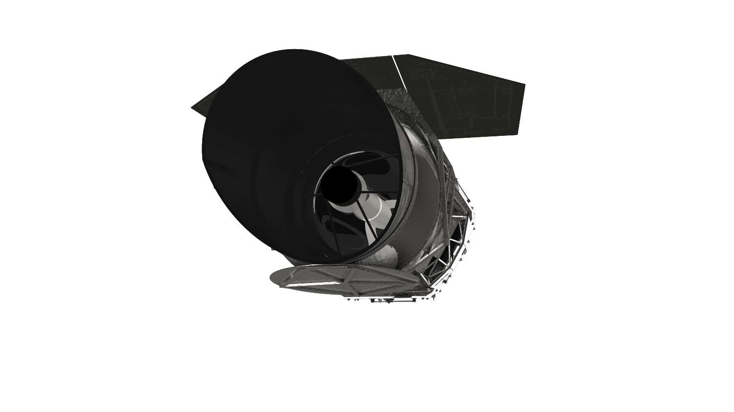
Introduction
WFIRST, the Wide Field InfraRed Survey Telescope, is a future NASA telescope
to explore exoplanets and answer essential questions in the field of dark
Energy and infrared astrophysics.
2.4 meter diameter primary mirror
Designed for 6 year mission
Will be located at the Earth-Sun Lagrange Point 2
Two instruments onboard – Wide Field imager (WFI) and a Coronagraph (CGI)
WFI will provide capabilities to perform the Dark Energy, Exoplanet microlensing, and NIR surveys
CGI supports the Exoplanet high contrast imaging and spectroscopy science
Credit: NASA GSFC (https://wfirst.gsfc.nasa.gov/gallery-full.html)

Slide 4
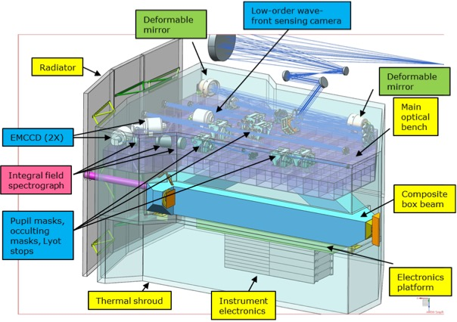
WFIRST Coronagraph
Coronagraph imager covers spectral range of 0.43 – 0.98 µm,
Two deformable mirrors form a sequential wavefront control system (WFCS) that
compensates for both phase and amplitude errors in the telescope and coronagraph optics
The spectroscopy mode uses and integral field spectrograph (IFS)
Image credit: NASA GSFC (https://wfirst.gsfc.nasa.gov/observatory.html)

Slide 5
Fundamentals of STOP Analysis
Thermal deformation is one of the major sources that can degrade the performance of a space telescope or antenna.
Structural Thermal Optical Performance (STOP) analysis is the tool to assess the performance of a space instrument under thermal loads.
STOP analysis includes
  Thermal analysis
  Structural (thermo-elastic) analysis
  Optical analysis
Structural model for STOP analysis
  Output request: displacements only. Requires relatively coarse mesh, compared to models used for stress analysis.
  A lot of analysis to perform.
  Try to minimize the size of the STOP model
  Can be used for other analysis, i.e., modal analysis, jitter analysis, random vibe analysis
Due to the requirement for high accuracy, temperature dependent CTE is used for calculating thermal loads
Thermal loads are driven by environmental (orbital mechanics) conditions, the thermal control system must ensure that the componentry such as the Coronagraph Instrument (CGI) hold requirements on set-point with ample stability

Slide 6
Motivation
Observing Scenario
Thermal Model
Structural Model
Optical Model
Optical Wavefront Errors

Slide 7
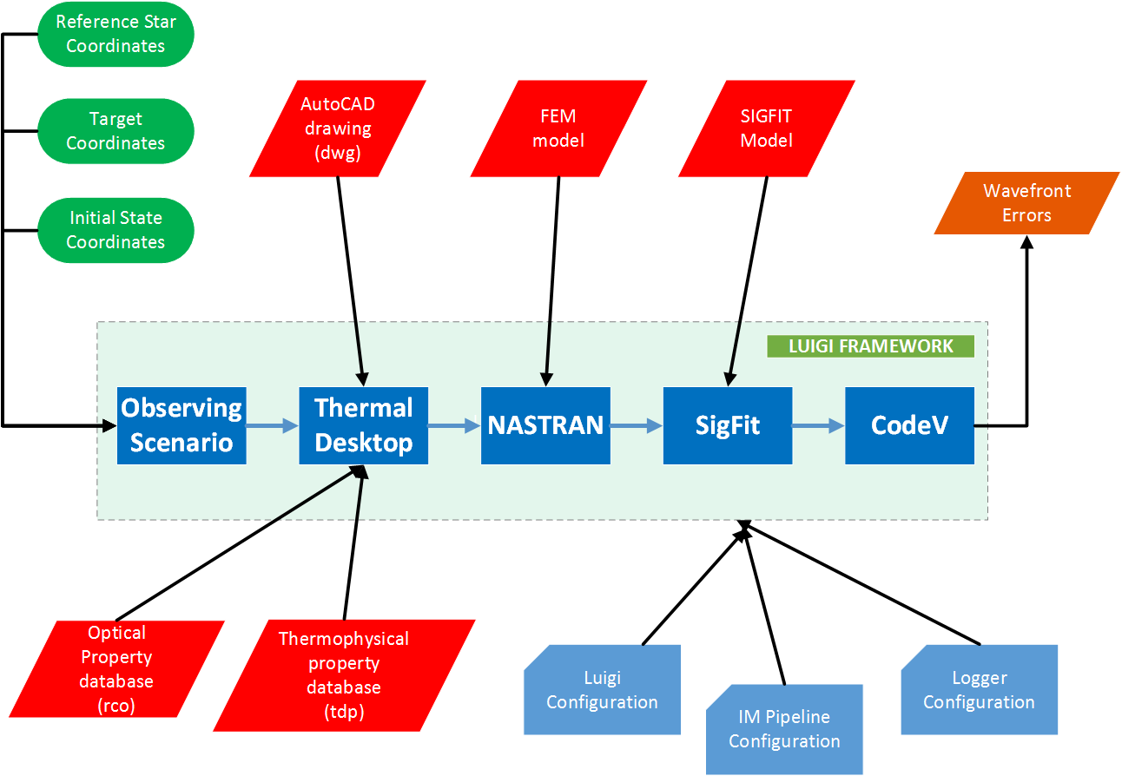
IMPipeline Block Diagram

Slide 8
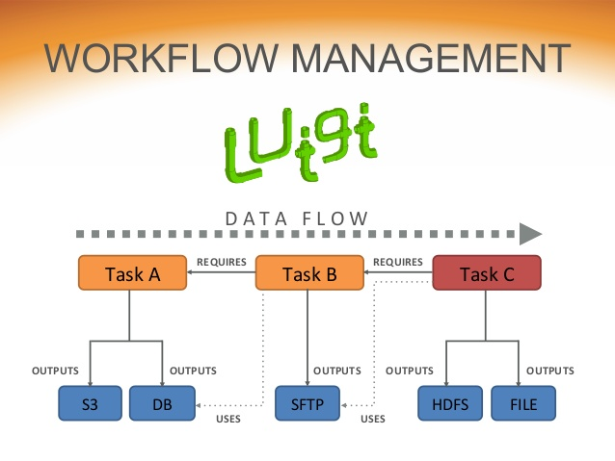

Luigi Pipeline Framework
World’s second most famous plumber
Source code: https://github.com/spotify/luigi
Python framework to build complex pipelines of batch jobs
Developed by engineers at Spotify and made open source for wider community
Luigi server comes with a web interface to visualize, search and filter tasks
Luigi is customizable, and handles dependency resolution, workflow management, visualization etc.

Slide 9
Observing Scenario
Solar heating is a major input to WFIRST coronagraph thermal model
The thermal model treats Solar radiation as plane wave incident on the spacecraft. We have to determine direction of the plane wave and the intensity of the flux
During operations, the spacecraft attitude will be a function of the stars WFIRST will be observing, and the time of year during which they are observed.
To simulate thermal effects of an observing scenario, we need to specify relation between the WFIRST spacecraft and the Sun.
As WFIRST is expected to be at the Sun-Earth Lagrange point, Earth’s infrared radiation is neglected.

Slide 10
Thermal Desktop
Thermal Desktop is a PC CAD-based thermal model builder.
Only runs on Windows OS and is integrated with AutoCAD.
It creates the node and conduction network, launches SINDA/FLUINT for the solution, and provides post processing results.
It interfaces with high level programming language using Component Object Model (COM). Component Object Model (COM) is a binary interface standard for software components. It is used to enable inter-process communication.
We have used python pywin32 package to interface with Thermal Desktop.

Slide 11
NASTRAN, SigFit and Code V
NX NASTRAN is a Finite Element solver for stress, vibration, buckling, structural failure, heat transfer, acoustic and aeroelasticity analyses.
Command line interface available to run in batch mode. Support for utilizing multiple processors/cores.
SigFit allows optomechanical engineers to integrate mechanical analysis with optical analysis.
It has a command line interface to run in batch mode
Code V optical design software is used to model, analyze, and provide fabrication support for the development of optical systems.
Code V can be run in both graphical command line interface

Slide 12
Pipeline Execution
Pipeline is executed from command line as a python script
> python impipeline.py RunCodeV --obsdate YYYYMMDD
--ref-ra XXX.XXX --ref-dec XX.XXX --target-ra XXX.XXX
--target-dec XX.XXX --initial-ra XXX.XXX --initial-dec XX.XXX
--outpath XXXXXXXXX
Command line input parameters:
  Mandatory
      --obsdate : observing date in YYYYMMDD format
      --ref-ra : RA of the reference star
      --ref-dec : DEC of the reference star
      --target-ra : RA of the target
      --target-dec : DEC of the target
  Optional
      --initial-ra : RA of initial pointing
      --initial-dec : DEC of initial pointing
      --outpath : Output directory where outputs are written to

Slide 13
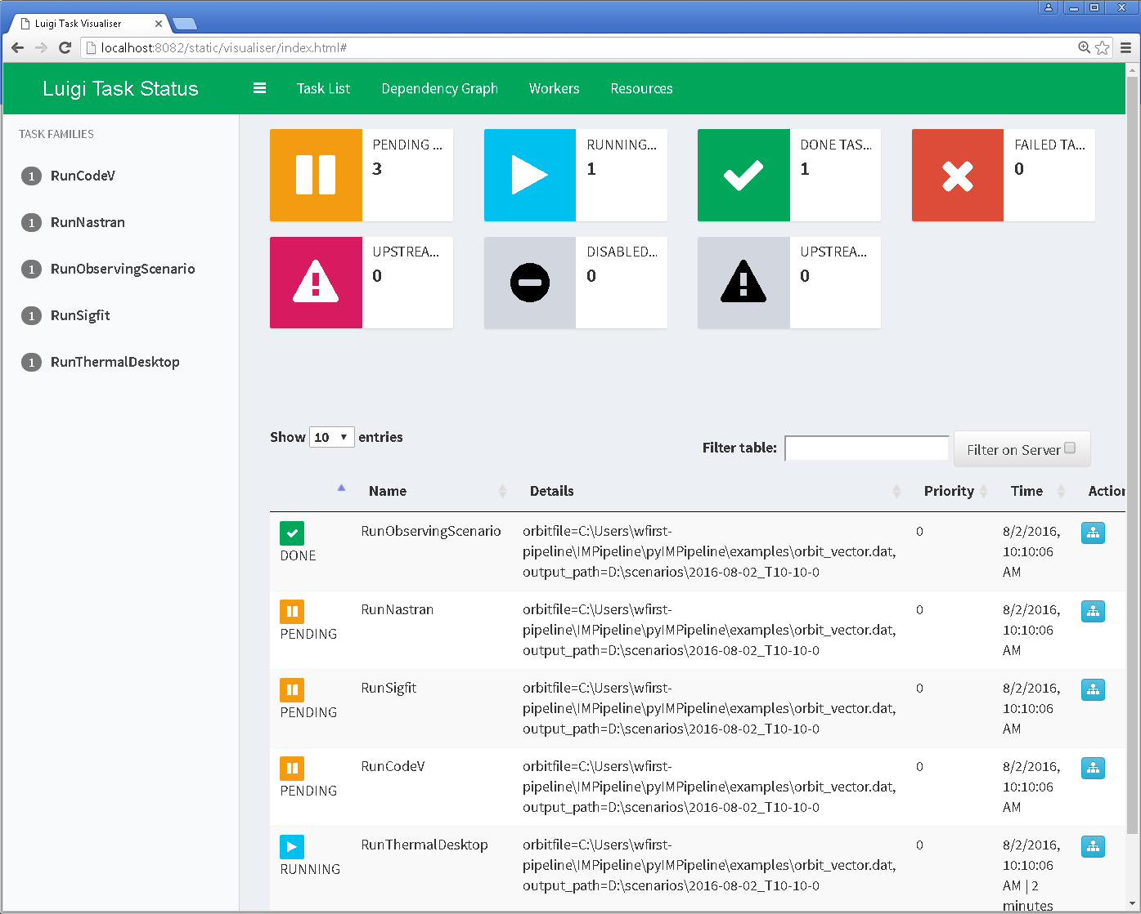
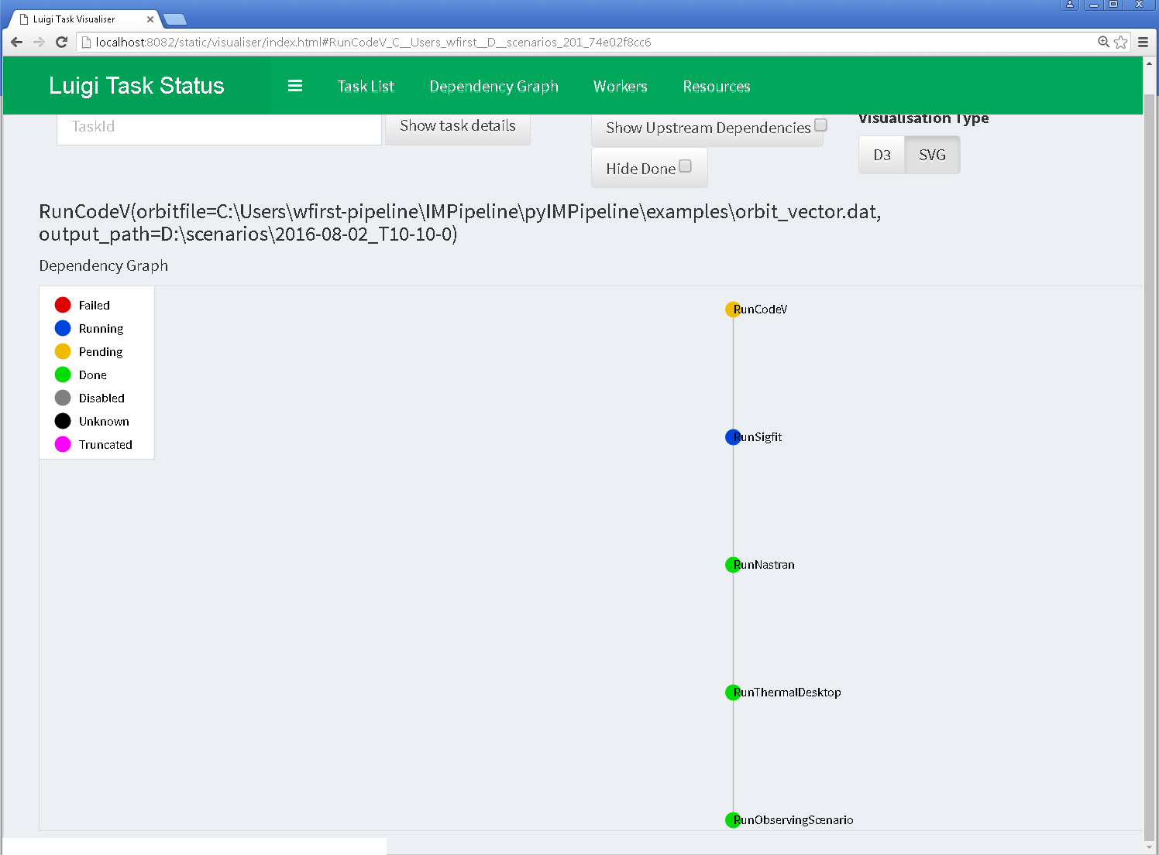
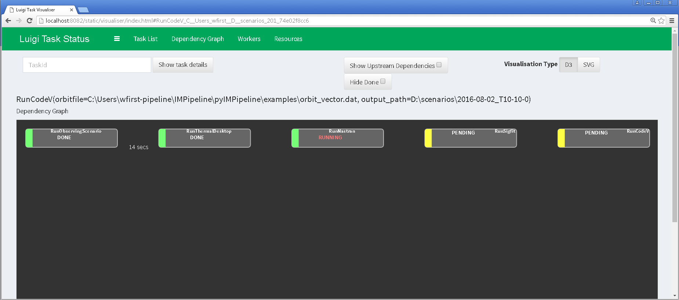
Pipeline Visualization
Pipeline execution status can be checked using Luigi’s web interface. Luigi runs a web server (Tornado) in the backend and displays task status in the web interface.
Web interface can be accessed by going to following URL in web browser:
http://localhost:8082/static/visualiser/index.html

Slide 14
Pipeline Output & Diagnostics
If user does not define an output directory, current timestamp is used as directory name
Although we are interested in wavefront errors, output files from Thermal Desktop, and NASTRAN are also saved for diagnostic purposes
A consolidated log file (impipeline.log) is generated for each run. It includes messages from all the tasks, along with timestamps. It can be used to track down errors
Creation of dummy file for each task signifies completion of that task to Luigi. So, the next time if you try to run the pipeline in the same directory where the pipeline ran successfully previously, Luigi will skip the execution
Using Luigi check pointing, it is easy to re-run the pipeline from any intermediate task

Slide 15
Customizing Pipeline
IMPipeline can be easily customized using configuration files
Three configuration files –
  impipeline.cfg : configure various tasks in the pipeline
  luigi.cfg : configure Luigi framework itself
  logger.cfg : configure logging capability of the pipeline
Email notification. Sends out an automated email notification if the pipeline fails with an error.
User level customization. Pipeline is developed to be run by multiple people involved in the project. The configuration files allows users to customize the pipeline run based on their individual requirements.

Slide 16
Verification and Validation of STOP Model
The recent study “Thermal system verification and model validation for NASA's cyro-genic passively cooled James Webb Space Telescope,“ by P. Cleveland and K. Parrish, 05ICES-236, SAE Aerospace, 2005 suggest the following three aspects be key ingredients in a thermal verification and model validation plan:
Margin requirements and tracking
Independent thermal modeling
Comprehensive thermal test program
To date, the following are how the above have and continued to be addressed in the V&V effort of the IMPipeline:
Flow down of top level requirements to the Coronagraph (CGI) modeling team from the WFIRST Observatory / TELESCOPE is communicated weekly via Integrated Modeling meetings to coordinate the workflow and design amongst JPL and GSFC engineering teams
JPL has developed its own internal model of the WFIRST Observatory / TELESCOPE /Collimator/ Coronagraph (CGI) independent of that created by GFSC
TVAC (thermal vacuum) of the WFIRST TELESECOPE and sub-components such as CGI and Collimator are future work

Slide 17
Verification and Validation of Models
Per "Verification and validation of simulation models," by J. Kleijnen, European Journal of Operational Research, Vol. 82, pp. 145-162, 1995
The verification and validation of simulation models such as those used within the IMPipeline discussed herein involves the following activities:
  Verification
    “Includes good programming practice (such as modular programming)” such as that detailed in the Python script for the IMPipeline
    “Checking intermediate simulation outputs” this has been and continues to be the standard daily work flow practice when dealing with the results of the IMPipeline
  Validation
    “Comparing simulated and real data through simple tests such as graphical tests” this is documented in the daily workflow of the IMPipeline activities by formulating and construction various in-situ, turn-key “Operational Scenario” which involve a series of yaw, pitch, roll and pointing maneuvers of the TELESCOPE / OBSERVATORY simulation model framework , data from each OS is viewed and post-processes via graphical results
    “Obtaining real world data” (this will be future work)
    “Perform sensitivity analysis based on Monte Carlo sampling” an example of this is shown on the next chart, whereby the number of Monte Carlo rays is varied to ascertain the impact on the RADK (Radiation Conductors) and model simulation run time

Slide 18
Preliminary Results - I
Exercise pipeline to investigate thermal stability of the instrument

Slide 19
Preliminary Results - II

Slide 20
Monte Carlo Ray Tracing Trade Study
A trade study was performed to determine the optimal # of rays per node versus error and the associated runtime

Slide 21
Future Work
Create a library of wavefront errors for various “Operational Scenarios”
Validation of CGI performance using updated observatory STOP model
Extend the IMPipeline beyond STOP analysis by Integrating the CGI wavefront propagation code in the pipeline to generate realistic speckle patterns.

Slide 22
Thank You!

Slide 23
Backup Slides

Slide 24
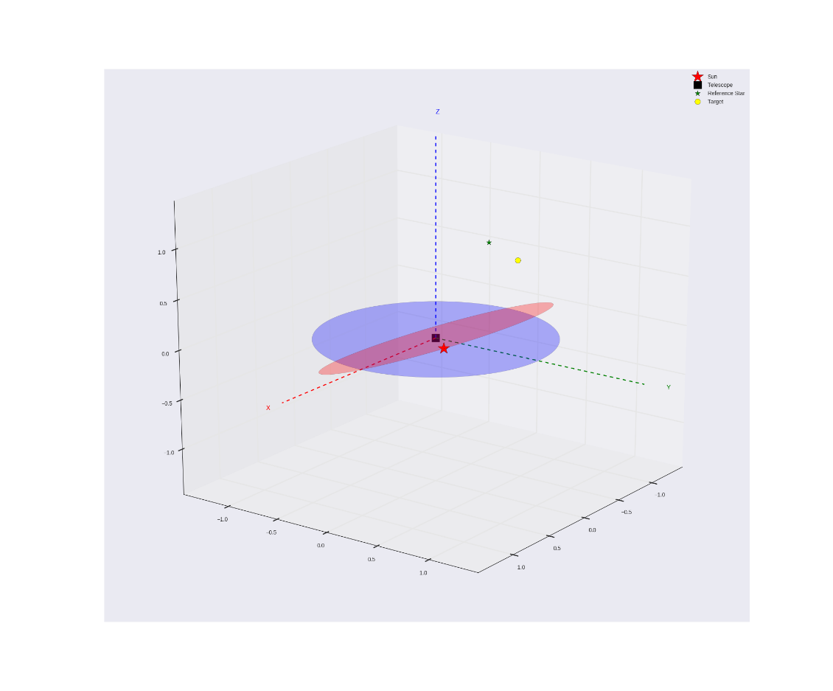
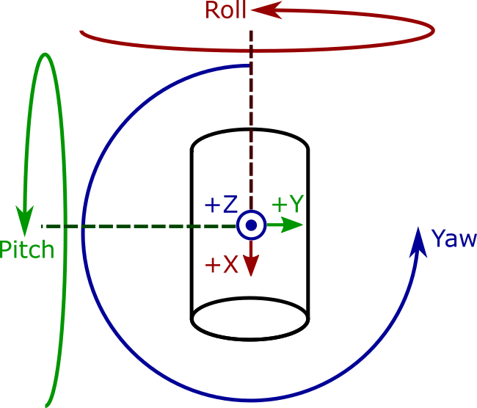
Observing Scenario - I
Solar vector X, Y, and Z components comprise a unit vector pointing in spacecraft body-fixed coordinates to the center of the Sun.
  Solar Vector X = sin(pitch)
  Solar Vector Y = sin(roll)
  Solar Vector Z = cos(pitch) * cos(roll)
Spacecraft coordinate frame and rotations (William Schulze)

Slide 25
Observing Scenario - II
Determine position of Sun relative to Earth in ecliptic coordinate system
Check if the target is within the Sun exclusion angle
Transform position of reference star and target to ecliptic coordinate system
Express all positions in heliocentric ecliptic coordinates
Define spacecraft body centered coordinate system (BCCS)
Determine transformation matrix between heliocentric coordinates and BCCS
Initial orientation of spacecraft is +Z pointing towards the Sun and +X (boresight) direction pointing south out of the equatorial
Slew to reference star
Slew to target 2 and repeat steps as for target 1
Reference Star Differential Imaging (RDI) roll
  Roll about X for specified angle (+13 degrees to -13 degrees)
Generate a text file with instantaneous time and Solar vector angles for telescope maneuver from initial state to target star

