Slide 1
MidiFind Melody Recognition Engine
Tyler Post
Vicky Biliby
Joe Crozier
Group 20
2XB3

Slide 2
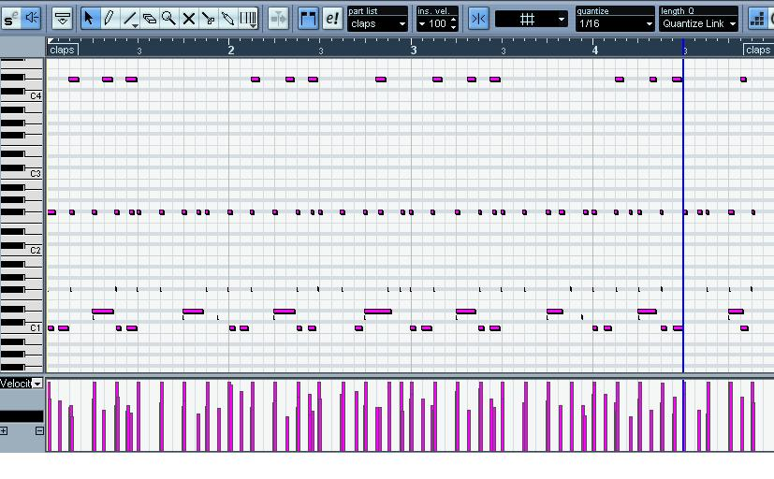
Why midifind?
RWI (Recognition Without Identification) is experienced by the majority of people and can be a frustrating experience
General MIDI can be an excellent way to express music in a space and time efficient manner

Slide 3
Scope and Objective
MidiFind aims to allow the user to solve RWI
Users can easily enter a melody into the software and MidiFind will use searching algorithms to identify it
If an exact match cannot be found, MidiFind will provide its best guess
Guesses will be ordered by relevancy
MidiFind will work from a database of approximately 28,000 different MIDI tracks

Slide 4
Requirements
Users can input a melody with no prior musical knowledge
Output will be all songs in database which match the inputted melody
Searches are fast and reproducible
MidiFind’s GUI is intuitive, attractive, and easy to use
MidiFind is safe and reliable

Slide 5

Design Specifications
Users input a melody via a musical contour
The contour is saved as a string, then MidiFind uses the Knuth-Morris-Pratt string searching algorithm to find the associated track
Included in the software is a CSV file containing string contours for every song in the database
Only a portion of the melody needs to be entered in the contour, not the entire song
QuickSort is used to sort the matched tracks, ordered by occurrence of the contour

Slide 6
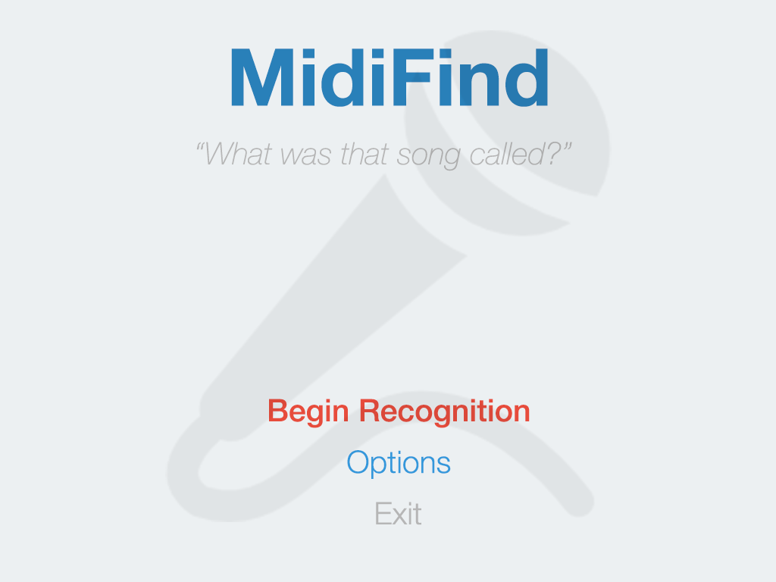
Design Specifications
MidiFind was built entirely in Python
The Mido library is used for MIDI manipulation
GUI and MIDI output is implemented through PyGame

Slide 7
Verification and validation
MidiFind is validated by entering the melody of a known track, and ensuring that MidiFind returns the correct name and artist
If the inputted contour does not exist in the database, MidiFind will inform the user a matching track could not be found

Slide 8
Demonstration
MidiFind in action!

