Slide 1



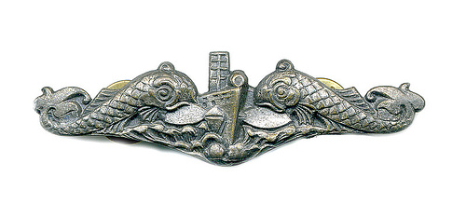
Submarine Learning Center
Integrated Low Pressure Electrolyzer Combined Maintenance
A-652-0093V1
A-652-0093_M1L1S1V1
Notes:
SUBMARINE OFFICER INDOCTRINATION COURSE INSTRUCTOR's NOTES PAGES
UNCLASSIFIED
A-2E-0045 Rev B UNCLASSIFIED
.

Slide 2
Submarine Learning Center
Integrated Low Pressure Electrolyzer (ILPE) Operational Characteristics and Capabilities
Integrated Low Pressure Electrolyzer Combined Maintenance
A-652-0093V1
A-652-0093_M1L1S1V1
Notes:
SUBMARINE OFFICER INDOCTRINATION COURSE INSTRUCTOR's NOTES PAGES
UNCLASSIFIED
A-2E-0045 Rev B UNCLASSIFIED
.

Slide 3
Purpose of the ILPE
Produce Product Gas
Fluid Management
Minimize Overboard Fluid Discharges
A-652-0093_M1L1S1V1
Notes:
SUBMARINE OFFICER INDOCTRINATION COURSE INSTRUCTOR's NOTES PAGES
UNCLASSIFIED
A-2E-0045 Rev B UNCLASSIFIED

Slide 4
Operational Characteristics and Capabilities
Power
  440 VAC Power, 115 VAC Power, RCU Power
Production of Fluids:
  Product Gas 15 - 225 SCFH
  Byproduct Gas 30 - 450 SCFH
Waste Gas Storage, Consumption and Discharge
Liquid Product Management
A-652-0093_M1L1S1V1
Notes:
SUBMARINE OFFICER INDOCTRINATION COURSE INSTRUCTOR's NOTES PAGES
UNCLASSIFIED
A-2E-0045 Rev B UNCLASSIFIED
Operational characteristics:
Ref Cpt 2, schematic
Walk thru a simple start-up/operation/shutdown
Para 1.3, fig.1-1

Slide 5
Security Requirements
This presentation is Unclassified, but the ILPE’s ability to generate certain gasses and the method of disposal of said gasses is classified Confidential.
A-652-0093_M1L1S1V1
Notes:
SUBMARINE OFFICER INDOCTRINATION COURSE INSTRUCTOR's NOTES PAGES
UNCLASSIFIED
A-2E-0045 Rev B UNCLASSIFIED

Slide 6
Section Review
A-652-0093_M1L1S1V1
Notes:
SUBMARINE OFFICER INDOCTRINATION COURSE INSTRUCTOR's NOTES PAGES
UNCLASSIFIED
A-2E-0045 Rev B UNCLASSIFIED

