Slide 1



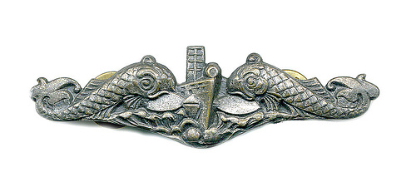
Submarine Learning Center
Integrated Low Pressure Electrolyzer (ILPE) Preventive Maintenance
Integrated Low Pressure Electrolyzer Combined Maintenance
A-652-0093V1
A-652-0093_M3L1S1V1
Notes:
SUBMARINE OFFICER INDOCTRINATION COURSE INSTRUCTOR's NOTES PAGES
UNCLASSIFIED
A-2E-0045 Rev B UNCLASSIFIED
.

Slide 2
Submarine Learning Center
MRC S-2
A-652-0093_M3L1S1V1
Notes:
SUBMARINE OFFICER INDOCTRINATION COURSE INSTRUCTOR's NOTES PAGES
UNCLASSIFIED
A-2E-0045 Rev B UNCLASSIFIED
.

Slide 3
Step Highlights
This presentation highlights a few steps of the MRC
Photos were taken in the lab using the RCU Part Task Trainer (PTT) and the RCU calibration kit
You will get the opportunity to perform this in the lab if your training site has the PTT installed
Target flowrate for this example is for FLR-951R (First line of table 1)
A-652-0093_M3L1S1V1

Slide 4
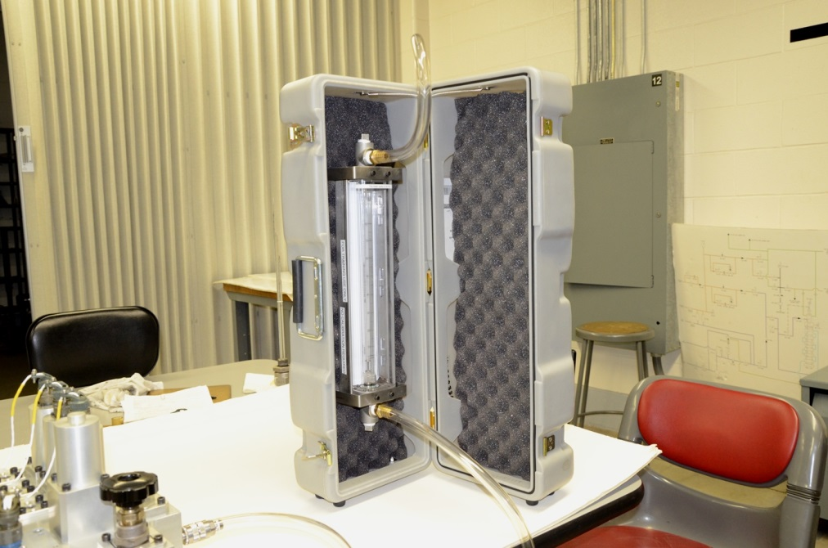
Step 1m
A-652-0093_M3L1S1V1

Slide 5
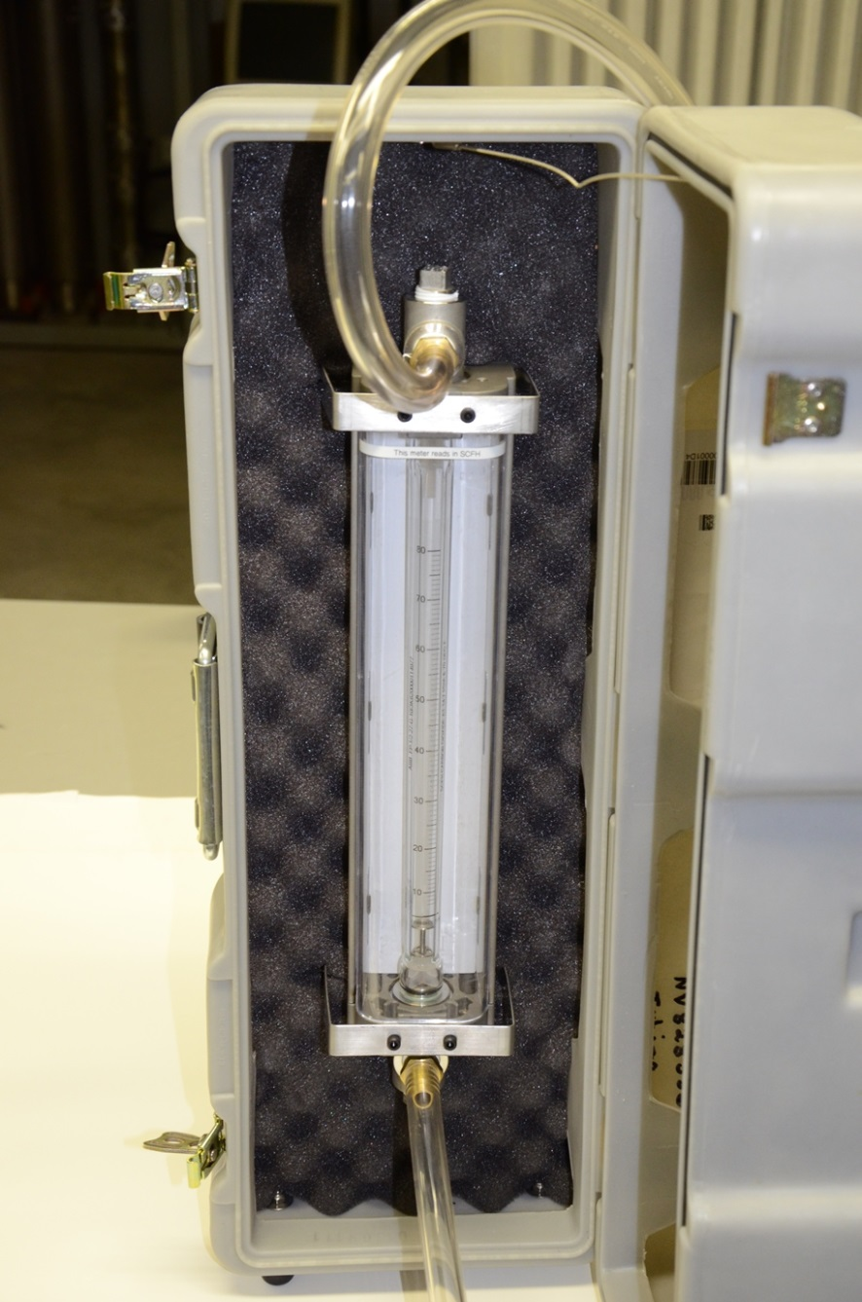
Step 1q
A-652-0093_M3L1S1V1

Slide 6
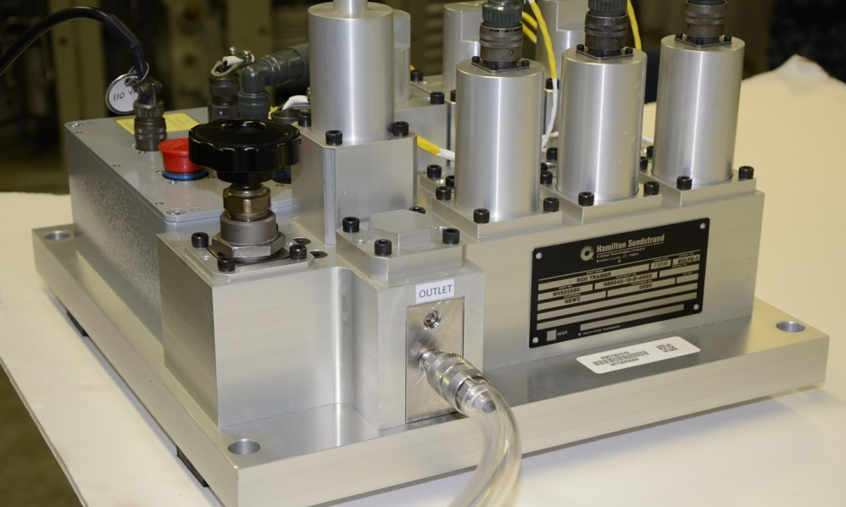
Step 1q
A-652-0093_M3L1S1V1

Slide 7
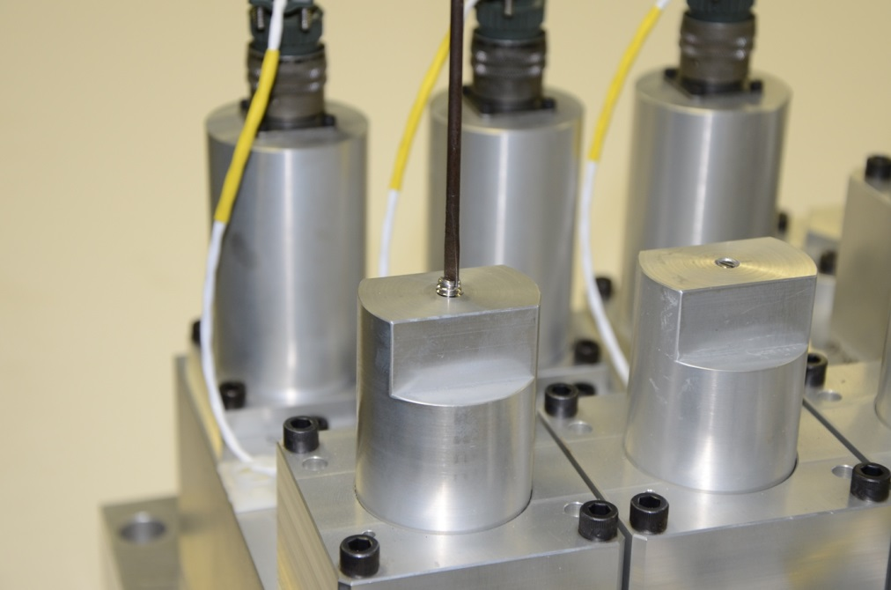
Step 1.s(1)
A-652-0093_M3L1S1V1

Slide 8
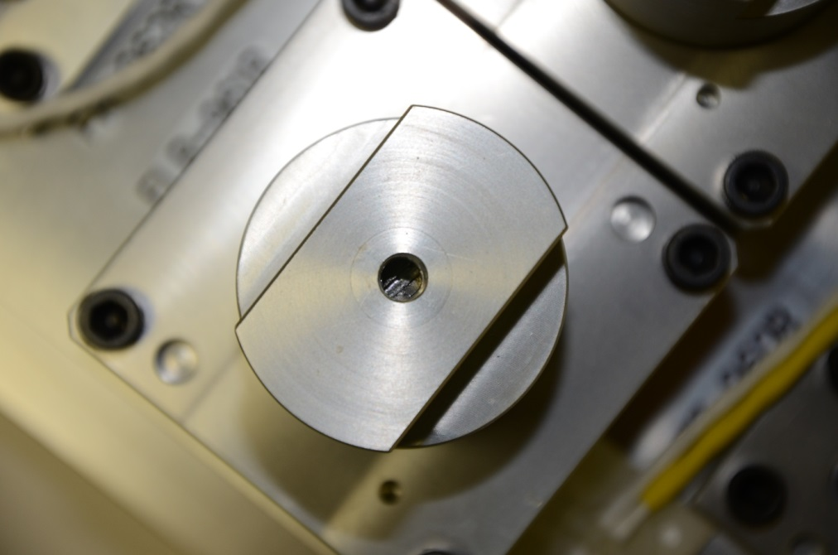
Step 1.s(5)
A-652-0093_M3L1S1V1

Slide 9
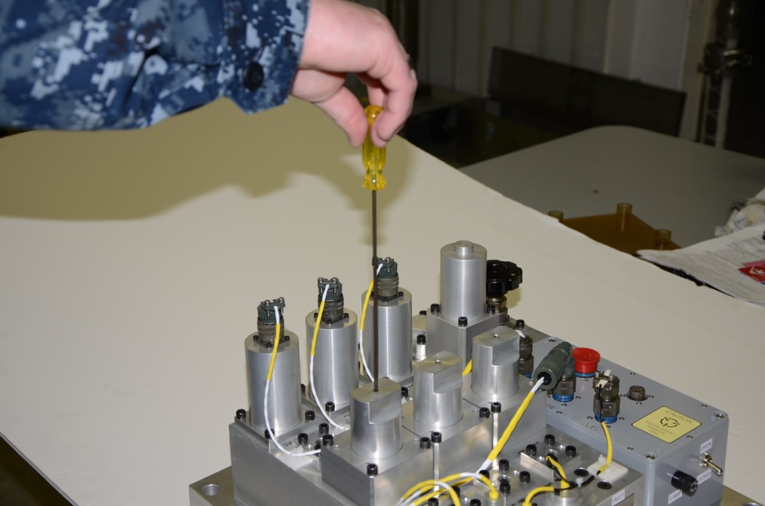
Step 1.s(5)
A-652-0093_M3L1S1V1

Slide 10
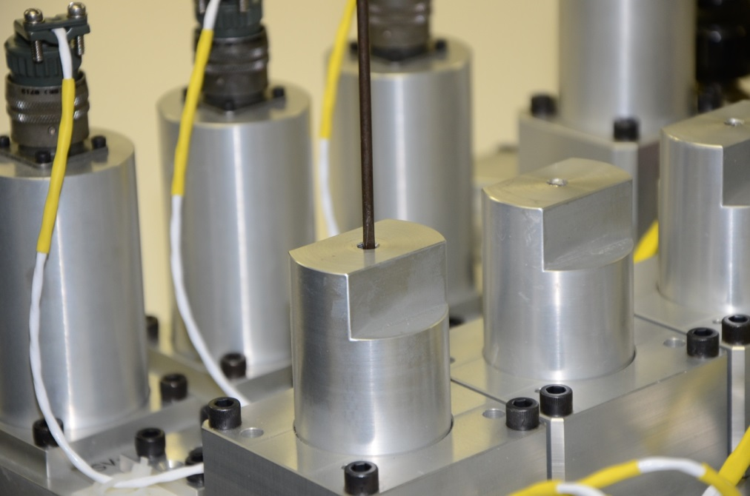
Step 1.s(5)
A-652-0093_M3L1S1V1

Slide 11
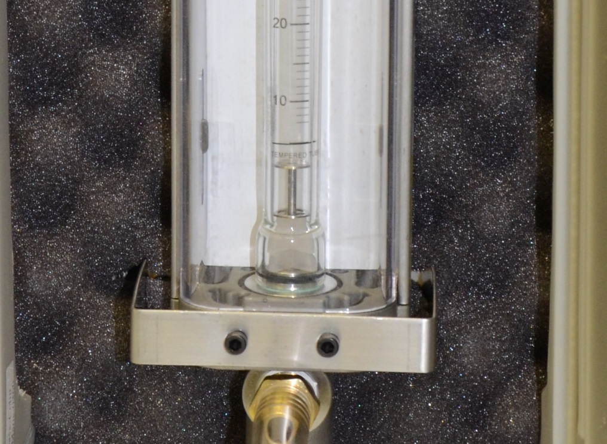
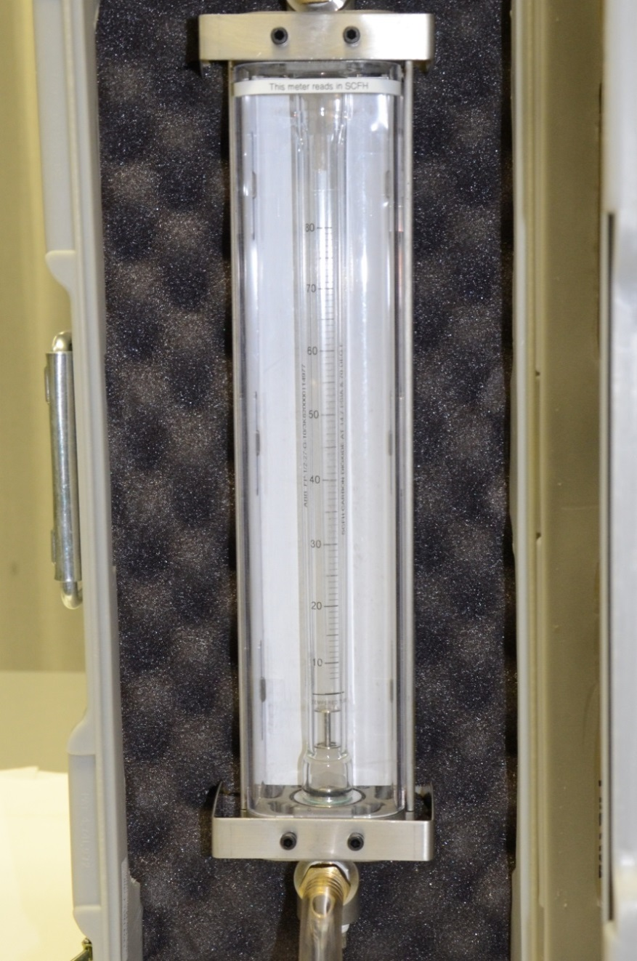
Step 1.s(5) – No Flow
A-652-0093_M3L1S1V1

Slide 12
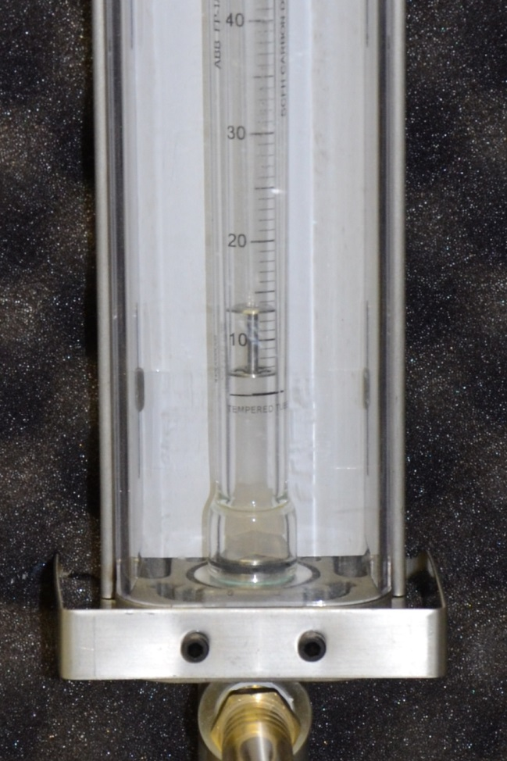
Step 1.s(5) – Low Flow
A-652-0093_M3L1S1V1

Slide 13
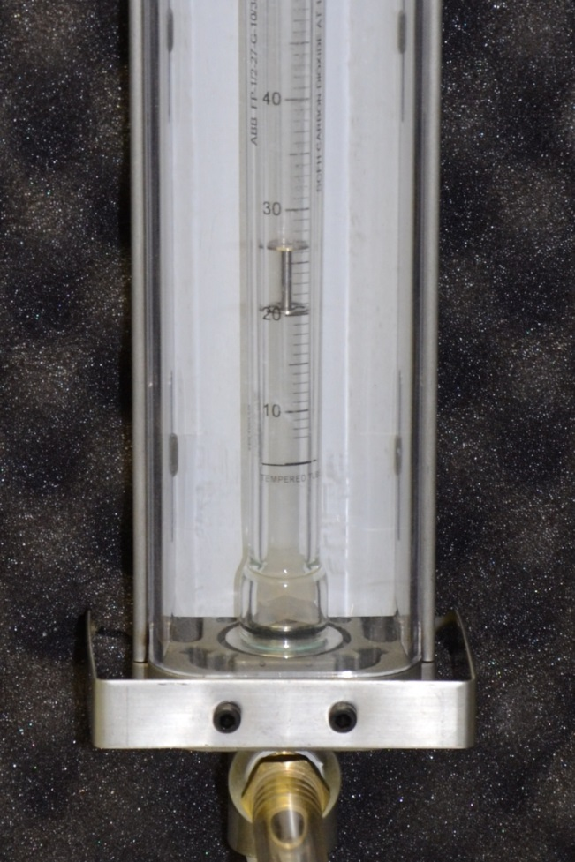
Step 1.s(5) – High Flow
A-652-0093_M3L1S1V1

Slide 14
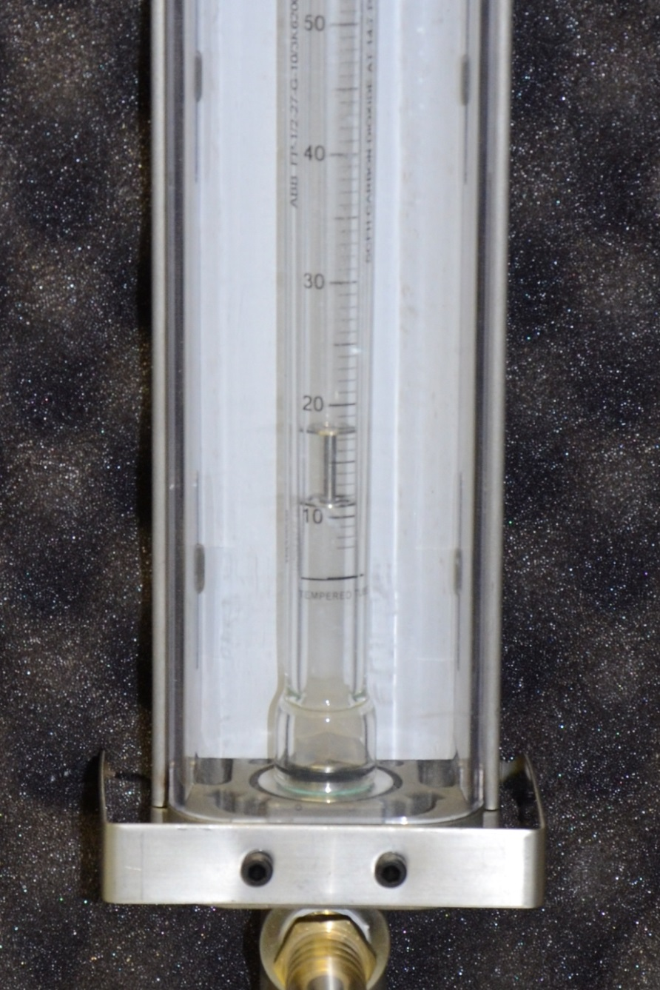
Step 1.s(5) – Incorrect Flow
Do not use the upper part of the float for setting flow rate
A-652-0093_M3L1S1V1

Slide 15
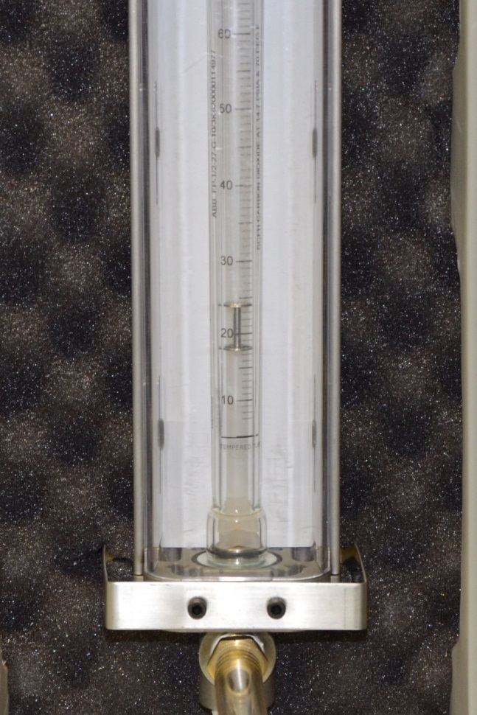
Step 1.s(5) – Correct Flow
Use the lower part of the float for setting flow rate
A-652-0093_M3L1S1V1

Slide 16
Section Review
A-652-0093_M3L1S1V1

