Slide 2
Node
CPU Usage
Memory Usage
Disk Read (B/s)
Disk Write (B/s)
Network Receive (B/s)
Network Transmit (B/s)
Hostnode
1.08%
16.37%
0
~14,495
~5,831
~4,258
Worker 1
1.33%
7.50%
0
~4,200
~6,444
~8,124
Worker 2
0.94%
7.28%
0
~3,500
~217,877
~8,633
Worker 3
5.29%
7.33%
0
~3,500
~49,094
~5,726
Worker 4
7.23%
7.34%
0
~3,500
~33,729
~6,739

Slide 3
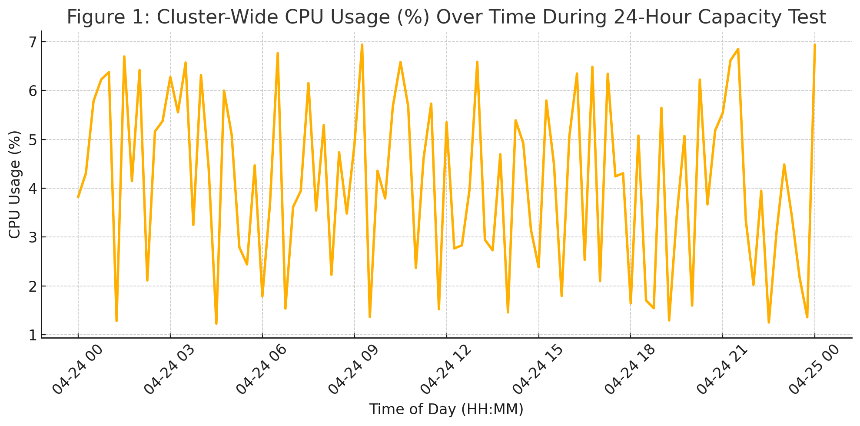
Cluster-Wide CPU Usage (%) Over Time During 24-Hour Capacity Test
7
CPU Usage (%)
6
5
4
3
2
1
0
3
6
9
12
15
18
21
24
Time of Day (Hour, 24-Hour Format)

Slide 4
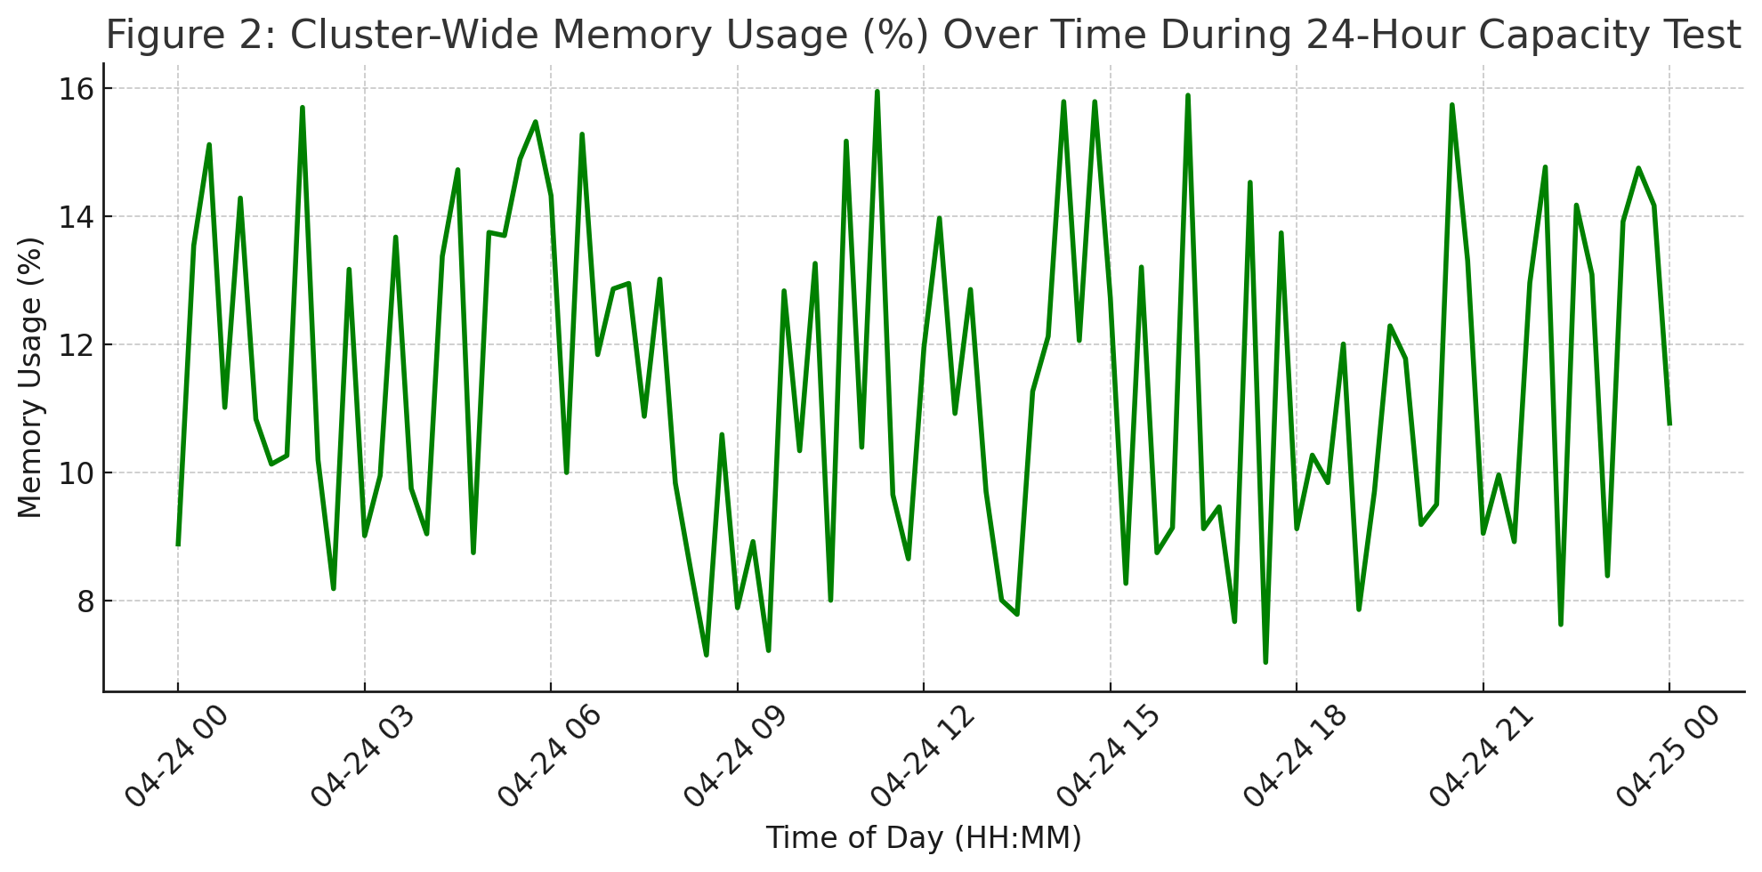
Cluster-Wide Memory Usage (%) Over Time During 24-Hour Capacity Test
16
Memory Usage (%)
14
12
10
8
0
3
6
9
12
15
18
21
24
Time of Day (Hour, 24-Hour Format)

