Slide 1
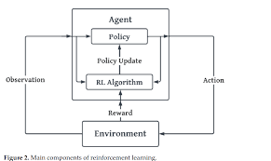


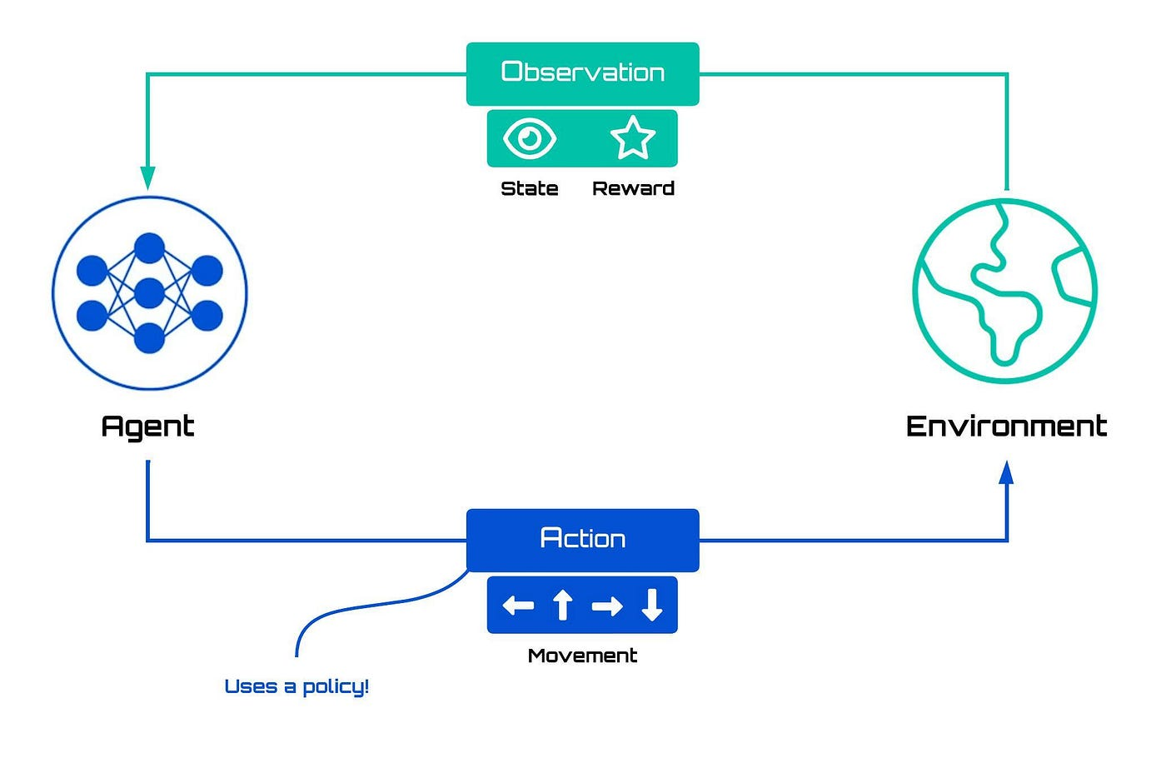
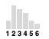










Policy Optimizer (PPO)
Observation
CIT Instance
$x$₁
State
Reward
C₁
$\text{¬}x$₁
$x$₂
$x$₁
$x$₂
C₂
$\text{¬}x$₂
Action
$x$₃
$\text{¬}x$₃
$x$₃
Solution Status
x̂ ~ π_{θ}(aₜ | sₜ)
CNF Representation
CNF as Bipartite Graph
GNN Encoder
Variable Embeddings (sₜ)
Policy (π_{θ})
x̂
x̂
$$\text{¬}$$
...
...
SAT Solver
MAML Initialisation
MAML Initialisation
Policy-Guided Variable Selection

Slide 2
Observation
CIT Instance
Policy Optimizer (PPO)
$x$₁
State
Reward
C₁
$\text{¬}x$₁
$x$₂
$x$₁
$x$₂
C₂
$\text{¬}x$₂
Action
$x$₃
$\text{¬}x$₃
$x$₃
x̂ ~ π_{θ}(aₜ | sₜ)
Solution Status
CNF Representation
CNF as Bipartite Graph
GNN Encoder
Variable Embeddings (sₜ)
Policy (π_{θ})
x̂
x̂
$$\text{¬}$$
SAT Solver
...
...
MAML Initialisation
MAML Initialisation
Policy-Guided Variable Selection

Slide 3


Observation
a) CIT Instance Input
j) PPO Learner
$x$₁
State
Reward
C₁
$\text{¬}x$₁
$x$₂
$x$₁
$x$₂
i) Solver State & Reward Signal
C₂
$\text{¬}x$₂
$x$₃
Action
$\text{¬}x$₃
$x$₃
x̂ ~ π_{θ}(aₜ | sₜ)
b) CNF Encoding
c) Bipartite Graph Representation of CNF Formula
d) GNN Feature Encoder
e) Learned Variable Embeddings (sₜ)
f) Policy Network (π_{θ}) with Probability Distribution
x̂
x̂
$$\text{¬}$$
...
...
h) CDCL SAT Solver
k) SAT Solution Status (Satisfiable/Unsatisfiable
MAML Initialisation
g) Policy-Guided Variable Selection Module

Slide 4
