Slide 1
GPU Programming Lecture 6 Atomic Operations and Histogramming

Slide 2
Objective
To understand atomic operations
Read-modify-write in parallel computation
Use of atomic operations in CUDA
Why atomic operations reduce memory system throughput
How to avoid atomic operations in some parallel algorithms
Histogramming as an example application of atomic operations
Basic histogram algorithm
Privatization

Slide 3
A Common Collaboration Pattern
Multiple bank tellers count the total amount of cash in a safe
Each grabs a pile and counts
Have a central display of the running total
Whenever someone finishes counting a pile, add the subtotal of the pile to the running total

Slide 4
A Common Coordination Pattern
Multiple customer service agents serving customers
Each customer gets a number
A central display shows the number of the next customer who will be served
When an agent becomes available, he/she calls the number and adds 1 to the display

Slide 5
A Common Arbitration Pattern
Multiple customers booking air tickets
Each
Brings up a flight seat map
Decides on a seat
Updates the seat map, marks the seat as taken
A bad outcome
Multiple passengers ended up booking the same seat

Slide 6
Atomic Operations
thread1:
Old ← Mem[x]
New ← Old + 1
Mem[x] ← New
thread2:
Old ← Mem[x]
New ← Old + 1
Mem[x] ← New
If Mem[x] was initially 0, what would the value of Mem[x] be after threads 1 and 2 have completed?
What does each thread get in their Old variable?
The answer may vary due to data races.

Slide 7
Timing Scenario #1
Time | Thread 1 | Thread 2
1 | (0) Old ← Mem[x]
2 | (1) New ← Old + 1
3 | (1) Mem[x] ← New
4 |  | (1) Old ← Mem[x]
5 |  | (2) New ← Old + 1
6 |  | (2) Mem[x] ← New
Thread 1 Old = 0
Thread 2 Old = 1
Mem[x] = 2 after the sequence

Slide 8
Timing Scenario #2
Time | Thread 1 | Thread 2
1 |  | (0) Old ← Mem[x]
2 |  | (1) New ← Old + 1
3 |  | (1) Mem[x] ← New
4 | (1) Old ← Mem[x]
5 | (2) New ← Old + 1
6 | (2) Mem[x] ← New
Thread 1 Old = 1
Thread 2 Old = 0
Mem[x] = 2 after the sequence

Slide 9
Timing Scenario #3
Time | Thread 1 | Thread 2
1 | (0) Old ← Mem[x]
2 | (1) New ← Old + 1
3 |  | (0) Old ← Mem[x]
4 | (1) Mem[x] ← New
5 |  | (1) New ← Old + 1
6 |  | (1) Mem[x] ← New
Thread 1 Old = 0
Thread 2 Old = 0
Mem[x] = 1 after the sequence

Slide 10
Timing Scenario #4
Time | Thread 1 | Thread 2
1 |  | (0) Old ← Mem[x]
2 |  | (1) New ← Old + 1
3 | (0) Old ← Mem[x]
4 |  | (1) Mem[x] ← New
5 | (1) New ← Old + 1
6 | (1) Mem[x] ← New
Thread 1 Old = 0
Thread 2 Old = 0
Mem[x] = 1 after the sequence

Slide 11
Atomic Operations – To Ensure Good Outcomes
thread1:
Old ← Mem[x]
New ← Old + 1
Mem[x] ← New
thread2:
Old ← Mem[x]
New ← Old + 1
Mem[x] ← New
Or
thread2:
Old ← Mem[x]
New ← Old + 1
Mem[x] ← New
thread1:
Old ← Mem[x]
New ← Old + 1
Mem[x] ← New

Slide 12
Without Atomic Operations
Mem[x] initialized to 0
thread1:
Old ← Mem[x]
New ← Old + 1
Mem[x] ← New
thread2:
Old ← Mem[x]
New ← Old + 1
Mem[x] ← New
Both threads receive 0
Mem[x] becomes 1

Slide 13
Atomic Operations in General
Performed by a single ISA instruction on a memory location address
Read the old value, calculate a new value, and write the new value to the location
The hardware ensures that no other threads can access the location until the atomic operation is complete
Any other threads that access the location will typically be held in a queue until its turn
All threads perform the atomic operation serially

Slide 14
Atomic Operations in CUDA
Function calls are translated into single instructions (a.k.a. intrinsics)
Atomic add, sub, inc, dec, min, max, exch (exchange), CAS (compare and swap)
Read CUDA C programming Guide 10.2 for details
Atomic Add
int atomicAdd(int* address, int val);
reads the 32-bit word old pointed to by address in global or shared memory, computes (old + val), and stores the result back to memory at the same address. The function returns old.

Slide 15
More Atomic Adds in CUDA
Unsigned 32-bit integer atomic add
unsigned int atomicAdd(unsigned int* address, unsigned int val);
Unsigned 64-bit integer atomic add
unsigned long long int atomicAdd(unsigned long long int* address, unsigned long long int val);
Single-precision floating-point atomic add (capability > 2.0)
float atomicAdd(float* address, float val);

Slide 16
Histogramming
A method for extracting notable features and patterns from large data sets
Feature extraction for object recognition in images
Fraud detection in credit card transactions
Correlating heavenly object movements in astrophysics
…
Basic histograms - for each element in the data set, use the value to identify a “bin” to increment

Slide 17
A Histogram Example
In phrase “Programming Massively Parallel Processors” build a histogram of frequencies of each letter
A(4), C(1), E(1), G(1), …
How do you do this in parallel?
Have each thread to take a section of the input
For each input letter, use atomic operations to build the histogram

Slide 18
Iteration #1 – 1st letter in each section
P
R
O
G
R
A
M
M
I
N
G
M
A
S
S
I
V
E
L
Y
P
Thread 0
Thread 1
Thread 2
Thread 3
1
2
1
A
B
C
D
E
F
G
H
I
J
K
L
M
N
O
P
Q
R
S
T
U
V

Slide 19
Iteration #2 – 2nd letter in each section
P
R
O
G
R
A
M
M
I
N
G
M
A
S
S
I
V
E
L
Y
P
Thread 0
Thread 1
Thread 2
Thread 3
1
1
1
3
1
1
A
B
C
D
E
F
G
H
I
J
K
L
M
N
O
P
Q
R
S
T
U
V

Slide 20
Iteration #3
P
R
O
G
R
A
M
M
I
N
G
M
A
S
S
I
V
E
L
Y
P
Thread 0
Thread 1
Thread 2
Thread 3
1
1
1
1
3
1
1
1
1
A
B
C
D
E
F
G
H
I
J
K
L
M
N
O
P
Q
R
S
T
U
V

Slide 21
Iteration #4
P
R
O
G
R
A
M
M
I
N
G
M
A
S
S
I
V
E
L
Y
P
Thread 0
Thread 1
Thread 2
Thread 3
1
1
1
1
1
3
1
1
1
1
2
A
B
C
D
E
F
G
H
I
J
K
L
M
N
O
P
Q
R
S
T
U
V

Slide 22
Iteration #5
P
R
O
G
R
A
M
M
I
N
G
M
A
S
S
I
V
E
L
Y
P
Thread 0
Thread 1
Thread 2
Thread 3
1
1
1
1
1
3
1
1
2
2
2
A
B
C
D
E
F
G
H
I
J
K
L
M
N
O
P
Q
R
S
T
U
V

Slide 23
What is wrong with the algorithm?

Slide 24
What is wrong with the algorithm?
Reads from the input array are not coalesced
P
R
O
G
R
A
M
M
I
N
G
M
A
S
S
I
V
E
L
Y
P
Thread 0
Thread 1
Thread 2
Thread 3
1
1
1
1
1
3
1
1
2
2
2
A
B
C
D
E
F
G
H
I
J
K
L
M
N
O
P
Q
R
S
T
U
V

Slide 25
A better approach?
Assign inputs to each thread in a strided pattern
Adjacent threads process adjacent input letters
P
R
O
G
R
A
M
M
I
N
G
M
A
S
S
I
V
E
L
Y
P
Thread 0
Thread 1
Thread 2
Thread 3
1
1
1
1
A
B
C
D
E
F
G
H
I
J
K
L
M
N
O
P
Q
R
S
T
U
V

Slide 26
Iteration 2
All threads move to the next section of input
P
R
O
G
R
A
M
M
I
N
G
M
A
S
S
I
V
E
L
Y
P
Thread 0
Thread 1
Thread 2
Thread 3
1
1
2
1
1
2
A
B
C
D
E
F
G
H
I
J
K
L
M
N
O
P
Q
R
S
T
U
V

Slide 27
A Histogram Kernel
The kernel receives a pointer to the input buffer
Each thread processes the input in a strided pattern
__global__ void histo_kernel(unsigned char *buffer,
long size, unsigned int *histo)
{
int i = threadIdx.x + blockIdx.x * blockDim.x;
// stride is total number of threads
int stride = blockDim.x * gridDim.x;

Slide 28
More on the Histogram Kernel
// All threads handle blockDim.x * gridDim.x
// consecutive elements
while (i < size) {
atomicAdd( &(histo[buffer[i]]), 1);
i += stride;
}
}

Slide 29
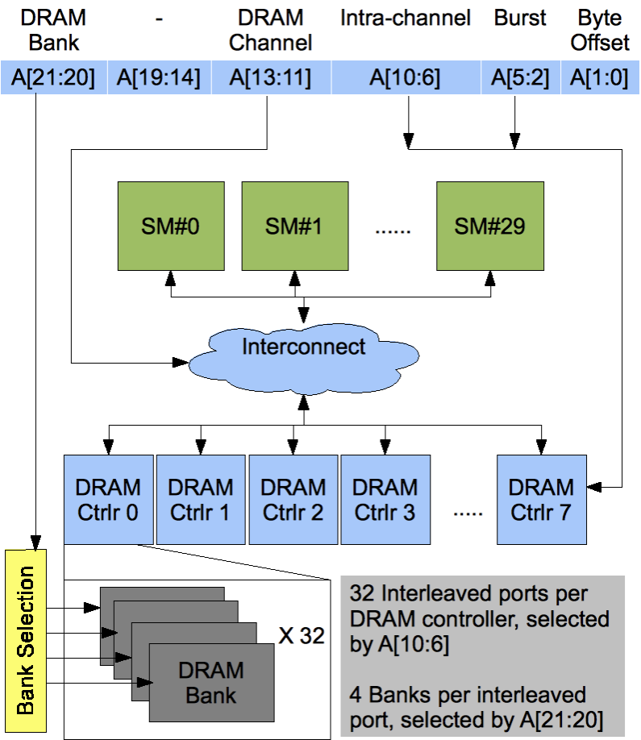
Atomic Operations on DRAM
An atomic operation starts with a read, with a latency of a few hundred cycles

Slide 30
Atomic Operations on DRAM
An atomic operation starts with a read, with a latency of a few hundred cycles
The atomic operation ends with a write, with a latency of a few hundred cycles
During this whole time, no one else can access the location

Slide 31
Atomic Operations on DRAM
Each Load-Modify-Store has two full memory access delays
All atomic operations on the same variable (RAM location) are serialized
time
internal routing
internal routing
DRAM delay
DRAM delay
DRAM delay
..
transfer delay
transfer delay
atomic operation N
atomic operation N+1

Slide 32
Latency determines throughput of atomic operations
Throughput of an atomic operation is the rate at which the application can execute an atomic operation on a particular location.
The rate is limited by the total latency of the read-modify-write sequence, typically more than 1000 cycles for global memory (DRAM) locations.
This means that if many threads attempt to do atomic operation on the same location (contention), the memory bandwidth is reduced to < 1/1000!

Slide 33
You may have a similar experience in supermarket checkout
Some customers realize that they missed an item after they started to check out
They run to the isle and get the item while the line waits
The rate of check is reduced due to the long latency of running to the isle and back.
Imagine a store where every customer starts the check out before they even fetch any of the items
The rate of the checkout will be 1 / (entire shopping time of each customer)

Slide 34
Hardware Improvements (cont.)
Atomic operations on L2 cache
medium latency, but still serialized
Global to all blocks
“Free improvement” on Global Memory atomics
time
internal routing
..
data transfer
data transfer
atomic operation N
atomic operation N+1

Slide 35
Hardware Improvements
Atomic operations on Shared Memory
Very short latency (but still serialized)
Private to each thread block
Need algorithm work by programmers (more later)
time
internal routing
..
data transfer
atomic operation N
atomic operation N+1

Slide 36
Atomics in Shared Memory Requires Privatization
Create private copies of the histo[] array for each thread block
__global__ void histo_kernel(unsigned char *buffer,
long size, unsigned int *histo)
{
__shared__ unsigned int histo_private[256];
if (threadIdx.x < 256) histo_private[threadidx.x] = 0;
__syncthreads();

Slide 37
Build Private Histogram
int i = threadIdx.x + blockIdx.x * blockDim.x;
// stride is total number of threads
int stride = blockDim.x * gridDim.x;
while (i < size) {
atomicAdd( &(histo_private[buffer[i]), 1);
i += stride;
}

Slide 38
Build Final Histogram
// wait for all other threads in the block to finish
__syncthreads();
if (threadIdx.x < 256)
atomicAdd( &(histo[threadIdx.x]), histo_private[threadIdx.x] );
}

Slide 39
More on Privatization
Privatization is a powerful and frequently used techniques for parallelizing applications
The operation needs to be associative and commutative
Histogram add operation is associative and commutative
The histogram size needs to be small
Fits into shared memory

