Slide 1
Lecture 11 – Related Programming Models: OpenCL

Slide 2
Objective
To Understand the OpenCL programming model
basic concepts and data types
Kernel structure
Application programming interface
Simple examples

Slide 3
Background
OpenCL was initiated by Apple and maintained by the Khronos Group (also home of OpenGL) as an industry standard API
For cross-platform parallel programming in CPUs, GPUs, DSPs, FPGAs,…
OpenCL draws heavily on CUDA
Easy to learn for CUDA programmers
OpenCL host code is much more complex and tedious due to desire to maximize portability and to minimize burden on vendors

Slide 4
OpenCL Programs
An OpenCL “program” is a C program that contains one or more “kernels” and any supporting routines that run on a target device
An OpenCL kernel is the basic unit of parallel code that can be executed on a target device
OpenCL Program
Misc support
functions
Kernel A
Kernel B
Kernel C

Slide 5
OpenCL Execution Model
Integrated host+device C program
Serial or modestly parallel parts in host C code
Highly parallel parts in device SPMD kernel C code
. . .
. . .

Slide 6
Mapping between OpenCL and CUDA data parallelism model concepts.
OpenCL Parallelism Concept | CUDA Equivalent
host | host
device | device
kernel | kernel
host program | host program
NDRange (index space) | grid
work item | thread
work group | block

Slide 7
OpenCL Kernels
Code that executes on target devices
Kernel body is instantiated once for each work item
An OpenCL work item is equivalent to a CUDA thread
Each OpenCL work item gets a unique index
__kernel void vadd(__global const float *a,
__global const float *b,
__global float *result)
{
int id = get_global_id(0);
result[id] = a[id] + b[id];
}

Slide 8
Array of Work Items
An OpenCL kernel is executed by an array of work items
All work items run the same code (SPMD)‏
Each work item can call get_global_id() to get its index for computing memory addresses and make control decisions
work group 0
work group 1
work group 7
work items
0
1
2
3
4
5
6
7
8
9
10
11
12
13
14
15
56
57
58
59
60
61
62
63
…
int id = get_global_id(0);
result[id] = a[id] + b [id];
…
…
int id = get_global_id(0);
result[id] = a[id] + b [id];
…
…
int id = get_global_id(0);
result[id] = a[id] + b [id];
…
…

Slide 9
Work Groups: Scalable Cooperation
Divide work item array into work groups
Work items within a work group cooperate via shared memory and barrier synchronization
Work items in different work groups cannot cooperate
OpenCL counterpart of CUDA Thread Blocks

Slide 10
OpenCL Dimensions and Indices
OpenCL API Call | Explanation | CUDA Equivalent
get_global_id(0); | global index of the work item in the x dimension | blockIdx.x*blockDim.x+threadIdx.x
get_local_id(0) | local index of the work item within the work group in the x dimension | threadIdx.x
get_global_size(0); | size of NDRange in the x dimension | gridDim.x*blockDim.x
get_local_size(0); | Size of each work group in the x dimension | blockDim.x

Slide 11
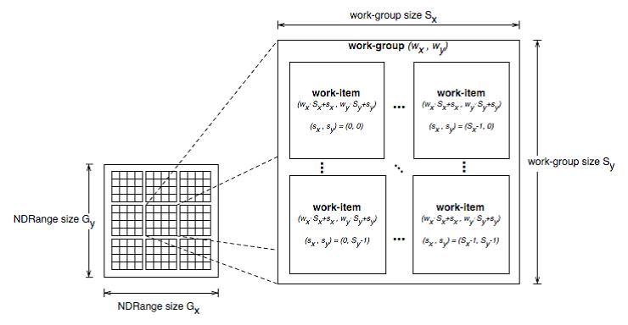
Multidimensional Work Indexing

Slide 12
OpenCL Data Parallel Model Summary
Parallel work is submitted to devices by launching kernels
Kernels run over global dimension index ranges (NDRange), broken up into “work groups”, and “work items”
Work items executing within the same work group can synchronize with each other with barriers or memory fences
Work items in different work groups can’t sync with each other, except by terminating the kernel

Slide 13
Objective
To Understand the OpenCL device architecture
Foundation to terminology used in the host code
Also needed to understand the memory model for kernels

Slide 14
OpenCL Hardware Abstraction
OpenCL exposes CPUs, GPUs, and other Accelerators as “devices”
Each device contains one or more “compute units”, i.e., cores, Streaming Multicprocessors, etc...
Each compute unit contains one or more SIMD “processing elements”, (i.e., SP in CUDA)
OpenCL Device
Compute Unit
PE
PE
PE
PE
PE
PE
PE
PE
Compute Unit
PE
PE
PE
PE
PE
PE
PE
PE

Slide 15
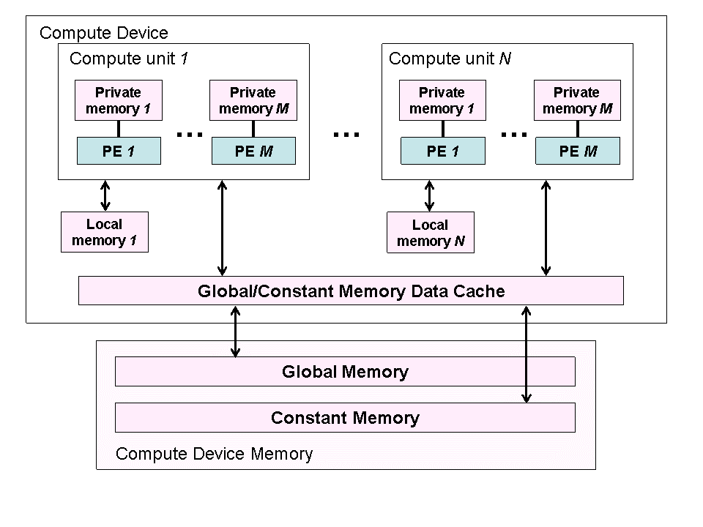
OpenCL Device Architecture

Slide 16
OpenCL Device Memory Types
Memory Type | Host access | Device access | CUDA Equivalent
global memory | Dynamic allocation; Read/write access | No allocation; Read/write access by all work items in all work groups, large and slow but may be cached in some devices. | global memory
constant memory | Dynamic allocation; read/write access | Static allocation; read-only access by all work items. | constant memory
local memory | Dynamic allocation; no access | Static allocation; shared read-write access by all work items in a work group. | shared memory
private memory | No allocation; no access | Static allocation; Read/write access by a single work item. | registers and local memory

Slide 17
OpenCL Context
Contains one or more devices
OpenCL device memory objects are associated with a context, not a specific device
OpenCL Context
OpenCL Device
OpenCL Device

Slide 18
Objective
To learn to write OpenCL host code
Create OpenCL context
Create work queues for task parallelism
Device memory Allocation
Kernel compilation
Kernel launch
Host-device data copy

Slide 19
OpenCL Context
Contains one or more devices
OpenCL memory objects are associated with a context, not a specific device
clCreateBuffer() is the main data object allocation function
error if an allocation is too large for any device in the context
Each device needs its own work queue(s)
Memory copy transfers are associated with a command queue (thus a specific device)

Slide 20
OpenCL Device Command Execution
Application
Command
Cmd Queue
Cmd Queue
Command
OpenCL Device
OpenCL Device
OpenCL Context

Slide 21
OpenCL Context Setup Code (simple)
cl_int clerr = CL_SUCCESS;
cl_context clctx = clCreateContextFromType(0, CL_DEVICE_TYPE_ALL, NULL, NULL, &clerr);
size_t parmsz;
clerr = clGetContextInfo(clctx, CL_CONTEXT_DEVICES, 0, NULL, &parmsz);
cl_device_id* cldevs = (cl_device_id *) malloc(parmsz);
clerr = clGetContextInfo(clctx, CL_CONTEXT_DEVICES, parmsz, cldevs, NULL);
cl_command_queue clcmdq = clCreateCommandQueue(clctx, cldevs[0], 0, &clerr);

Slide 22
OpenCL Kernel Compilation: vadd
OpenCL kernel source code as a big string
const char* vaddsrc =
“__kernel void vadd(__global float *d_A, __global float *d_B, __global float *d_C, int N) { \n“ […etc and so forth…]
cl_program clpgm;
clpgm = clCreateProgramWithSource(clctx, 1, &vaddsrc, NULL, &clerr);
char clcompileflags[4096];
sprintf(clcompileflags, “-cl-mad-enable");
clerr = clBuildProgram(clpgm, 0, NULL, clcompileflags, NULL, NULL);
cl_kernel clkern = clCreateKernel(clpgm, “vadd", &clerr);
Gives raw source code string(s) to OpenCL
Set compiler flags, compile source, and retrieve a handle to the “vadd” kernel

Slide 23
OpenCL Device Memory Allocation
clCreateBuffer();
Allocates object in the device Global Memory
Returns a pointer to the object
Requires five parameters
OpenCL context pointer
Flags for access type by device (read/write, etc.)
Size of allocated object
Host memory pointer, if used in copy-from-host mode
Error code
clReleaseMemObject()‏
Frees object
Pointer to freed object

Slide 24
OpenCL Device Memory Allocation (cont.)‏
Code example:
Allocate a 1024 single precision float array
Attach the allocated storage to d_a
“d_” is often used to indicate a device data structure
VECTOR_SIZE = 1024;
cl_mem d_a;
int size = VECTOR_SIZE* sizeof(float);
d_a = clCreateBuffer(clctx, CL_MEM_READ_ONLY, size, NULL, NULL);
…
clReleaseMemObject(d_a);

Slide 25
OpenCL Host-to-Device Data Transfer
clEnqueueWriteBuffer();
Memory data transfer to device
Requires nine parameters
OpenCL command queue pointer
Destination OpenCL memory buffer
Blocking flag
Offset in bytes
Size (in bytes) of written data
Source host memory pointer
List of events to be completed before execution of this command
Event object tied to this command

Slide 26
OpenCL Device-to-Host Data Transfer
clEnqueueReadBuffer();
Memory data transfer to host
requires nine parameters
OpenCL command queue pointer
Source OpenCL memory buffer
Blocking flag
Offset in bytes
Size of bytes of read data
Destination host memory pointer
List of events to be completed before execution of this command
Event object tied to this command
Notes:
The blocking flag is a boolean type, which specifies when control returns from the function. If it is TRUE (means it is a blocking call), it means that control will not return until the data has been read and copied from device memory. If it is FALSE, then it means control may return and the following statements may be executed, but there is no guarantee that the data copy from device memory has completed. Same applicable to WriteBuffer, except that it’s a write operation.
The offset specifies the offset in bytes from the start of the buffer that you want the data to be read/written to.
The event object (last param) can be tested to see if this command has completed before proceeding with other operations.

Slide 27
OpenCL Host-Device Data Transfer (cont.)‏
Code example:
Transfer a 64 * 64 single precision float array
a is in host memory and d_a is in device memory
clEnqueueWriteBuffer(clcmdq, d_a, CL_FALSE, 0,
mem_size, (const void * )a, 0, 0, NULL);
clEnqueueReadBuffer(clcmdq, d_result, CL_FALSE, 0,
mem_size, (void * ) host_result, 0, 0, NULL);

Slide 28
OpenCL Host-Device Data Transfer (cont.)‏
clCreateBuffer and clEnqueueWriteBuffer can be combined into a single command using special flags.
Eg:
d_A=clCreateBuffer(clctxt,
CL_MEM_READ_ONLY | CL_MEM_COPY_HOST_PTR, mem_size, h_A, NULL);
Combination of 2 flags here. CL_MEM_COPY_HOST_PTR to be used only if a valid host pointer is specified.
This creates a memory buffer on the device, and copies data from h_A into d_A.
Includes an implicit clEnqueueWriteBuffer operation, for all devices/command queues tied to the context clctxt.
Notes:
This combination of flags typically translates to a simple createBuffer operation for that context, followed by multiple clEnqueueWriteBuffer operations for all command queues tied to that context. Thus, for multiple devices tied to that context, using this command will copy data to all devices.
There is no limitation in the spec as to the nature of this call (blocking or not). So, it is upto the driver to choose what to do. Since the blocking behaviour is not defined, and (more importantly), there are no events tied to this command, it is best to reserve its use for read-only data.

Slide 29
Device Memory Allocation and Data Transfer for vadd
float *h_A = …, *h_B = …;
// allocate device (GPU) memory
cl_mem d_A, d_B, d_C;
d_A = clCreateBuffer(clctx, CL_MEM_READ_ONLY |
CL_MEM_COPY_HOST_PTR, N *sizeof(float), h_A, NULL);
d_B = clCreateBuffer(clctx, CL_MEM_READ_ONLY |
CL_MEM_COPY_HOST_PTR, N *sizeof(float), h_B, NULL);
d_C = clCreateBuffer(clctx, CL_MEM_WRITE_ONLY,
N *sizeof(float), NULL, NULL);
Notes:
There is no error-handling code shown in this example (due to lack of space, as they are quite verbose). However, they are very important, especially during debugging errors. I will be demonstrating an example during the lab introduction.

Slide 30
Device Kernel Configuration Setting for vadd
clkern=clCreateKernel(clpgm, “vadd", NULL);
…
clerr= clSetKernelArg(clkern, 0, sizeof(cl_mem),(void *)&d_A);
clerr= clSetKernelArg(clkern, 1, sizeof(cl_mem),(void *)&d_B);
clerr= clSetKernelArg(clkern, 2, sizeof(cl_mem),(void *)&d_C);
clerr= clSetKernelArg(clkern, 3, sizeof(int), &N);
Notes:
There is no error-handling code shown in this example (due to lack of space, as they are quite verbose). However, they are very important, especially during debugging errors. I will be demonstrating an example during the lab introduction.

Slide 31
Device Kernel Launch and Remaining Code for vadd
cl_event event=NULL;
clerr= clEnqueueNDRangeKernel(clcmdq, clkern, 1, NULL,
Gsz, Bsz, 0, NULL, &event);
clerr= clWaitForEvents(1, &event);
clEnqueueReadBuffer(clcmdq, d_C, CL_TRUE, 0,
N*sizeof(float), h_C, 0, NULL, NULL);
clReleaseMemObject(d_A);
clReleaseMemObject(d_B);
clReleaseMemObject(d_C);
}

