Slide 1
Multithreading with Qt
Tyler Trephan

Slide 2
Roadmap
What is Qt?
Qt Multithreading
QThread
Signals and Slots
Examples

Slide 3
What is Qt?
Qt (“cute”) is cross-platform application framework
Provides custom C++ extensions to easily develop code for multiple platforms
First developed in 1994
Mostly targeted towards applications with GUIs
Latest Version: 5.7

Slide 4
Qt Multithreading
Qt 5.7 provides multiple “multithreading technologies”
Each technology is at a different level of abstraction

Slide 5
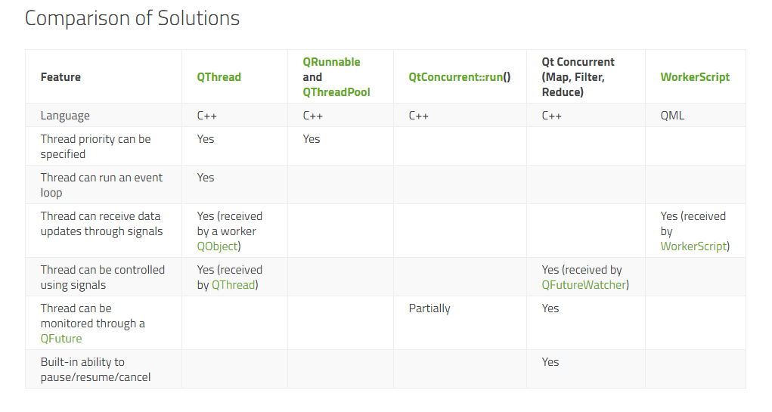
“Multithreading Technologies”

Slide 6
“Multithreading Technologies”

Slide 7
So why QThread?
It provides the most power and flexibility for a developer
In time critical programming, this power and flexibility is vital to taking advantage of Qt’s multithreading ability
Manage thread creation and destruction
Ability to set a thread’s priority
Schedule threads to a specific core

Slide 8
QThread
A QThread object manages on thread of control within your program
Two ways to use a QThread
Create a subclass of Qthread and reimplement the run() function with your thread’s desired behavior
Use worker QObjects on a Qthread

Slide 9
QThread Subclass
Create a class that inherits from QThread
In the subclass, reimplement QThread’s run() function
Now, when you start your QThread subclass, the functionality implemented in the run() function will execute on your new thread

Slide 10
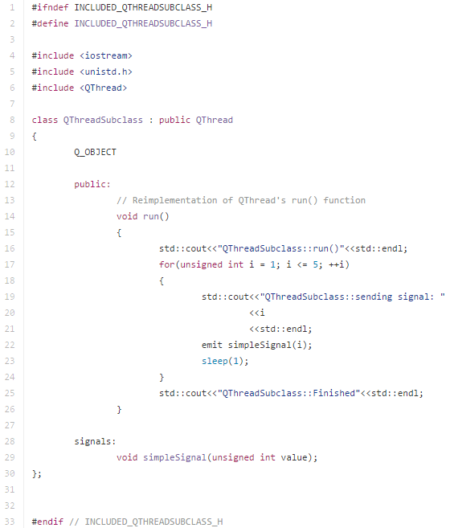
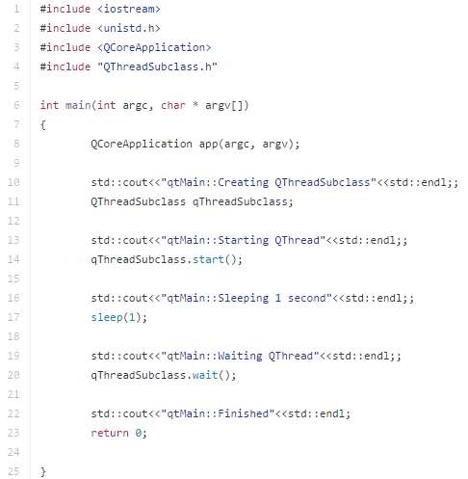
Example: QThread Subclass

Slide 11
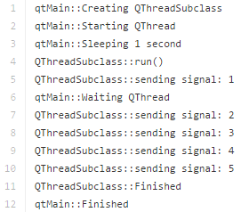
Example: QThread Subclass (Cont.)

Slide 12
Worker QObjects on a QThread
Create classes that inherit from QOjbect to act as worker object’s on your QThread
Move thread to your Qthread with the QOjbect::moveToThread() function
Interact with you new worker objects on different threads using Qt’s Signals and Slots

Slide 13
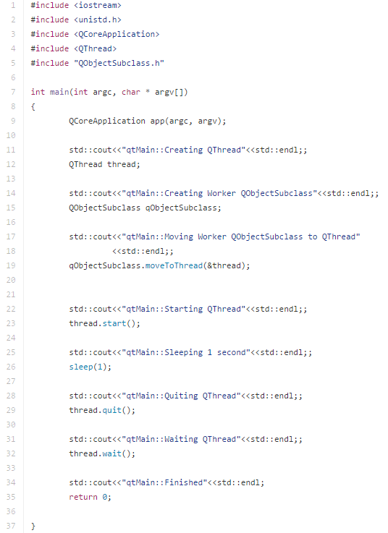
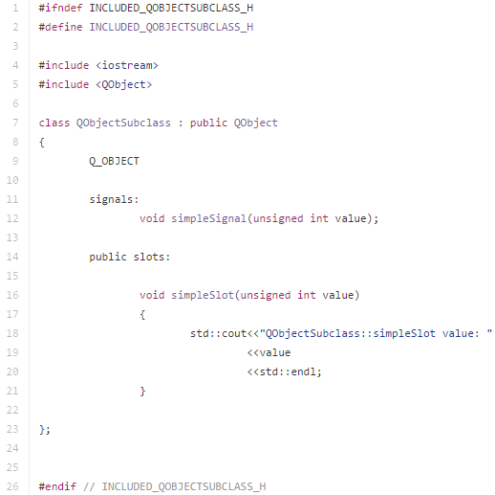
Example: Worker QObjects on a QThread

Slide 14
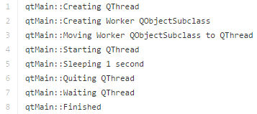
Example: Worker QObjects on a QThread (Cont.)

Slide 15
Signals and Slots
Qt’s Signals and Slots are used to facilitate communication between objects
Signals are emitted and handled by the connected Slots
Direct connection vs. Queued connection
It is a simple solution to manage communication between different threads of execution

Slide 16
Direct Connection
When a signal is emitted, execution of the slot happens directly after it is called.
Does not change the current execution thread
Behaves like a normal function call

Slide 17
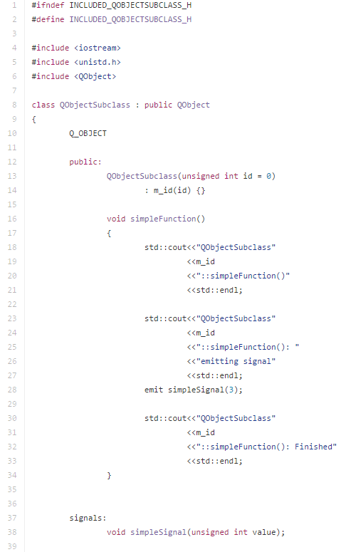
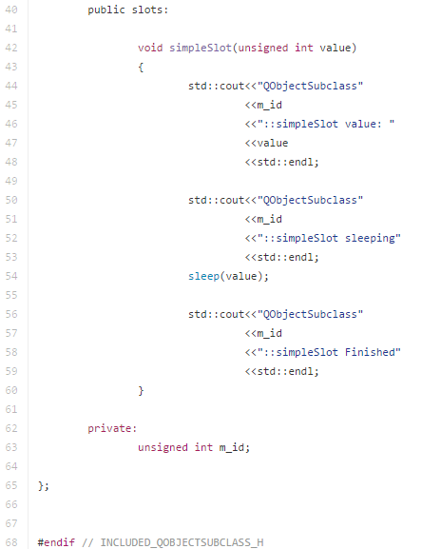
Example: Direct Connection

Slide 18
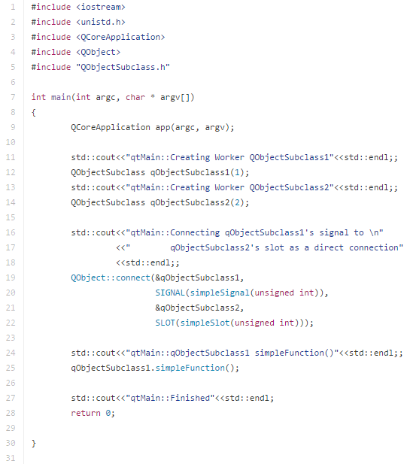
Example: Direct Connection (Cont.)

Slide 19
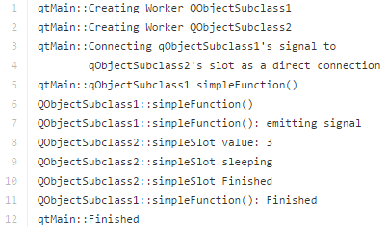
Example: Direct Connection (Cont.)

Slide 20
Queued Connection
When a signal is emitted, it is placed on the event queue of the QObject containing the slot to be executed
After the signal is emitted, execution of the code after the signal continues.
The slot will be executed when the event is queued up on the corresponding thread

Slide 21
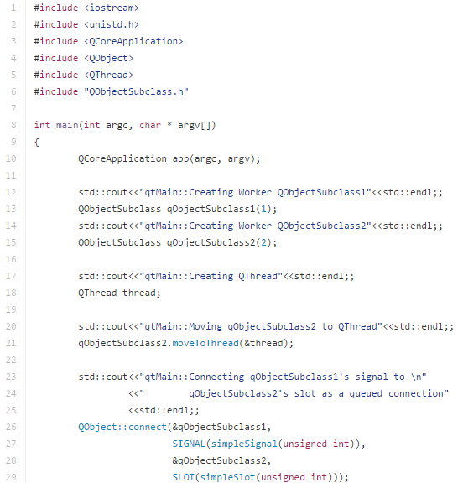
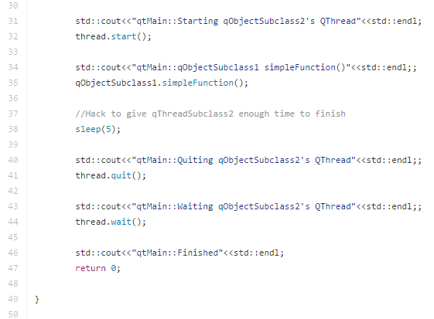
Example: Queued Connection

Slide 22
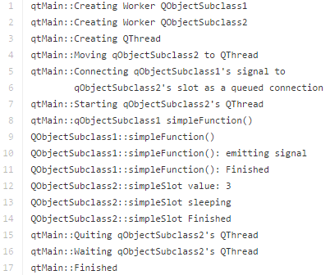
Example: Queued Connection (Cont.)

Slide 23
More Details about Signals and Slots

Slide 24
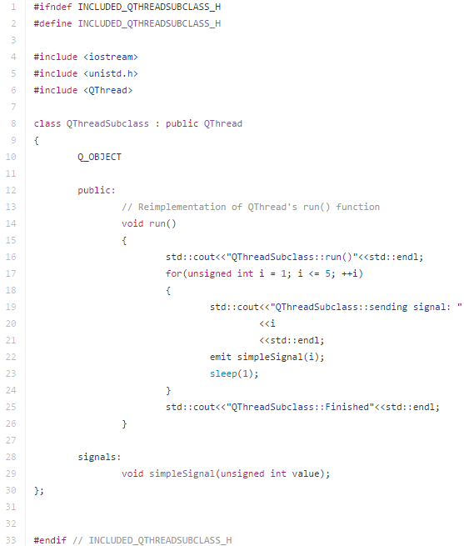
Example: Let’s Put It All Together

Slide 25
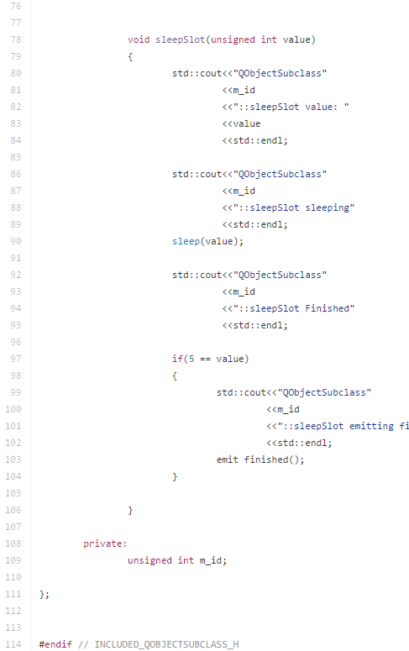
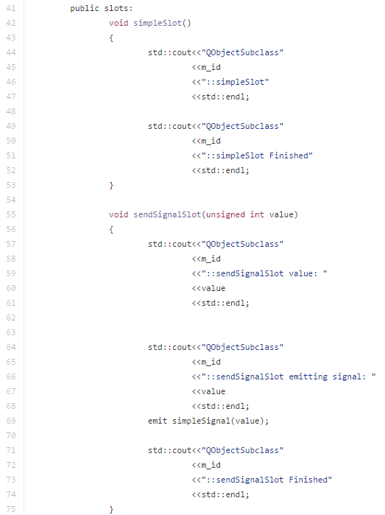
Example: Let’s Put It All Together (Cont.)

Slide 26
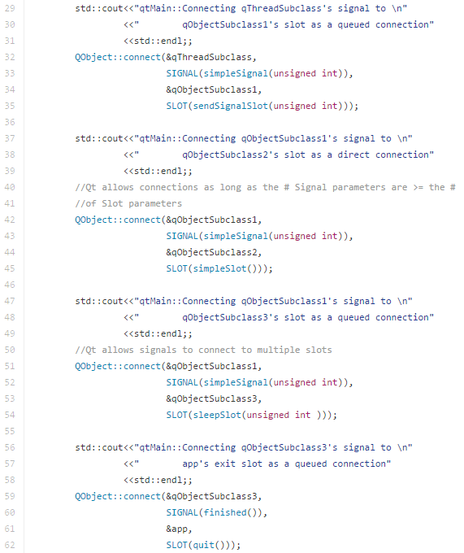
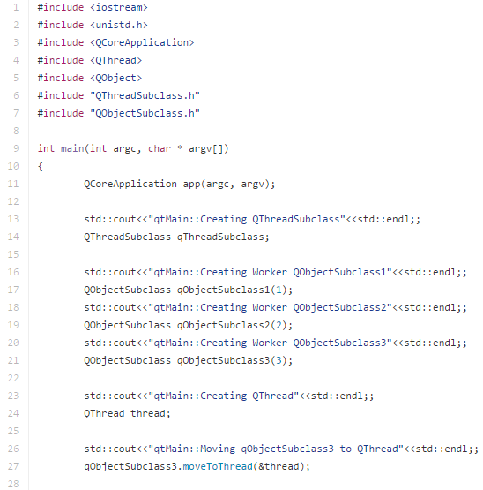
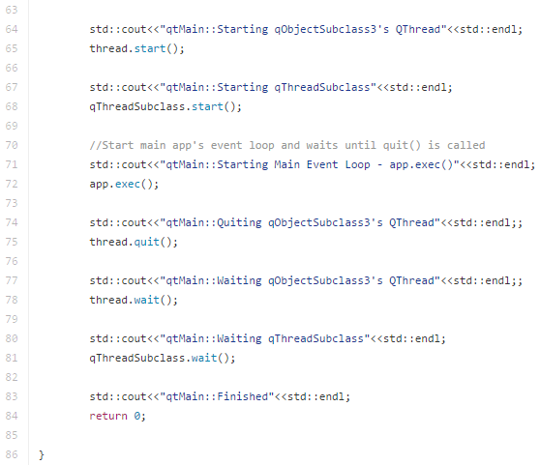
Example: Let’s Put It All Together (Cont.)

Slide 27
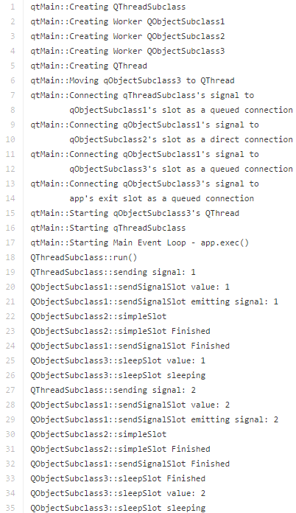
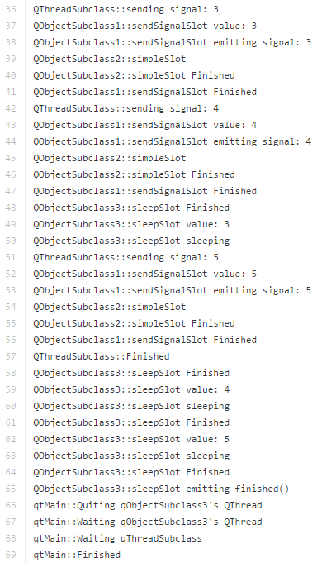
Example: Let’s Put It All Together (Cont.)

Slide 28
References
http://doc.qt.io/qt-5/threads-technologies.html

