Slide 1
Multithreading with Qt
Tyler Trephan

Slide 2
Roadmap
What is Qt?
Qt Multithreading Overview
QThread
Signals and Slots
Examples

Slide 3
What is Qt?
Qt (“cute”) is a cross-platform application framework that provides custom C++ extensions to easily develop code for multiple platforms
First developed in 1994
Mostly targeted towards applications with GUIs
Latest Version: 5.7

Slide 4
Qt Multithreading
Qt 5.7 provides multiple “multithreading technologies”
Each technology is at a different level of threading abstraction

Slide 5
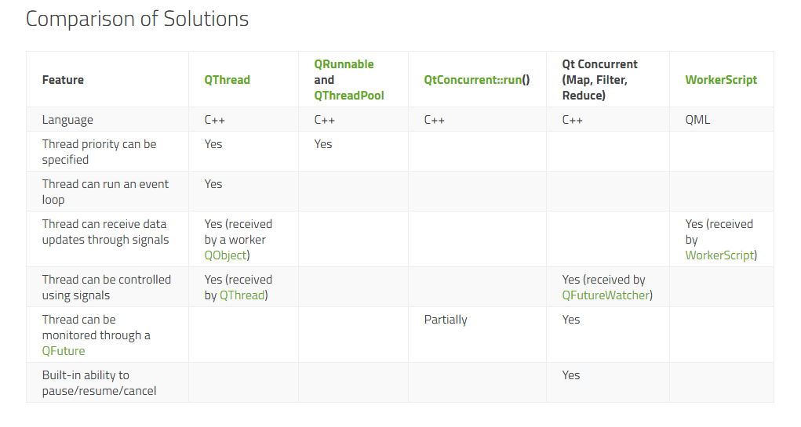
“Multithreading Technologies”

Slide 6
“Multithreading Technologies”

Slide 7
So why QThread?
Platform independent
Lowest level Qt threading abstraction which provides the most power and flexibility for development
Easy to manage
Set thread’s priority
Communicate using Signals and Slots

Slide 8
QThread
A QThread object manages a thread of control within your program
Two ways to use a QThread
Create a QThread subclass and reimplement the run() function with your thread’s desired behavior
Use worker QObjects on a QThread

Slide 9
QThread Subclass
Create a class that inherits from QThread
In the subclass, reimplement QThread’s run() function
When you start your QThread subclass, the functionality implemented in the run() function will execute on your new thread

Slide 10
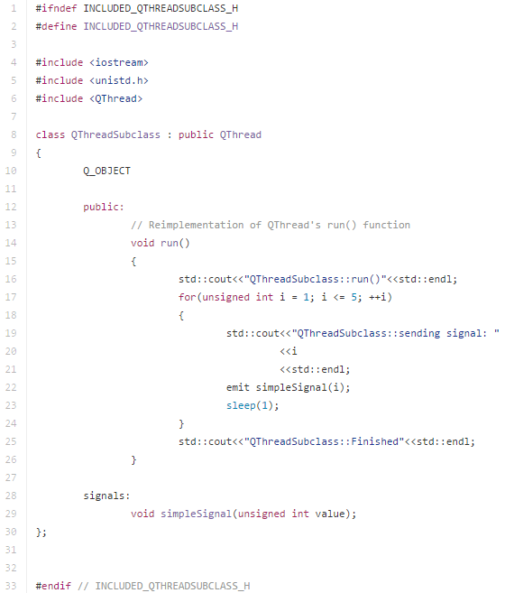
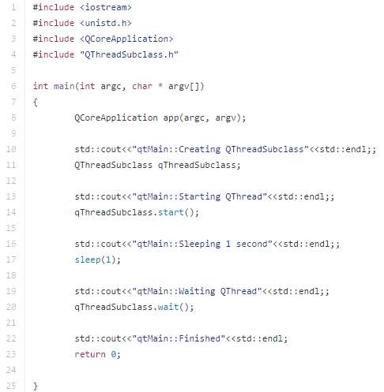
Example: QThread Subclass
Reimplemented run()
Starts run() on new thread
Main thread waits for subclass thread to finish

Slide 11
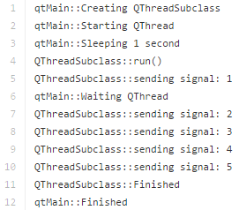
Example: QThread Subclass (Cont.)
Main thread
starts
Subclass thread
starts
Main thread waits on subclass thread
Subclass thread finishes
Main thread
finishes

Slide 12
Worker QObjects on a QThread
Create classes that inherit from QObject to act as worker objects on your QThread
Move QObjects to your QThread with the QObject::moveToThread() function
Interact with you new worker objects on different threads using Signals and Slots
The QThread’s event loop handles incoming signals to its worker QObjects

Slide 13
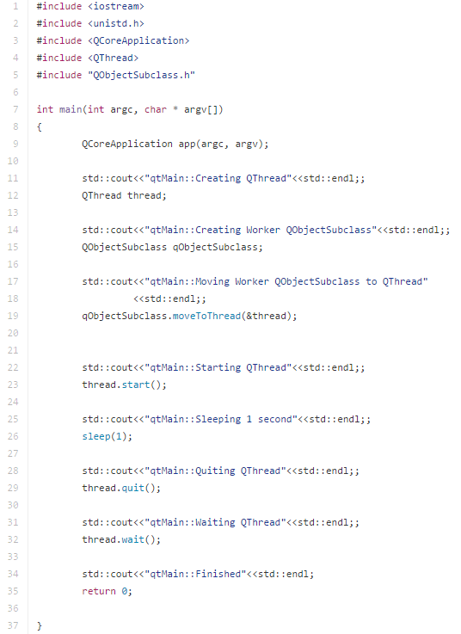
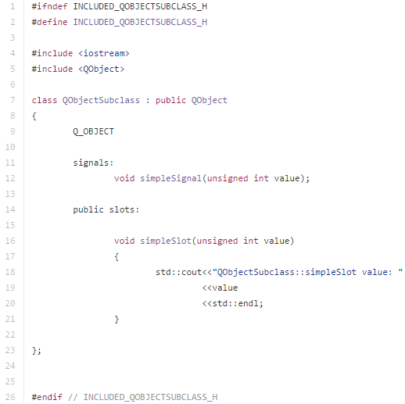
Example: Worker QObjects on a QThread
Worker QObject subclass
Move worker QObject onto new QThread
Start and quit QThread’s event loop

Slide 14
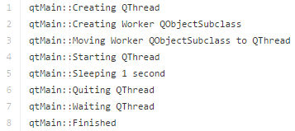
Example: Worker QObjects on a QThread (Cont.)
QObjectSubclass never runs because no signal initiates its slot

Slide 15
Signals and Slots
Qt’s Signals and Slots are used to facilitate communication between QObjects
Signals are emitted and handled by the connected Slots
Easy management of communication between QObjects on different threads
Direct connection vs. Queued connection

Slide 16
Direct Connection
Slot execution happens directly after a connected signal is emitted
Behaves like a normal function call
Slot execution happens on the signal’s thread

Slide 17
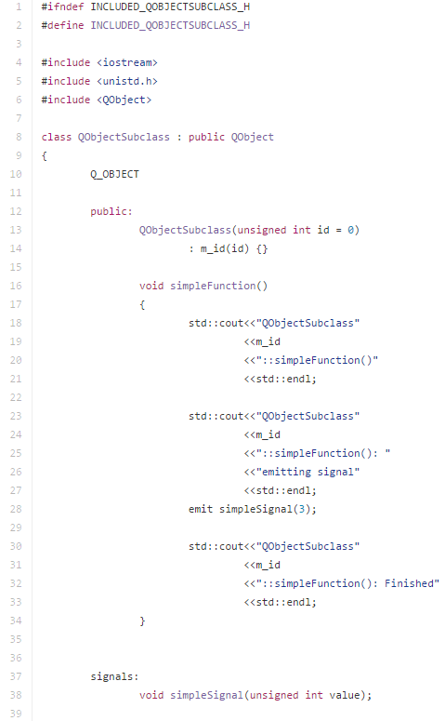
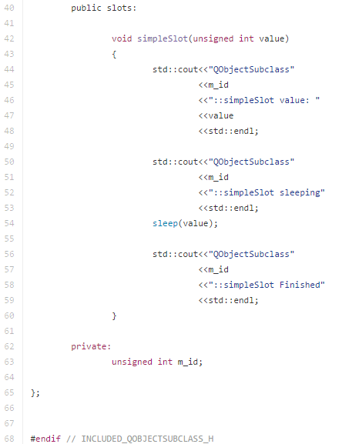
Example: Direct Connection
QObjectSubclass has a simple slot
Normal function emits a simple signal

Slide 18
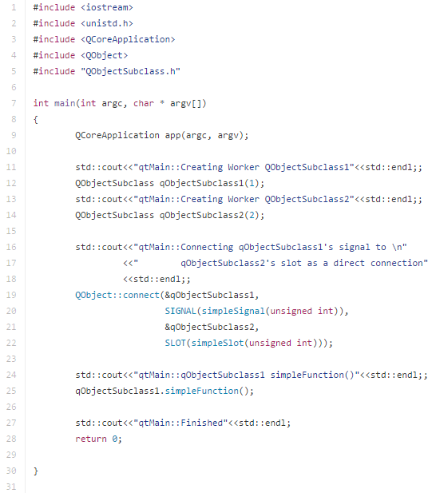
Example: Direct Connection (Cont.)
Connects QObject 1’s signal to QObject 2’s slot
Main thread calls QObject 1’s simple function

Slide 19
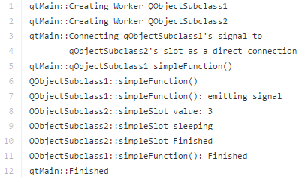
Example: Direct Connection (Cont.)
Sequential execution of the signal and slot
Returns back to function that emitted the signal

Slide 20
Queued Connection
When a signal is emitted, it is placed on the event queue of the QObject containing the slot to be executed
After the signal is emitted, the QObject that emitted the signal continues to execute the next instruction.
The slot will be executed when the event is queued up on the corresponding thread

Slide 21
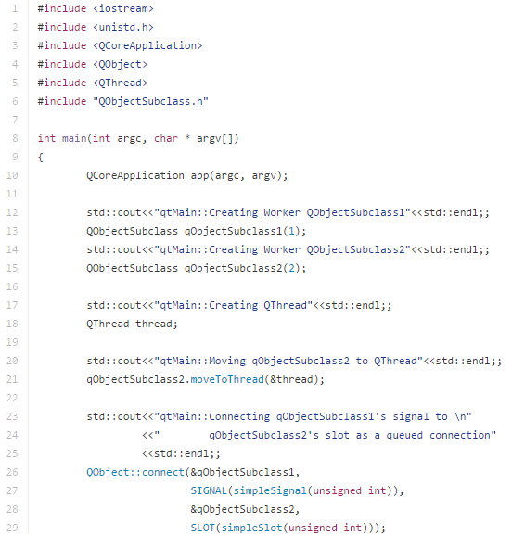
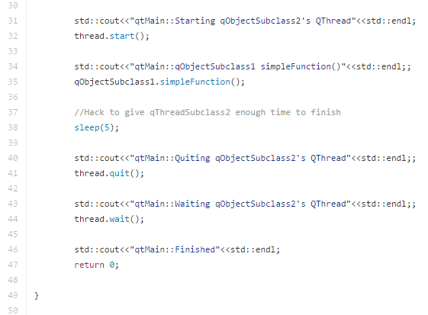
Example: Queued Connection
This example uses the same QObjectSubclass from the last example
Moves QObject 2 to a QThread

Slide 22
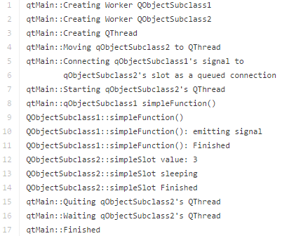
Example: Queued Connection (Cont.)
Signal is emitted from Object 1 on the main thread
QObject 1 and QObject 2 now execute on different threads

Slide 23
More Details about Signals and Slots
A signal can be connected to multiple slots, and a slot can be connected to multiple signals
Signals and Slots can pass non primitive data types
Must register non primitive data types
All references will be converted to copies
Signals can be connected to other signals
The signal’s number of parameters must be greater than or equal to the slot’s number of parameters

Slide 24
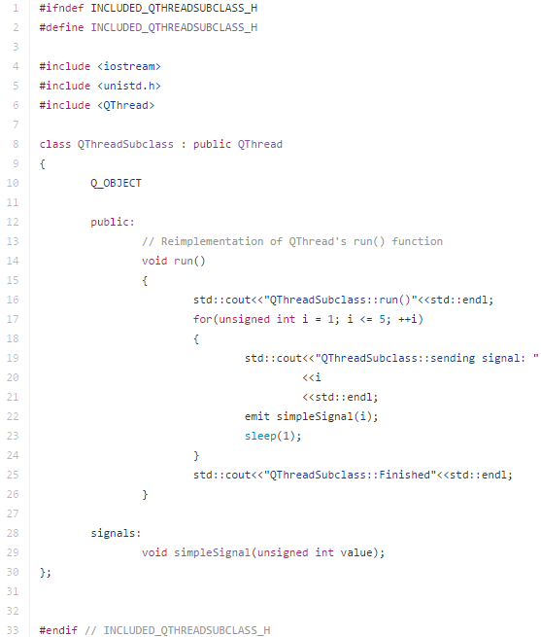
Example: Let’s Put It All Together
Emits a signal

Slide 25
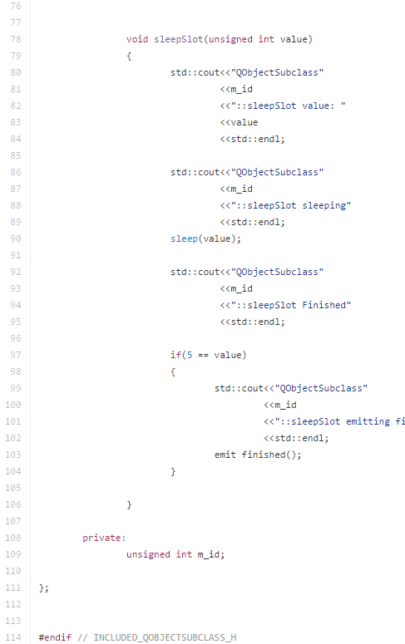
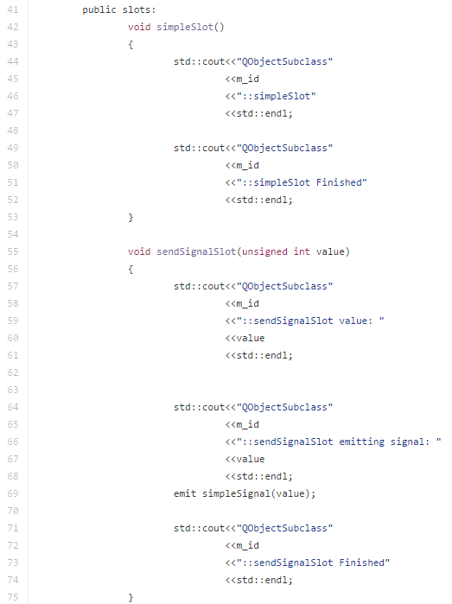
Example: Let’s Put It All Together (Cont.)
Modifications to QObjectSubclass
New slots

Slide 26
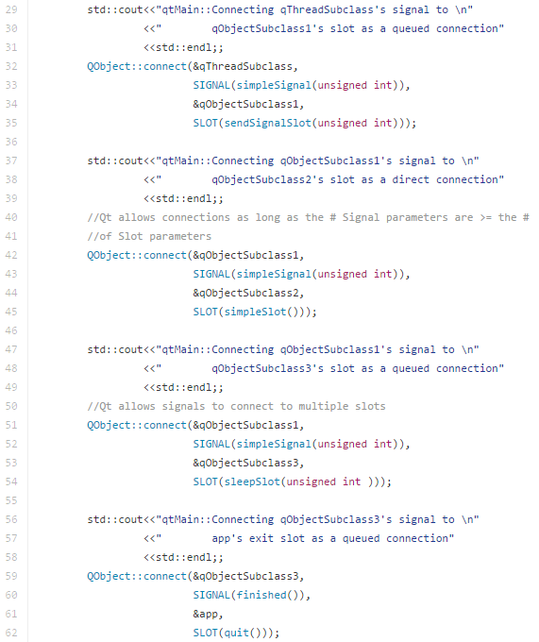
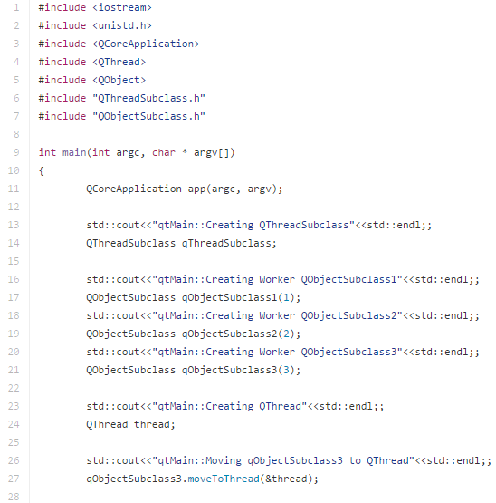
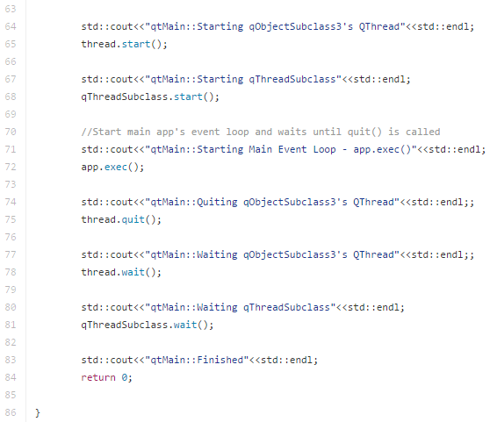
Example: Let’s Put It All Together (Cont.)
Slot drops signal’s input parameter
Signal connected to multiple slots
Signal tells the application to quit the main event loop

Slide 27
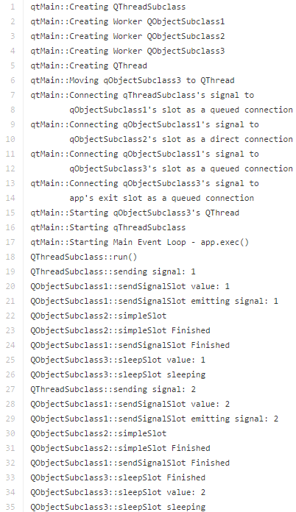
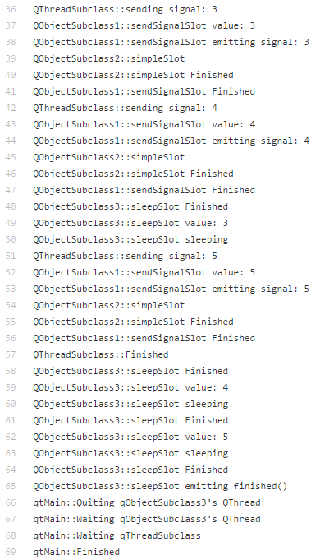
Example: Let’s Put It All Together (Cont.)
Starting and exiting the main application’s event loop
Signals stored on the QThread‘s event queue are executed when previous event finishes

Slide 28
Links
References:
http://doc.qt.io/qt-5/threads-technologies.html
https://en.wikipedia.org/wiki/Qt_(software)
Code Repository:
https://github.com/tylertrephan/qt-multithreading-tutorial

