Slide 1
Samad, Guandong, and Tyler
Brain Stimulator Progress Update

Slide 2
Problem Description
Make a device that can generate waveforms of precise frequency and current to stimulate deep parts of the brain using electrodes.

Slide 3
Key Events from Last Week
Bluetooth connectivity with between rpi and web app
App layout and backend
Programmable gain amplifier schematic creation
Continued battery search
Power calculations

Slide 4












Programmable Gain Amplifier
On output of DDS to buffer up to 5V domain from 1V8 domain.
Will this be able to switch on the fly? May need to be constant / amplitude specific

Slide 5
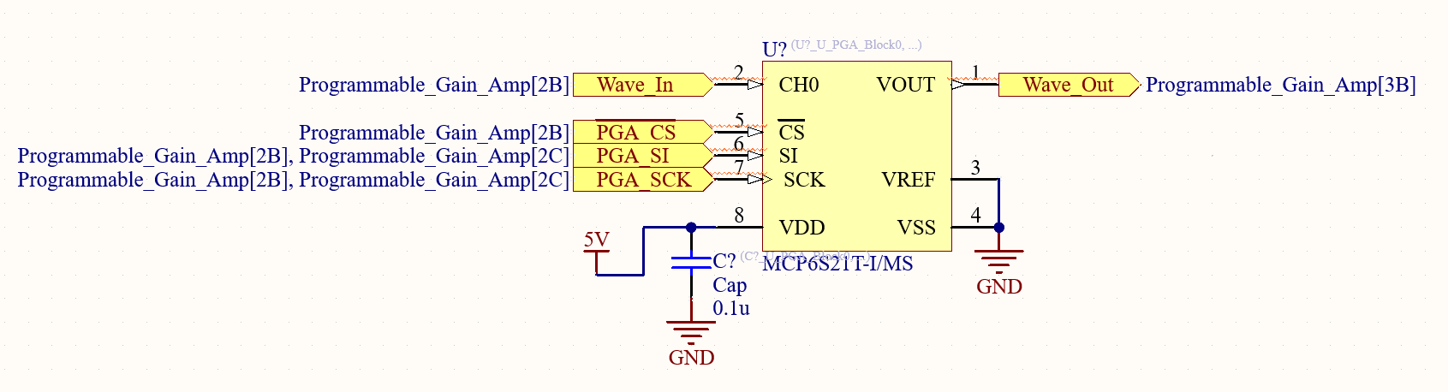
Programmable Gain Amplifier
On output of DDS to buffer up to 5V domain from 1V8 domain.
Will this be able to switch on the fly? May need to be constant / amplitude specific

Slide 6
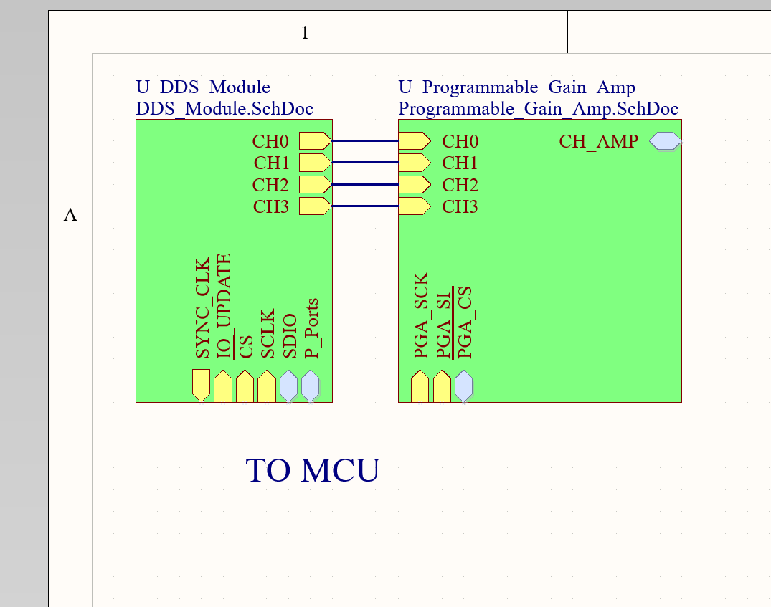
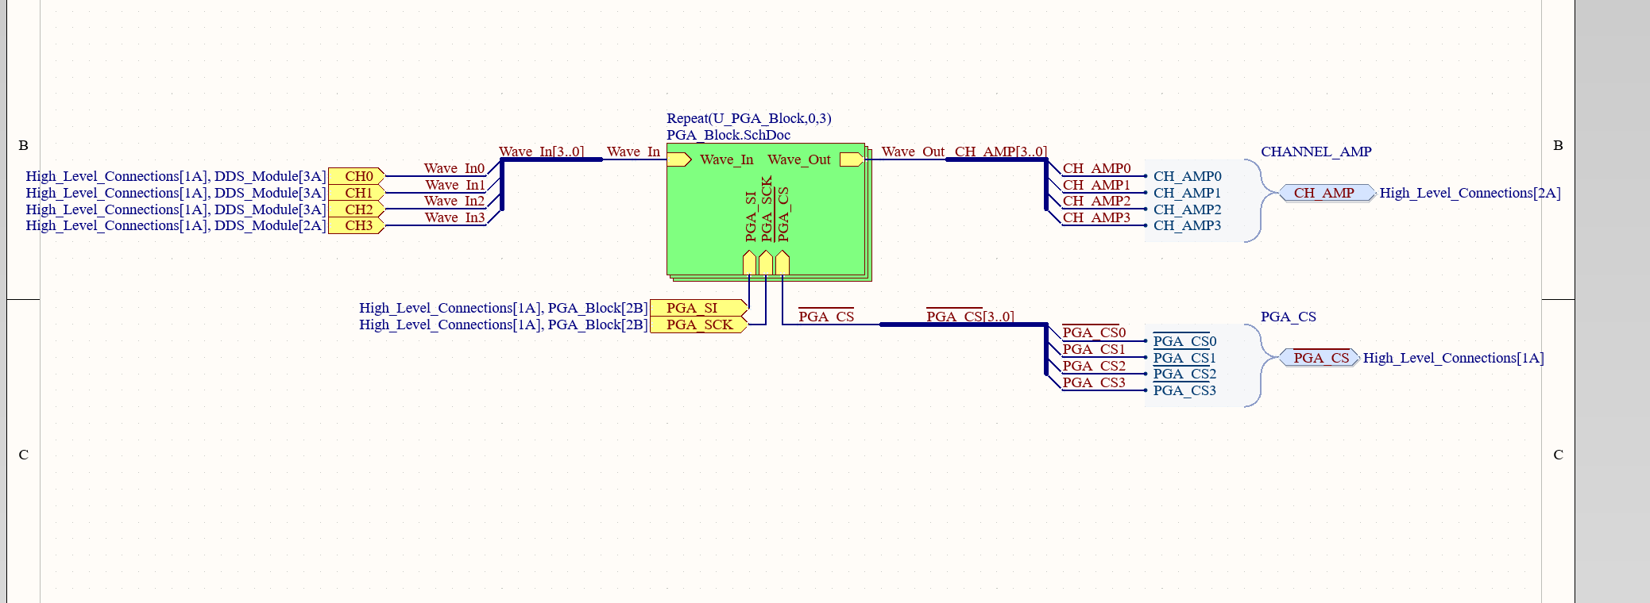
PGA Tour (Routing)

Slide 7
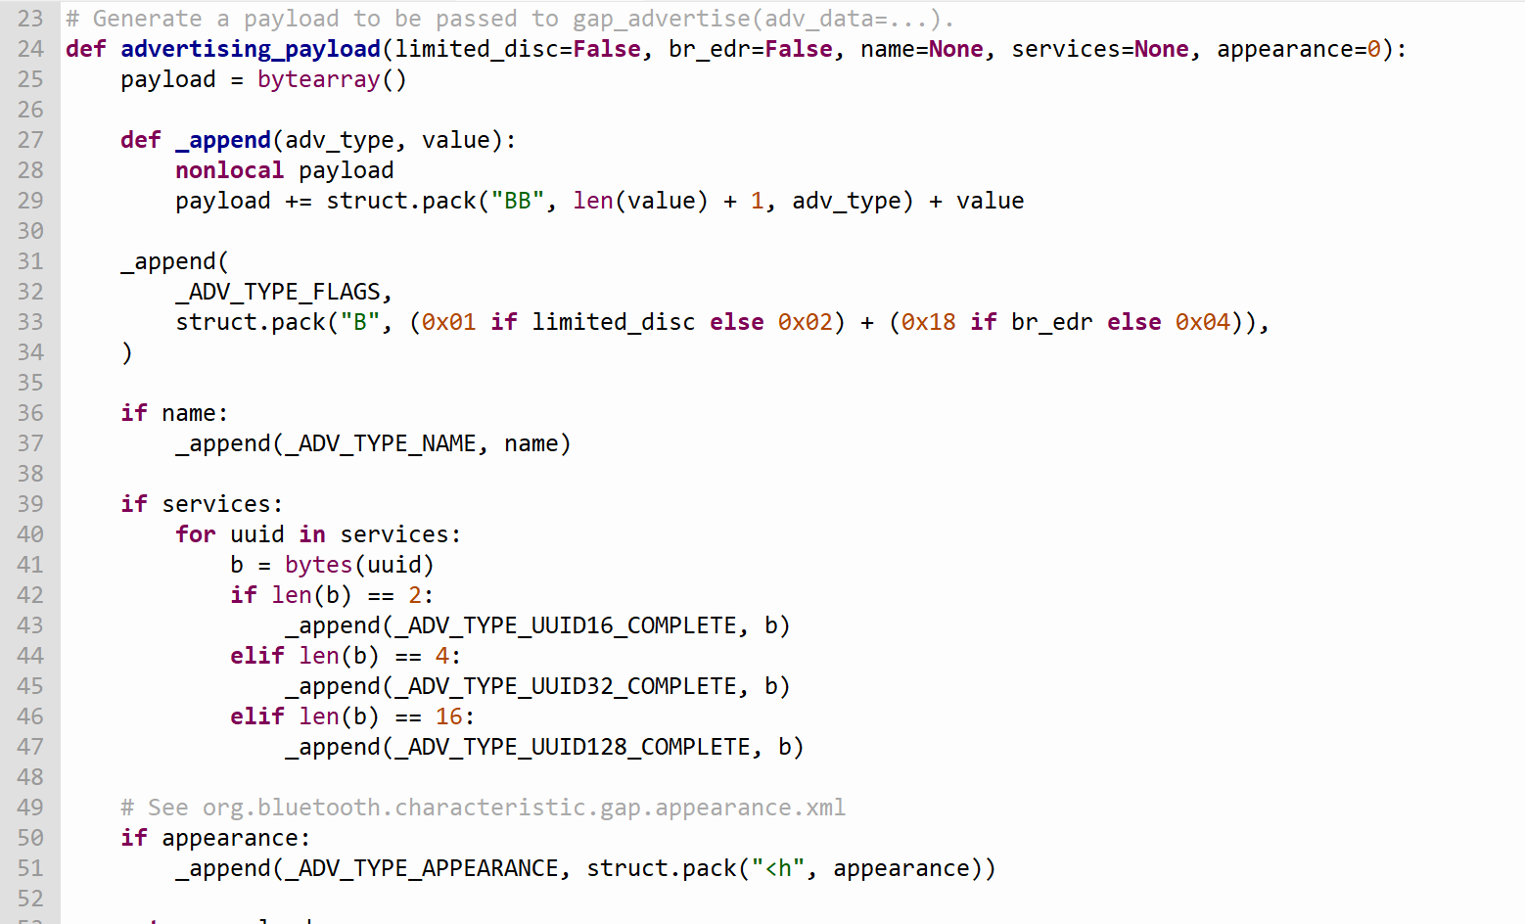
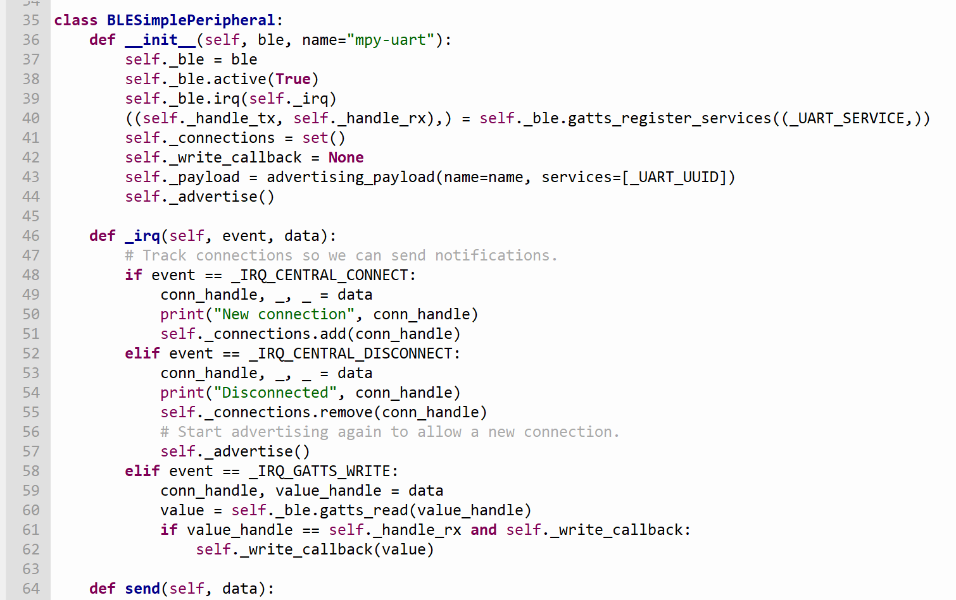
Bluetooth Connection to the MCU (Raspberry pi Pico W)
Save two MicroPython modules in our RPi Pico to communicate via Bluetooth Low Energy
Helpers for generating BLE advertising payloads
Creates a simple BLE peripheral
https://electrocredible.com/raspberry-pi-pico-w-bluetooth-ble-micropython/

Slide 8
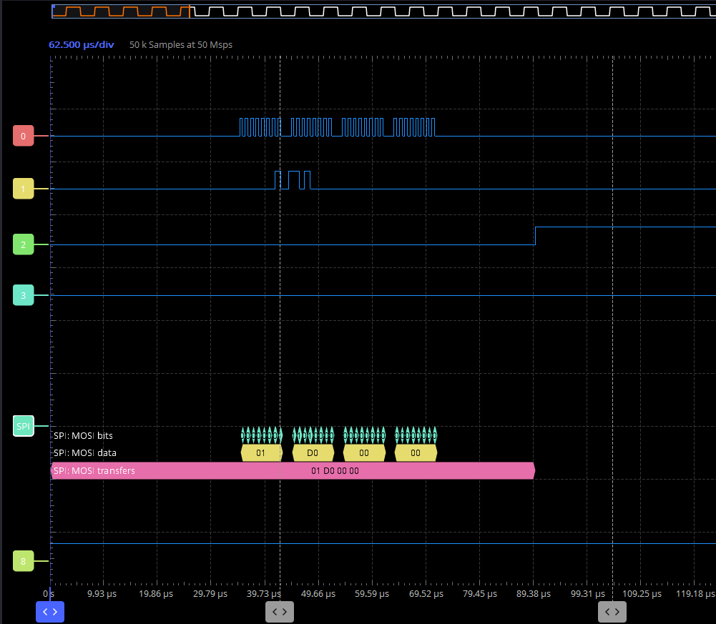
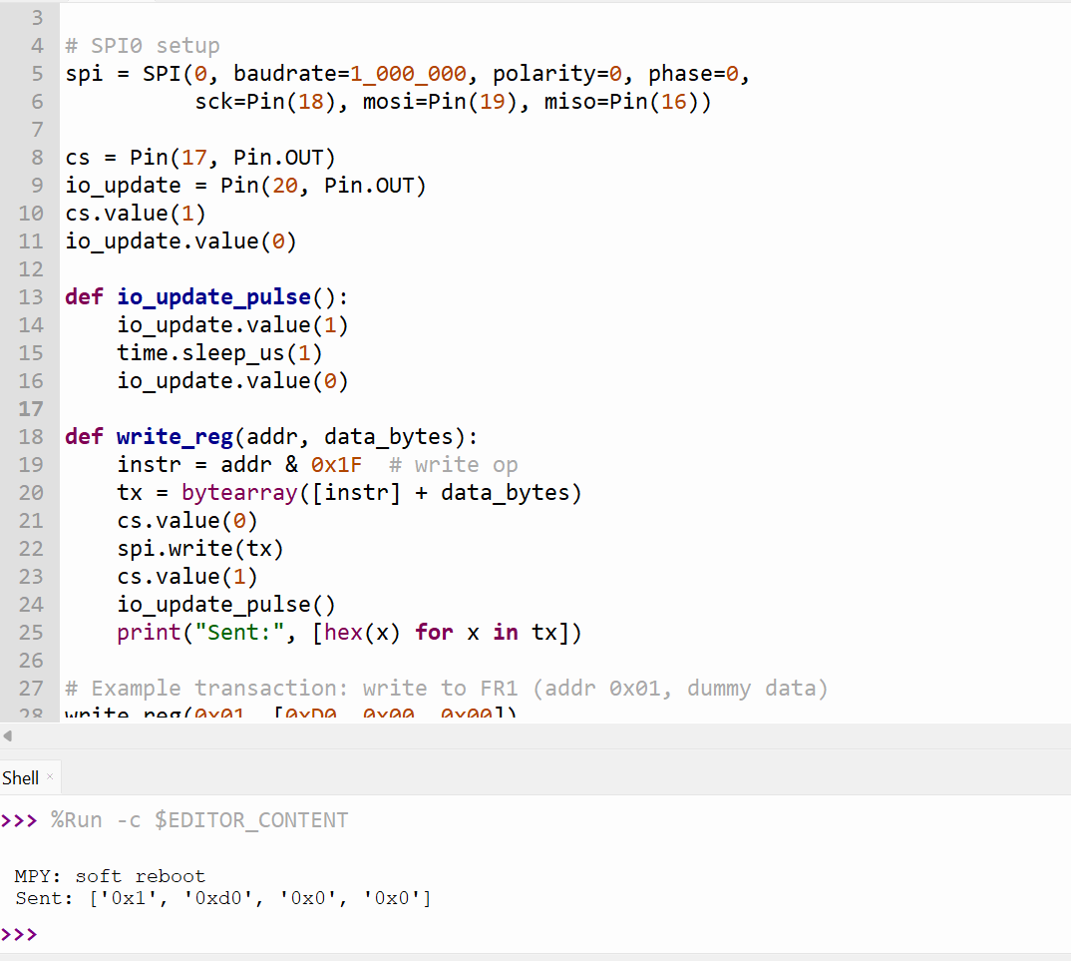
SPI Testing with The Raspberry PI
This simulates writing to a function register in the DDS
Waveform caught by oscilloscope
Next, we need to test it with DDS directly

Slide 9
Web App
Choosing browser based for best portability
Using webbluetooth with JS
Need room to expand easily to more channels

Slide 10
Web App
Enable/disable on outputs
Beat frequency calculation
Non-volatile programming capable (How to modify code? Constant address?)

Slide 11
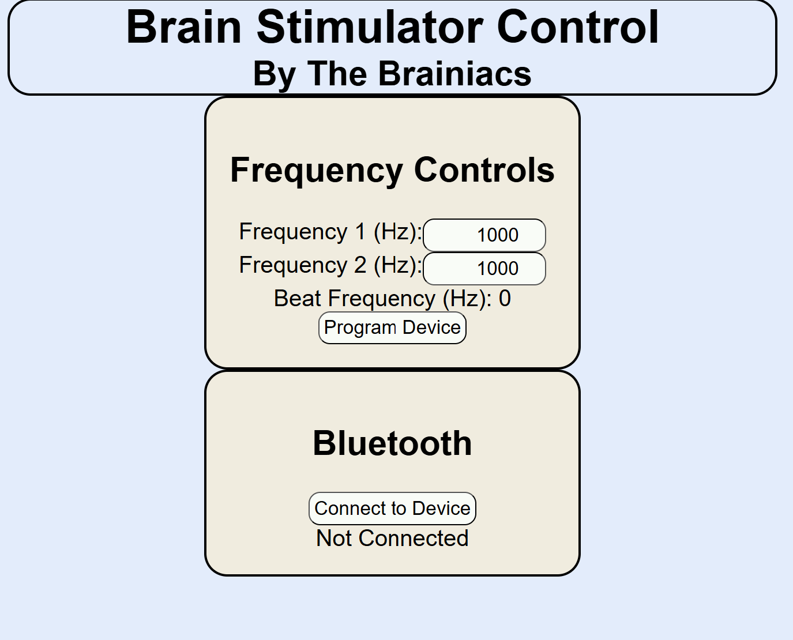
Web App Continued
(I <3 CSS)

Slide 12
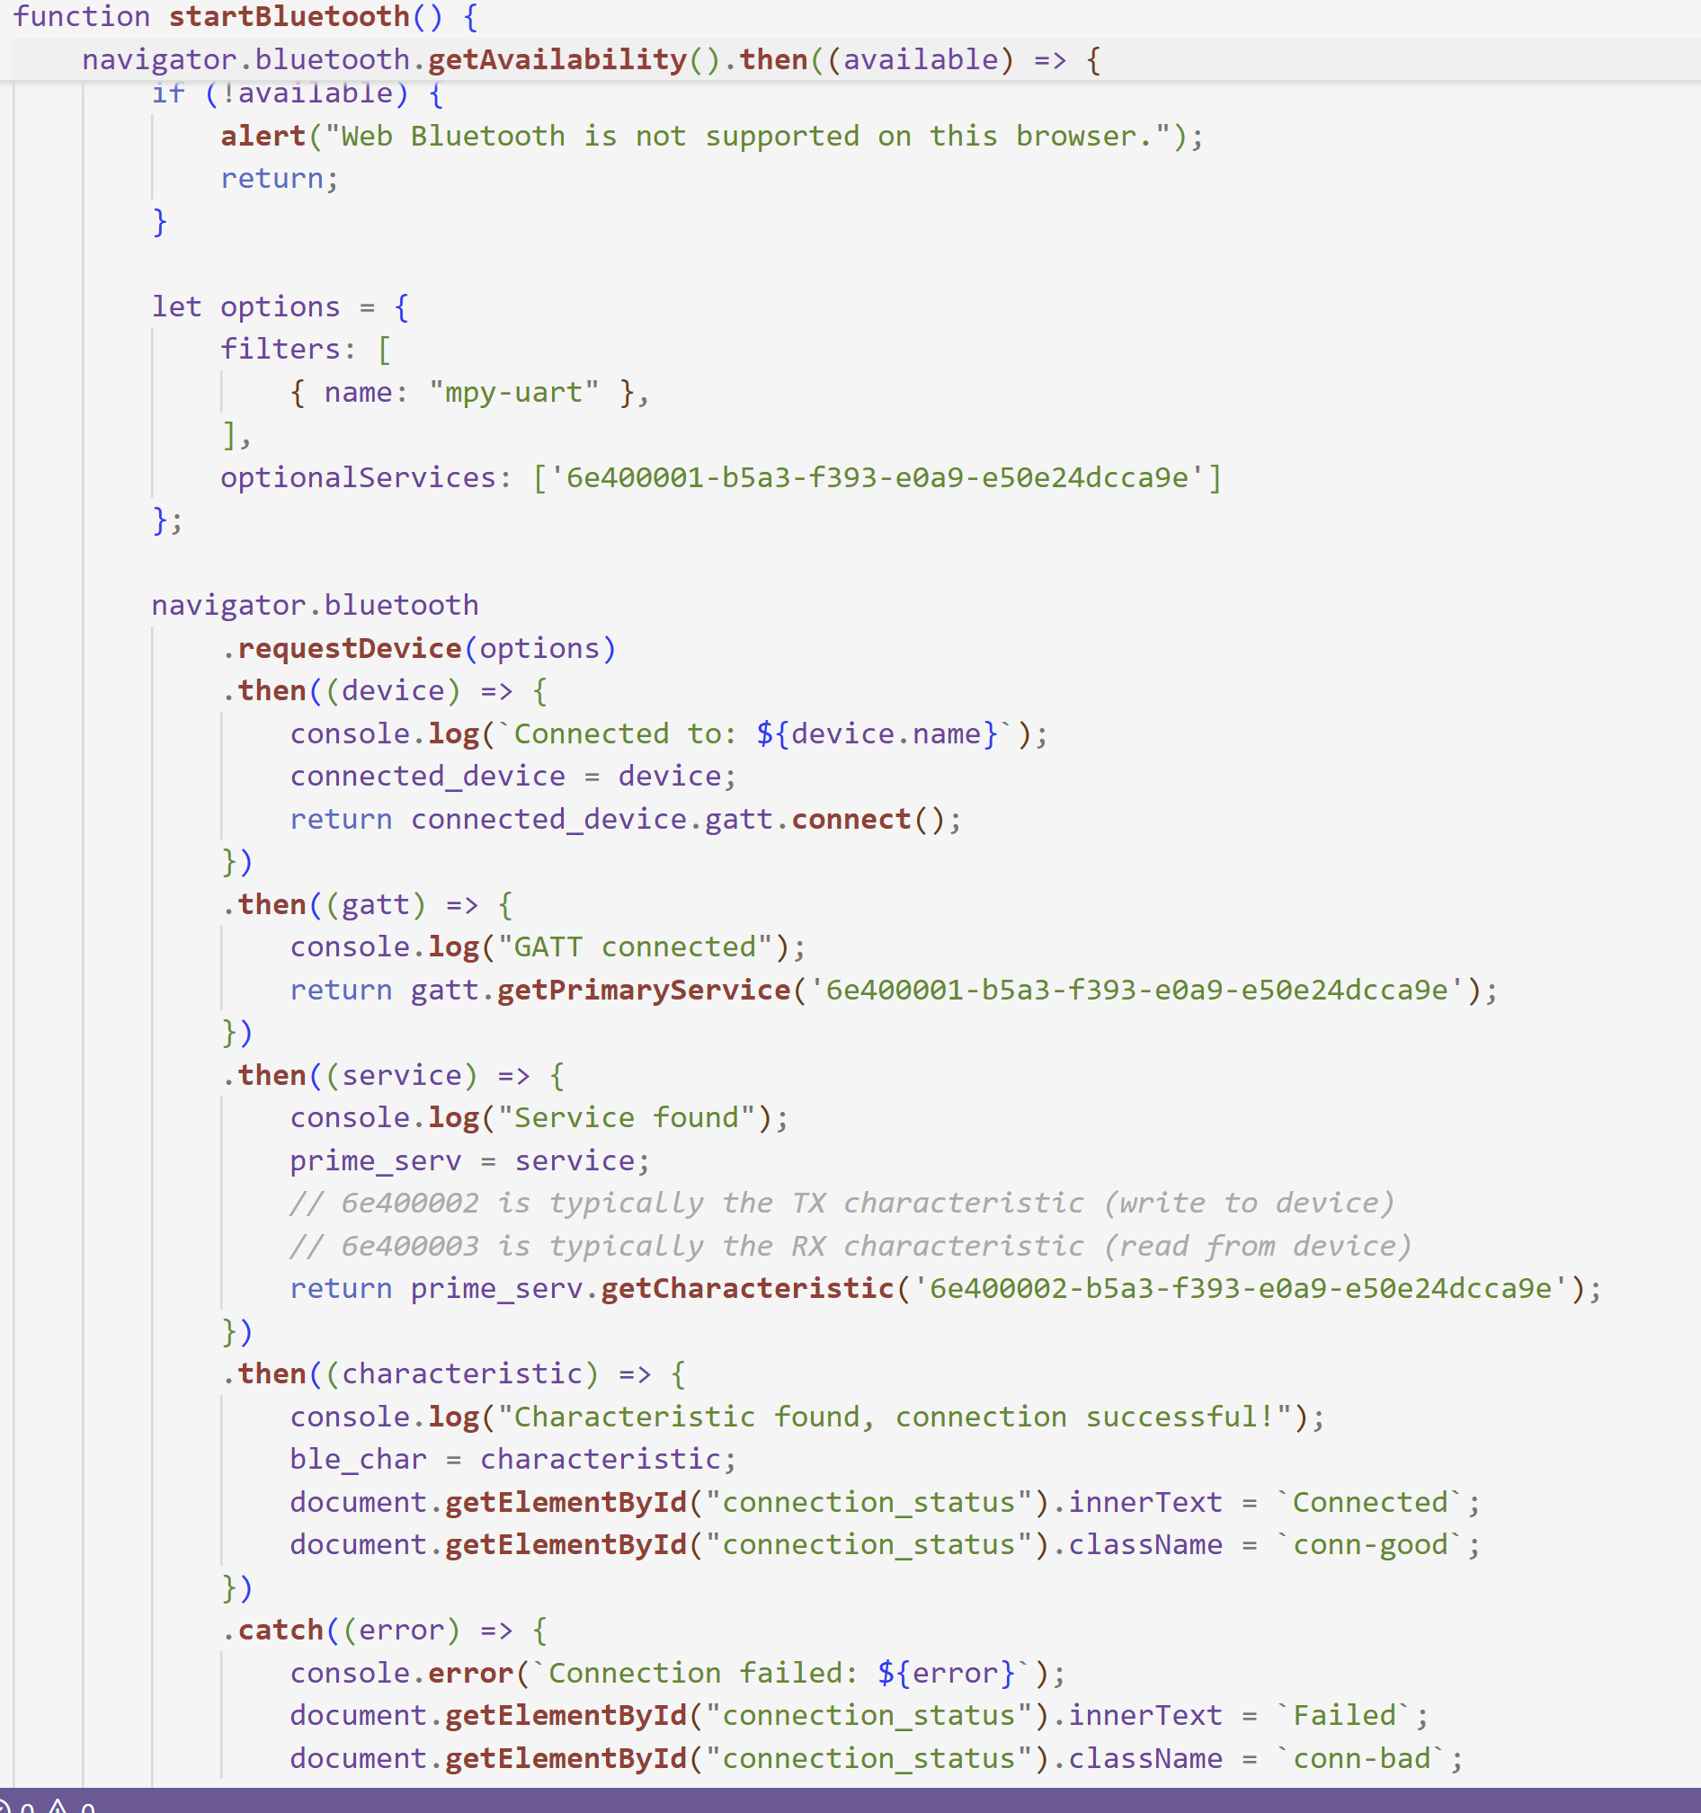
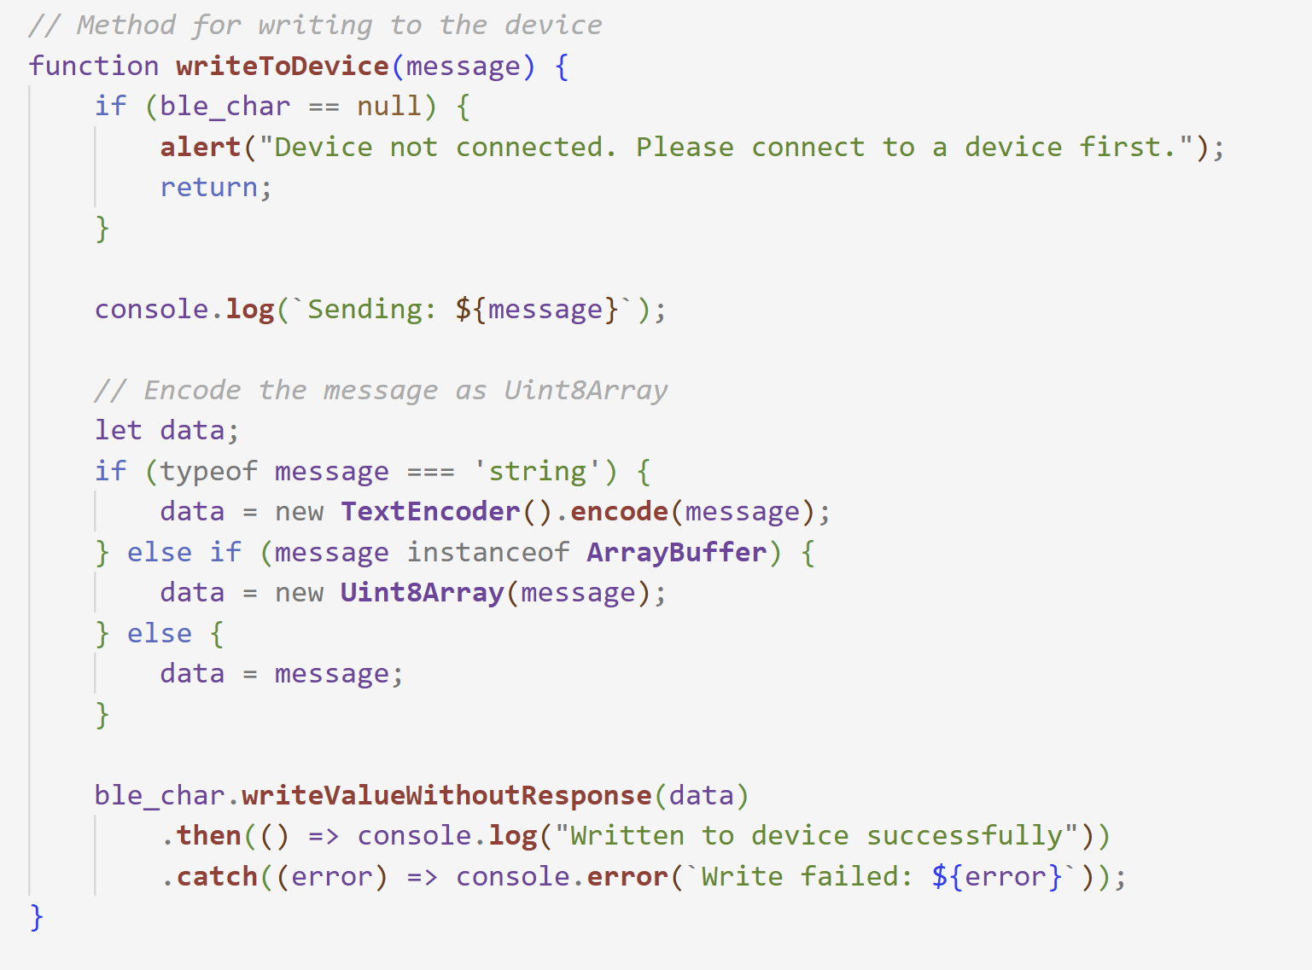
Web App Backend

Slide 13
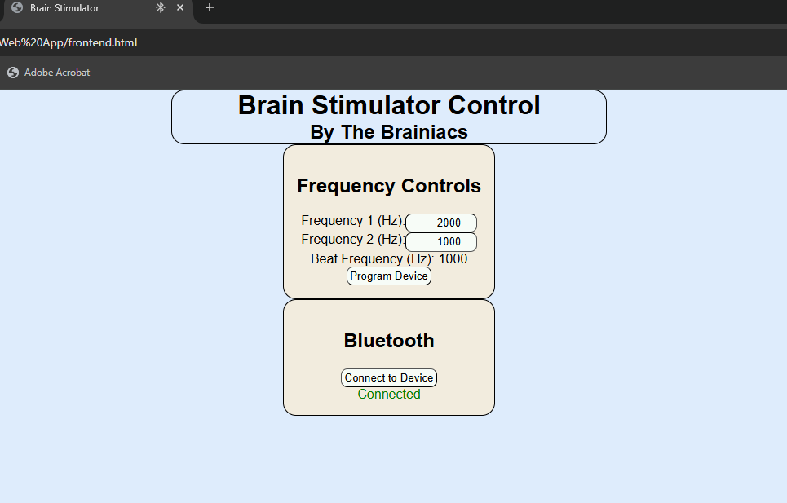
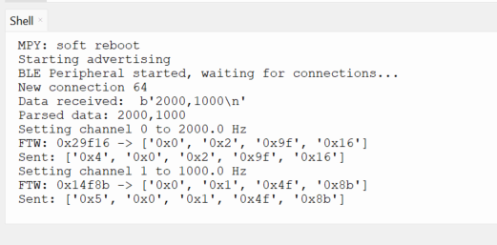
Writes to two channels

Slide 14
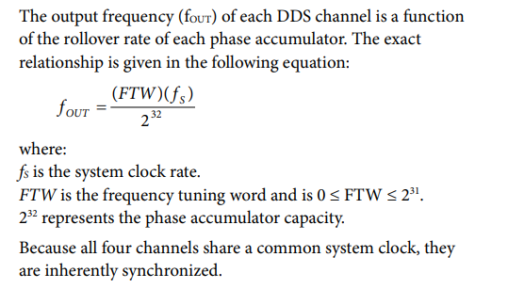
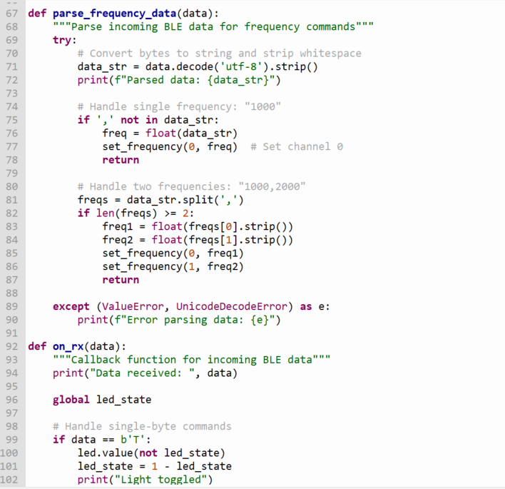
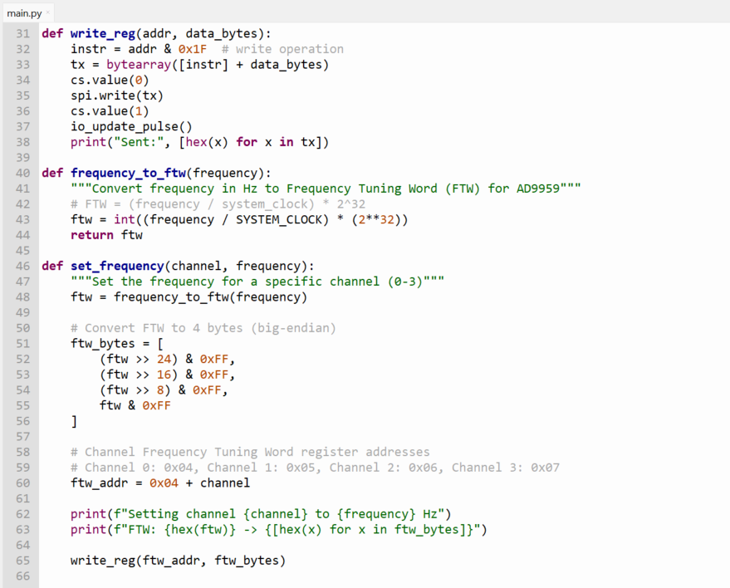
RPI Backend

Slide 15
Plans for Battery
Calculate required amp hours to narrow search
Find something with integrated BMS
Use dimensions to make housing and board dimensions

Slide 16
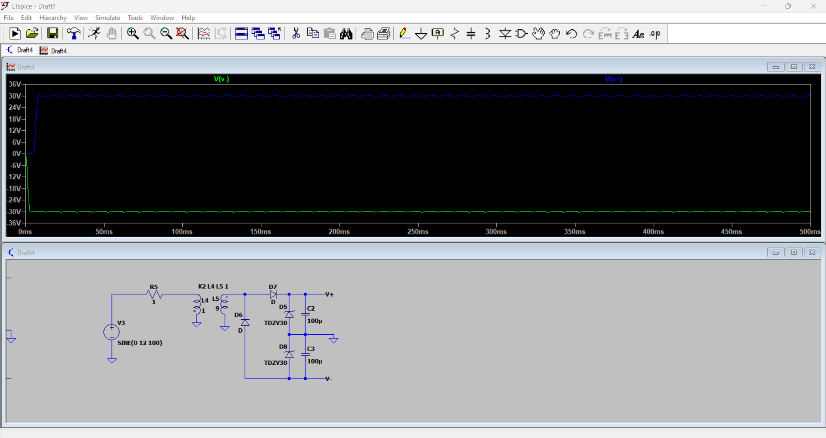
Simulation

Slide 17
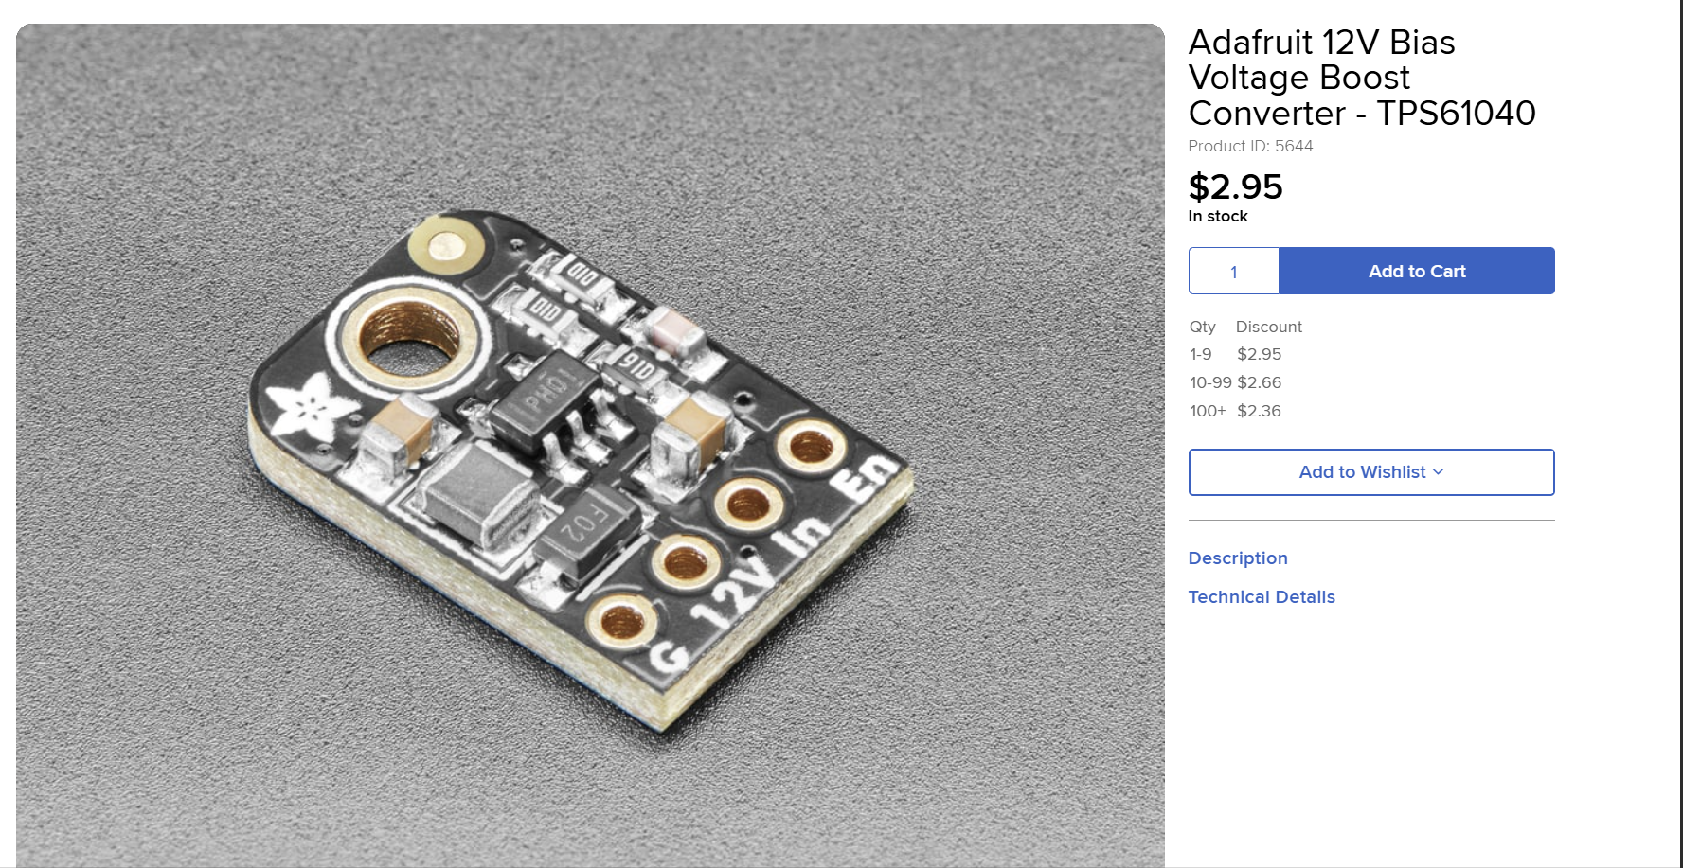
DC-DC Converter

Slide 18
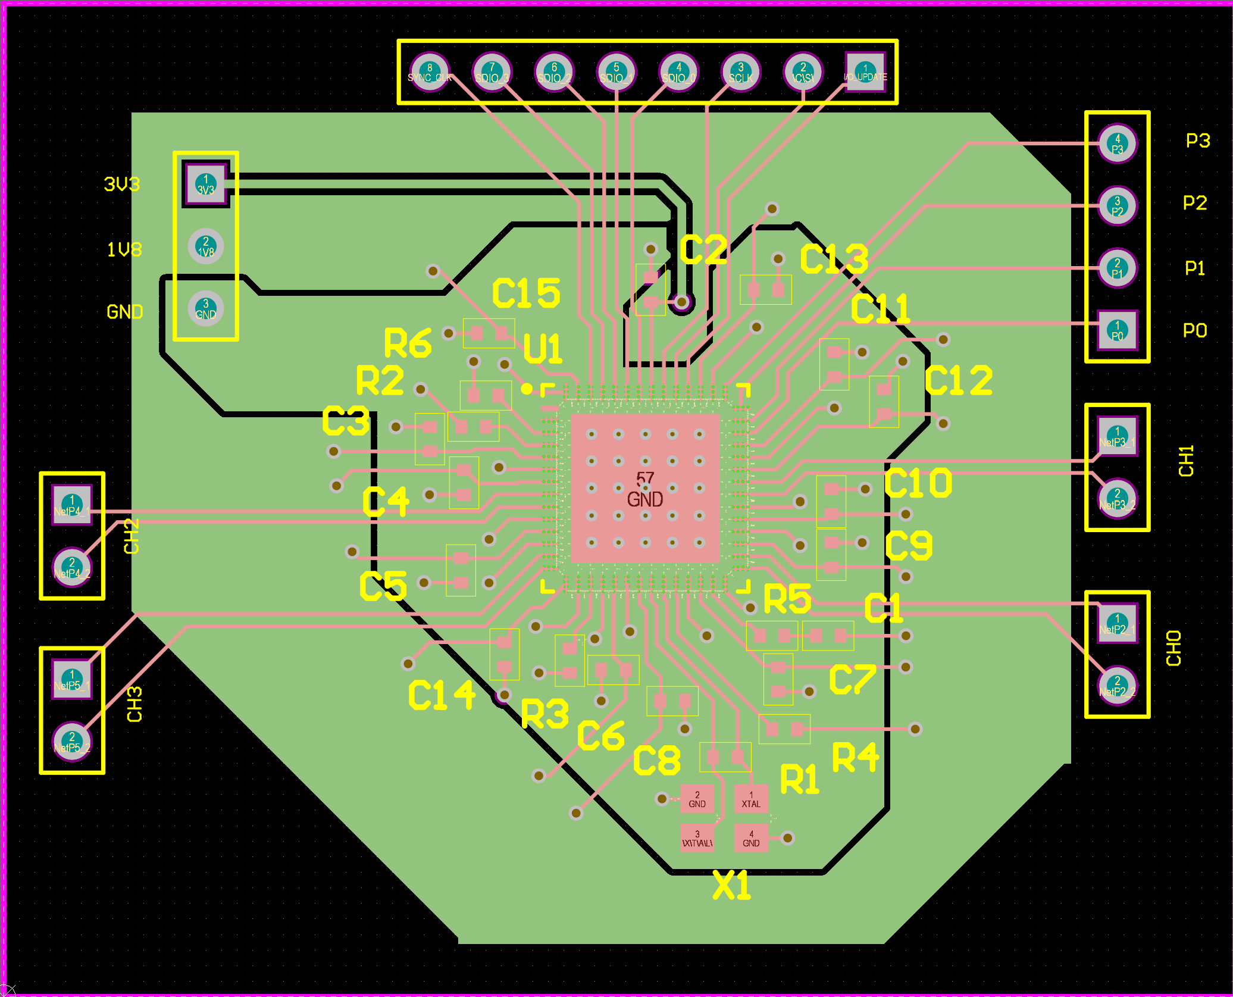
DDS Test Board
For SPI and programming

Slide 19
Challenges so far
Height limit with isolation transformers
Amplifier sourcing/creation
Web app connection
DDS Verificaiton

Slide 20
Immediate Plan
Continue schematic and symbol creation
Find battery for device
Determine board measurements for housing
Code pairing and app integration
DDS Verification / DDS Breakout Board assembly

Slide 21
Questions/Feedback

