Slide 1
Samad, Guandong, and Tyler
Brain Stimulator Progress Update

Slide 2
Problem Description
Make a device that can generate waveforms of precise frequency and current to stimulate deep parts of the brain using electrodes.

Slide 3
Key Events from Last Week
Got simulation working on desired current source
Started playing with test MCU
Requested samples of components
Started circuitry and layout for DDS segment
Started footprints and symbols for ADC
Tweaks to housing

Slide 4
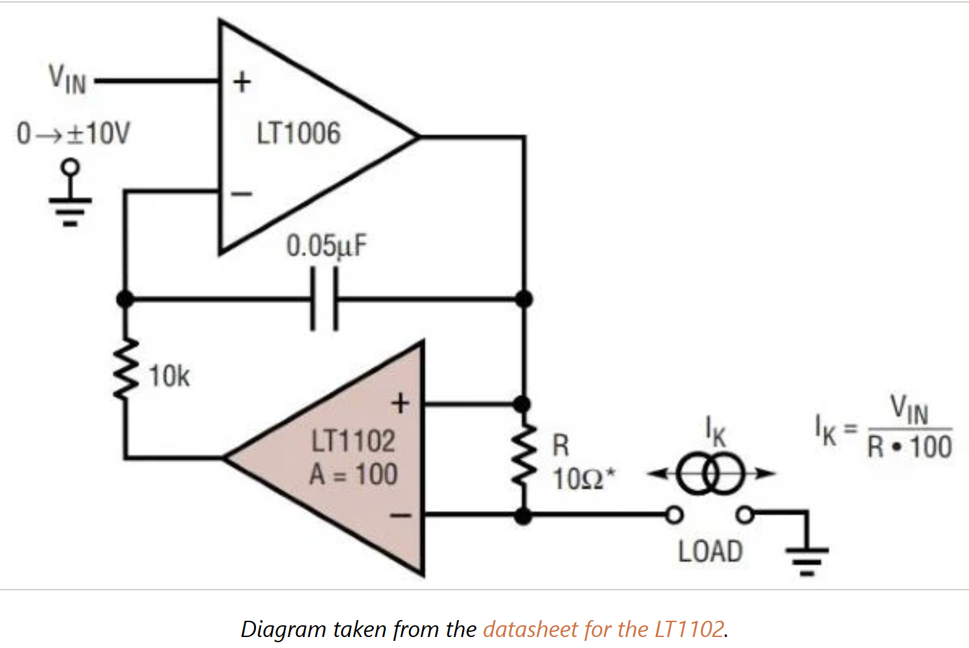
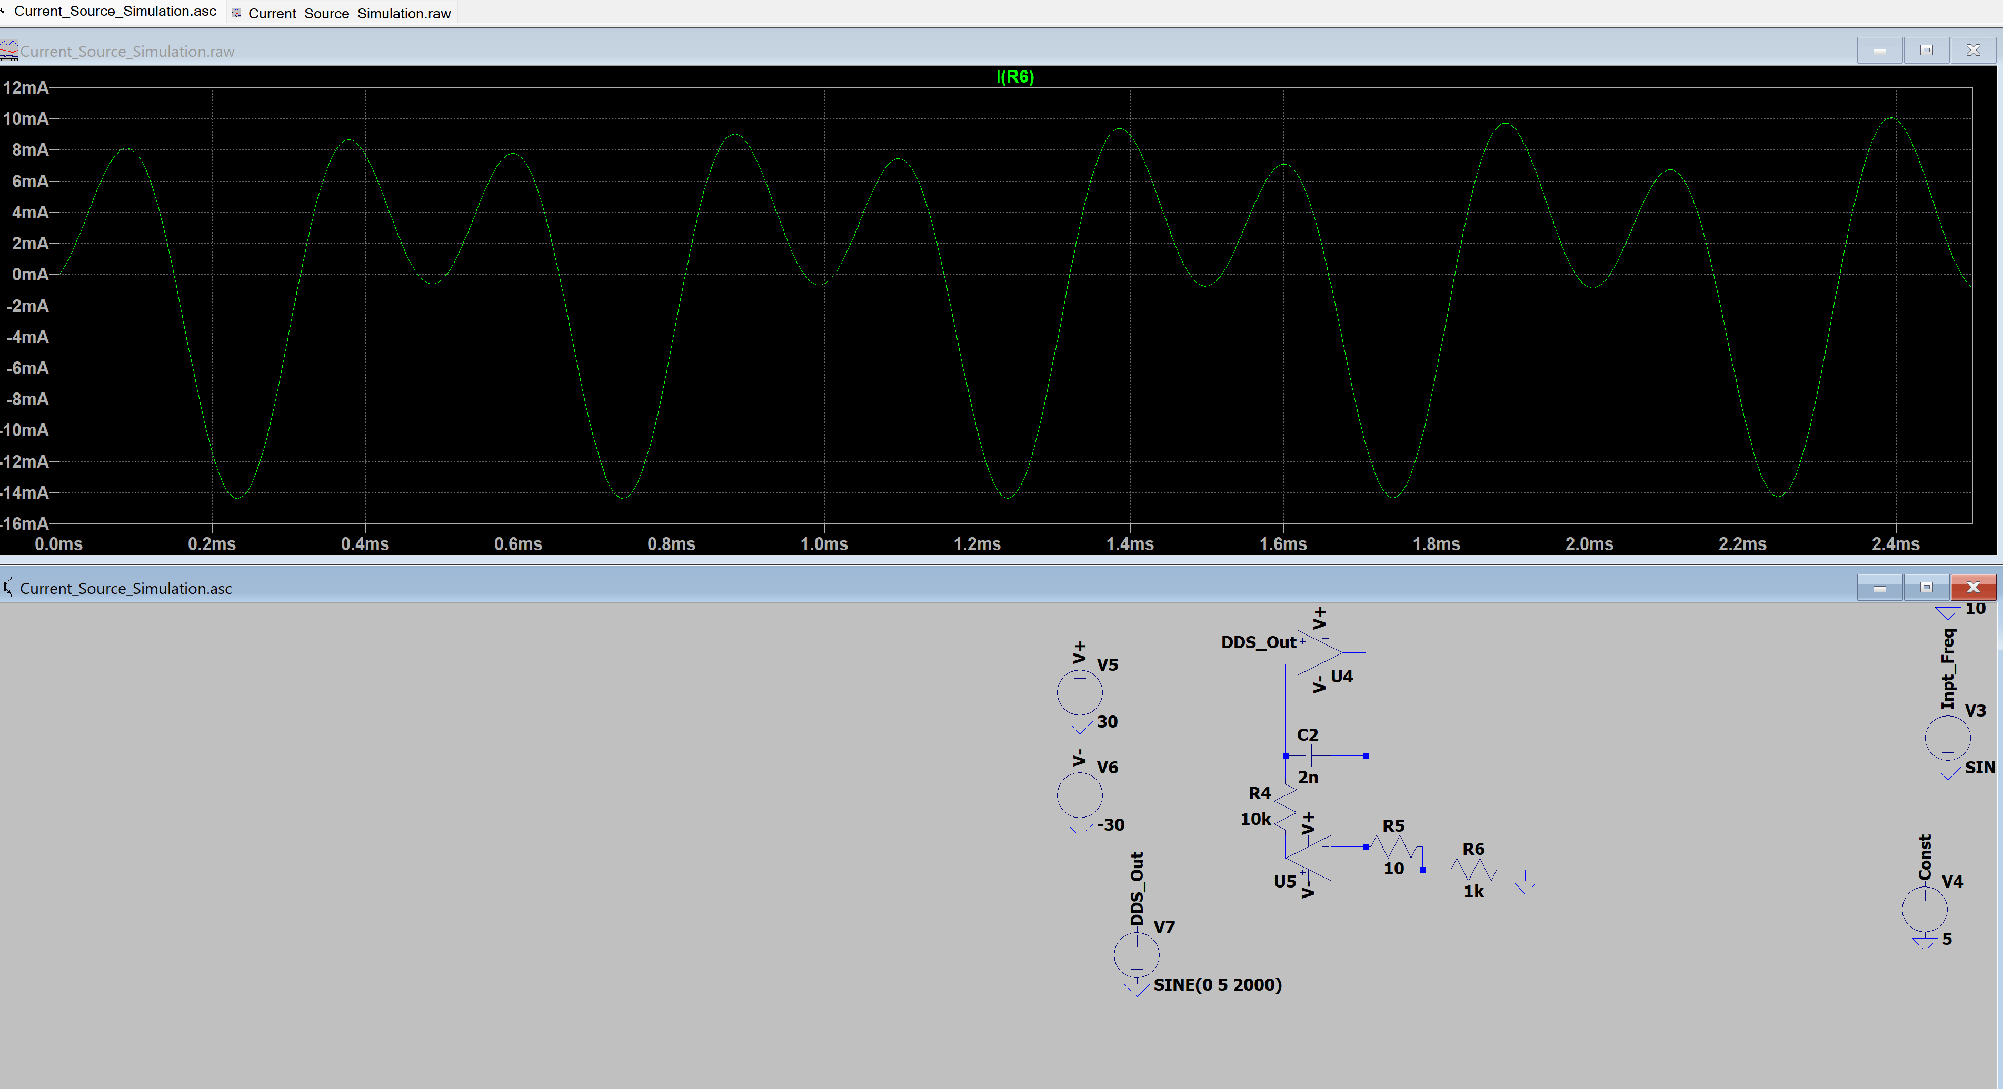
Voltage Controlled Current Source
Based on design by Jim Williams
How to Design a Simple, Voltage-Controlled, Bidirectional Current Source - Technical Articles

Slide 5
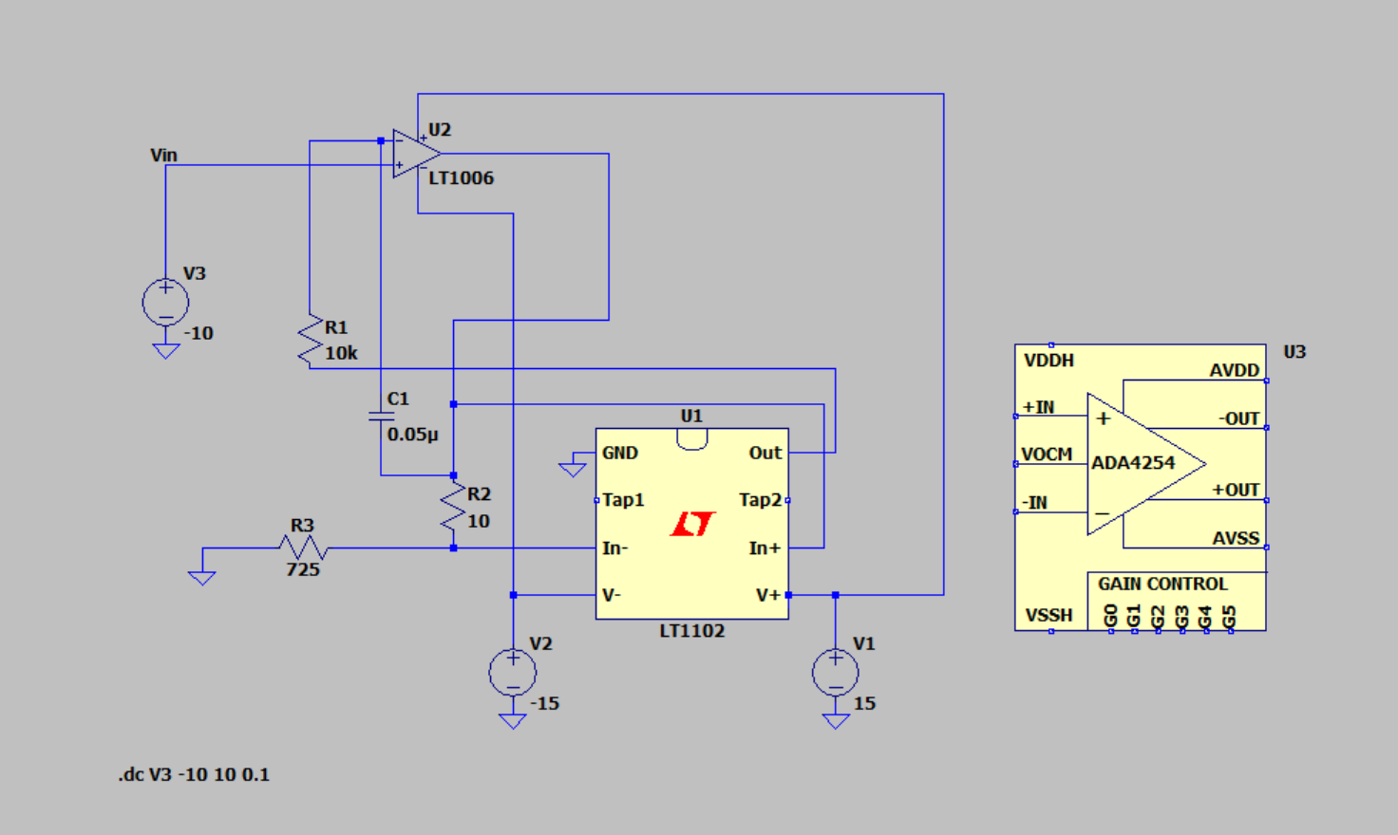
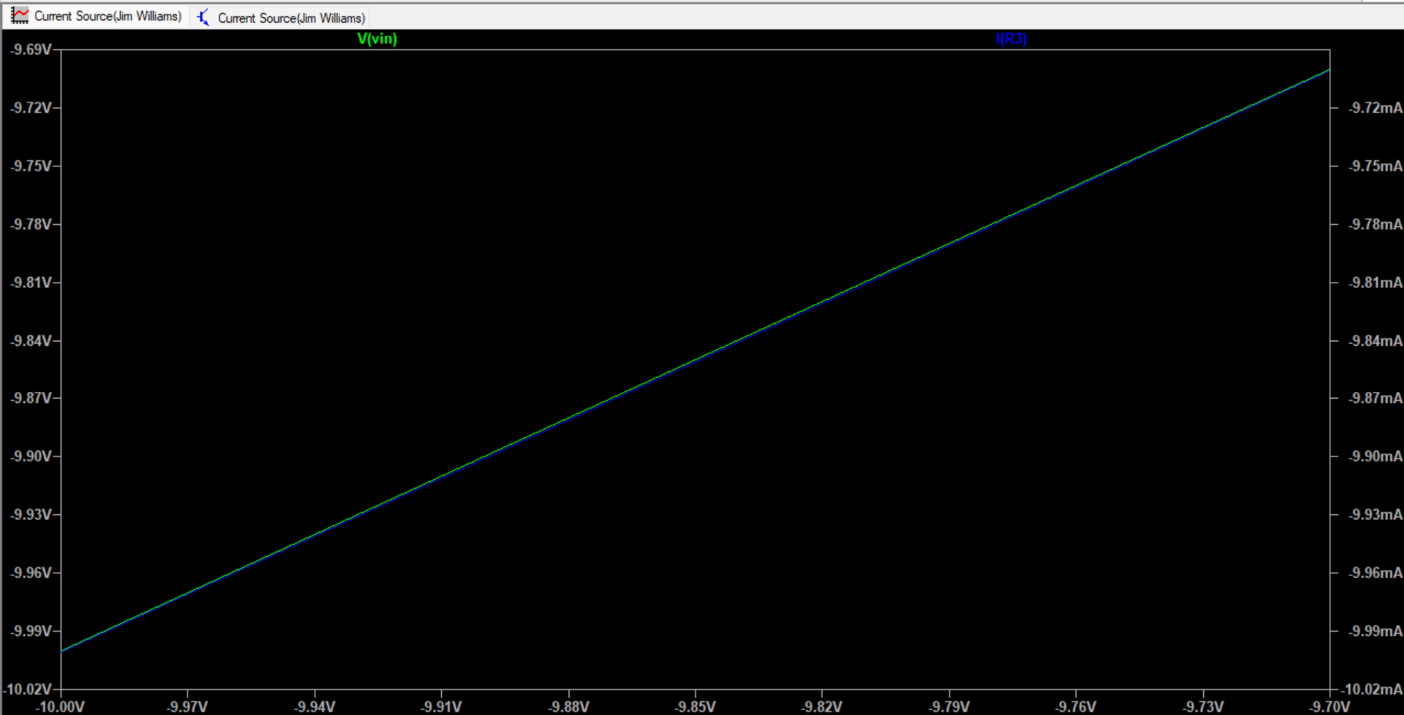
Working Current Source
Need to figure out better op amps for higher load
Max load resistance right now is around 725Ohms

Slide 6
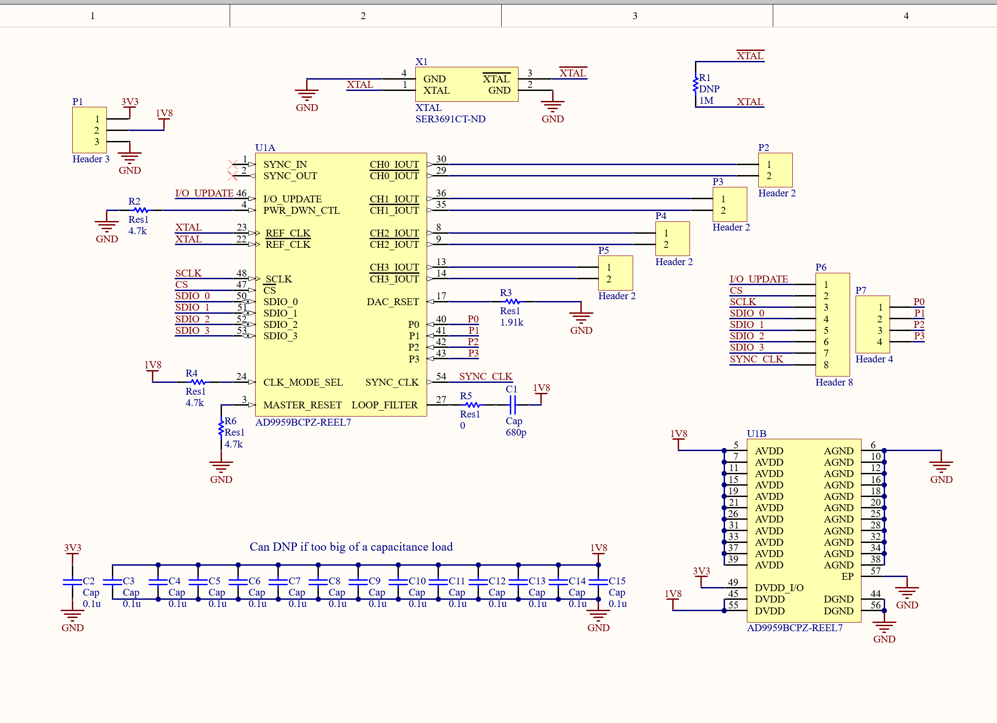
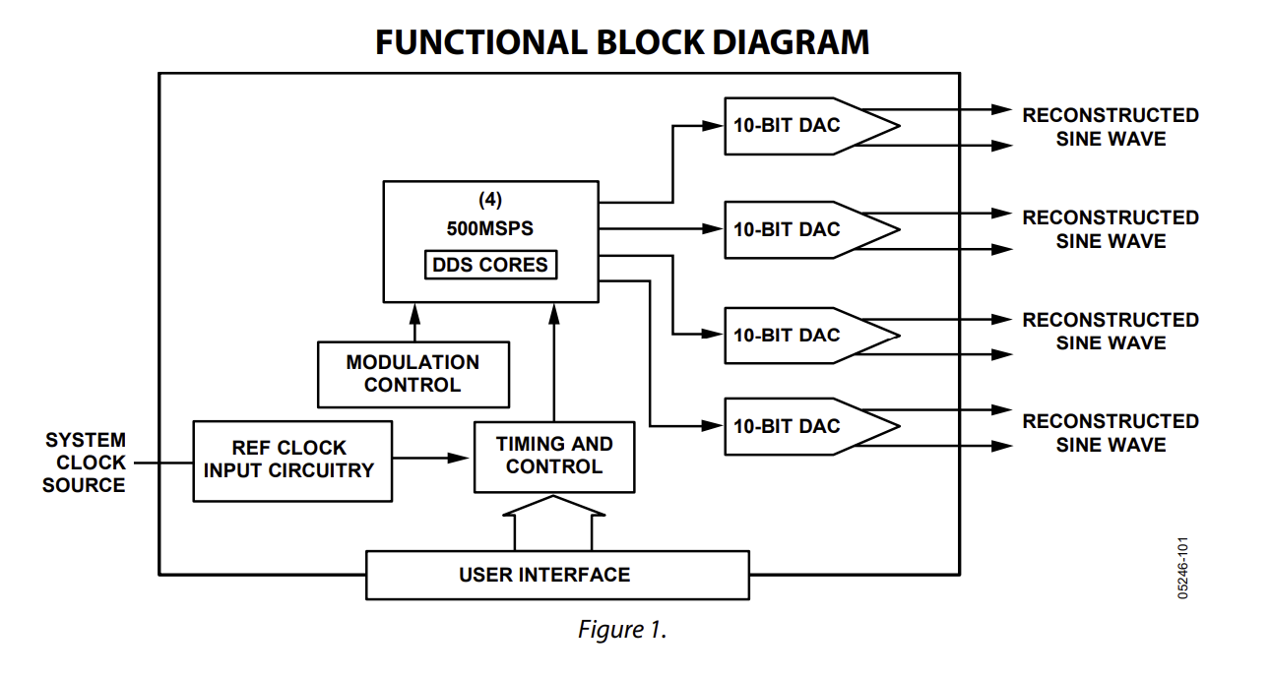
DDS Module

Slide 7
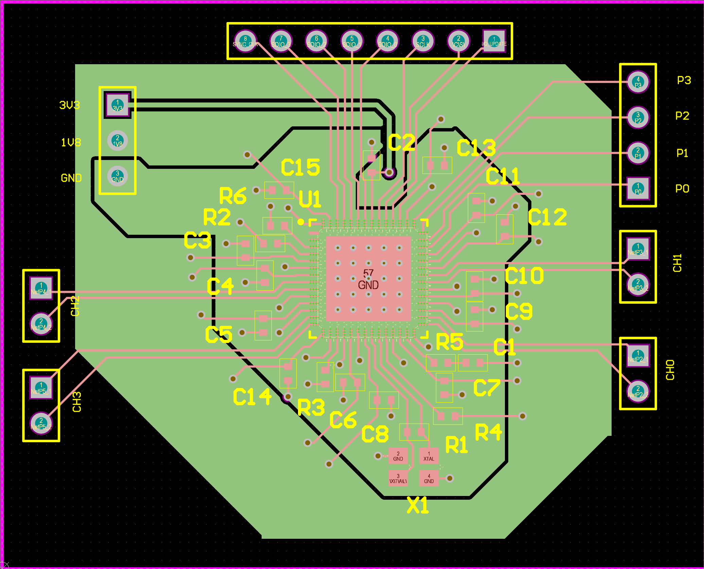
DDS Module Continued

Slide 8
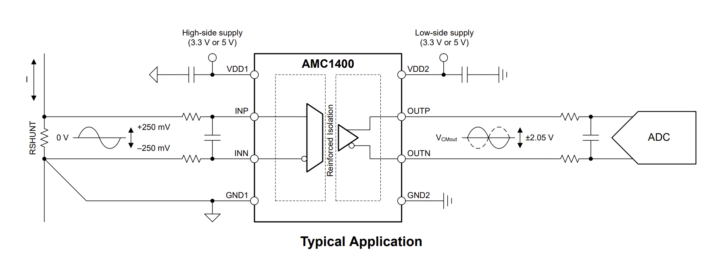
ADC
Need isolation for safety
Should be able to communicate with MCU directly

Slide 9
Battery Feedback
Need 16 Hours Battery Life. Ideas so far:
Have multiple batteries, one for isolated side and one for non-isolated side (MCU)
Use a power bank so that no battery management circuitry is required

Slide 10
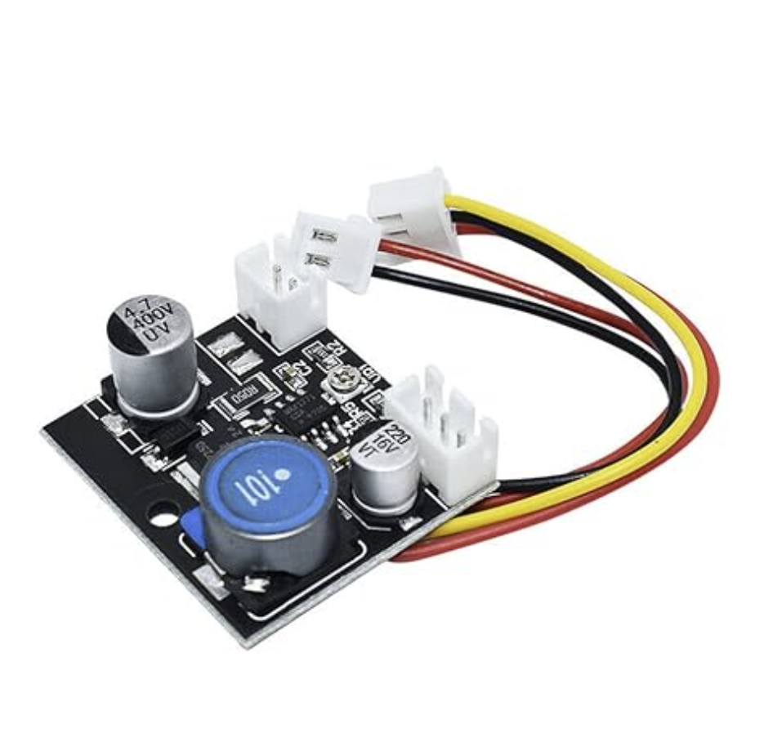
High Voltage Rails
Need to drive to +/-30V with room for improvement.
Use boost converter
How do we minimize footprint?

Slide 11
Isolation
Leaning towards using inductors at the output
Large space requirement, major downside, however not much taller than a banana jack anyway
Would need less isolation before this point, everything on one battery
Still easy to manage with a control loop through ADC

Slide 12
Challenges so far
Determining where to isolate from
Finding MCU with Bluetooth capabilities

Slide 13
Immediate Plan
Continue schematic and symbol creation
Find battery for device
Find components for Jim Williams source that handle high voltage and simulate
Determine board measurements for housing

Slide 14
Questions/Feedback

