Slide 1
Samad, Guandong, and Tyler
Brain Stimulator Progress Update

Slide 2
Problem Description
Make a device that can generate waveforms of precise frequency and current to stimulate deep parts of the brain using electrodes.

Slide 3
Key Events from Last Week
Got flyback and iso-adc breakout boards
Made final amplifier stages
Made voltage controlled current source circuitry
Did first pass final board placement

Slide 4
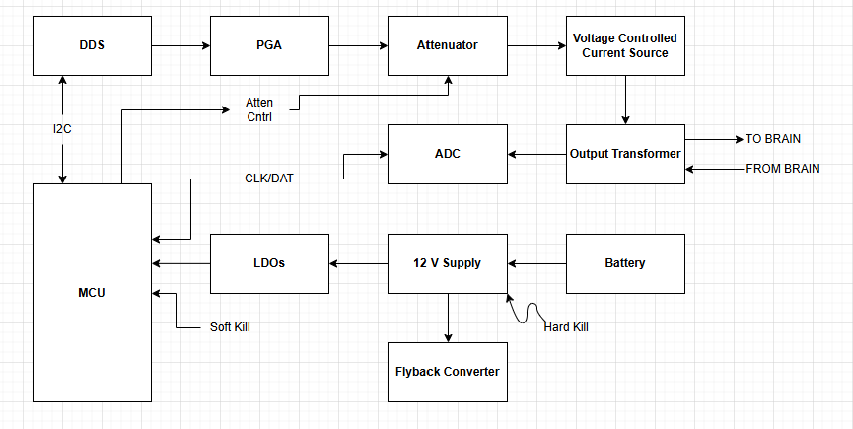
Block Diagram

Slide 5
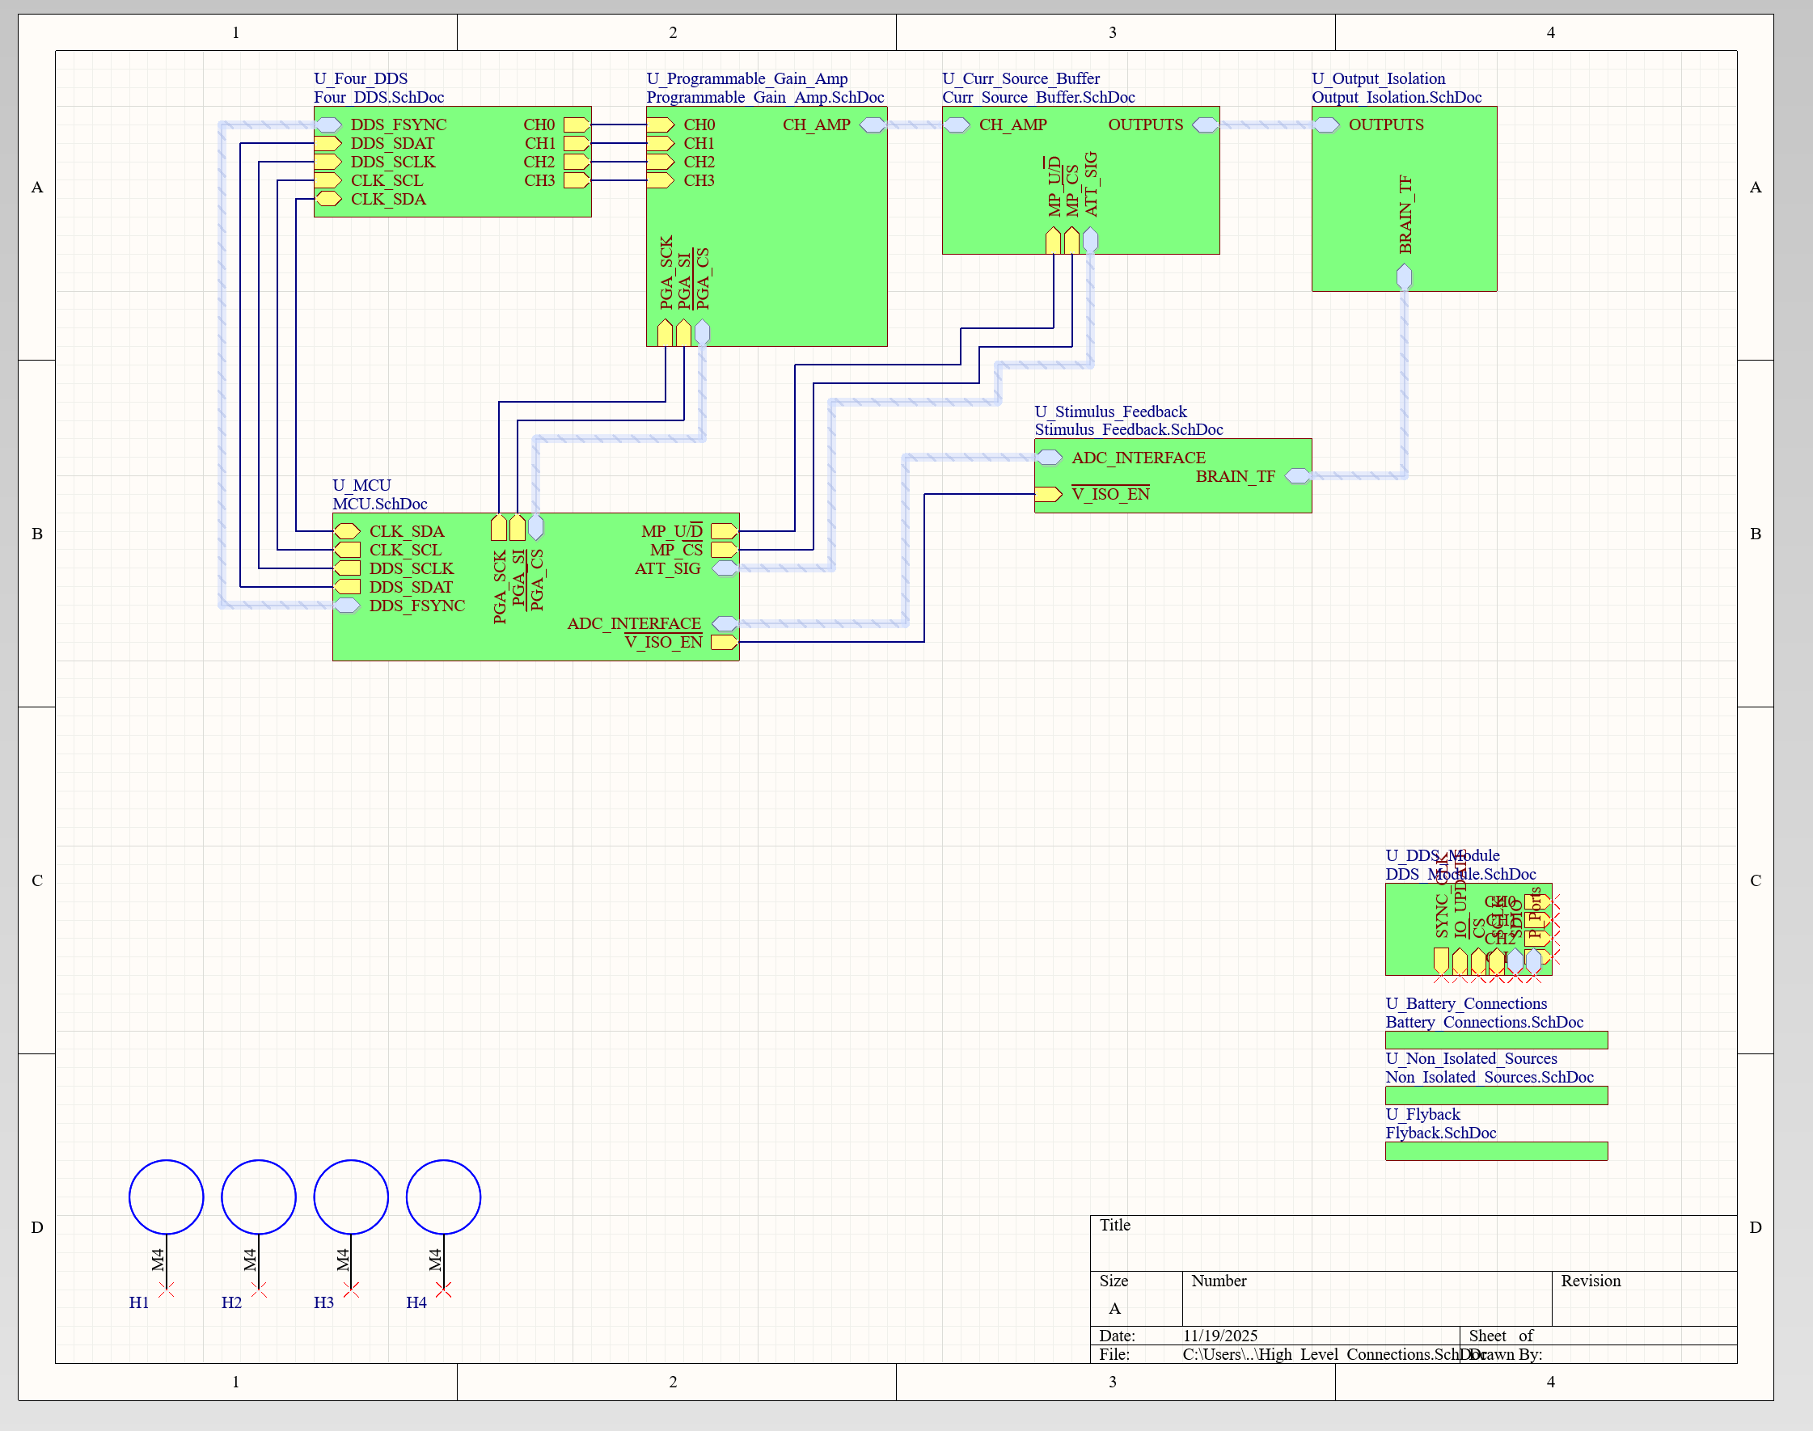
Schematic Updates

Slide 6
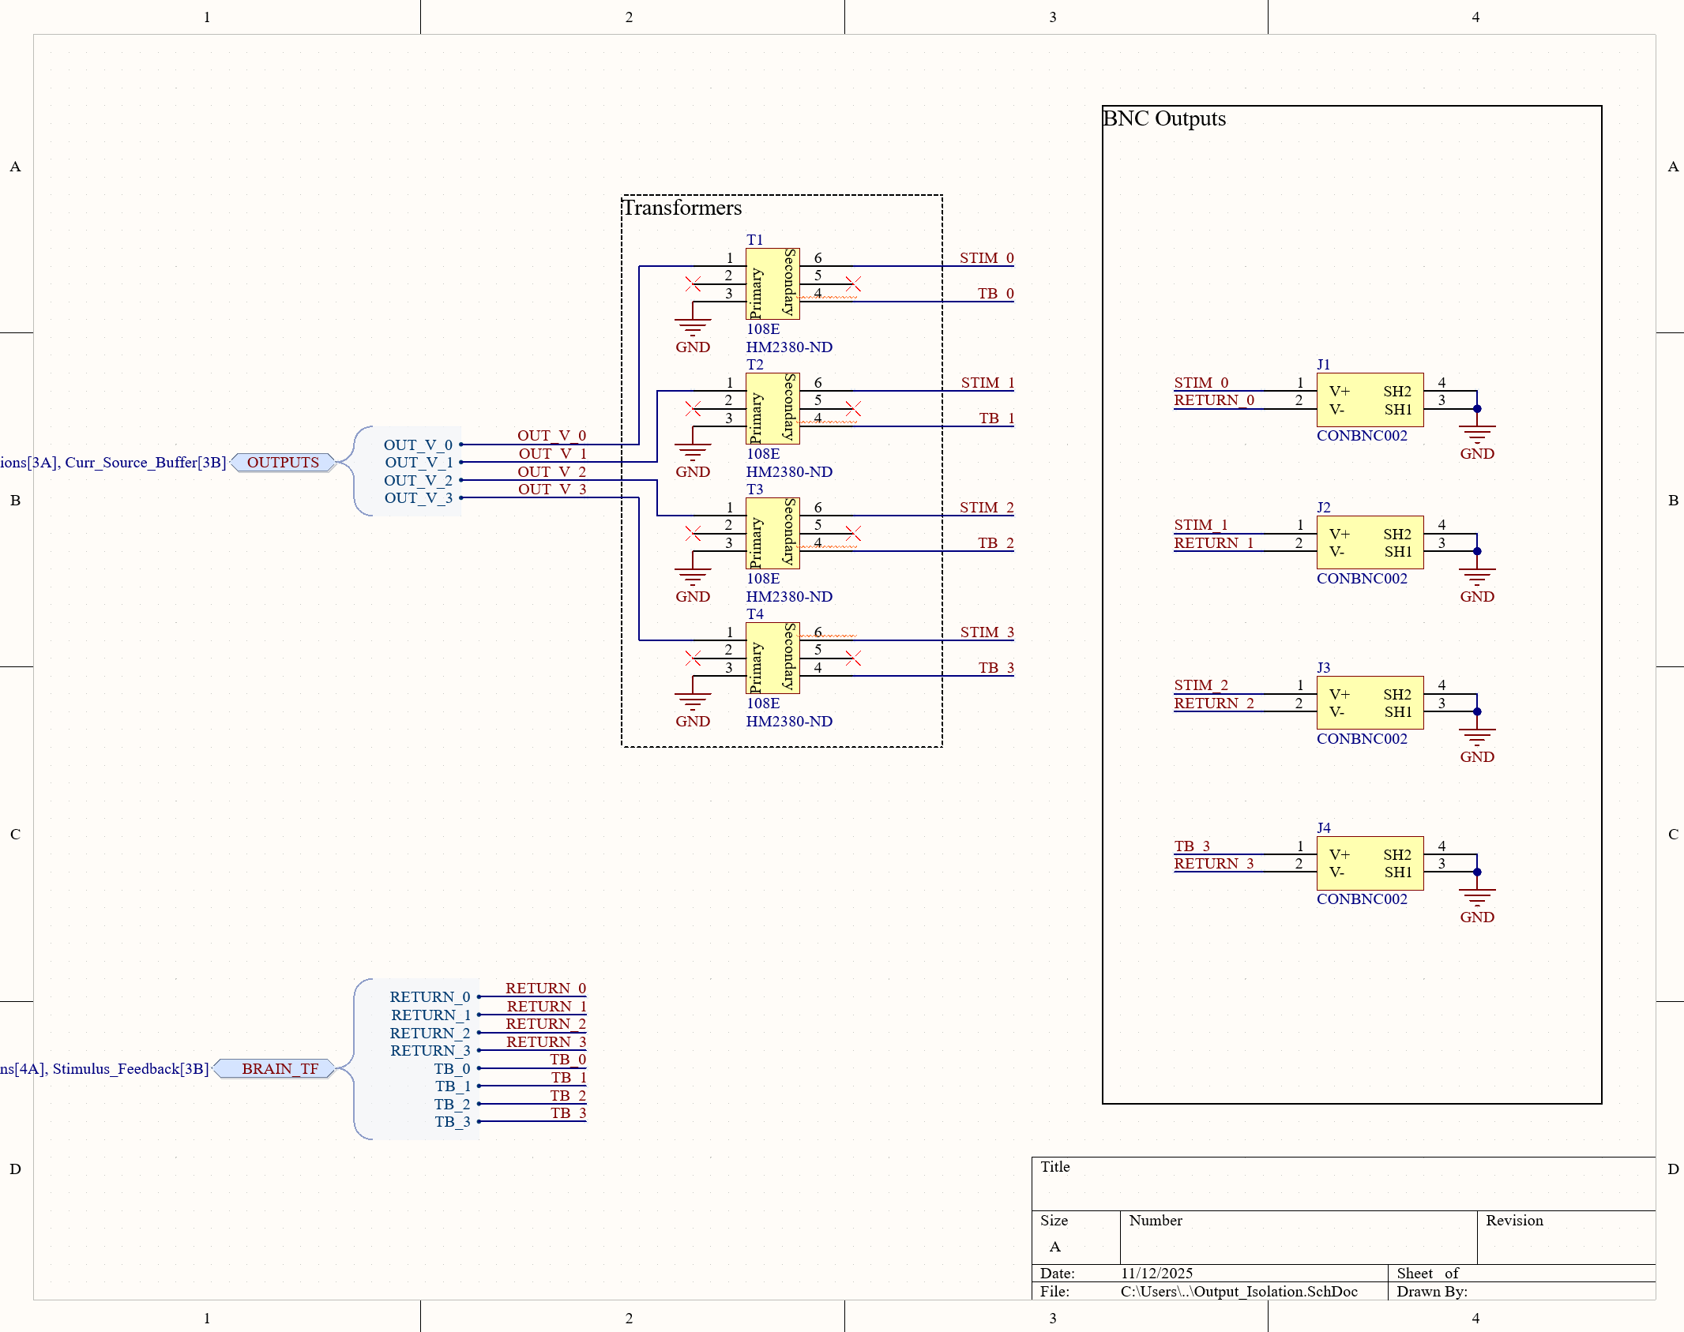
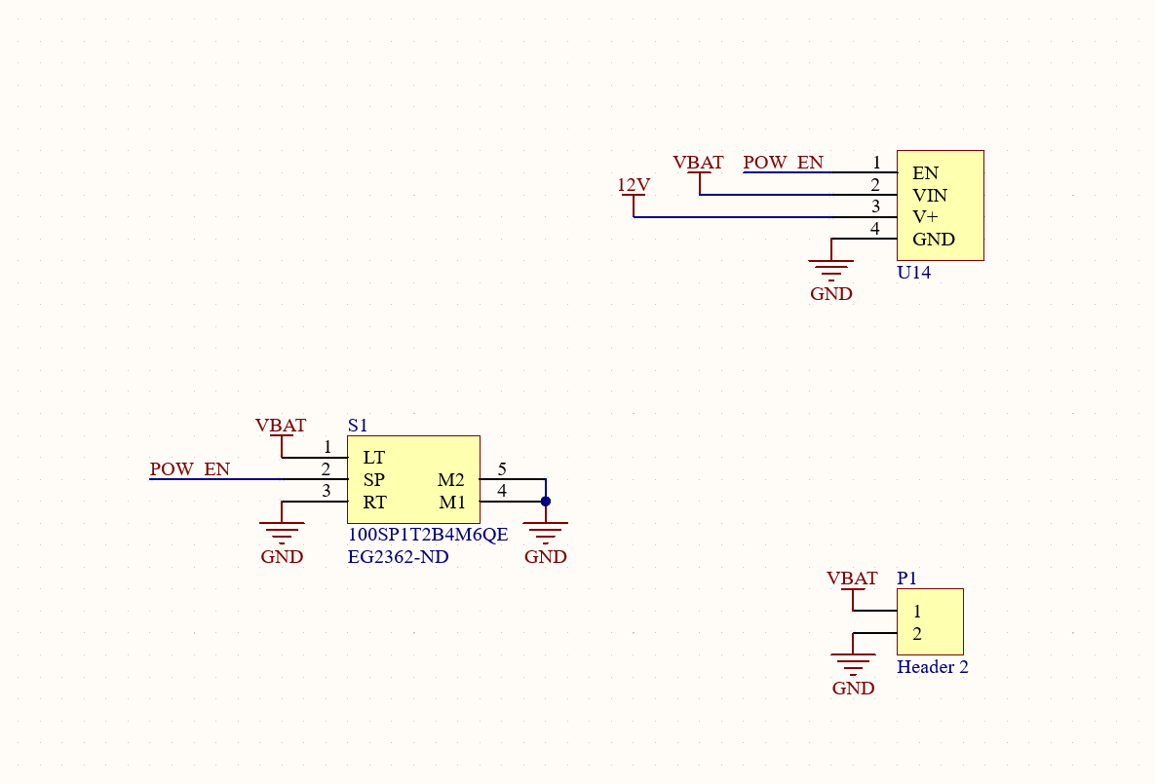
Schematic Updates Continued

Slide 7
Kill Switch
Cut off 12V enable because otherwise the switching regulators will be on and incur losses
Comes at the price of powering down MCU
Soft kill is currently done through software. Ideally will add button but need to find space.

Slide 8
Switch from Audio Jack to BNC
More robust
Downside is size

Slide 9
Current Source
Use a midpoint offset to turn 0-5 V sine wave into a -5-5 mA current source
Tight tolerance resistor which has the voltage across it controlled such that current is known

Slide 10
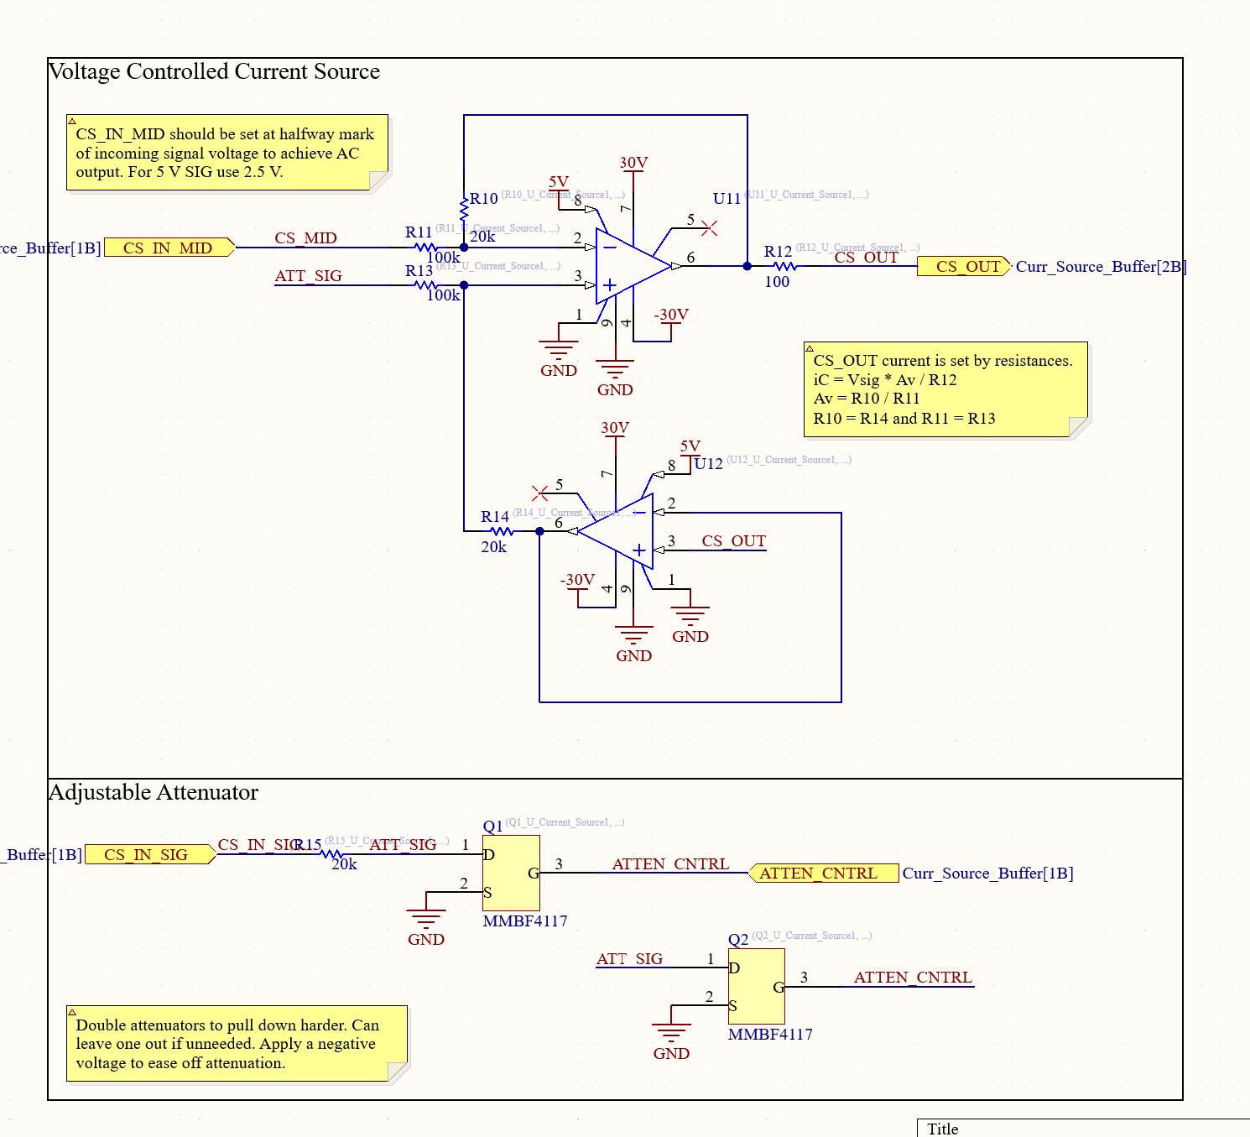
Schematic Updates Continued

Slide 11
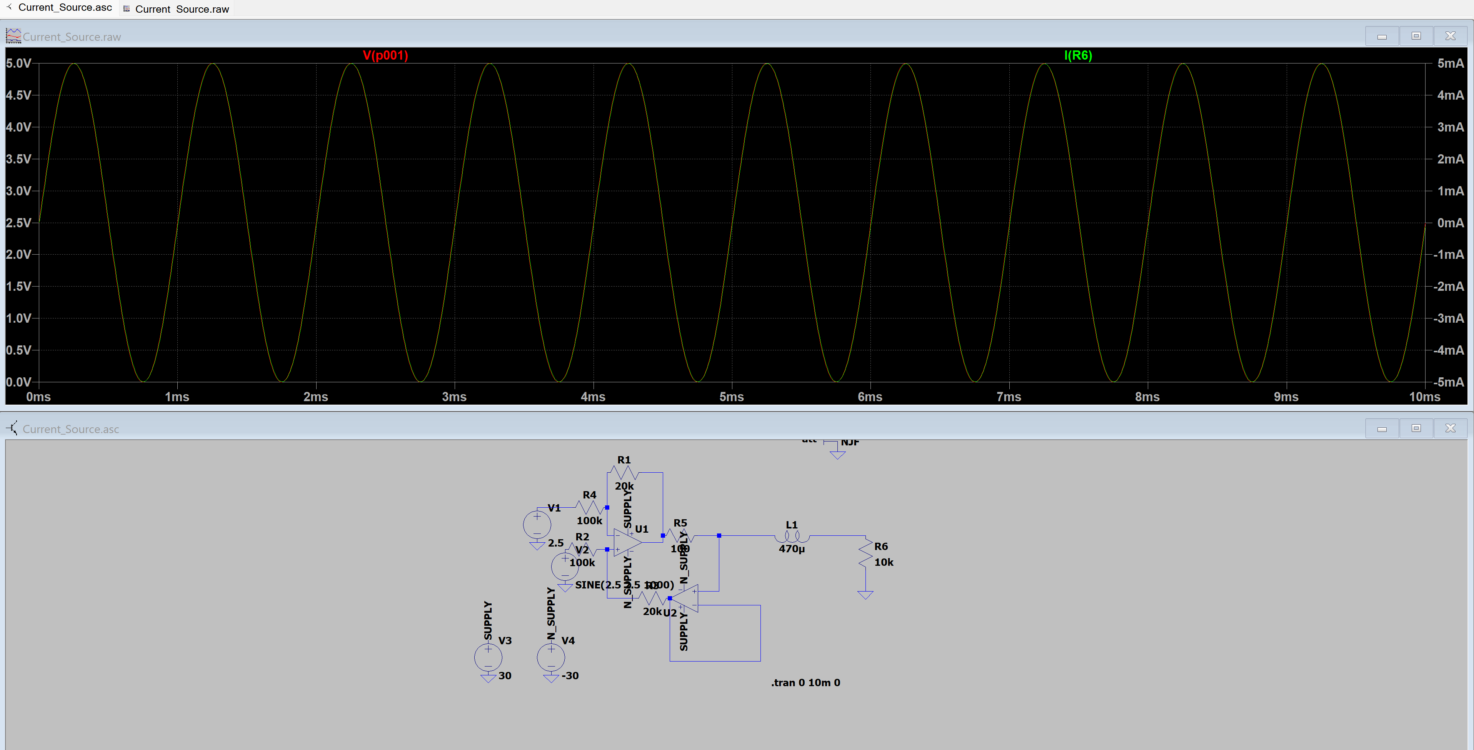
Current Source Simulation

Slide 12
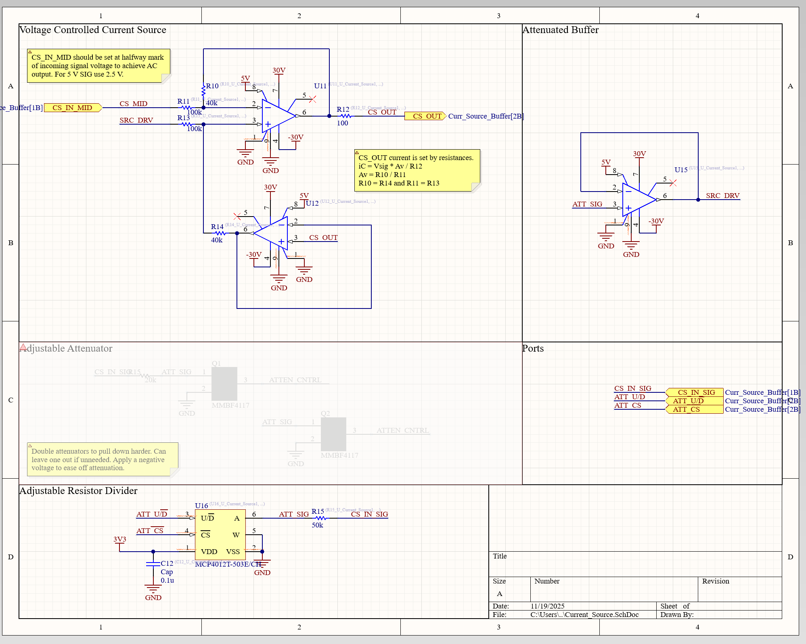
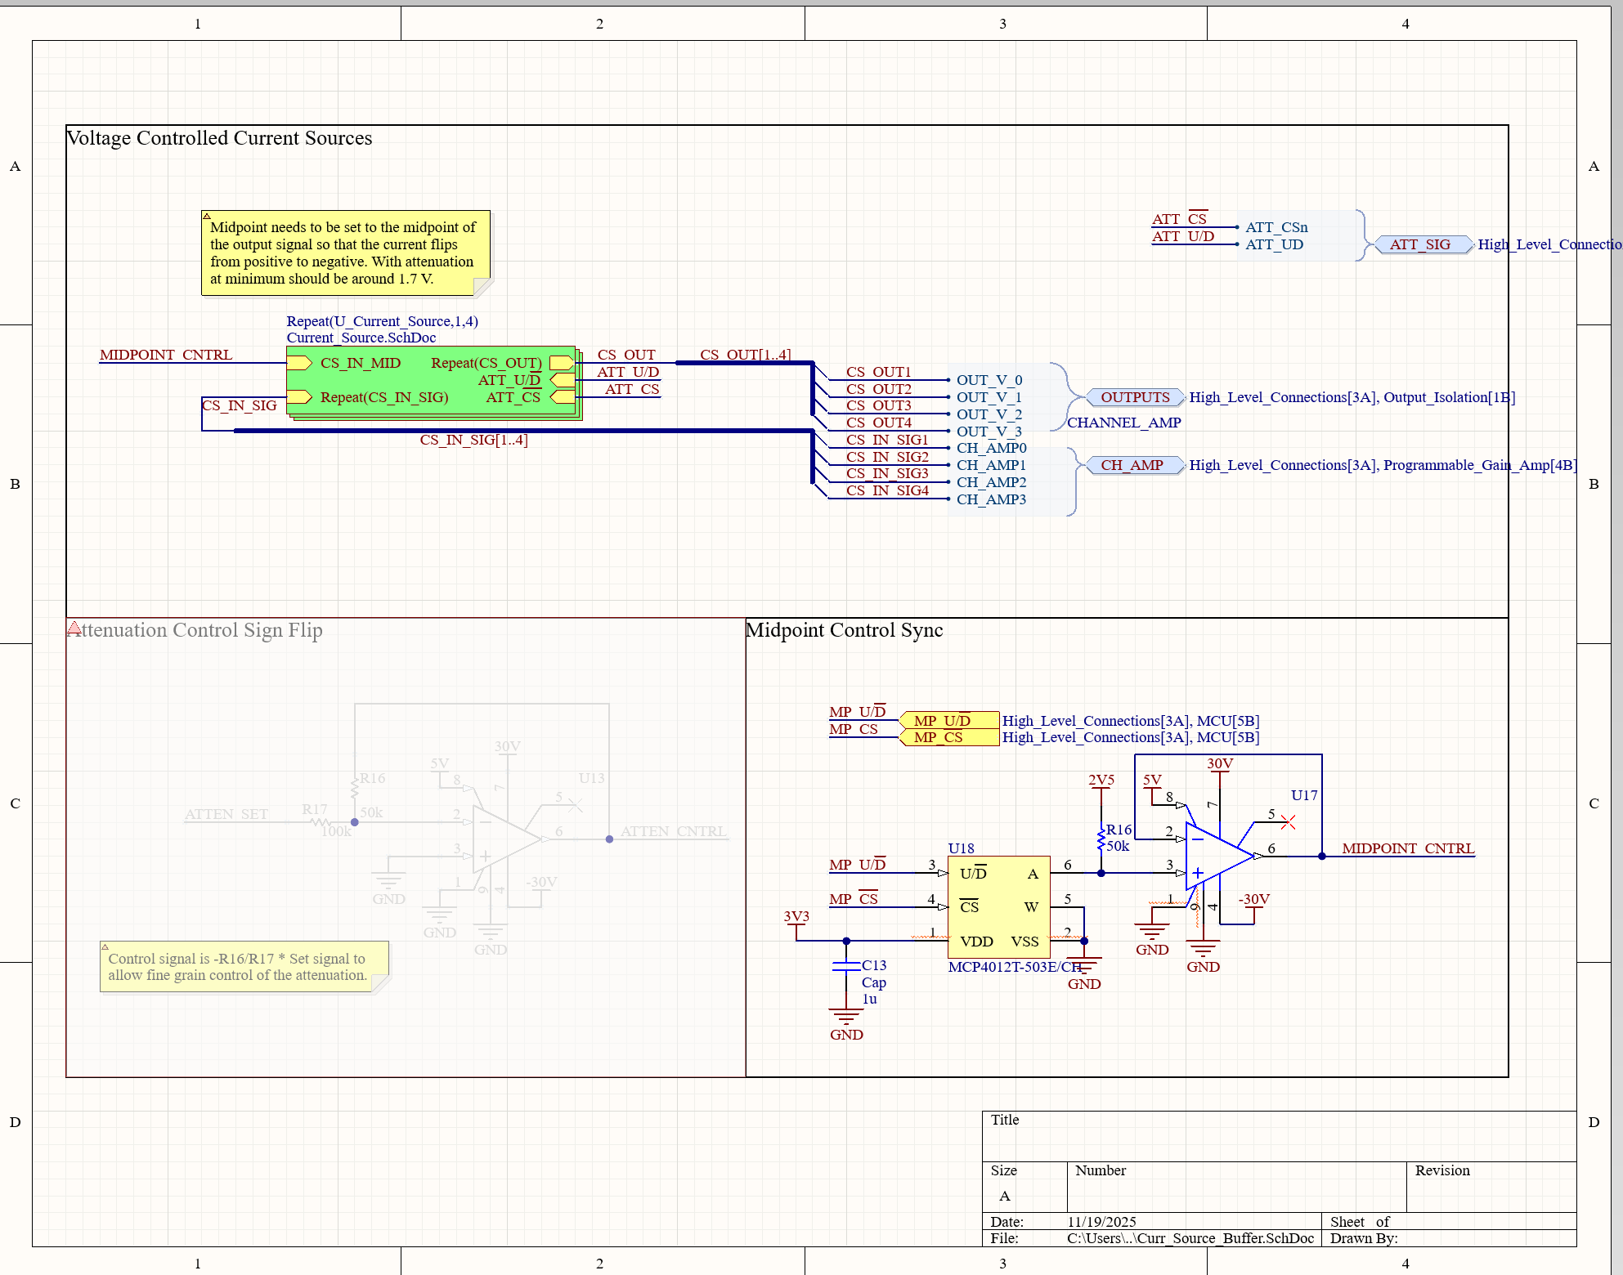
Schematic Updates Continued

Slide 13
Flyback Converter
Get +/-30 V rails
Incur some losses from two switching converters, almost unavoidable
Feed into final amplifier stage

Slide 14
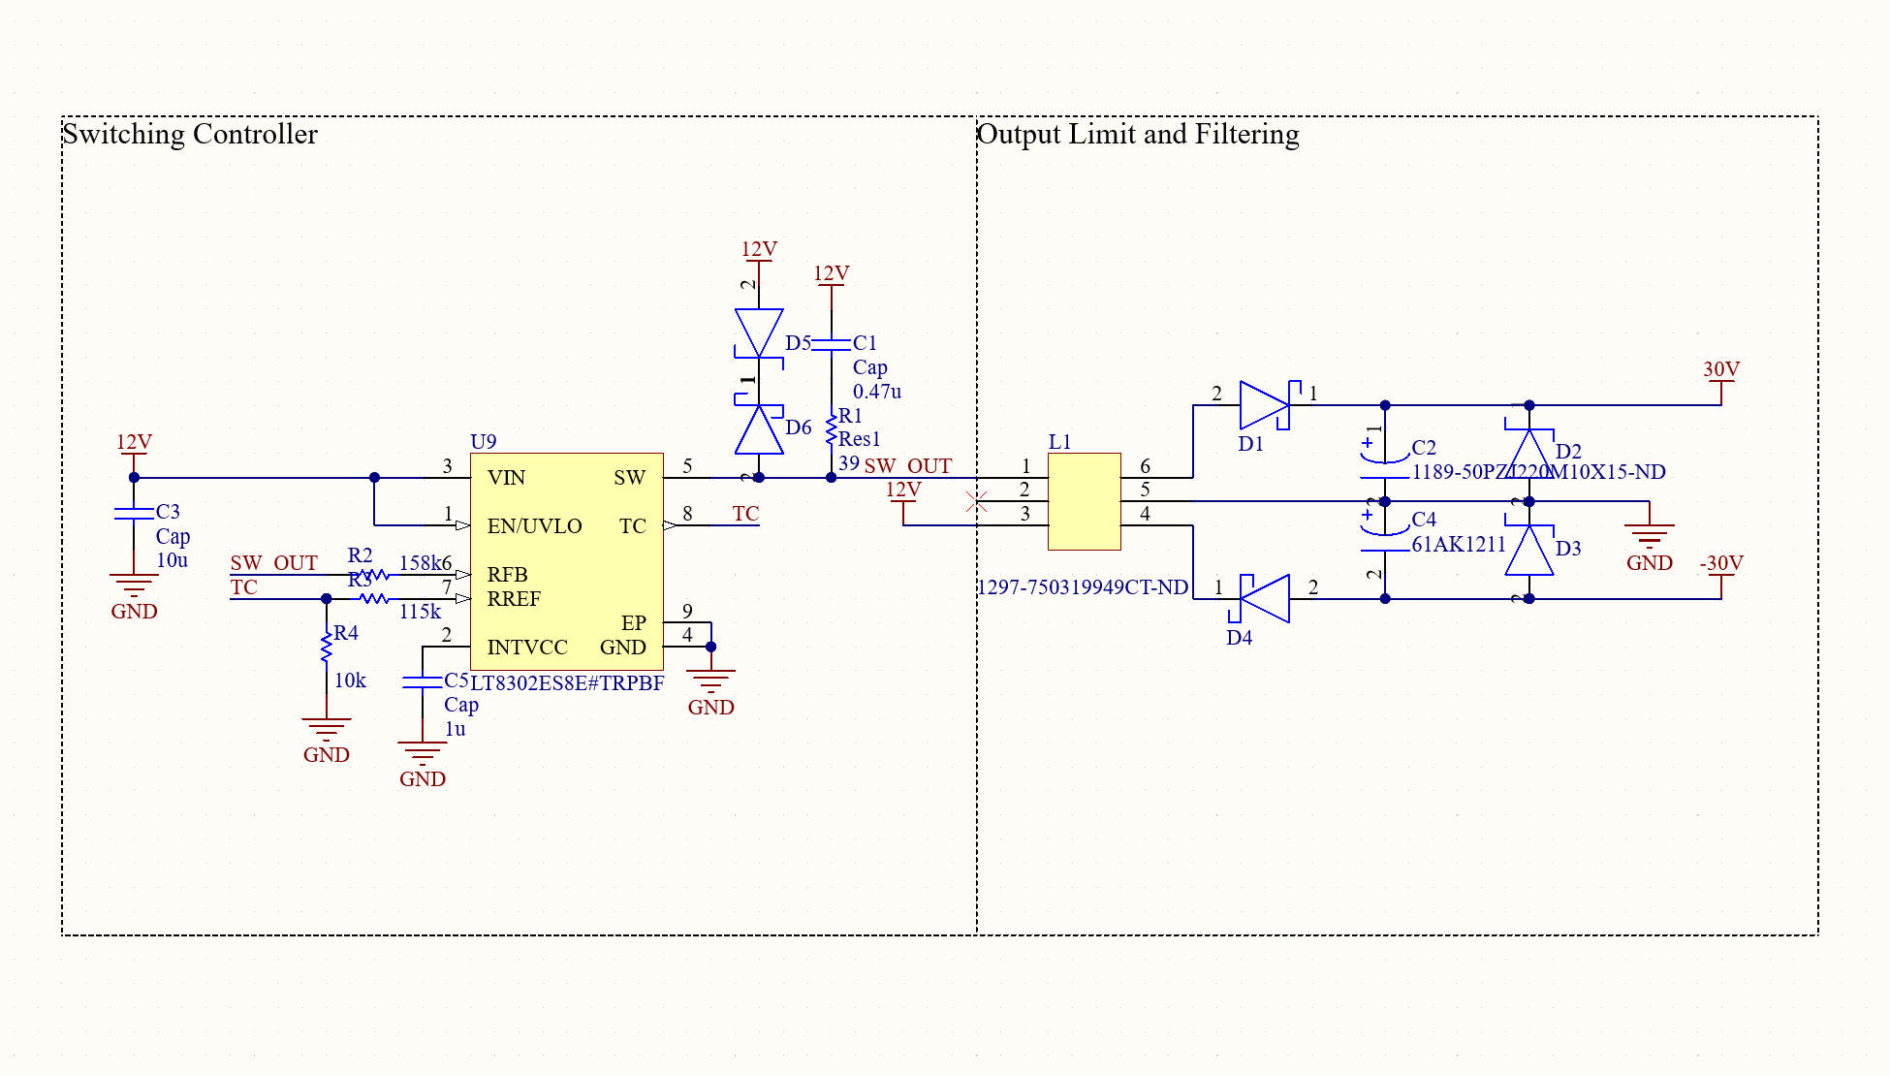
Schematic Updates Continued

Slide 15
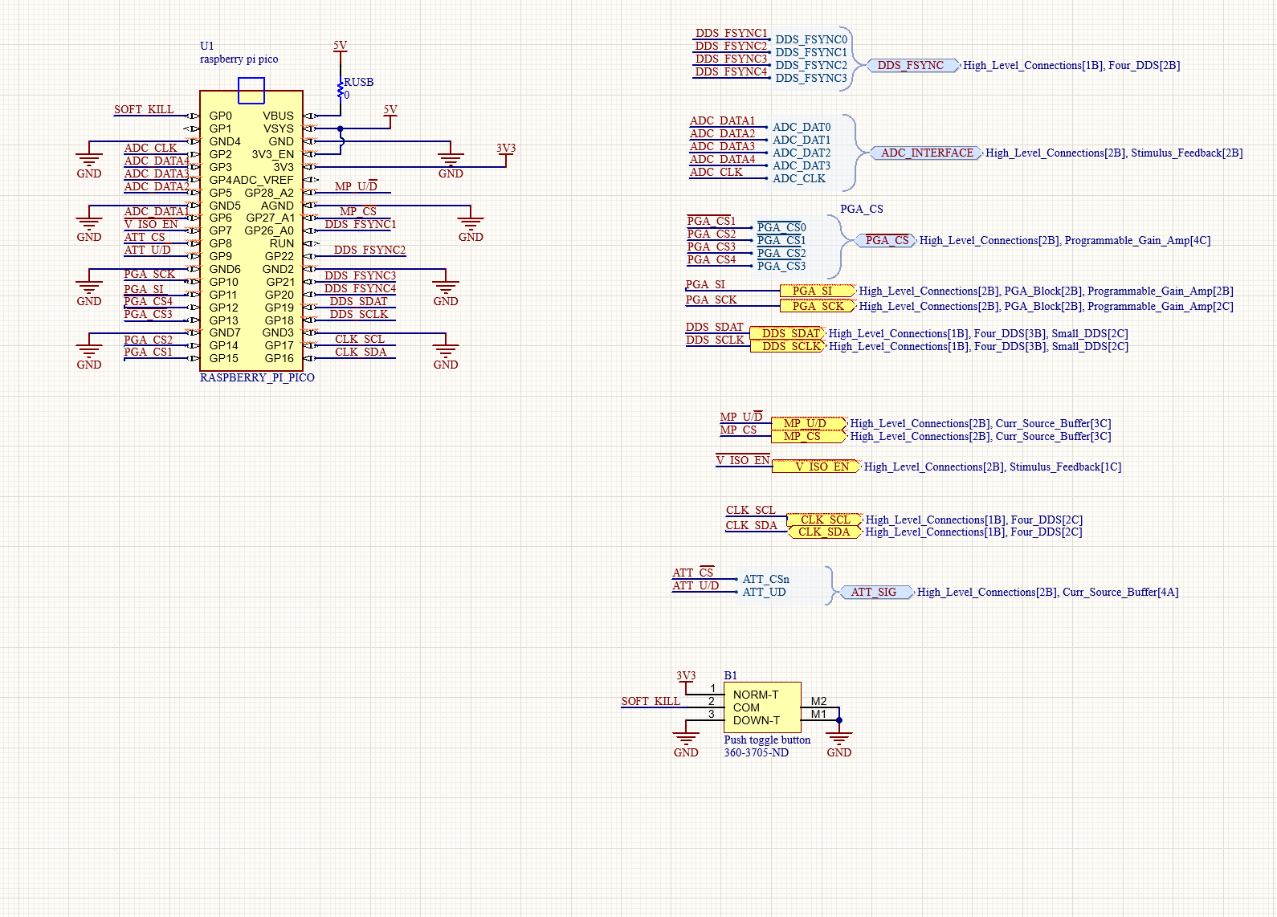
Schematic Updates Continued

Slide 16
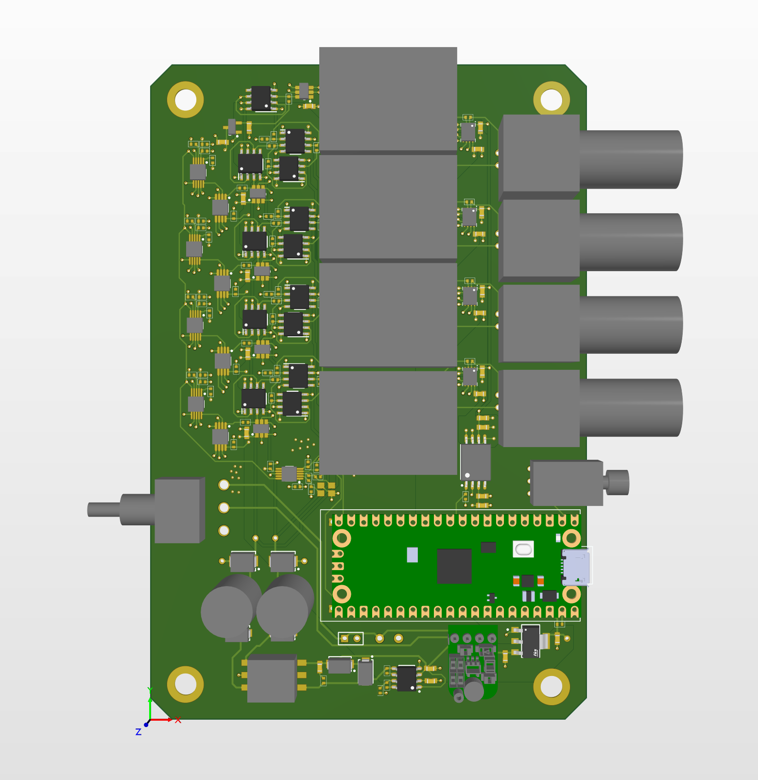
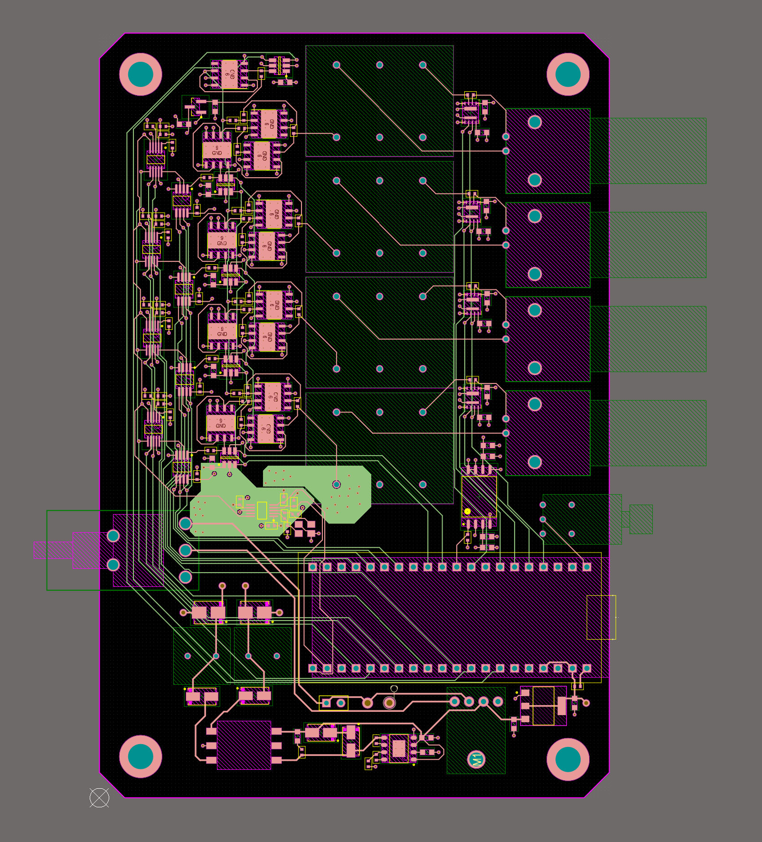
Final Board Placement

Slide 17
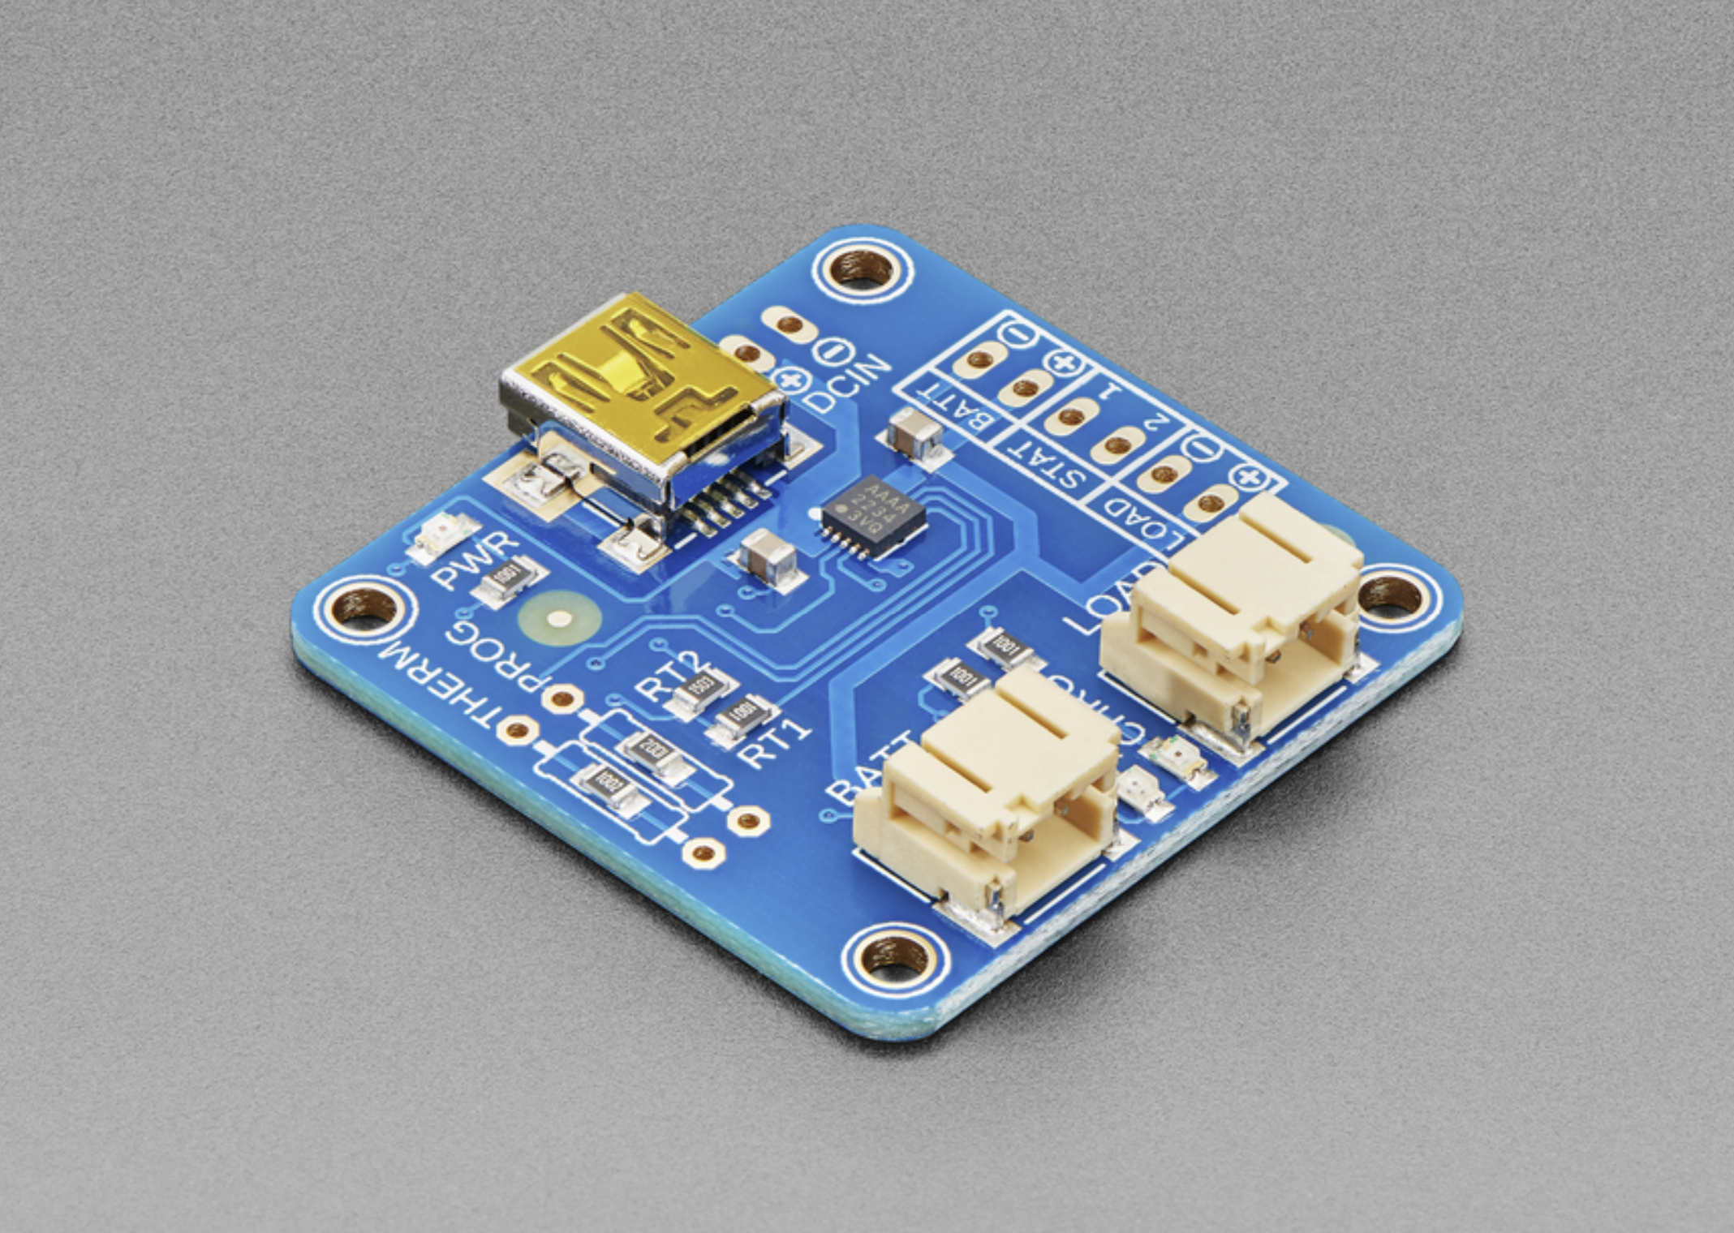
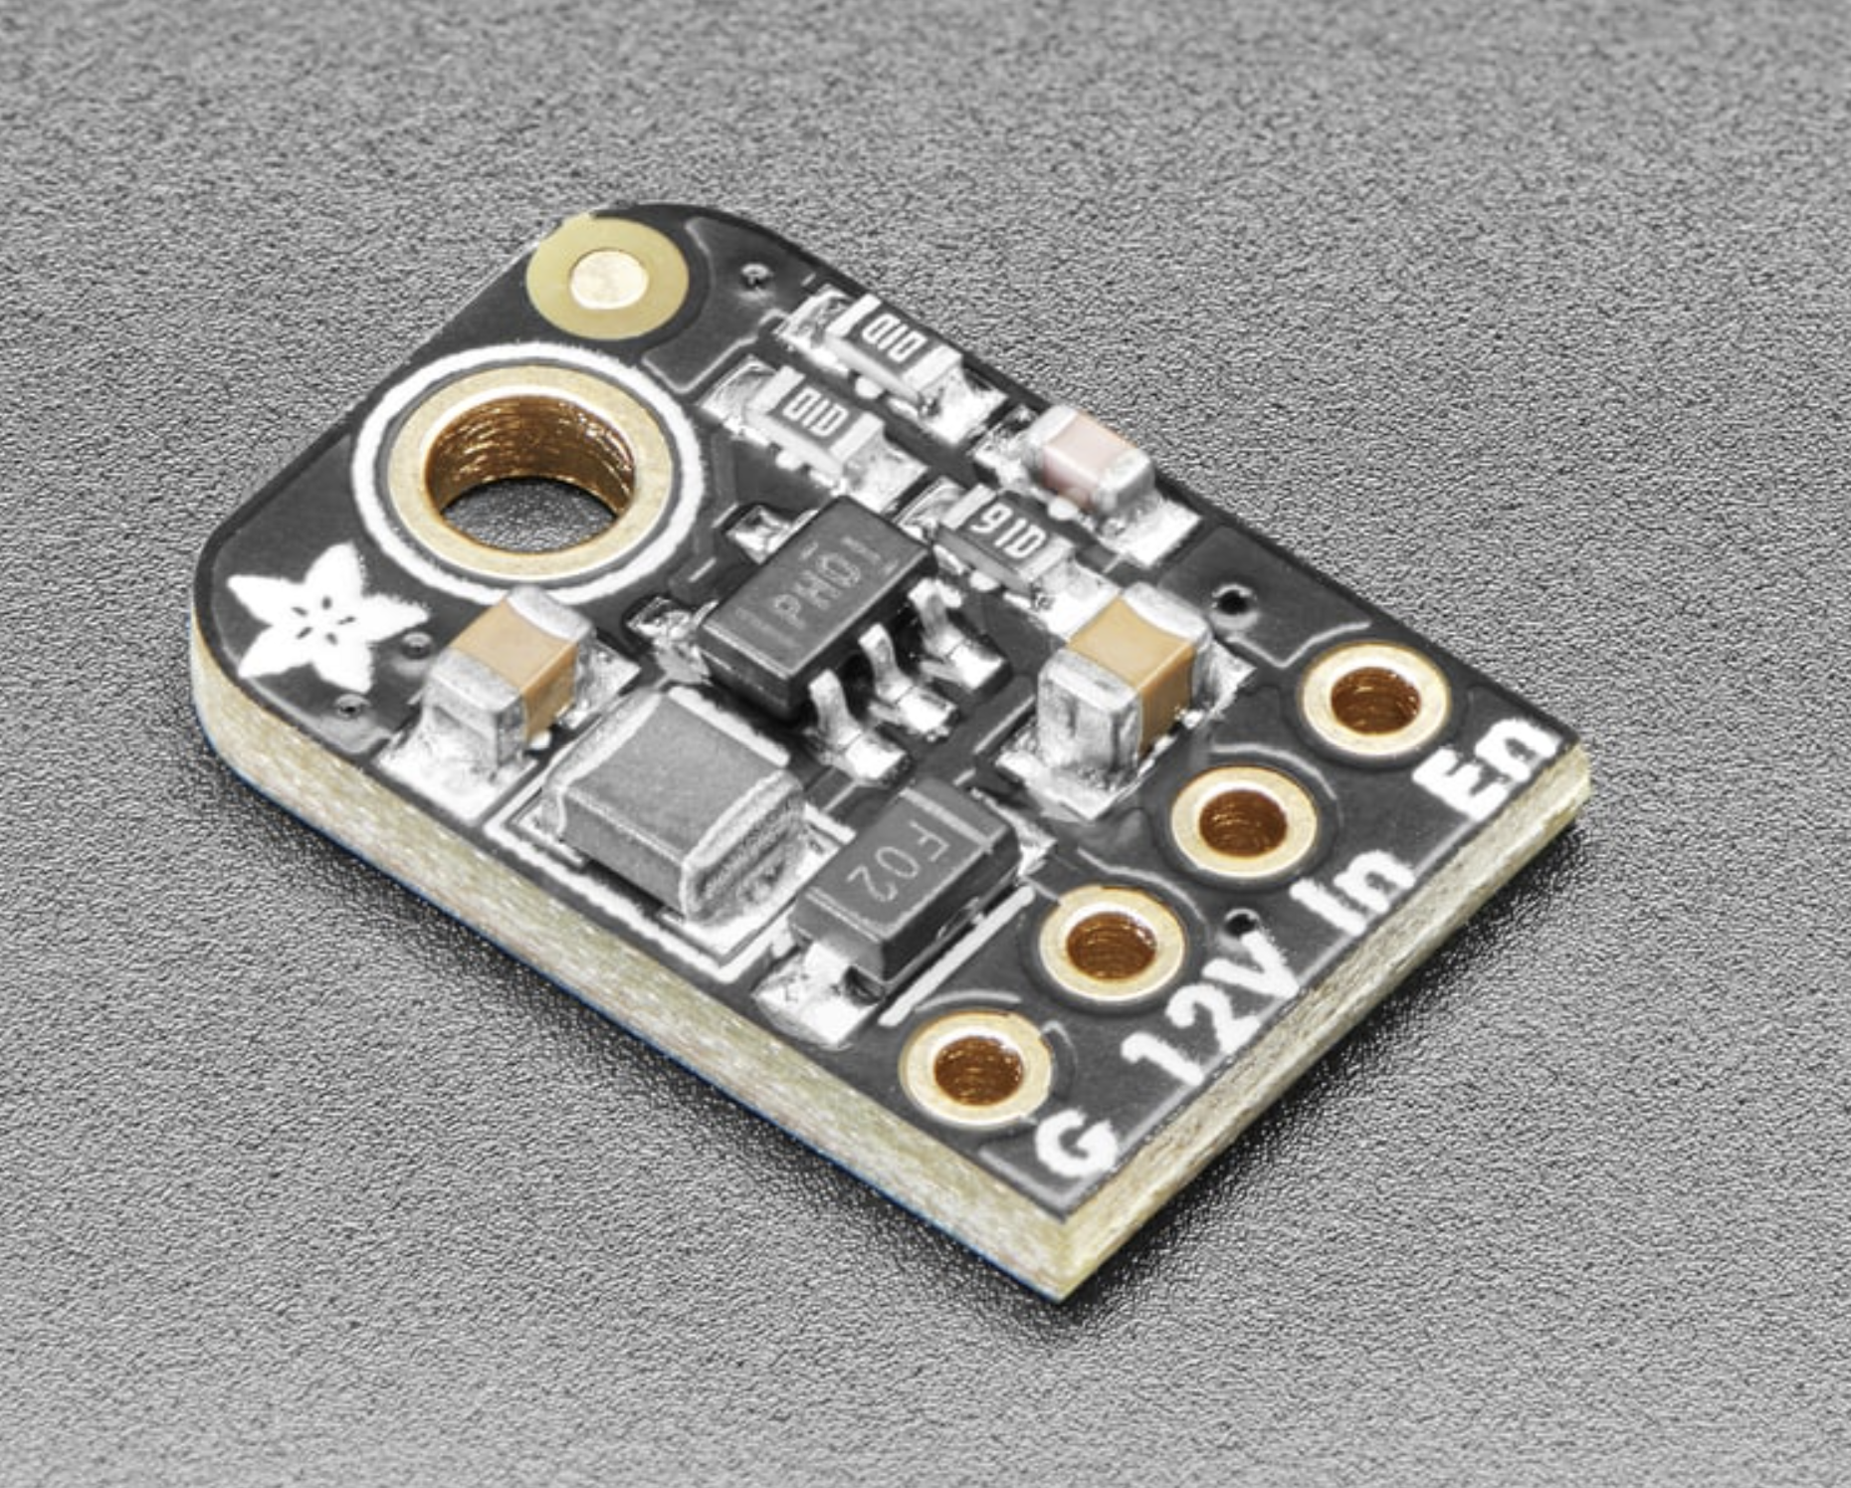
Other Components

Slide 18
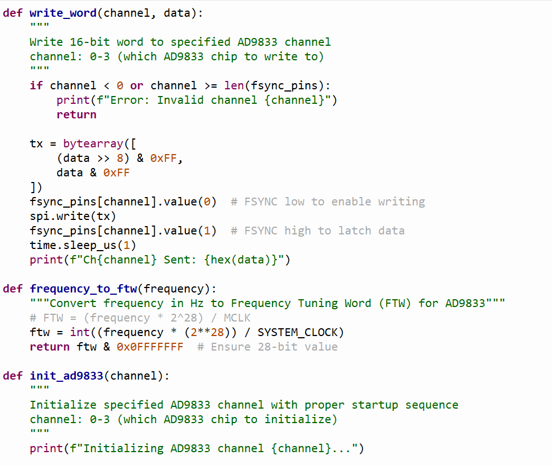
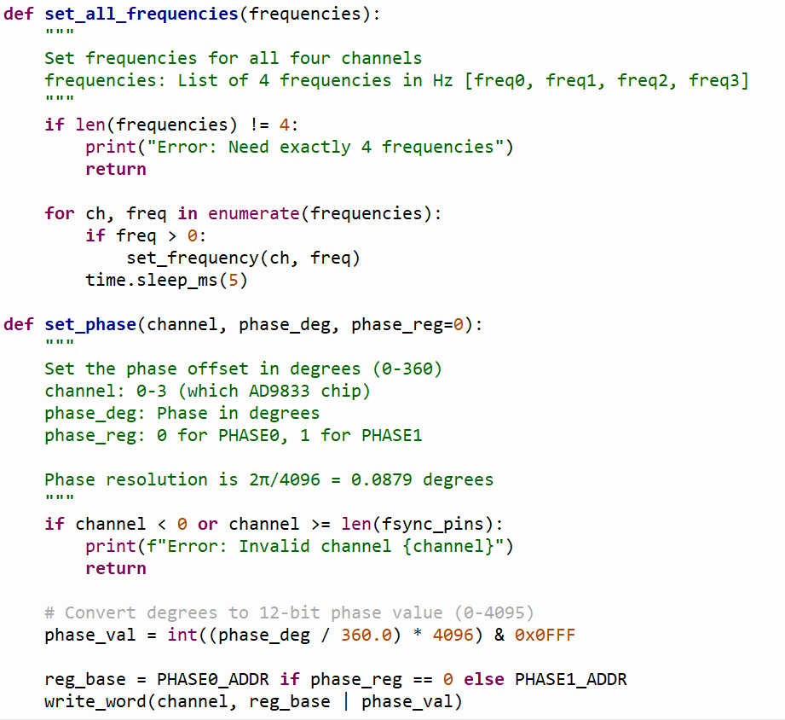
Updated Programming interface with DDS and Web App

Slide 19
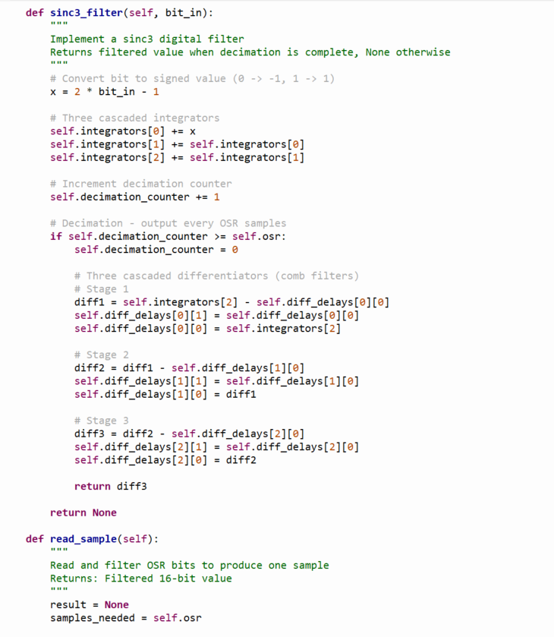
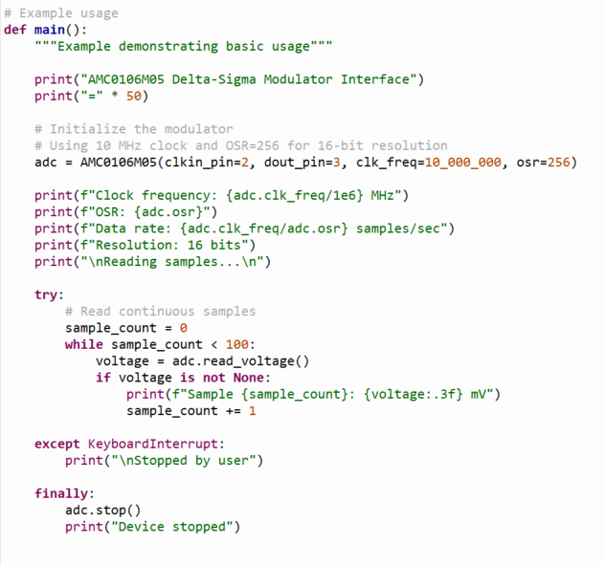
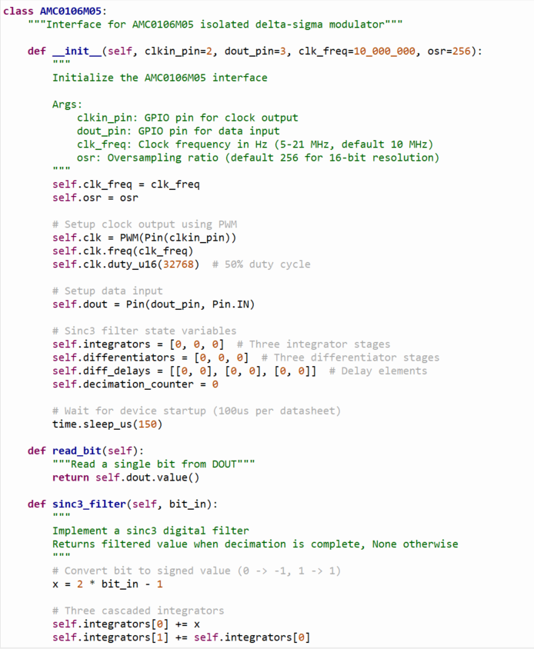
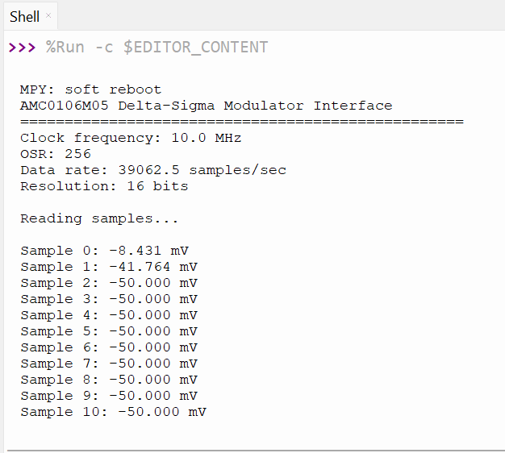
Programming interface for the ADC

Slide 20
Budget
Current Expenses :
DDS Test Board: $33
Component Order: $140
Battery Order: $44
Total: $217

Slide 21
Challenges so far
Choosing Connector
Board sizing
Power supply

Slide 22
Immediate Plan
Order Board
Create software
Pray
Make housing
Component order
Report work

Slide 23
Questions/Feedback

