Slide 1
Samad, Guandong, and Tyler
Brain Stimulator Progress Update

Slide 2
Problem Description
Make a device that can generate waveforms of precise frequency and current to stimulate deep parts of the brain using electrodes.

Slide 3
Key Events from Last Week
Got flyback and iso-adc breakout boards
Made final amplifier stages
Made voltage controlled current source circuitry
Did first pass final board placement

Slide 4
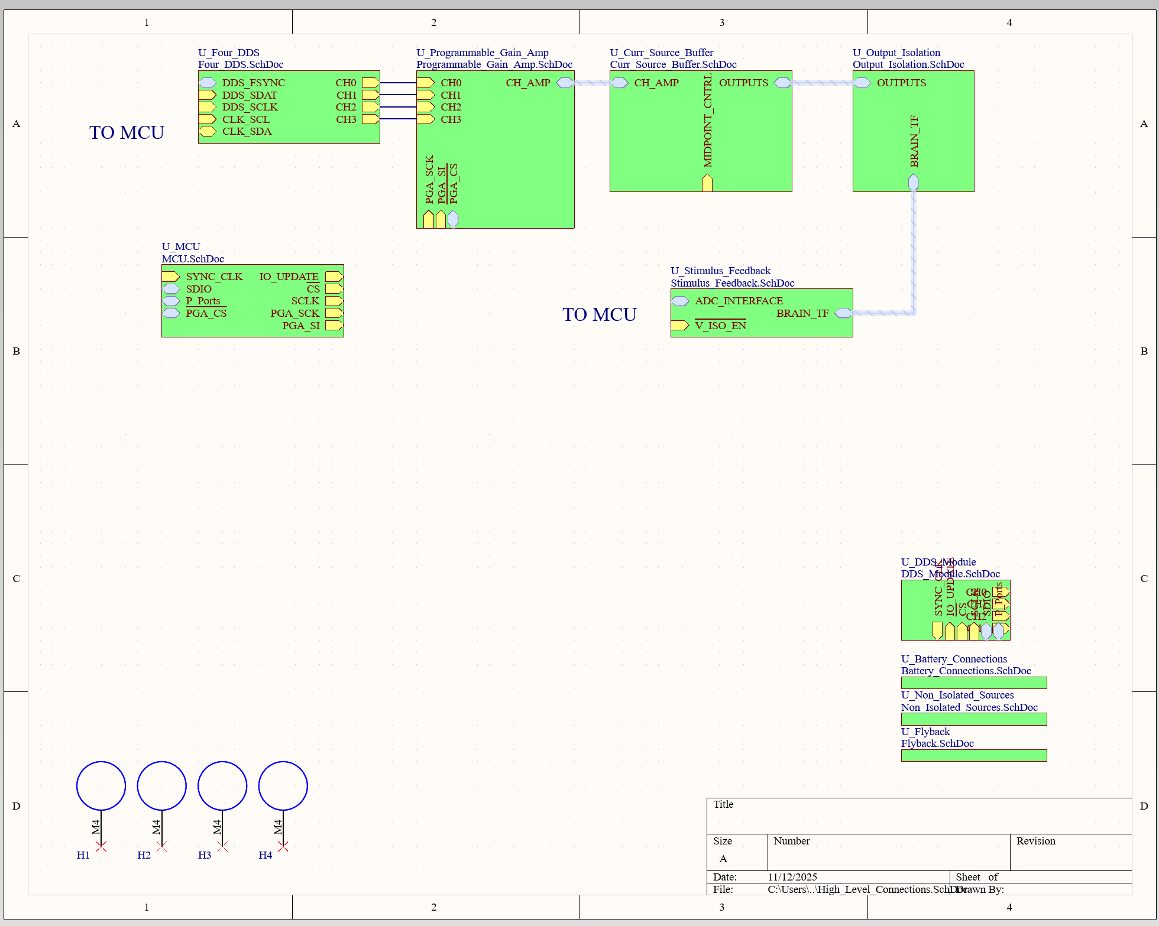
Schematic Updates

Slide 5
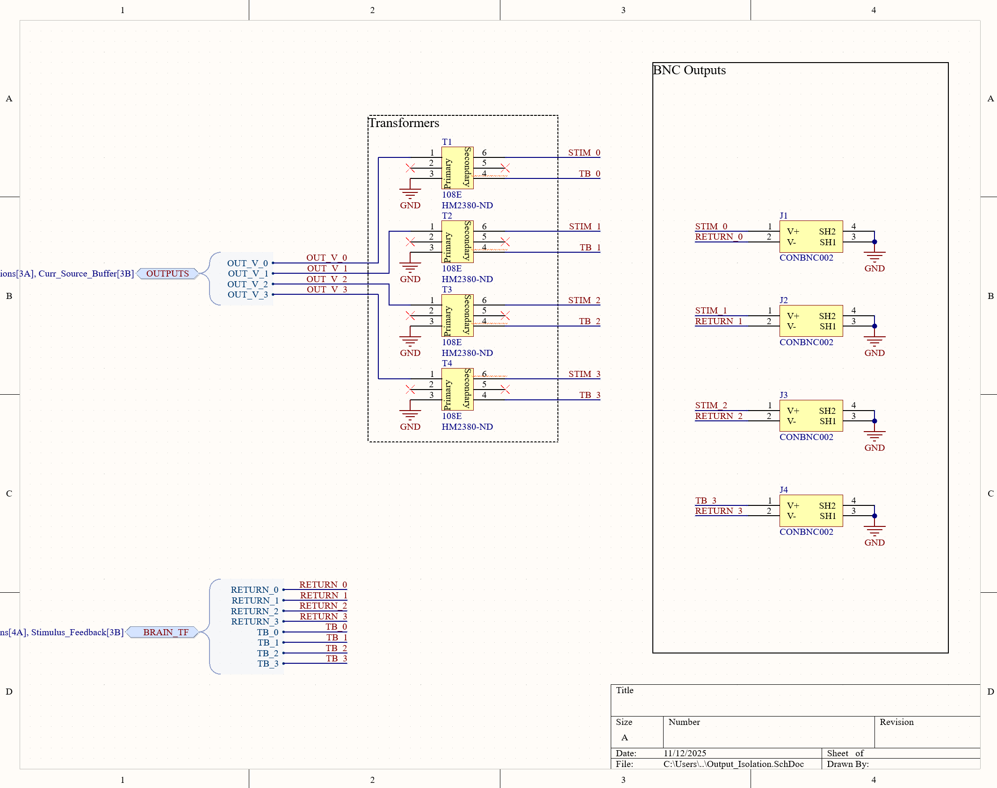
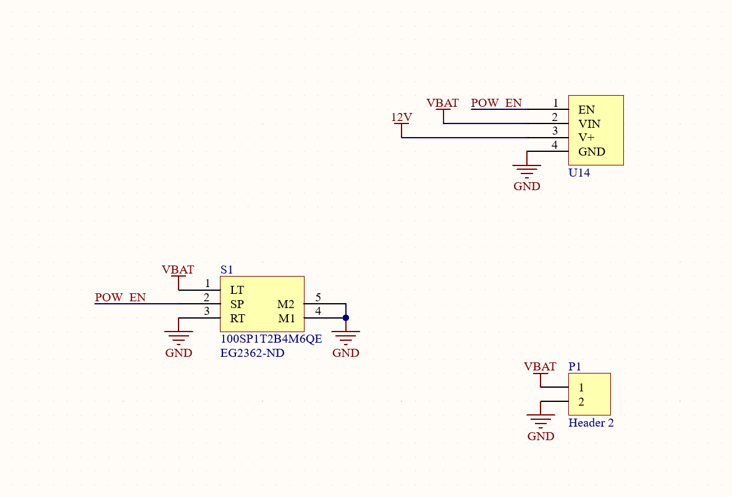
Schematic Updates Continued

Slide 6
Kill Switch
Cut off 12V enable because otherwise the switching regulators will be on and incur losses
Comes at the price of powering down MCU
Soft kill is currently done through software. Ideally will add button but need to find space.

Slide 7
Switch from Audio Jack to BNC
More robust
Downside is size

Slide 8
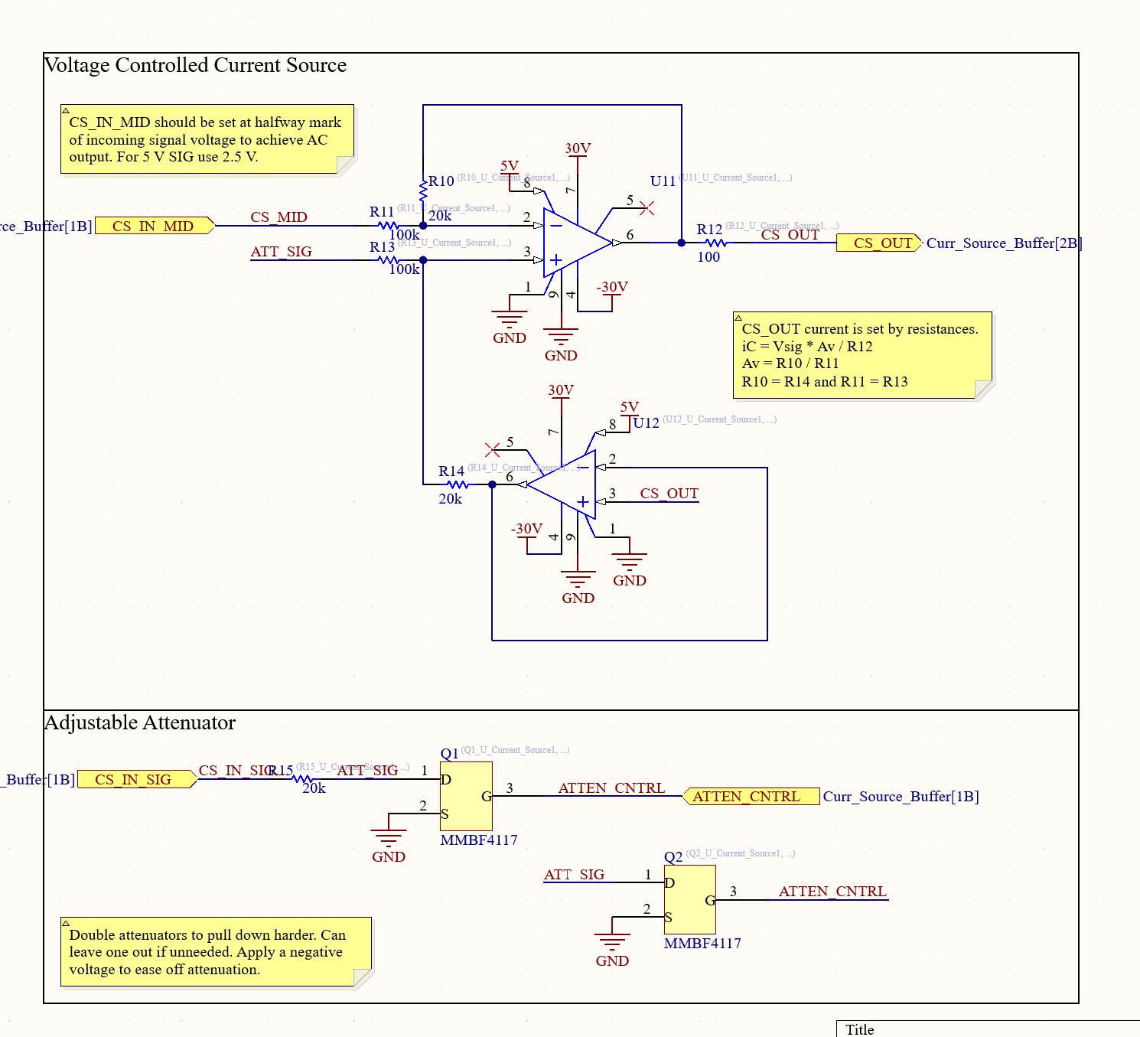
Schematic Updates Continued

Slide 9
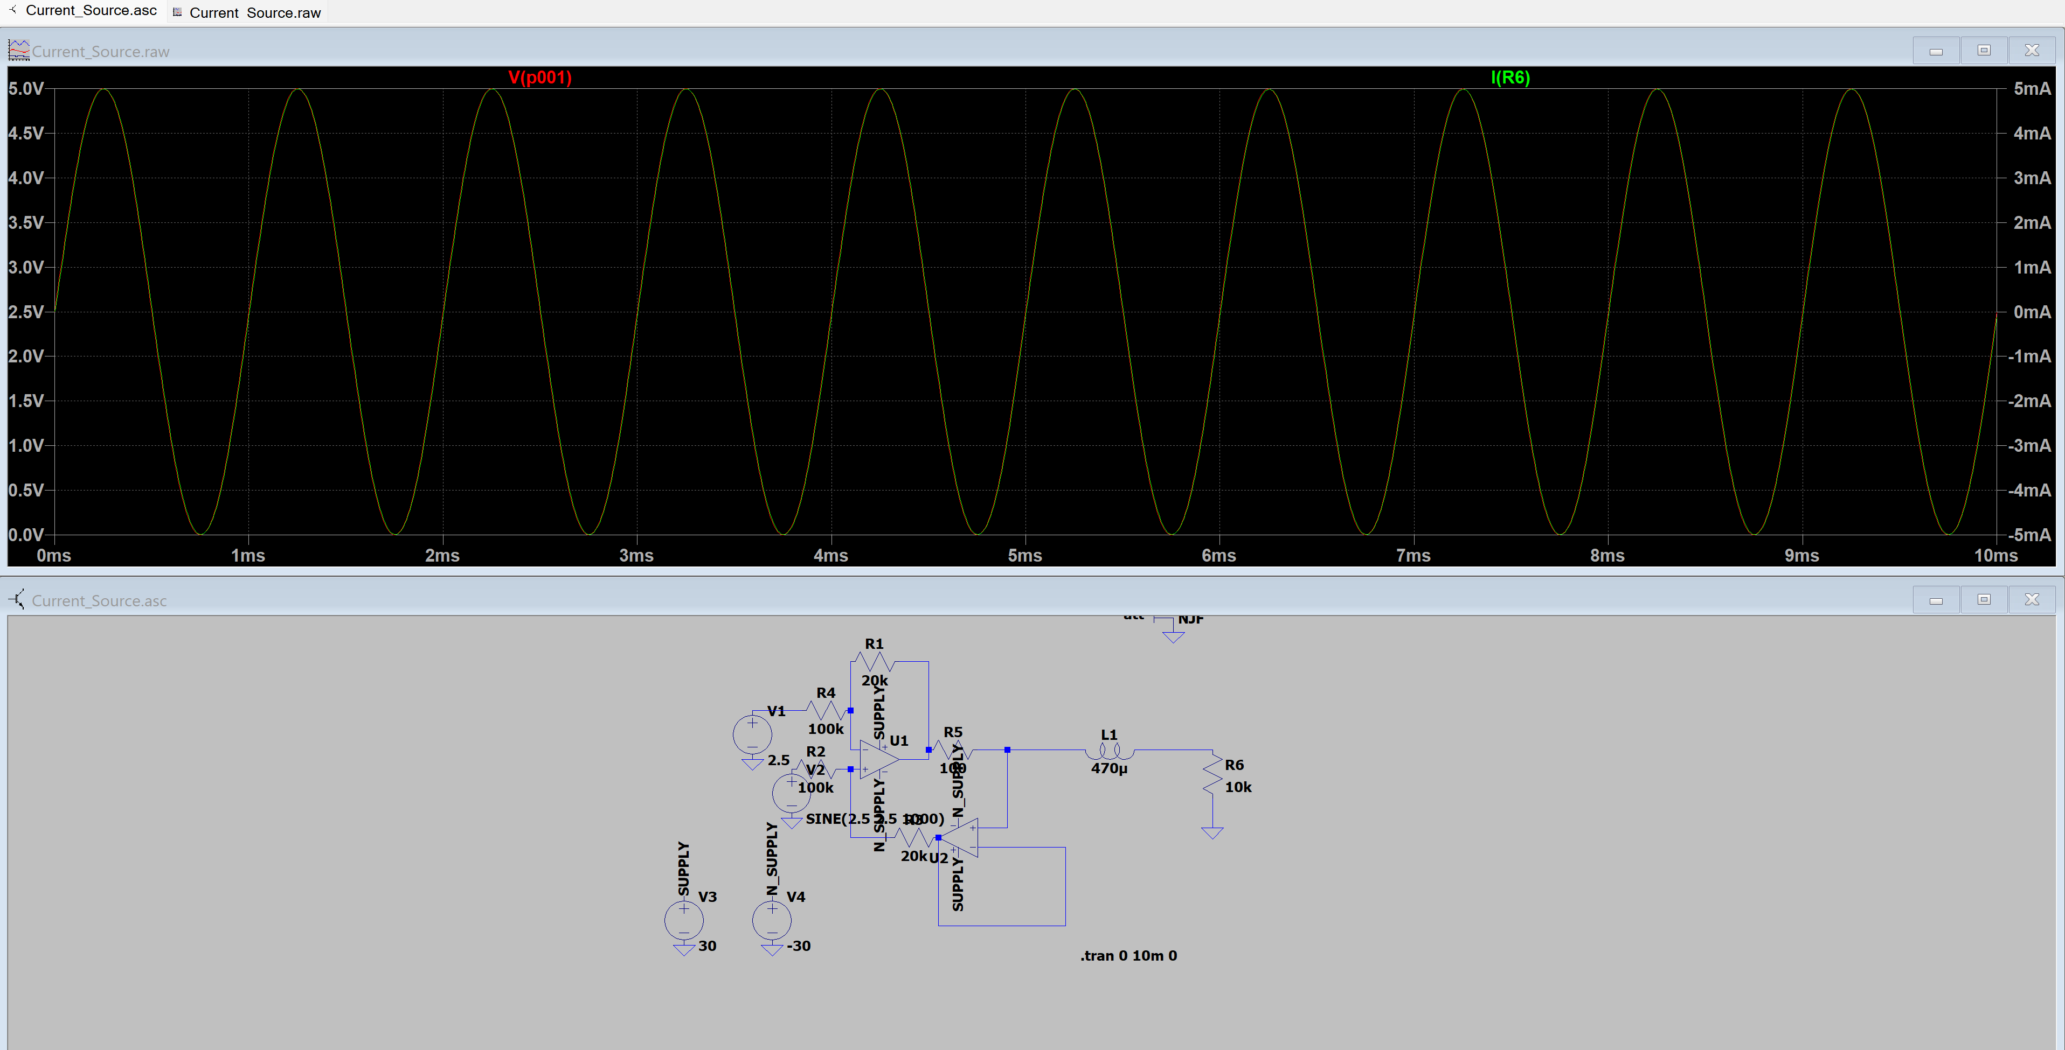
Current Source Simulation

Slide 10
Current Source
Use a midpoint offset to turn 0-5 V sine wave into a -5-5 mA current source
Tight tolerance resistor which has the voltage across it controlled such that current is known

Slide 11
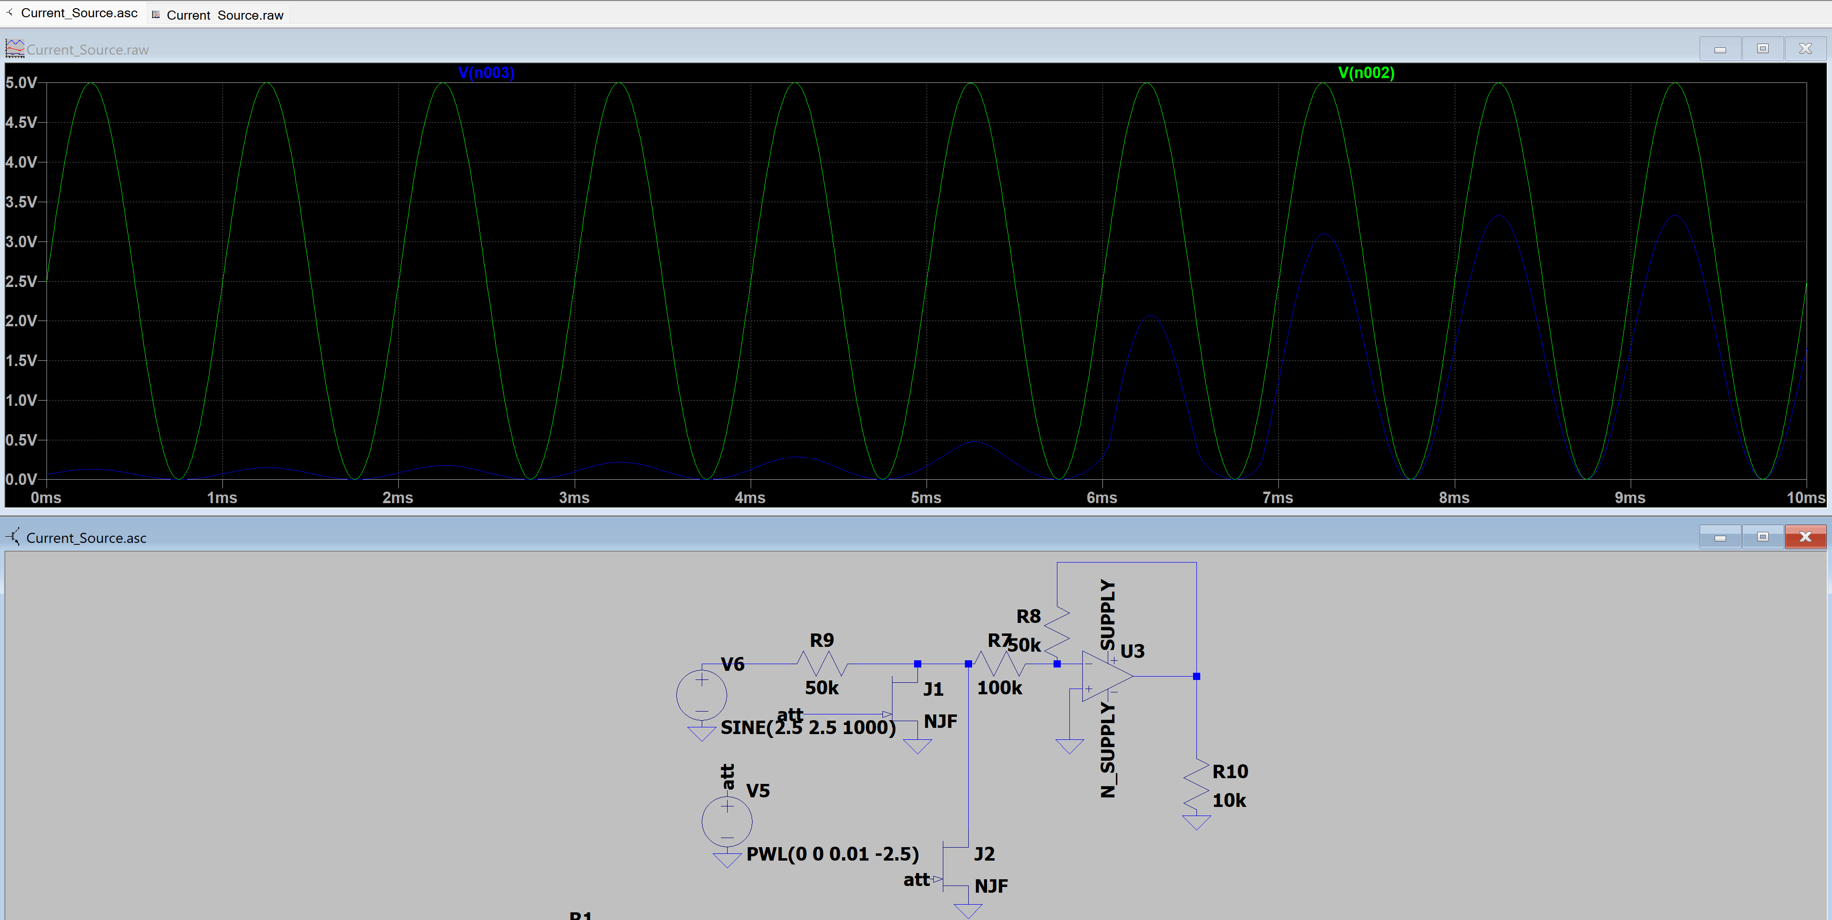
Voltage Controlled Attenuator Simulation

Slide 12
Voltage Controlled Attenuator
After initial amplification the sine wave will be max 0-5V constant sine wave, so need amplitude control
Step down instead of up. Apply a negative voltage to the gate of a JFET to control linear region resistance of the device
Use JFETs in voltage divider to step down voltage swing

Slide 13
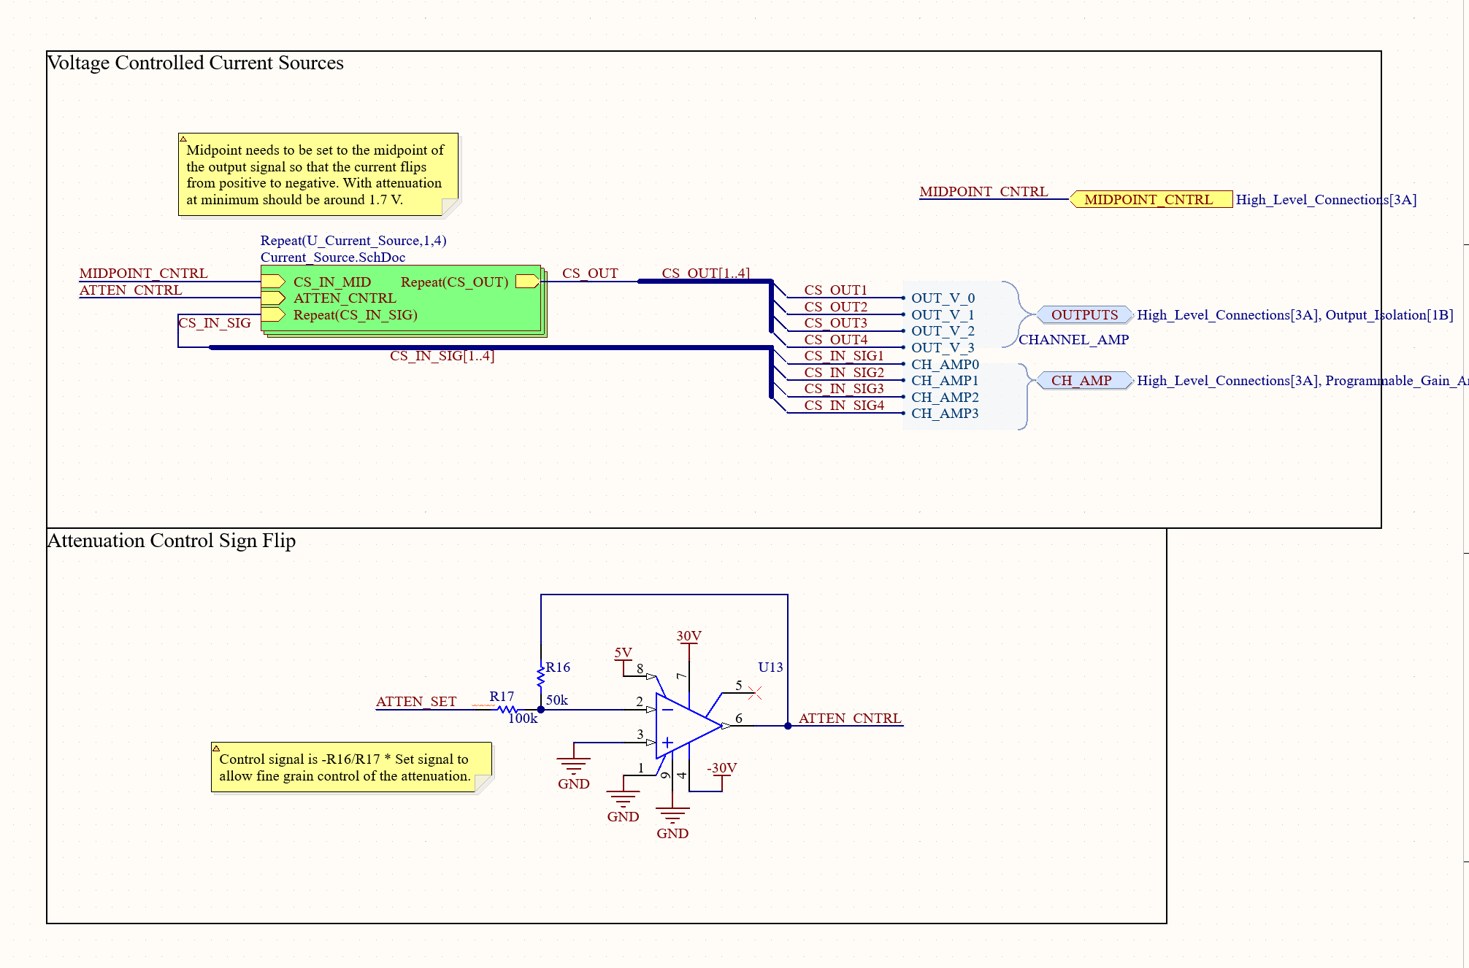
Schematic Updates Continued

Slide 14
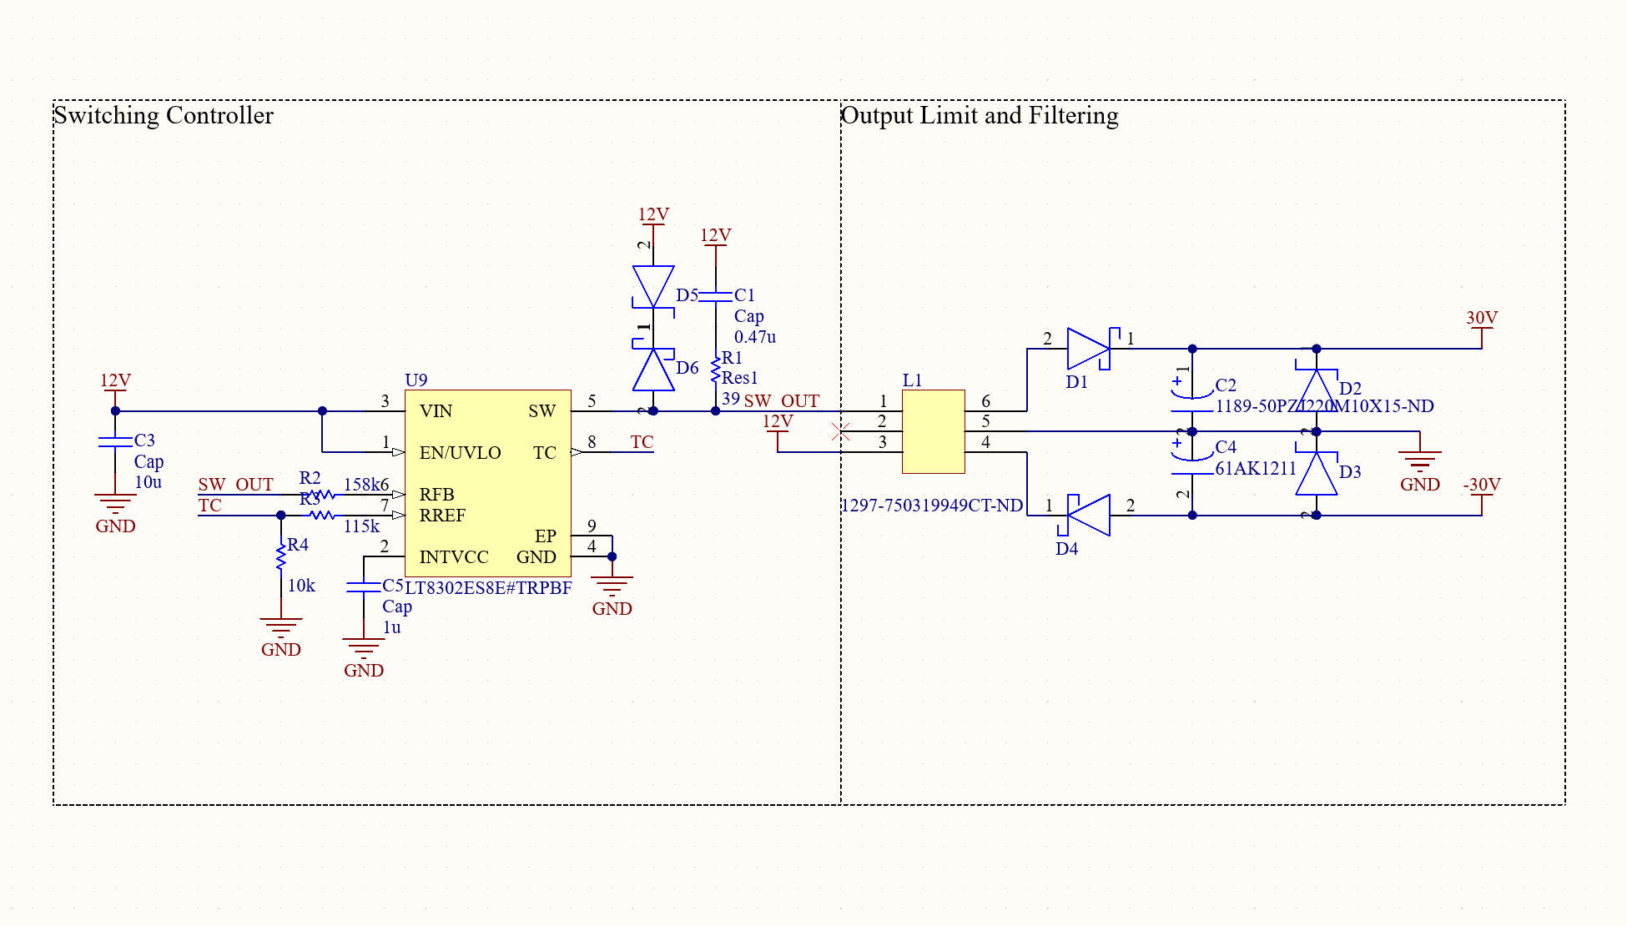
Schematic Updates Continued

Slide 15
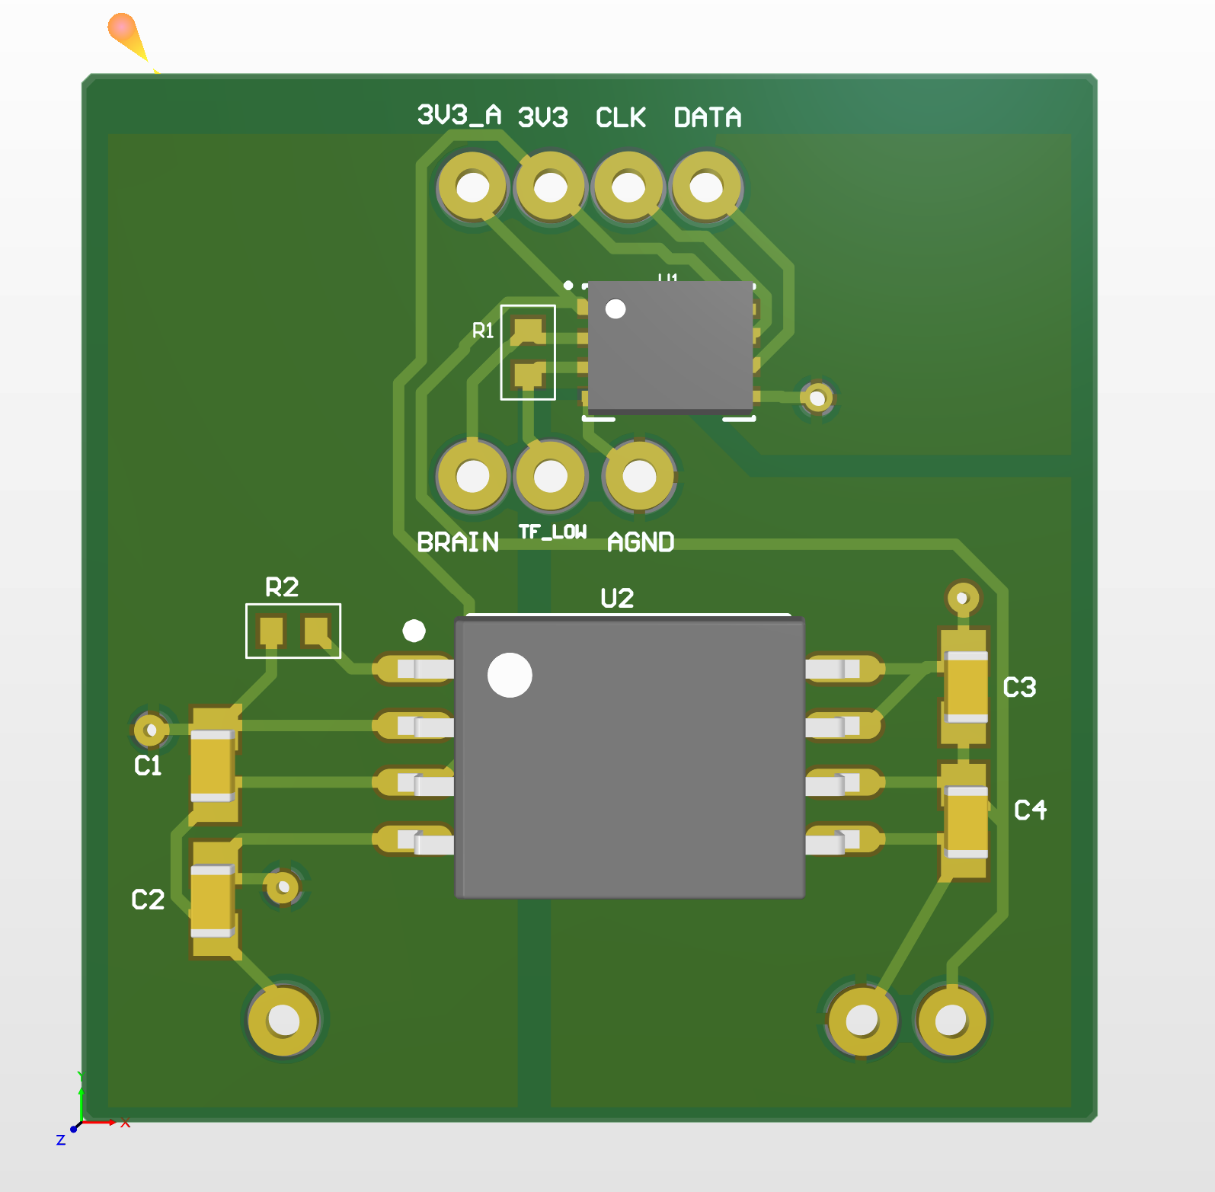
ADC Breakout board Layout

Slide 16
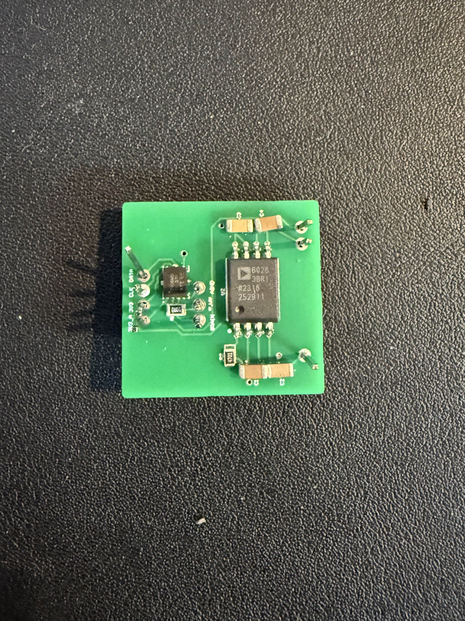
Assembled ADC and DC-DC Breakout Board

Slide 17
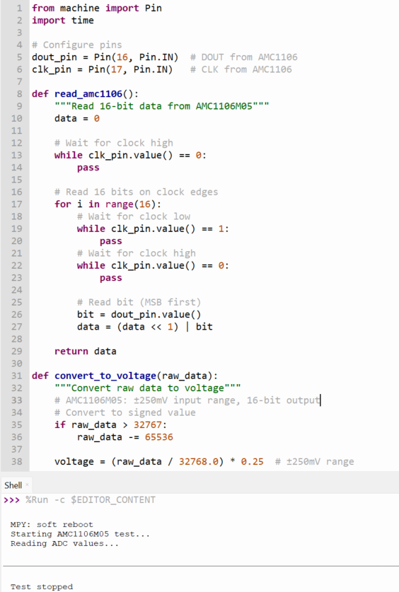
ADC testing
Possibly no clock signal, needs more testing

Slide 18
Flyback Converter
Get +/-30 V rails
Incur some losses from two switching converters, almost unavoidable
Feed into final amplifier stage

Slide 19
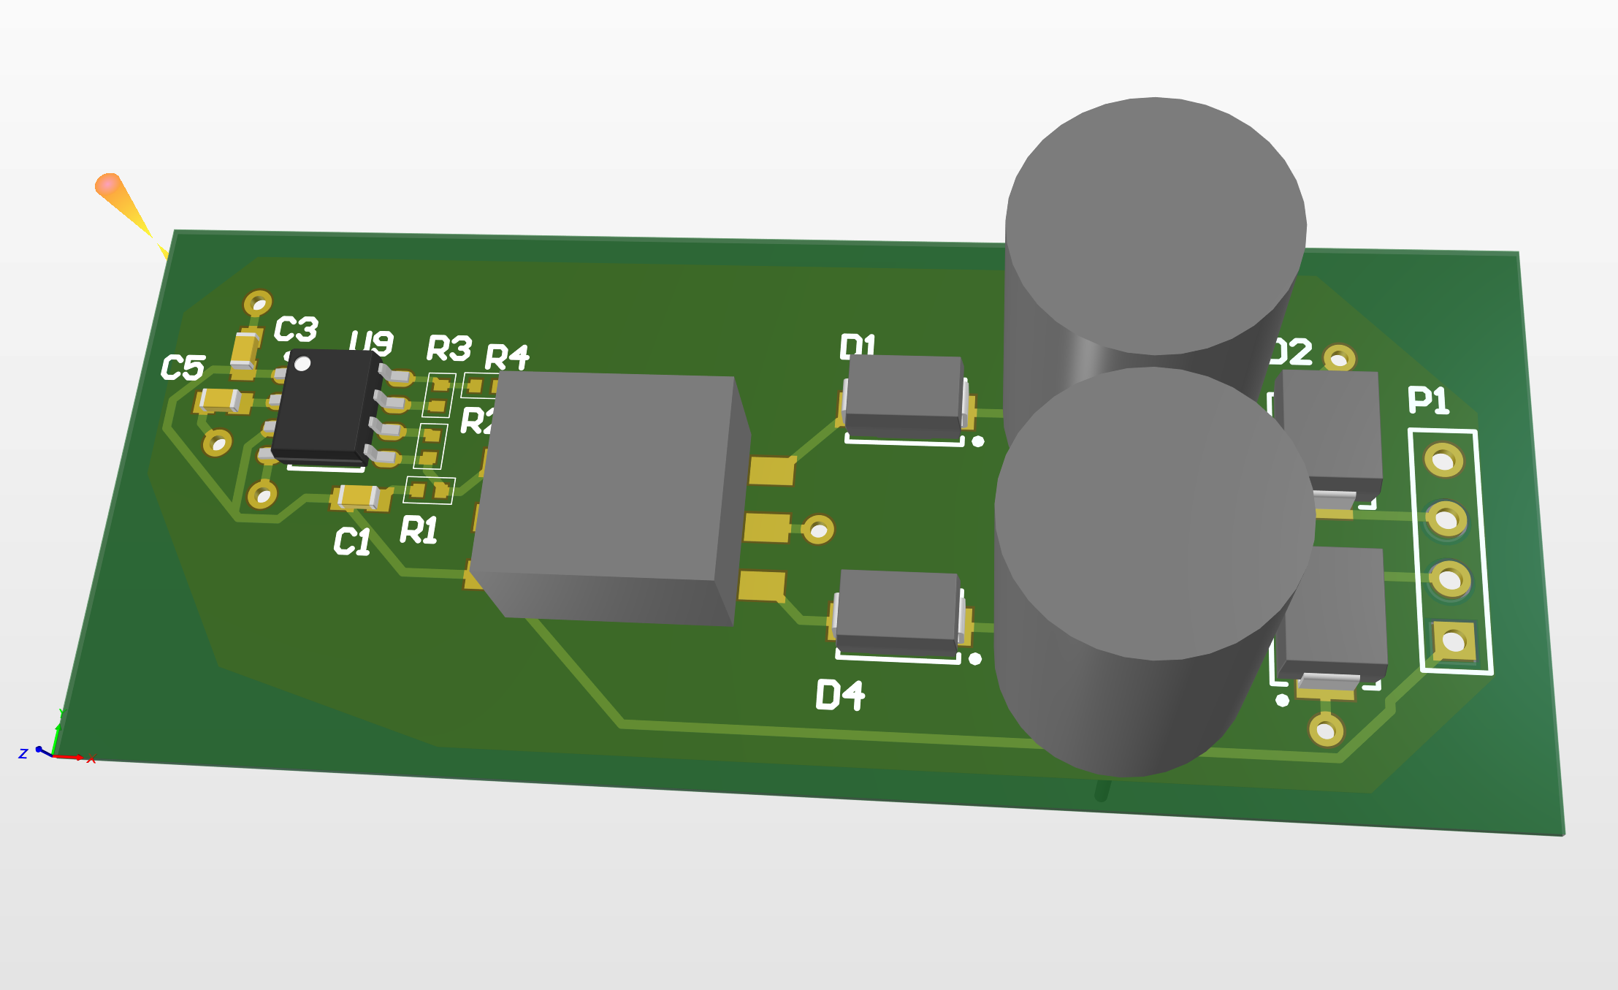
Flyback Breakout

Slide 20
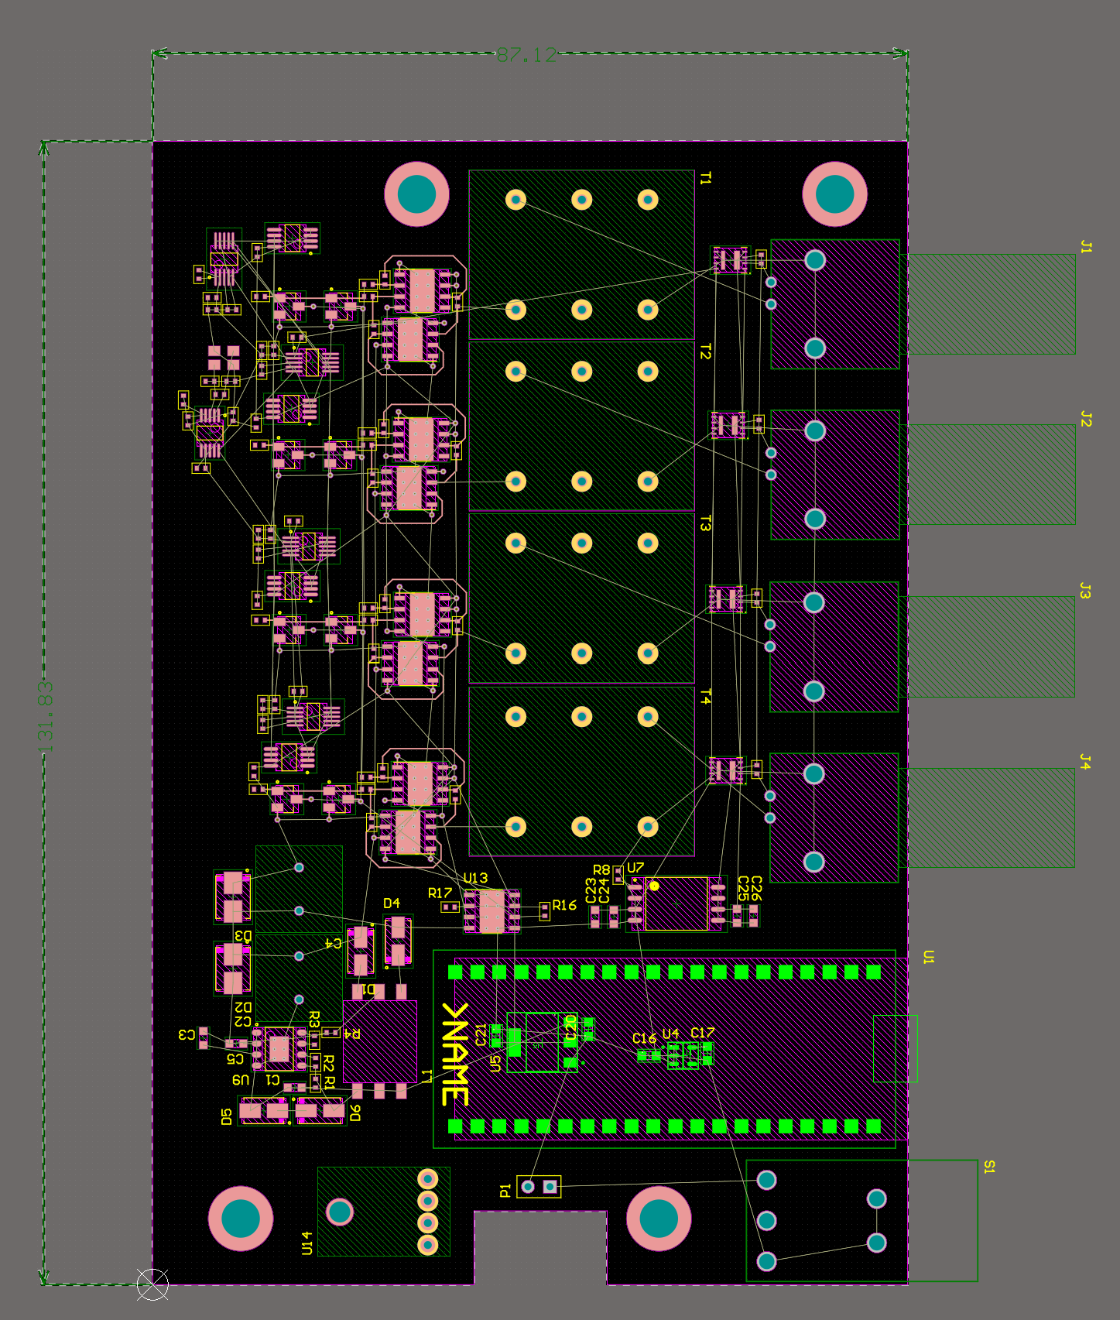
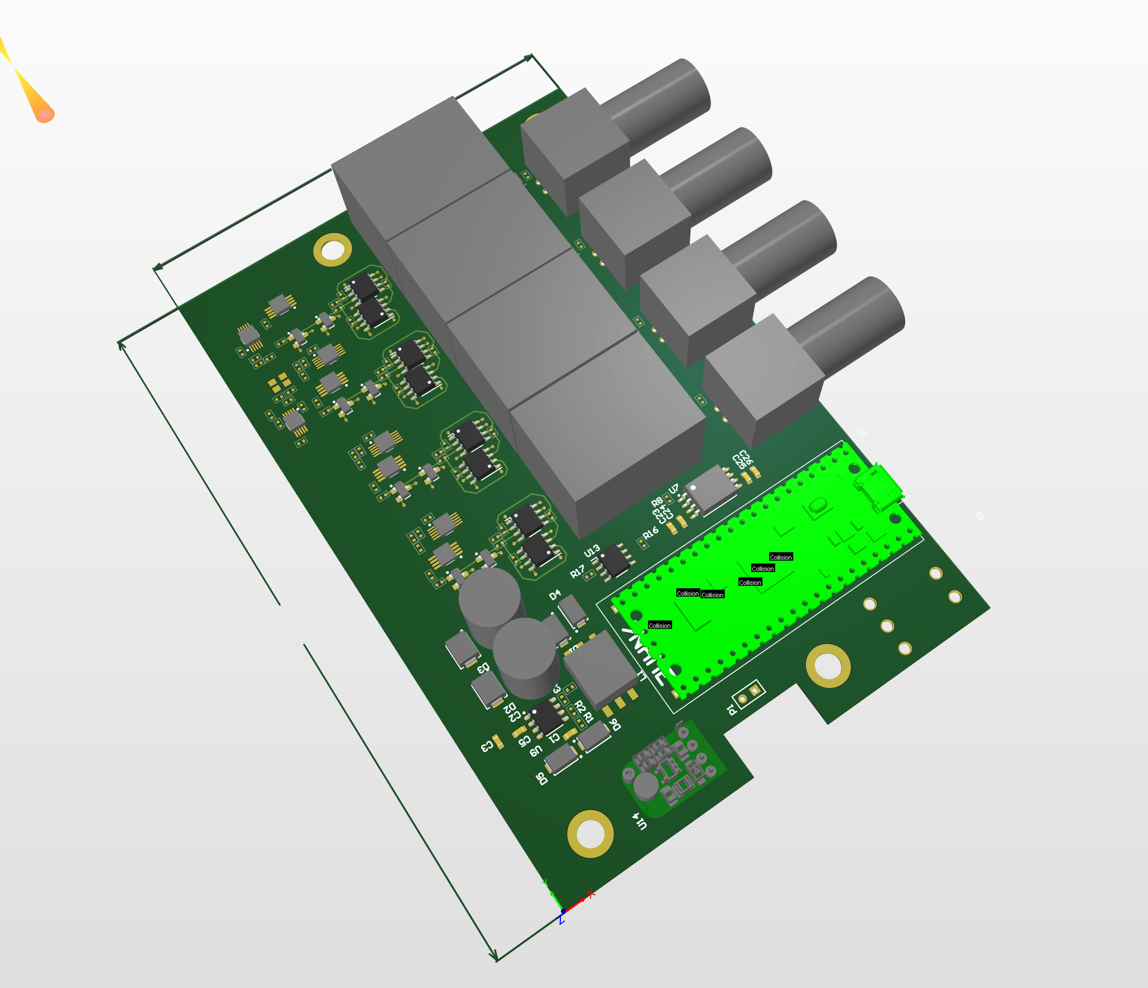
Final Board Placement

Slide 21
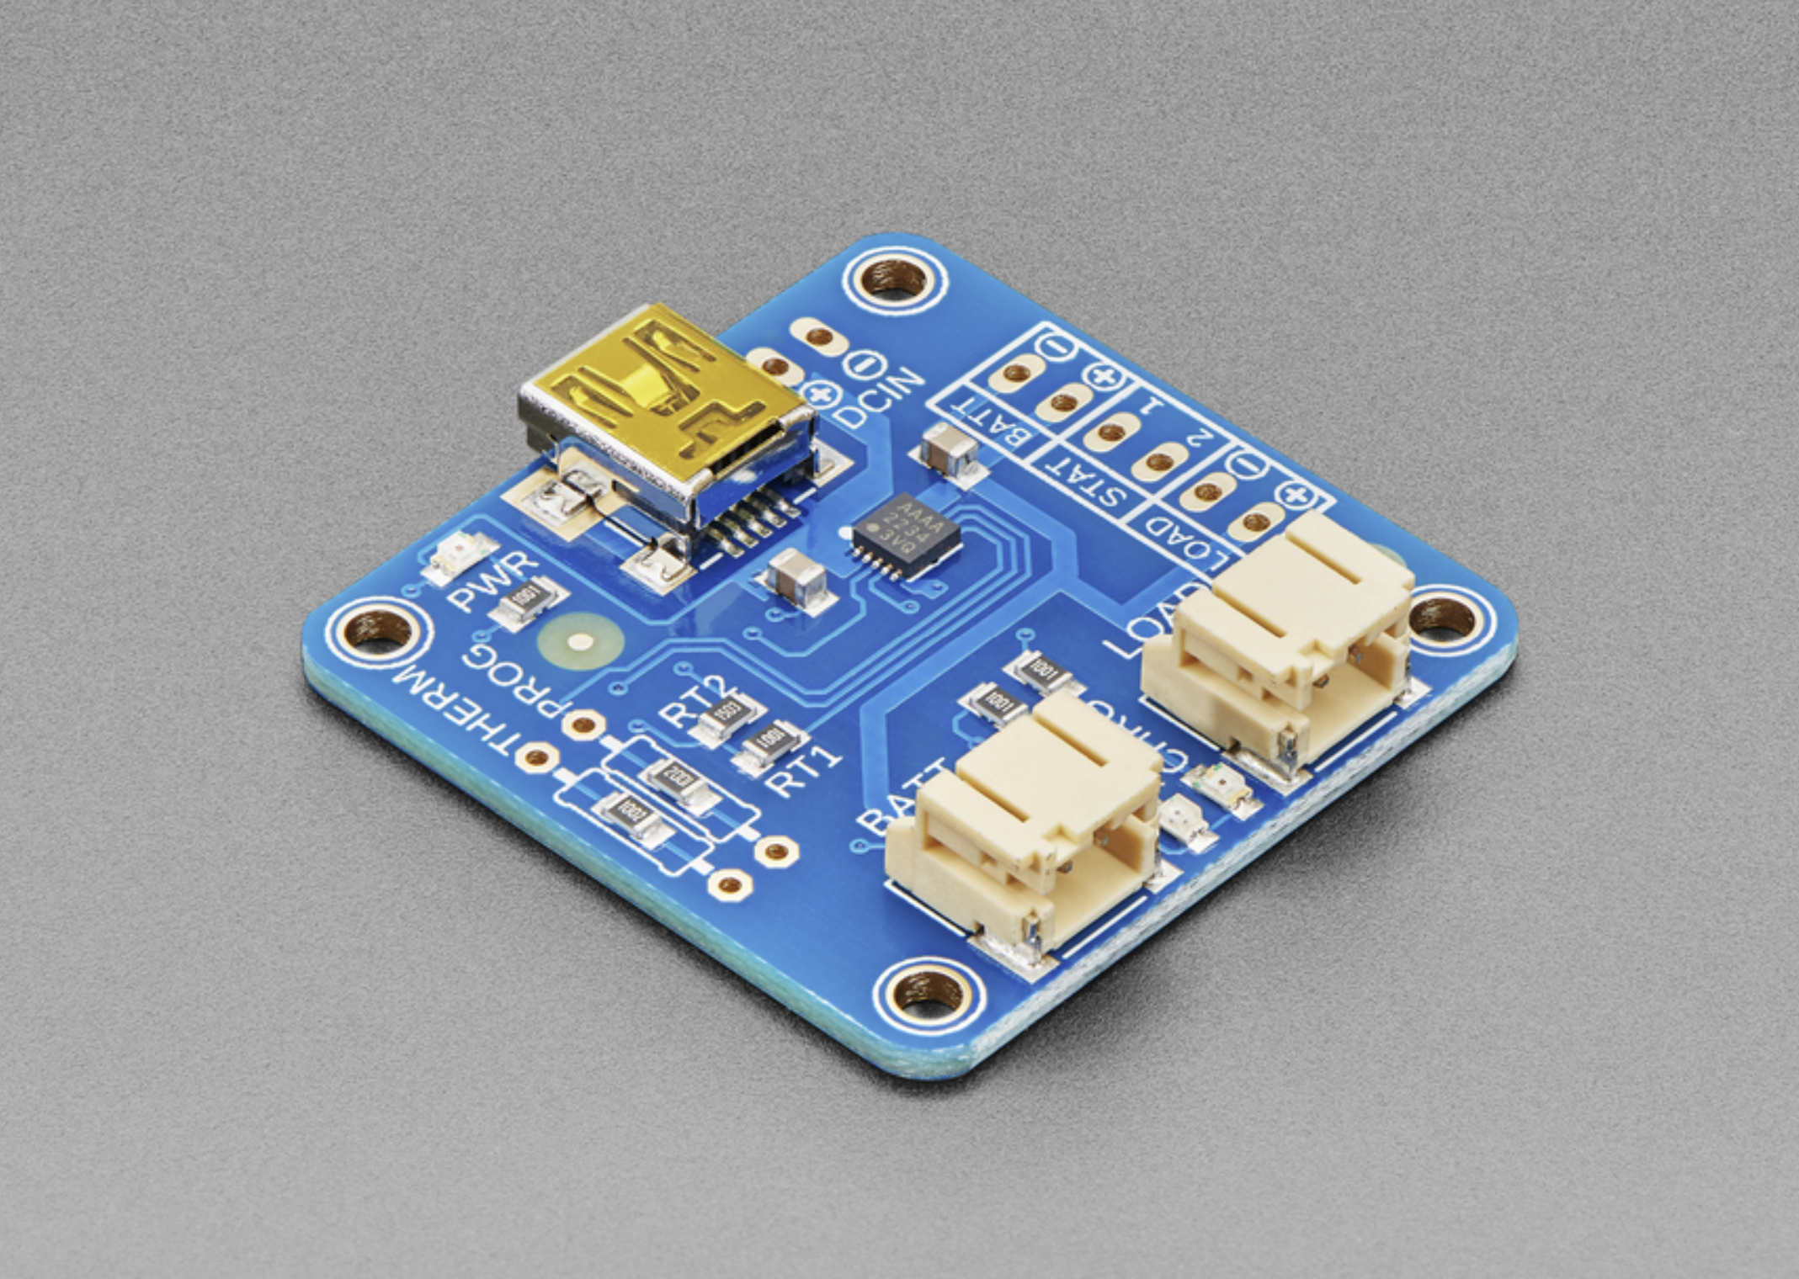
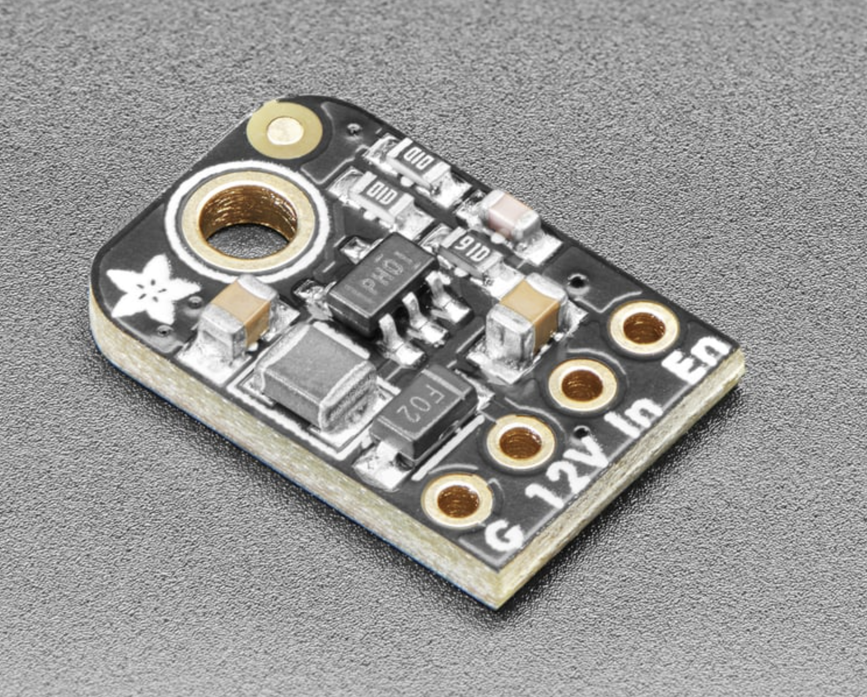
Other Components

Slide 22
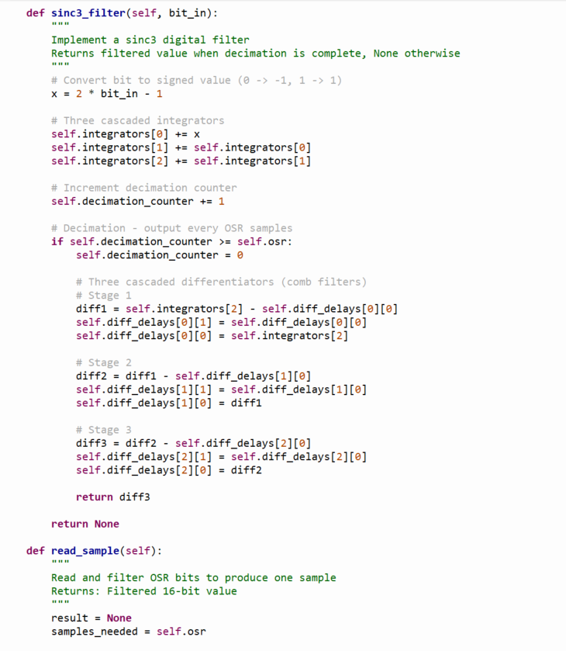
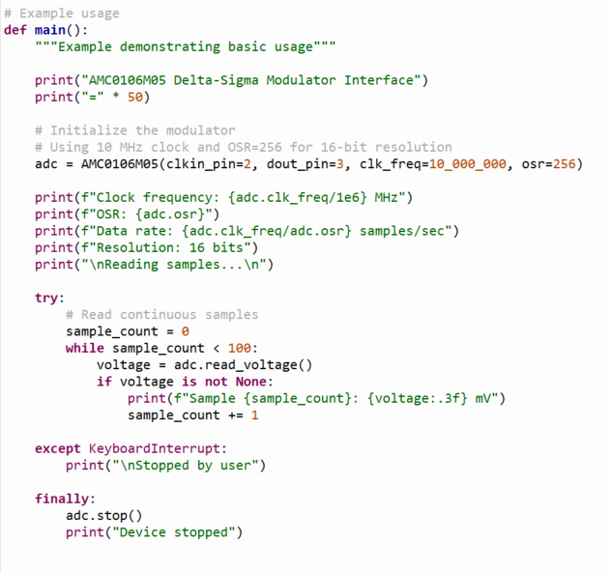
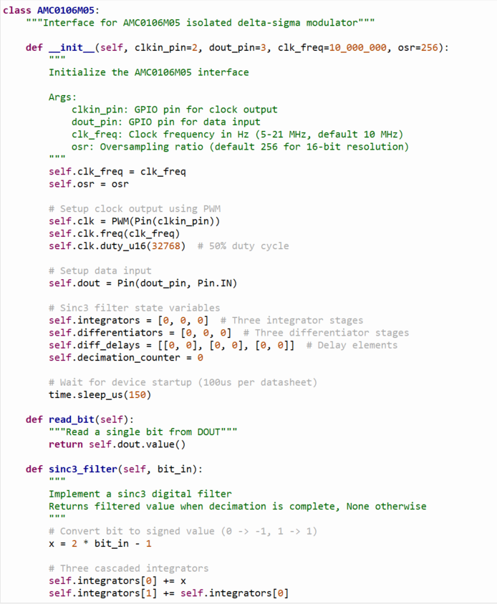
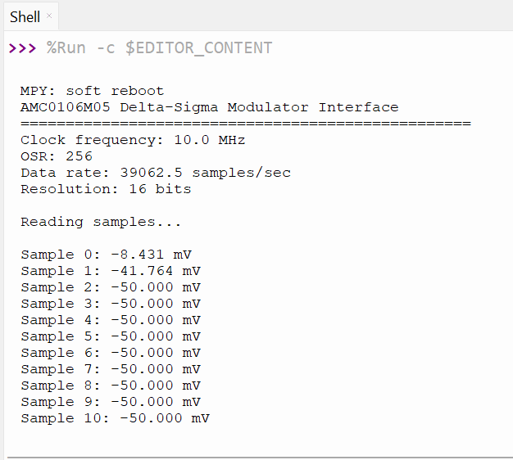
Programming interface for the ADC

Slide 23
Budget
Current Expenses :
DDS Test Board: $33
Component Order: $140
Battery Order: $44
Total: $217

Slide 24
Challenges so far
Choosing Connector
Board sizing
Power supply

Slide 25
Immediate Plan
Get MCU pinout
Route board and order by Friday
Test subsections before board order
Get BOM together

Slide 26
Questions/Feedback

