Slide 1
Samad, Guandong, and Tyler
Brain Stimulator Progress Update

Slide 2
Problem Description
Make a device that can generate waveforms of precise frequency and current to stimulate deep parts of the brain using electrodes.

Slide 3
Key Events from Last Week
Schematic changes to accommodate new DDS
Added flyback converter to schematic
Flyback Breakout
Start of placement onto final PCB (Not routing until all placed)

Slide 4
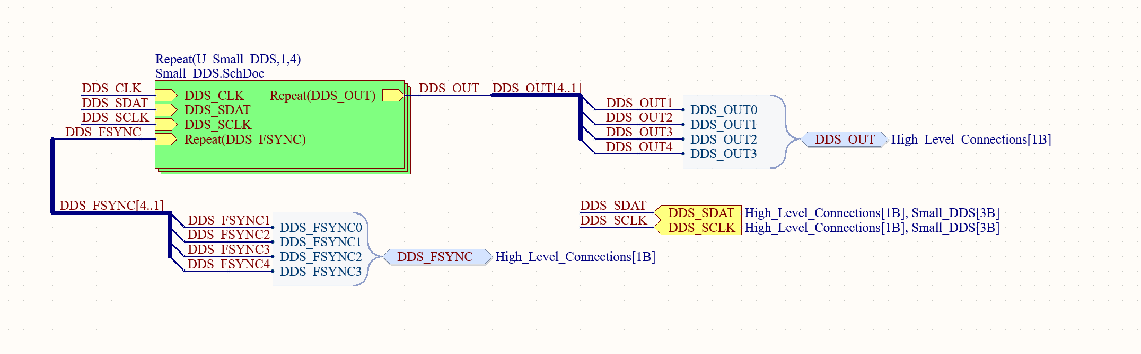
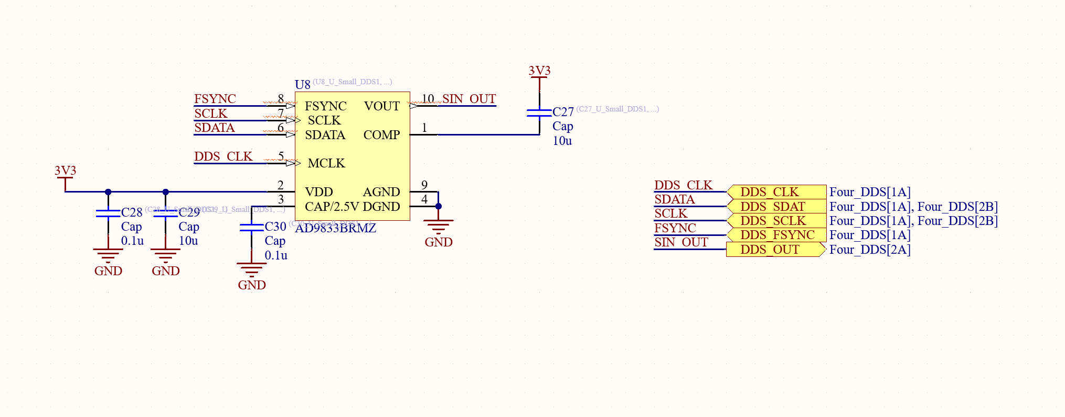
Schematic Updates

Slide 5
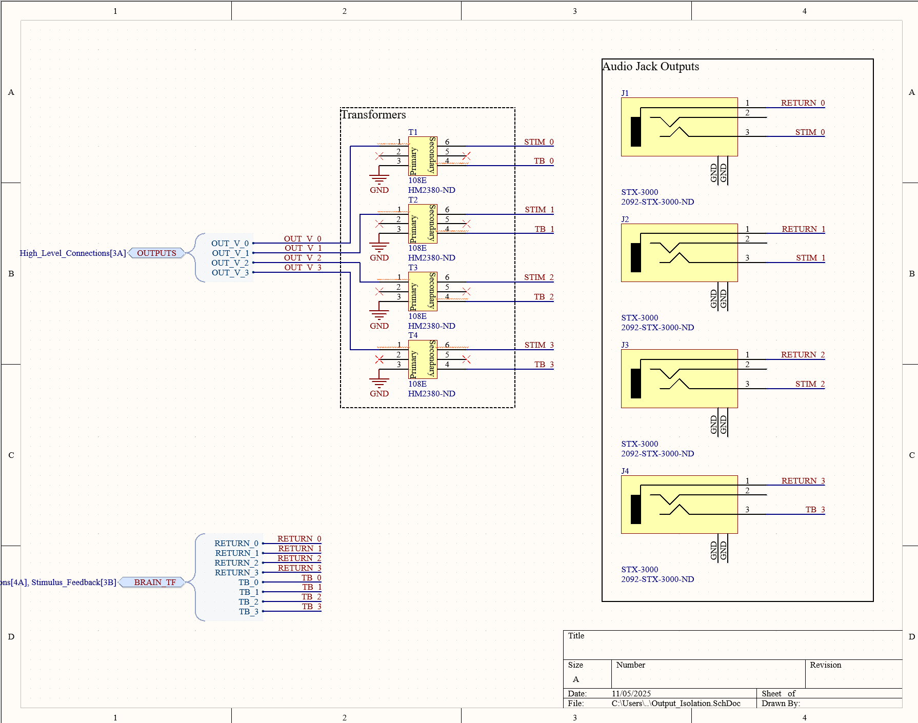
Schematic Updates Continued

Slide 6
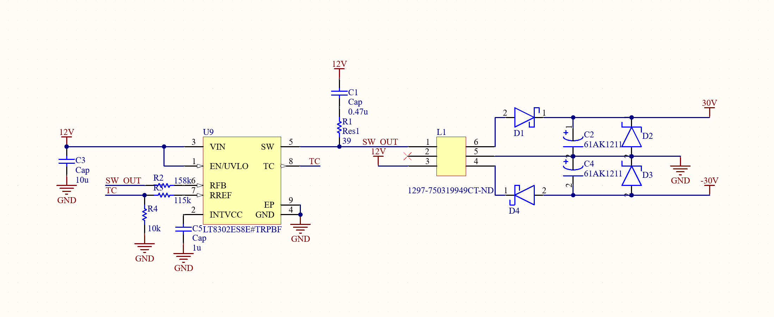
Schematic Updates COntinued

Slide 7
Justification for Audio Jacks
Readily available
Fast repair, requires no rework
Downside is might pop out and cause pain, will have to test
Space saving compared to banana jacks

Slide 8
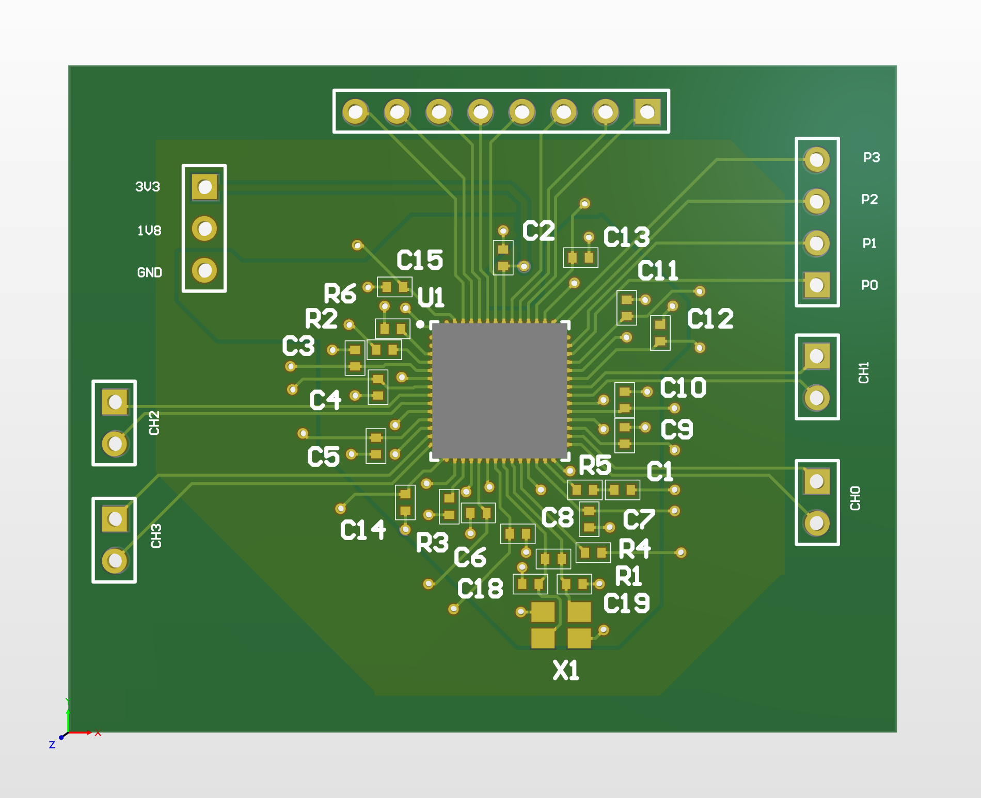
Revised Breakout Board Layout

Slide 9
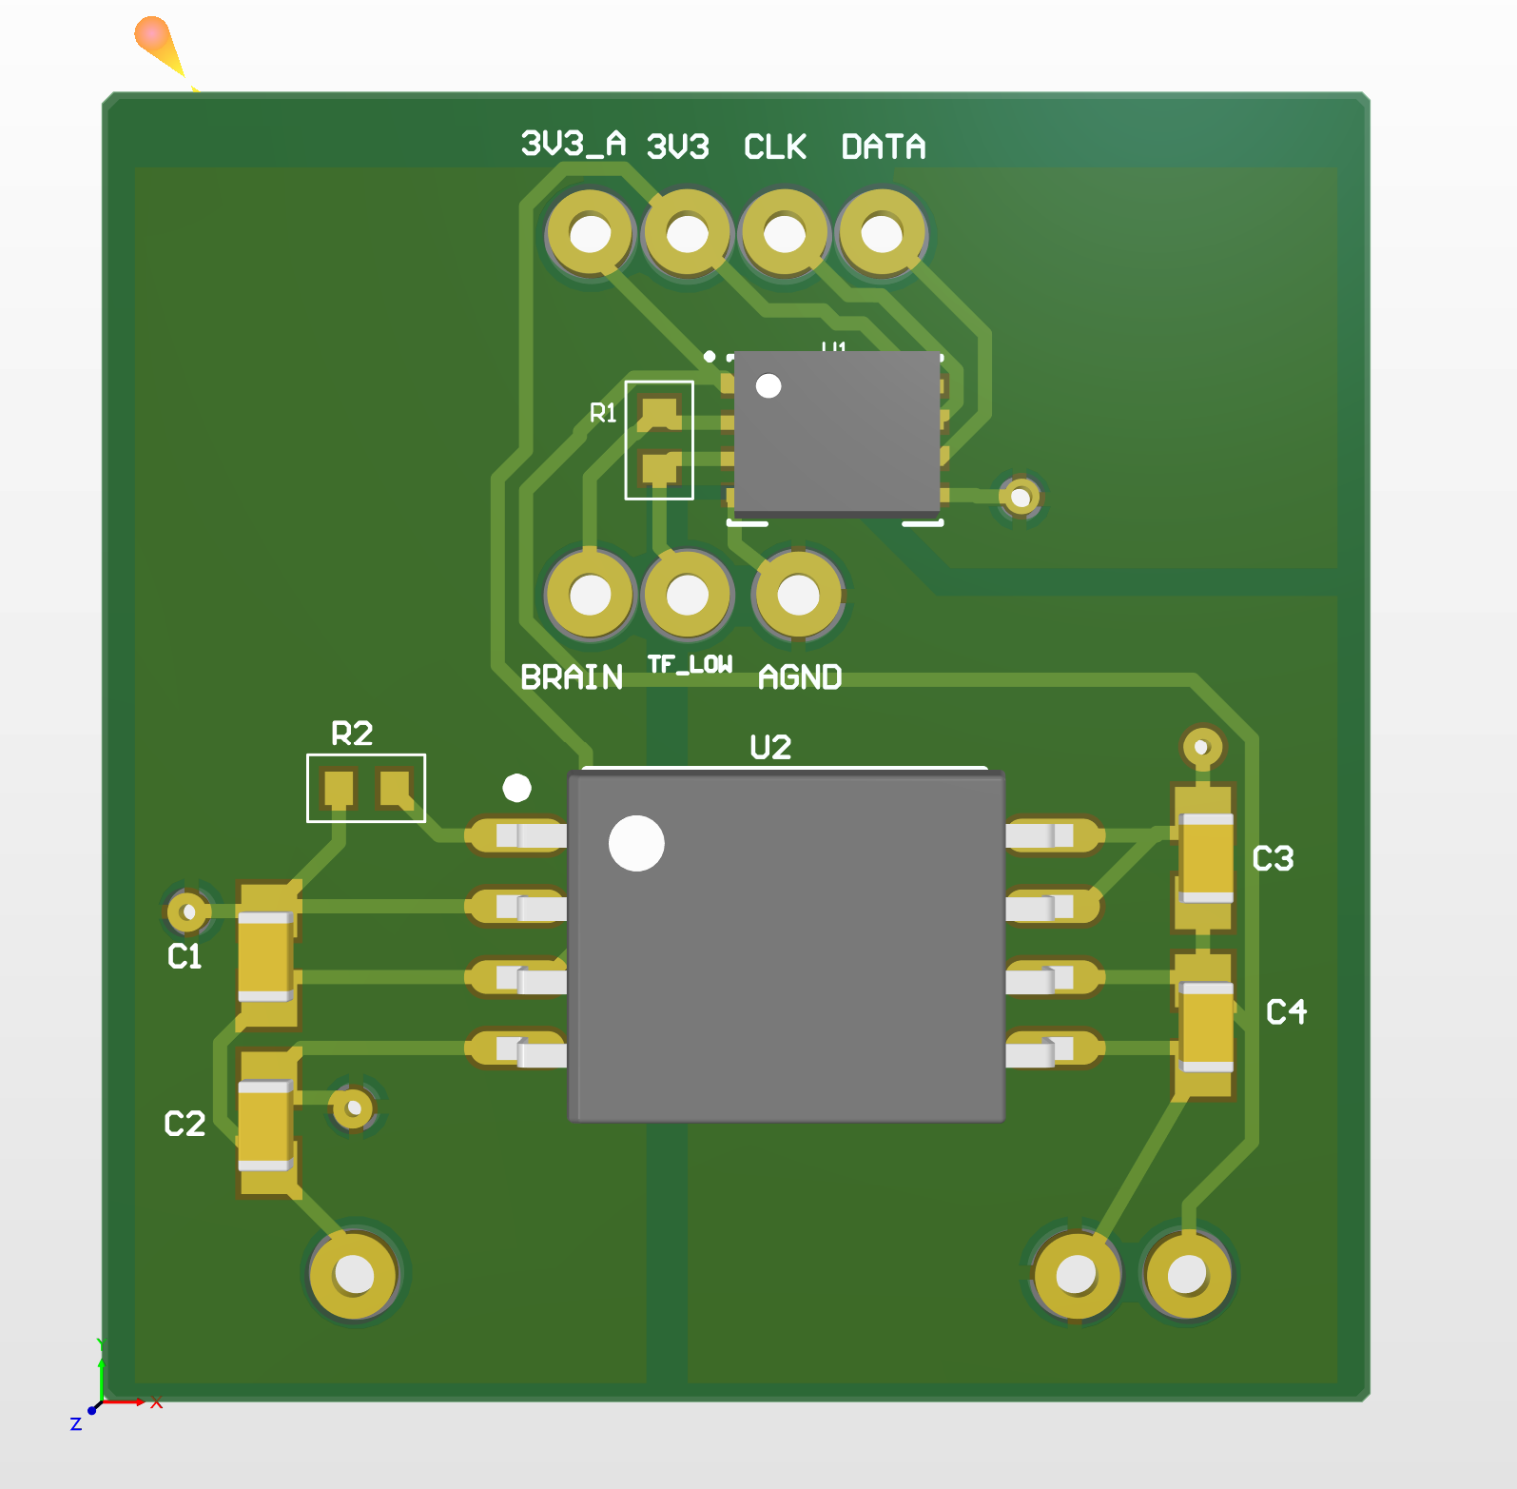
ADC Breakout board Layout

Slide 10
Switch to Four Small DDS
Big DDS great in theory because it has a lot of features, bad in practice because it has a lot of features (over-speced)
Smaller DDS have more voltage focus
DDS are expensive, but reduce load on the MCU

Slide 11
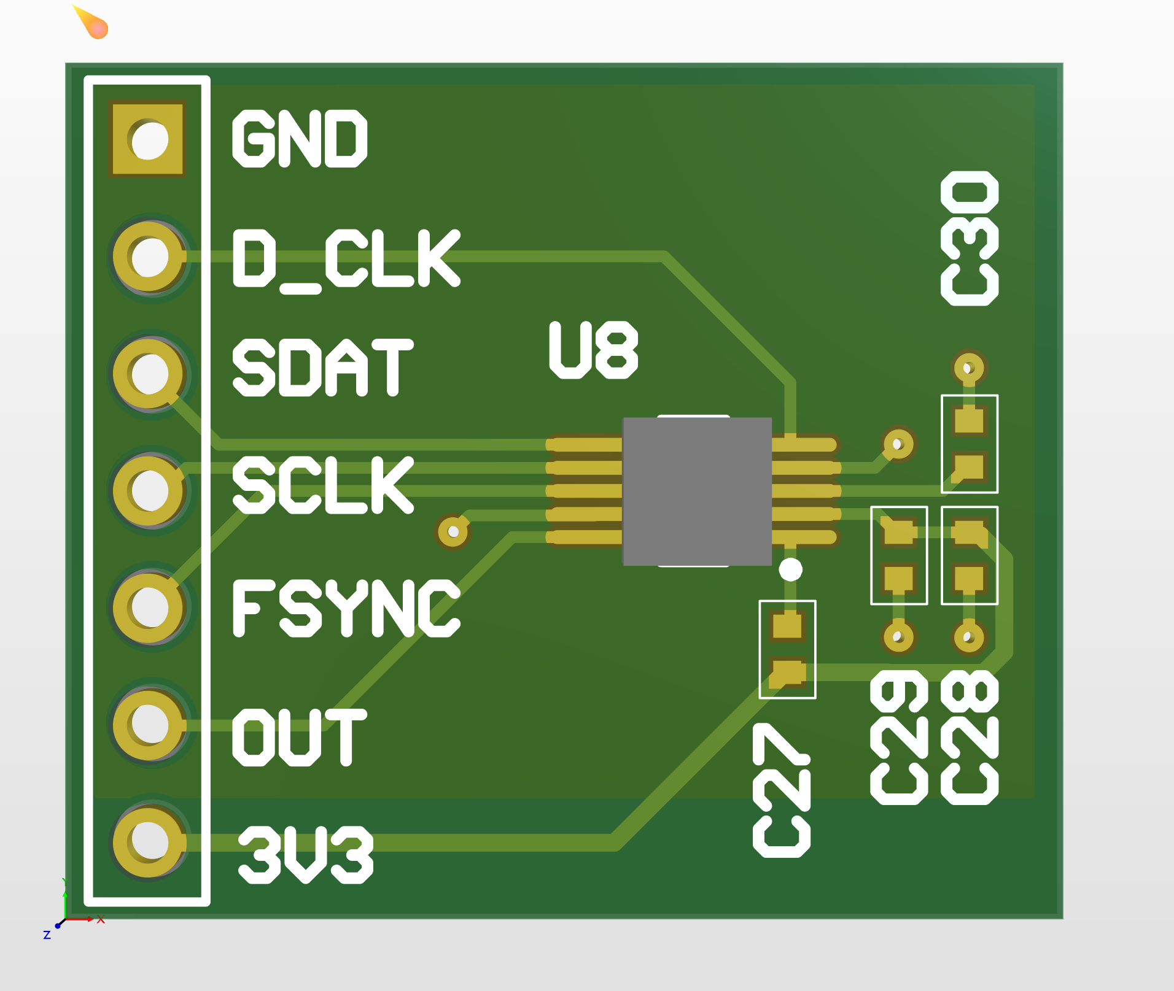
DDS Breakout Board

Slide 12
Flyback Converter
Get +/-30 V rails
Incur some losses from two switching converters, almost unavoidable
Feed into final amplifier stage

Slide 13
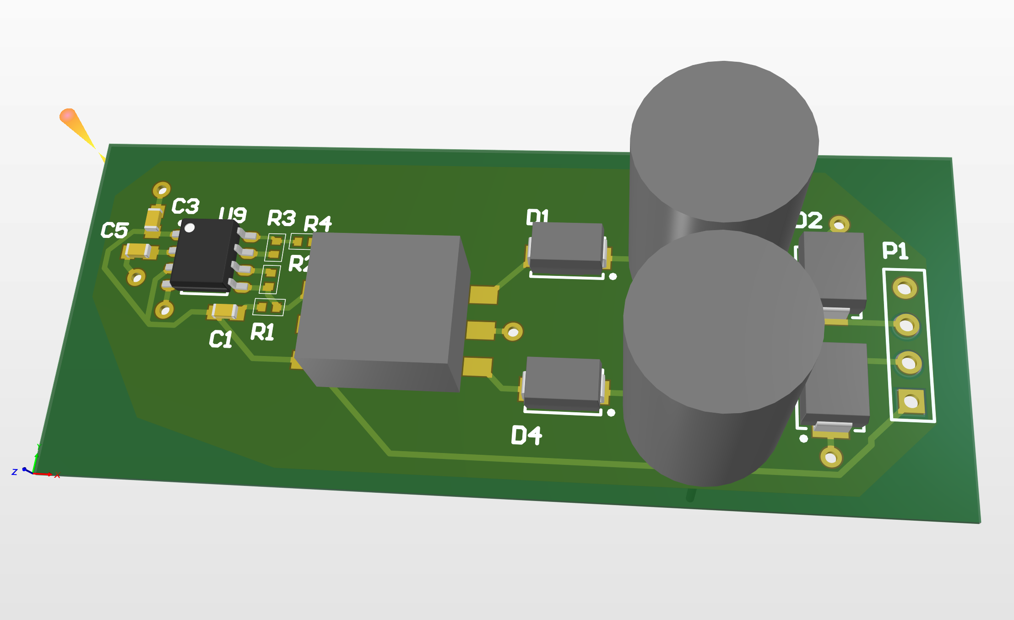
Flyback Breakout

Slide 14
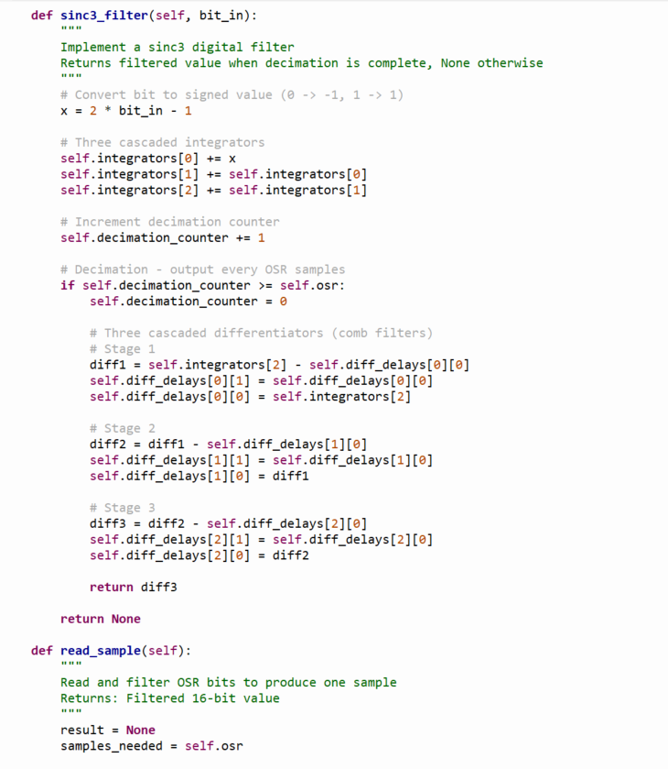
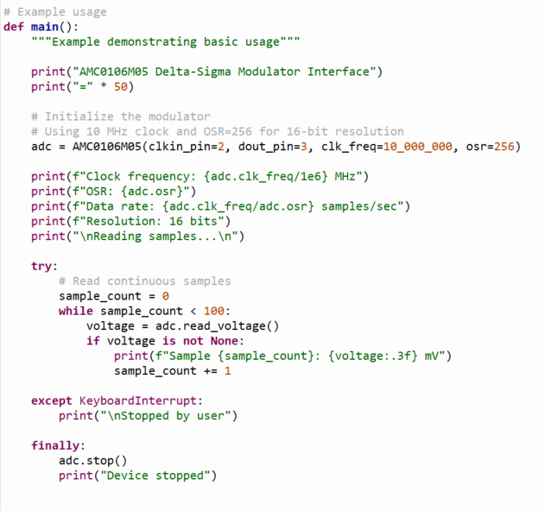
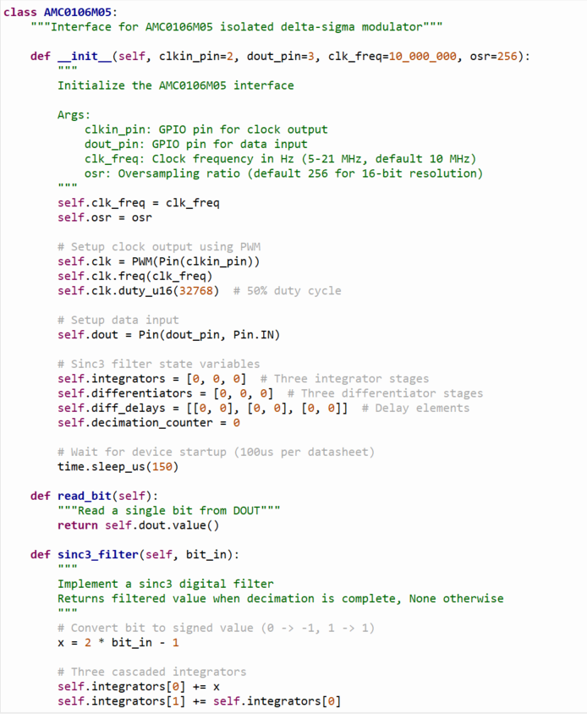
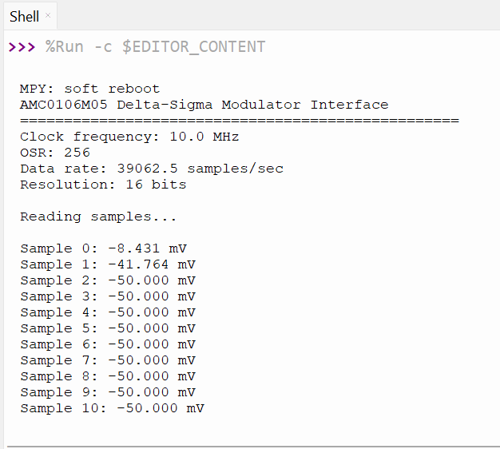
Programming interface for the ADC

Slide 15
Budget
Current Expenses :
DDS Test Board: $33
Component Order: $140
Battery Order: $44
Total: $217

Slide 16
Challenges so far
Space is extremely limited
How do we keep it under 100mm by 100mm?
Some components are hard to find

Slide 17
Immediate Plan
Assemble our breakouts
Tests subsections
Route laid out rooms to each other

Slide 18
Questions/Feedback

