Slide 1
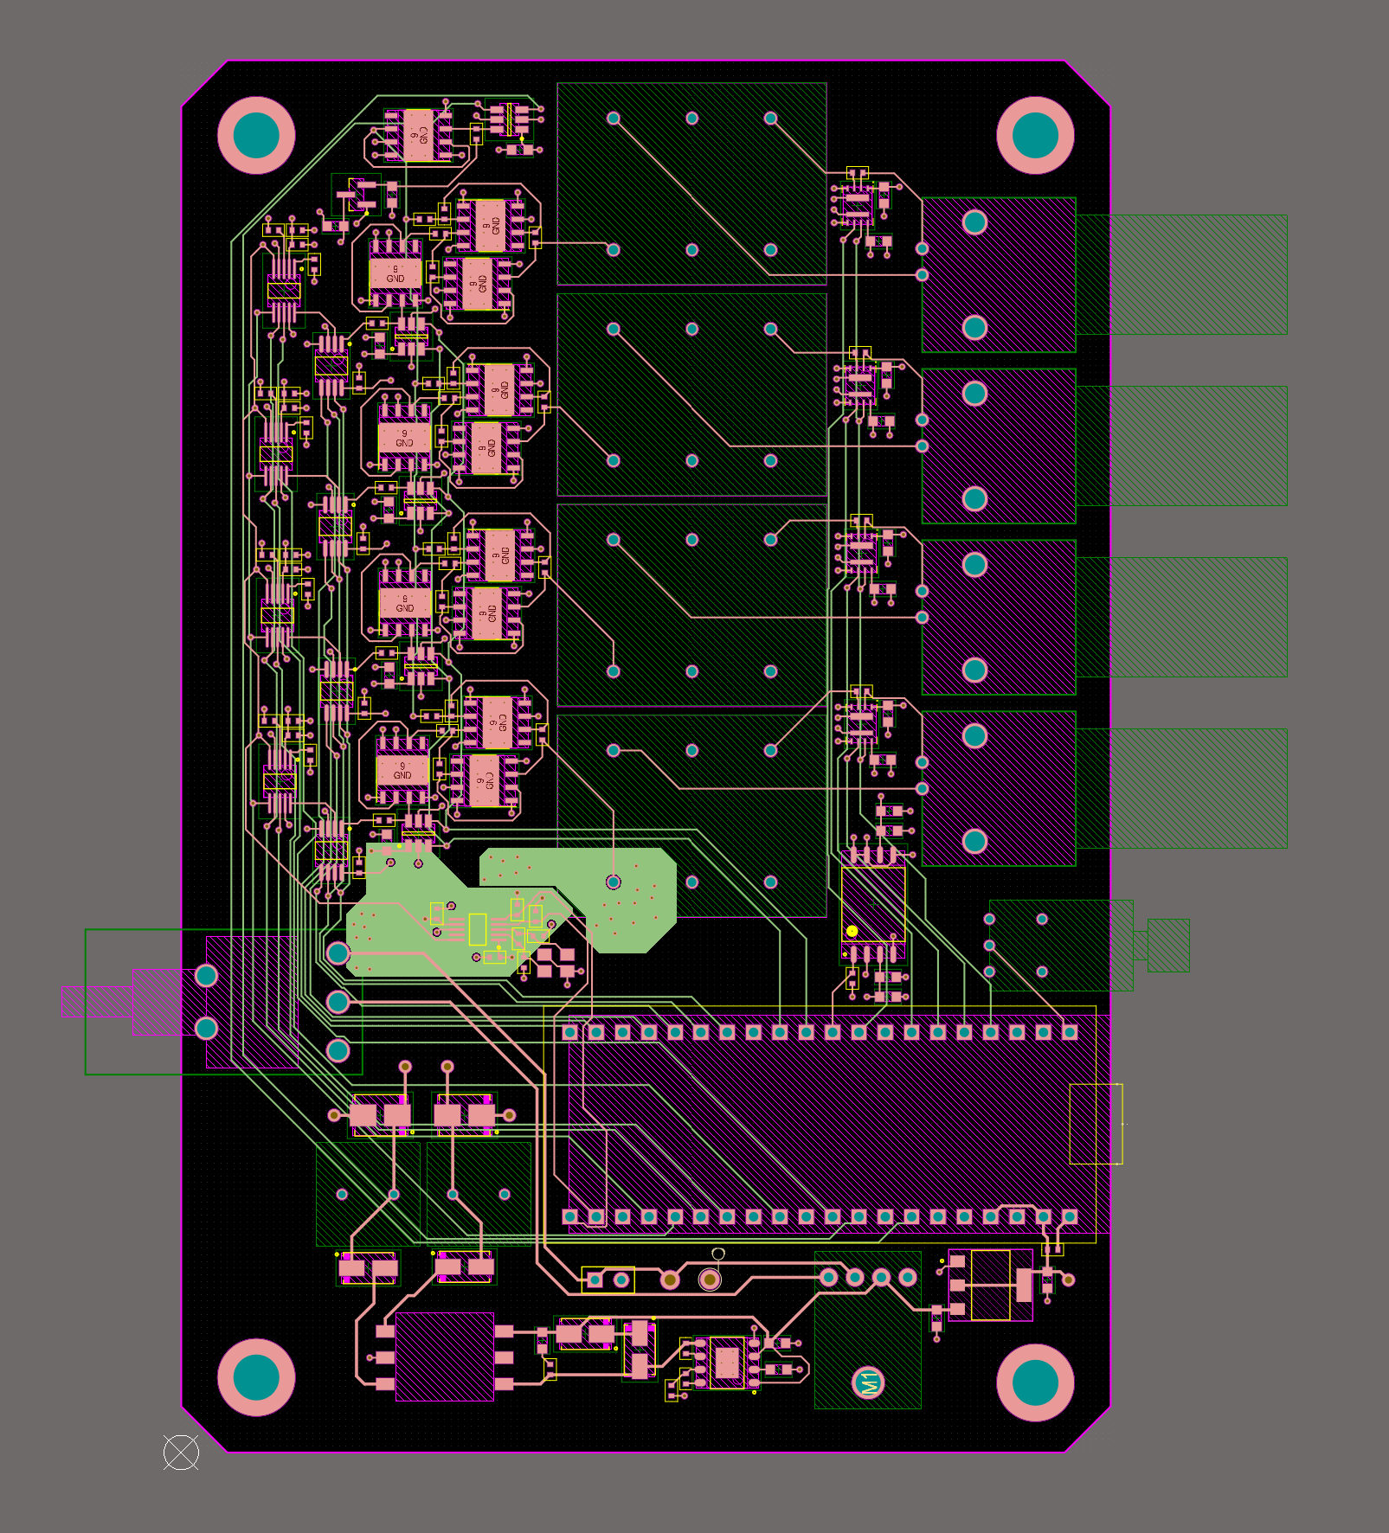
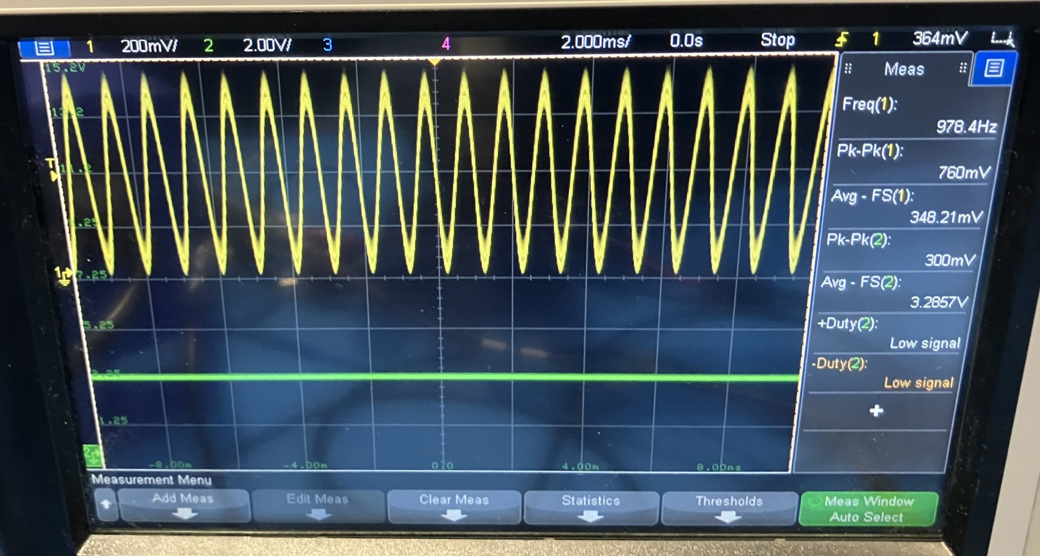
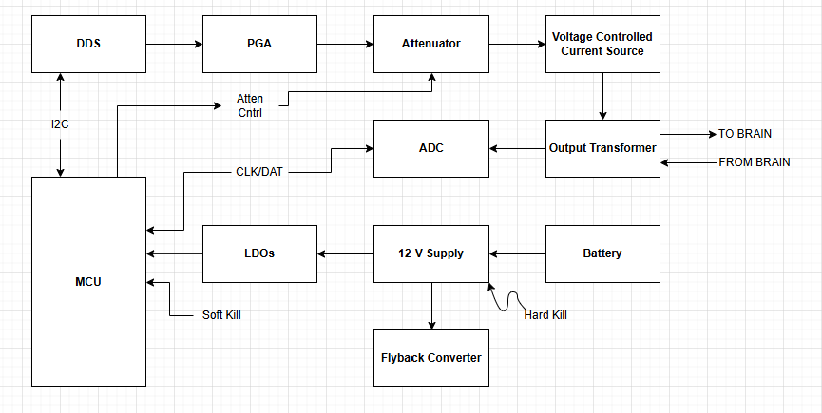
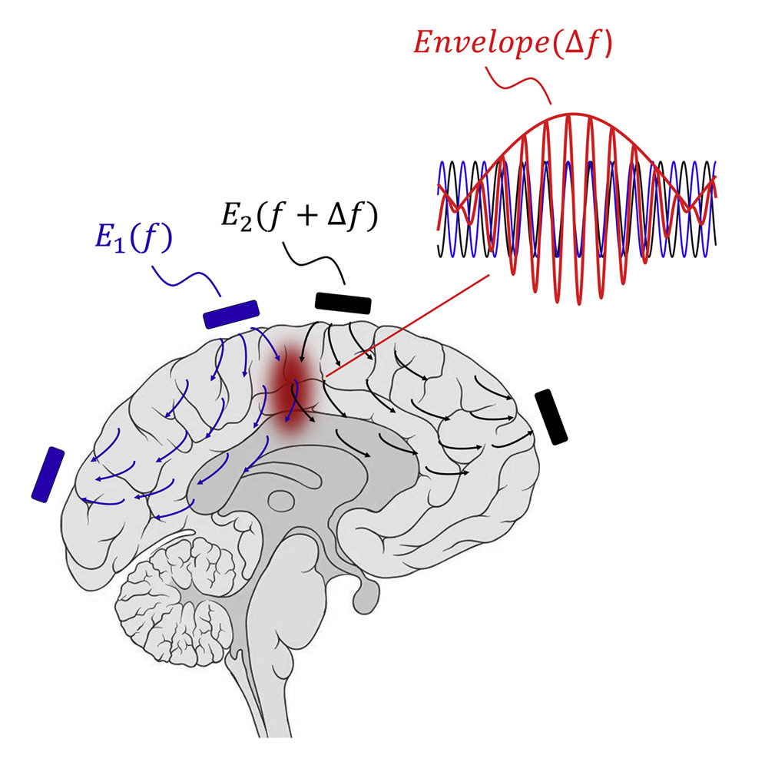
ECE 455
The Brain Stimulator
Samad Quryshi, Tyler White, Guandong Koang
ECE ???
<Team Name>
Background and Motivation
The Problem
Results
Deep brain stimulation (DBS) has emerged as a highly effective neuromodulation technique for treating several neurological disorders, most notably Parkinson’s disease, where it has significantly improved motor symptoms and quality of life for thousands of patients. Building on its clinical success, recent research has explored DBS as a potential therapy for severe opioid addiction, with early studies demonstrating promising outcomes in reducing cravings and supporting long-term recovery [1].
Existing stimulators are expensive and not portable
Participants in studies need to be blinded to whether they are being stimulated
Current research relies on brand proprietary components
We addressed these issues by making a portable, wireless brain stimulator that can be programmed remotely over Bluetooth and hides stimulation status from the user.
What went right?
DDS programmability verified
Isolated ADC feedback verified
Battery voltage and charging verified
Bluetooth functionality and web app verified
What caused issues?
Large current draw from +/-30 V boost converter
Insufficient current sourcing from 12 V boost converter
Isolated thermal concerns at larger currents
Summary:
We were unable to achieve full functionality, but are hopeful that tweaks to power supply circuitry will make the device function properly
Our Approach
Next Steps
Temporal Interface
Redo power circuitry
Make custom 12 V converter
Reduce size of +/- 30 V converter to draw less current
Update housing to hold battery charger
Add indicators to device
Two slightly different frequencies create a “beat frequency” at the difference of their frequencies
Using isolated loops and electrodes, can send higher frequency current oscillations along the surface of the head to create low frequency pulses deep in the brain [1]
References
Pipelined amplifier stages
Precise control using DDS
Ramp function to reduce pain
Transformer isolated four port output
Onboard battery
Feedback ADCs for current monitoring
[1] N. Grossman, et. al. “Noninvasive deep brain stimulation via temporally interfering electric fields,” Cell, vol. 169, no. 6, pp 1029-1041, June 1, 2017, doi: 10.1016/j.cell.2017.05.024.
ECE Capstone Open House 2024
Project done in conjunction with Joshua Brown, Professor of Psychological and Brain Sciences at Indiana University Bloomington

