Slide 1
Samad, Guandong, and Tyler
Brain Stimulator Progress Update

Slide 2
Problem Description
Make a device that can generate waveforms of precise frequency and current to stimulate deep parts of the brain using electrodes.

Slide 3
Key Events from Last Week
Bluetooth connectivity with between rpi and web app
Continued battery search
Work on web app – attempted SPI transfers
New LDO and routing everything to output transformer

Slide 4
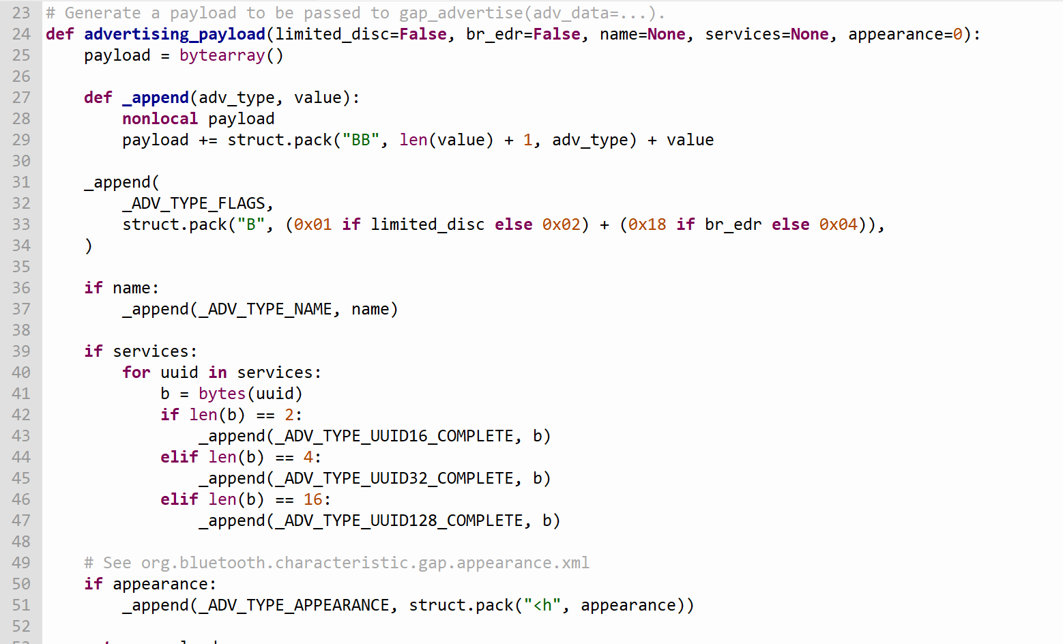
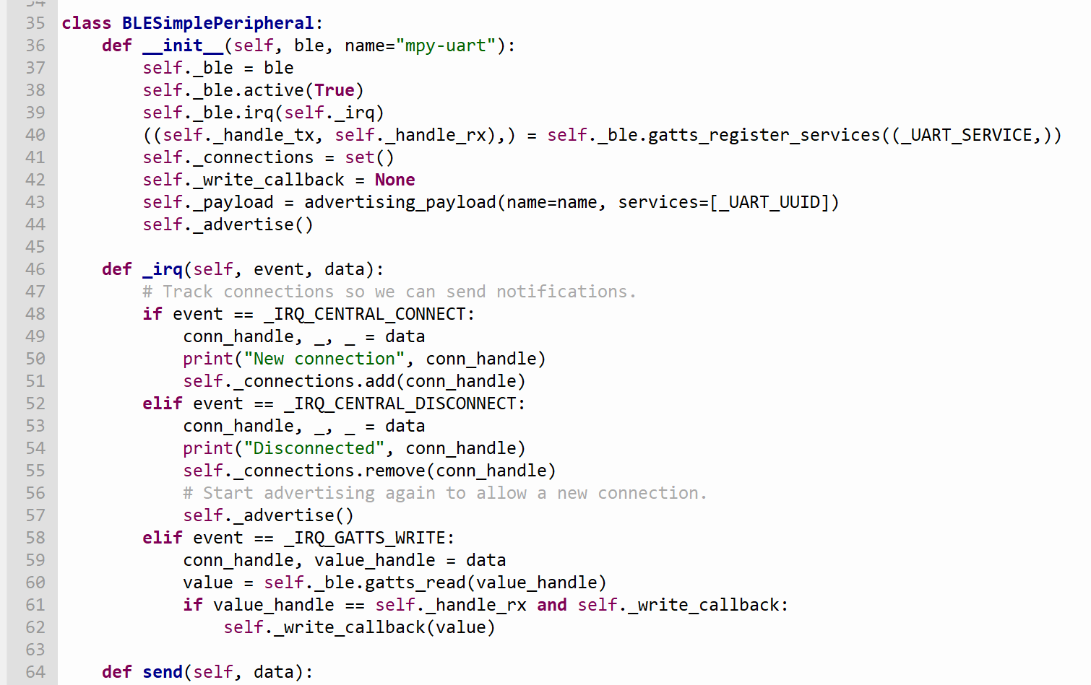
Bluetooth Connection to the MCU (Raspberry pi Pico W)
Save two MicroPython modules in our RPi Pico to communicate via Bluetooth Low Energy
Helpers for generating BLE advertising payloads
Creates a simple BLE peripheral
https://electrocredible.com/raspberry-pi-pico-w-bluetooth-ble-micropython/

Slide 5
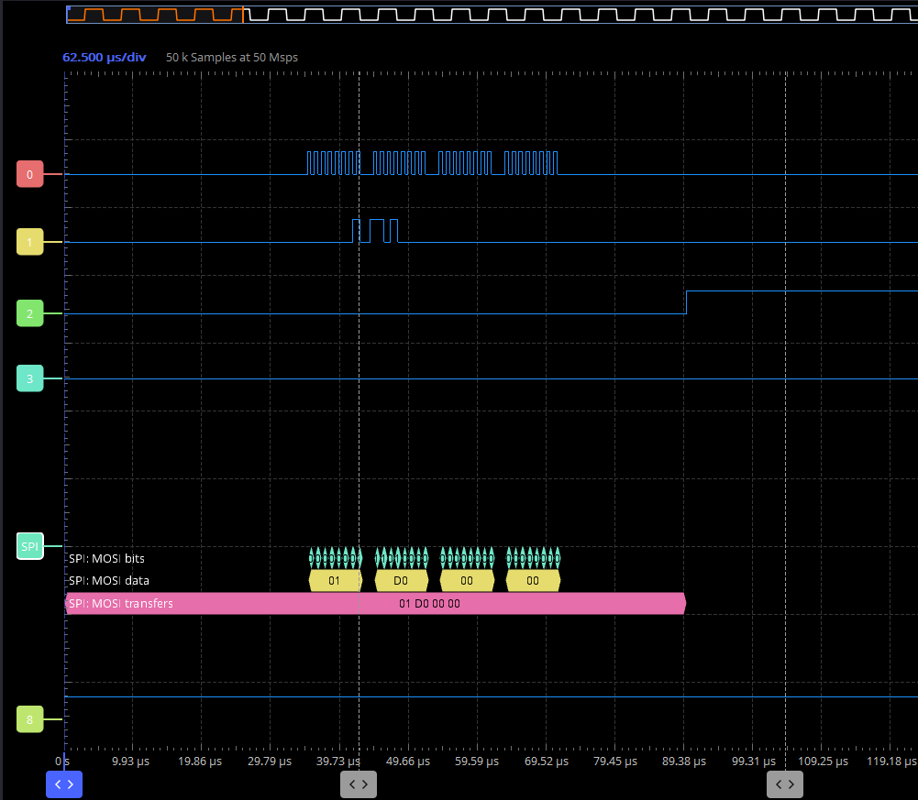
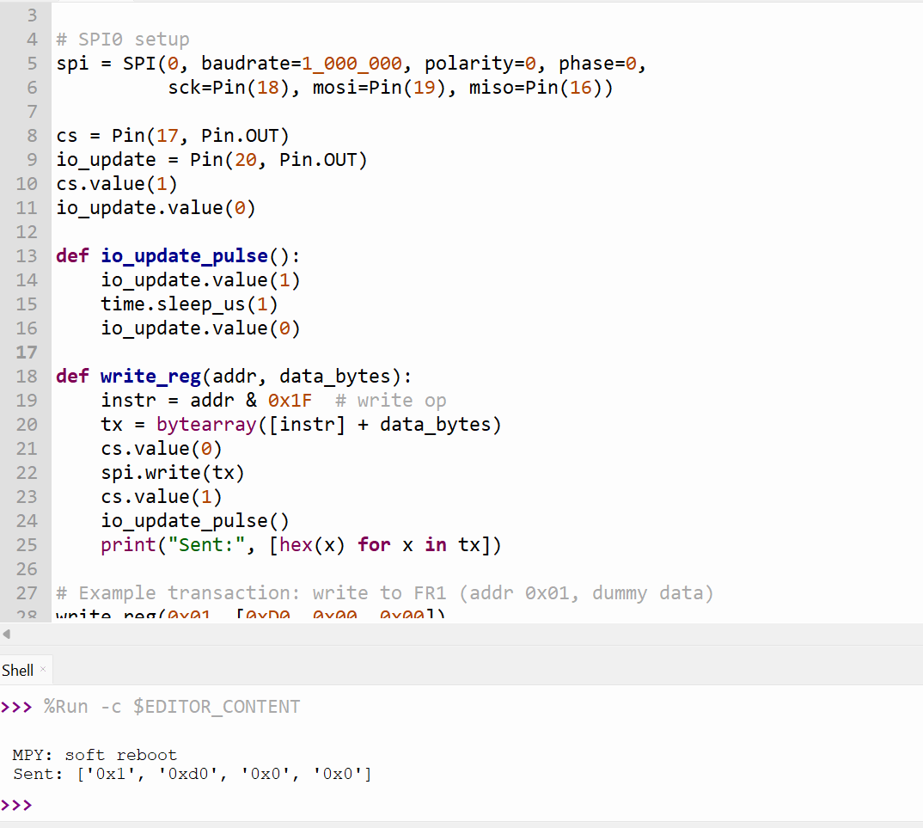
SPI Testing with The Raspberry PI
This simulates writing to a function register in the DDS
Waveform caught by oscilloscope
Next, we need to test it with DDS directly

Slide 6
Web App
Choosing browser based for best portability
Using webbluetooth with JS
Need room to expand easily to more channels

Slide 7
Web App
Enable/disable on outputs
Beat frequency calculation
Non-volatile programming capable (How to modify code? Constant address?)

Slide 8
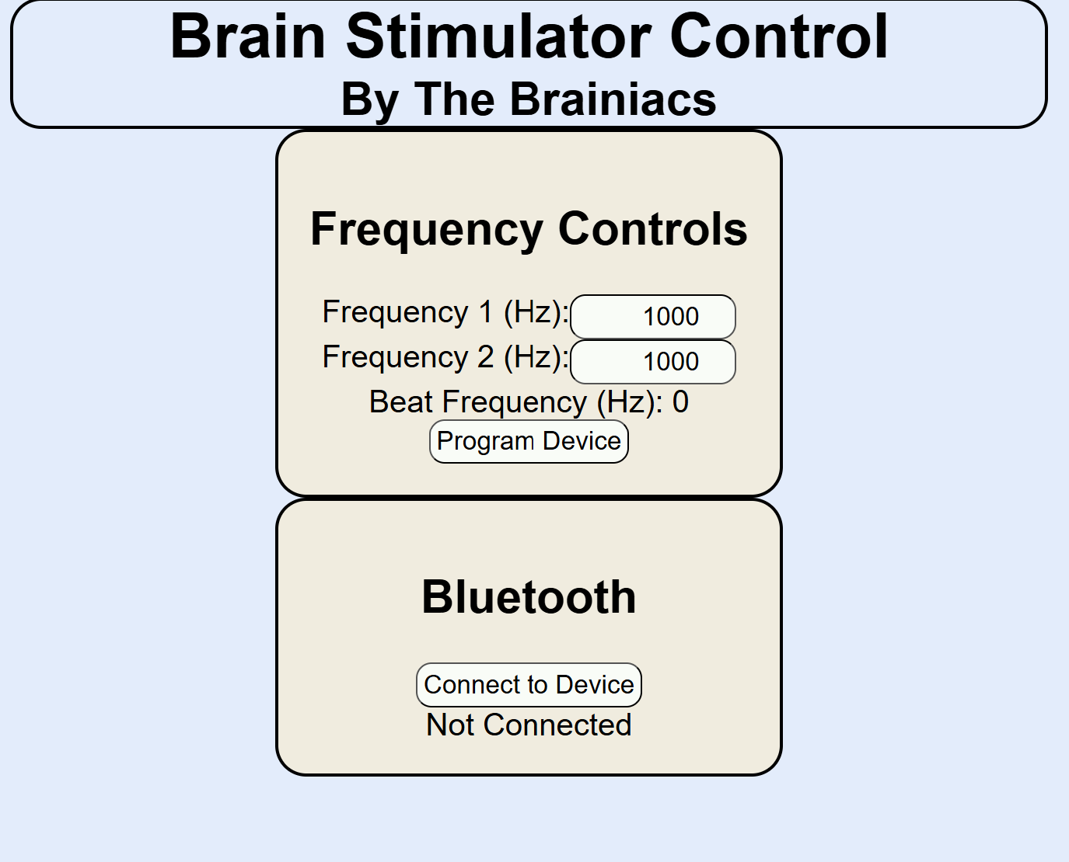
Web App Continued
(I <3 CSS)

Slide 9
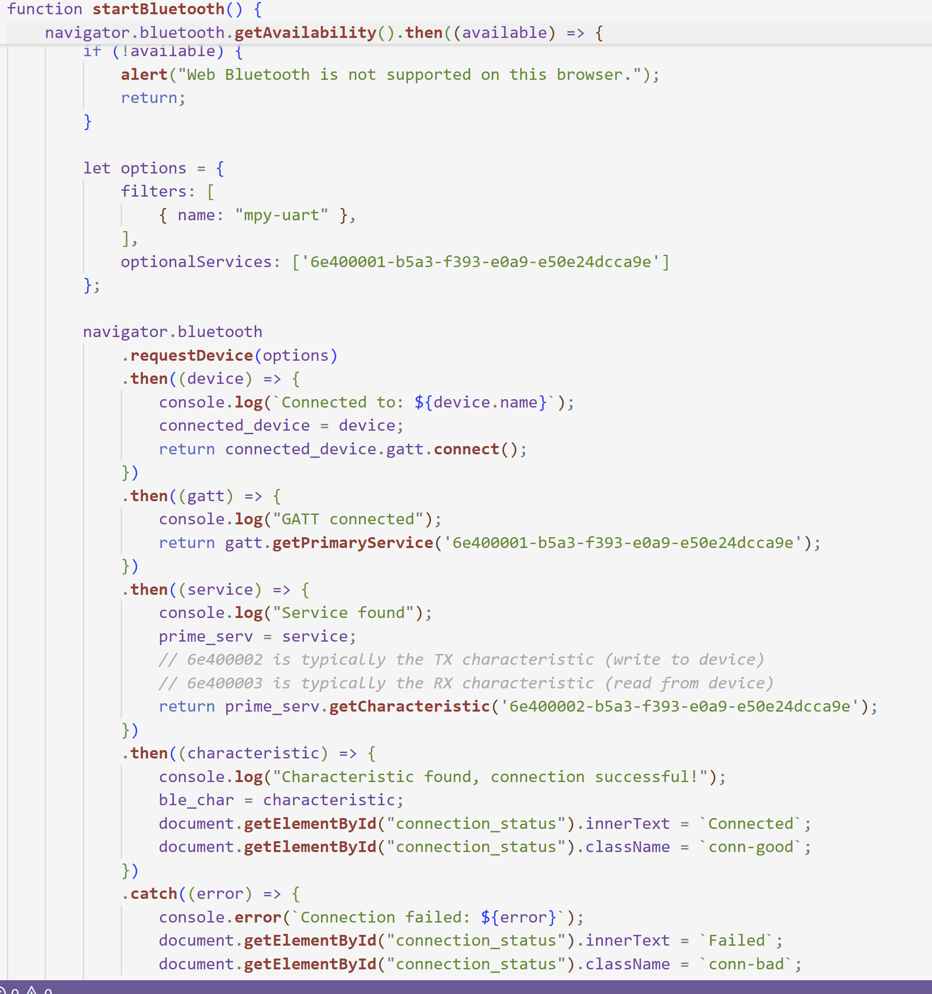
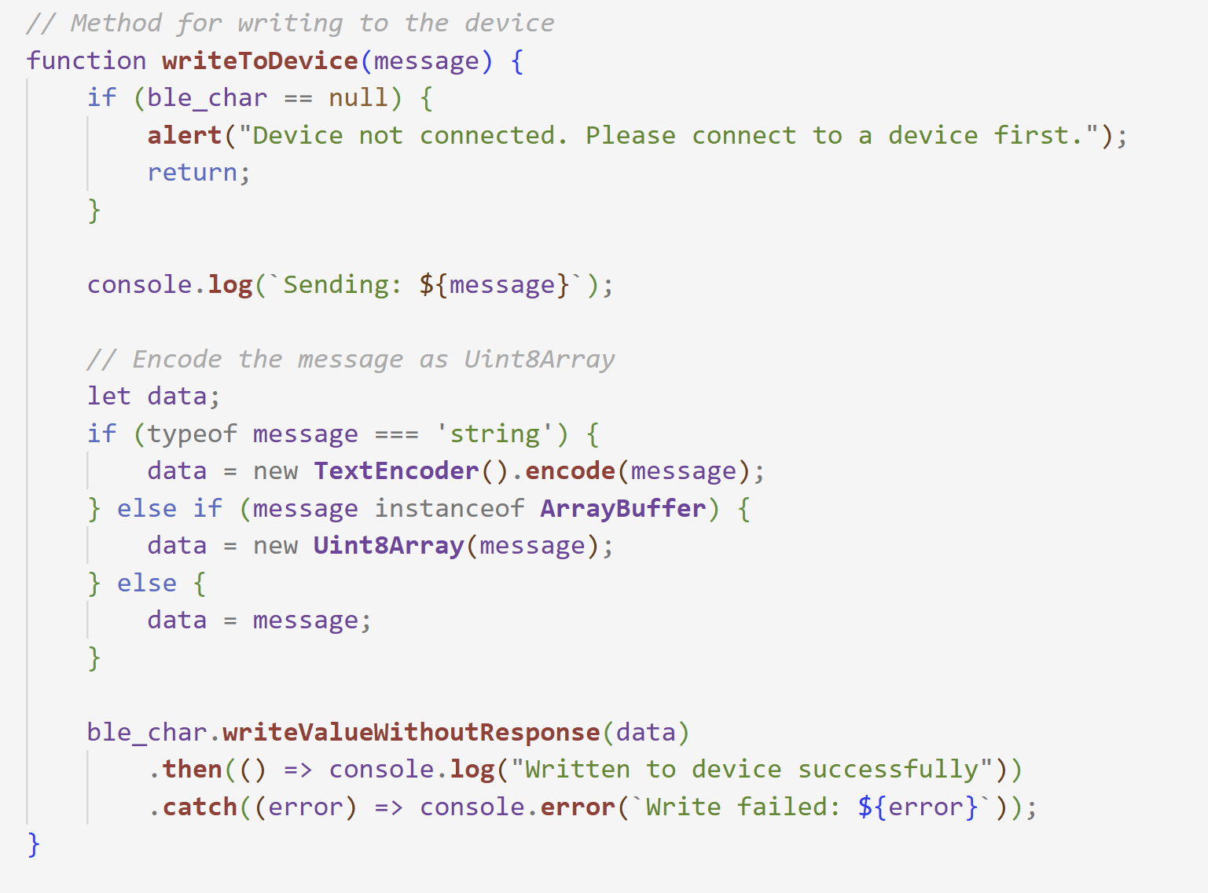
Web App Backend

Slide 10
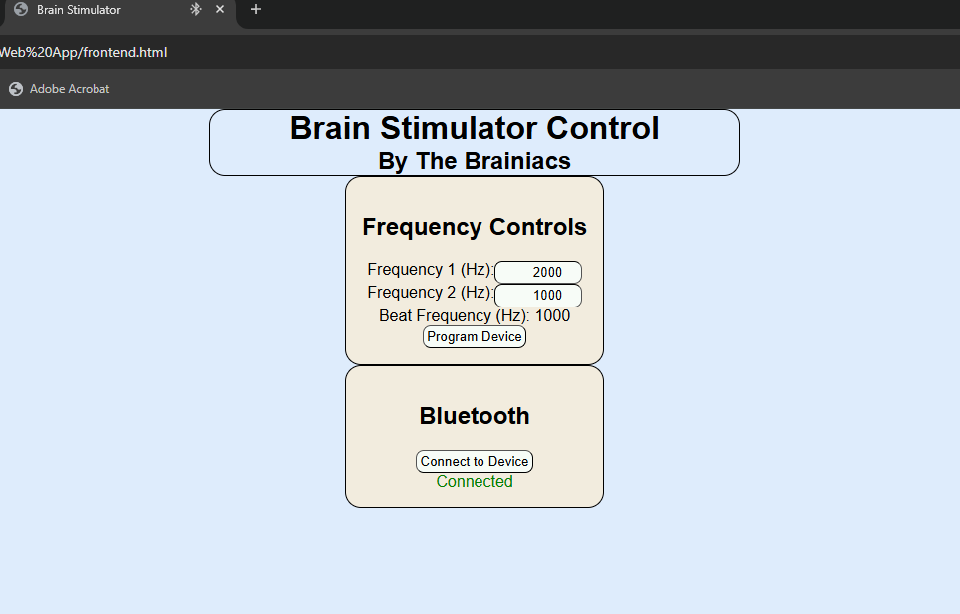
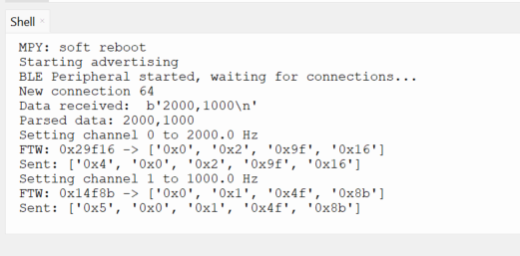
Writes to two channels

Slide 11
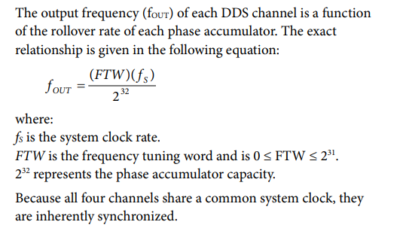
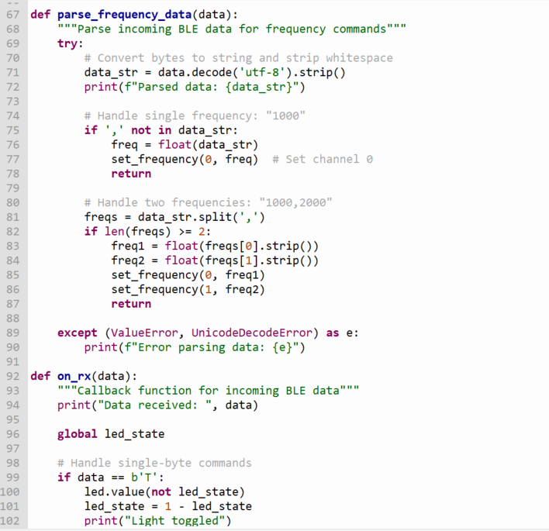
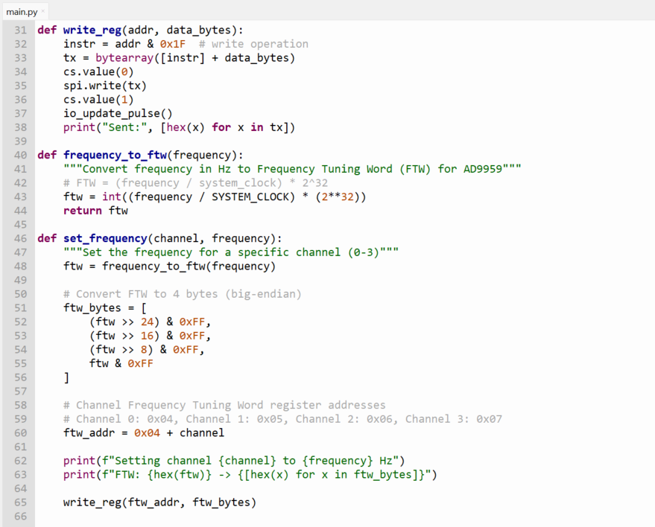
RPI Backend

Slide 12
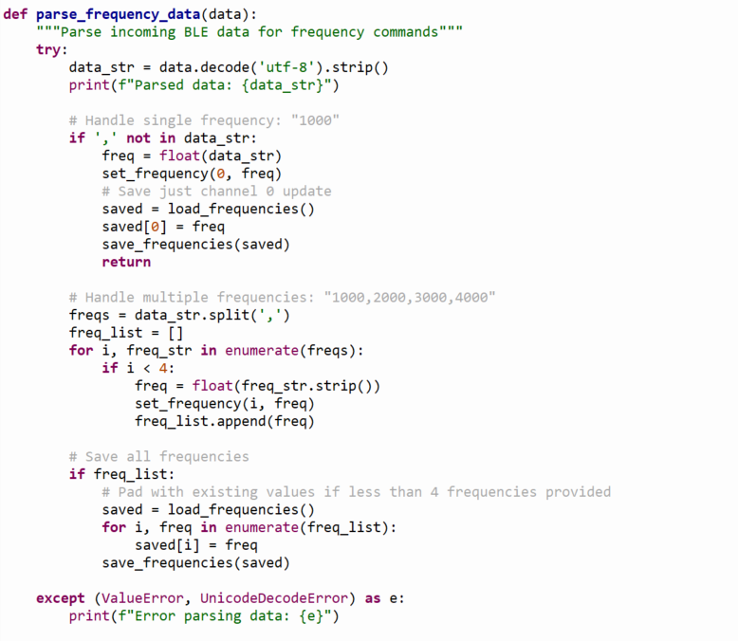
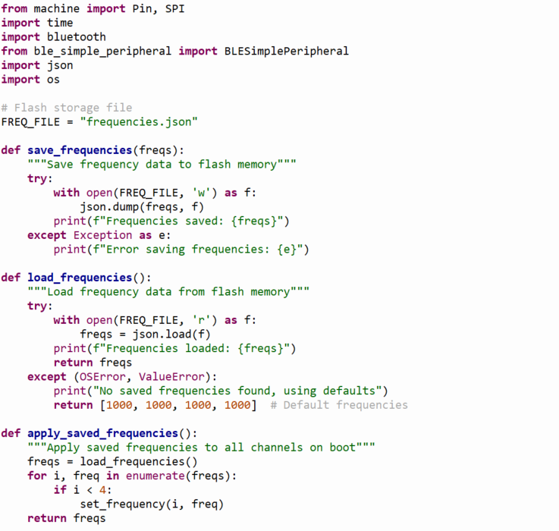
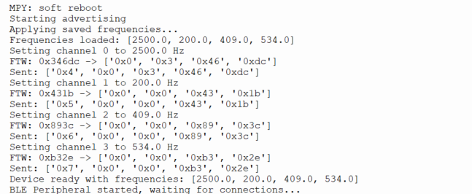
Flash memory to store last used frequencies

Slide 13
Plans for Battery
Calculate required amp hours to narrow search
Find something with integrated BMS
Use dimensions to make housing and board dimensions

Slide 14
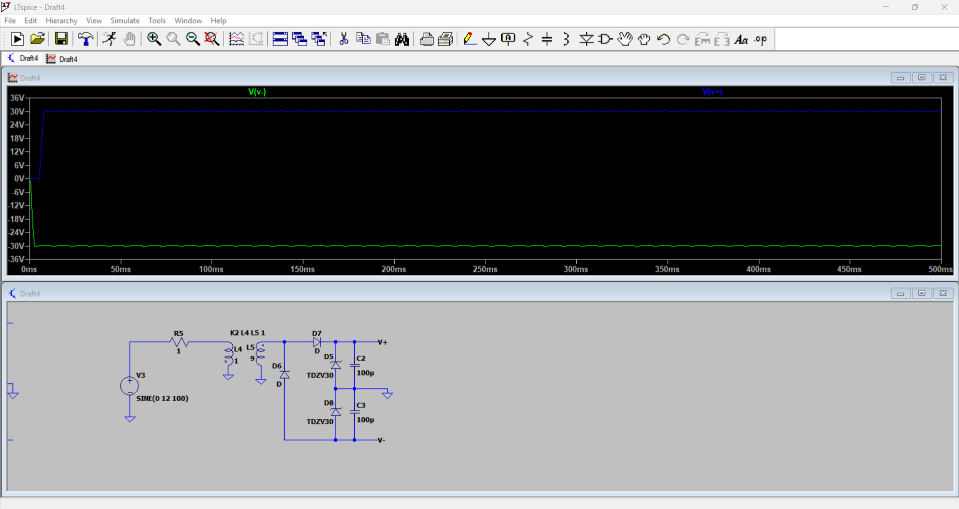
Simulation

Slide 15
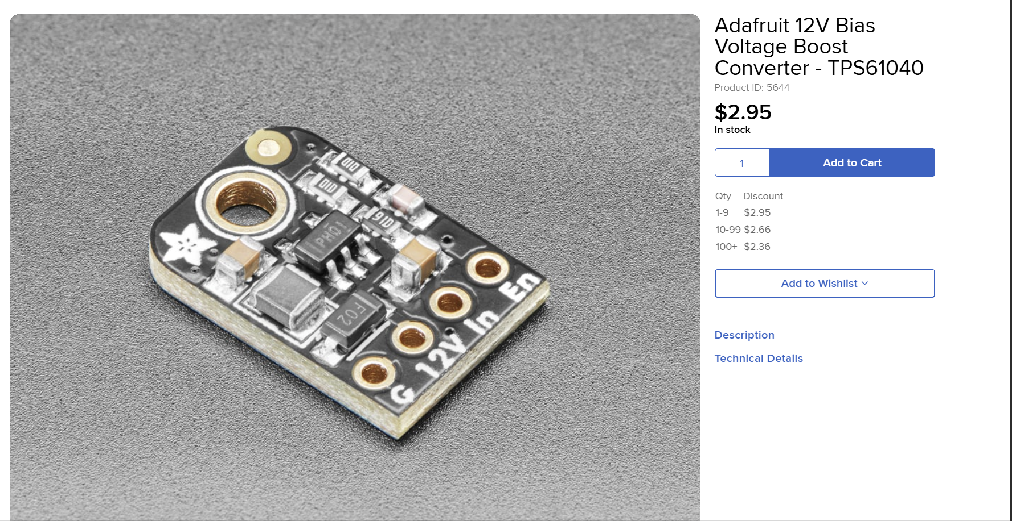
DC-DC Converter

Slide 16
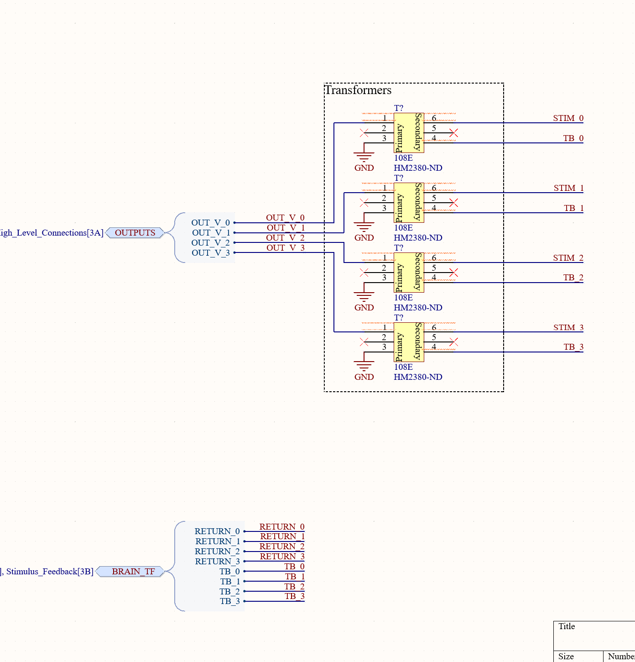
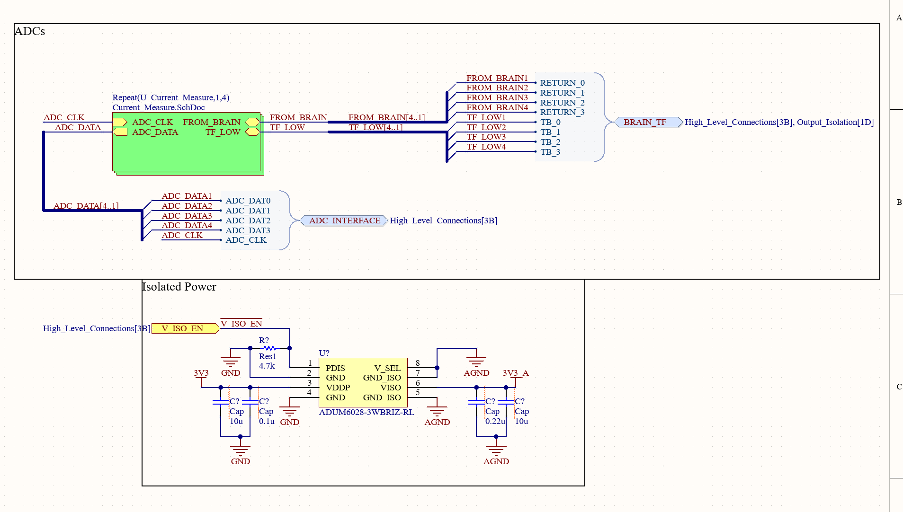
Schematic Updates

Slide 17
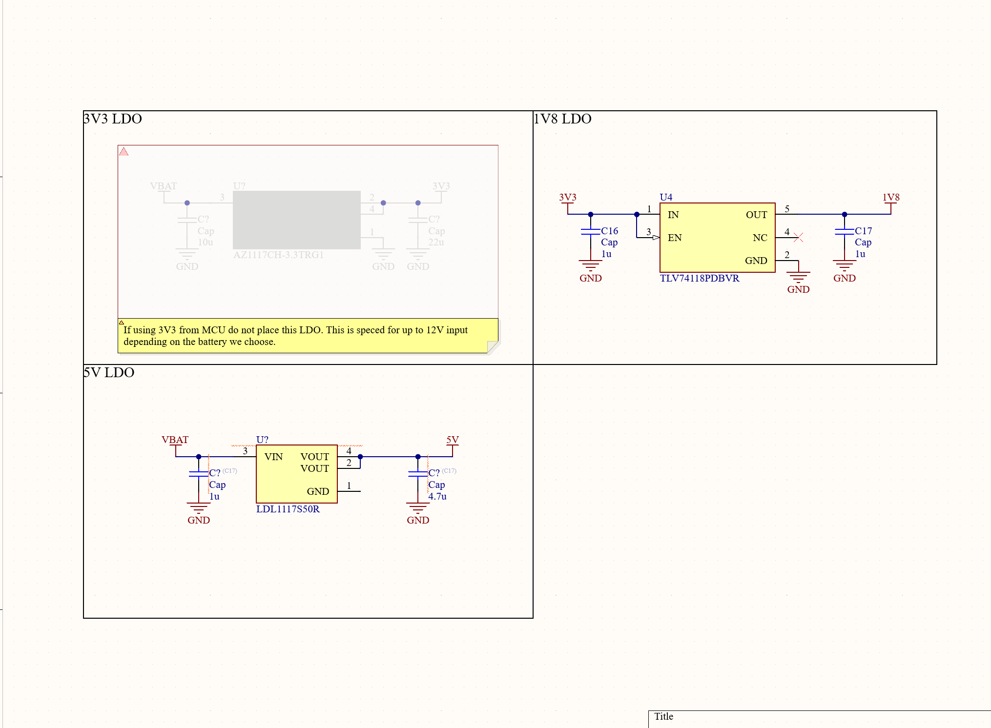
Schematic Updates Continued

Slide 18
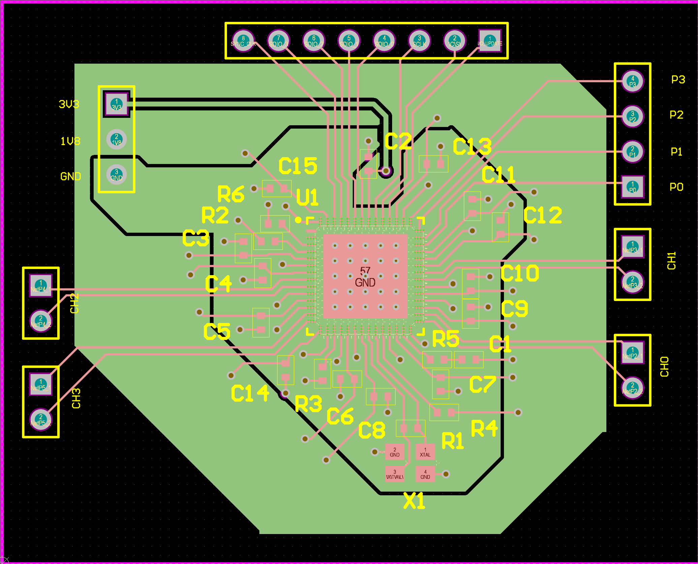
DDS Test Board
For SPI and programming – Doesn’t blow up!

Slide 19
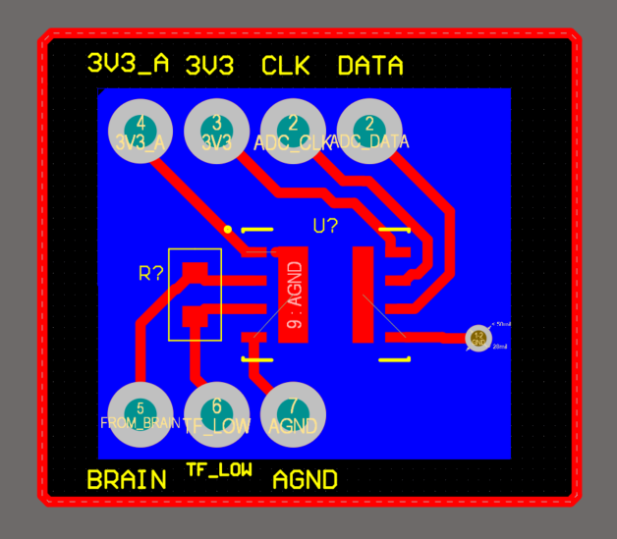
ADC Breakout board
Needs to be ordered and tested

Slide 20
DDS Board Testing
Connected DDS to RPI and attempted to initiate SPI transactions. Have so far been unable to see the transactions output on the designated SPI lines. Have not diagnosed the problem.

Slide 21
Challenges so far
Height limit with isolation transformers
Amplifier sourcing/creation
DDS Verificaiton

Slide 22
Immediate Plan
Continue schematic and symbol creation
Find battery for device
Determine board measurements for housing
DDS Validation

Slide 23
Questions/Feedback

