Slide 1
Samad, Guandong, and Tyler
Brain Stimulator Progress Update

Slide 2
Problem Description
Make a device that can generate waveforms of precise frequency and current to stimulate deep parts of the brain using electrodes.

Slide 3
Key Events from Last Week
Battery came in (And tested?)
Lots of boards
DDS Verification (☹)
Change of direction for output generation

Slide 4
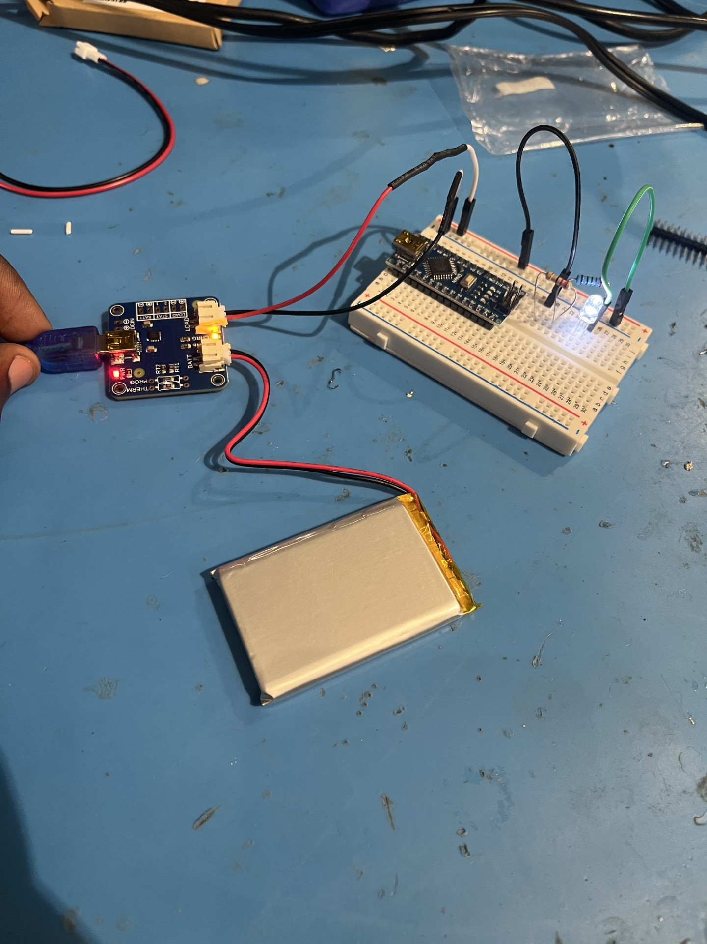
Battery Updates

Slide 5
Flyback Updates

Slide 6
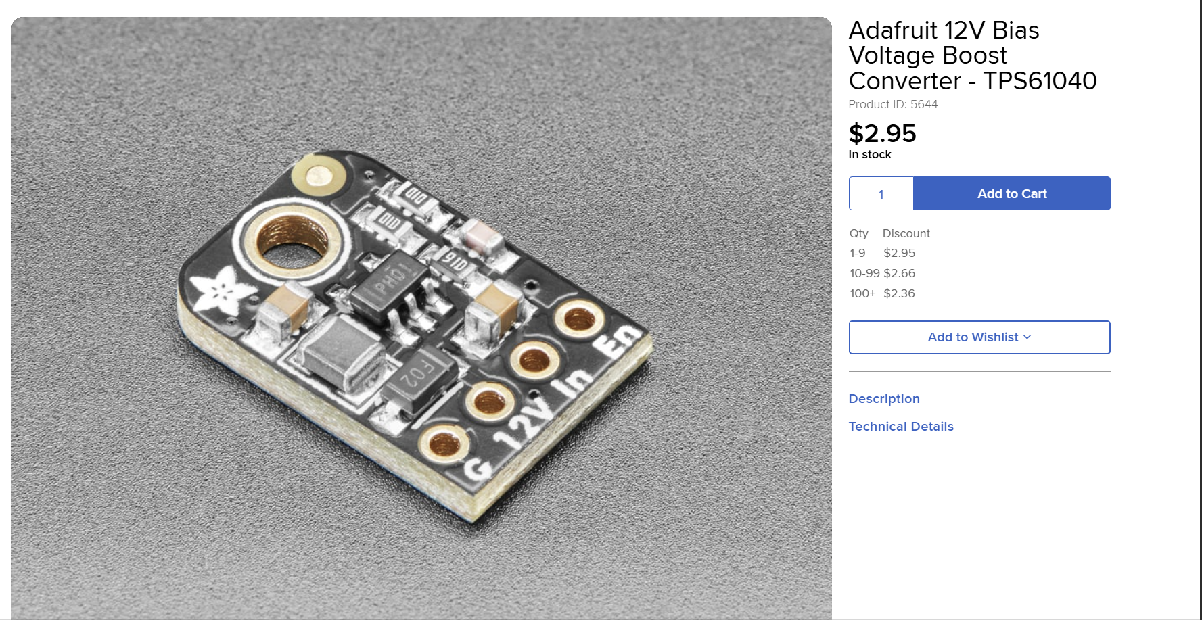
DC-DC Converter

Slide 7
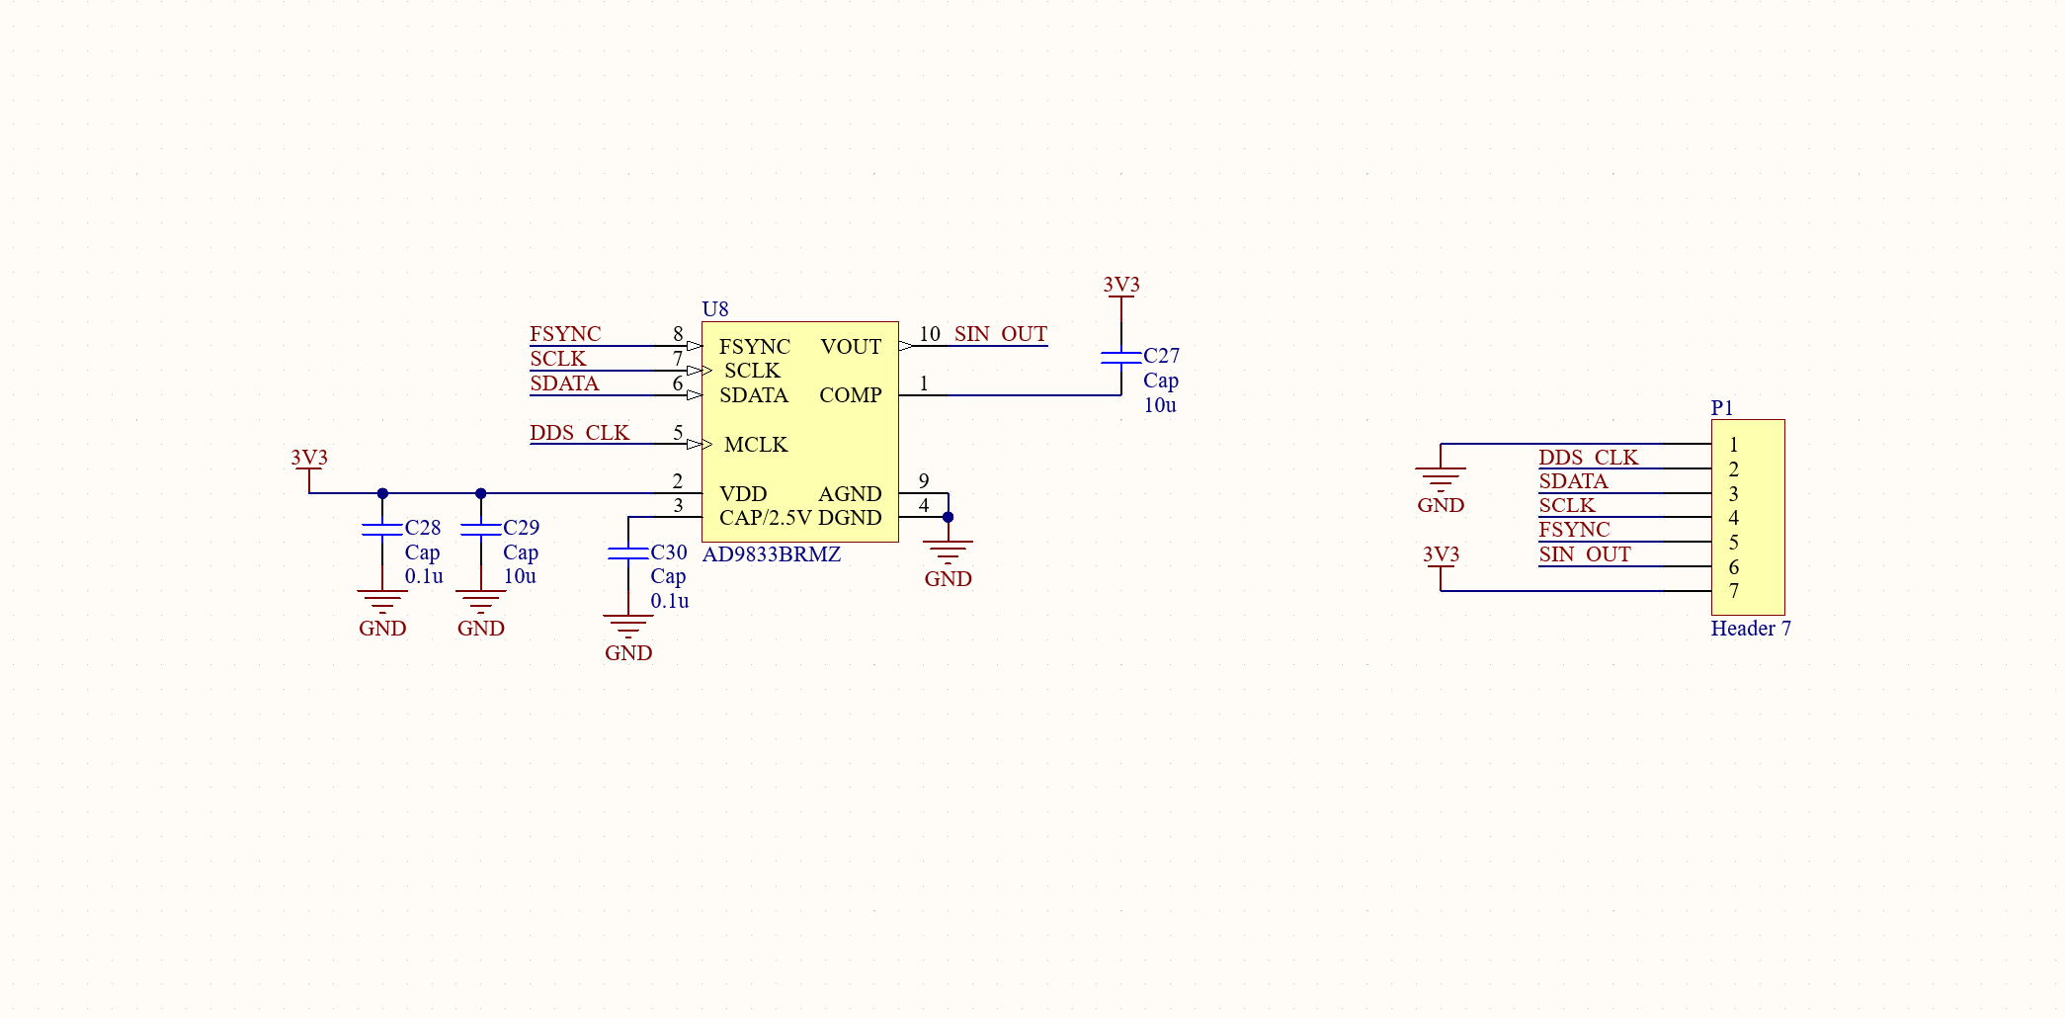
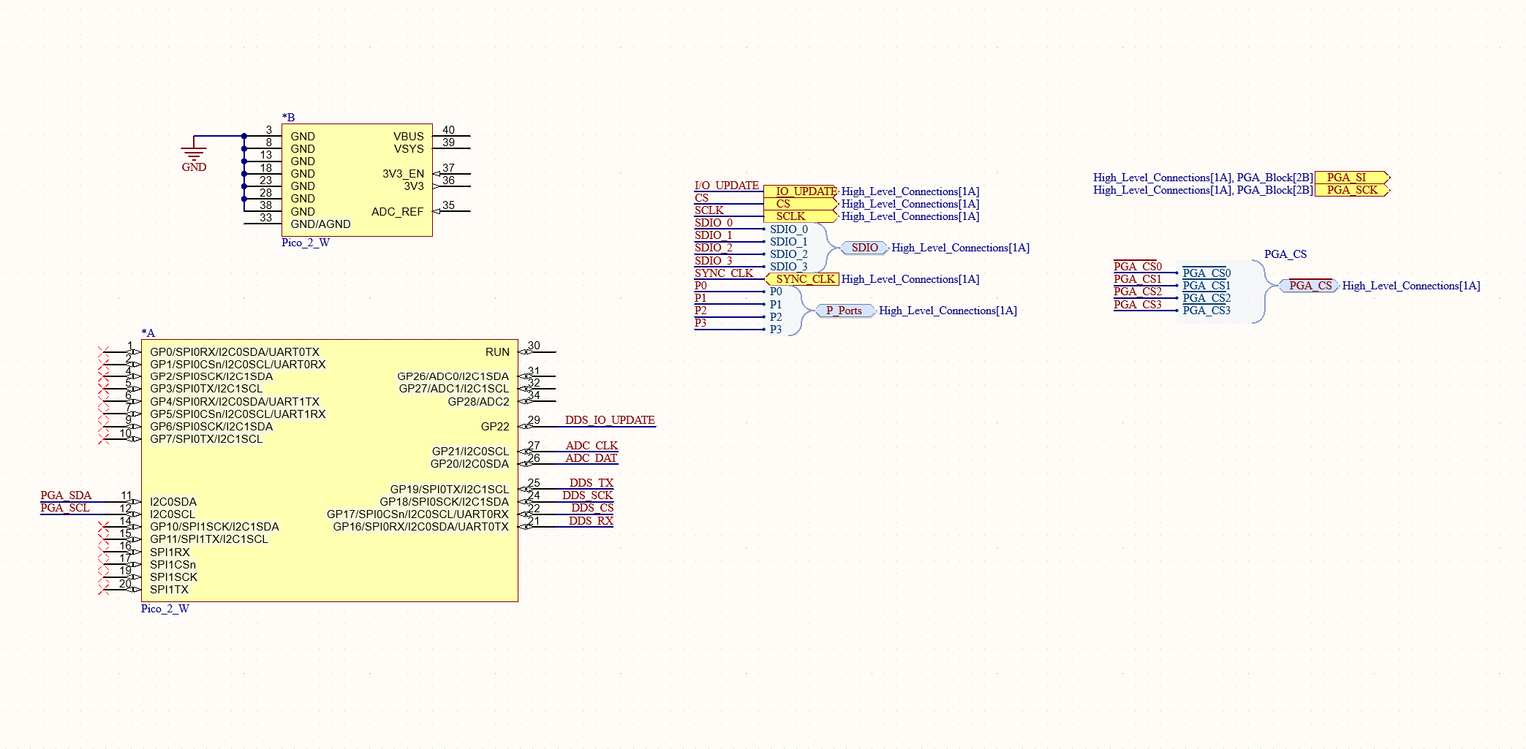
Schematic Updates

Slide 8
Revised Breakout Board
What went wrong?
Order of power-up not controlled
Crystal not oscillating
Pulling 50mA current (Not terrible, but where is it going?)

Slide 9
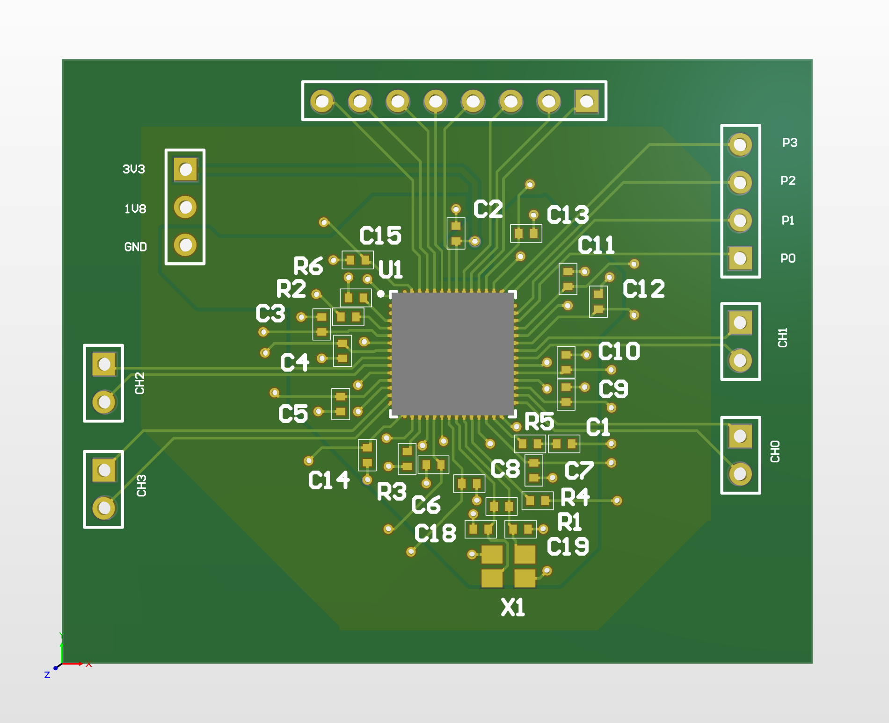
Revised Breakout Board Layout

Slide 10
ADC Breakout Board
Test isolated power rail
Ensure accurate readings given current
Work on software support for ADC
Feedback loop for output current

Slide 11
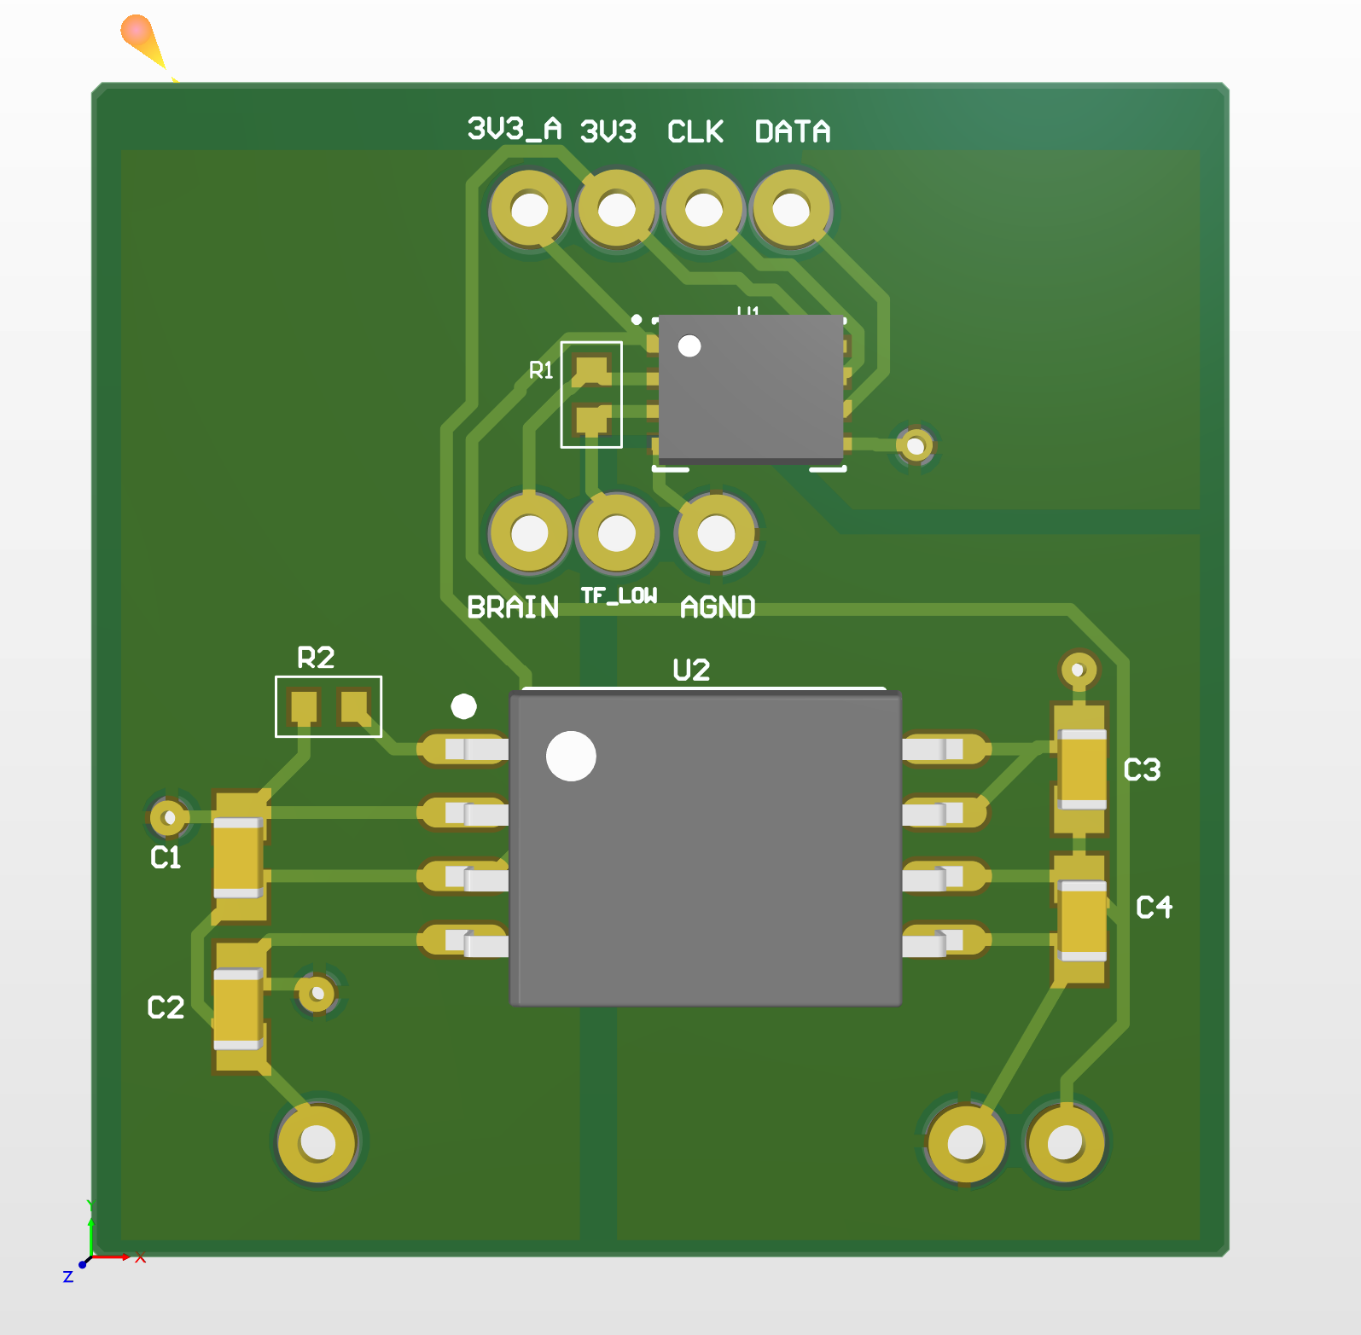
ADC Breakout board Layout

Slide 12
Switch to Four Small DDS
Big DDS great in theory because it has a lot of features, bad in practice because it has a lot of features (over-speced)
Smaller DDS have more voltage focus
DDS are expensive, but reduce load on the MCU

Slide 13
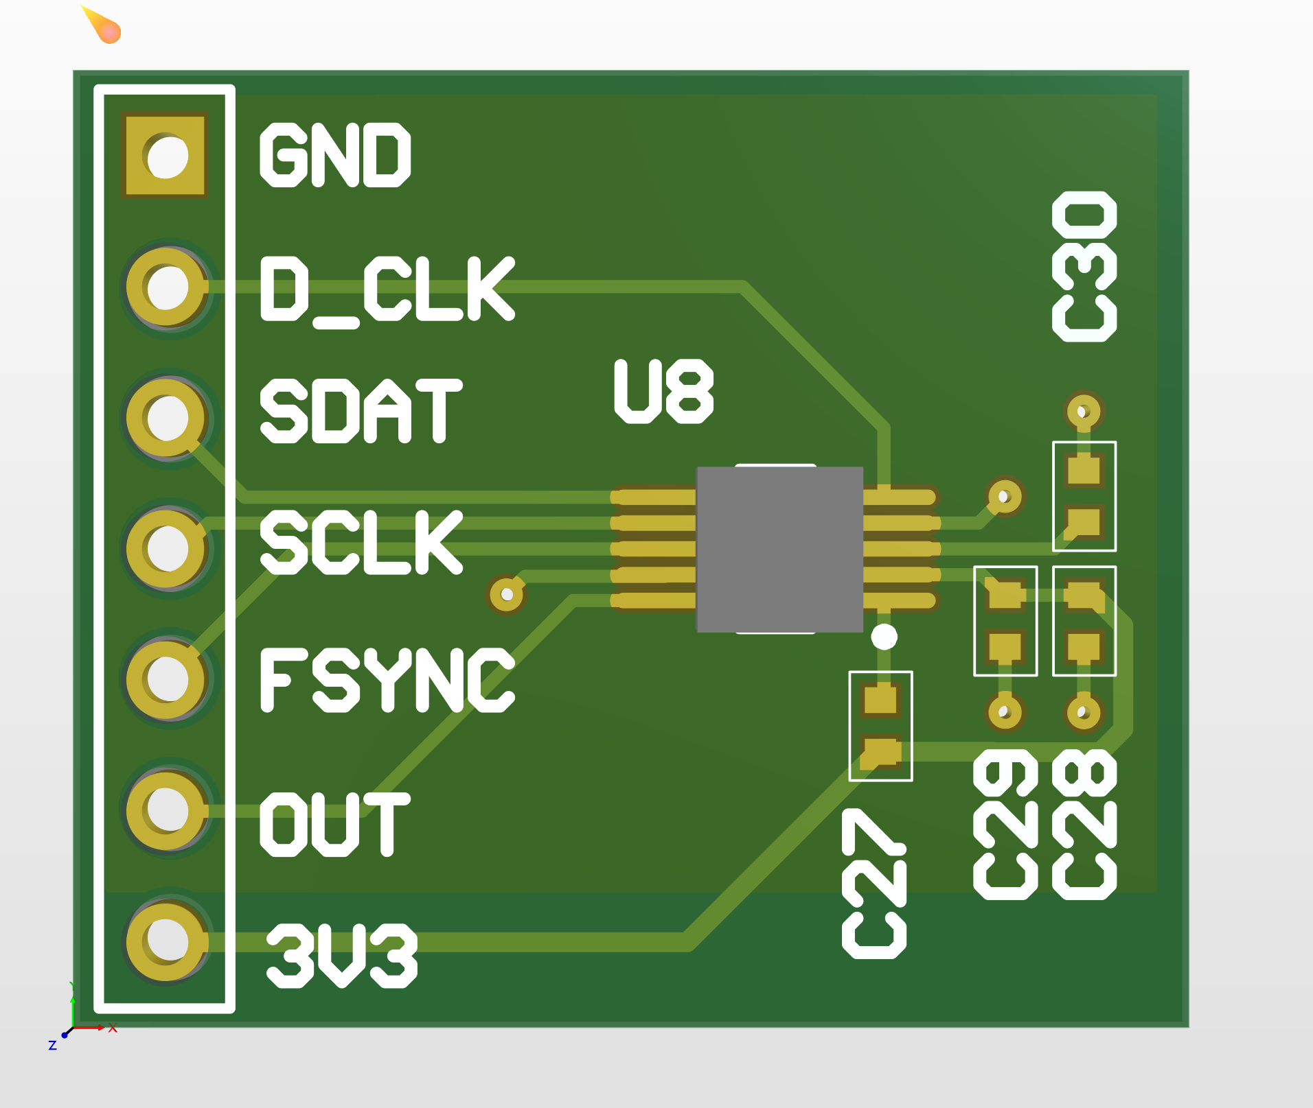
DDS Breakout Board

Slide 14
Budget
Current Expenses :
DDS Test Board: $33
Component Order: $140
Battery Order: $44
Total: $217

Slide 15
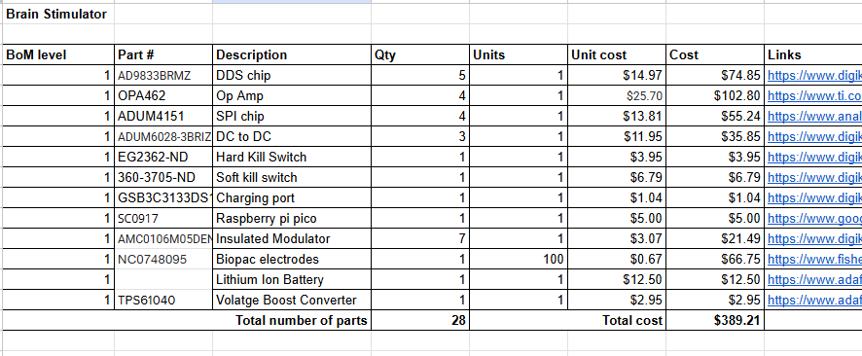
Updated BOM

Slide 16
Challenges so far
Space is extremely limited
Some components are hard to find

Slide 17
Immediate Plan
Layout completed rooms
Get flyback stuff working
Battery
ADC software

Slide 18
Questions/Feedback

