Slide 1
Zephyr: A State-Based, Event-Driven, Domain-Specific Language for 2D, Top-Down, Action Role-Playing Games
Tyler Wolverton
Thesis Defense

Slide 2
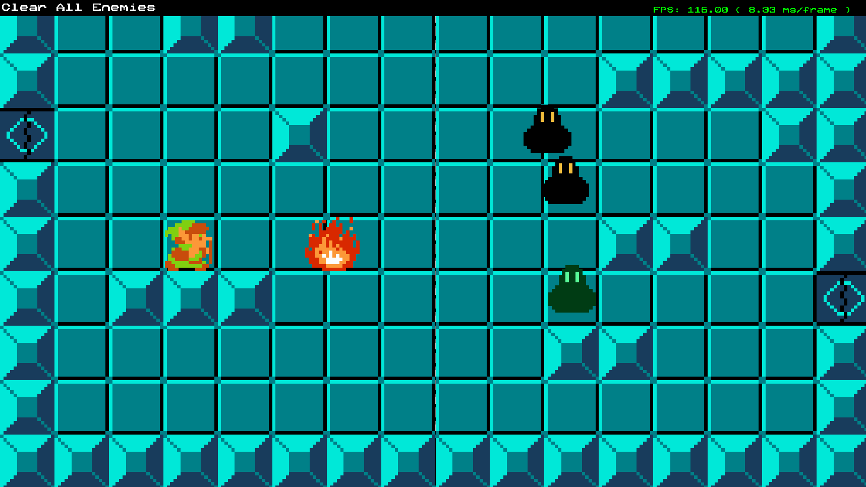
Introduction
Introduction
Scope
Schedule
Theory
Previous Work
Artifact
Implementation
Architecture
Syntax
Playtest Results
Profiling Results
Bibliography
Zephyr is a domain-specific language that defines state machines that can listen to and fire events to interact with a custom C++ game engine.
Source scripts are compiled into bytecode at game startup and interpreted by a virtual machine (VM) at runtime.
The language is demonstrated with a 2D action role-playing game (RPG) similar to The Legend of Zelda (NES).

Slide 3
Scope
Introduction
Scope
Schedule
Theory
Previous Work
Artifact
Implementation
Architecture
Syntax
Playtest Results
Profiling Results
Bibliography

Slide 4
Schedule
Introduction
Scope
Schedule
Theory
Previous Work
Artifact
Implementation
Architecture
Syntax
Playtest Results
Profiling Results
Bibliography

Slide 5
Theory
Introduction
Scope
Schedule
Theory
Previous Work
Artifact
Implementation
Architecture
Syntax
Playtest Results
Profiling Results
Bibliography

Slide 6
Previous Work
Introduction
Scope
Schedule
Theory
Previous Work
Artifact
Implementation
Architecture
Syntax
Playtest Results
Profiling Results
Bibliography

Slide 7
Artifact
Introduction
Scope
Schedule
Theory
Previous Work
Artifact
Implementation
Architecture
Syntax
Playtest Results
Profiling Results
Bibliography

Slide 8
Implementation
Introduction
Scope
Schedule
Theory
Previous Work
Artifact
Implementation
Architecture
Syntax
Playtest Results
Profiling Results
Bibliography

Slide 9
Architecture
Introduction
Scope
Schedule
Theory
Previous Work
Artifact
Implementation
Architecture
Syntax
Playtest Results
Profiling Results
Bibliography

Slide 10
Syntax
Introduction
Scope
Schedule
Theory
Previous Work
Artifact
Implementation
Architecture
Syntax
Playtest Results
Profiling Results
Bibliography

Slide 11
Playtest Results
Introduction
Scope
Schedule
Theory
Previous Work
Artifact
Implementation
Architecture
Syntax
Playtest Results
Profiling Results
Bibliography

Slide 12
Profiling Results
Introduction
Scope
Schedule
Theory
Previous Work
Artifact
Implementation
Architecture
Syntax
Playtest Results
Profiling Results
Bibliography

Slide 13
Bibliography
Introduction
Scope
Schedule
Theory
Previous Work
Artifact
Implementation
Architecture
Syntax
Playtest Results
Profiling Results
Bibliography

