Slide 1
Zephyr: A State-Based, Event-Driven, Domain-Specific Language for 2D, Top-Down, Action Role-Playing Games
Tyler Wolverton
Thesis Defense

Slide 2
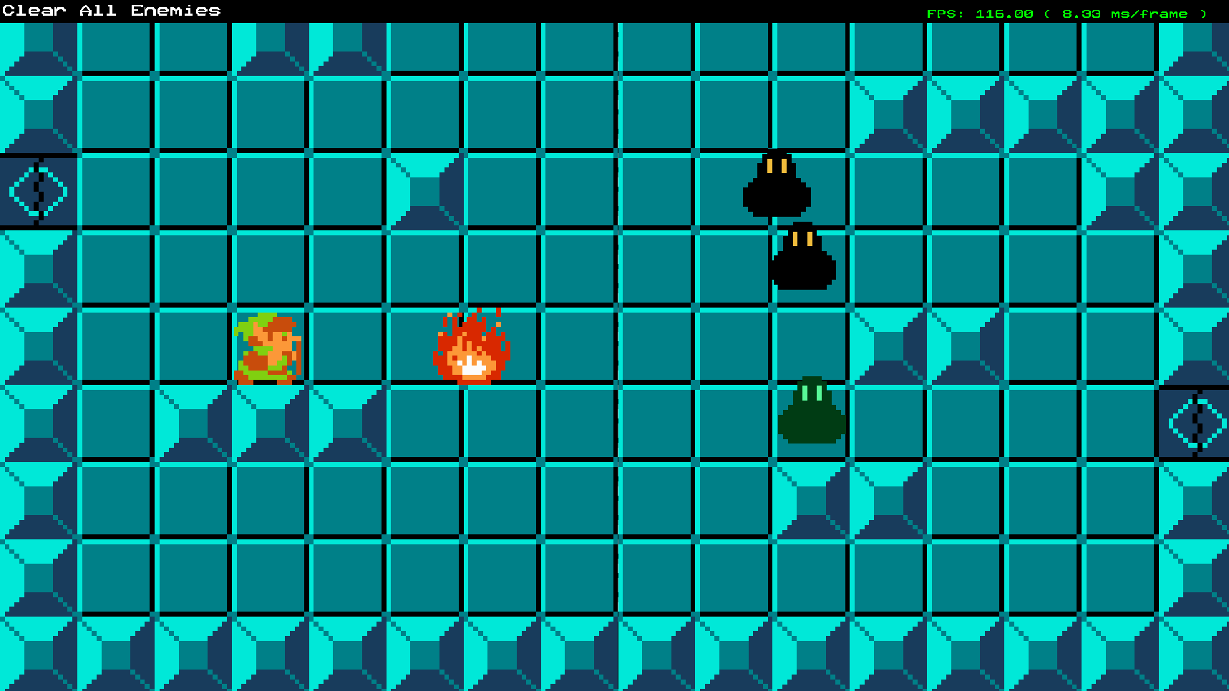
Introduction
Introduction
Scope
Schedule
Theory
Previous Work
Artifact
Implementation
Architecture
Syntax
User Feedback
Profiling Results
Bibliography
Zephyr is a domain-specific language that defines state machines that can listen to and fire events to interact with a custom C++ game engine.
Source scripts are compiled into bytecode at game startup and interpreted by a virtual machine (VM) at runtime.
The language is demonstrated with a 2D action role-playing game (RPG) similar to The Legend of Zelda (NES).

Slide 3
Scope
Introduction
Scope
Schedule
Theory
Previous Work
Artifact
Implementation
Architecture
Syntax
User Feedback
Profiling Results
Bibliography

Slide 4
Schedule
Introduction
Scope
Schedule
Theory
Previous Work
Artifact
Implementation
Architecture
Syntax
User Feedback
Profiling Results
Bibliography

Slide 5
Theory
Introduction
Scope
Schedule
Theory
Previous Work
Artifact
Implementation
Architecture
Syntax
User Feedback
Profiling Results
Bibliography

Slide 6
Genre
Introduction
Scope
Schedule
Theory
Previous Work
Artifact
Implementation
Architecture
Syntax
User Feedback
Profiling Results
Bibliography
Action RPG systems can be defined in data easily [1].
Common functionality includes enemies, dialogue with NPCs, and interactable environment objects.
The Legend of Zelda and Dungeon Explorer were used to identify common functionality within the genre [2][3].

Slide 7
Event System
Introduction
Scope
Schedule
Theory
Previous Work
Artifact
Implementation
Architecture
Syntax
User Feedback
Profiling Results
Bibliography
Events are an effective way to communicate between states in a scripting system [4].
Events can be used to communicate between the game engine and script objects [5].

Slide 8

Syntax/DSLs
Introduction
Scope
Schedule
Theory
Previous Work
Artifact
Implementation
Architecture
Syntax
User Feedback
Profiling Results
Bibliography
Benefits of a DSL [6][7]
More effectively communicate with domain experts
Focus on high level concepts by hiding implementation details
Errors are specific to domain
Easier for non-programmers to use
Highly tuned for a specific purpose
Zephyr has built in Entity, Vec2, state machines and event handling.
superEgg .1,.05,4 at .2,.2 green distort 0.01 petals 8 blue superegg .1,.1,2 at .5,.2 grey distort .02 inner .5 orange distort .02 petals 12 blue size 3 circle at .35,.35 size .05 distort .04 petalblue petals 8 size 20 petalblue superegg .1,.05,4 at .2,.45 white distort .1 inner .5 distort .01 yellow
Figure 1: Whimsy code and output example [8].

Slide 9
Compiler
Introduction
Scope
Schedule
Theory
Previous Work
Artifact
Implementation
Architecture
Syntax
User Feedback
Profiling Results
Bibliography
Script source is compiled into bytecode.
Scanner converts source into tokens.
Parser converts tokens into bytecode.

Slide 10
Scanner
Introduction
Scope
Schedule
Theory
Previous Work
Artifact
Implementation
Architecture
Syntax
User Feedback
Profiling Results
Bibliography
The scanner uses a single token lookahead approach to process the source string into a list of tokens [9].
Token data
Type
Data
Line number

Slide 11
Parser
Introduction
Scope
Schedule
Theory
Previous Work
Artifact
Implementation
Architecture
Syntax
User Feedback
Profiling Results
Bibliography
The Zephyr compiler is a single-pass compiler, which converts tokens directly into bytecode.
Zephyr compiles one source file into multiple chunks of bytecode to be managed as states and events.
Each bytecode chunk is small and does not need much context which makes a single-pass compiler feasible [9].

Slide 12
Virtual Machine
Introduction
Scope
Schedule
Theory
Previous Work
Artifact
Implementation
Architecture
Syntax
User Feedback
Profiling Results
Bibliography
Each chunk of bytecode is interpreted by a virtual machine at runtime. The VM processes the bytecode one byte at a time and executes each operation.

Slide 13
Bytecode
Introduction
Scope
Schedule
Theory
Previous Work
Artifact
Implementation
Architecture
Syntax
User Feedback
Profiling Results
Bibliography
Bytecode contains instructions and references to constant values used in operations [10].
Constant values are saved in a side vector and the indices into that vector are saved in bytecode.
A stack is used to store intermediate values during interpretation [10].
Stack-based vs register-based
Stack instructions are smaller
Stack will have more instructions

Slide 14
Finite State Machine AI
Introduction
Scope
Schedule
Theory
Previous Work
Artifact
Implementation
Architecture
Syntax
User Feedback
Profiling Results
Bibliography
Finite state machines are a good fit for AI behavior in the context of a state-based DSL.
The main features of an AI state are the update behavior logic and transitions between states [11].
Each state can define functions to call when transitioning out of or into the state.

Slide 15
Visual Studio Code Plugin
Introduction
Scope
Schedule
Theory
Previous Work
Artifact
Implementation
Architecture
Syntax
User Feedback
Profiling Results
Bibliography
Custom language extensions can be created for Visual Studio Code by utilizing a template[12].
Static keywords, comments, and scope operators can be defined easily.
Out of Scope [13]
Highlighting variables and functions
Interactive programming environment
Interactive debugger

Slide 16
Previous Work: Uncharted 2’s Scripting Language
Introduction
Scope
Schedule
Theory
Previous Work
Artifact
Implementation
Architecture
Syntax
User Feedback
Profiling Results
Bibliography
Each script defines a finite state machine and is associated with one game object [14].
Key functionality [14]
Define attributes and states
Update function
Respond to events
State transitional actions [14]
The language uses a register-based VM and supports multi-threading using tracks [14].

Slide 17
Out of Scope
Introduction
Scope
Schedule
Theory
Previous Work
Artifact
Implementation
Architecture
Syntax
User Feedback
Profiling Results
Bibliography
Interactive Debugging
An interactive DSL debugger would be a thesis all by itself as that is still an active area of research in computer science [15].
DSL related errors can effectively be debugged through variable inspection [16].
Visual Scripting
Visual scripting was explored for the thesis but due to the complexity of implementing a UI node-based system it was determined to be out of scope.

Slide 18
Artifact
Introduction
Scope
Schedule
Theory
Previous Work
Artifact
Implementation
Architecture
Syntax
User Feedback
Profiling Results
Bibliography

Slide 19
Implementation
Introduction
Scope
Schedule
Theory
Previous Work
Artifact
Implementation
Architecture
Syntax
User Feedback
Profiling Results
Bibliography

Slide 20
Compiler
Introduction
Scope
Schedule
Theory
Previous Work
Artifact
Implementation
Architecture
Syntax
User Feedback
Profiling Results
Bibliography
Scanner
Parser
Error handling
Hot Reloading

Slide 21
Virtual Machine
Introduction
Scope
Schedule
Theory
Previous Work
Artifact
Implementation
Architecture
Syntax
User Feedback
Profiling Results
Bibliography
Bytecode generation
Stack-based interpretation

Slide 22
ZephyrObject
Introduction
Scope
Schedule
Theory
Previous Work
Artifact
Implementation
Architecture
Syntax
User Feedback
Profiling Results
Bibliography

Slide 23
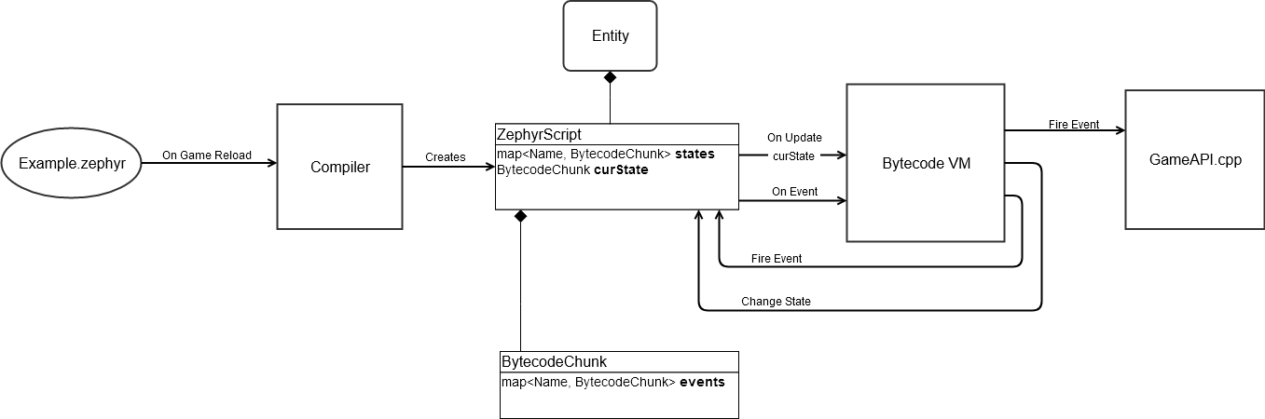
Architecture
Introduction
Scope
Schedule
Theory
Previous Work
Artifact
Implementation
Architecture
Syntax
User Feedback
Profiling Results
Bibliography

Slide 24
Architecture
Introduction
Scope
Schedule
Theory
Previous Work
Artifact
Implementation
Architecture
Syntax
User Feedback
Profiling Results
Bibliography

Slide 25
Architecture
Introduction
Scope
Schedule
Theory
Previous Work
Artifact
Implementation
Architecture
Syntax
User Feedback
Profiling Results
Bibliography

Slide 26
Architecture
Introduction
Scope
Schedule
Theory
Previous Work
Artifact
Implementation
Architecture
Syntax
User Feedback
Profiling Results
Bibliography

Slide 27
Architecture
Introduction
Scope
Schedule
Theory
Previous Work
Artifact
Implementation
Architecture
Syntax
User Feedback
Profiling Results
Bibliography

Slide 28
Syntax
Introduction
Scope
Schedule
Theory
Previous Work
Artifact
Implementation
Architecture
Syntax
User Feedback
Profiling Results
Bibliography

Slide 29
User Feedback
Introduction
Scope
Schedule
Theory
Previous Work
Artifact
Implementation
Architecture
Syntax
User Feedback
Profiling Results
Bibliography

Slide 30
Profiling Results
Introduction
Scope
Schedule
Theory
Previous Work
Artifact
Implementation
Architecture
Syntax
User Feedback
Profiling Results
Bibliography

Slide 31
Bibliography
Introduction
Scope
Schedule
Theory
Previous Work
Artifact
Implementation
Architecture
Syntax
User Feedback
Profiling Results
Bibliography
[1] M. Lewis, "Sculpting a Gameplay Scripting Solution," in Game Developer's Conference, San Francisco, 2016.
[2] The Legend of Zelda. [Nintendo Entertainment System]. Japan: Nintendo, 1985.
[3] Dungeon Explorer. [TurboGrafx-16]. Japan: Atlus, 1989.
[4] A. Desai, V. Gupta, E. Jackson, S. Qadeer, S. Rajama and D. Zufferey, "P: A Domain-Specific Language for Asynchronous Event-Driven Programming," July 2014. [Online]. Available: https://www.researchgate.net/publication/266660871_P_a_domain-specific_language_for_asynchronous_event-driven_programming_invited_talk_abstract. [Accessed 9 July 2020].
[5] J. Gregory, "Scripting," in Game Engine Architecture, 2nd Ed., Boca Raton, Taylor & Francis, 2014, pp. 954-978.
[6] F. Tomasetti, "The complete guide to (external) Domain Specific Languages," 20 February 2017. [Online]. Available: https://tomassetti.me/domain-specific-languages/. [Accessed 11 June 2020].
[7] M. Mernik, J. Heering and A. M. Sloane, "When and How to Develop Domain-Specific Languages," ACM Computing Surveys, vol. 37, no. 4, 2005.
[8] M. West, "The Whimsy Of Domain-Specific Languages," Gamasutra, 3 September 2008. [Online]. Available: https://www.gamasutra.com/view/feature/130077/the_whimsy_of_domainspecific_.php. [Accessed 18 June 2020].
[9] R. Nystrom, Crafting Interpreters, 2020.
[10] R. Nystrom, "Bytecode," in Game Programming Patterns, Coppell, TX, Genever Benning, 2014, pp. 155-180.
[11] C. Berglund, "Designing a simple game AI using Finite State Machines," Gamasutra, 27 February 2017. [Online]. Available: https://www.gamasutra.com/blogs/CarlBerglund/20170227/292378/Designing_a_simple_game_AI_using_Finite_State_Machines.php. [Accessed 25 June 2020].
[12] B. Parizek, "Notes on how to create a Language Grammar and Custom Theme for a Textmate Bundle," [Online]. Available: https://benparizek.com/notebook/notes-on-how-to-create-a-language-grammar-and-custom-theme-for-a-textmate-bundle. [Accessed 10 2020].
[13] V. Kaplan, "Writing Your Own Debugger and Language Extensions with Visual Studio Code," Code Magazine, September/October 2018.
[14] Gregory, J., 2009. State-Based Scripting In Uncharted 2: Among Thieves.
[15] H. Wu, J. Gray and M. Mernik, "Demonstration of a Domain-Specific Language Debugging Framework," Elsevier Science B. V., Amsterdam, 2007.
[16] M. Brockington, "Choosing, Designing and Implementing Scripting Languages: Tales from the Script," in Game Developer's Conference, San Francisco, 2001.

