Slide 1
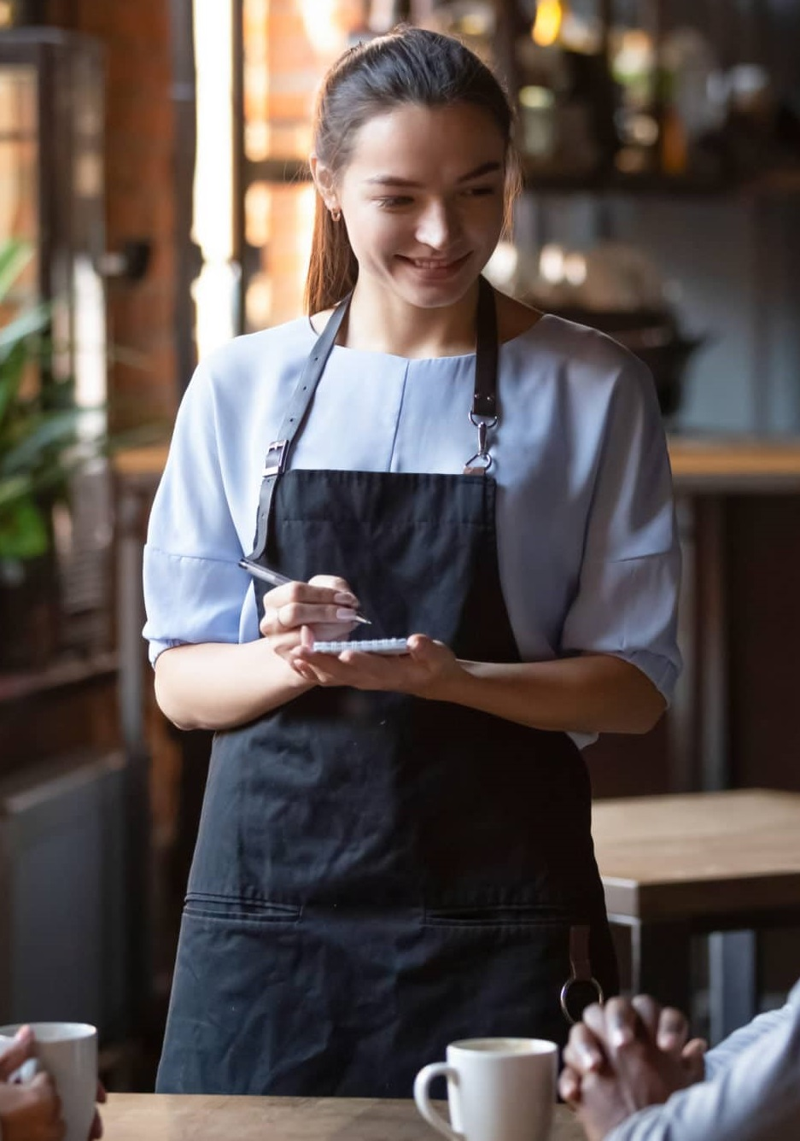





“ I want a tool to help take order from customers easier, and a better communication tools with the kitchen and manager. “
PERSONALITY
BIO
Energetic
Extrovert
Decision maker
Entertainer
Consul
Fast Learner
Rebecca is college student in Toronto learning about hospitality in George Brown college as her main subject. As a part time job, she started working as a Server in a medium-size Toronto restaurant in hoping to gain knowledge. As this is her first time working as a hostess in Toronto, she is struggling in some part but soon learn from her mistake.
Beside from her work life, Rebecca is an outgoing person who love to interact with peoples and try her
best to help those in needed as much as possible.
Behavior
Overseeing the front of the house
Handling high pressure
Communication
Motivations
IMPACT
PROMOTION
TEAMWORK
RECOGNITION
Influences
Goals
Frustrations
· CREDIBILITY
· COLLEAGUES
· TECHNOLOGY
· BLOGS/ FORUMS
· PSYCHOLOGY
Providing customer with their best experience when dinning.
Manage the workflow of the front-end house.
Managing the schedule and reservation from the client
Busy Friday night dinning.
Difficulty managing the schedule and reservation from customers.
Unsatisfied dinning experience from customer.
Calculating the end of day sales and reporting to the manager.
Rebecca Gutierrez
25, Toronto - Ontario
Cashier/Server
^{· STATUS}
^{In relationship}
^{· TIER}
^{MID-LEVEL}
^{· SALARY}
^{$19/h}
^{· SEX}
^{FEMALE}
Notes:
xong
<number>

Slide 2

“
PERSONALITY
BIO
“I want to eliminate the redundancy in my workflow and focus on things that are more important to the restaurant or to myself.”
Executive
Logistician
Commander
Architect
Calm headed
Decision maker
Michael is an outstanding person who thrive to bring out the best in everything and keeping it organized. Because of his personality and experience, he is currently task with a position as a restaurant manager for a busy downtown restaurant in Toronto. Here, where most of his day are spent working on paperwork and interacting with FOH and BOH employees.
Outside from his working life, Michael love to spend most of his time taking care of his garden, meditating or read inspiring books that help better himself. Michael also is a film enthusiastic who love to watch and talk about movie related topics.
Behavior
Overseeing the restaurant
Charismatic
Providing need
Motivations
Scheduling staff hours
REASSURANCE
ACHIEVEMENT
TEAMWORK
BENEFITS
Influences
Goals
Frustrations
· CREDIBILITY
· TV/ MOVIES
· CELEBRITIES
· PSYCHOLOGY
· NEWS
Smoothly navigate to the needed information
Notification of what is needed from my employee with their details.
Automatic calculation for financial need.
Clear easy to understand table of employee, inventory, schedule,…etc information.
Managing the staff schedule when every staff has different personal life schedule in hand.
Inventory information management by paper which cause headache to find and edit.
Financial management using excel.
Michael Scott
35, Toronto - Ontario
Restaurant manager
^{· STATUS}
^{Married}
^{· TIER}
^{MID-LEVEL}
^{· SALARY}
^{$75,000 per year}
^{· SEX}
^{MALE}
Notes:
xong
<number>

Slide 3
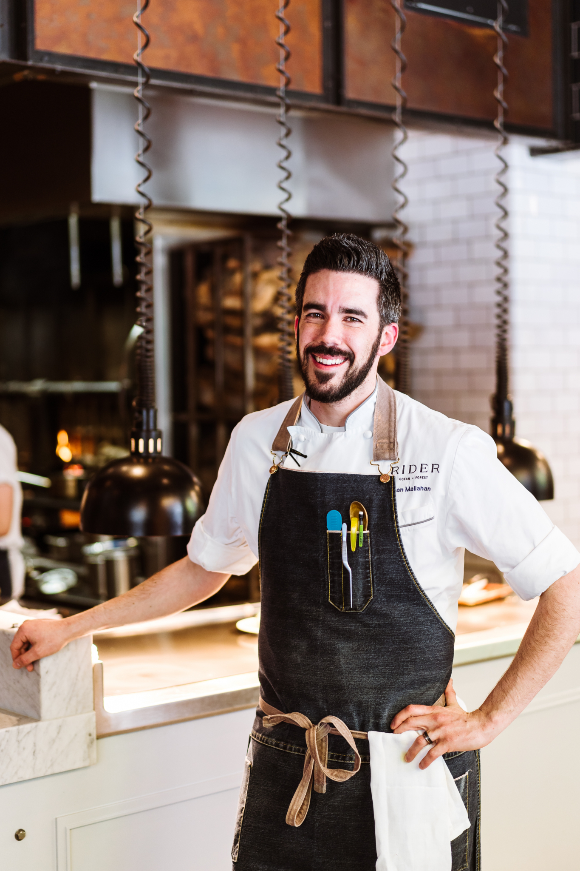
PERSONALITY
BIO
“I want my team and myself to focus on making delicious food and having a better working experiences than doing making mistake.”
Energetic
Extrovert
Decision maker
Entertainer
Consul
David currently working as Line cook in a restaurant where he spend most of his time managing the workflow of his fellow kitchen member and checking the inventory at night. Beside managing, David is an outstanding cooker who put great food on the table that amaze the dinner.
Outside from his life as a chef, David spend his time taking care of his 2-year-old child and spending quality time with his lovely wife. Also David is an Athlete who love sport as he want to keep his body in shape.
Behavior
Overseeing the kitchen
Oral commutation
Pedantic
Motivations
IMPACT
FULFILLMENT
TEAMWORK
PROMOTION
Influences
Goals
Frustrations
· CREDIBILITY
· COLLEAGUES
· NEWS
· BLOGS/ FORUMS
· SOCIAL MEDIA
Improve my time and efficiency when checking inventory.
Digital order printed for every station in the kitchen.
Improve communication when order is being process, finish, or unfinish.
Unreadable handwriting when receiving order.
Forgetting order and being ask by teammate.
Miss communication between teammate.
Hand paper checking inventory every night when shift is over.
David Robinson
29, Toronto-Ontario
Kitchen Staff
^{· STATUS}
^{In relationship}
^{· TIER}
^{MID-LEVEL}
^{· SALARY}
^{$40,000 per years}
^{. SEX}
^{LGBT}
Notes:
Luoi chinh personality qua……
<number>

