Slide 1
Data Science Toolbox: NumPy, Pandas, Scikit-learn
Tim Babych, PL.PyCON 2015

Slide 2
About
Machine Leaning overview
Data Science & Big Data
Algorithms and tools
Skills and Courses
Questions

Slide 3

Machine Learning
Field of study that gives computers the ability to learn
without being explicitly programmed
Arthur Samuel, 1959

Slide 4
Supervised learning
“Right answers” do exist
Spam detectors
Weather prediction
Game outcomes
Medical diagnosis
Insurance
Object detection
Speech recognition

Slide 5
Unsupervised learning
There are no right answers! Much harder
Find some structure in given data
Cluster data into groups
Playing games

Slide 6
Data Science Flow
Define Goals & Metrics
Data Product
Gather & Clean Data
Evaluate Results
Make Decision
iterate
Visualise
Explore & Analyze
Build/Train model
Select Algorithm

Slide 7
Machine Learning part
Define Goals & Metrics
Data Product
Gather & Clean Data
Evaluate Results
Make Decision
feedback
Visualise
Explore & Analyze
Build/Train model
Select Algorithm

Slide 8
Popular tools for the tasks
Define Goals & Metrics
Web Products Django, Flask, API
Test Model Scikit-learn, Matplotlib
Data Product
Gather & Clean Data
Evaluate Results
Make Decision
feedback
Visualise
Matplotlib, D3, ggplot, bokeh
Visualise
Explore Data Pandas, Matplotlib, StatsModels, NumPy, Unix
Explore & Analyze
Build/Train model
BuildModel
Scikit-learn, Pandas, NumPy, SciPy, NLTK
Select Algorithm

Slide 9
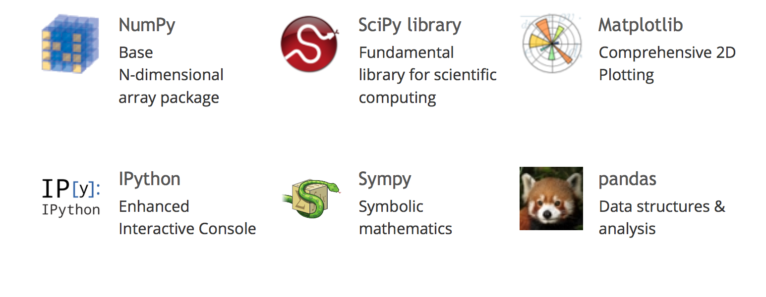
SciPy stack

Slide 10
Example: Titanic passengers
survival (0 = No; 1 = Yes) pclass Passenger Class (1 = 1st; 2 = 2nd; 3 = 3rd) name sex age sibsp Number of Siblings/Spouses Aboard parch Number of Parents/Children Aboard ticket Ticket Number fare cabin embarked Port of Embarkation (C = Cherbourg; Q = Queenstown; S = Southampton)

Slide 11
Toolkit
pip install numpy scikit-learn pandas matplotlib
pip install "ipython[notebook]"
OR
Use Anaconda distribution

Slide 12
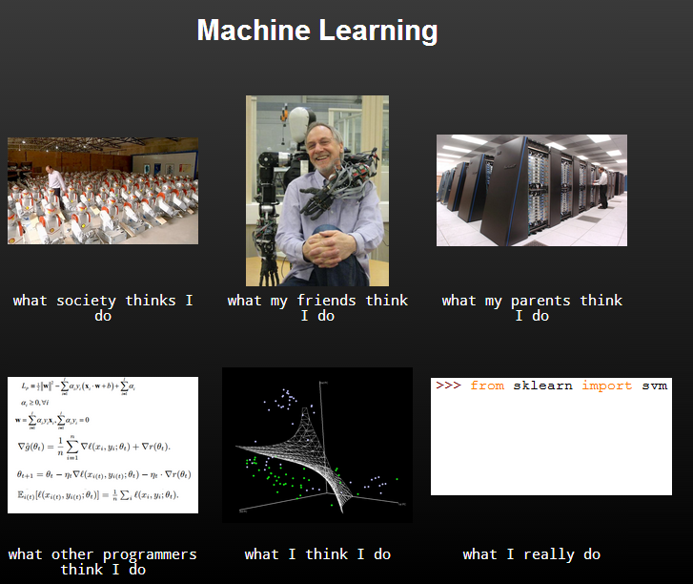

Slide 13
Let’s dive into Jupyter notebooks: they are awesome!
https://github.com/tymofij/datascience-pandas-talk-pycon-pl

Slide 14
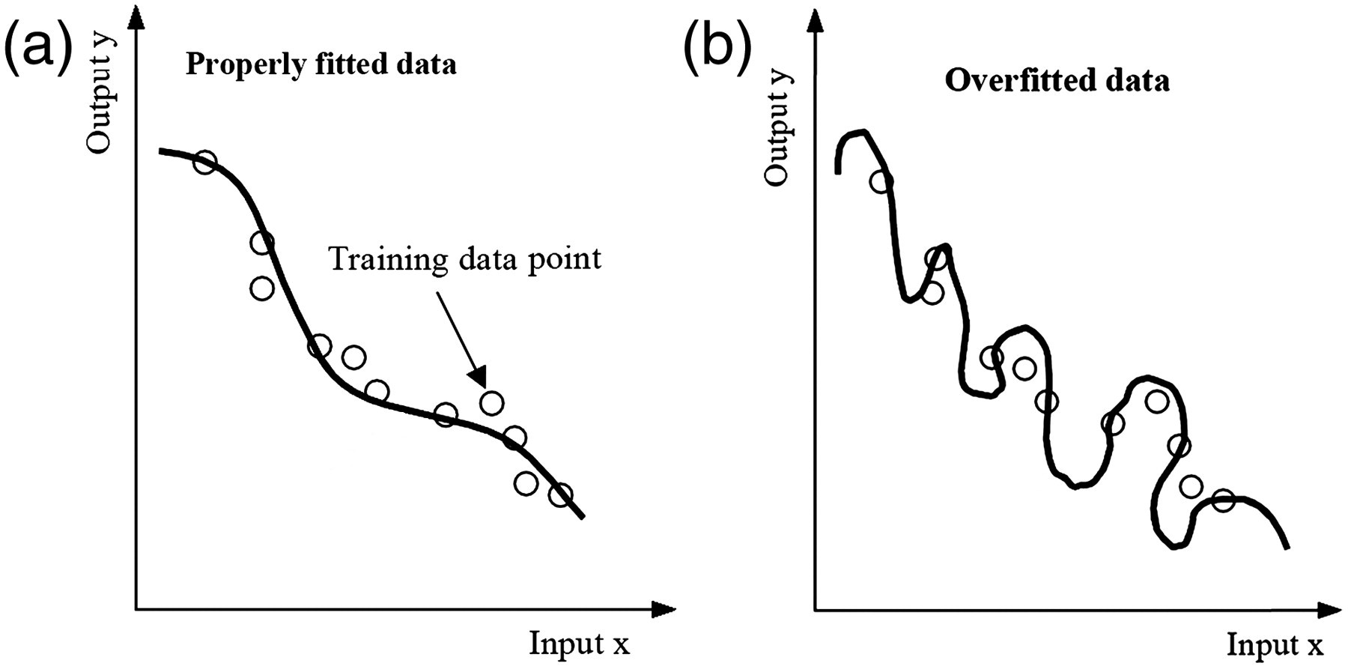
Do not overdo it.

Slide 15
A day in datascientist’s life
Evaluate results
according to metric
Select Features, Model
Train Model

Slide 16

DataRobot’s help
Train Model
Select Features, Lots of Models
Train Model
Evaluate results
according to metric
Train Model
Train Model
Train Model

Slide 17
DataRobot is hiring!
Software Engineers
Data Scientists
DevOps
Boston and Kyiv offices
http://www.datarobot.com/careers/

Slide 18
Selected Books
Learning From Data - small, good for beginners and has an online course
Machine Learning: A Probabilistic Perspective larger and still current and very popular
The Elements of Statistical Learning: Data Mining, Inference, and Prediction a lot of theory, has free PDF edition

Slide 19
Selected Machine Learning resources
Machine Learning by Andy Ng (Coursera)
Intro to Machine Learning by Sebastian Thrun (Udacity)
dataquest.io
Kaggle competitions and tutorials

Slide 20
Thanks!
Questions?
Tim Babych
tim.babych@gmail.com
http://clear.com.ua
http://github.com/tymofij http://twitter.com/tymofiy

