Slide 1
What’s a server and how do I set one up?
Tyler Monaghan
November 30, 2018
Center for textual studies and digital humanities

Slide 2
Why this workshop?
The coolest DH projects always seem to run on servers
Software online often lists a “server version”
R and Rstudio; Omeka; WordPress
Ubuntu (Linux)
Learning HTML and CSS
Sites like WordPress limit what you can do with HTML and CSS
Omeka, T4, others, accept some limited HTML/CSS but ignore others
If you want a publicly accessible project, it has to live somewhere

Slide 3
Who I am
BA in History and Secondary Education
MA in DH
Never wrote a line of code before last September
Learned most of this via online tutorials and guides

Slide 4


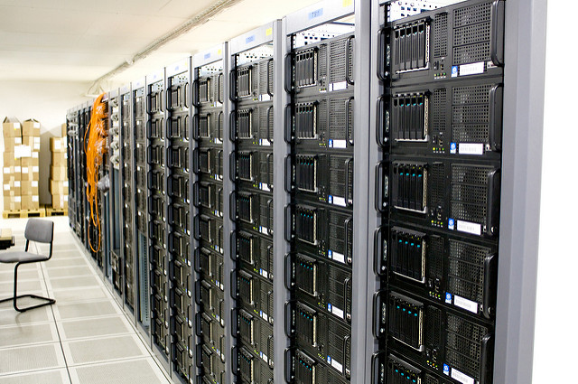
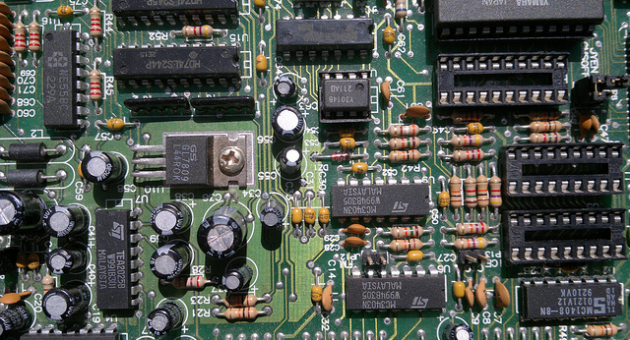
What is a server?
You may think of some of the images on the right when you picture a server
Or perhaps lines of green text scrolling past on a black terminal, or your network shared drive
There are servers – but so is this computer, if we make it one!
Notes:
http://www.flickr.com/photos/torkildr/3462607995/
http://flickr.com/photos/cyberslayer/5873358487
http://commons.wikimedia.org/wiki/File:Wmf_sdtpa_servers_2009-01-20_36.jpg

Slide 5
What is a server?
A server is ANY computer that “serves” other programs or devices
Usually we mean serving web pages, database content, or games
A server is generally always on, and accessible from the web (any internet-connected computer) or a local network (think Loyola’s shared drives and login system)
Usually purpose-built, but not necessarily

Slide 6


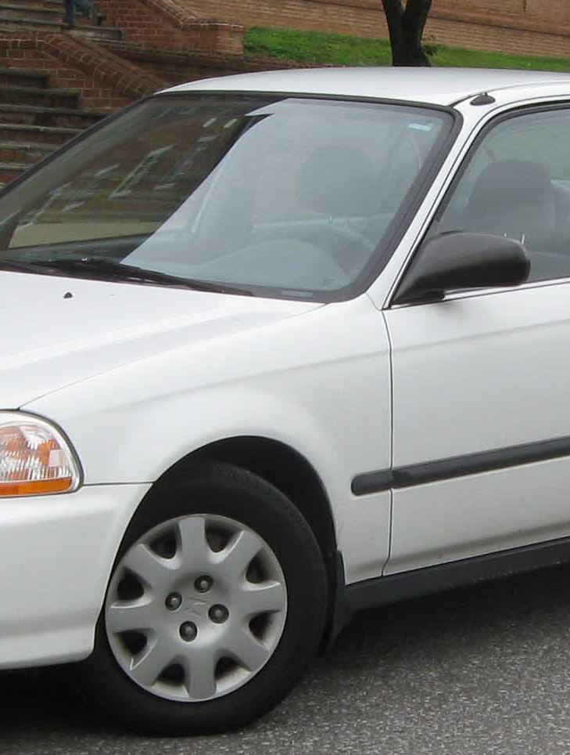
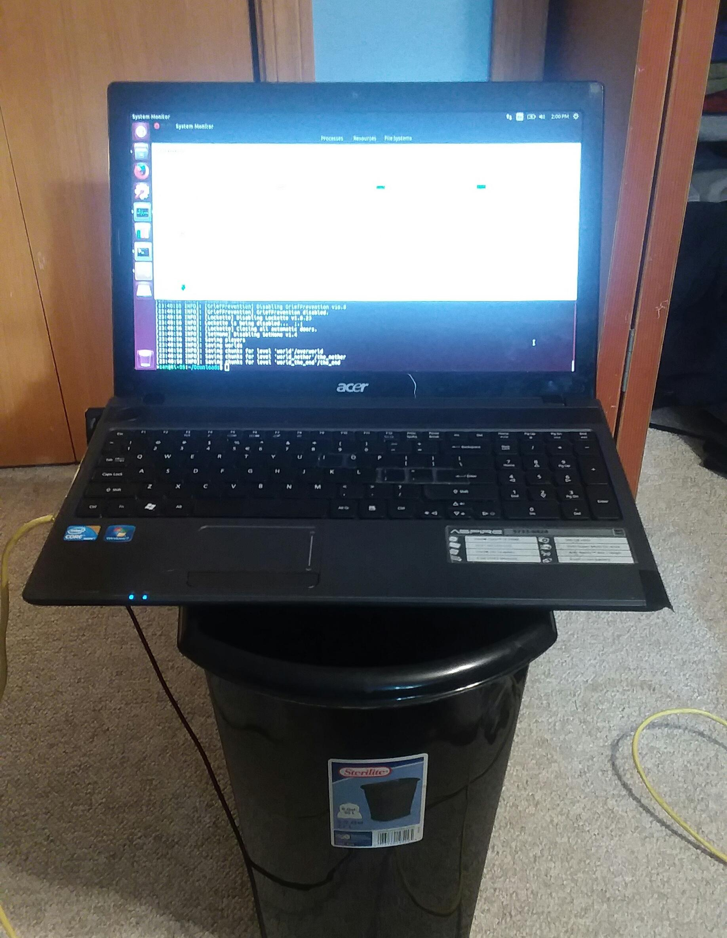
Car analogy page
Notes:
https://en.wikipedia.org/wiki/Honda_Civic_(sixth_generation)
http://ihsankhairir.blogspot.com/2011/06/photos-super-gt-race-cars.html
http://www.flickr.com/photos/torkildr/3462607995/
http://www.appropedia.org/How_to_use_a_KillAWatt_meter

Slide 7
What do you mean, “serving?”
Rarely = “not constantly.” Compare a LibGuide(static)
with a Twitter feed(dynamic)
STATIC WEB PAGES
Think about a site you have bookmarked that rarely* changes – maybe a favorite LibGuide
That page is a file that your browser (client) asks for (from the server) when you visit that address
DYNAMIC CONTENT
Feeds (Facebook, Twitter); search results pages
The server gathers the info and presents it to the user’s browser (or app) as a file

Slide 8
What do you mean, “serving?”
MEDIA
When you request a video or song to play, you’re asking to access something that’s sitting on a server somewhere
“Streaming” just means you begin playing the file before it’s completely downloaded
GAMES
Servers help players find each other and coordinate moves among the different players
If I’m in a driving game with ten people, the server transmits each turn of my wheel to the other nine people in the game in real-time
Each client only connects to the server instead of all 9 other players

Slide 9
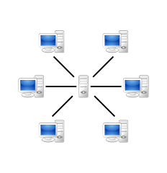
A few server use-case illustrations

Slide 10
Why use a server?
Servers often have more memory and less overhead
They don’t have to think about whether you’re about to start Pandora or play Candy Crush or open 32 Chrome tabs
Great for big data sets
Databases
Textual analysis (Voyant-Tools, HathiTrust, SOTU-db 😎)
Full control
A great environment for learning HTML/CSS

Slide 11
SOTU-db use case
State of the Union Database (SOTU-db)
Running on a server from LUC CS dept.
The server holds all my web page files and styling rules
The server contains the text corpora and the programs to run analysis
When a user visits the page, the server:
Serves them the page and styling
Accepts their input in a search box
Runs programs and commands over corpora according to the user’s input
Returns results back to the user in human-readable format

Slide 12
How do I set one up?
You can check out AWS (Amazon) or Azure (Microsoft)
Paid solutions – free trials?
Lots of features, good support
Can be overwhelming (these are production-ready – race car)
See what resources LUC can make available
Library, CTSDH, CS dept?
DIY
This is what we’ll do in the workshop today – sort of
This can be tough / not a good idea to have accessible on the web
We’ll use “localhost”

Slide 13
A note on data security
Data security is NOT covered by this workshop
If you are exposing your work to the public on the web, you’ll need to take basic security measures like encrypting your connections
If you are working with sensitive data (like client personal info or private collections) you should be sure you are NOT making this accessible to your server – ensure you stop the server running after the workshop

Slide 14
Workshop time
We are going to set up your computer as an Apache server for static web pages
We will create a “hello world” HTML page
We will create a style document

Slide 15
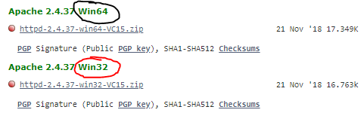
INSTALL APACHE
Windows
Mac
Determine whether you need 64 or 32 bit:
Hit windows key > type “system” > open “system information
Under “system type” x64 means 64 bit
Go to apachelounge.com/download
Extract the Apache24 folder to c:\ or another folder (not program files)
Finder > “Terminal”
Type “sudo apachectl start”
You did it!
Test: open Safari or Chrome
Type “localhost” in address bar, hit enter

Slide 16
Create HTML File
Open a text editor
Notepad on Windows
TextEdit on Mac
Copy the text to the right →
Save As…
Windows:
c:\Apache24\htdocs\index.html
Mac:
/Library/WebServer/Documents/index.html
<!DOCTYPE html> <html> <h1>This is a Heading</h1> <p>This is a paragraph.</p> </html>
Done? Test it out:
Visit “localhost” in your browser again

Slide 17
Add Styling with CSS
CREATE A NEW CSS FILE
Create a new file in your text editor
Enter the text to the right →
Save the file as “style.css”
POINT YOUR HTML TO THE CSS
Back in your index.html file…
Insert this line:
p {
color:red;
}
<link rel="stylesheet" href="style.css">
Test it out!
Reload your “localhost” in your browser – what changed?

Slide 18



What’s happening here?
APACHE SERVER
+
Requests the page
Returns styled page
Server receives request, applies CSS styling rules to HTML content
Your browser

Slide 19
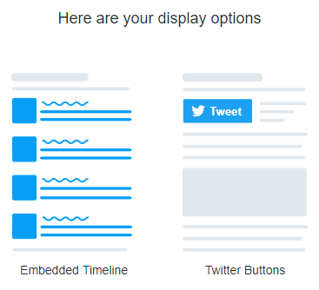
Let’s add some dynamic content: Embed a Twitter Feed
GO TO publish.twitter.com
Type a hashtag, @handle, or URL of a Twitter list
May I suggest @luctsdh – or do your own
Select “Embedded Timeline” →
Click the “Copy Code” button!
Paste into your HTML file (above the </html>
Save and reload

