Slide 1
YAWK
You Are Welcome Krakow

Slide 2
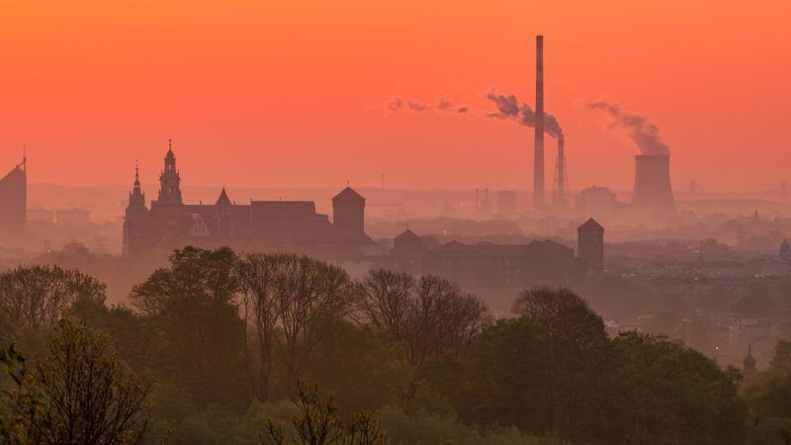
Introduction
Predicting future PM10 values for the Krakow by using Deep Neural Network to help Krakow to be better place to breathe...

Slide 3
Hourly Predictions
Aim
predict next hour based on set of previous time series

Slide 4
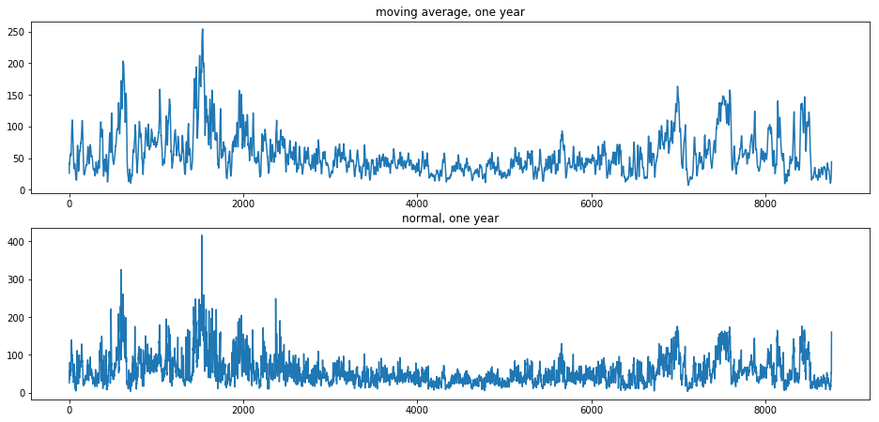
Data Visualization

Slide 5
Data Pre-processing
handling missing values -> impute values from other years
moving average -> 12 hours for each frame
preparation data as input for LSTM:
-> framing 24 hours as base for prediction of next hour
-> Input shape: (43795, 24, 1)
-> Output shape: (43795,)

Slide 6
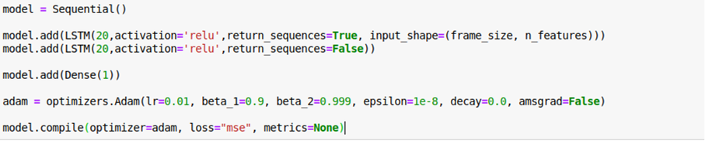
Model

Slide 7
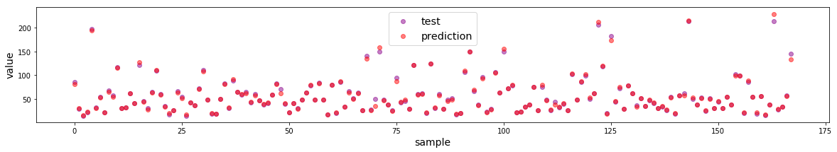
Score & Conclusion
Final R2 Score = 0.99

Slide 8
Daily Predictions
Aim
predict next day’s PM10 value based on last 20 days

Slide 9
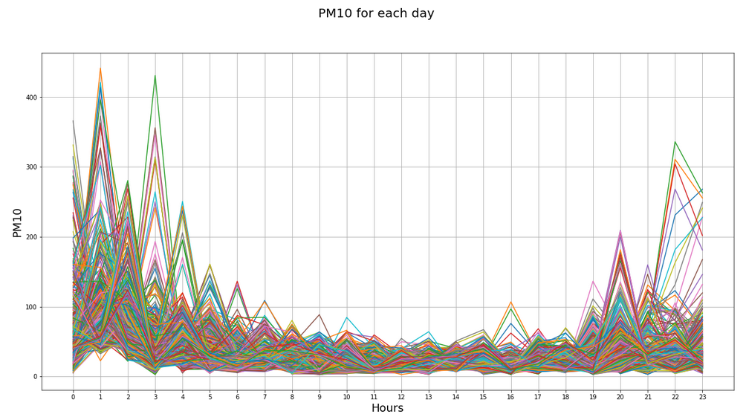
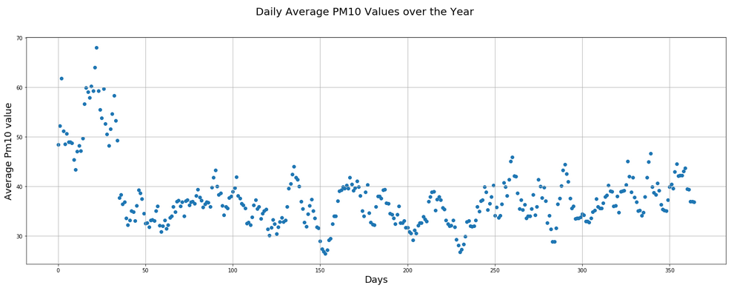
The Data

Slide 10


Data PreProcessing
Handling the null values
Framing the data for training

Slide 11
Simple LSTM model with only 4 hidden layers
Layer 1: tanh LSTM with 24 neurons
Layer 2: 10% Dropout
Layer 3: tanh LSTM with 16 neurons
Layer 4: 10% Dropout

Slide 12
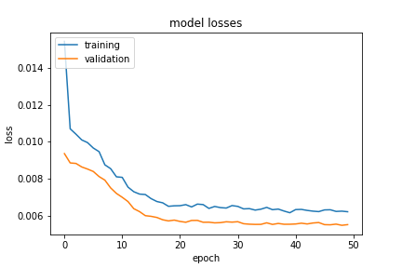
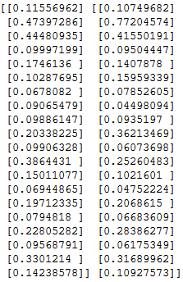
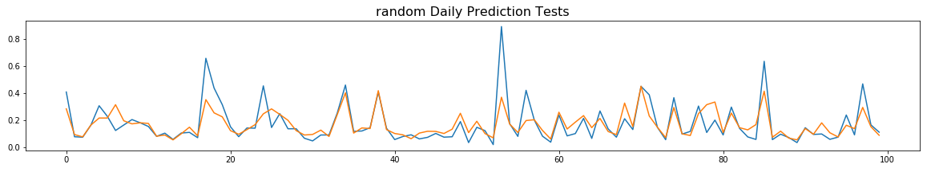
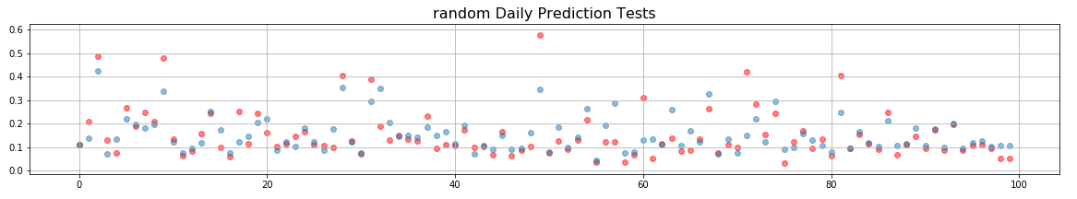
Score & Conclusion

Slide 13

Thank you for your attention
Efe Ergün
Bartosz Tynski

