Slide 1
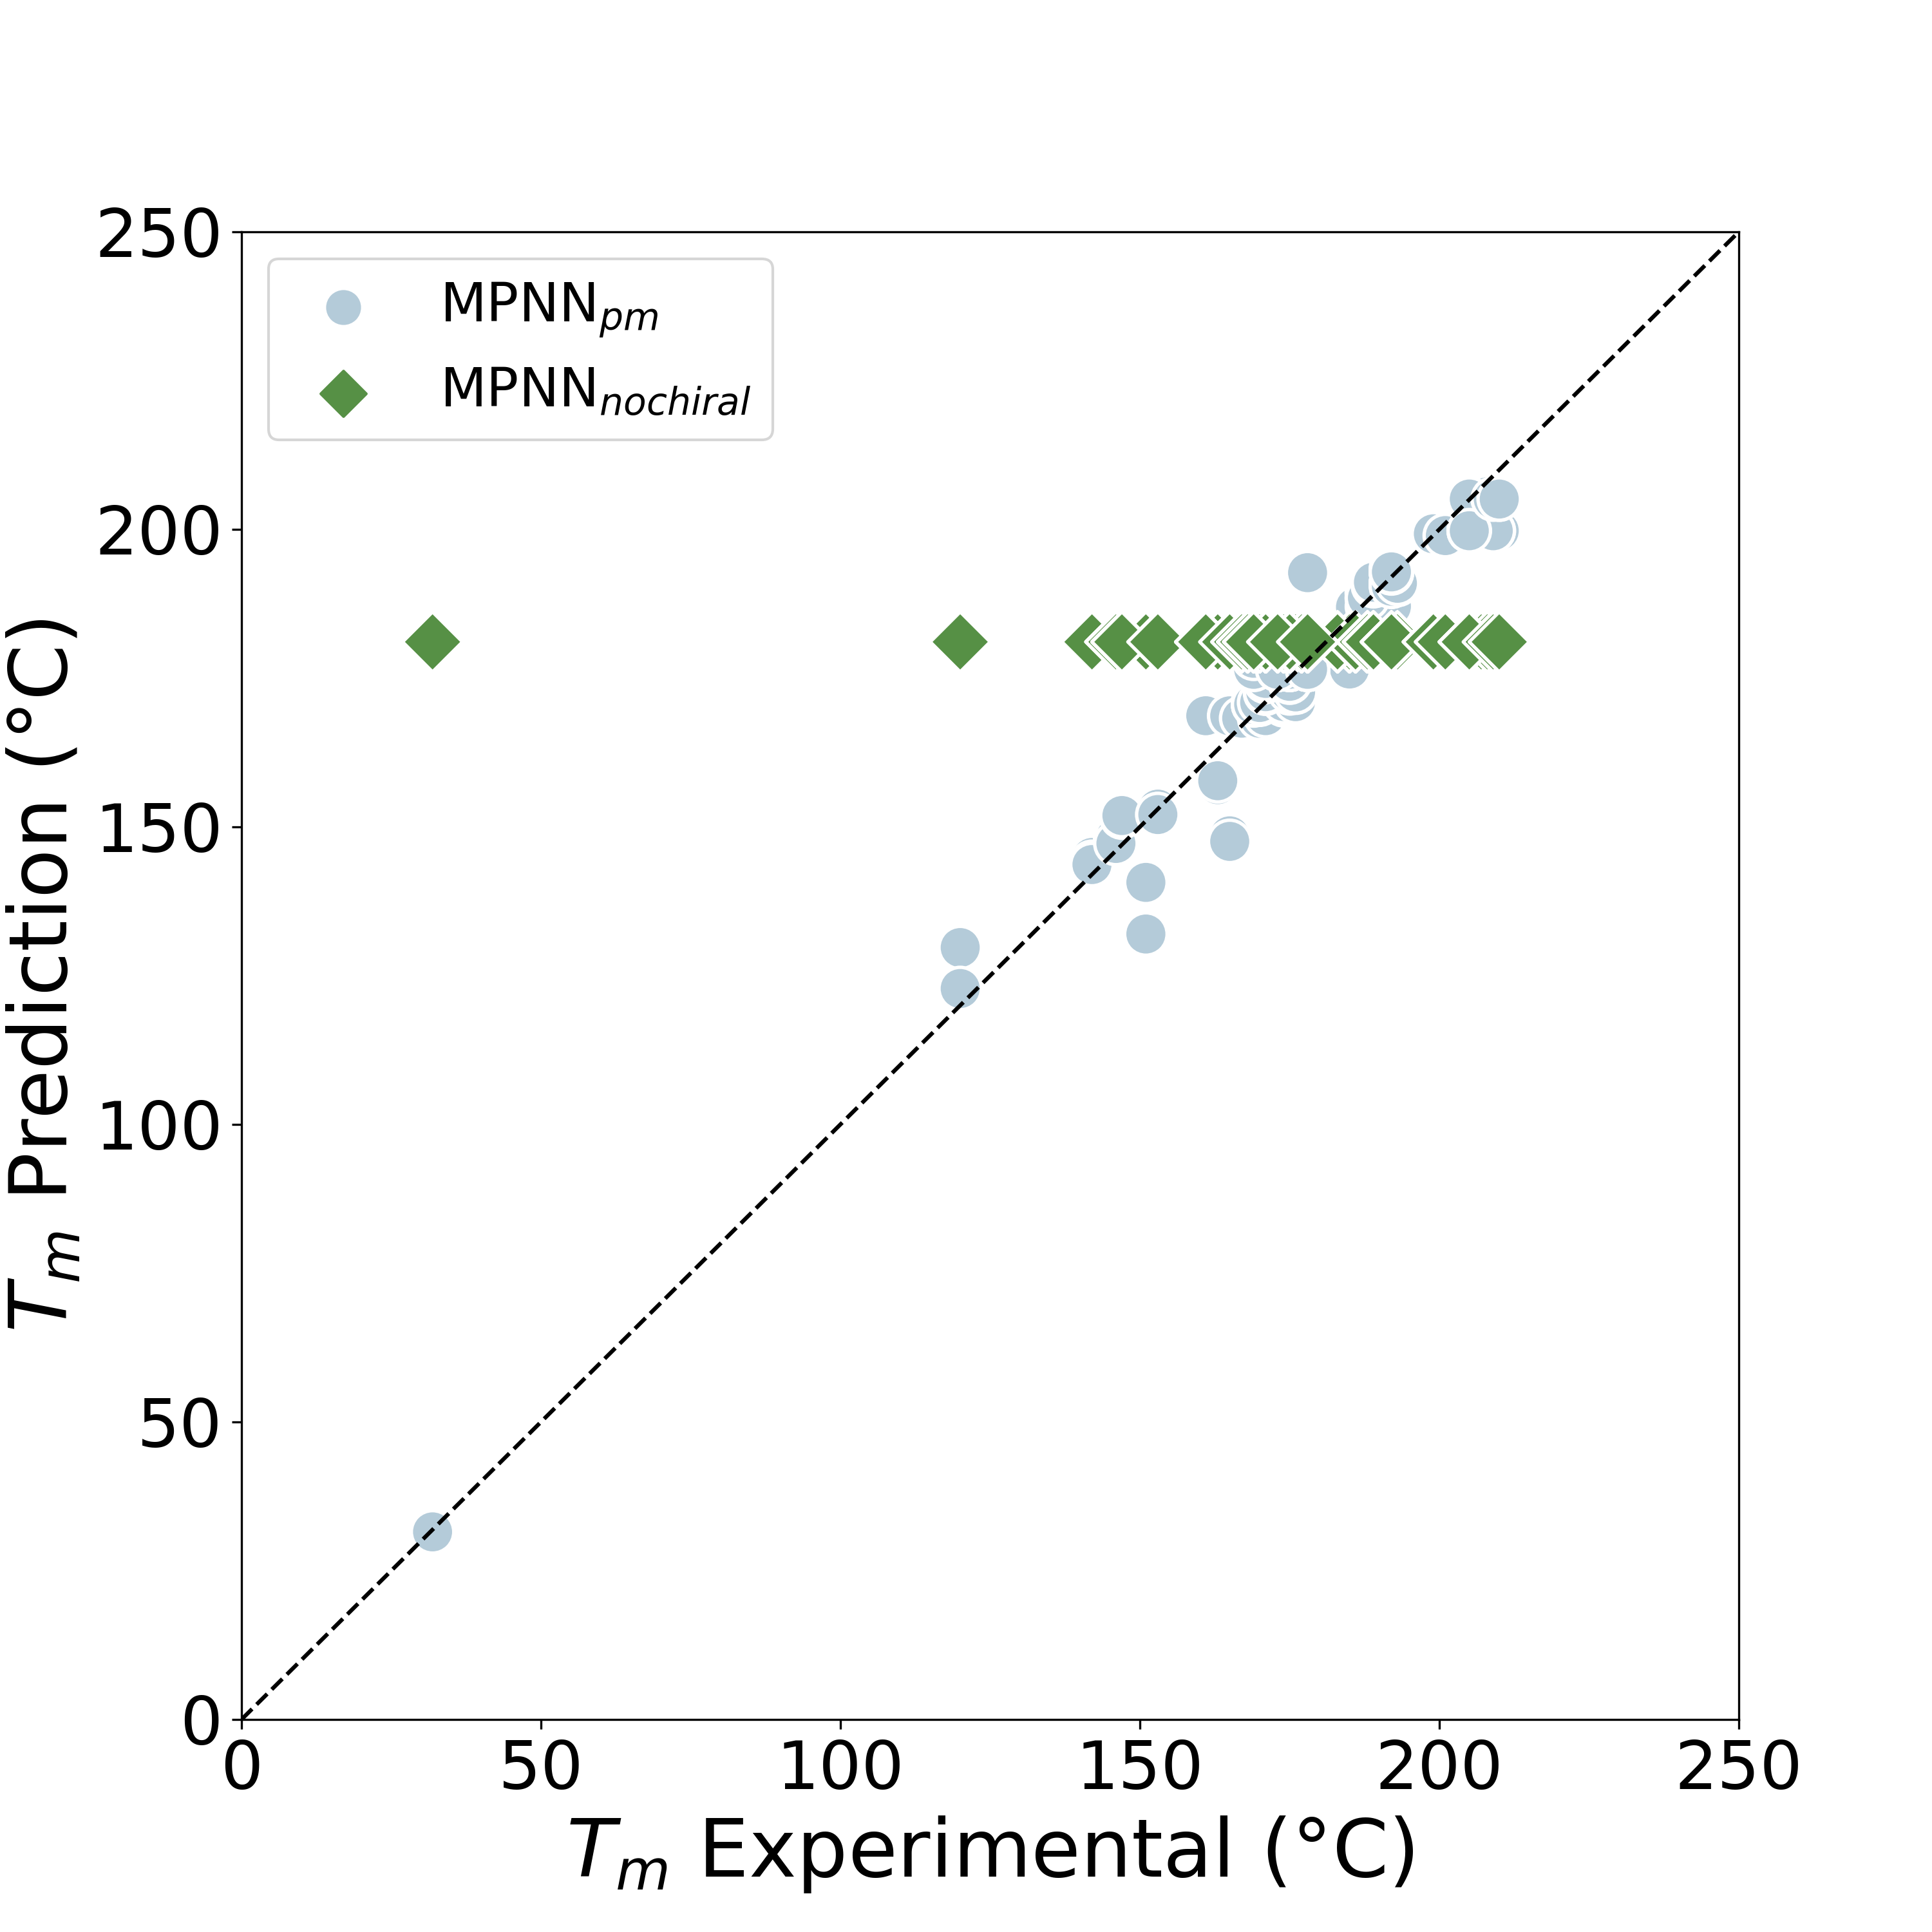
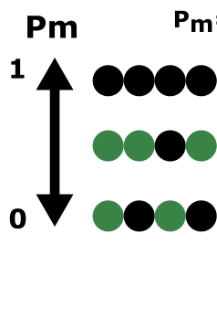
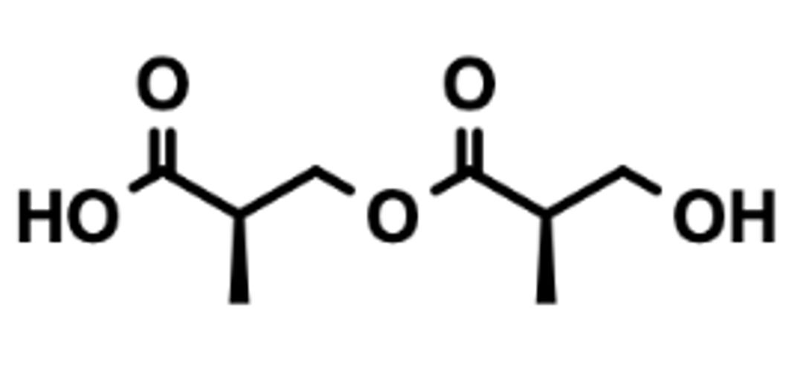
p_{m} Value
Inputs
P_{m}
Bond Matrix
Chiral Tags
Atom Matrix
(R)
(R)
Connectivity
Matrix

