Slide 1
Equations
Quenched average, np, A --> \inf ; np/A → \sigma
Discrete Gaussian chain

Slide 2
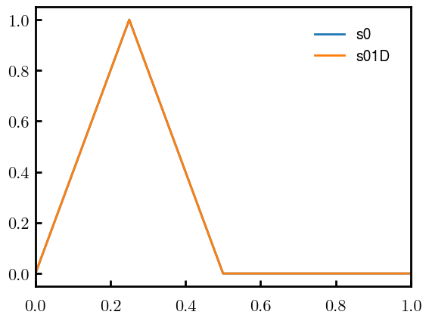
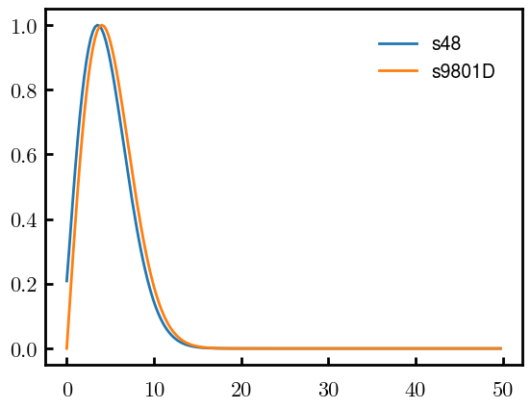
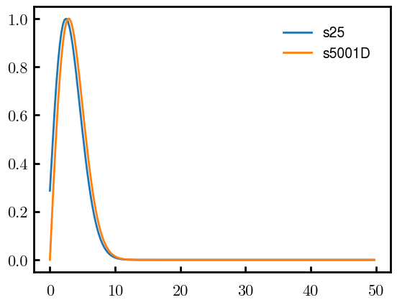
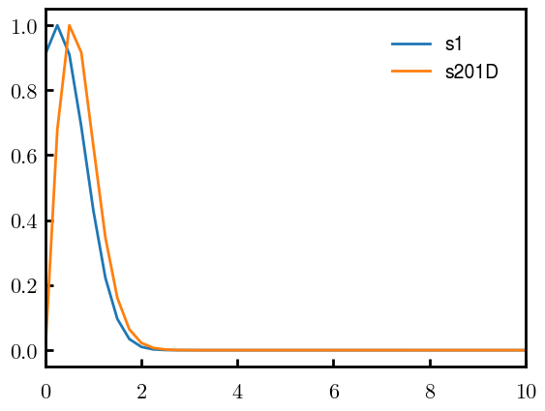
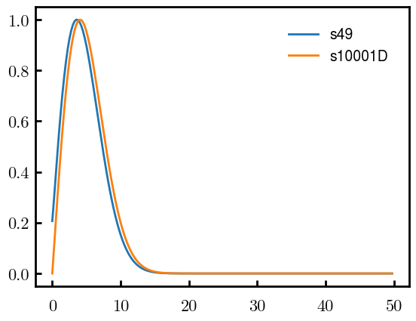
DGC vs MDE (q, normalized, init=0, s02)
N = 50
Ns0 = 1000
ds0 = 0.05
Ds0 = 20
To delete if current runs work

Slide 3
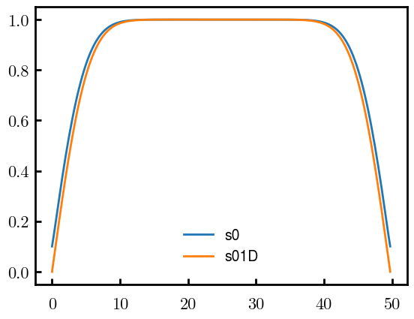
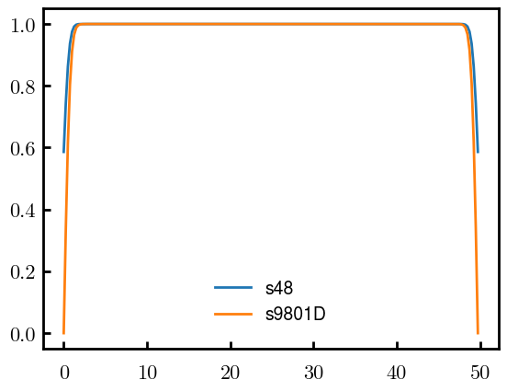
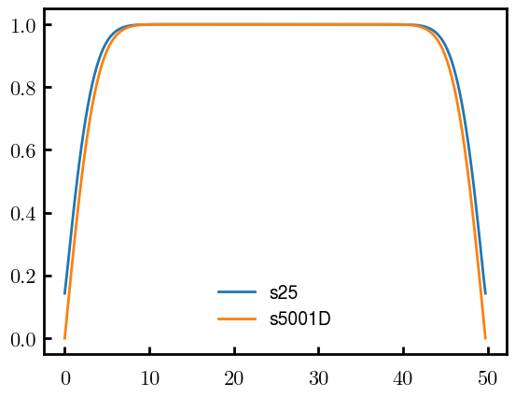

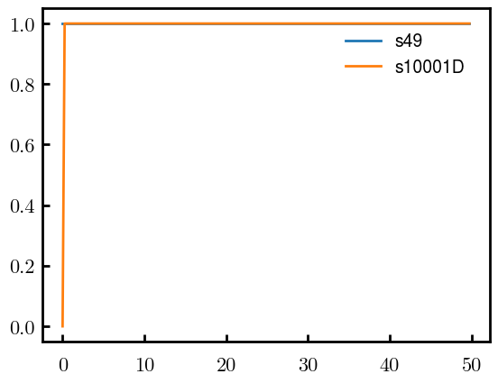
DGC vs MDE (qc, normalized, init=0, s02)
N = 50
Ns0 = 1000
ds0 = 0.05
Ds0 = 20
To delete if current runs work

Slide 4
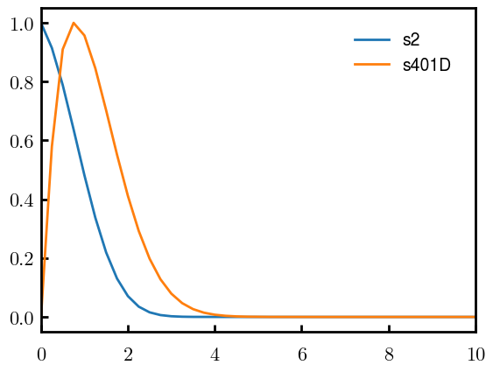
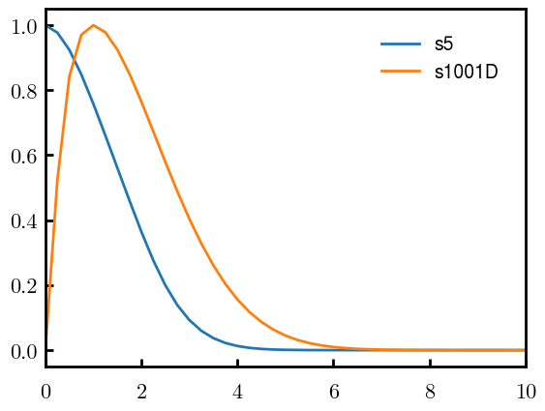
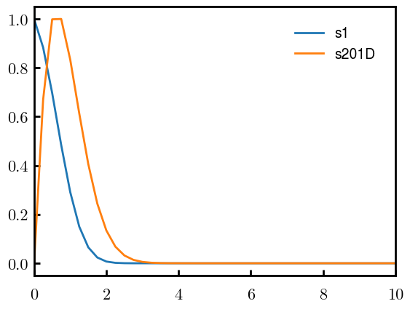
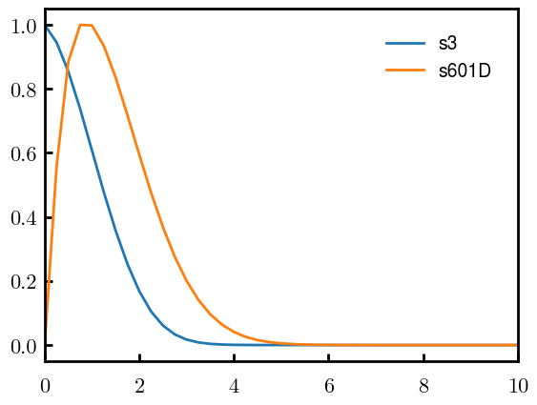
DGC vs MDE (q, normalized, s0.10)
N = 50
Ns0 = 1000
ds0 = 0.05
Ds0 = 20
To delete if current runs work

Slide 5
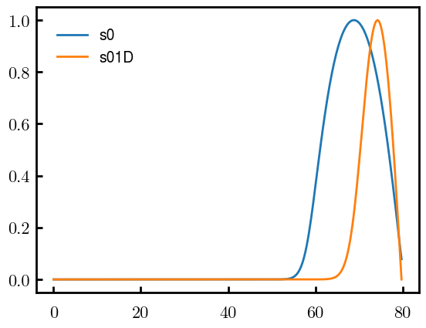
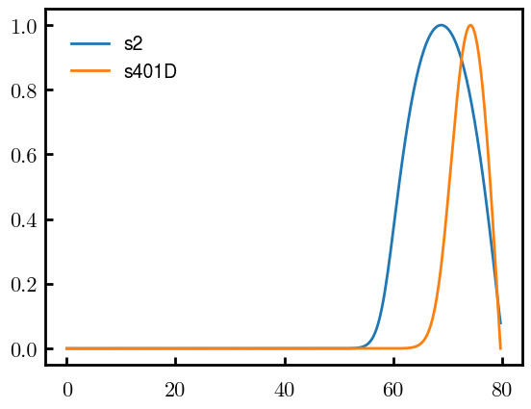
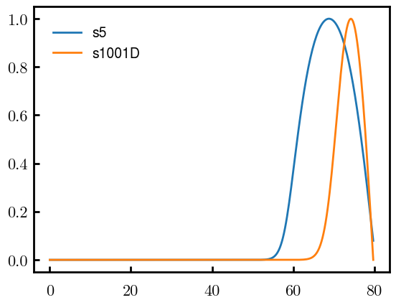


DGC vs MDE (qc, normalized, s0.10)
N = 50
Ns0 = 1000
ds0 = 0.05
Ds0 = 20
To delete if current runs work

Slide 6
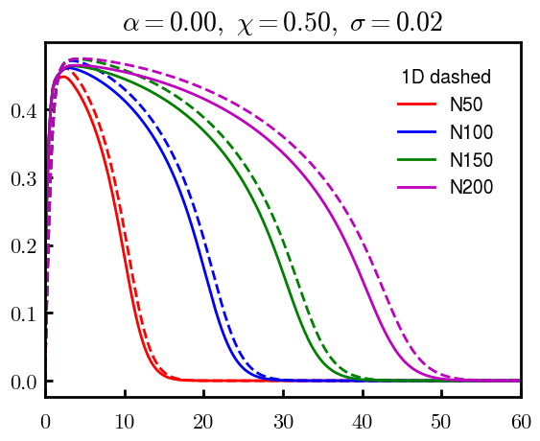
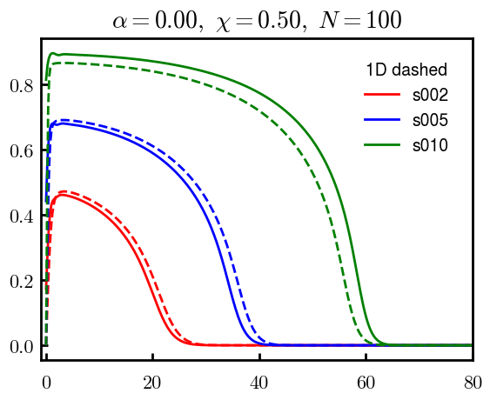
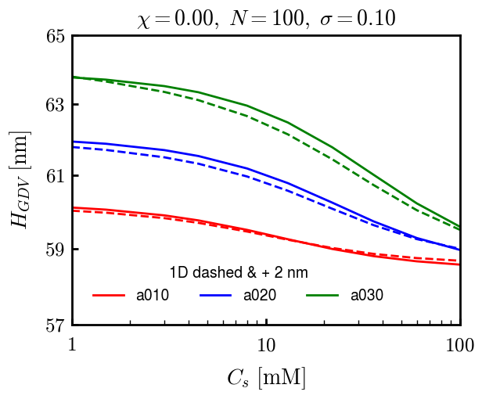
DGC (3D; NxNy=1) vs MDE (1D)

Slide 7
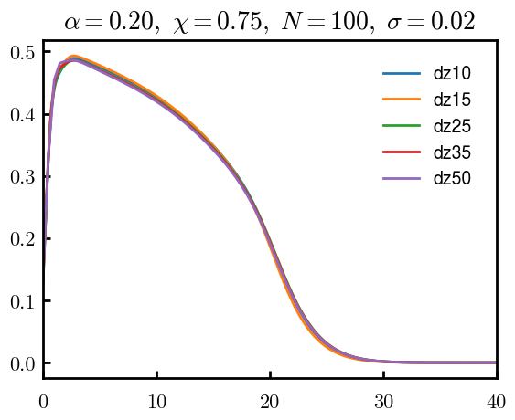
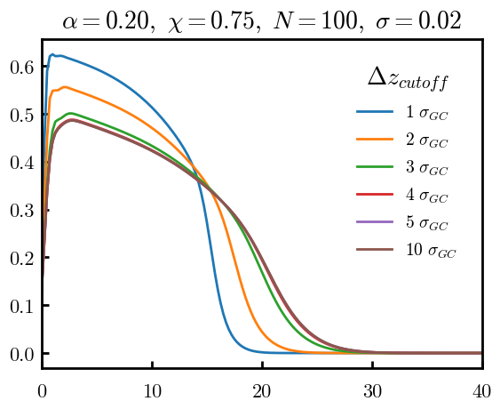
Numericals

Slide 8
Scaling

Slide 9
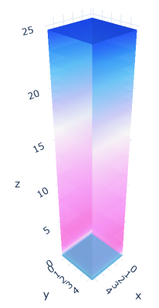
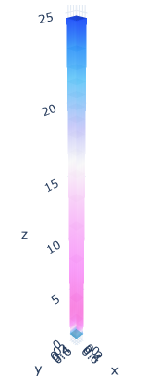

3D
Lxy = 1
Lxy = 5

Slide 10
OLD

Slide 11
Annealed

Slide 12
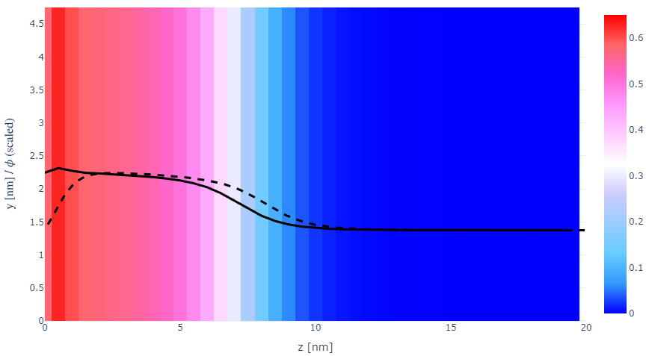
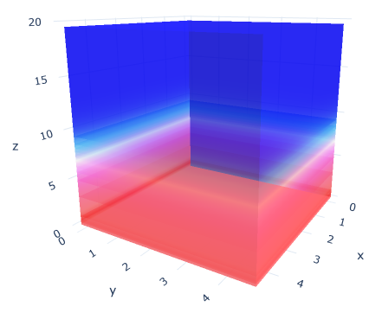

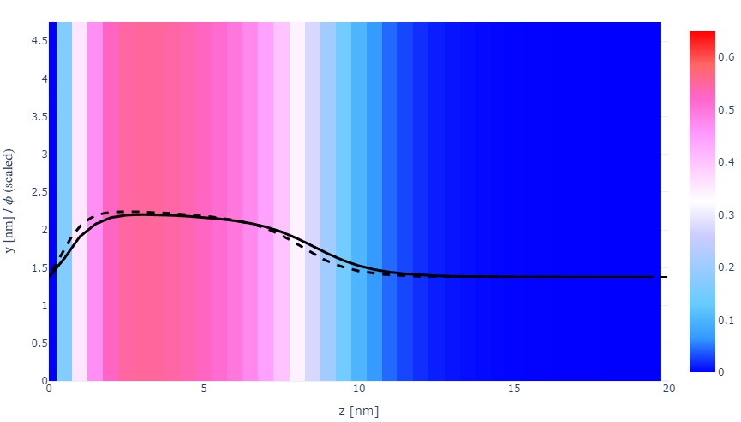
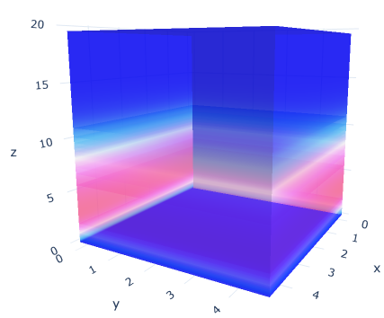
z-FFT vs z-FD (MDE) – REDFT01 xy(z)
Lx = 5, Ly = 5, Lz = 50. s = 0.02. x = 0.75. a = 0.00, N = 50
3D vs 1D (dashed): dz = 0.5, ds = 0.20; dz_1D = 0.113, ds_1D = 0.083
FFT (xyz)
FFT (yz vs pha)
FD (xyz)
FD (yz vs pha)
Diff btw 1D/3D should just be dz, ds, etc.

Slide 13
PB: REDFT00 (x= -0.5) vs REDFT01 (x=0)
Lx = 5, Ly = 5, Lz = 50. s = 0.02. x = 0.75. a = 0.00, N = 50
3D vs 1D (dashed): dz = 0.5, ds = 0.20; dz_1D = 0.113, ds_1D = 0.083
Compare pot_elec and freeE with each other and 1D

Slide 14
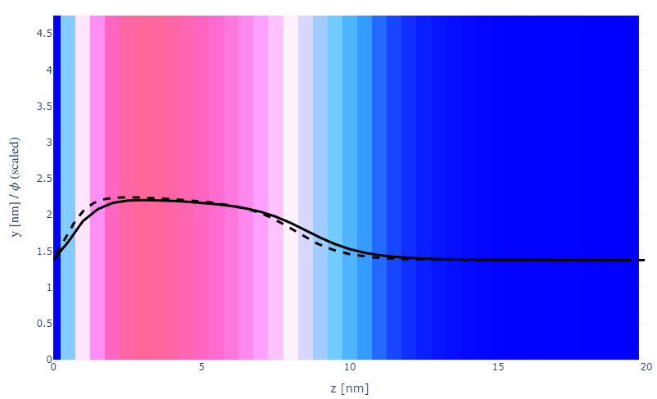
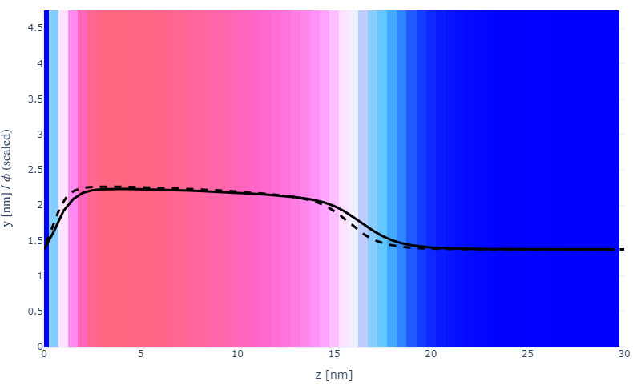

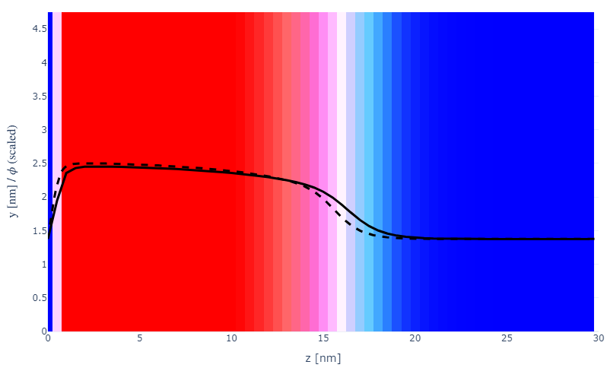
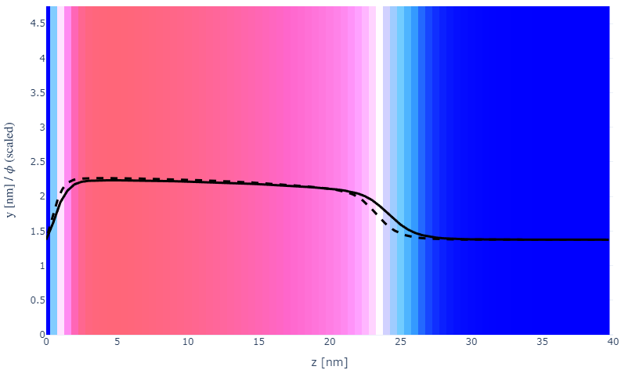
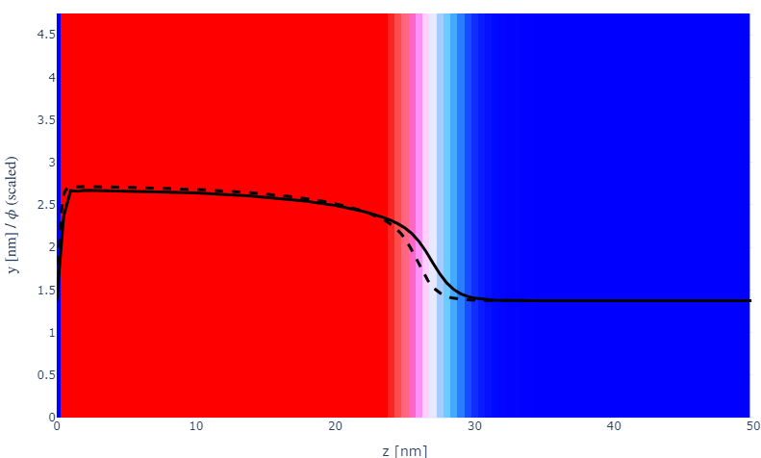
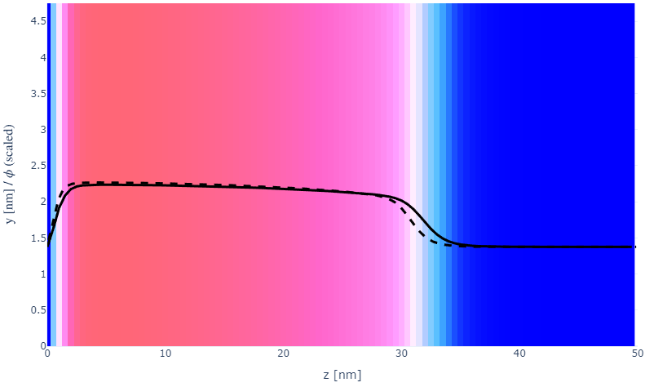
Parameter space (s, N)
a000x075
s002N050
N100
20
30
s005
N150
30
40
s010
N200
50
50

Slide 15
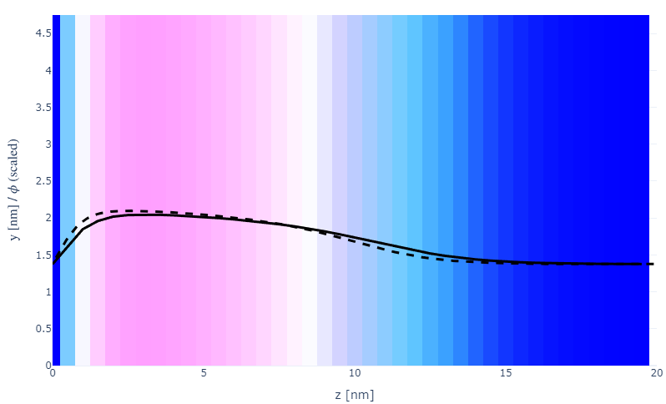
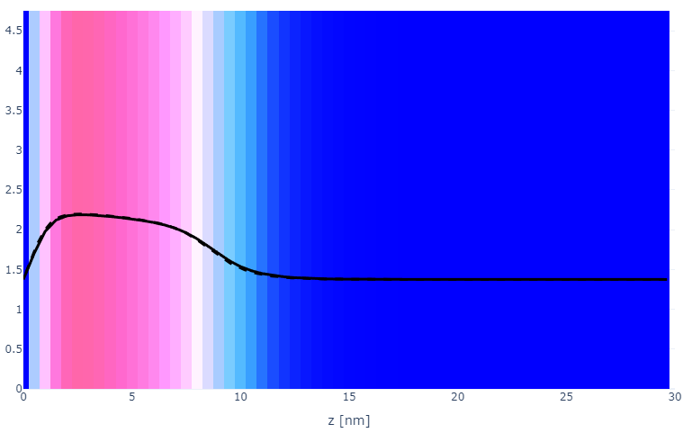
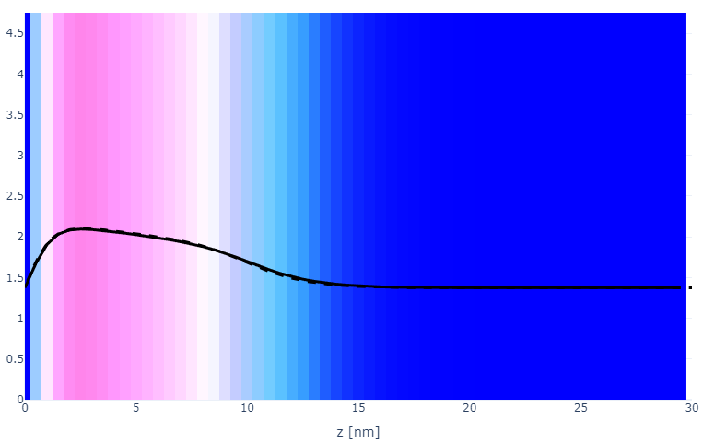
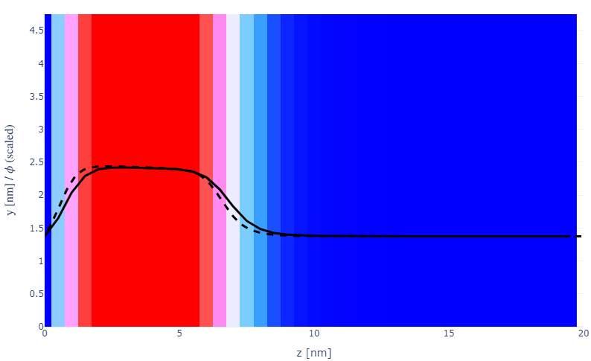
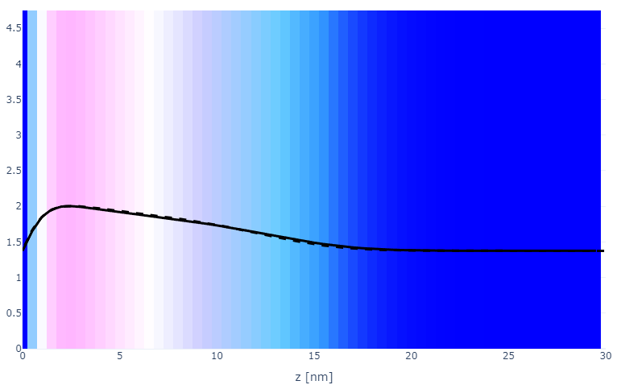
Parameter space (x, a)
a000x055s002
a010x075
20
30
x075
a020x075
20
30
x100
a030x075
20
30

Slide 16
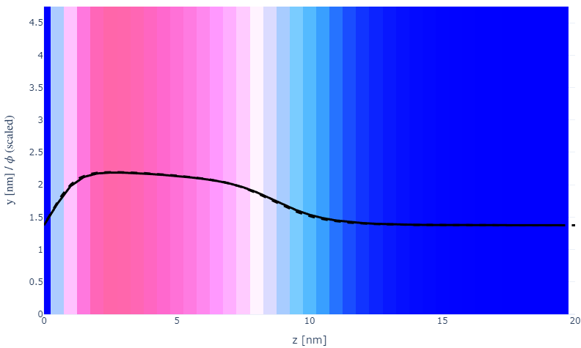
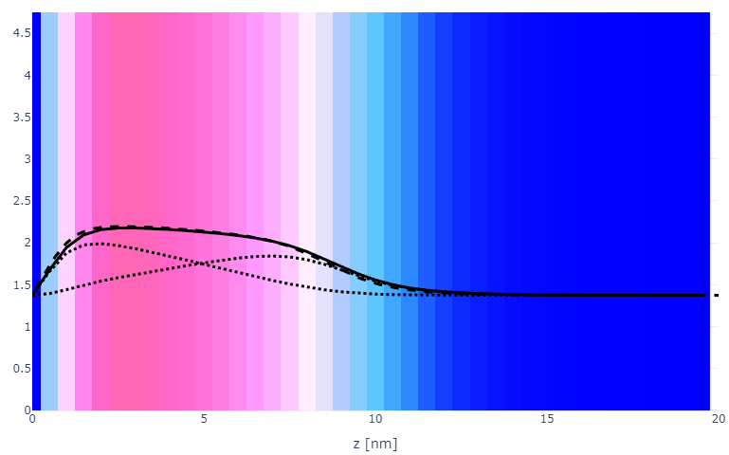
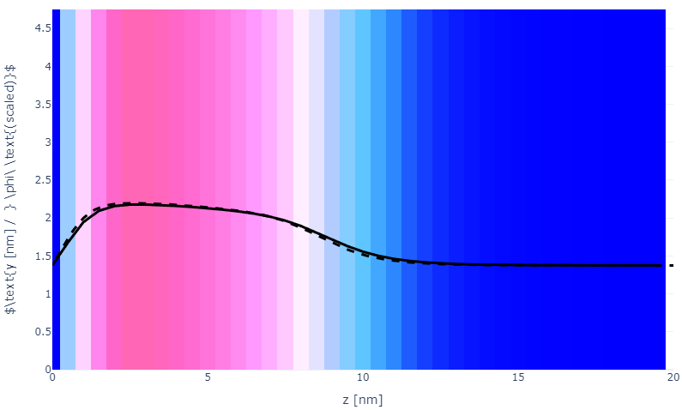

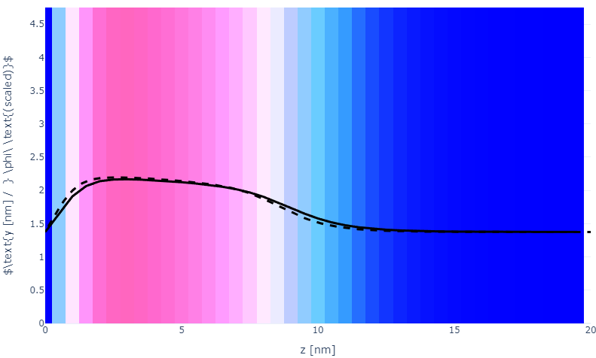

Numerical space (dz, ds, Y)
a010x075ds05
a010x075Y2
a010x075ds10
a010x075Y5
a010x075ds15
a010x075Y10

Slide 17

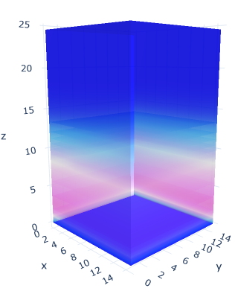
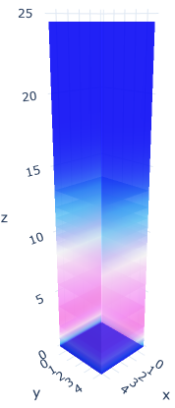
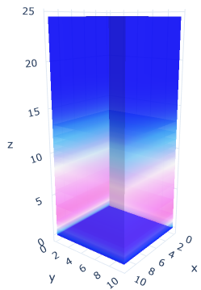
Plate size (Lx=Ly)
a020x075; Lxy = 5
Lxy = 10
Lxy = 15

Slide 18
Specifying Grafted Points

Slide 19
Strategy
2D binary array for surface sites of homogeneously grafted polymer given grafting density, simulation box size, and discretization (and assuming dx = dy)
Fullspace must be periodic on x0 = xL, y0 = yL
Halfspace must be even on xL/2 and yL/2 (overlap of boundary following REDFT00) and periodic on x0 = xL, y0 = yL.
Homogeneous spacing as determined by regular hexagon, where grafting point at centroid of hexagon
In case there are edge effects, try shifting the centroids away from the boundaries of the xy-plane (only did for fullspace)
Make sure no edge effects by comparing results of full FFT with cos FFT

Slide 20
Test conditions
Sigma = 0.05 c/nm2
Lx = 15 nm
Ly = 15 nm
dx = 0.4 nm
Cast in terms of dx (for rounding and PBC for grafting points):
Sigma = 0.0668 c/nm2
Lx = 14.80 nm
Ly = 11.20 nm
(Sigma error decrease with dx)

Slide 21
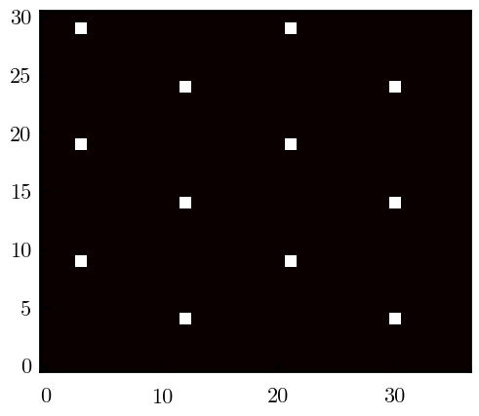
Padded PBC (Full FFT)
Hexagons drawn for illustration of hexagon approach

Slide 22
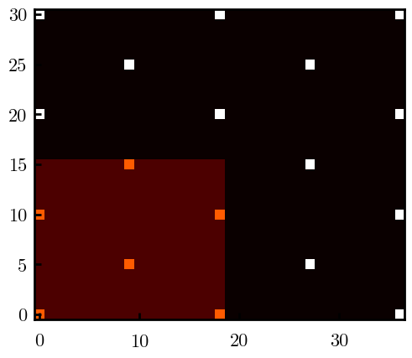
Unpadded PBC (Full/Cos FFT)

Slide 23
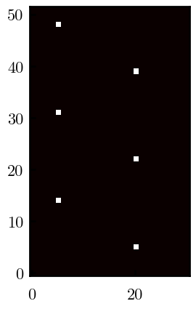
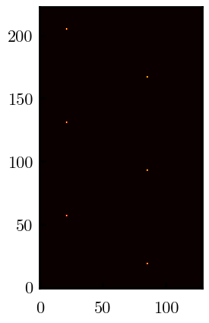
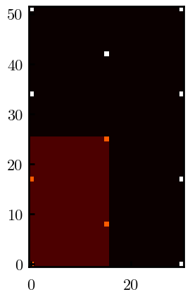



Other conditions (full and half results overlapped to show match)
s = 0.0241 (20.28%; dx=0.4), Lx, Ly = 12.40, 20.80
s = 0.0208 (4.08%; dx=0.1), Lx, Ly = 12.90, 22.30
s = 0.1332 (11%; dx=0.1), Lx, Ly = 20.50, 20.40

