Slide 1
Nafion
Last updated 06/21/2024

Slide 2
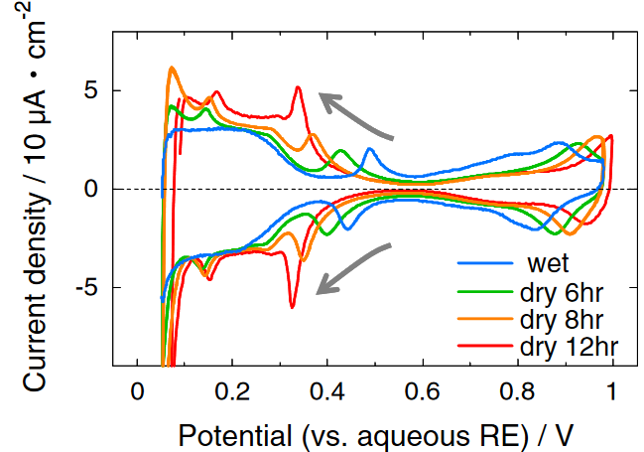
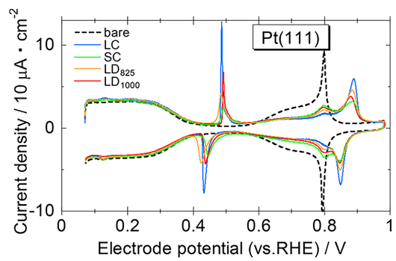
Motivation
For hydrogen fuel cells, Pt loading/efficiency is limiting factor for cost/efficacy
Leading theory: Pt poisoned by adsorbed ionomer SO3 at high operating V
However, scientific community has limited understanding of polymer physics
Using polyelectrolyte brush SCFT can provide physical insights as well as computational framework for rational design of PEM ionomers
SO3 (ad/de)sorption
Relevant experiments:
SO3 adsorption measured by cyclic voltammetry (CV) – 0.100 M HClO4
Apply potential at some scanning rate, measured current corresponds to interaction at electrode (e.g., reaction, adsorption)
(top) As humidity decreases, more current at lower voltage
Thus, as ionomer—Pt distance decreases, more SO3 adsorption
(bottom) Long ionomer sidechains (LC) more current than short sidechain (SC)
Note: LD = long distance between ether/SO3H; discussion becomes muddled on effect
Kodama et al. (2013) Electrochem. Commun. Kodama et al. (2018) ACS Catal.

Slide 3
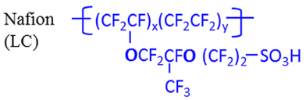
System
Schematic/Simplified system:
Polymer brush immersed in solution
Solution in contact with positively charged electrode
In real fuel cell:
Proton source from splitting of hydrogen (cathode, far left of schematic)
Proton sink from reaction with oxygen at Pt, forming water (anode, right side of schematic)
In CV experiments:
Pt coated with thin film of ionomer immersed in solution of 0.100 M HClO4
Preliminary SCFT model:
Grafted polymers are Nafion sidechains “grafted” onto the bulk ionomer membrane
In the future, model can be extended to consider entire Nafion chains to more accurately describe poisoning mechanism
+
+
−
+++++++++++
+
+
+
−
+
+
+
−
+
+
+
+
−
+
+
+
−
+
+
+
−
+
+
Backbone
Sidechain

Slide 4
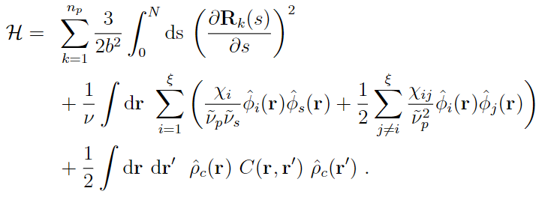
Model
Interactions
Self-consistent field theory for charged multiblock macromolecules
Coupled system of 5 algebraic equations and 2 partial differential equations
For sidechain-only system, 2 blocks; Block 2 contains -1e for SO3-
F-H parameters taken from literature (Wu, Paddison, Elliot, Energy Env. Sci. 2008. 1. 284-293)
Elastic energy
Flory-Huggins (Hydrophobicity)
Electrostatics

Slide 5
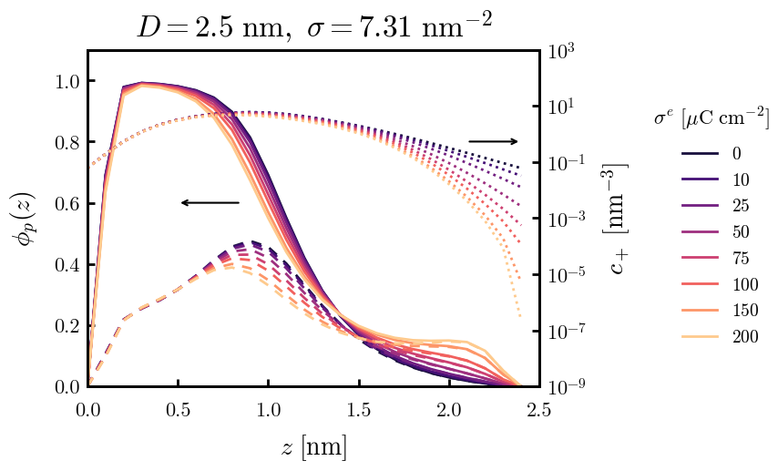
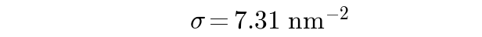
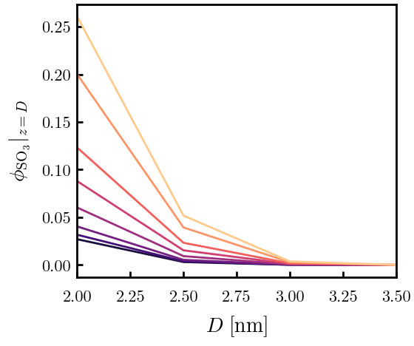

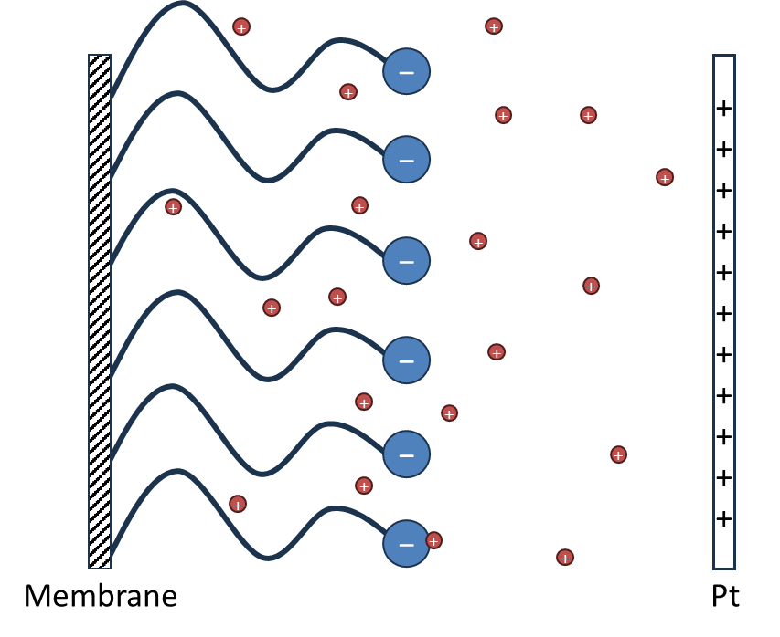
Sidechain only (Continuous Gaussian Chain)
Model: “grafting surface” is bulk membrane/thin film; only considering elasticity of sidechains
True grafting density unknown, 7.31 c/nm² is approximately the density of sidechains based on the random walk of its backbone
(Left) Density of polymer on Pt surface as a function of membrane–Pt separation distance. Colors indicate Pt surface charge density
(Right) Polymer density distributions (solid) and proton distributions (dotted) for D = 2.49 nm. Density distribution of SO3 bead is dashed.
Ionic strength 0.100 M

Slide 6
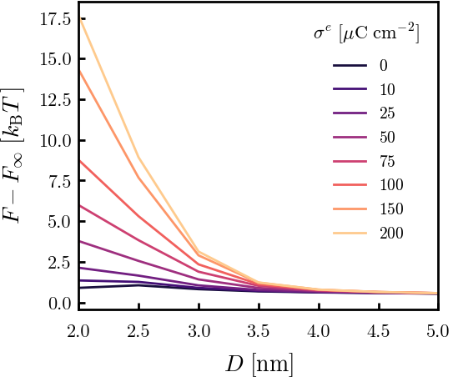
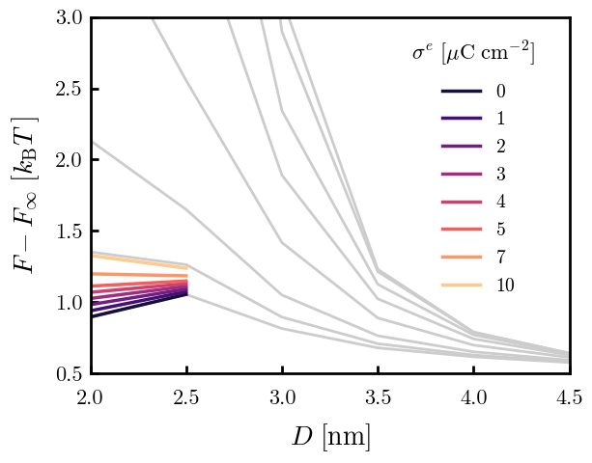
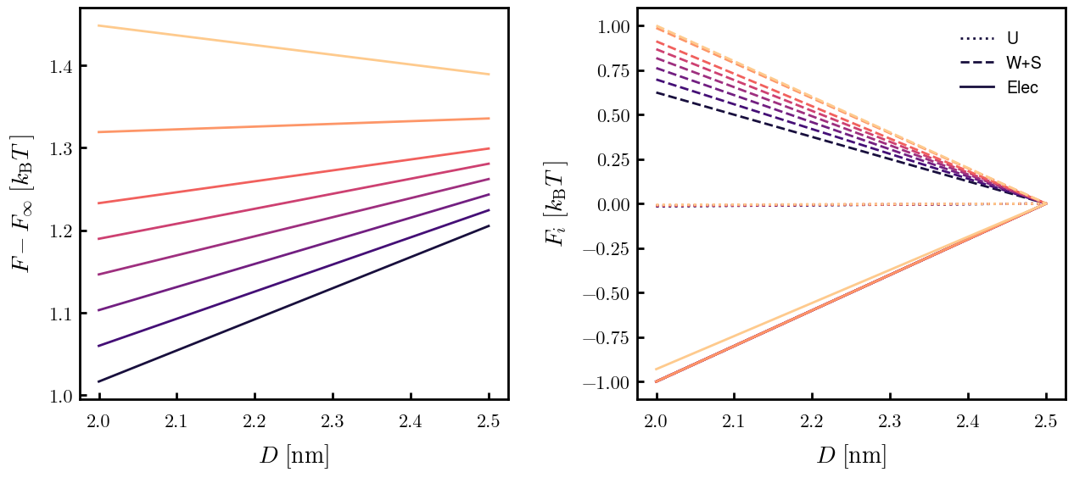
Sidechain only (Continuous Gaussian Chain)
0.100 M
In CV data, reaction goes to completion by 0.5 V (vs. RHE)
Surface charge (metal) ~10 uC/cm² according to Saha & Zenyuk. JPCC. 2021.
(Top) SCFT free energies as a function of D.
(Top right) Free energies for 1—10 uC/cm² colored. Small D is favorable at low charges, becomes unfavorable as surface charge reaches ~7 uC/cm²
(Bottom right) Normalized contributions to free energy for 1—10 uC/cm². Contributions that equal 1 at D = 2.0 are the dominant interactions.
U: Hydrophobicity; W+S: Elastic/Polymer; Electrostatic
For < 10 uC/cm², electrostatic interactions outweigh elastic penalties and lower D is favorable. At 10 uC/cm², elastic penalties become dominant and higher D is favorable.
Takeaway: competition between elastic stretching of sidearms and electrostatic attraction balances at 7 uC/cm² (very roughly 0.5 V)

Slide 7
Counterion PB

Slide 8
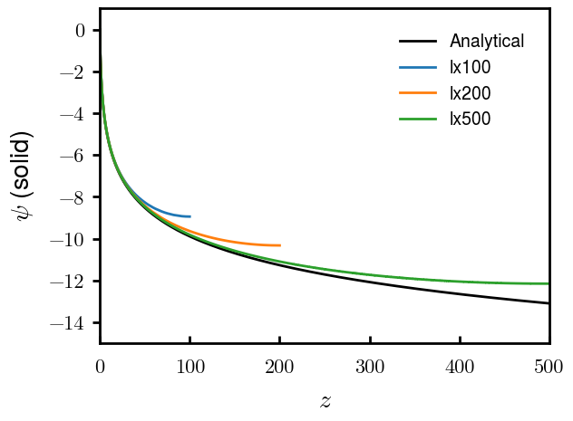
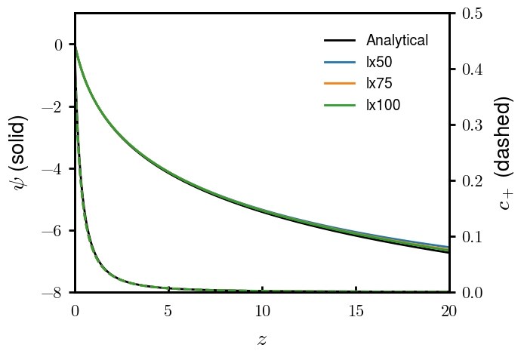
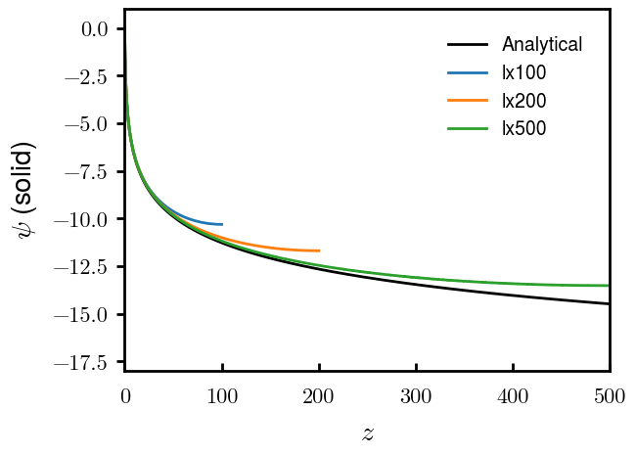
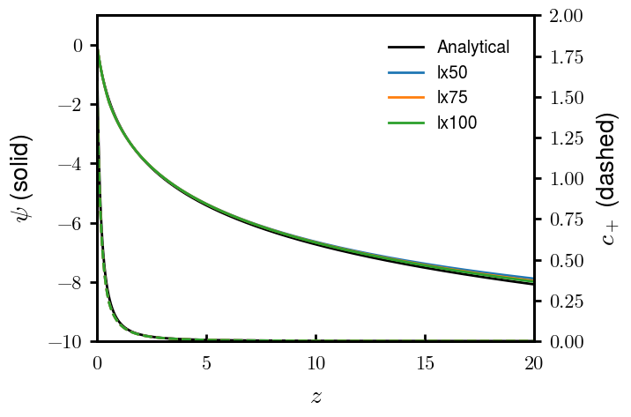
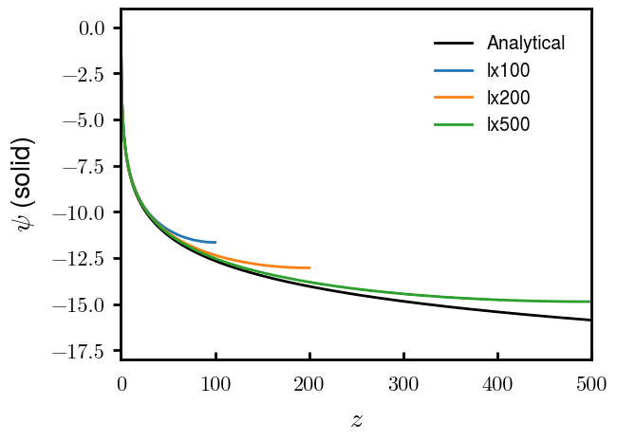
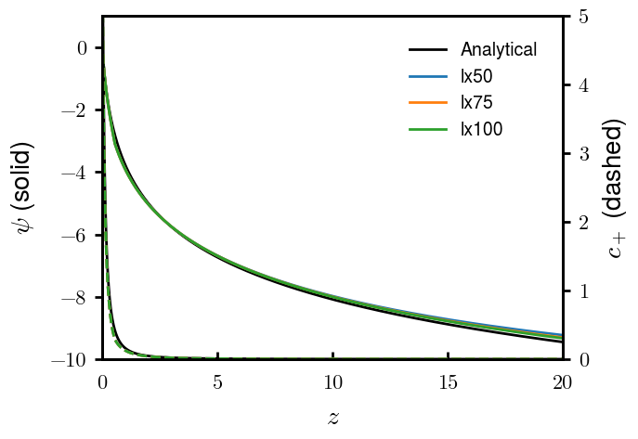
Counterion only; NBC—(D)—NBC validations
sigma = -5e-20 C/nm2
sigma = -10e-20 C/nm2
sigma = -20e-20 C/nm2
Log-divergence, exact as lx → infty
Method: NBC left, NBC right, DBC somewhere

Slide 9
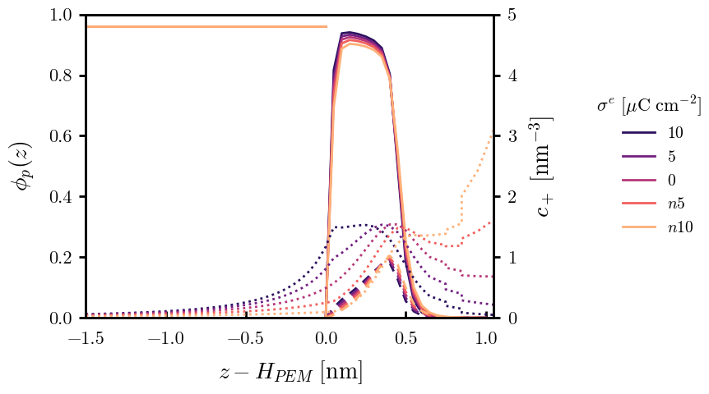
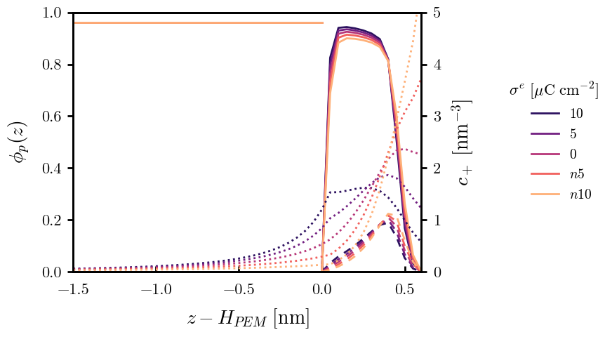
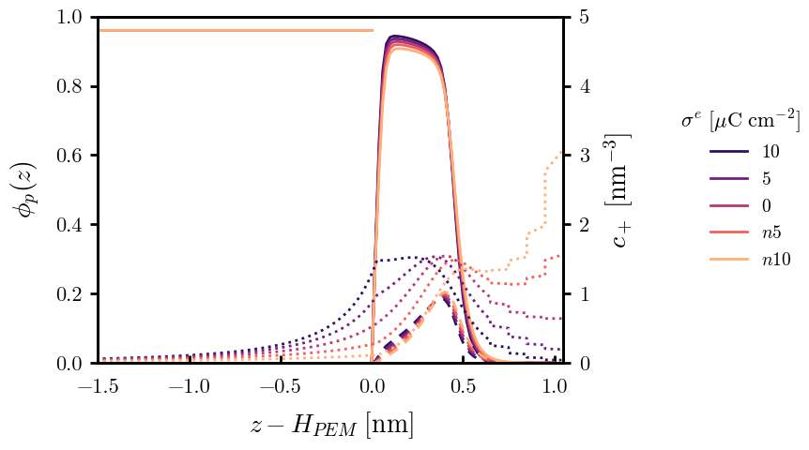
Prelim results (20240906)
RH = 10%, sigma=1.35 nm-2
Lpha = 1.0 nm
Lpha = 0.6 nm
dz = 0.05
dz = 0.02

Slide 10
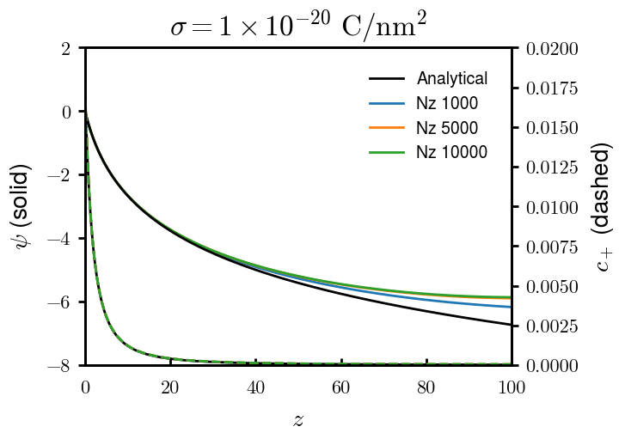
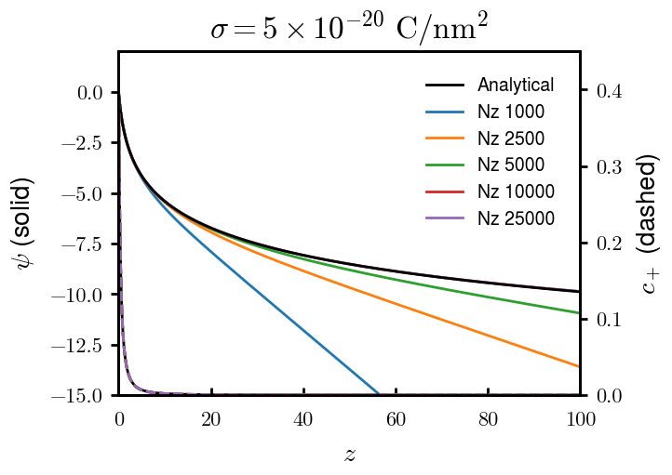
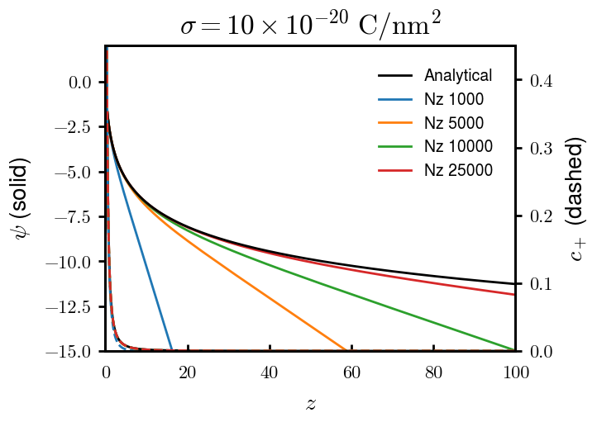
Counterion only; DBC—NBC validations
Method: Newton iteration (a = 0.8), DBC right, NBC left

Slide 11
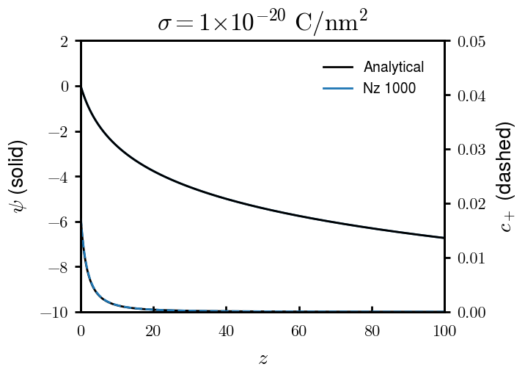
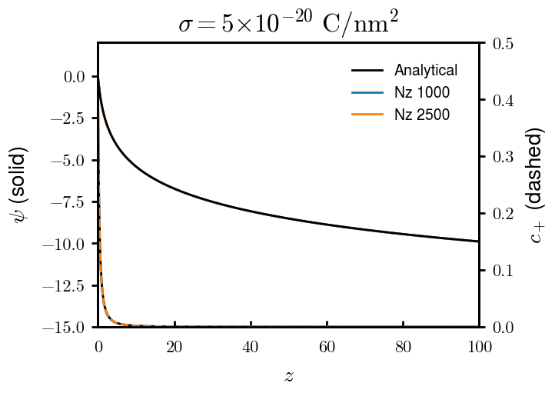
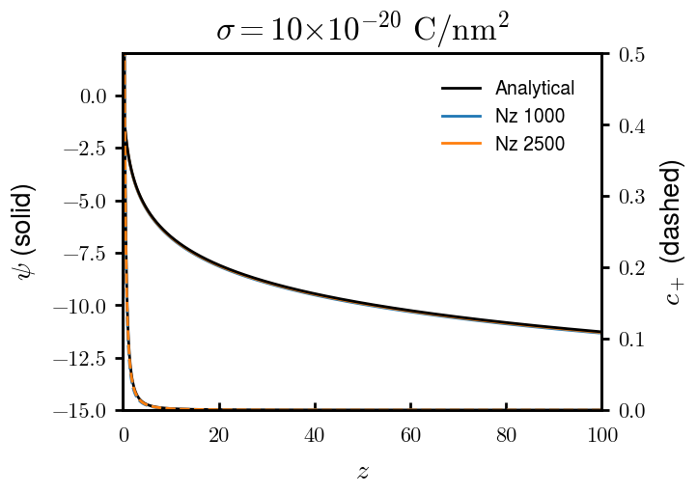
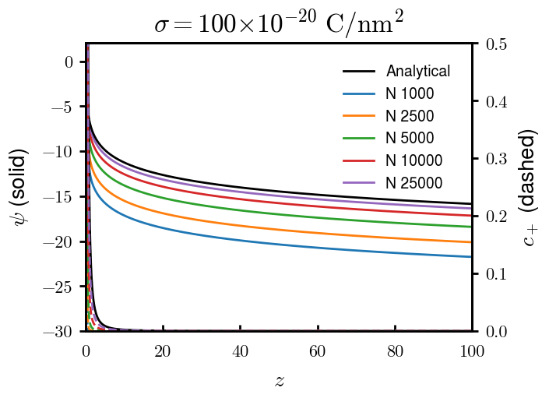
Counterion only; (t) NBC—NBC validations
T = 1.0; Nt = 20,000
T = 1.0; Nt = 20,000
Doesn’t properly reflect slope 0. Abandoned
T = 1.0; Nt = 20,000
T = 1.0; Nt = 20,000
Method: Heat. SS at gradient change zero. Nested newton iteration. NBC right, NBC left. psi(0) = 0 shifted.

Slide 12
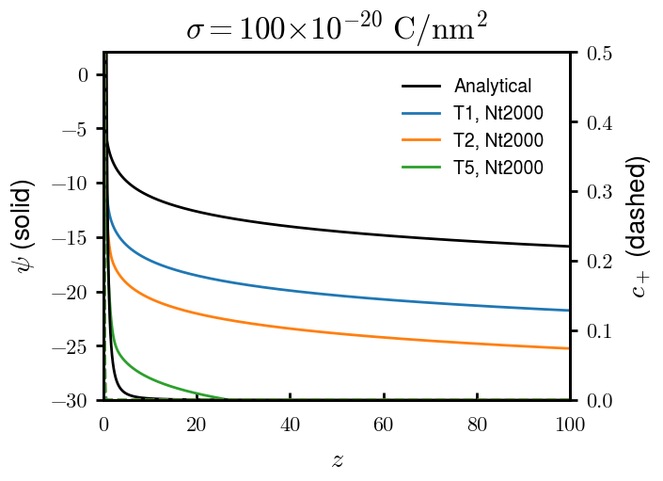
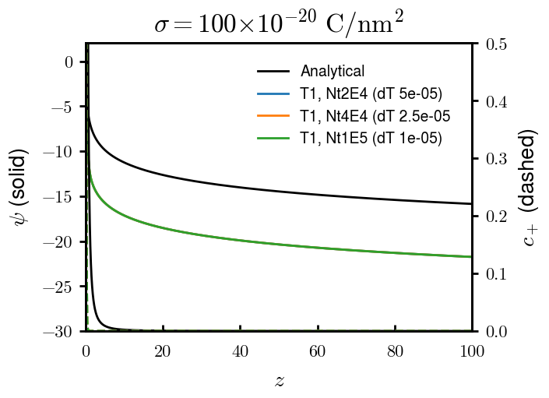

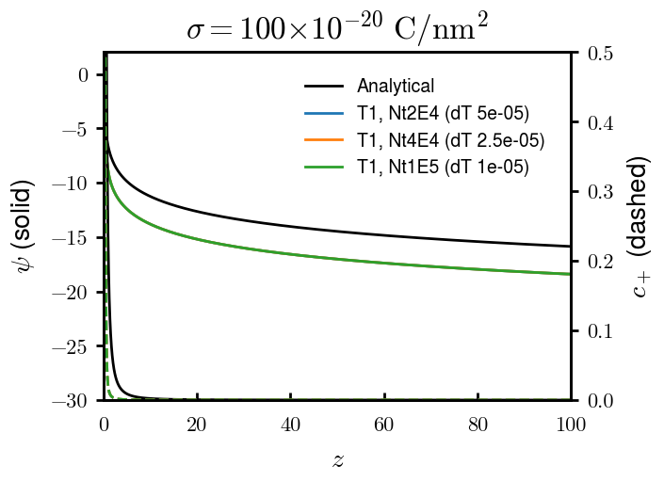
Time in “Heat”
Total T, const Nt
dT, const Total T
Total T, const dT
N = 1000
Doesn’t properly reflect slope 0. Abandoned
N = 5000

Slide 13
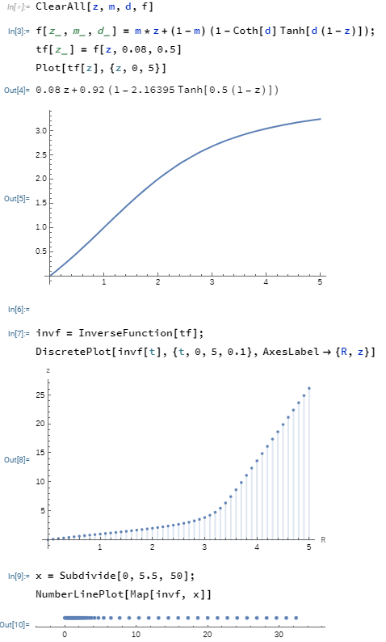
Uneven grid (theory)
Mapping theory
FD equations

Slide 14
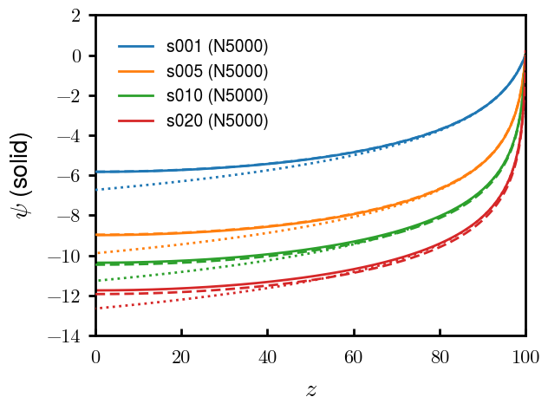

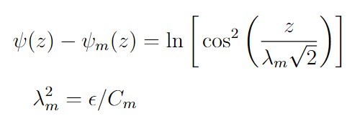
Uneven grid (analytical compare)
Dotted:
Infinite boundary condition, log-divergence
Note: midpoint concentration can be calculated analytically but wasn’t quite right. In plot, used midpoint concentration obtained with N = 10,000
Dashed:
Srivastav et al. Part I. 2024. Langmuir
Finite boundary condition

Slide 15
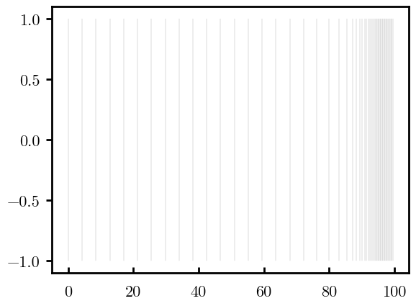

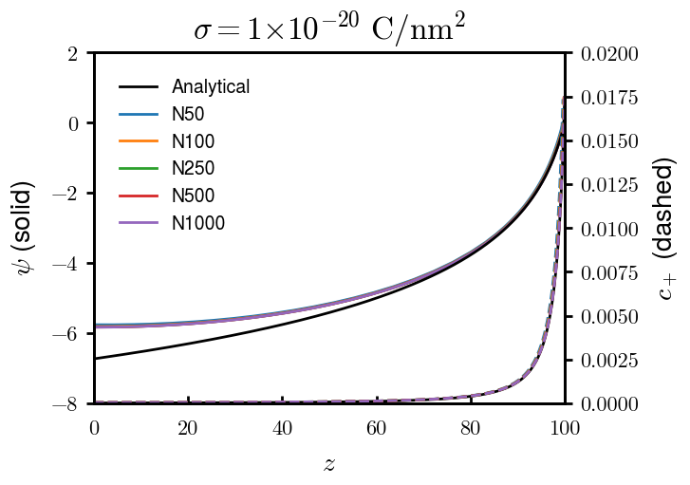
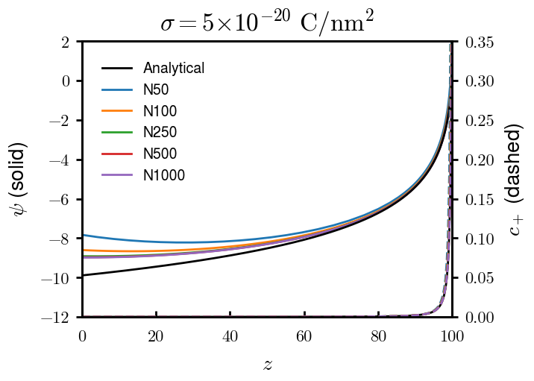
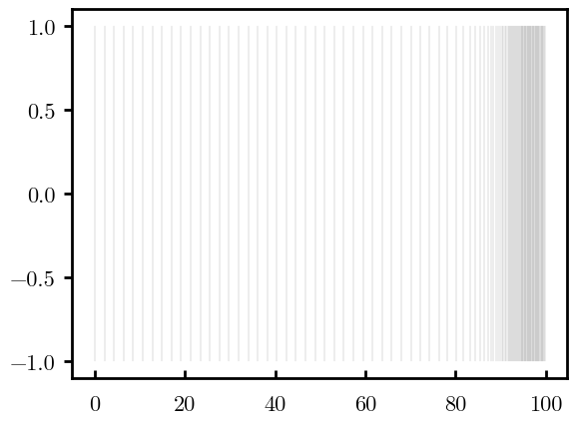
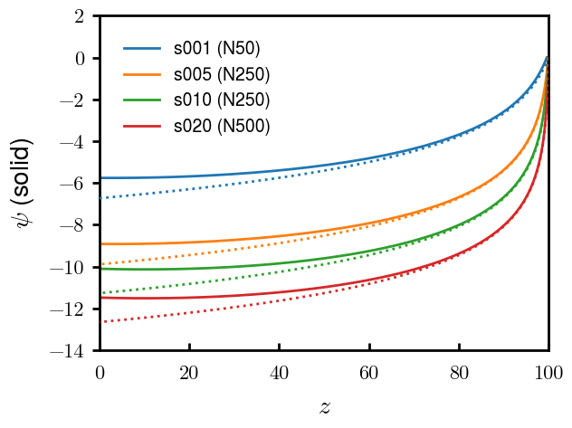
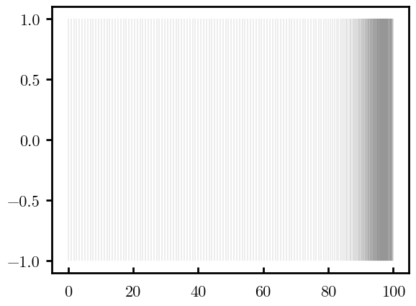
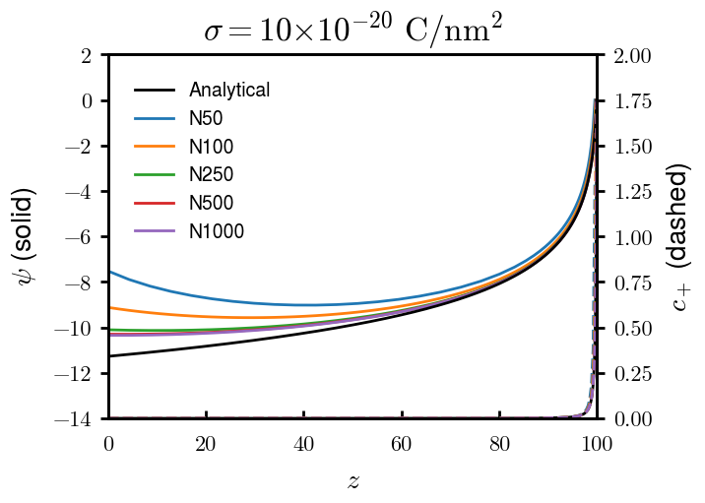
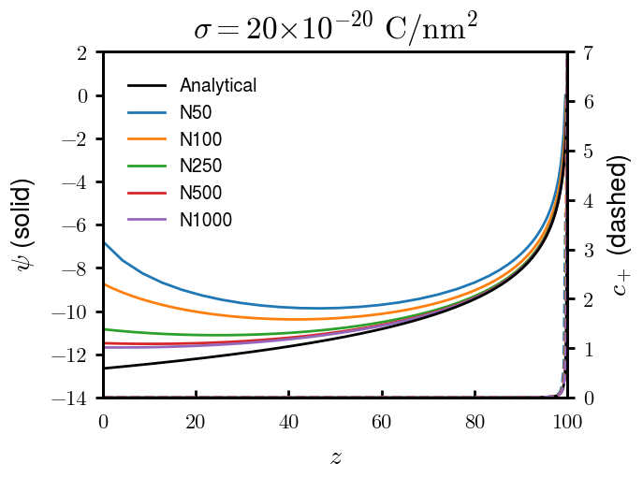
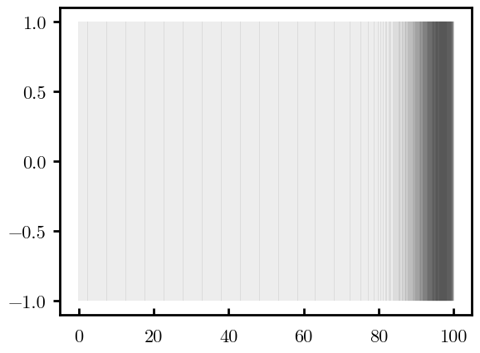
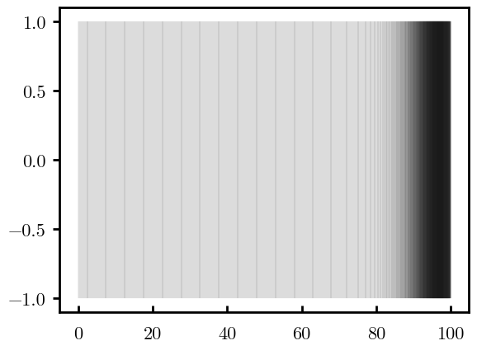
Uneven grid (N)
Transition knee in red (z ~ 90)
Analytical = log-divergence (original)
N = 50
N = 100
N = 250
N = 500
Analytical dotted
N = 1000

Slide 16
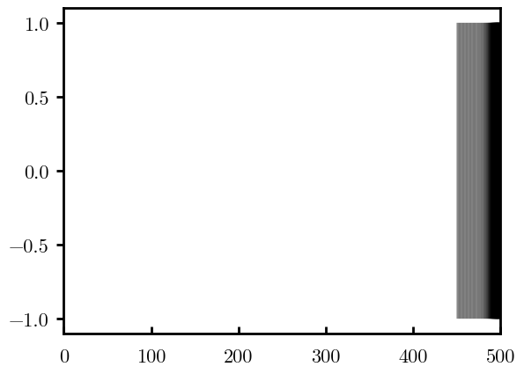
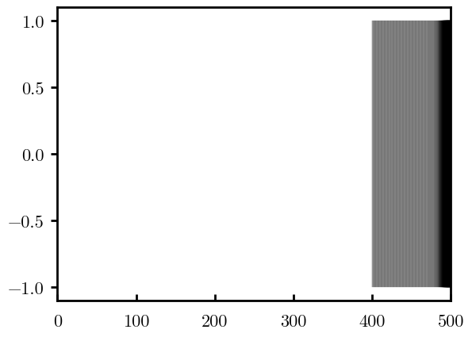
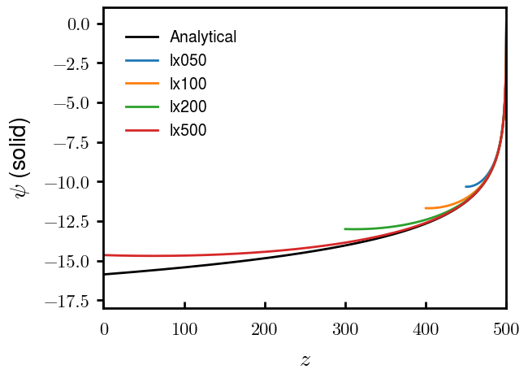
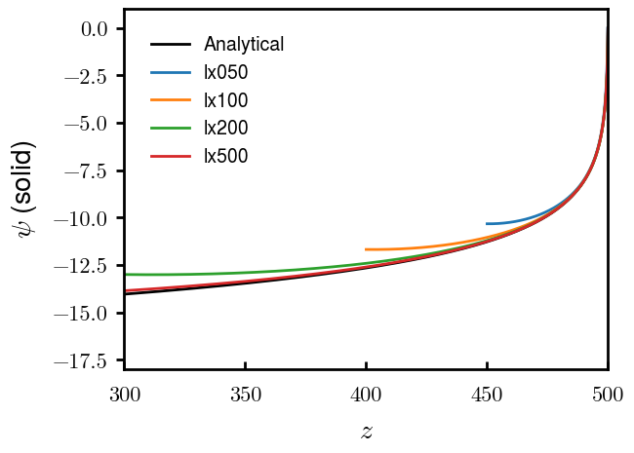
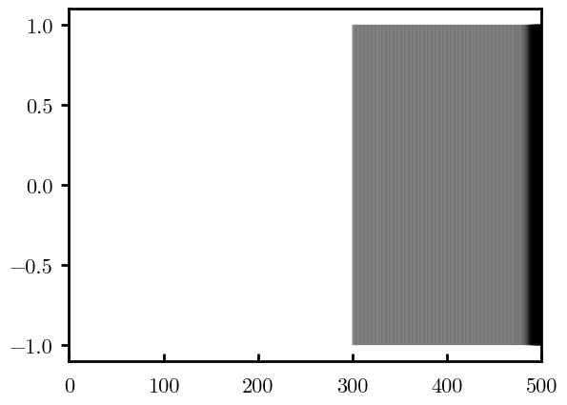
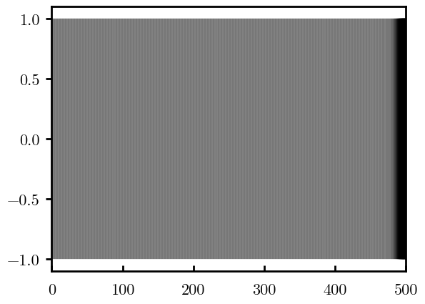
Uneven grid (Lx, left)
L = 50
(N=764)
Chop from left
s = −20e-20
L = 100
(N=1000)
Original
Extend left (evenly)
L = 200
(N=1471)
L = 500
(N=2884)

Slide 17
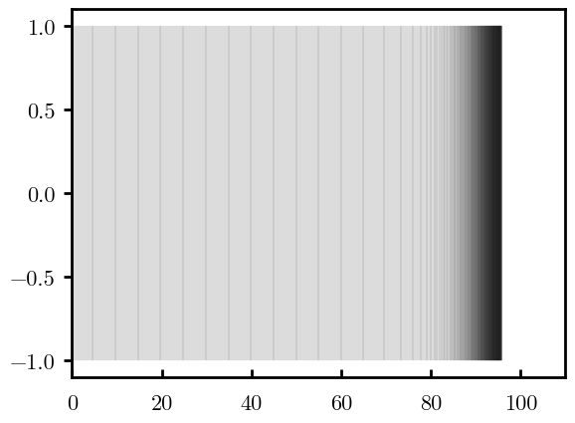





Uneven grid (Lx, right)
L = 95
(N=746)
Chop from right
s = −20e-20
L = 100
(N=1000)
Original
Extend right (evenly)
L = 101
(N=1051)
L = 110
(N=1508)

Slide 18






Uneven grid + homo “polymer” (neg/pos surf)
s = −1e-20
s = −5e-20
s = −10e-20
s = +1e-20
s = +5e-20
s = +10e-20
Homo charge
Homo charge
Homo charge

Slide 19
Full SCFT Validations

Slide 20


Surface charge (neutral polymer; m = 0.08)
Dashed:
Note: midpoint concentration can be calculated analytically but couldn’t get to work. In plot, used midpoint concentration obtained numerically
Srivastav et al. Part I. 2024. Langmuir
Finite boundary condition

Slide 21


Surface charge (neutral polymer; m = 0.35)
Dashed:
Note: midpoint concentration can be calculated analytically but couldn’t get to work. In plot, used midpoint concentration obtained numerically
Srivastav et al. Part I. 2024. Langmuir
Finite boundary condition

Slide 22



Extending PEM, s = -5e-20 C/nm2
Dotted:
Infinite boundary condition, log-divergence

Slide 23



Extending water layer, s = 0e-20 C/nm2

Slide 24



PEM charge density, s = 0e-20 C/nm2
cd00 not correct pha vol, consistent with other cd00; WA error/discontinuity?

Slide 25


Sidechain grafting density
m = 0.35, d = 0.50, x = [0, 5.5]. m = 0.08 did not work for sig3.0+

Slide 26


Water chemical potential
With chi = 2, Patm = 1 (np 320, N 100, A 50):
RH 5%: mu -3.00
RH 10%: mu -2.30
RH 25%: mu -1.39
RH 40%: mu -0.92
RH 60%: mu -0.51
Redo with Lz 100 (knee location)

