Slide 1
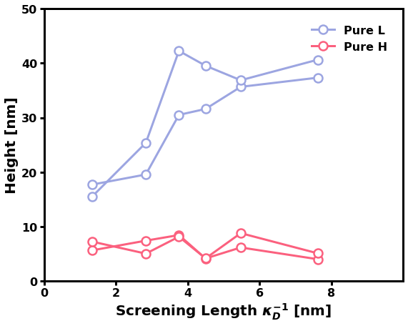
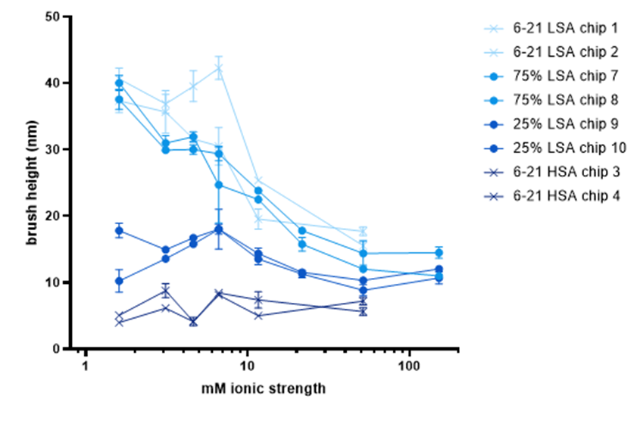

Slide 2
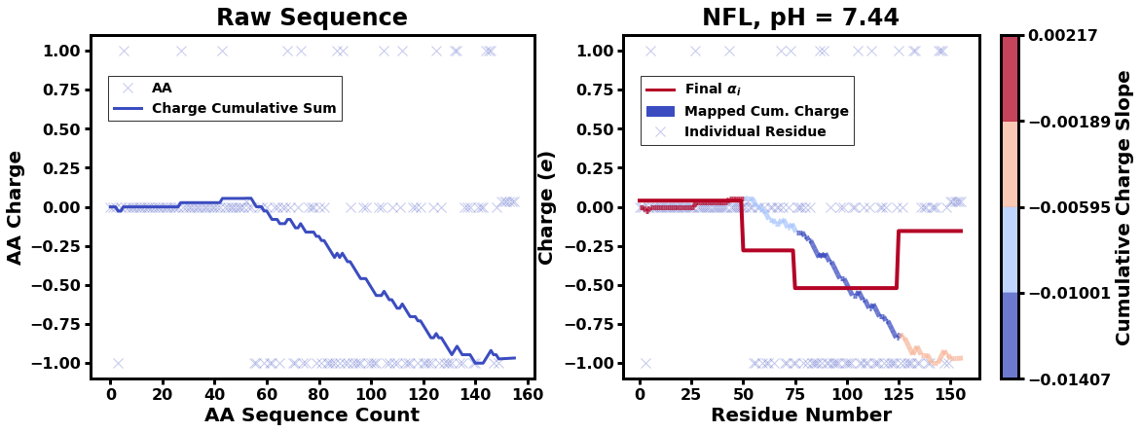
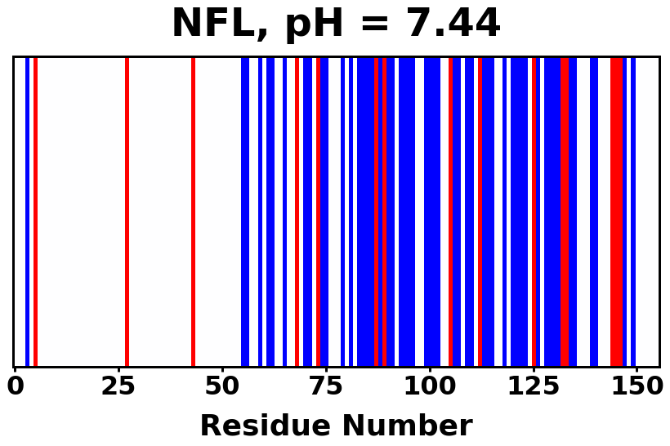

 | Slope Bins 4 | Smear Count 25
Block number | Alpha w/ Henderson Hasselbalch | Chi Chi_max = 2.2
[0 50] | 0.040012 | 1.160000
[50 75] | -0.278451 | 0.720000
[75 125] | -0.519707 | 0.608000
[125 156] | -0.154453 | 0.529032

Slide 3
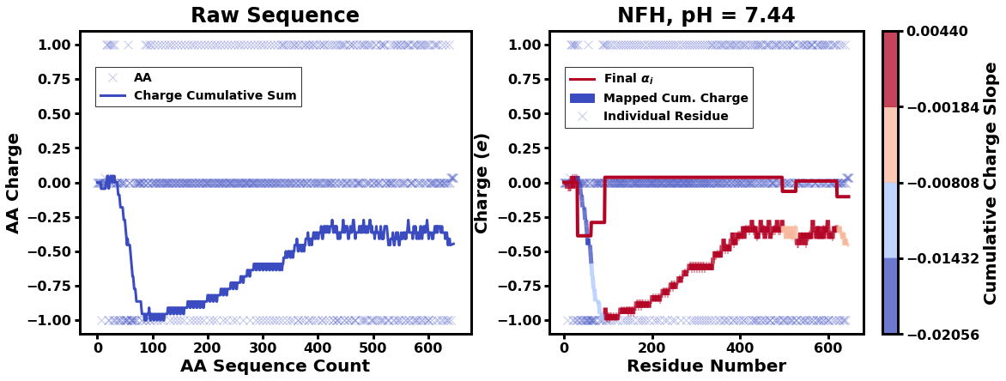

 | Slope Bins 4 | Smear Count 31
Block number | Alpha w/ Henderson Hasselbalch | Chi Chi_max = 2.2
[0 31] | 0.001103 | 0.922581
[31 62] | -0.386873 | 0.703226
[62 93] | -0.290146 | 0.967742
[93 496] | 0.037164 | 1.098759
[496 527] | -0.064533 | 0.819355
[527 620] | 0.010682 | 0.756989
[620 647] | -0.103326 | 0.696296

Slide 4
Approach
B, and v will be different for L and H
Chi should be same
Match pure L and H first, then mix
SCFT Purpose:
Additional information of underlying protein organization
Possible underlying conformational change driven by Cs

Slide 5
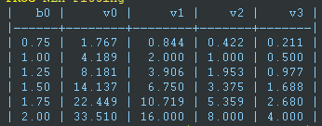

b = 0.75

Slide 6
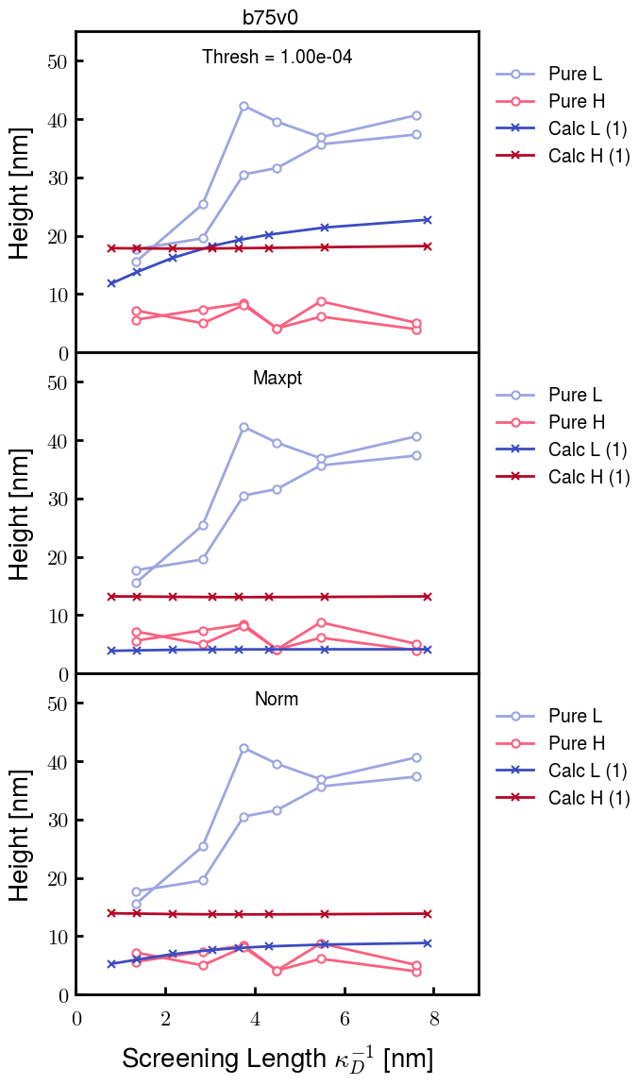
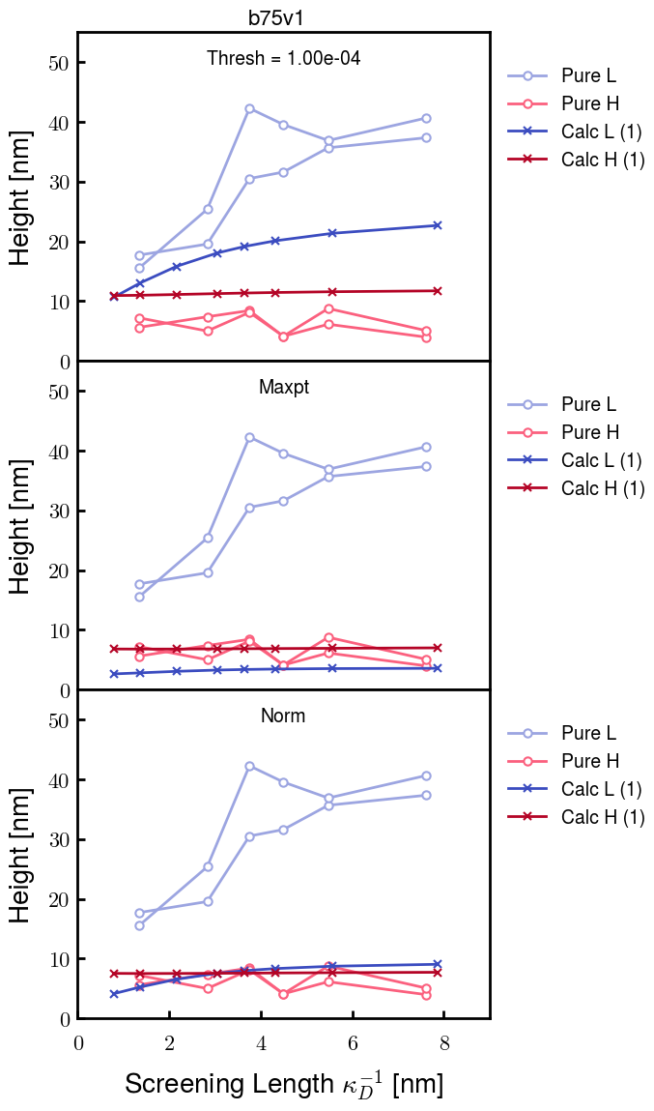
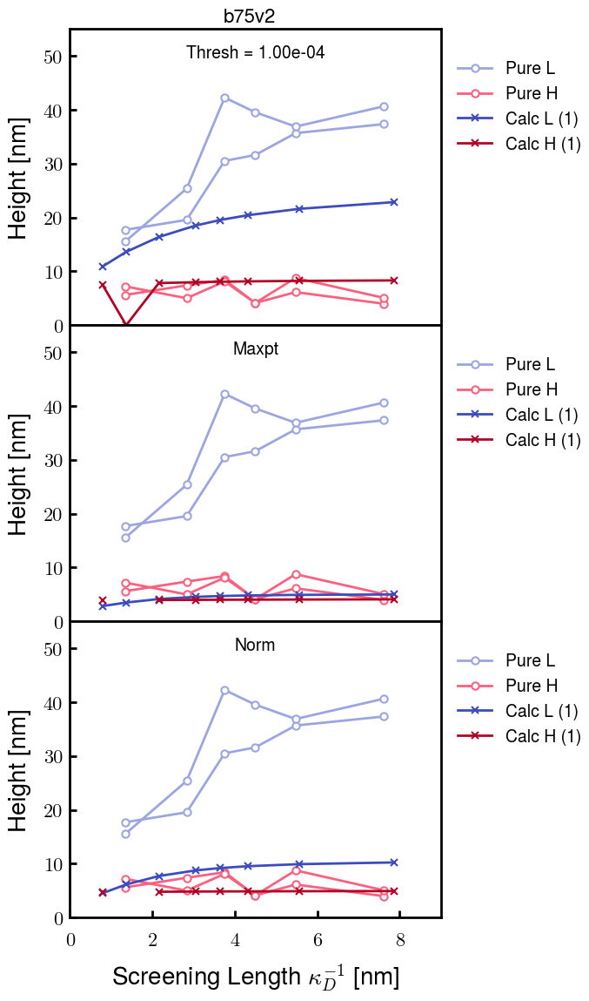
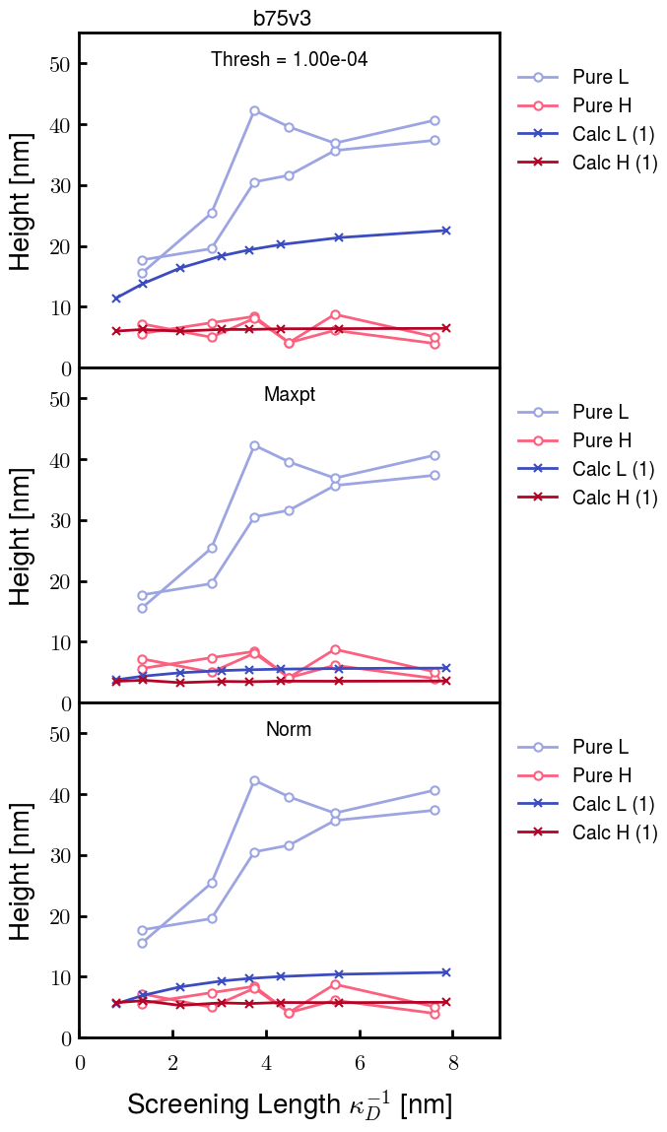

Slide 7
b = 1.0

Slide 8
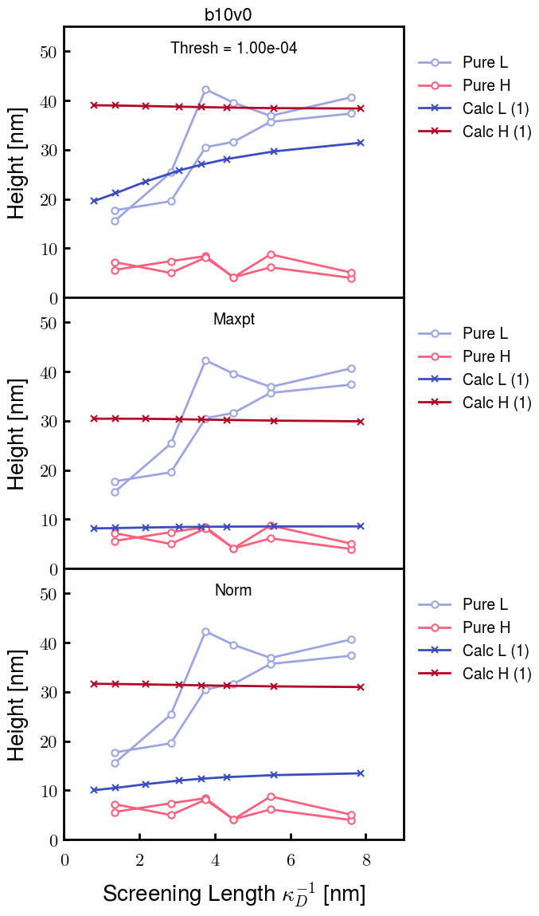
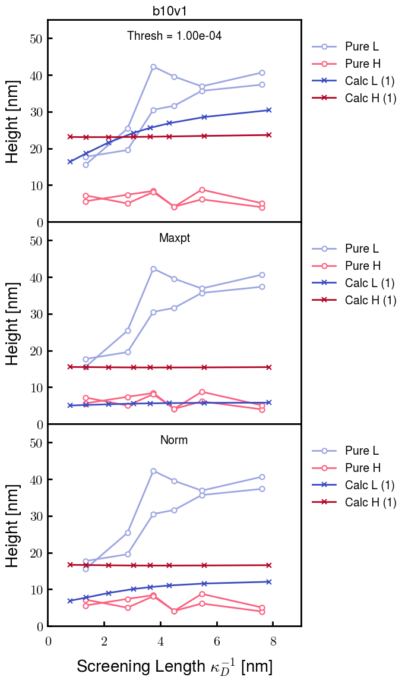
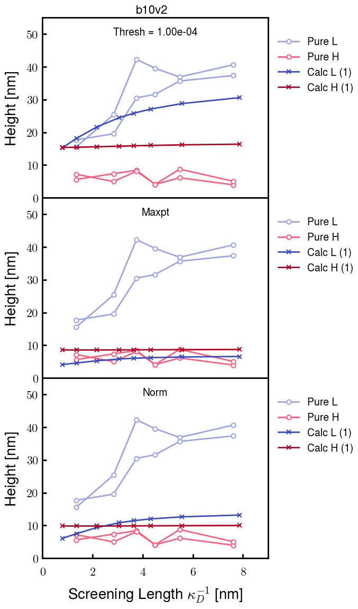
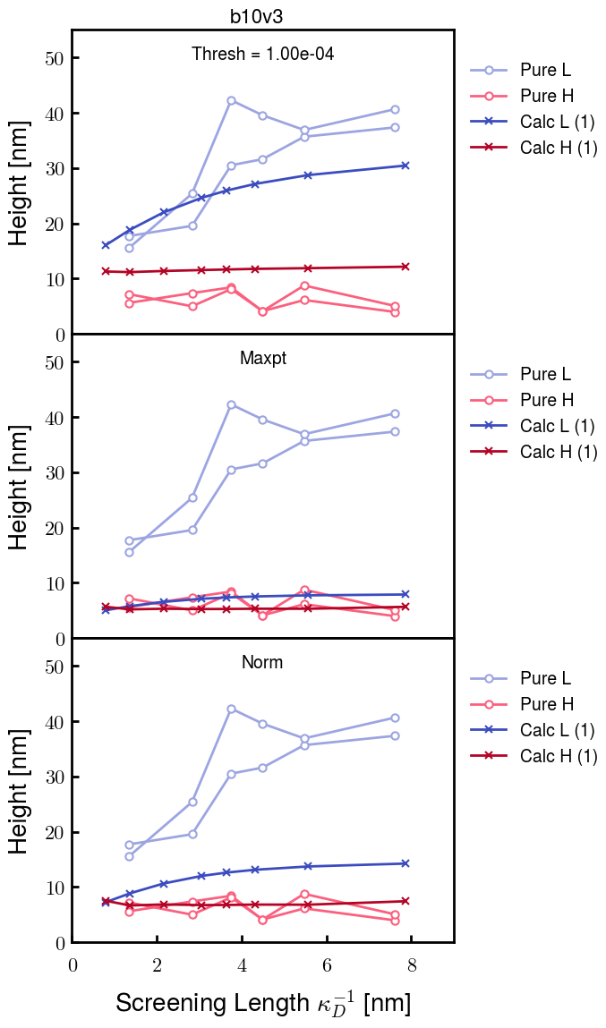

Slide 9
b = 1.25

Slide 10
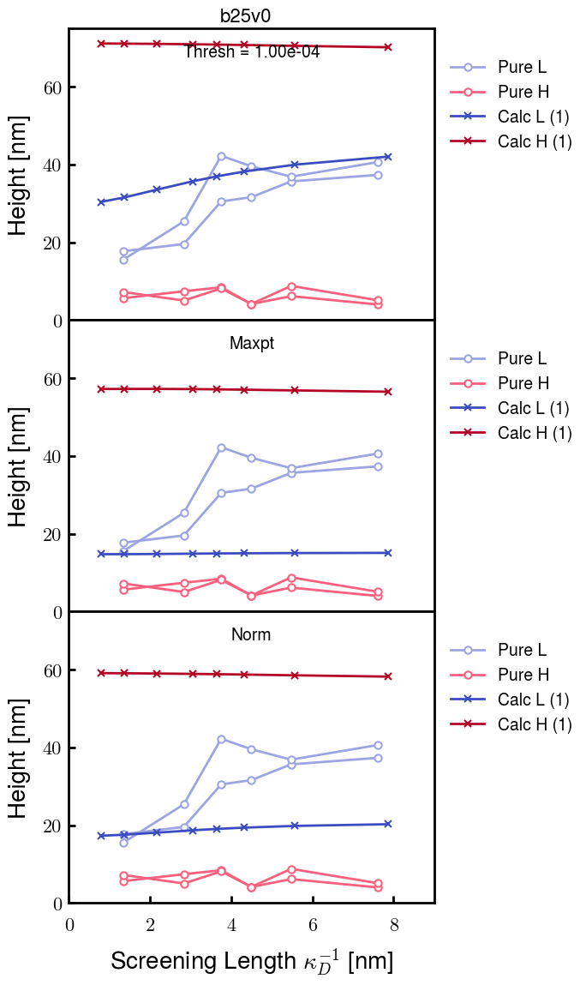
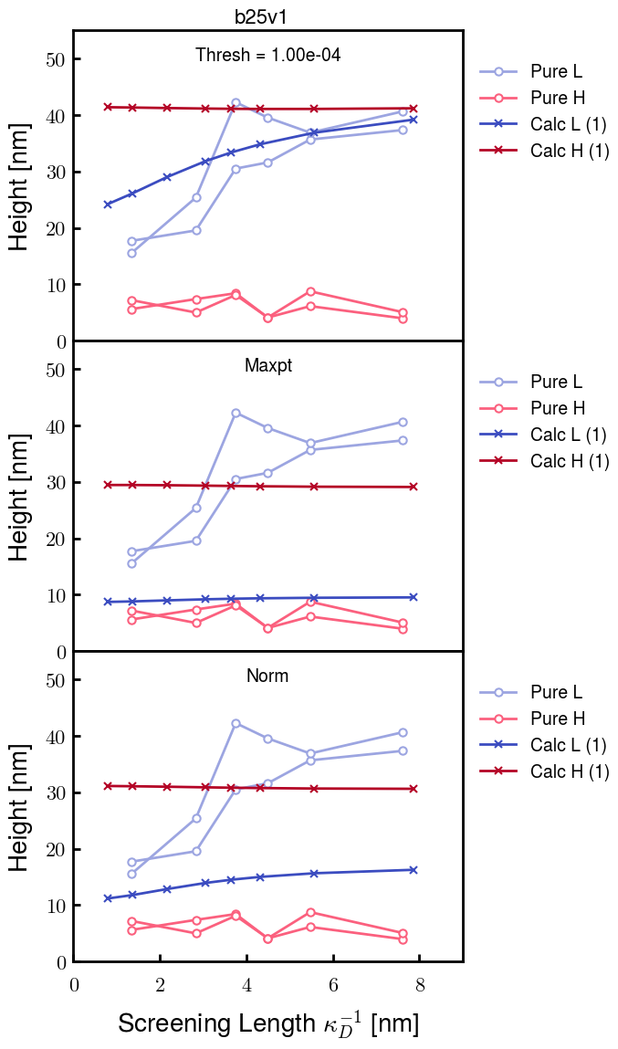
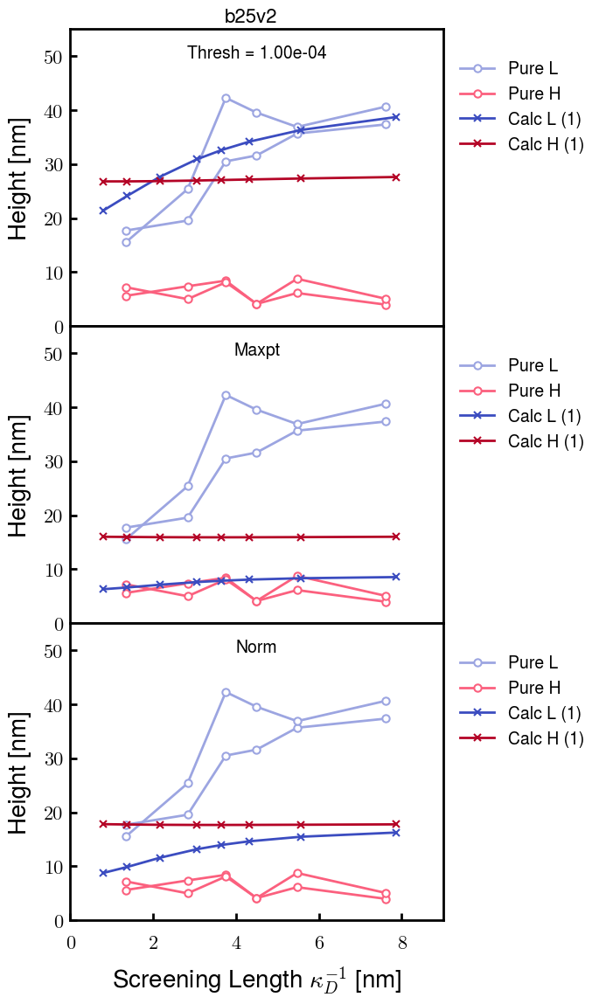
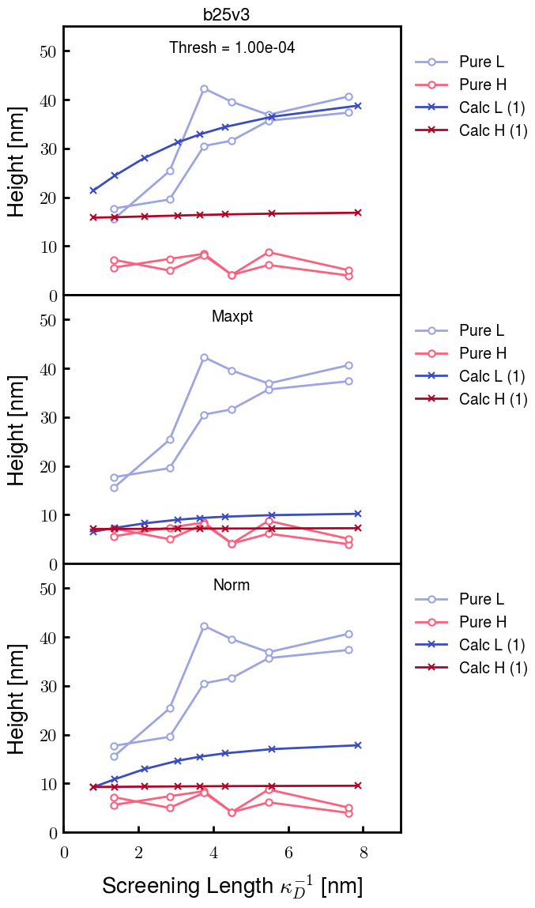
Chi 2.6

Slide 11
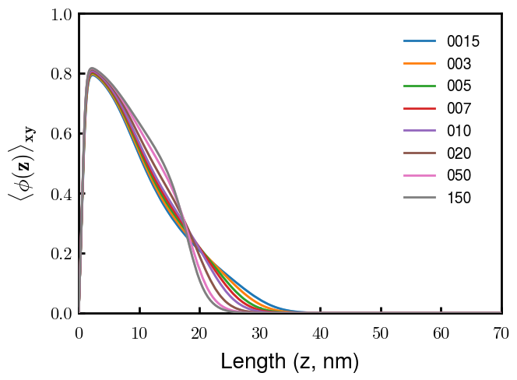
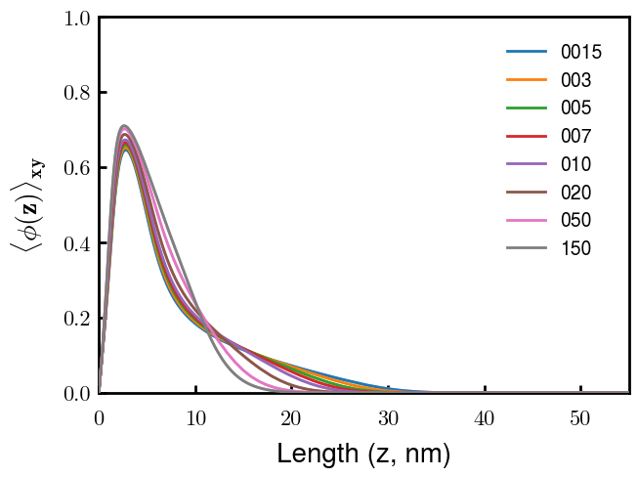
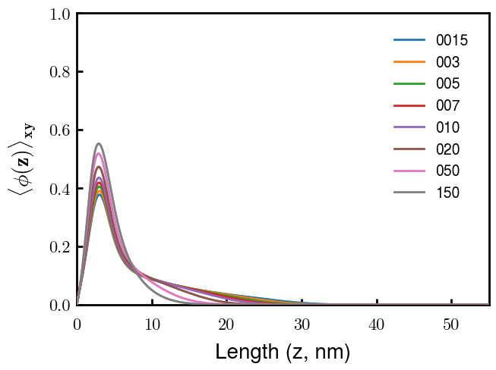
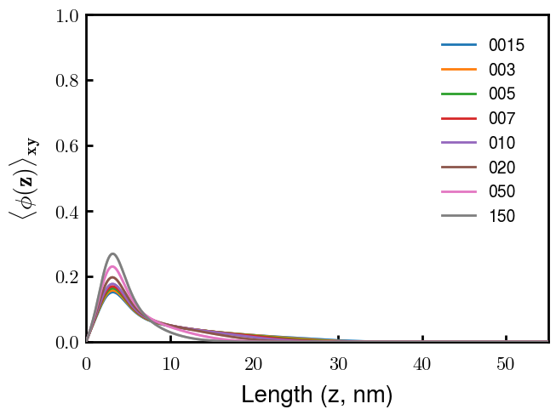
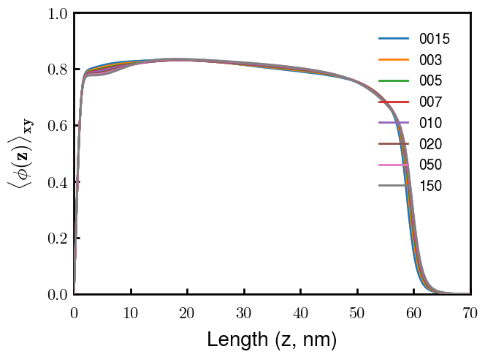
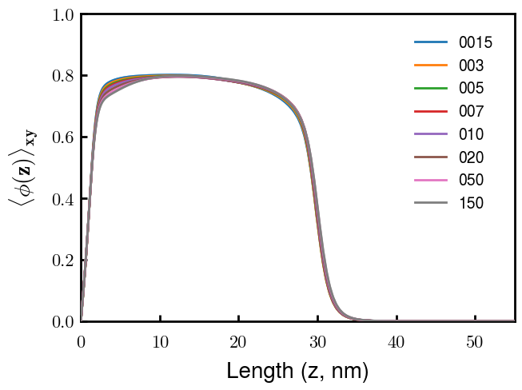
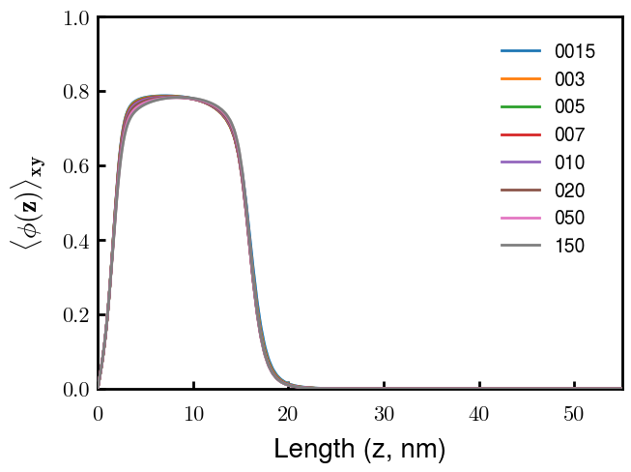
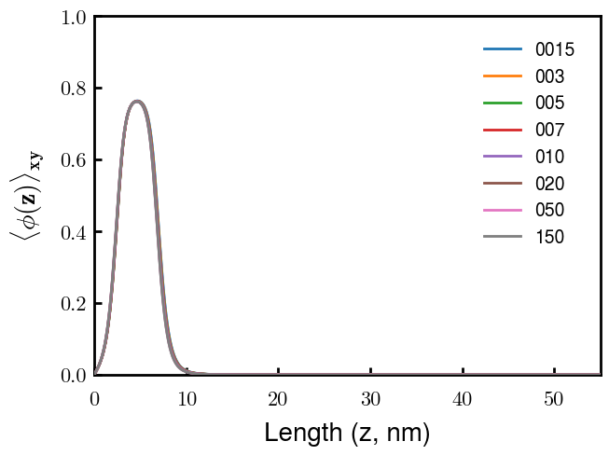
b25v0
b25v1
b25v2
b25v3

Slide 12
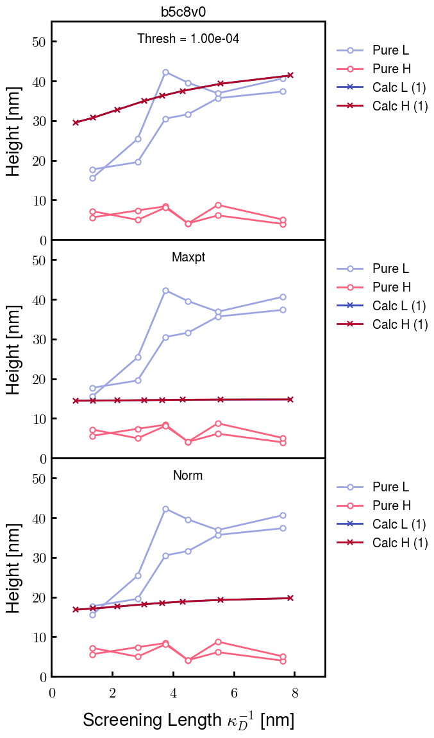
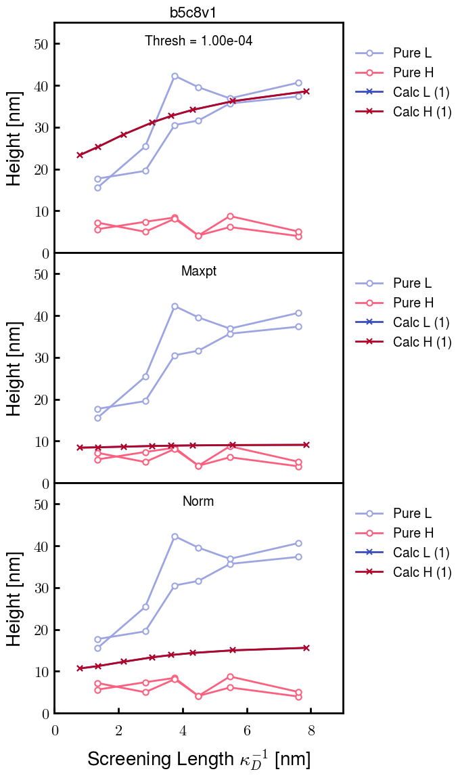
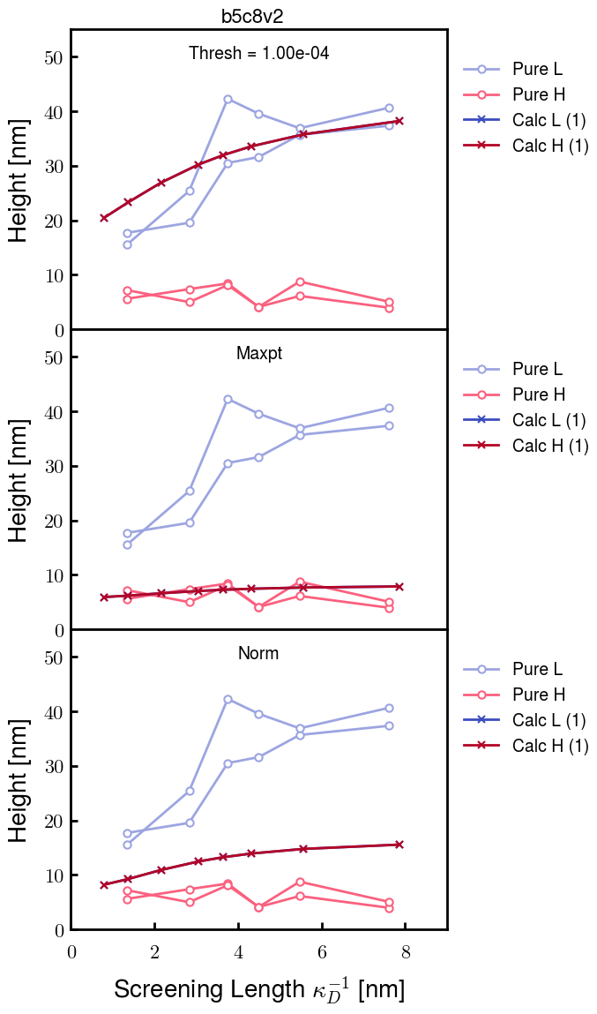

Chi 2.8

Slide 13
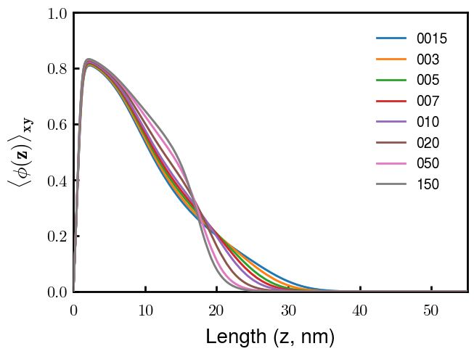
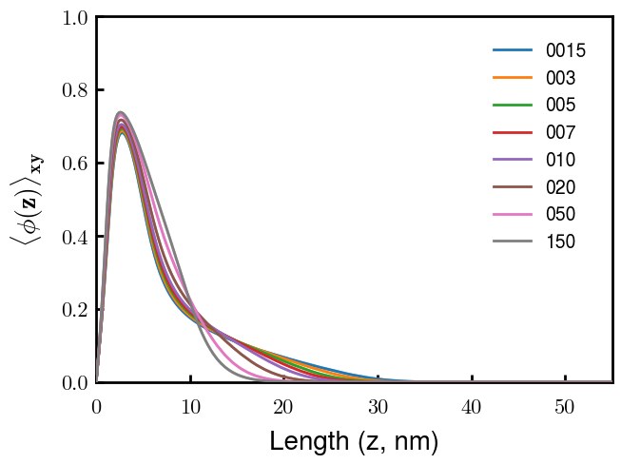
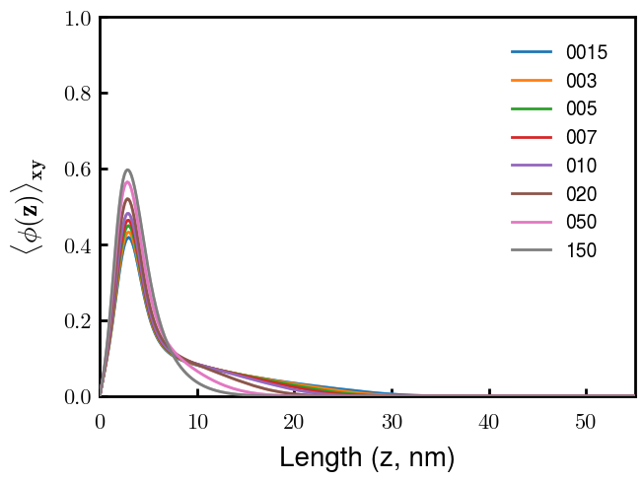


Slide 14
b = 1.50

Slide 15
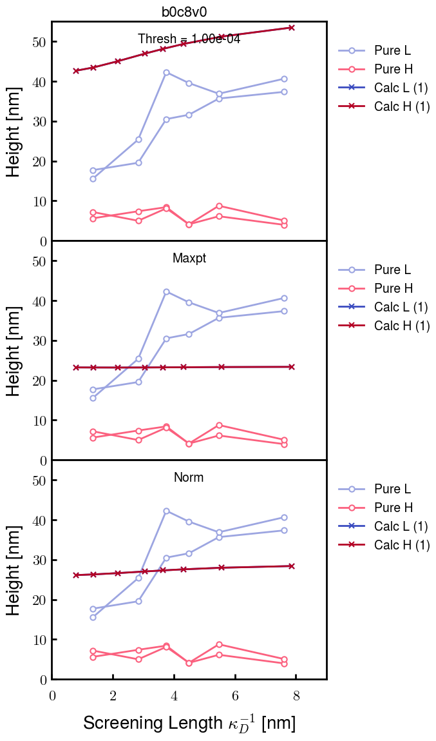
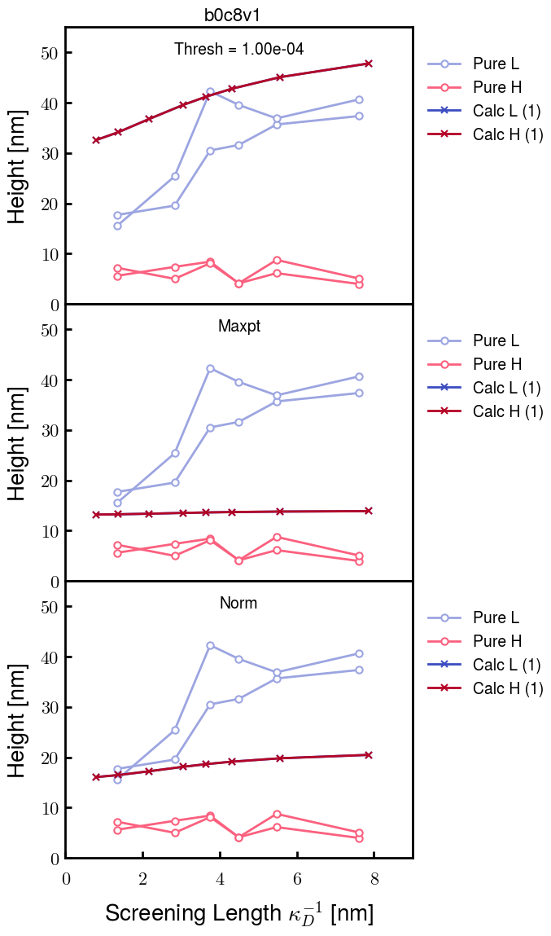
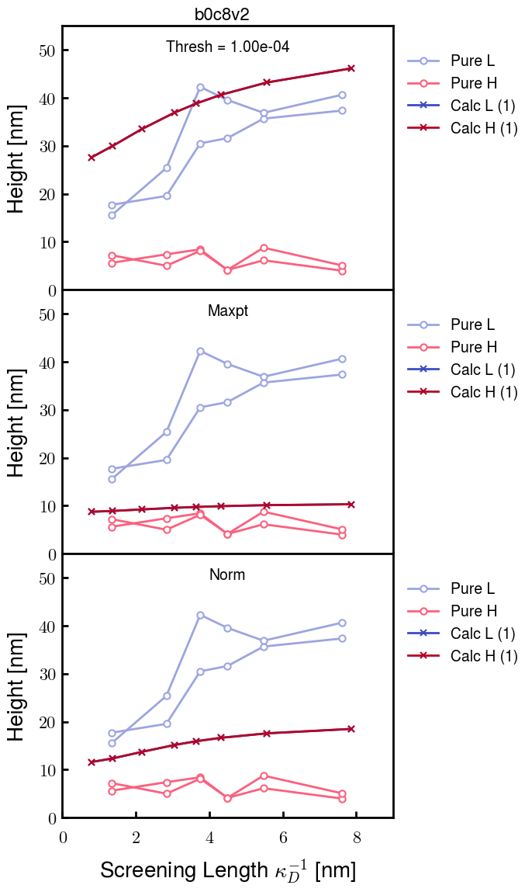
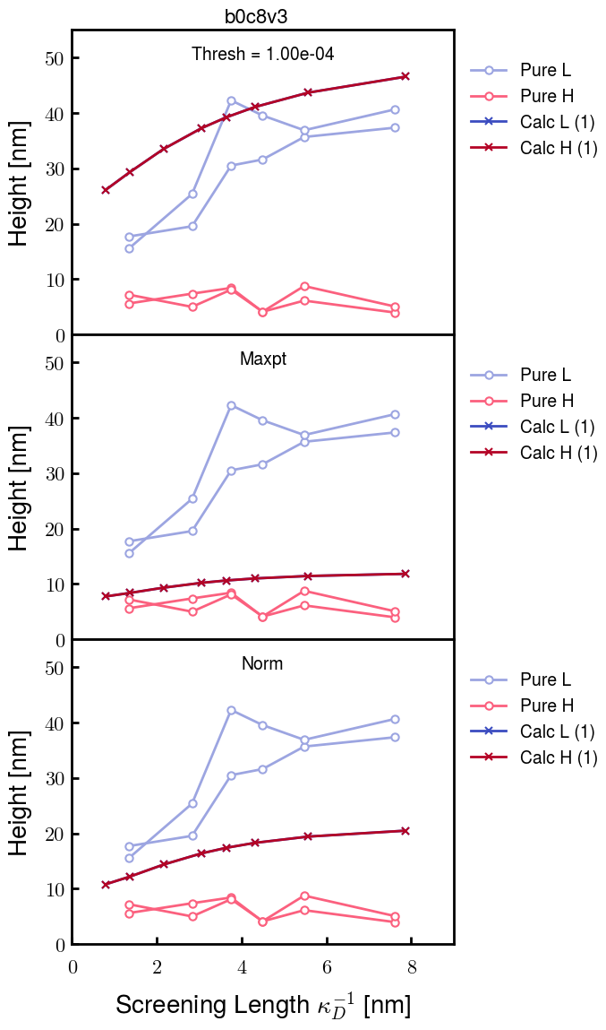
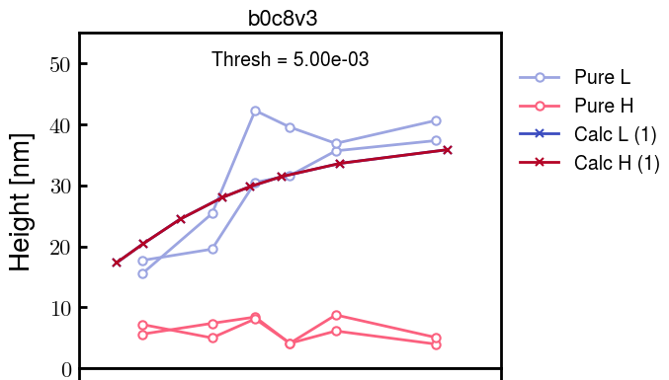
Chi 2.8

Slide 16
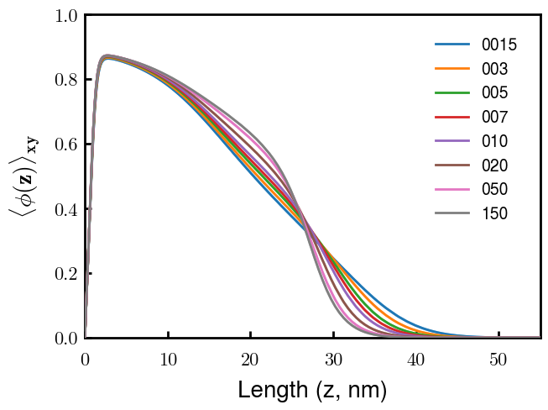
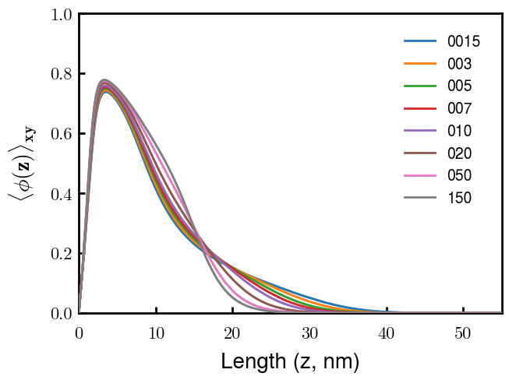
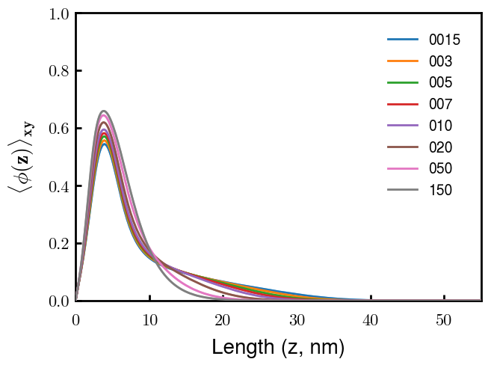
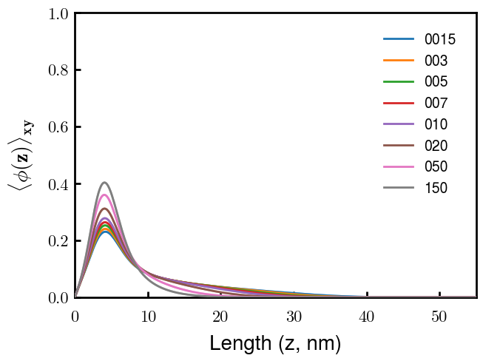

Slide 17

Traced b25v3 and applied onto others
Decreasing v0 leads to better behavior at the cost of less realistic polymer density profiles. Need to increase b0 to compensate.

