Slide 1
Interacting brushes

Slide 2
Preliminary MFT
Homopolymer charge alpha
Chi = 0.5, Nm = 200, sigma = 0.05, b = 1.0, v = 4/3pi
Cs = 10 mM

Slide 3
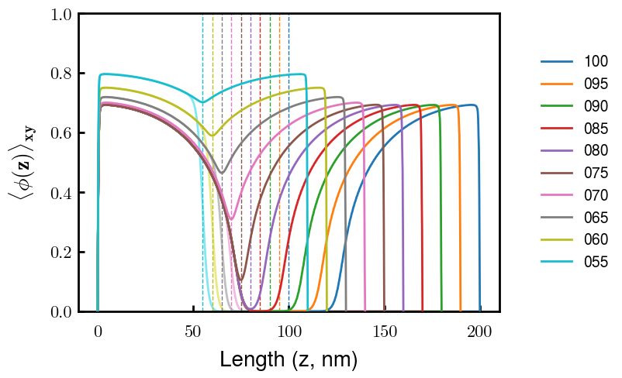
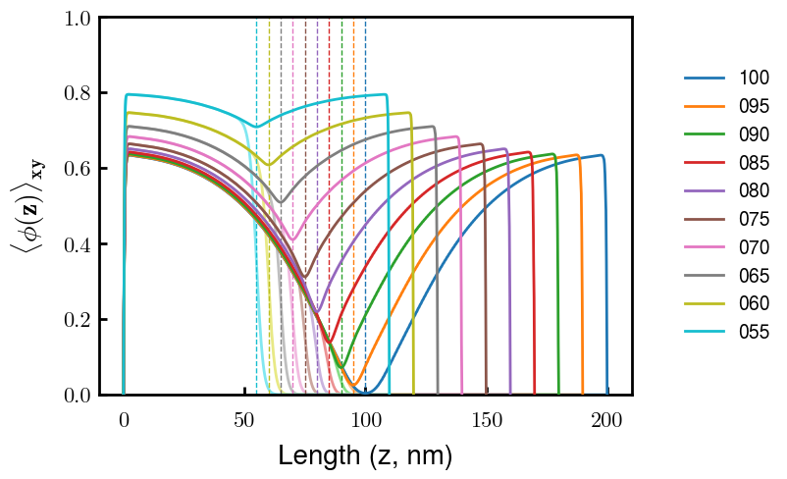
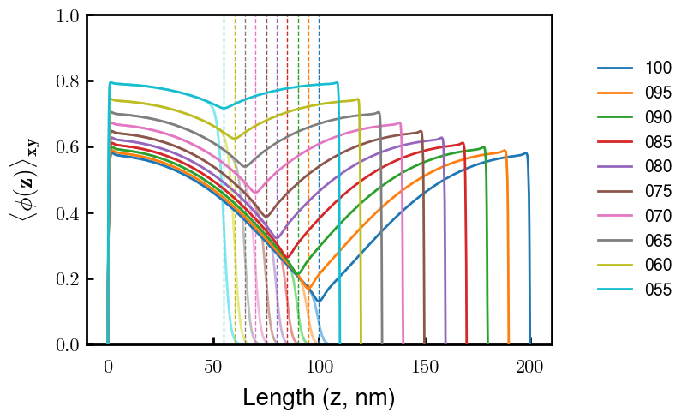
a0
a025
a050

