Slide 1
Strategy
2D binary array for surface sites of homogeneously grafted polymer given grafting density, simulation box size, and discretization (and assuming dx = dy)
Fullspace must be periodic on x0 = xL, y0 = yL
Halfspace must be even on xL/2 and yL/2 (overlap of boundary following REDFT00) and periodic on x0 = xL, y0 = yL.
Homogeneous spacing as determined by regular hexagon, where grafting point at centroid of hexagon

Slide 2
Test conditions
Sigma = 0.05 c/nm2
Lx = 15 nm
Ly = 15 nm
dx = 0.4 nm
Cast in terms of dx (for rounding and PBC for grafting points):
Sigma = 0.0668 c/nm2
Lx = 14.80 nm
Ly = 11.20 nm
(Sigma error decrease with dx)

Slide 3
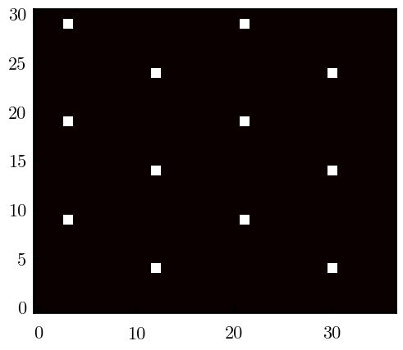
Padded PBC (Full FFT)
Hexagons drawn for illustration of hexagon approach

Slide 4
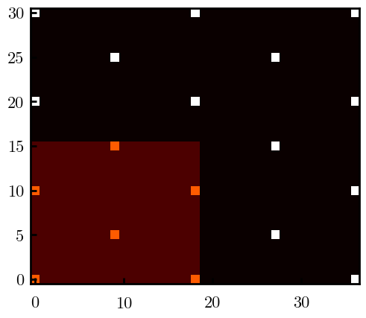
Unpadded PBC (Full/Cos FFT)

Slide 5
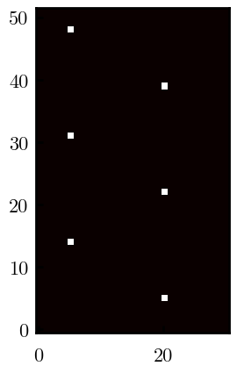
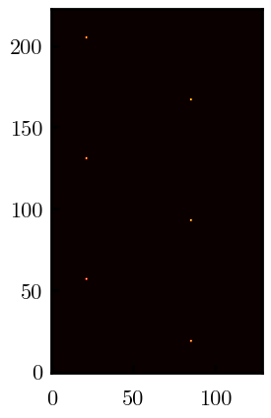
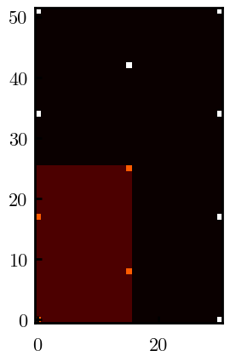
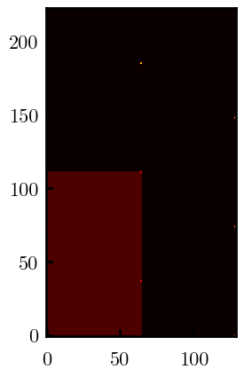
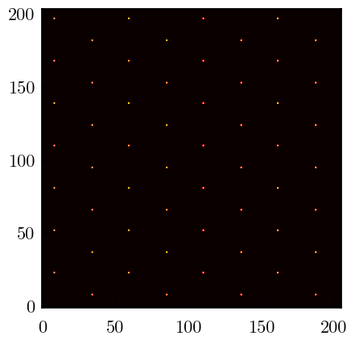
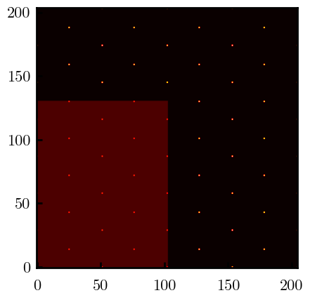
Other conditions
s = 0.0241 (20.28%; dx=0.4), Lx, Ly = 12.40, 20.80
s = 0.0208 (4.08%; dx=0.1), Lx, Ly = 12.90, 22.30
s = 0.1332 (11%; dx=0.1), Lx, Ly = 20.50, 20.40

