Slide 1
SYSG

Slide 2
Interacting

Slide 3
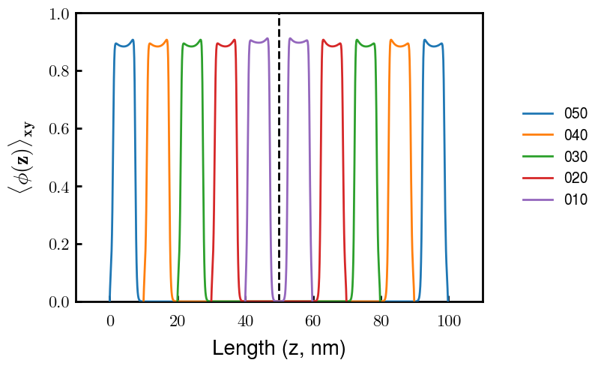
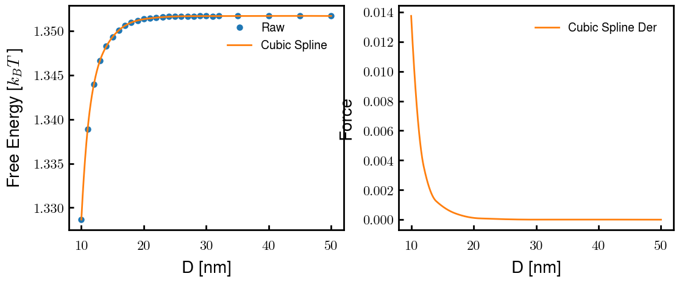
p1a4 c2.00

