Slide 3



SCFT Build-up — System
What is the system made up of?
s
+
-
Interactions:
Elasticity (monomer-monomer)
Solubility (solvent-monomer)
Electrostatics (ion-monomer)
Assumptions:
+
-
s
+
Chains within brush identical
s
s
s
-
+
+
+
+
+
+
+
-
+
s
+
s
+
-
s
+
-
s
Ion correlations neglected
Finite ion volume neglected
s
+
+
s

Slide 4

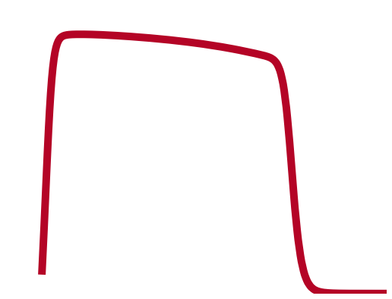


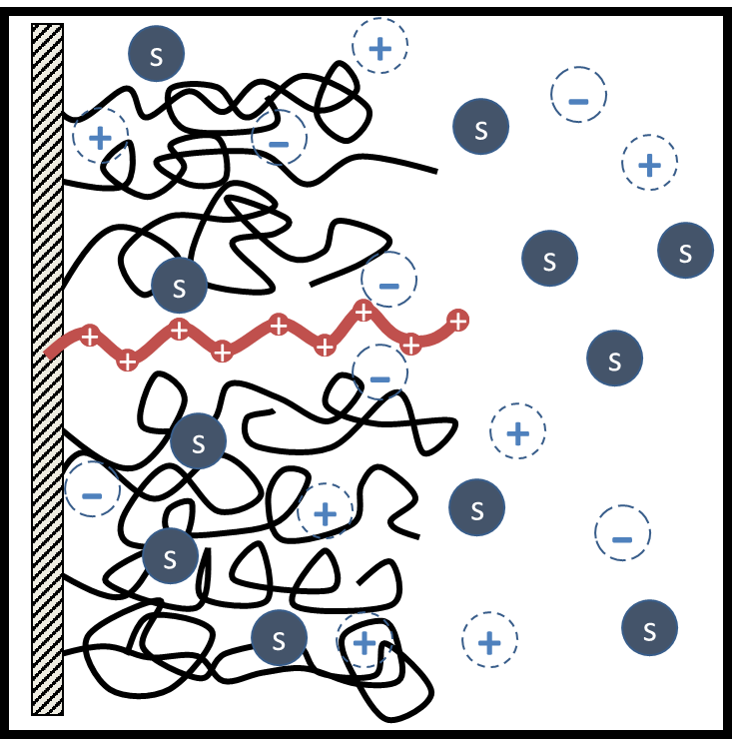
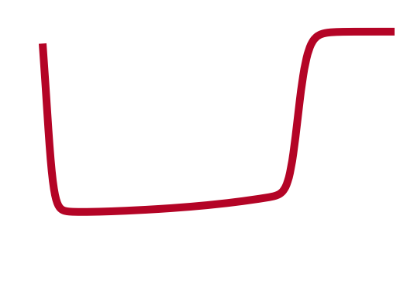
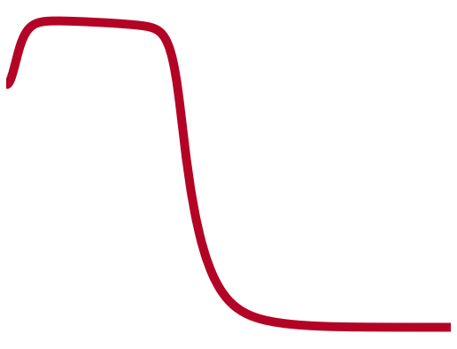
SCFT Build-up — System
What is the end-result of the model?
Generate fields (equations) that all particles in the system experience
Continuous functions
Depend in a mean-field way on all other particles
“Self-consistent field theory” (SCFT)
111
s
+
-
+
-
s
+
s
s
s
-
+
+
+
+
+
+
+
-
+
s
+
s
+
-
111
111
+
s
-
s
s
+
+
s
(Andelman, 2006)

Slide 5
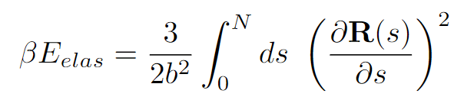
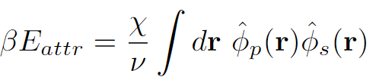
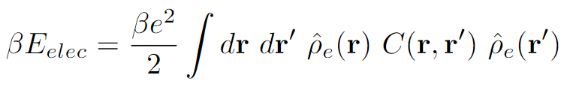
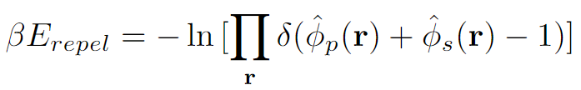
SCFT Build-up — Equations
Goal: Adapt framework for free polyelectrolyte in solution to model end-grafted protein brushes in solution
Interactions:
Elastic entropy following Gaussian statistics
Flory-Huggins 2-body interactions
Electrostatics, ignoring any correlations
Incompressibility

Slide 6
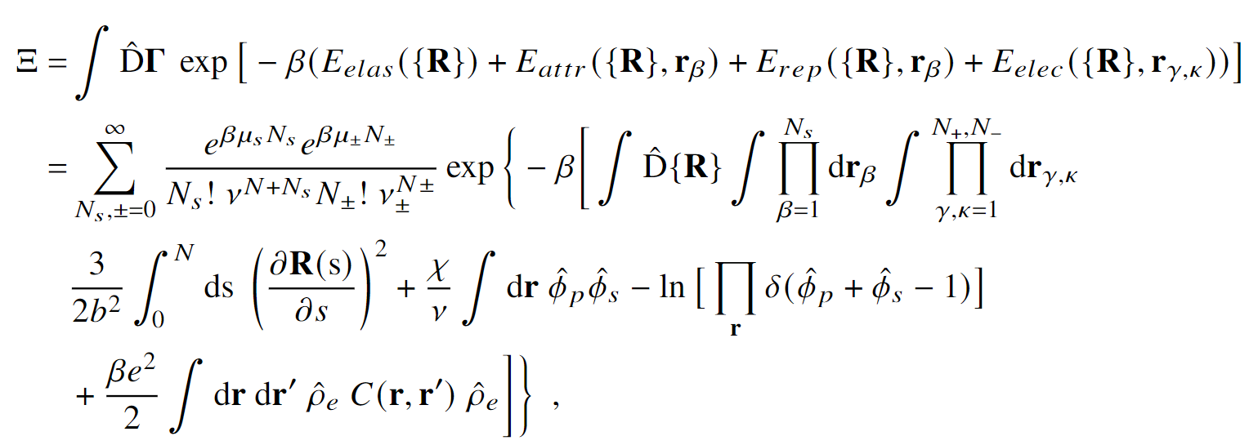






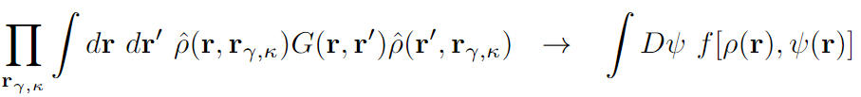

SCFT Build-up — Equations
Semicanonical partition function
Canonical in polymer, grand canonical in ions and solvent
Block copolymer formalism
Particle-to-field transformations
Hubbard-Stratonovich transformation
Saddle-point approximation

Slide 7
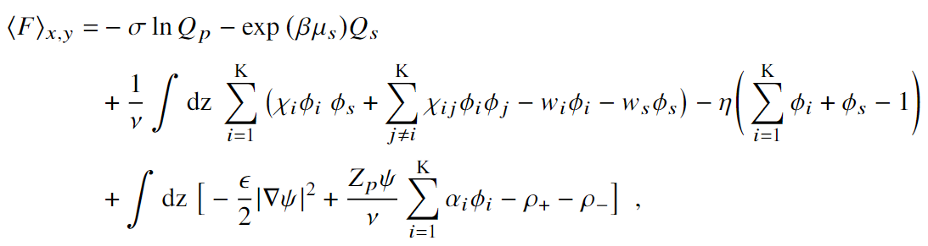



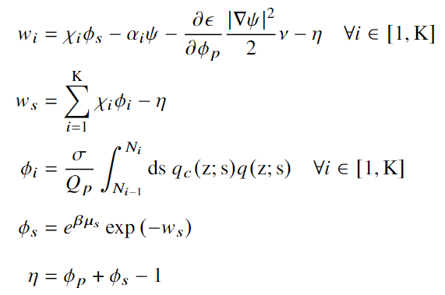

SCFT Build-up — Equations
Variational Free Energy
After statistical average over grafting surface (x-y plane)
Functional Minimization
SCF Equations

Slide 8
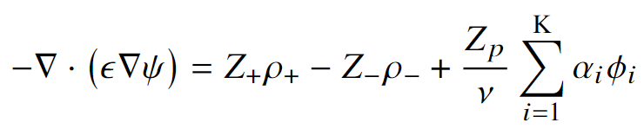
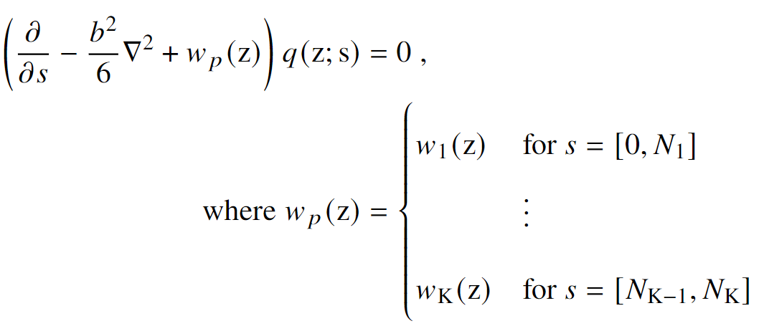

SCFT Build-up — Equations
SCF Equations, cont.
Mean-field Poisson-Boltzmann Equation
Modified Diffusion Equation
Block K
$$\{χ_{K},N_{K}, α_{K}\}$$
Block 2
Block 1

Slide 9
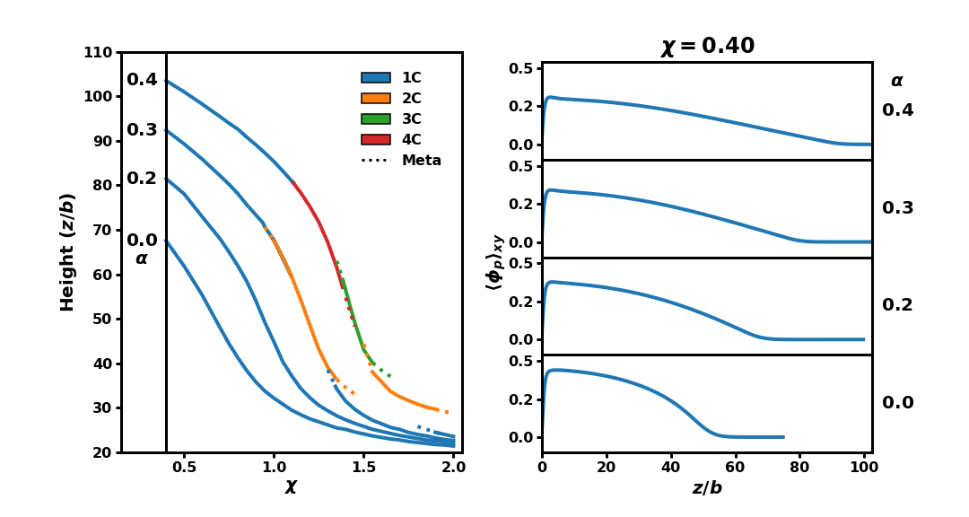
Internal Charge

Slide 10
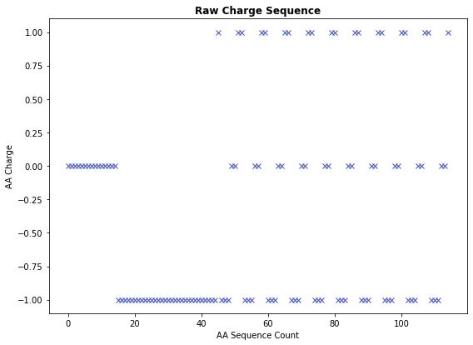
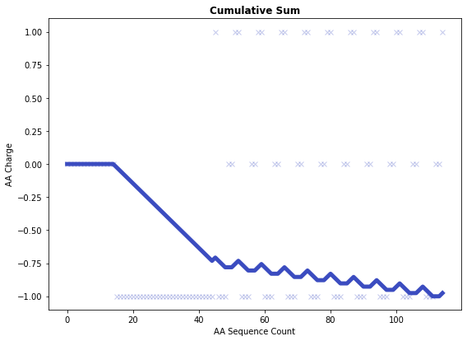
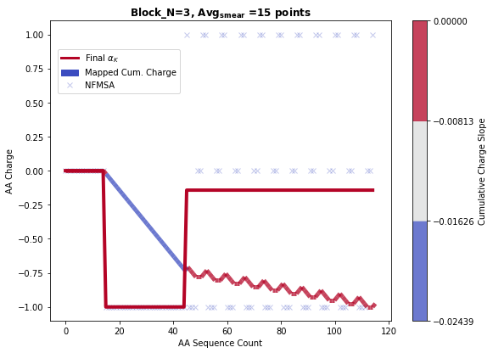
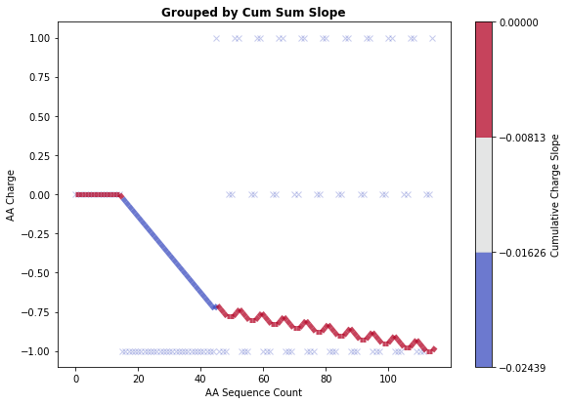
Protein Coarse-graining
Coarse-graining performed by grouping charges based on contributions to the slope of the cumulative charge
Hyperparameters: Number of bins, Minimum number of AA per block
Sample sequence:
HHHHHHHHHHHHHHH DDDDDDDDDDDDDDDDDDDDDDDDDDDDDD KDDDHHK KDDDHHK KDDDHHK KDDDHHK KDDDHHK KDDDHHK KDDDHHK KDDDHHK KDDDHHK KDDDHHK

Slide 11
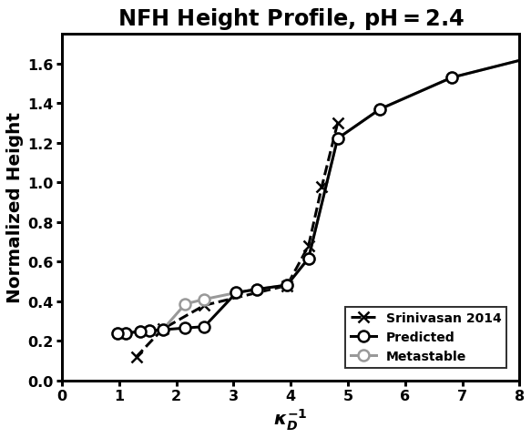

Cooperative Collapse of the Dilute Phase
How does internal structure affect response to salt concentration?
Dramatic collapse
Cooperative collapse

