Slide 1
Equations
Quenched average, np, A --> \inf ; np/A → \sigma
Discrete Gaussian chain

Slide 2
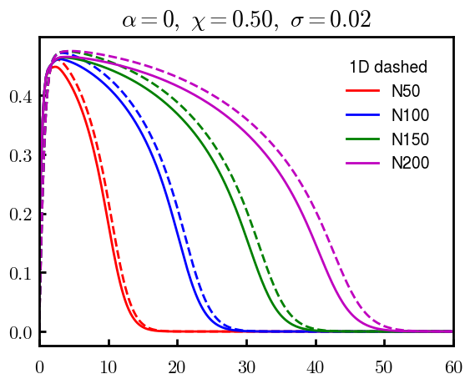
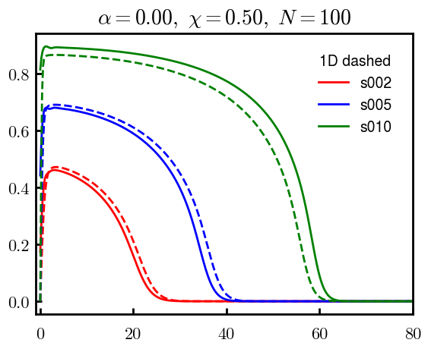
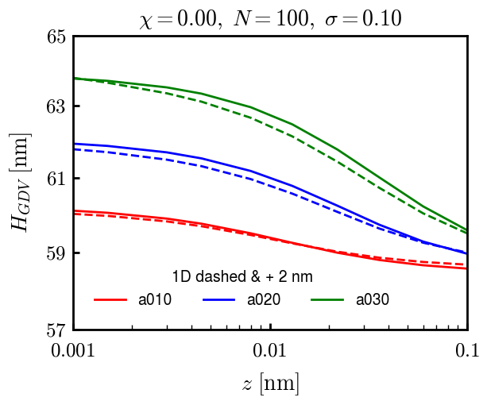
DGC (3D; NxNy=1) vs MDE (1D)

Slide 3
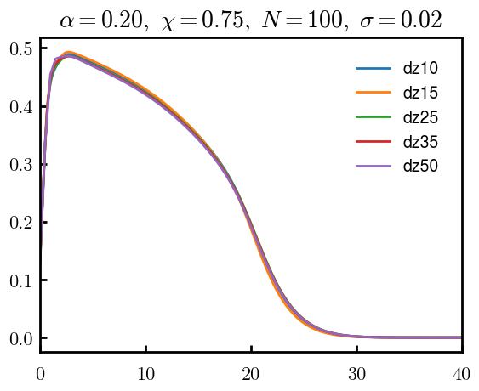
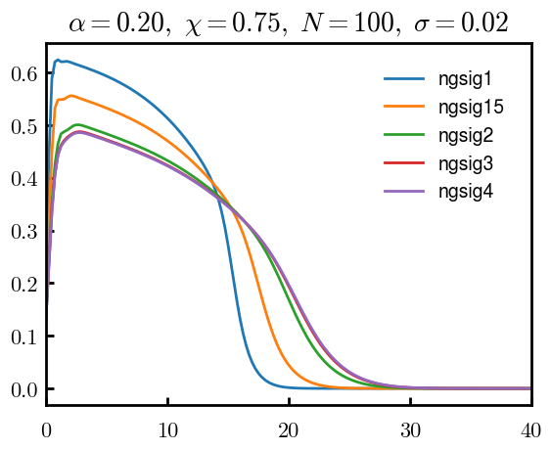
Numericals

Slide 4
Scaling

Slide 5
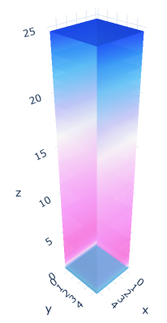
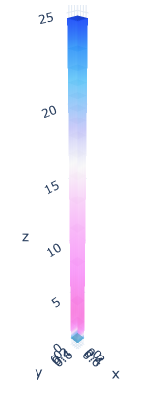

3D
Lxy = 1
Lxy = 5

Slide 6
OLD

Slide 7
Annealed

Slide 8
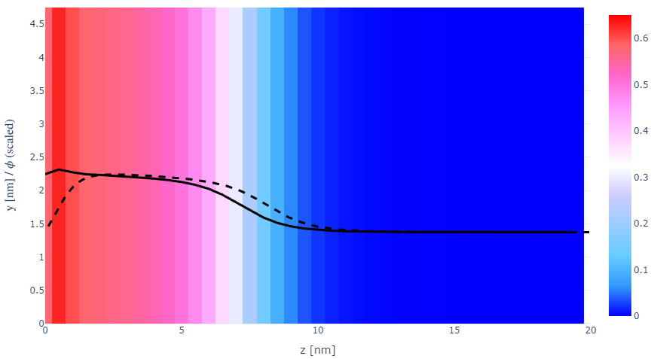
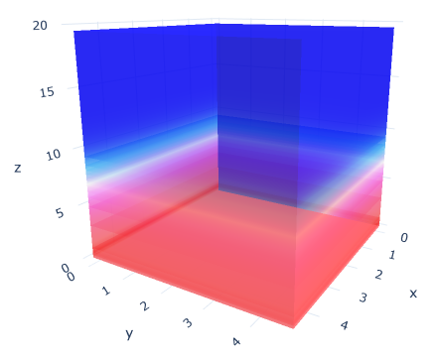

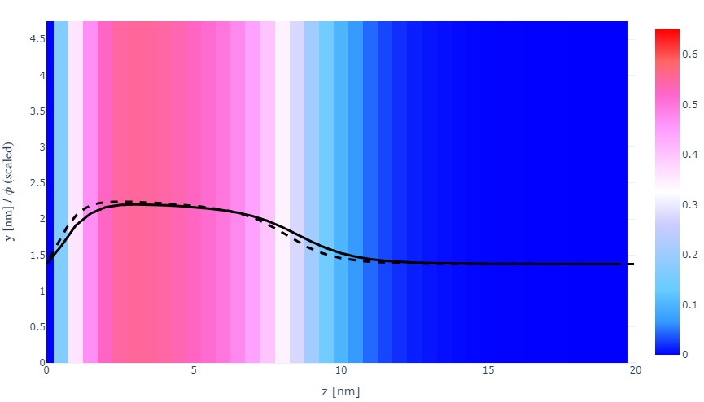
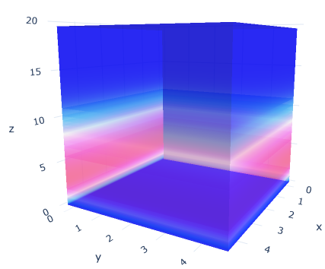
z-FFT vs z-FD (MDE) – REDFT01 xy(z)
Lx = 5, Ly = 5, Lz = 50. s = 0.02. x = 0.75. a = 0.00, N = 50
3D vs 1D (dashed): dz = 0.5, ds = 0.20; dz_1D = 0.113, ds_1D = 0.083
FFT (xyz)
FFT (yz vs pha)
FD (xyz)
FD (yz vs pha)
Diff btw 1D/3D should just be dz, ds, etc.

Slide 9
PB: REDFT00 (x= -0.5) vs REDFT01 (x=0)
Lx = 5, Ly = 5, Lz = 50. s = 0.02. x = 0.75. a = 0.00, N = 50
3D vs 1D (dashed): dz = 0.5, ds = 0.20; dz_1D = 0.113, ds_1D = 0.083
Compare pot_elec and freeE with each other and 1D

Slide 10
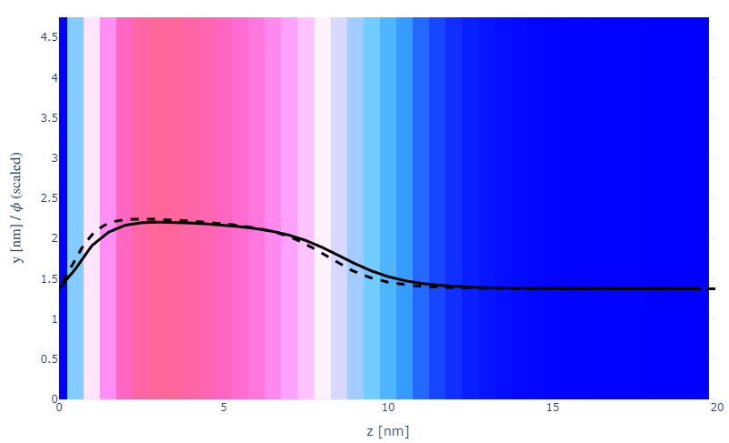
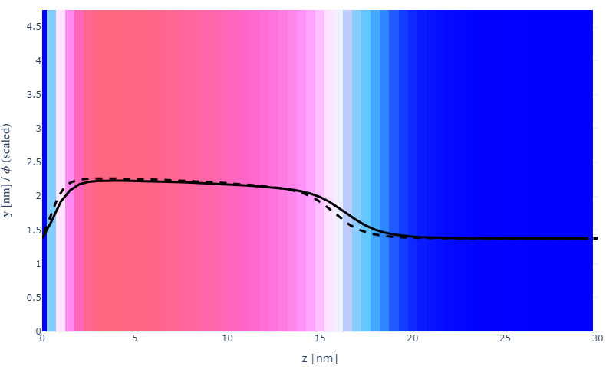

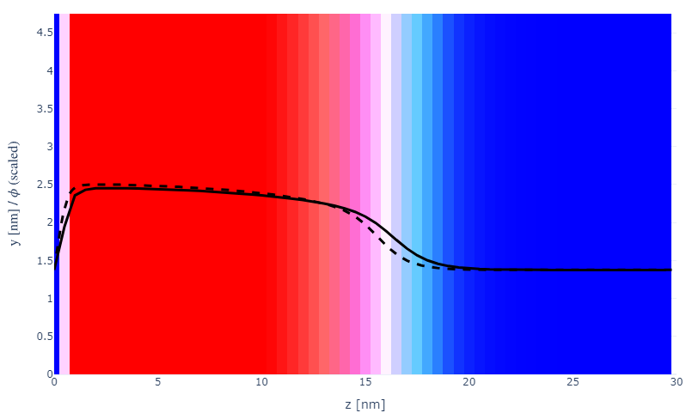
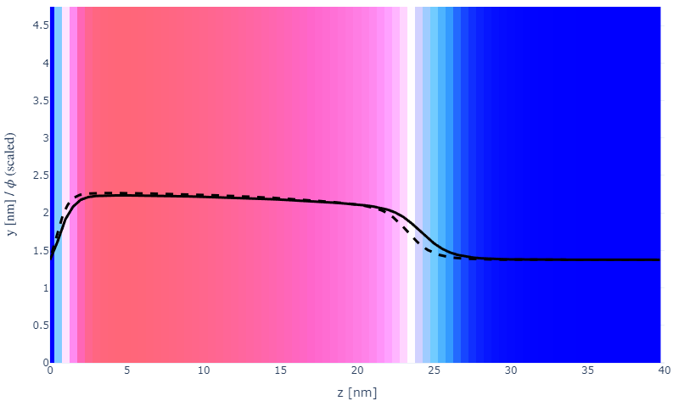
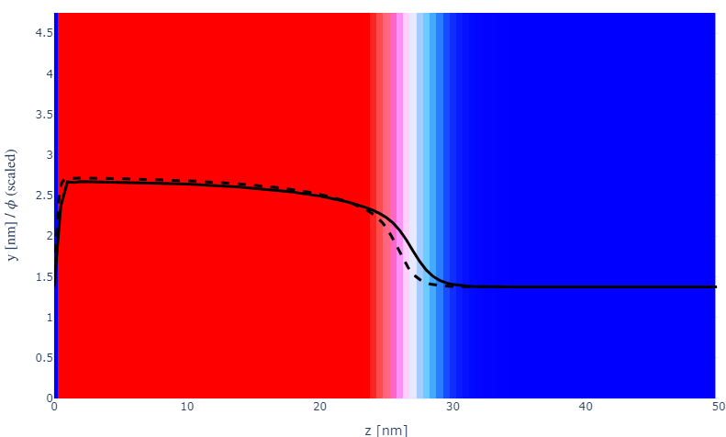
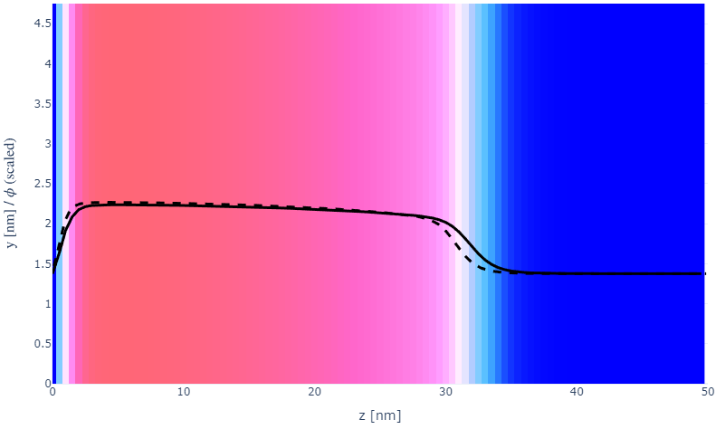
Parameter space (s, N)
a000x075
s002N050
N100
20
30
s005
N150
30
40
s010
N200
50
50

Slide 11
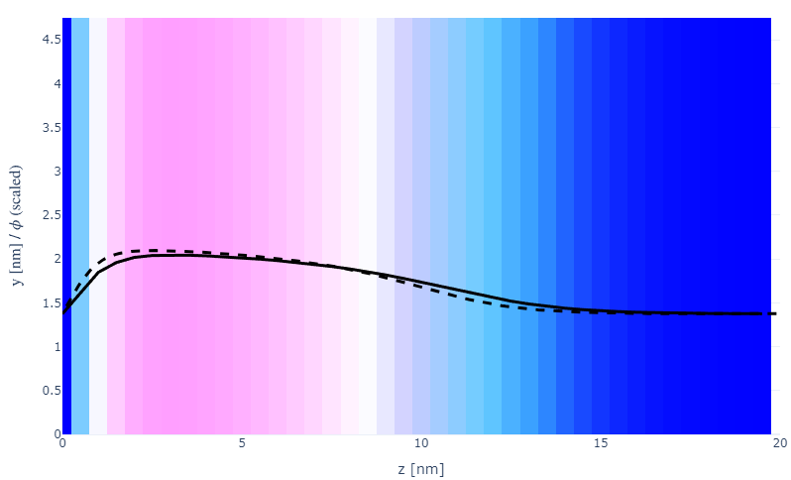
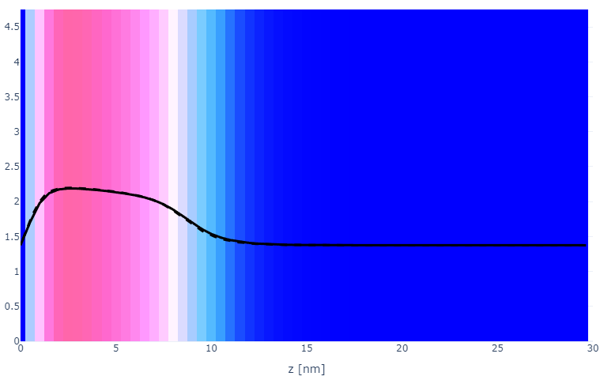
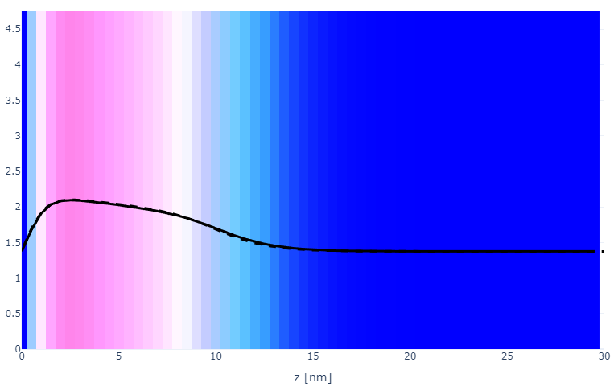
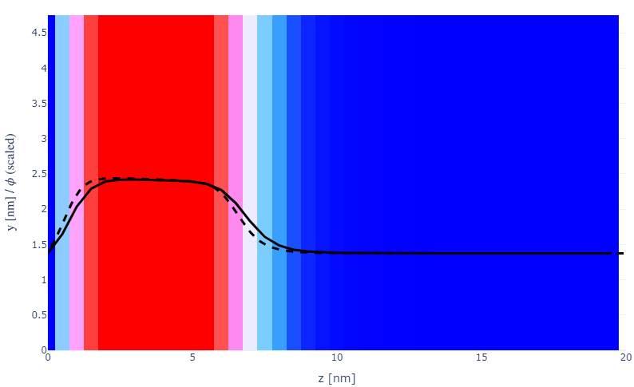
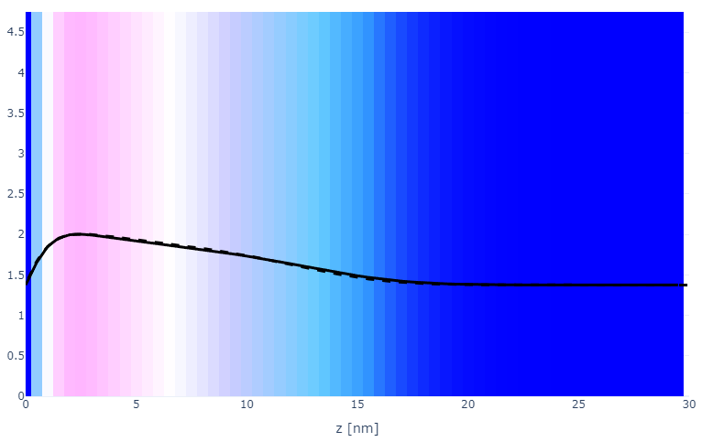
Parameter space (x, a)
a000x055s002
a010x075
20
30
x075
a020x075
20
30
x100
a030x075
20
30

Slide 12
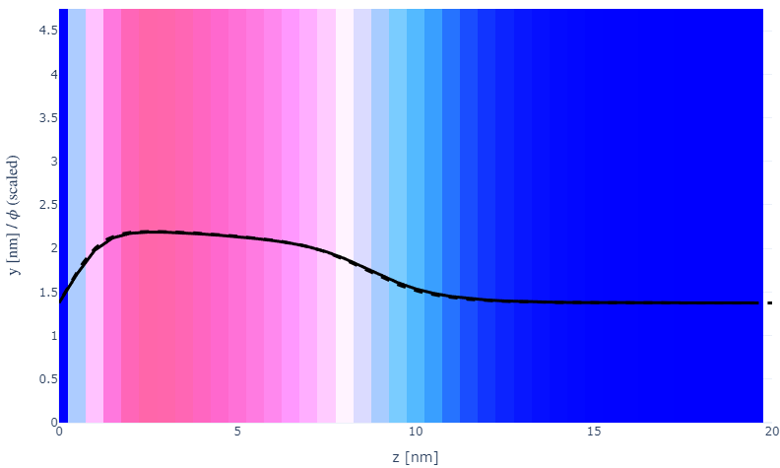
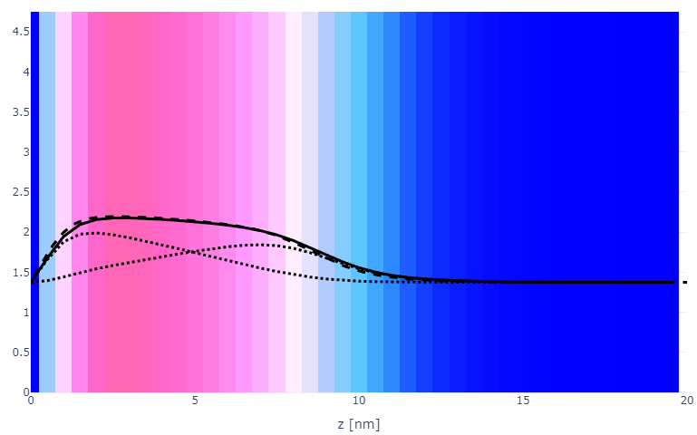
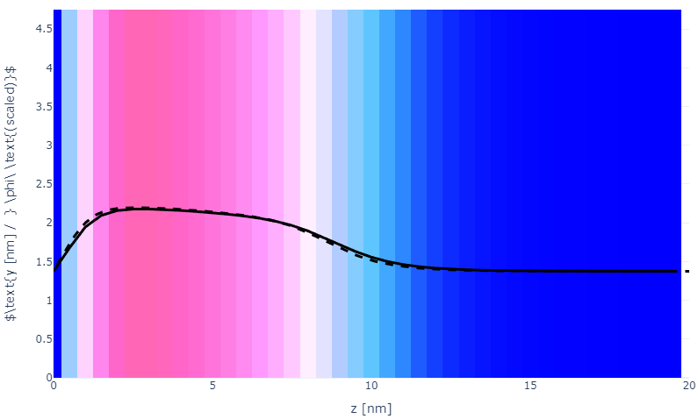

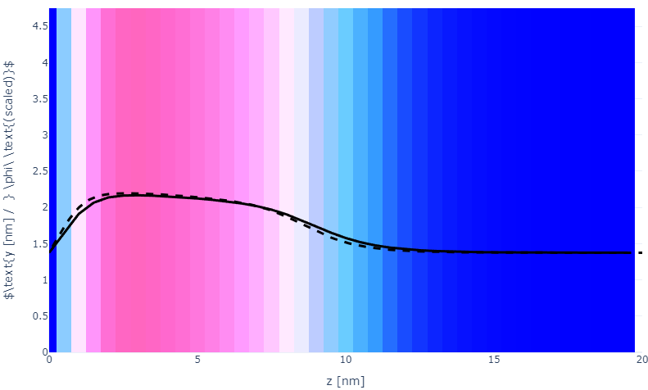

Numerical space (dz, ds, Y)
a010x075ds05
a010x075Y2
a010x075ds10
a010x075Y5
a010x075ds15
a010x075Y10

Slide 13

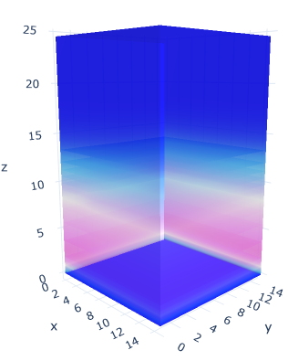
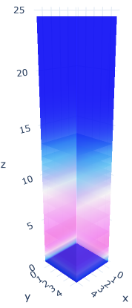
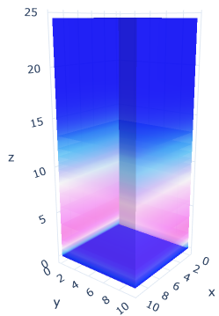
Plate size (Lx=Ly)
a020x075; Lxy = 5
Lxy = 10
Lxy = 15

Slide 14
Specifying Grafted Points

Slide 15
Strategy
2D binary array for surface sites of homogeneously grafted polymer given grafting density, simulation box size, and discretization (and assuming dx = dy)
Fullspace must be periodic on x0 = xL, y0 = yL
Halfspace must be even on xL/2 and yL/2 (overlap of boundary following REDFT00) and periodic on x0 = xL, y0 = yL.
Homogeneous spacing as determined by regular hexagon, where grafting point at centroid of hexagon
In case there are edge effects, try shifting the centroids away from the boundaries of the xy-plane (only did for fullspace)
Make sure no edge effects by comparing results of full FFT with cos FFT

Slide 16
Test conditions
Sigma = 0.05 c/nm2
Lx = 15 nm
Ly = 15 nm
dx = 0.4 nm
Cast in terms of dx (for rounding and PBC for grafting points):
Sigma = 0.0668 c/nm2
Lx = 14.80 nm
Ly = 11.20 nm
(Sigma error decrease with dx)

Slide 17
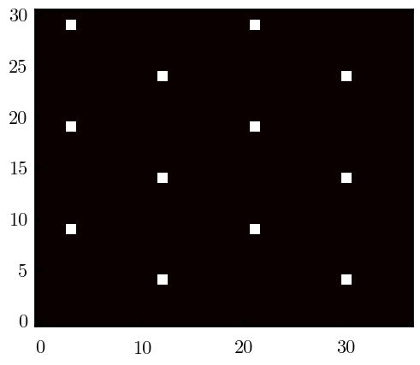
Padded PBC (Full FFT)
Hexagons drawn for illustration of hexagon approach

Slide 18
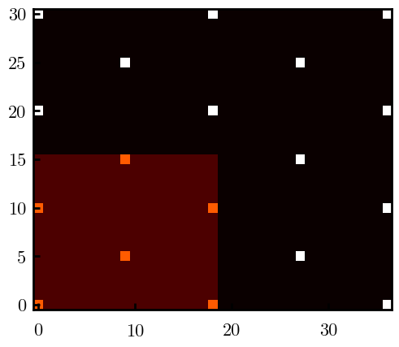
Unpadded PBC (Full/Cos FFT)

Slide 19
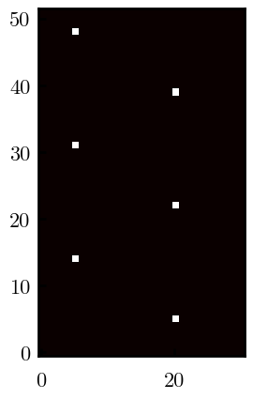
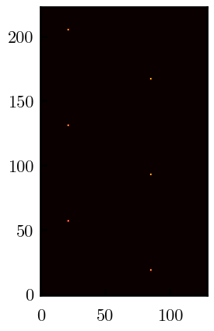
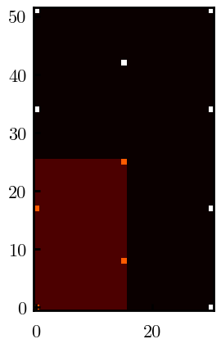
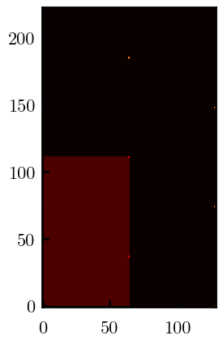
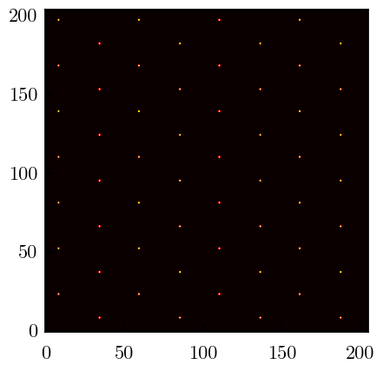
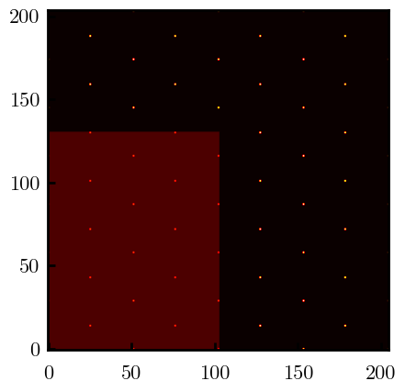
Other conditions (full and half results overlapped to show match)
s = 0.0241 (20.28%; dx=0.4), Lx, Ly = 12.40, 20.80
s = 0.0208 (4.08%; dx=0.1), Lx, Ly = 12.90, 22.30
s = 0.1332 (11%; dx=0.1), Lx, Ly = 20.50, 20.40

