Slide 1
SYSG

Slide 2
Schematic, similar to NFH but simpler like Chao, not multiblock protein

Slide 3
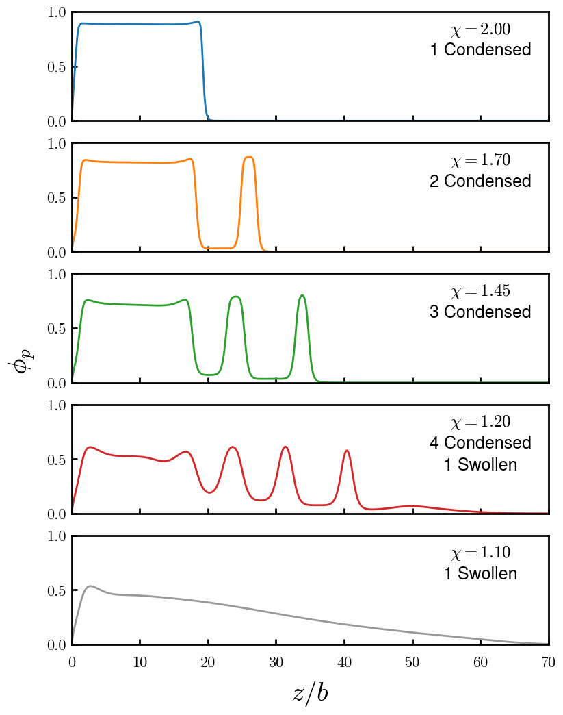
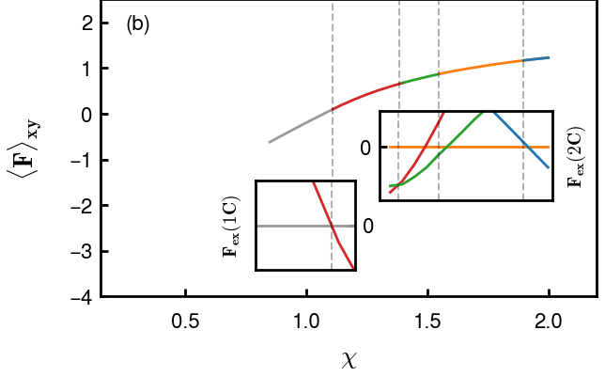
Possible brush morphologies (including +d)
Possible brush morphologies (including +d)
Add 4 pure
Find cleaner way to portray F change and transition points

Slide 4
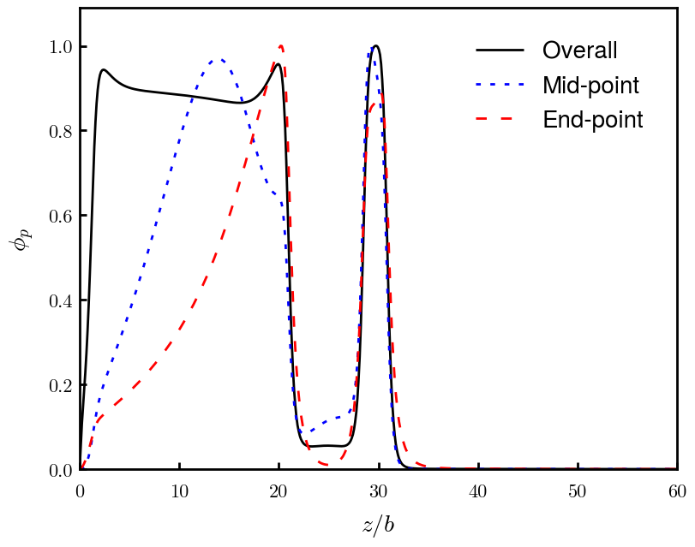
Explain locked-in-layer model using end-point distributions
Colored schematic, like NFH paper
Note: all normalized (overall, mid-, end-)

Slide 5
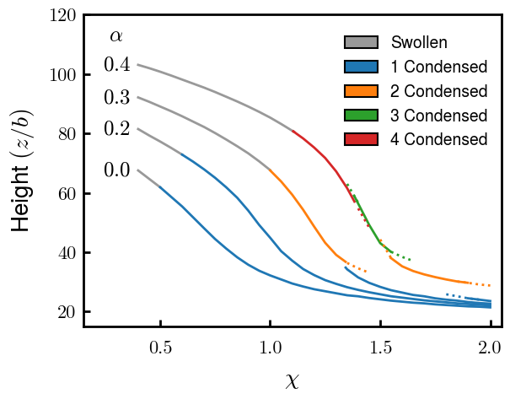
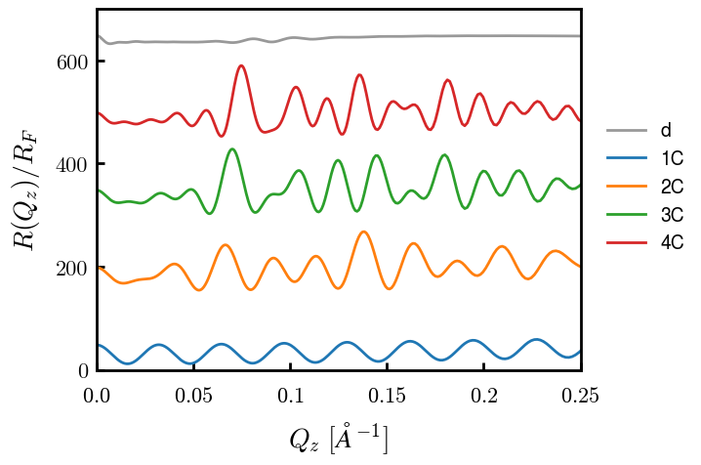
Detecting xC through experiments: Height (via threshold)
Scaling chi available?
Reflectivity: Signatures of each C
# of peaks at low Qz (high frequency)
Find more rigorous way to mark peaks

Slide 6
Force for alpha = 0.4, 2C

Slide 7
Interacting

Slide 8
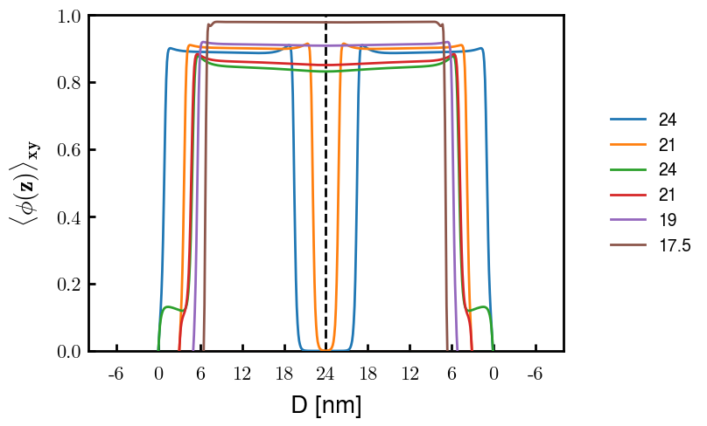
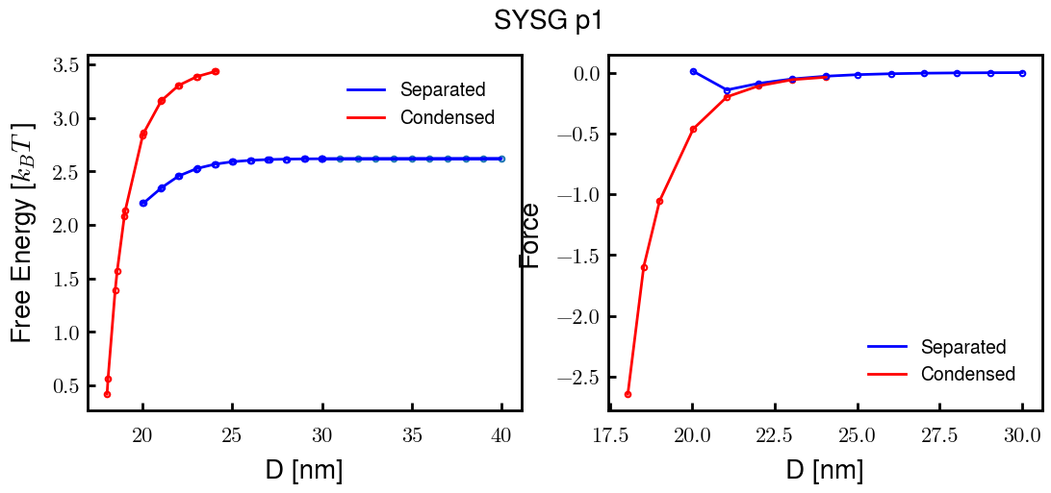
p1a4 c2.00

Slide 9
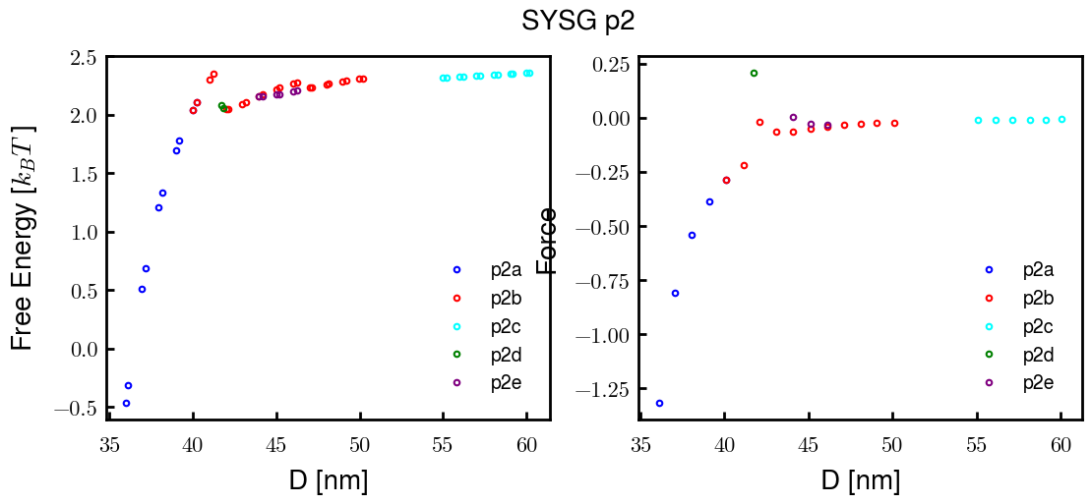
p2a4 c1.75

