Slide 1
Annealed

Slide 2
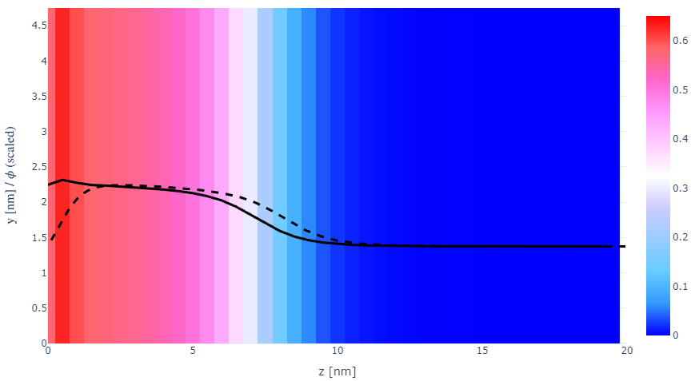
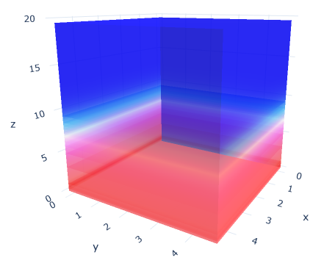

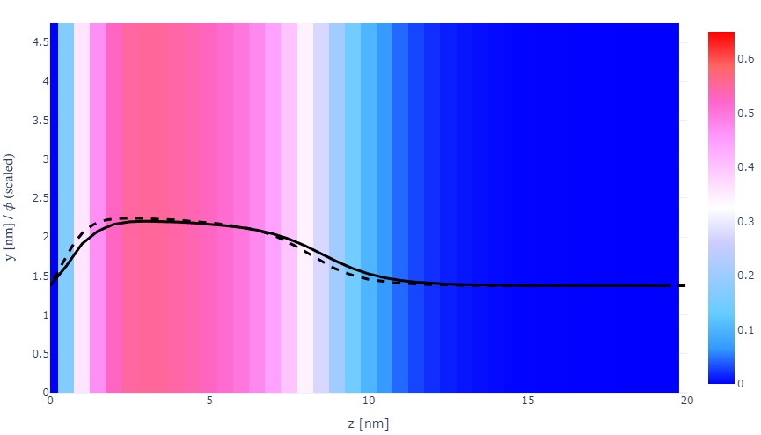
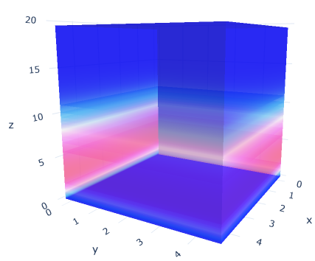
z-FFT vs z-FD (MDE) – REDFT01 xy(z)
Lx = 5, Ly = 5, Lz = 50. s = 0.02. x = 0.75. a = 0.00, N = 50
3D vs 1D (dashed): dz = 0.5, ds = 0.20; dz_1D = 0.113, ds_1D = 0.083
FFT (xyz)
FFT (yz vs pha)
FD (xyz)
FD (yz vs pha)
Diff btw 1D/3D should just be dz, ds, etc.

Slide 3
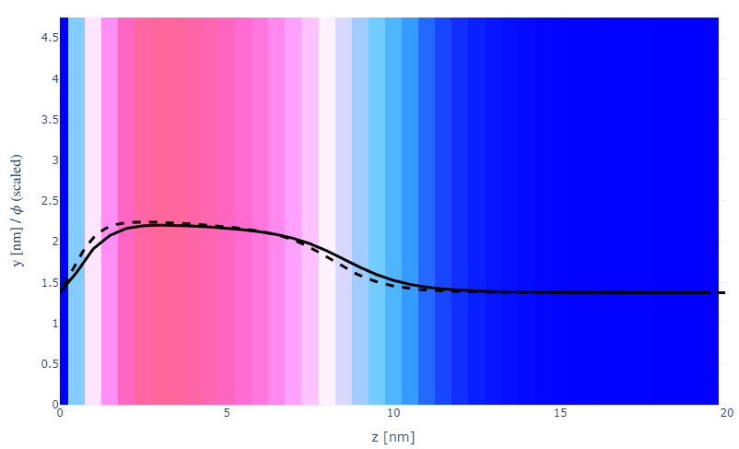
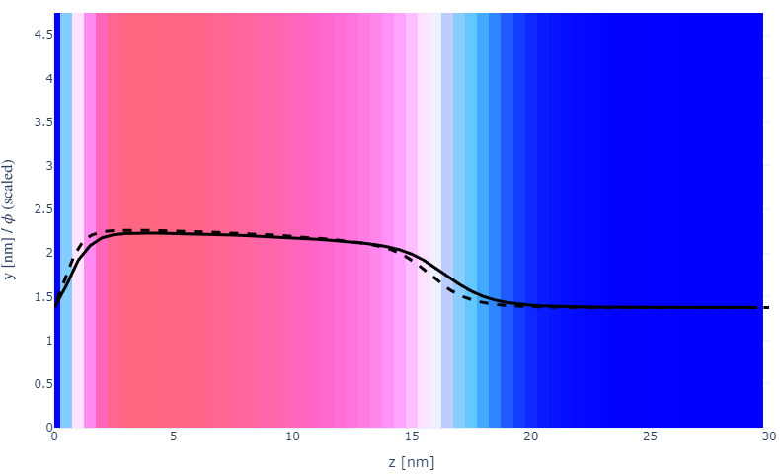

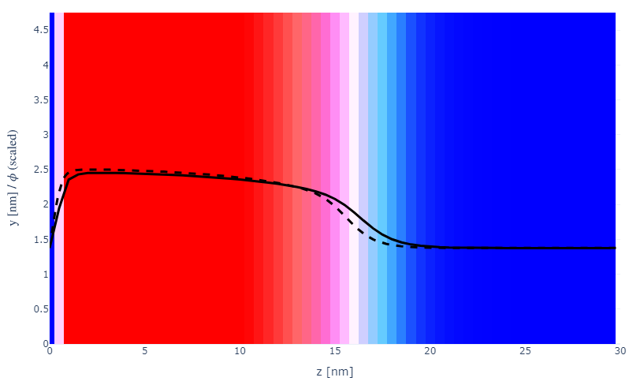
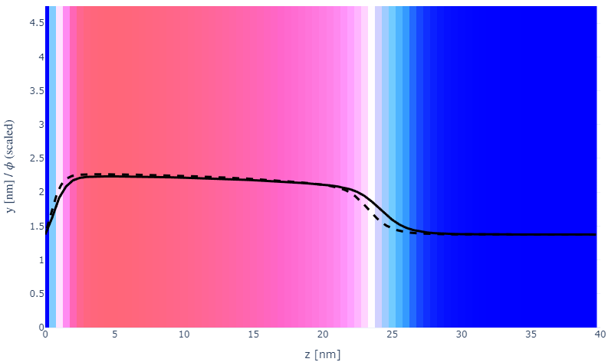
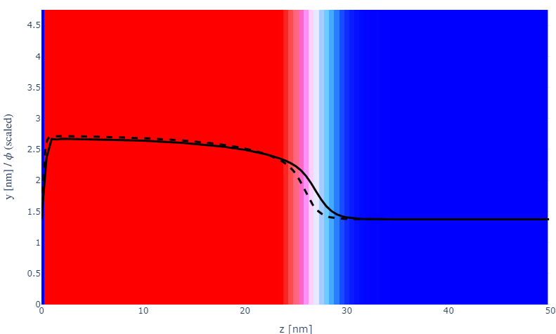
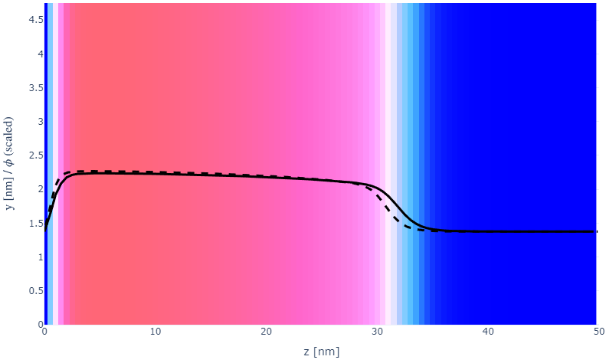
Parameter space (s, N)
a000x075
s002N050
N100
20
30
s005
N150
30
40
s010
N200
50
50

Slide 4
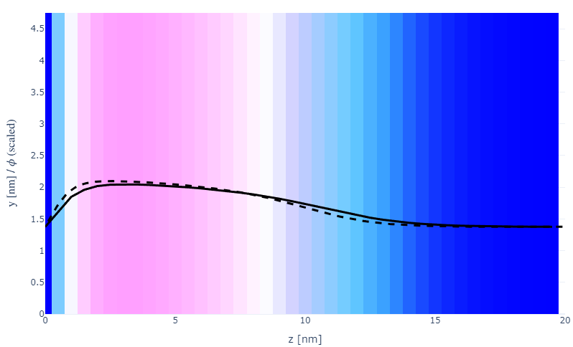
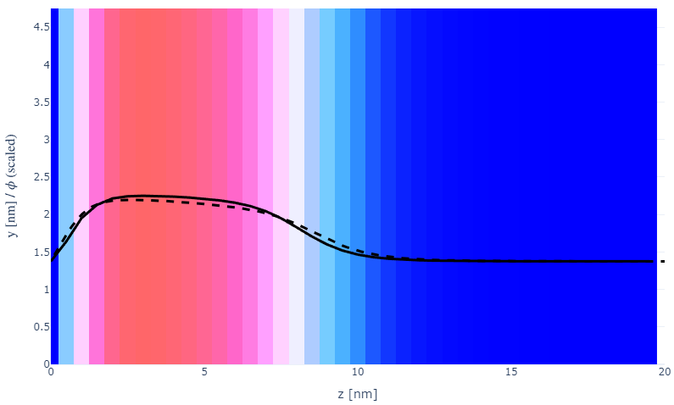
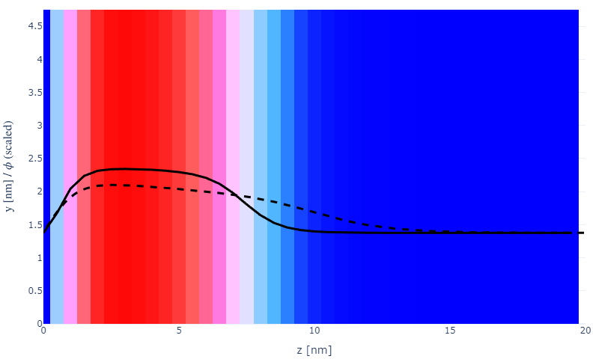
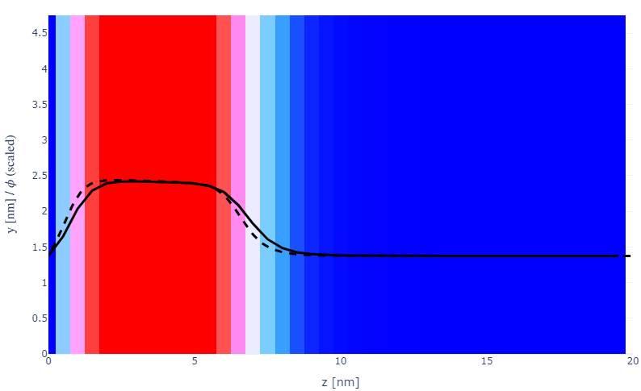
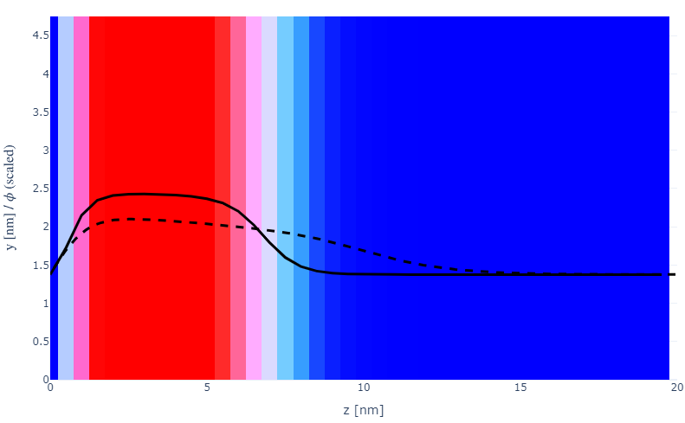
Parameter space (x, a)
Something wrong with PB
eps_prof fixed
L_Deb fixed
a000x055s002
a010x075c010
20
20
a000x075s002
a020x075c010
20
20
a000x100s002
a030x075c010
20
20

Slide 5
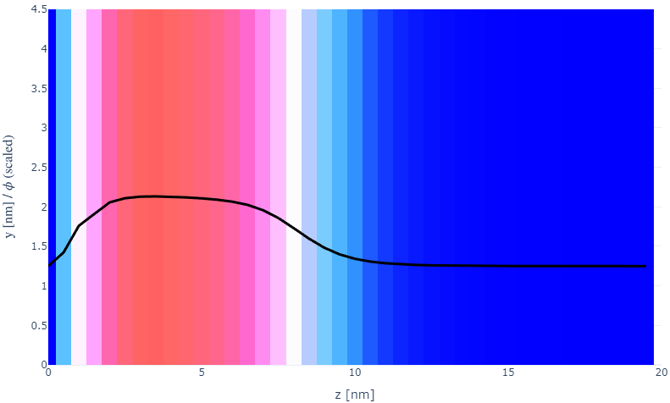
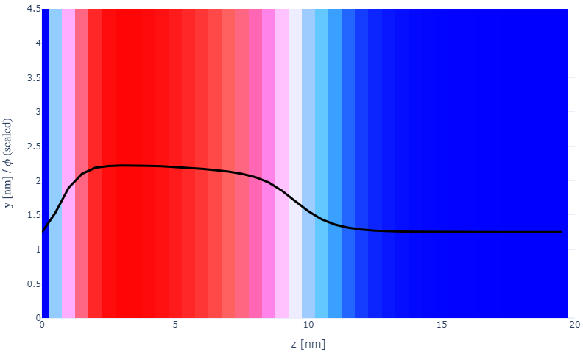
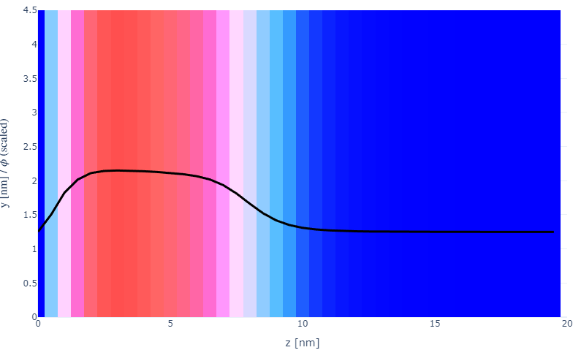
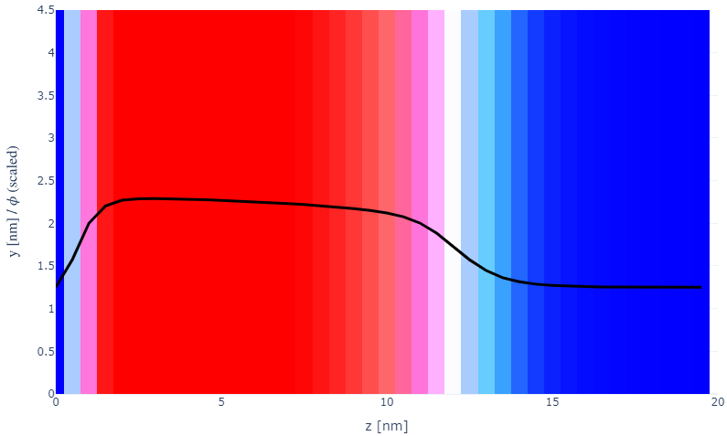
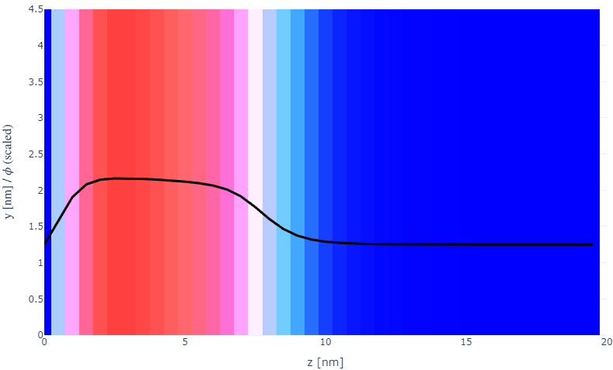
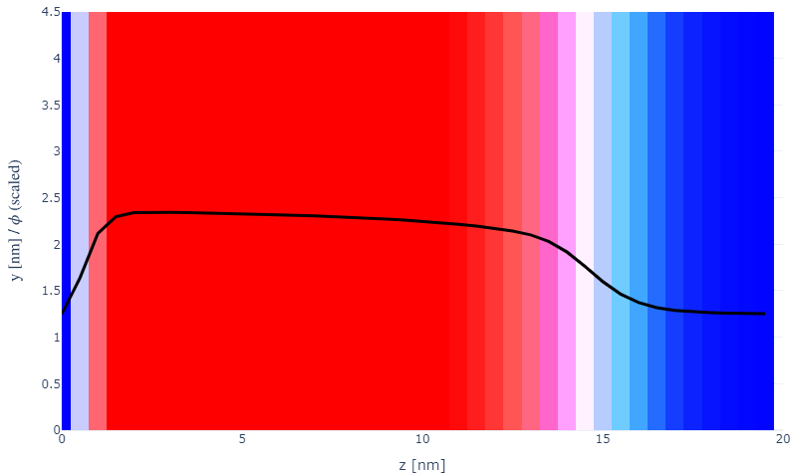
Numerical space (dz, ds, Y)
Something wrong with PB
Something wrong with Y
a010x075N050
ds30dz50
a010x075N050Y2
a010x075N050
ds20dz50
a010x075N050Y5
a010x075N050
ds10dz50
a010x075N050Y10

Slide 6
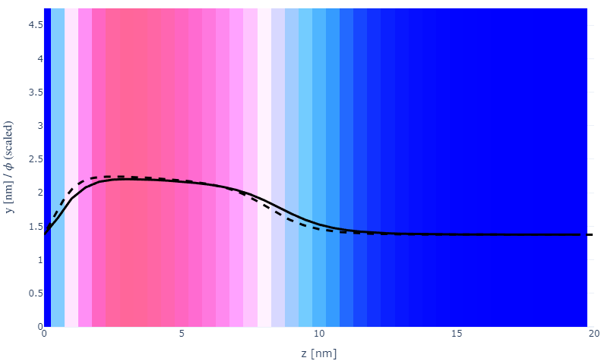
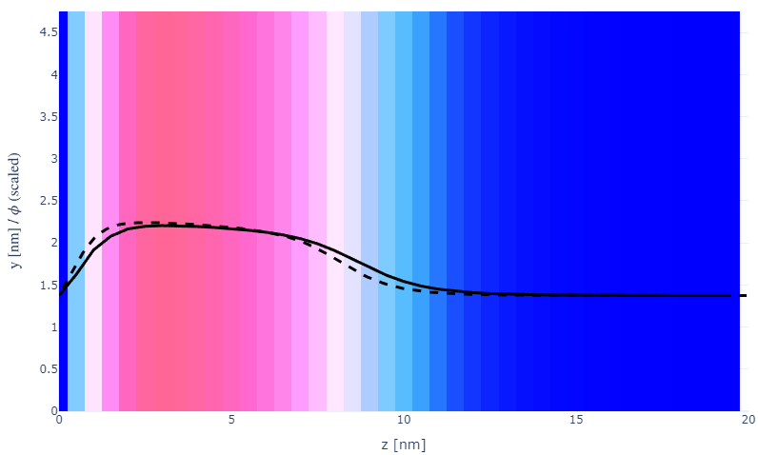
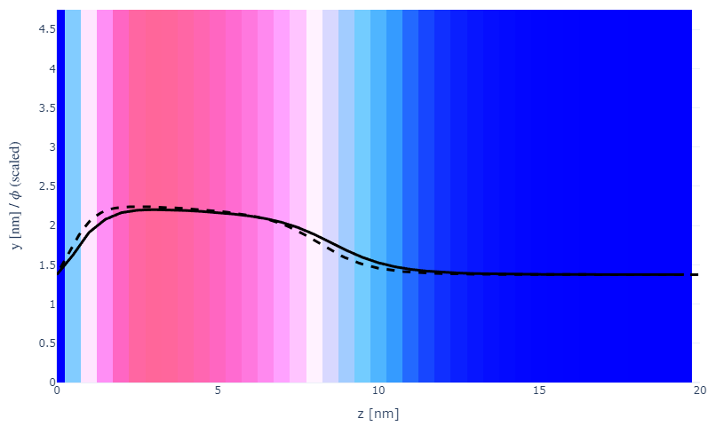
Y neutral
a000x075s002
Y1
a000x075s002
Y5
Gets.c / Int_PHA_ K_i[X] ← K_i[Y] fixed
Int_phAQUAD fixed
a000x075s002
Y2
a000x075s002
Y10

Slide 7
Specifying Grafted Points

Slide 8
Strategy
2D binary array for surface sites of homogeneously grafted polymer given grafting density, simulation box size, and discretization (and assuming dx = dy)
Fullspace must be periodic on x0 = xL, y0 = yL
Halfspace must be even on xL/2 and yL/2 (overlap of boundary following REDFT00) and periodic on x0 = xL, y0 = yL.
Homogeneous spacing as determined by regular hexagon, where grafting point at centroid of hexagon
In case there are edge effects, try shifting the centroids away from the boundaries of the xy-plane (only did for fullspace)
Make sure no edge effects by comparing results of full FFT with cos FFT

Slide 9
Test conditions
Sigma = 0.05 c/nm2
Lx = 15 nm
Ly = 15 nm
dx = 0.4 nm
Cast in terms of dx (for rounding and PBC for grafting points):
Sigma = 0.0668 c/nm2
Lx = 14.80 nm
Ly = 11.20 nm
(Sigma error decrease with dx)

Slide 10
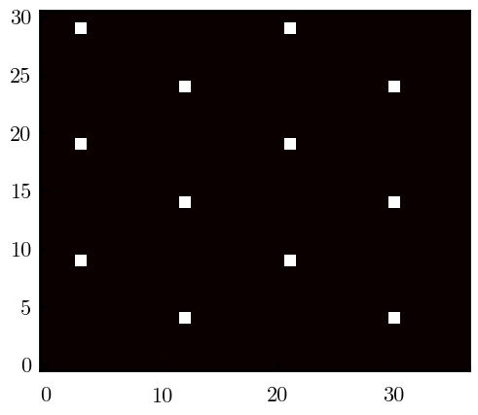
Padded PBC (Full FFT)
Hexagons drawn for illustration of hexagon approach

Slide 11
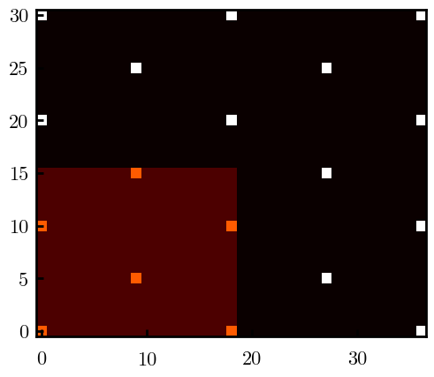
Unpadded PBC (Full/Cos FFT)

Slide 12
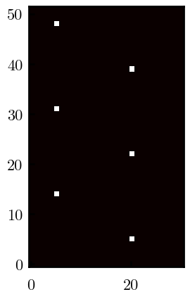
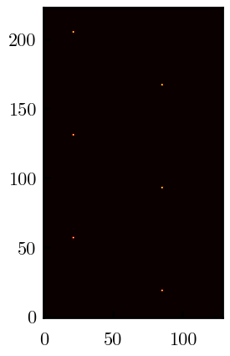
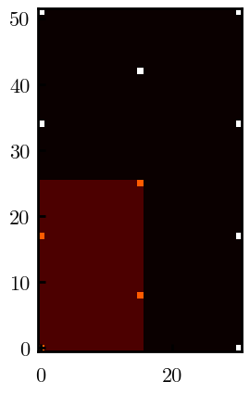
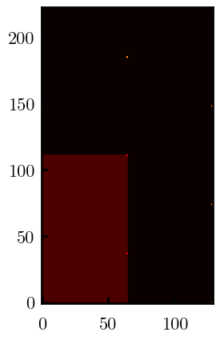
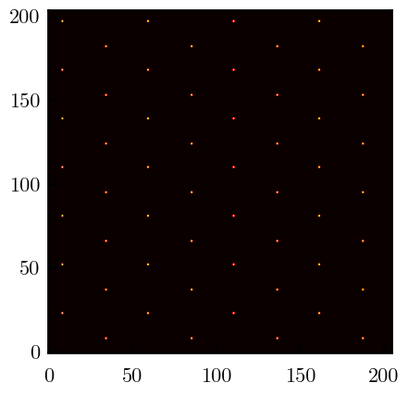
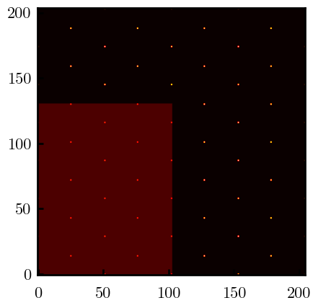
Other conditions (full and half results overlapped to show match)
s = 0.0241 (20.28%; dx=0.4), Lx, Ly = 12.40, 20.80
s = 0.0208 (4.08%; dx=0.1), Lx, Ly = 12.90, 22.30
s = 0.1332 (11%; dx=0.1), Lx, Ly = 20.50, 20.40

