Slide 1
Interacting brushes

Slide 2
MFT Results
Homopolymer charge alpha
Chi = 0.5, Nm = 200, sigma = 0.05, b = 1.0, v = 4/3pi

Slide 3
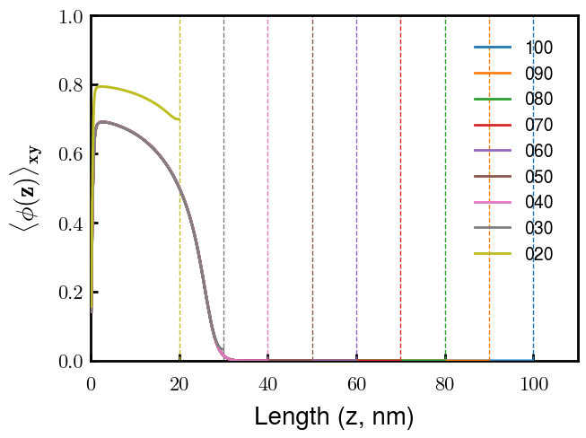

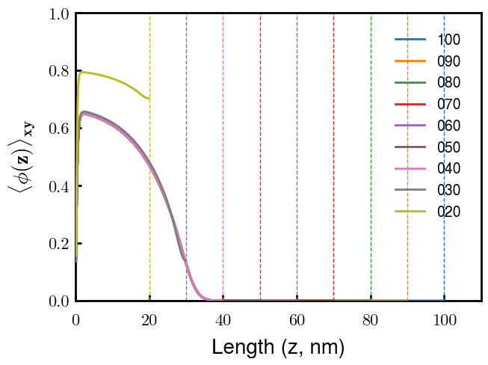
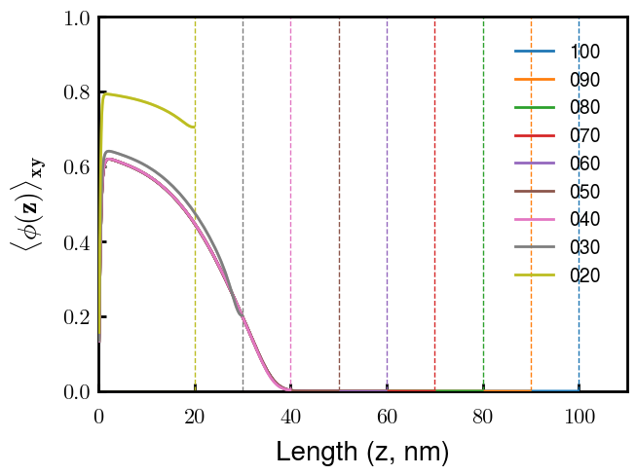
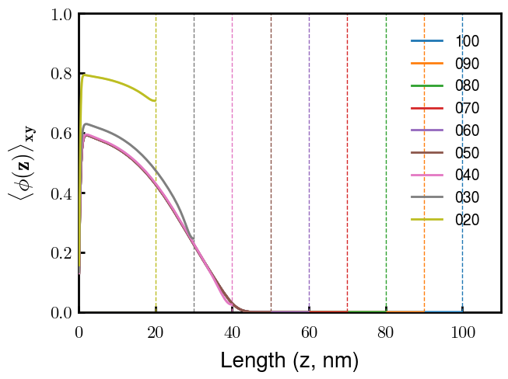
a000
a010
a020
a030
a040

