Slide 1
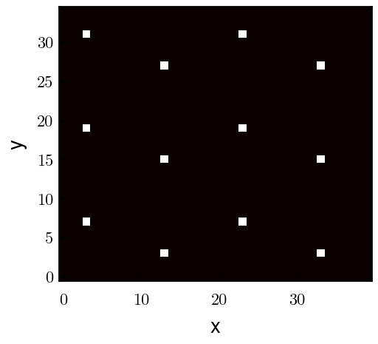
Padded PBC (Full FFT)

Slide 2
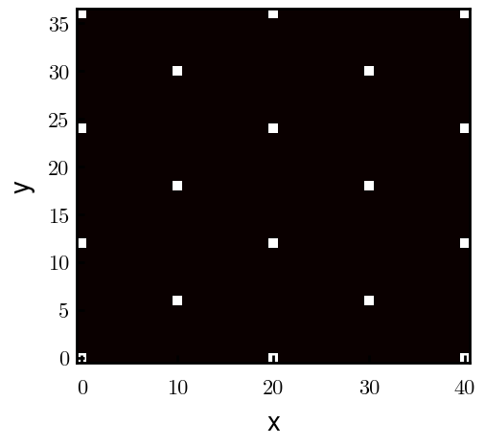
Unpadded PBC (Full FFT)

Slide 3
NBC (REDFT00 Cos FFT)

