Slide 1
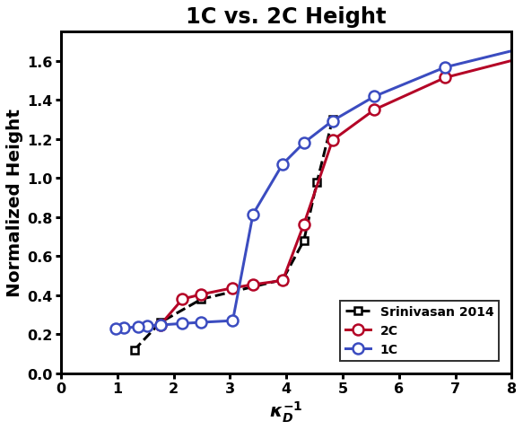
P_update
Format: b0 v0 chi_max
Need to see collapse of dilute layer to get sharp decrease

Slide 2
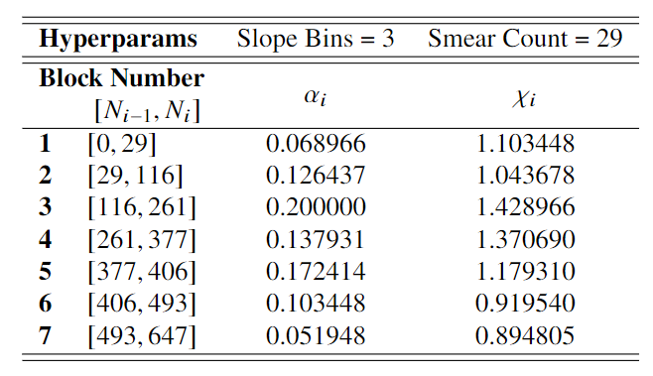
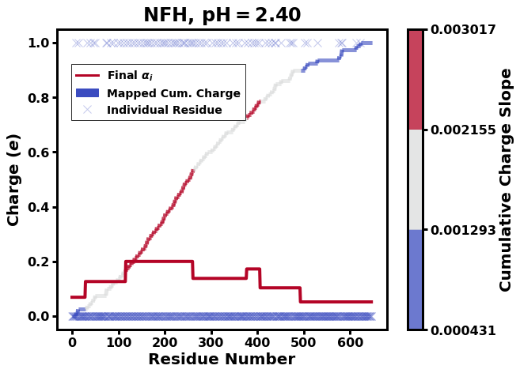
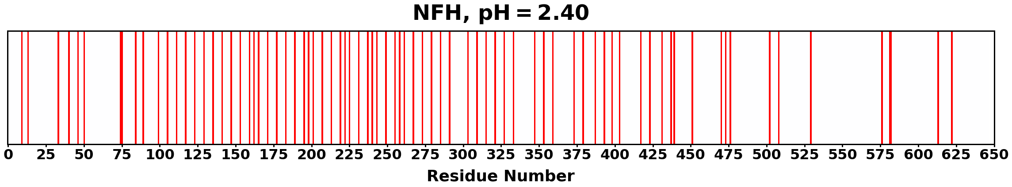
Incorrect

Slide 3
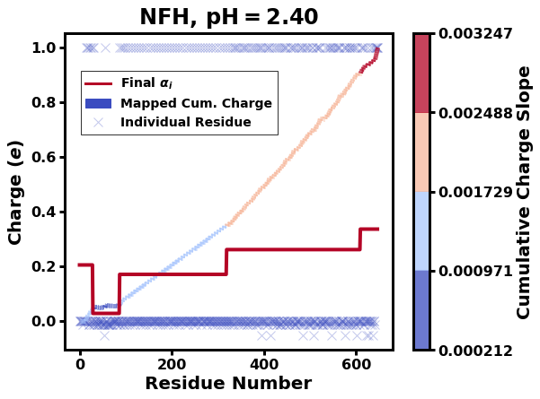
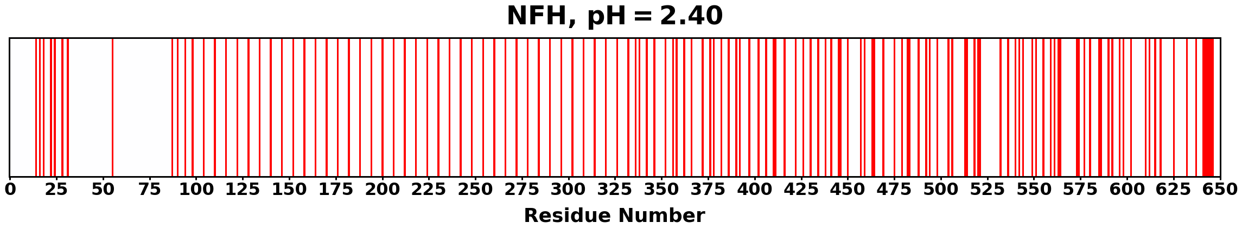
Corrected - 20220722

Slide 4
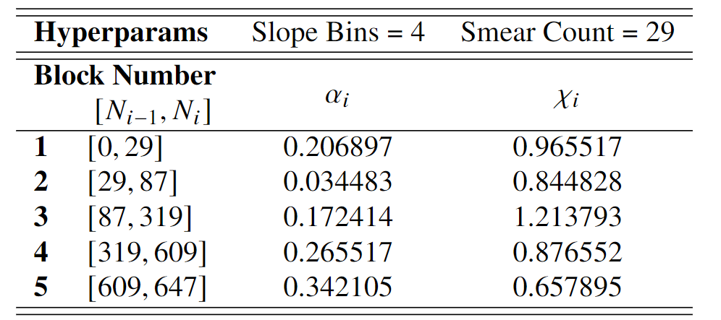
Corrected
Previous

Slide 5
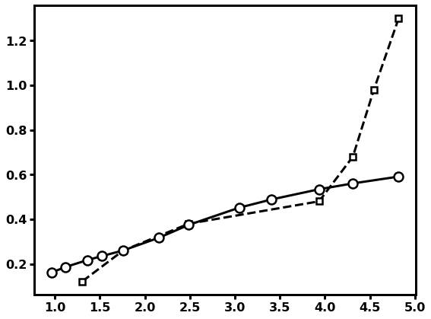
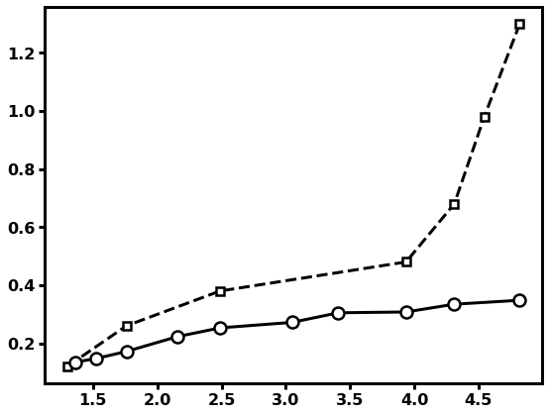

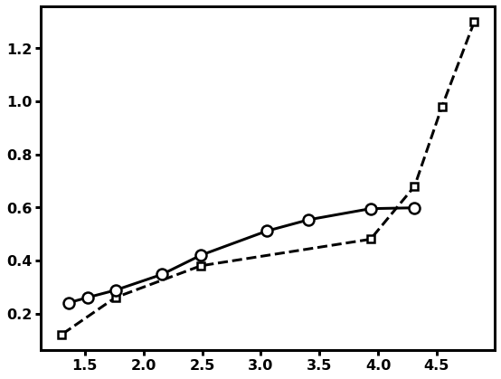
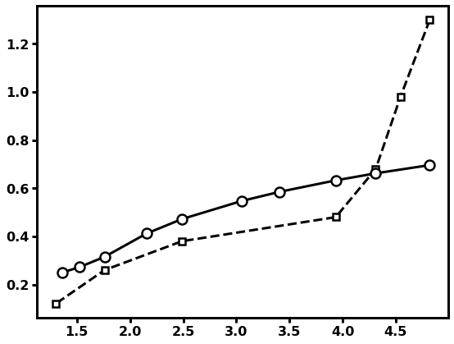
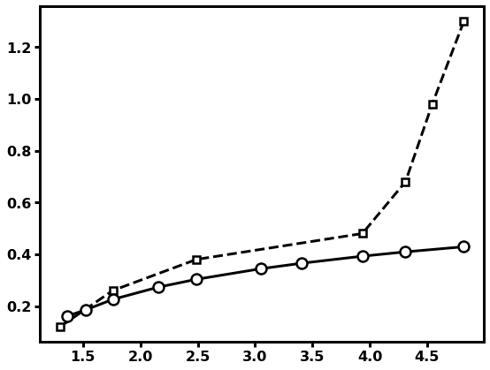
06 04 260
06 04 240
06 04 220
07 04 260
07 04 240
07 04 220

Slide 6
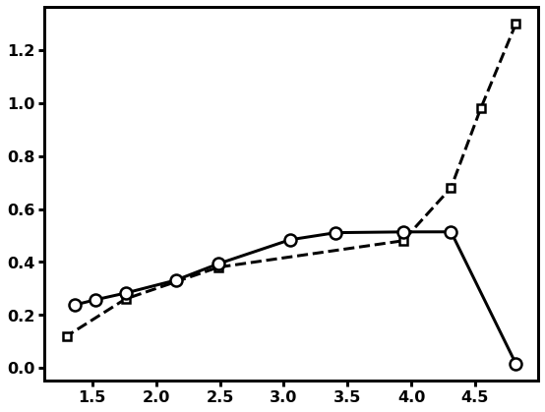
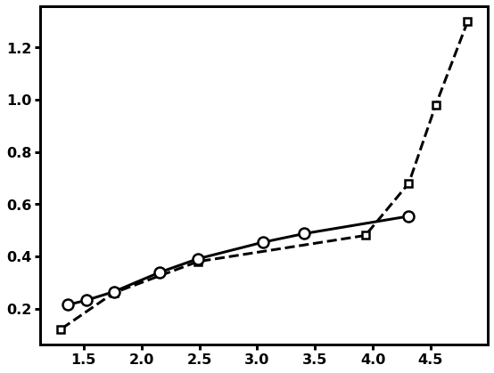
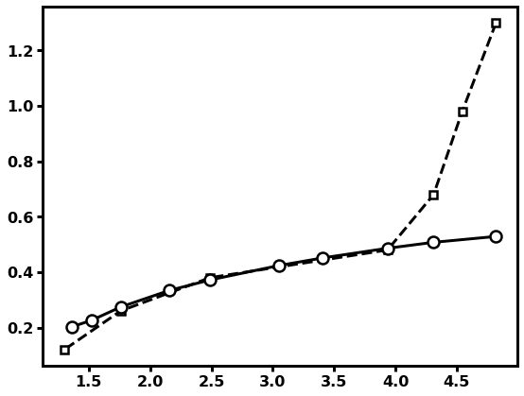
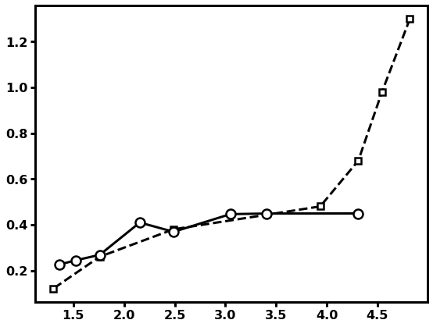
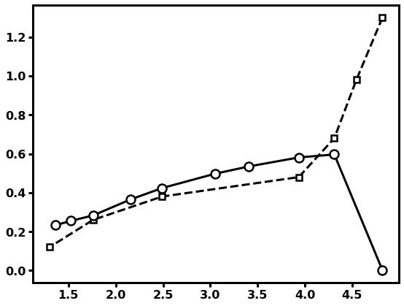

08 04 260
08 04 240
08 04 220
09 04 260
09 04 240
09 04 220

Slide 7
10 04 260
10 04 240
10 04 220
All stretched longer than given box size (150*0.6 = 90)

Slide 8






04 03 260
04 03 240
04 03 220
05 03 260
05 03 240
05 03 220

Slide 9

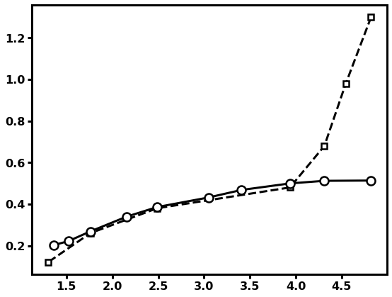



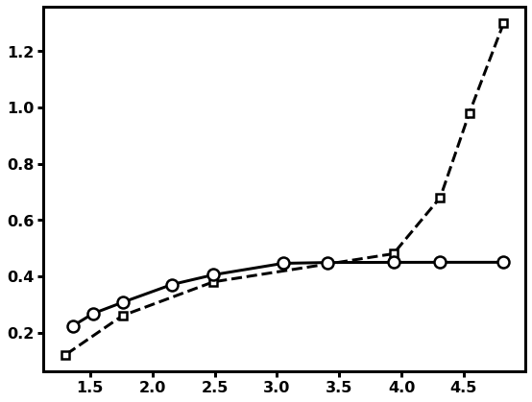
06 03 260
06 03 240
06 03 220
07 03 260
07 03 240
07 03 220

Slide 10
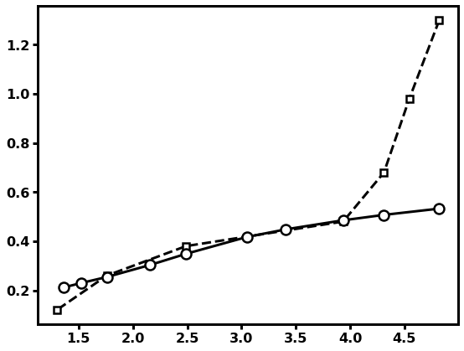
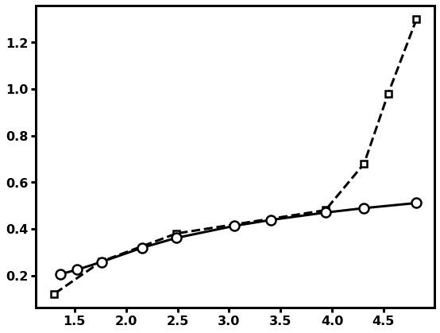
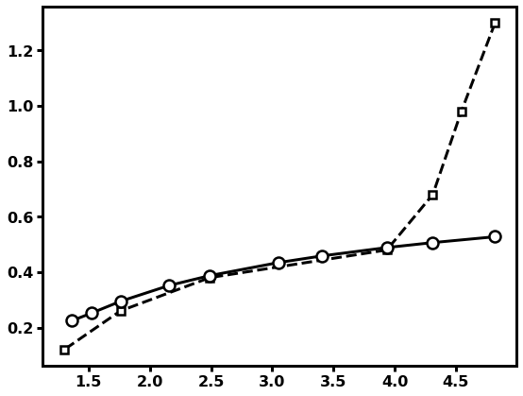
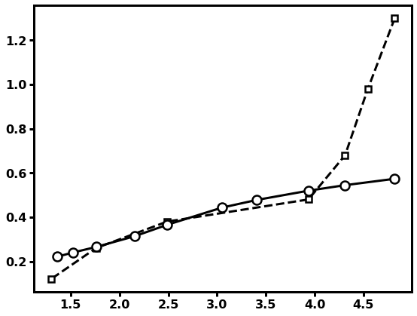
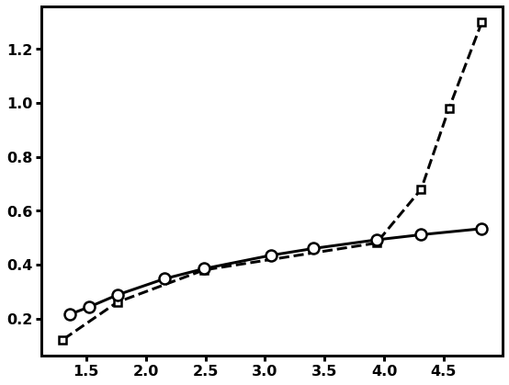
04 05 260
04 05 240
04 05 220
05 05 260
05 05 240
05 05 220

Slide 11

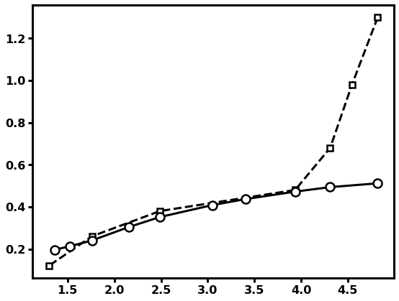

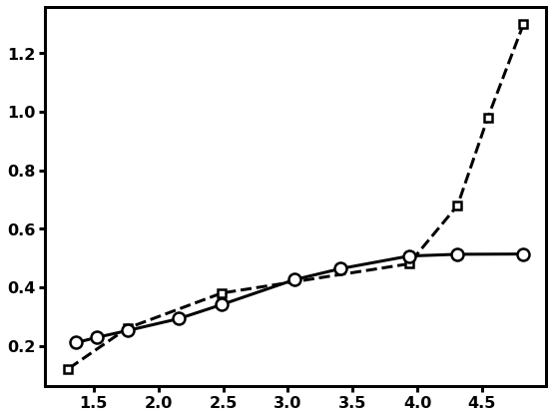
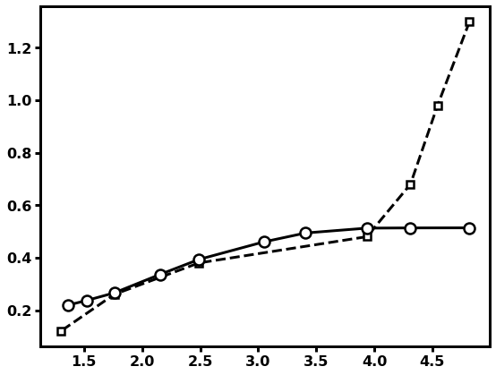
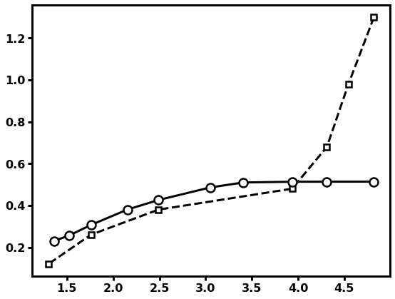
06 05 260
06 05 240
06 05 220
07 05 260
07 05 240
07 05 220

Slide 12
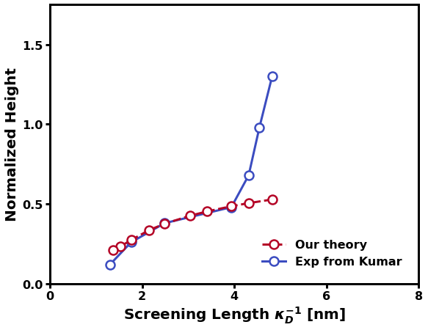

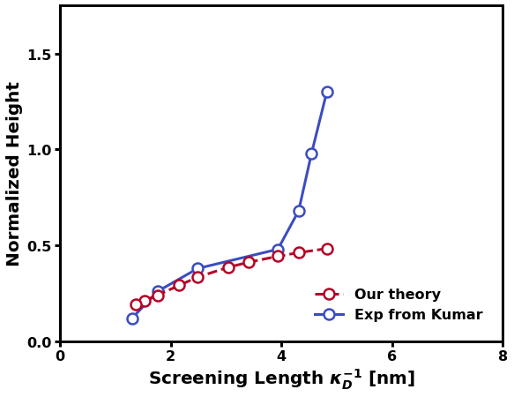
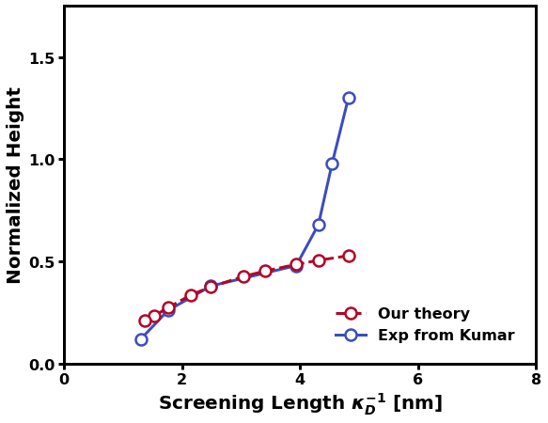
04 06 260
04 06 240
04 06 220
05 06 260
05 06 240
05 06 220

Slide 13
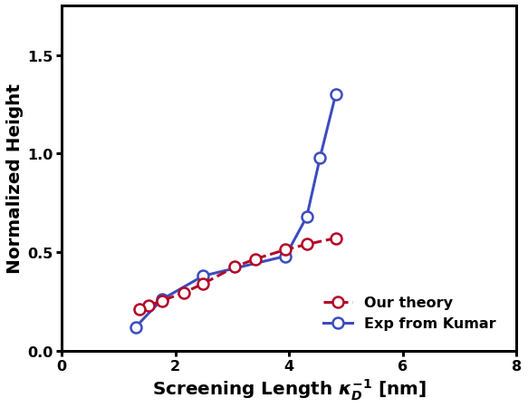
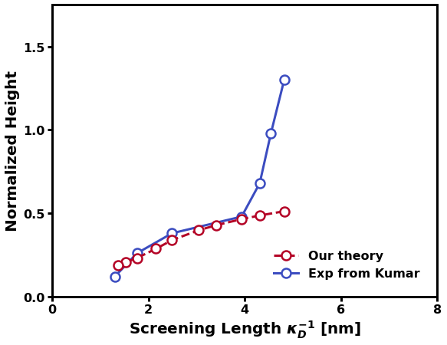
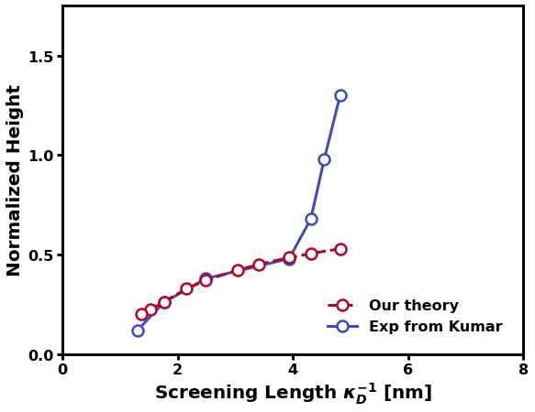



06 06 260
06 06 240
06 06 220
07 06 260
07 06 240
07 06 220

Slide 14
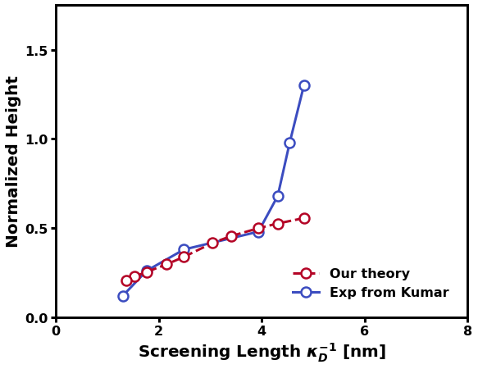

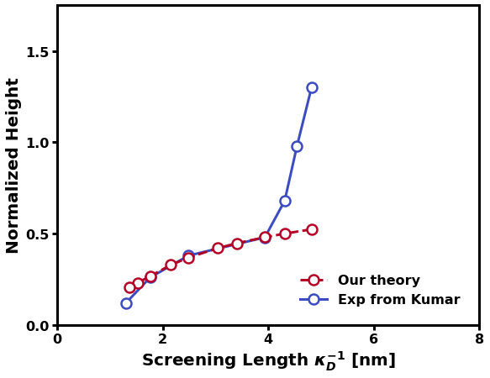
05 07 260
05 07 240
05 07 220
06 07 260
06 07 240
06 07 220

Slide 15
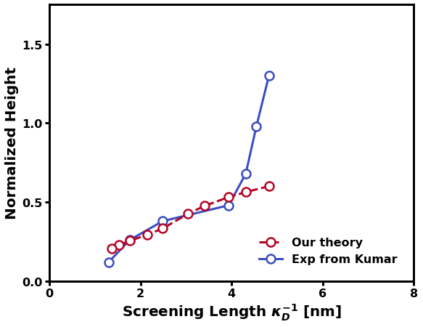
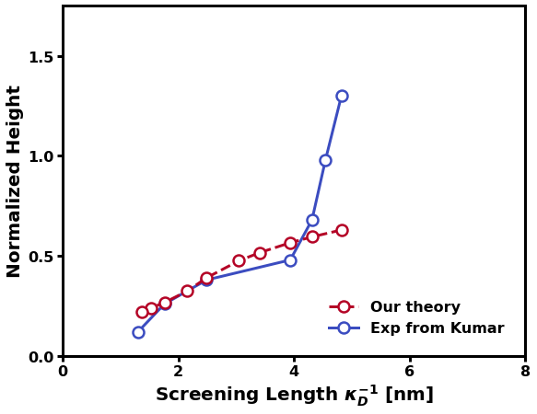

07 07 260
07 07 240
07 07 220
08 07 260
08 07 240
08 07 220

Slide 16
06 09 260
06 09 240
06 09 220
07 09 260
07 09 240
07 09 220

Slide 17





08 09 260
08 09 240
08 09 220
09 09 260
09 09 240
09 09 220

Slide 18



10 09 260
10 09 240
10 09 220

Slide 19
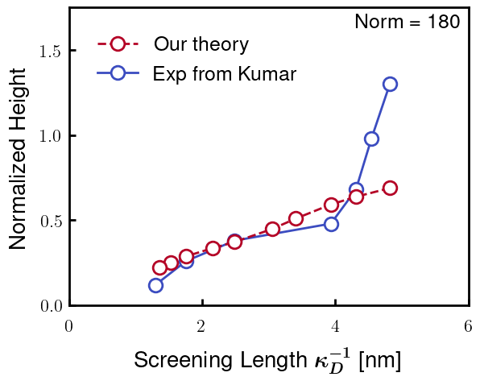
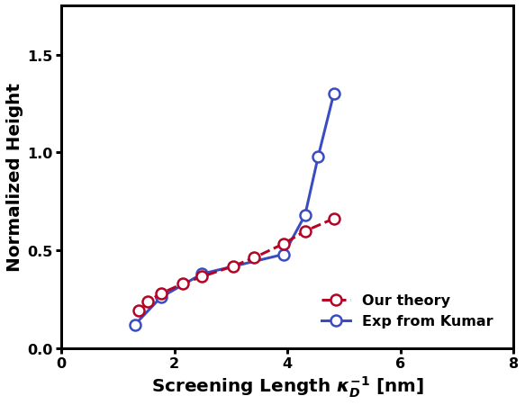
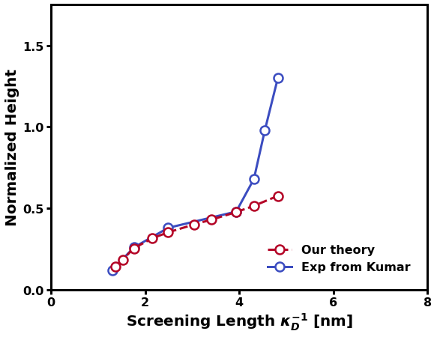
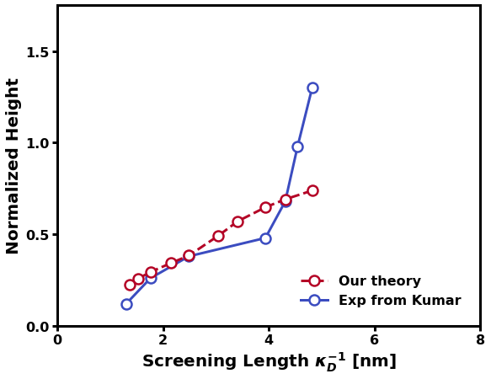

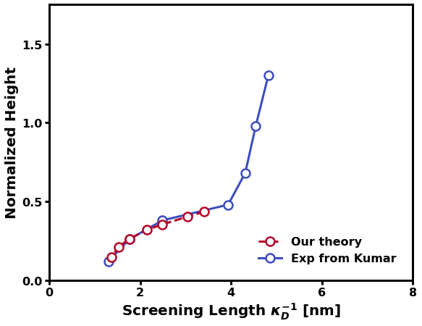
1.0 1.0 2.6
1.0 1.0 2.8
1.0 1.0 3.0
1.2 1.0 2.6
1.2 1.0 2.8
1.2 1.0 3.0

Slide 20



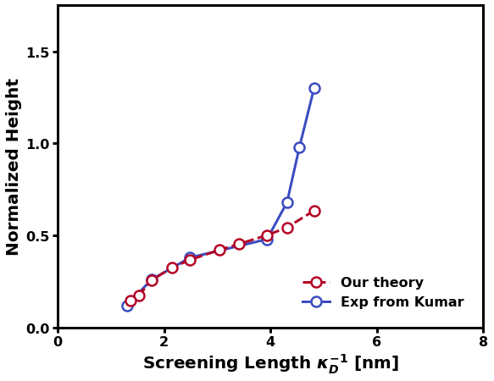
1.4 1.0 2.6
1.4 1.0 2.8
1.4 1.0 3.0
1.0 1.2 2.6
1.0 1.2 2.8
1.0 1.2 3.0

Slide 21

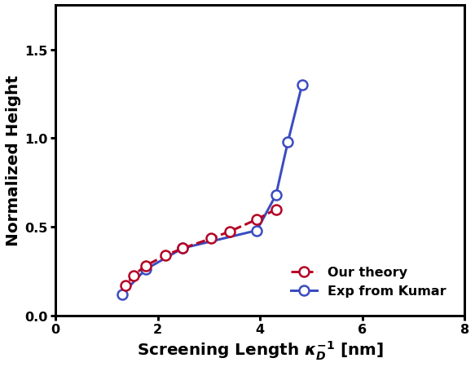


1.2 1.2 2.6
1.2 1.2 2.8
1.2 1.2 3.0
1.4 1.2 2.6
1.4 1.2 2.8
1.4 1.2 3.0

Slide 22



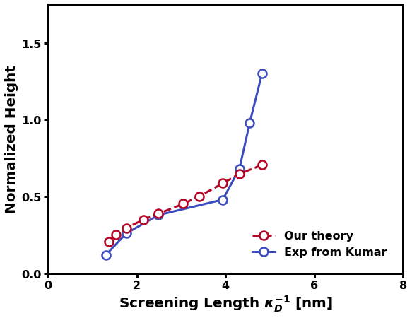

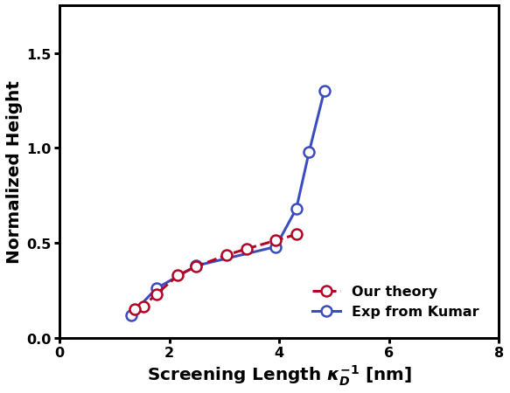
1.0 1.4 2.6
1.0 1.4 2.8
1.0 1.4 3.0
1.2 1.4 2.6
1.2 1.4 2.8
1.2 1.4 3.0

Slide 23

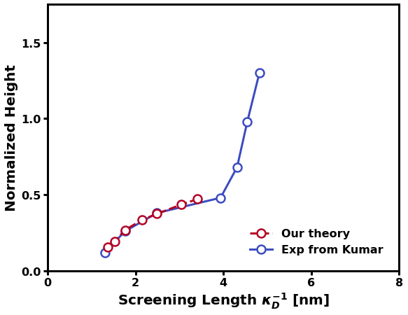

1.4 1.4 2.6
1.4 1.4 2.8
1.4 1.4 3.0

Slide 24
N func b0
N_K = K_AA * 0.360 [nm/AA] / b0 [nm/Kuhn]

Slide 25
Using excluded volume from Rubinstein Ch 3.1
Start with b = 0.5, 1.0, 1.5, 2.0, 5.0 nm
V0 = b^3 (spherical) (max flexible)
b^2 * d (cylindrical)
New options (09/03 code)
V0 = 4/3*pi*b^3 (b/d = 0.2387…) (Max flexible)
V1 = 1.00*b^3 (b/d = 1.0)
V2 = 0.50*b^3 (b/d = 2.0) (Rubinstein “flexible”)
V3 = 0.33*b^3 (b/d = 3.0) (Rubinstein “flexible”)
V4 = 0.15*b^3 (b/d = 6.5)
Rubinstein, pdf pg 108: b/d 2~3 for flexible,
PE, PEO: d = 0.8 nm
PS: d = 0.5 nm

Slide 26
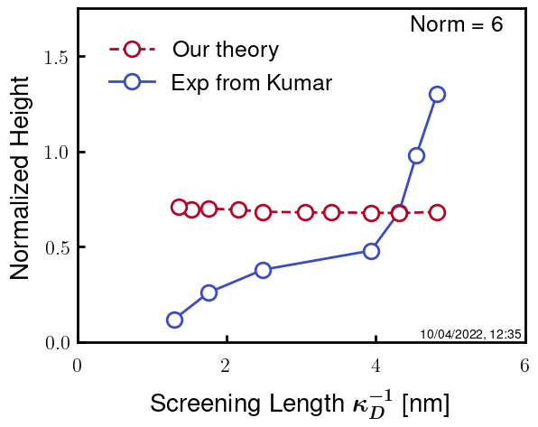
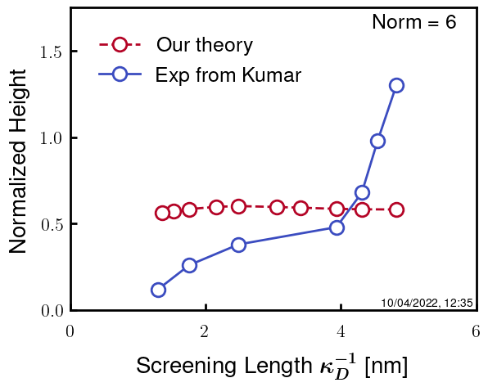



b05
Most flexible
Least Flexible

Slide 27





b05
Most flexible
Least Flexible

Slide 28





b10

Slide 29





b10

Slide 30





b15

Slide 31





b15

