Slide 3



SCFT Build-up — System
What is the system made up of?
s
+
-
Interactions:
Elasticity (monomer-monomer)
Solubility (solvent-monomer)
Electrostatics (ion-monomer)
Assumptions:
+
-
s
+
Chains within brush identical
s
s
s
-
+
+
+
+
+
+
+
-
+
s
+
s
+
-
s
+
-
s
Ion correlations neglected
Finite ion volume neglected
s
+
+
s

Slide 4

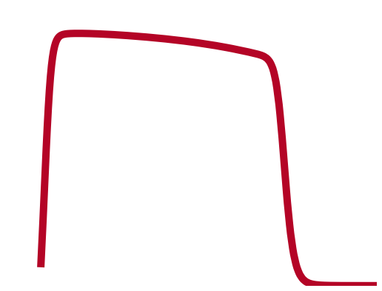


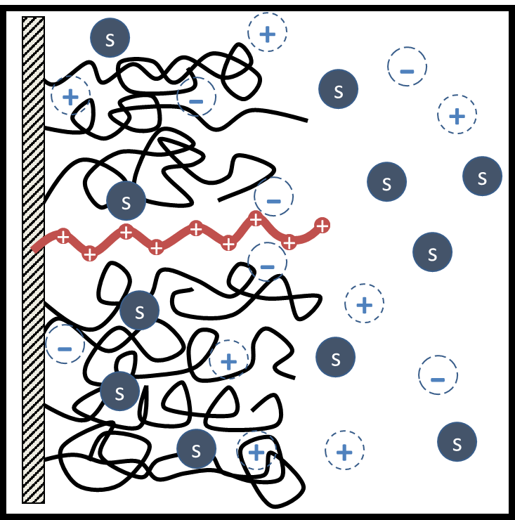
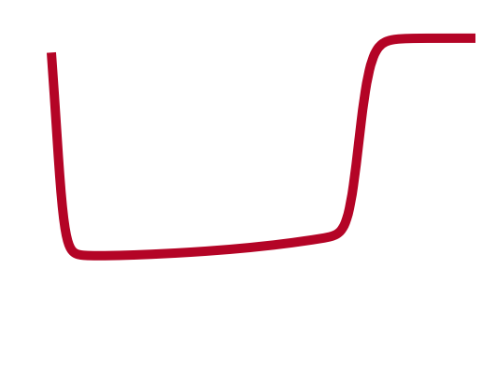
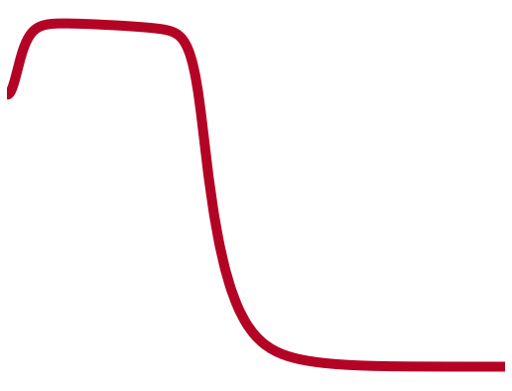
SCFT Build-up — System
What is the end-result of the model?
Generate fields (equations) that all particles in the system experience
Continuous functions
Depend in a mean-field way on all other particles
“Self-consistent field theory” (SCFT)
111
s
+
-
+
-
s
+
s
s
s
-
+
+
+
+
+
+
+
-
+
s
+
s
+
-
111
111
+
s
-
s
s
+
+
s
(Andelman, 2006)

Slide 5
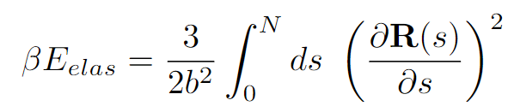
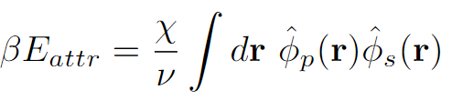
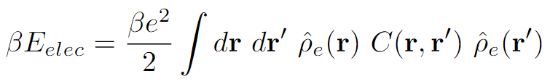
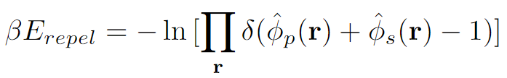
SCFT Build-up — Equations
Goal: Adapt framework for free polyelectrolyte in solution to model end-grafted protein brushes in solution
Interactions:
Elastic entropy following Gaussian statistics
Flory-Huggins 2-body interactions
Electrostatics, ignoring any correlations
Incompressibility

Slide 6
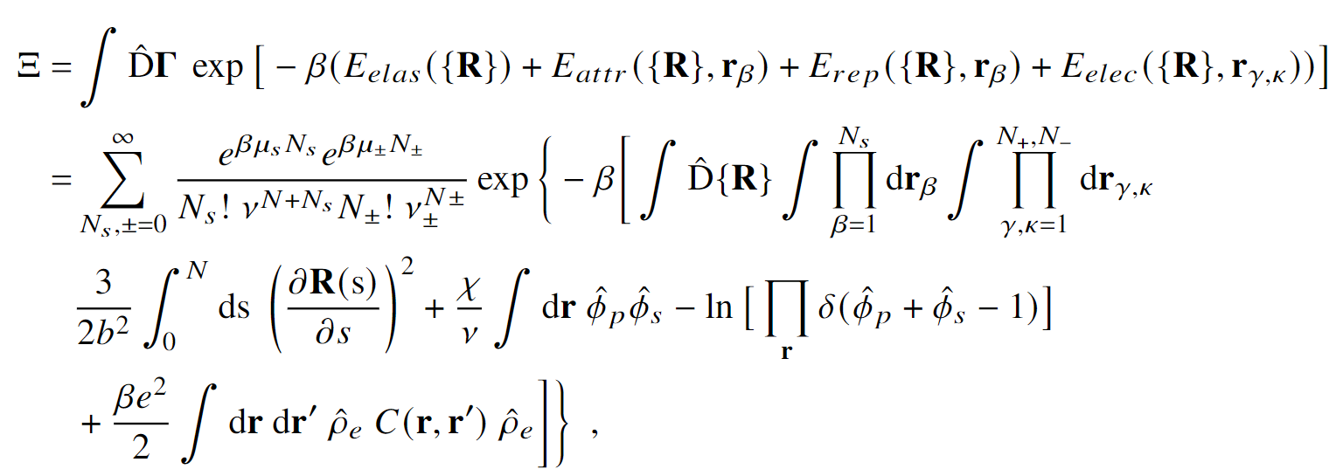






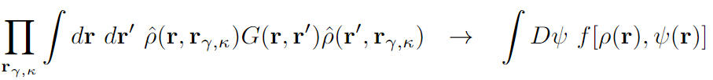

SCFT Build-up — Equations
Semicanonical partition function
Canonical in polymer, grand canonical in ions and solvent
Block copolymer formalism
Particle-to-field transformations
Hubbard-Stratonovich transformation
Saddle-point approximation

Slide 7
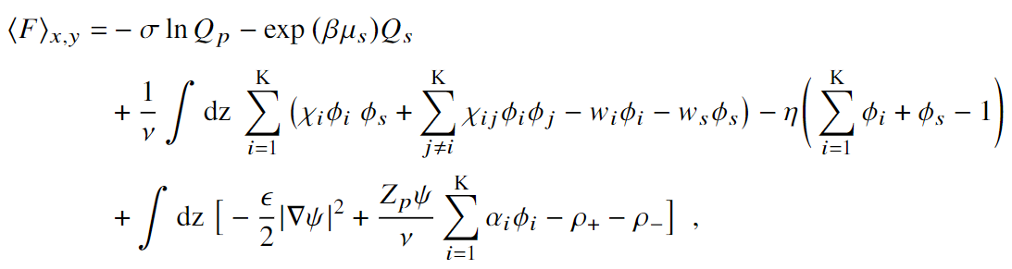



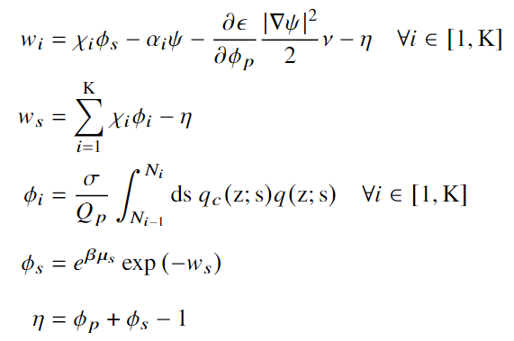

SCFT Build-up — Equations
Variational Free Energy
After statistical average over grafting surface (x-y plane)
Functional Minimization
SCF Equations

Slide 8
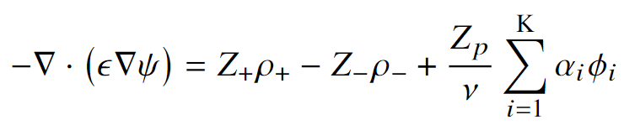
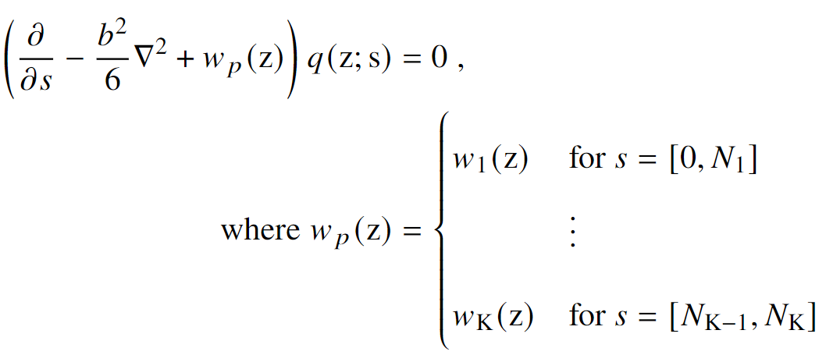

SCFT Build-up — Equations
SCF Equations, cont.
Mean-field Poisson-Boltzmann Equation
Modified Diffusion Equation
Block K
$$\{χ_{K},N_{K}, α_{K}\}$$
Block 2
Block 1

Slide 9
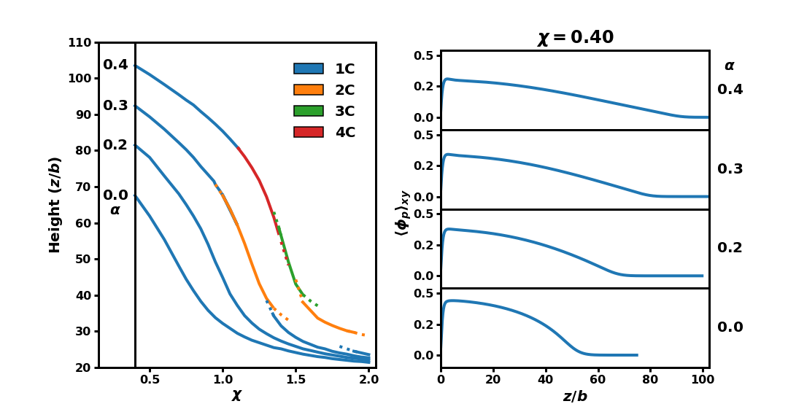
Internal Charge
Macroscopic
Microscopic

Slide 10
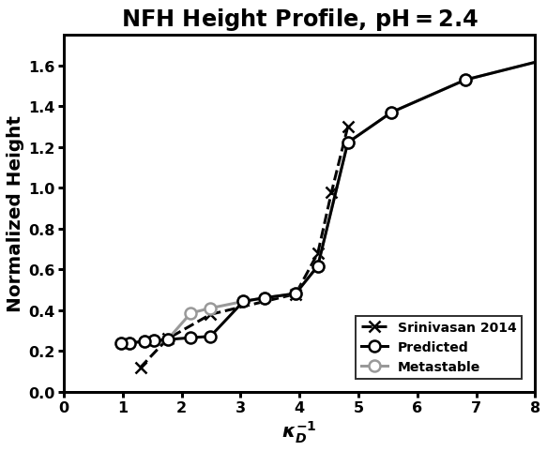

Cooperative Collapse of the Dilute Phase
How does internal structure affect response to salt concentration?
Dramatic collapse
Cooperative collapse

Slide 11
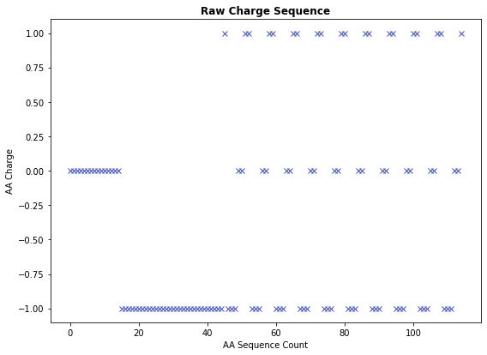
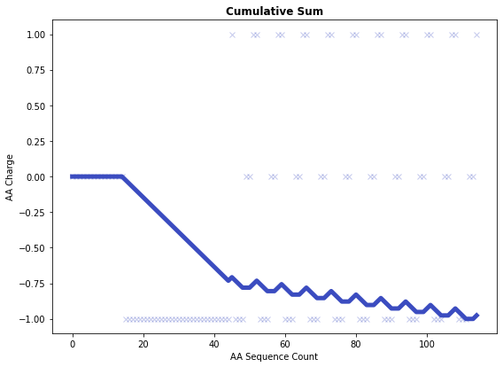
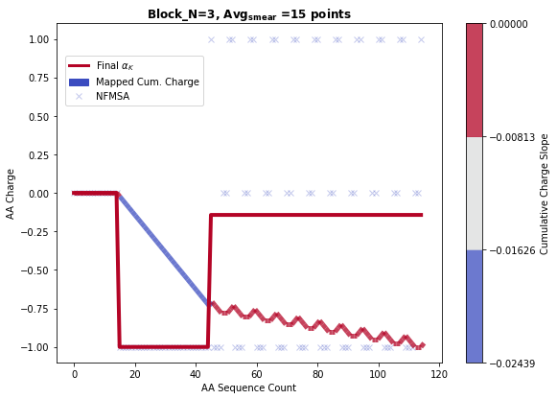
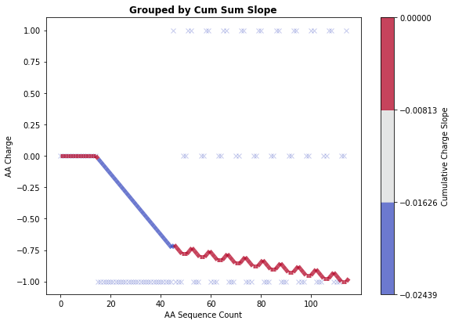
Protein Coarse-graining
Coarse-graining performed by grouping charges based on contributions to the slope of the cumulative charge
Hyperparameters: Number of bins, Minimum number of AA per block
Sample sequence:
HHHHHHHHHHHHHHH DDDDDDDDDDDDDDDDDDDDDDDDDDDDDD KDDDHHK KDDDHHK KDDDHHK KDDDHHK KDDDHHK KDDDHHK KDDDHHK KDDDHHK KDDDHHK KDDDHHK

