Slide 1
Test conditions
Sigma = 0.05 c/nm2
Lx = 15 nm
Ly = 15 nm
dx = 0.4 nm
Cast in terms of dx (for rounding and PBC for grafting points):
Sigma = 0.0668 c/nm2
Lx = 14.80 nm
Ly = 11.20 nm
(Sigma error decrease with dx)

Slide 2
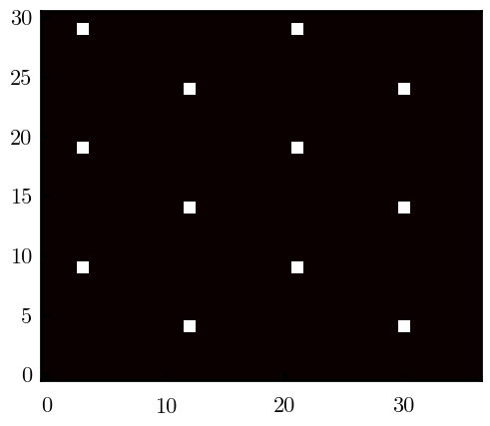
Padded PBC (Full FFT)

Slide 3
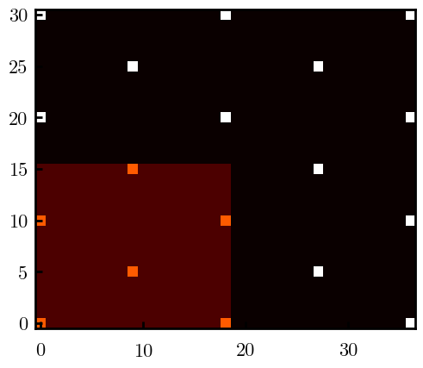
Unpadded PBC (Full/Cos FFT)

Slide 4
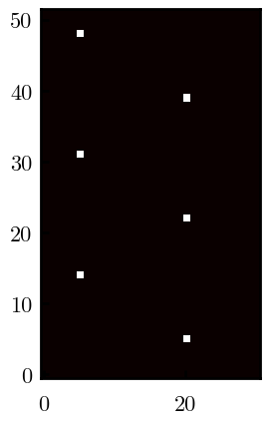
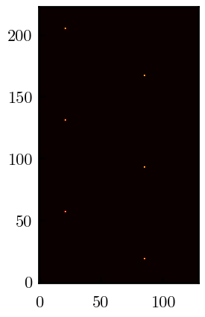
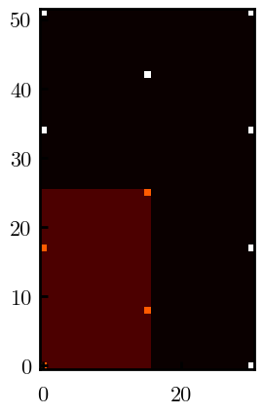
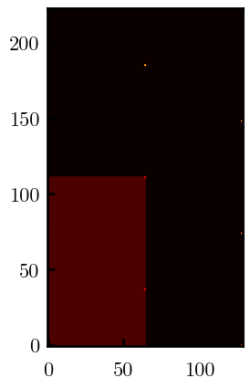
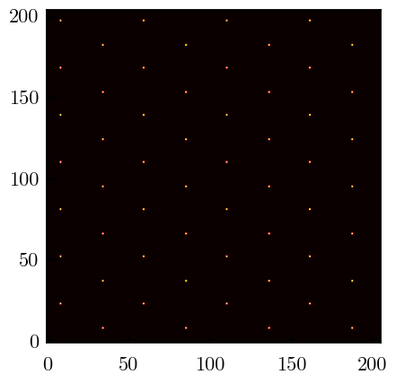
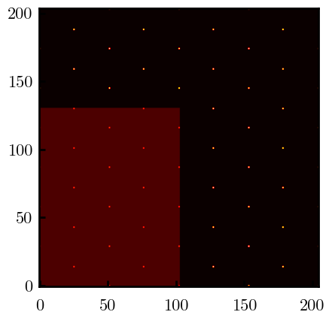
Other conditions
s = 0.0241 (20.28%; dx=0.4), Lx, Ly = 12.40, 20.80
s = 0.0208 (4.08%; dx=0.1), Lx, Ly = 12.90, 22.30
s = 0.1332 (11%; dx=0.1), Lx, Ly = 20.50, 20.40

