Slide 1
SYSG

Slide 2
Interacting

Slide 3
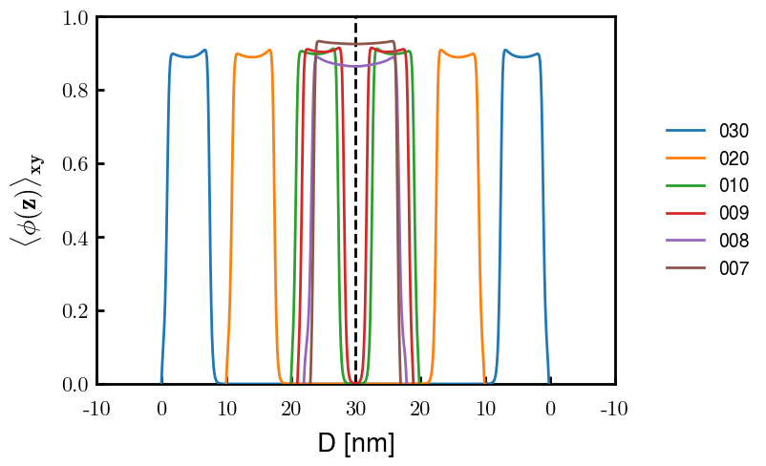
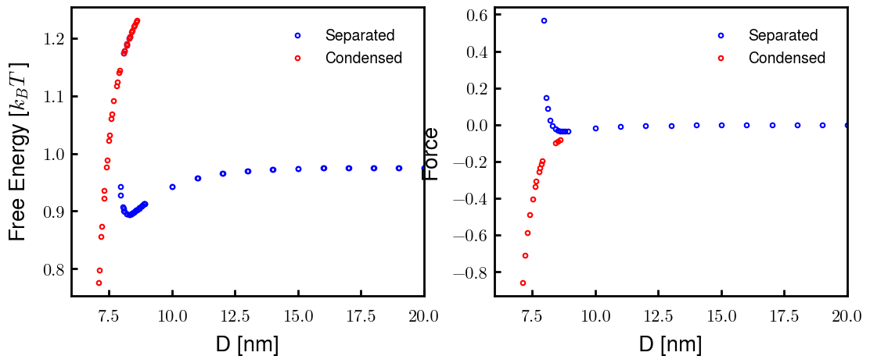
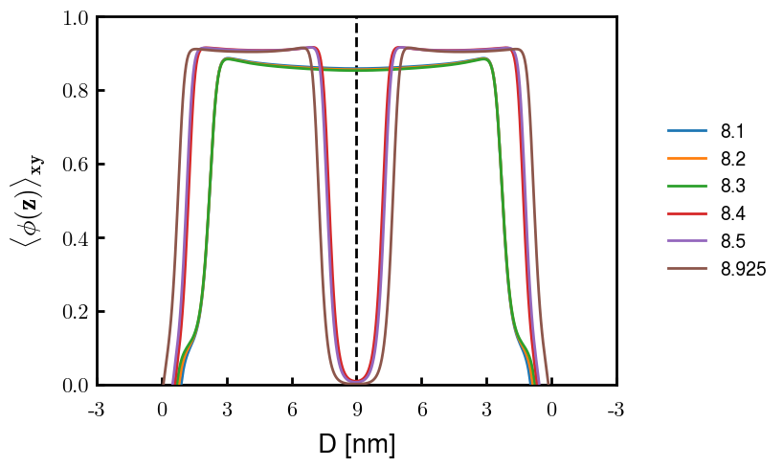
p1a4 c2.00
Old Nm

Slide 4
p1a4 c2.00

