Slide 1
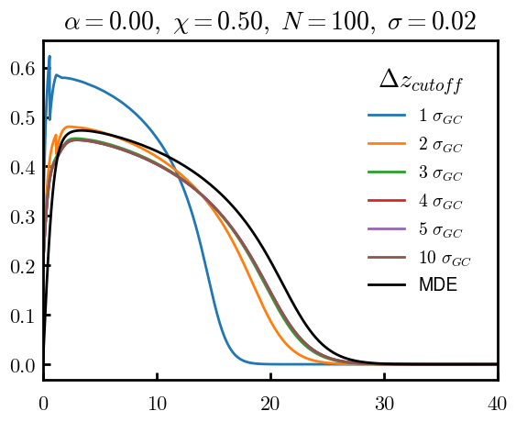
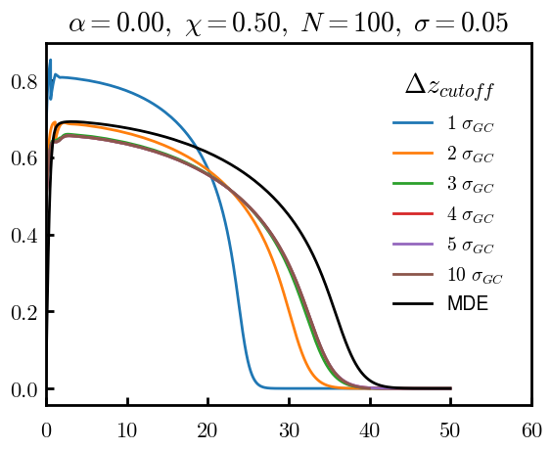
CURRENT; dz = 0.01 (MDE dz = 0.02)
3D: 91% volume
1D: 100% volume
3D: 86% volume
1D: 100% volume

Slide 2
Equations
Quenched average, np, A --> \inf ; np/A → \sigma
Discrete Gaussian chain

Slide 3
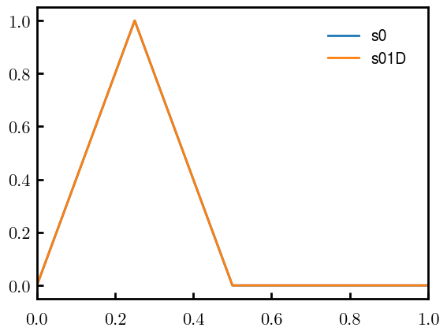
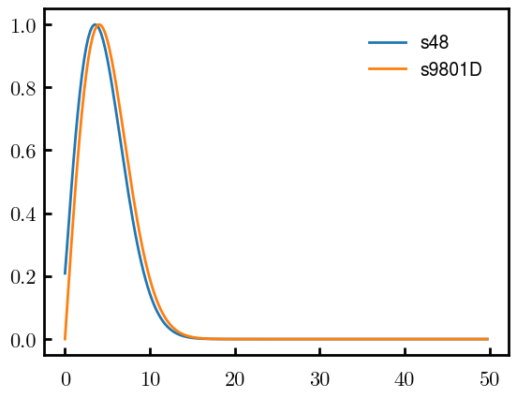
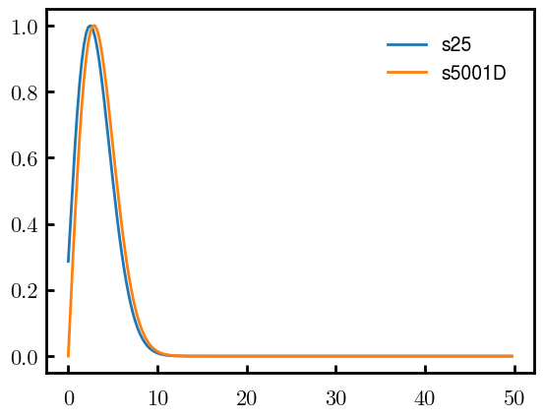
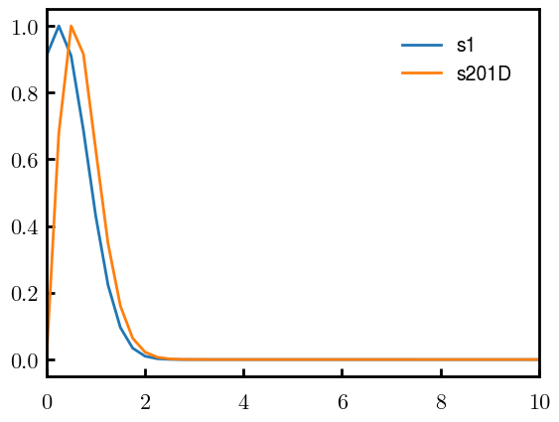
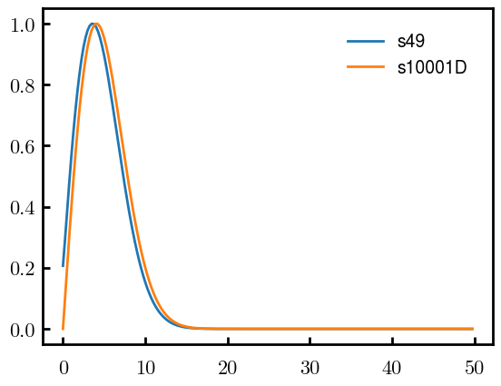
DGC vs MDE (q, normalized, init=0, s02)
N = 50
Ns0 = 1000
ds0 = 0.05
Ds0 = 20
To delete if current runs work

Slide 4
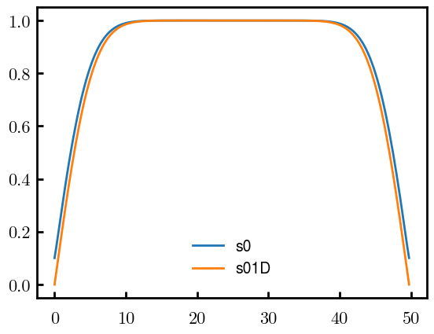
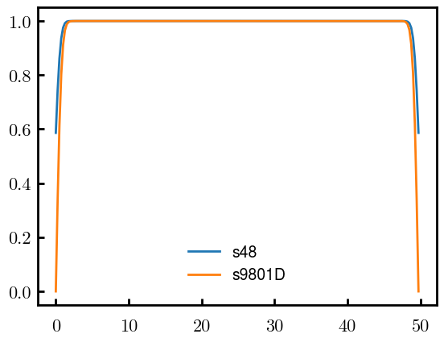
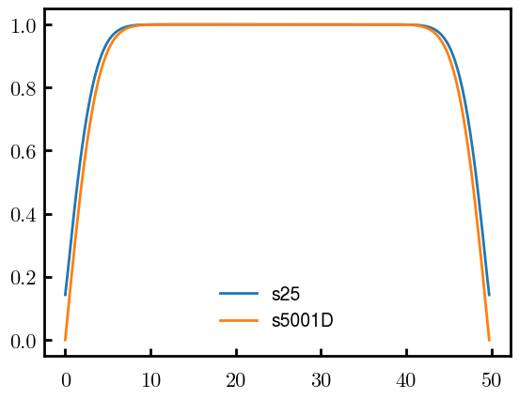

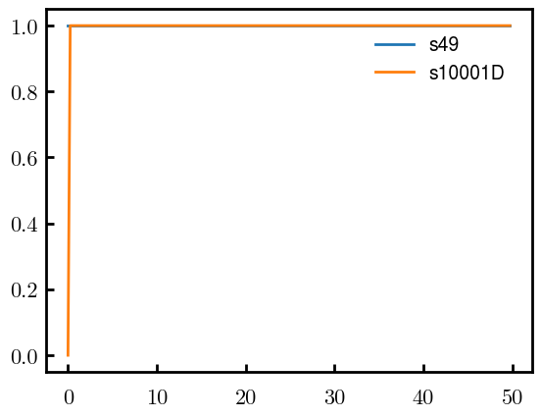
DGC vs MDE (qc, normalized, init=0, s02)
N = 50
Ns0 = 1000
ds0 = 0.05
Ds0 = 20
To delete if current runs work

Slide 5
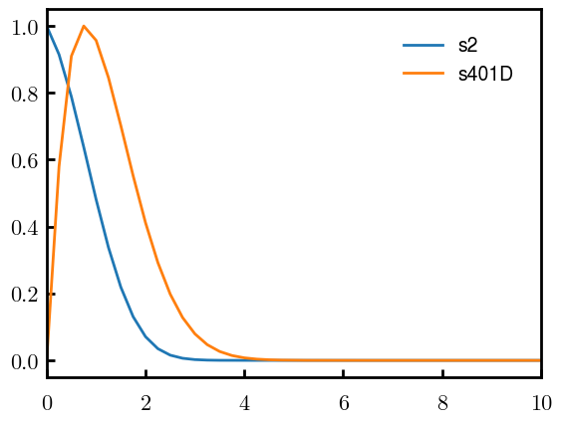
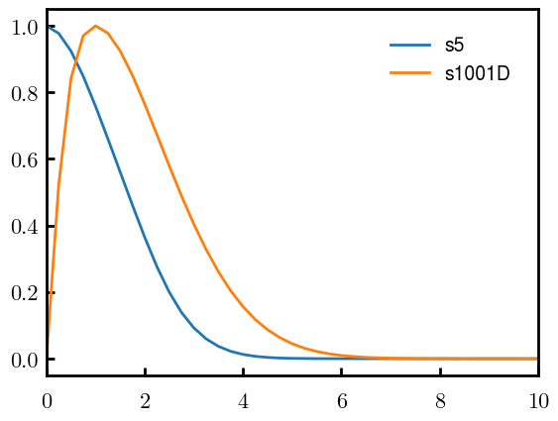
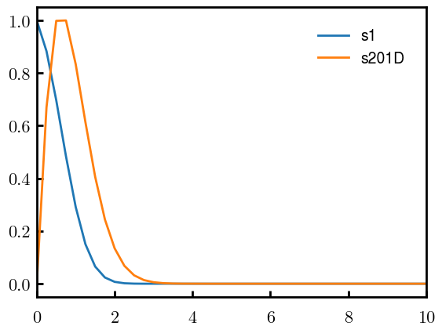
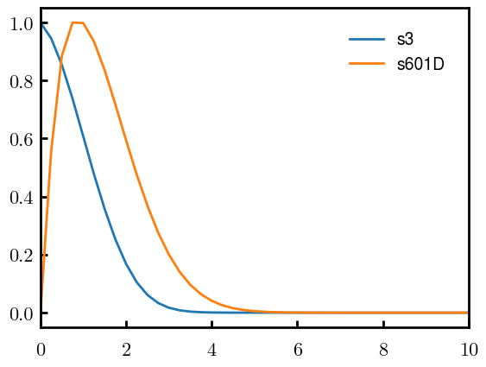
DGC vs MDE (q, normalized, s0.10)
N = 50
Ns0 = 1000
ds0 = 0.05
Ds0 = 20
To delete if current runs work

Slide 6
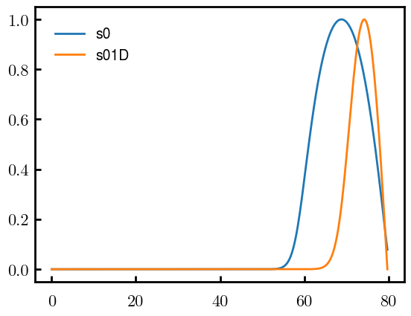
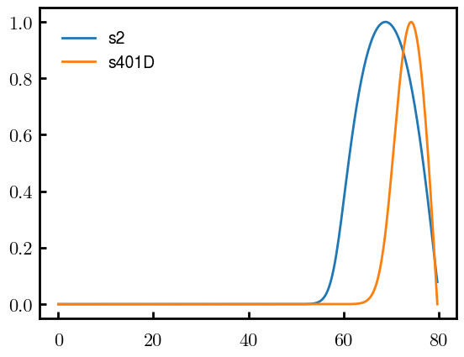
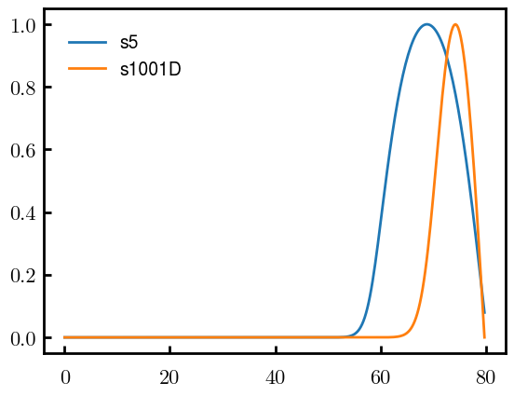


DGC vs MDE (qc, normalized, s0.10)
N = 50
Ns0 = 1000
ds0 = 0.05
Ds0 = 20
To delete if current runs work

Slide 7
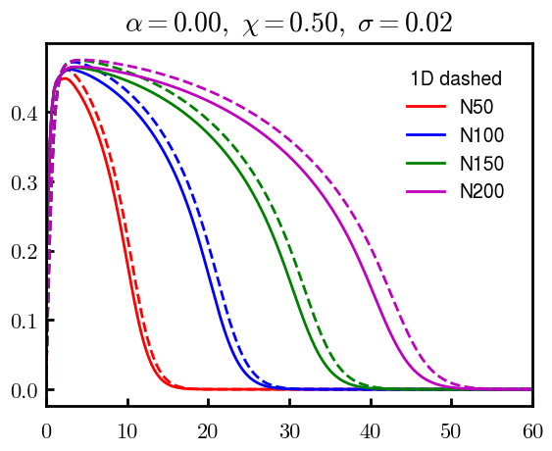
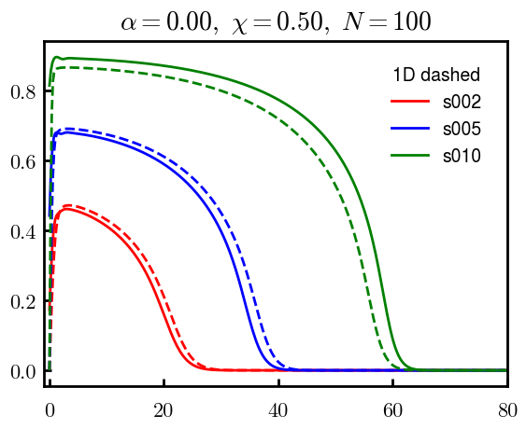
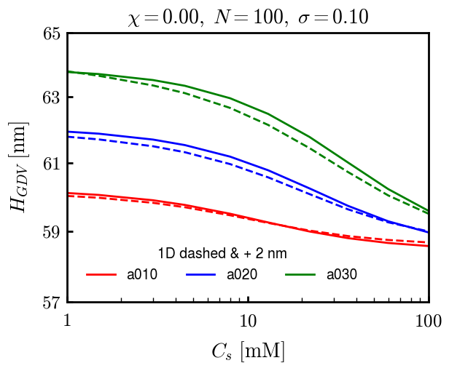
DGC (3D; NxNy=1) vs MDE (1D)

Slide 8
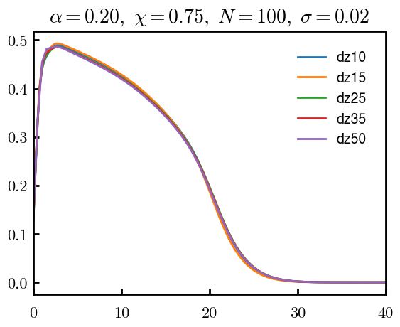
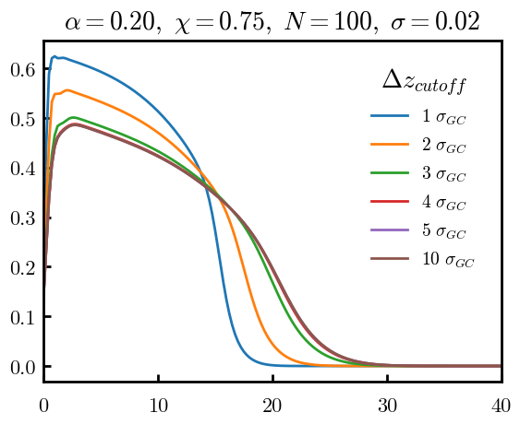
Numericals

Slide 9
Scaling

Slide 10
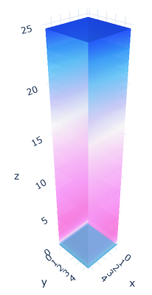
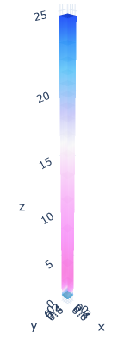

3D
Lxy = 1
Lxy = 5

Slide 11
OLD

Slide 12
Annealed

Slide 13
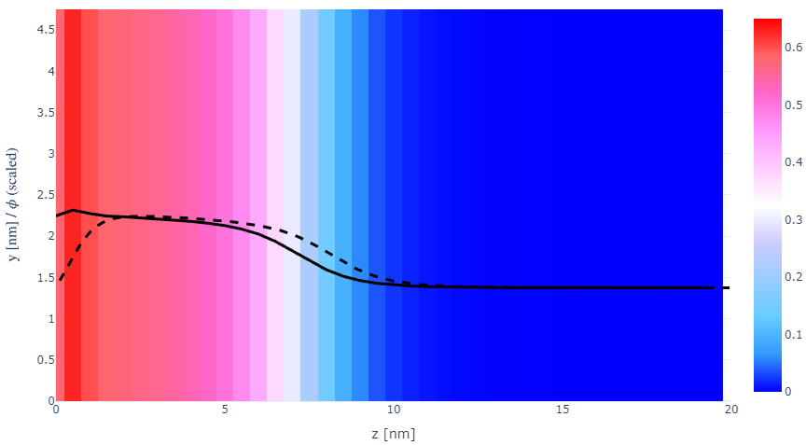
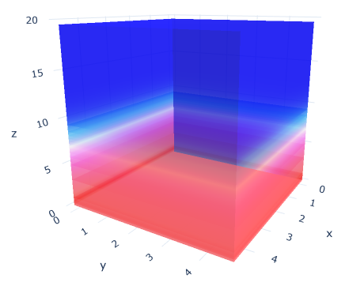

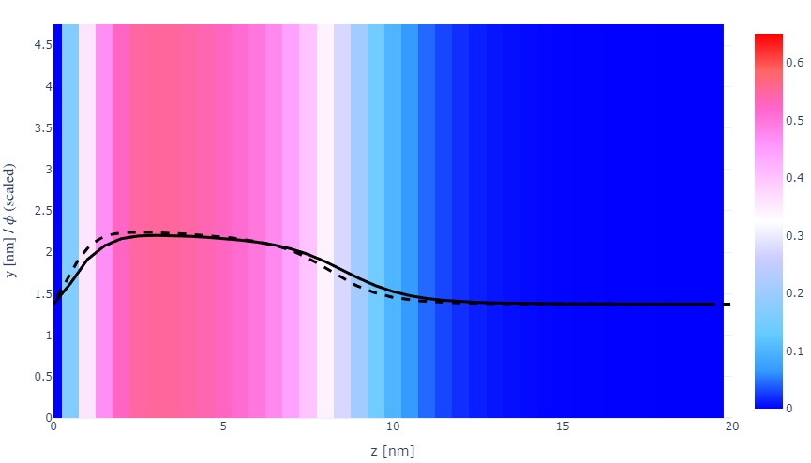
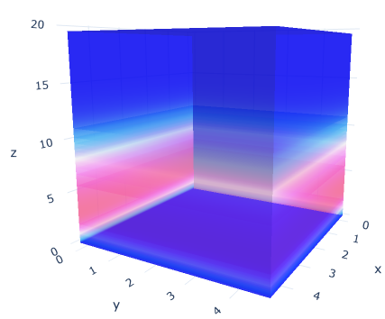
z-FFT vs z-FD (MDE) – REDFT01 xy(z)
Lx = 5, Ly = 5, Lz = 50. s = 0.02. x = 0.75. a = 0.00, N = 50
3D vs 1D (dashed): dz = 0.5, ds = 0.20; dz_1D = 0.113, ds_1D = 0.083
FFT (xyz)
FFT (yz vs pha)
FD (xyz)
FD (yz vs pha)
Diff btw 1D/3D should just be dz, ds, etc.

Slide 14
PB: REDFT00 (x= -0.5) vs REDFT01 (x=0)
Lx = 5, Ly = 5, Lz = 50. s = 0.02. x = 0.75. a = 0.00, N = 50
3D vs 1D (dashed): dz = 0.5, ds = 0.20; dz_1D = 0.113, ds_1D = 0.083
Compare pot_elec and freeE with each other and 1D

Slide 15
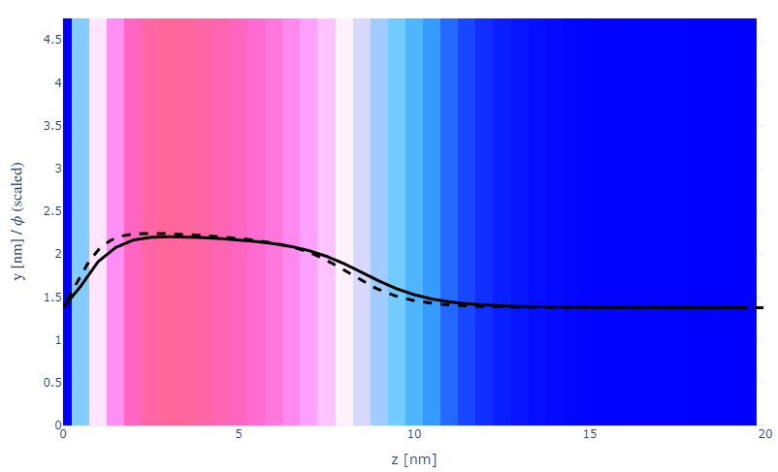
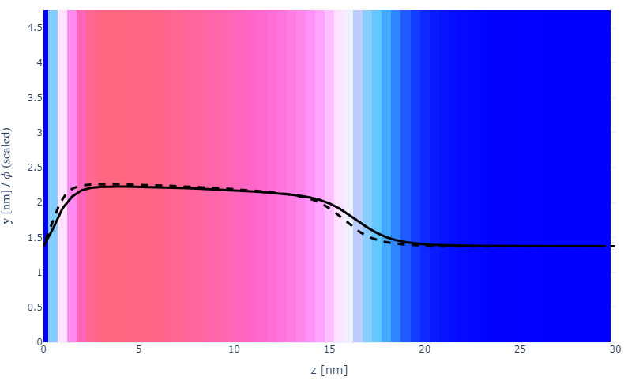

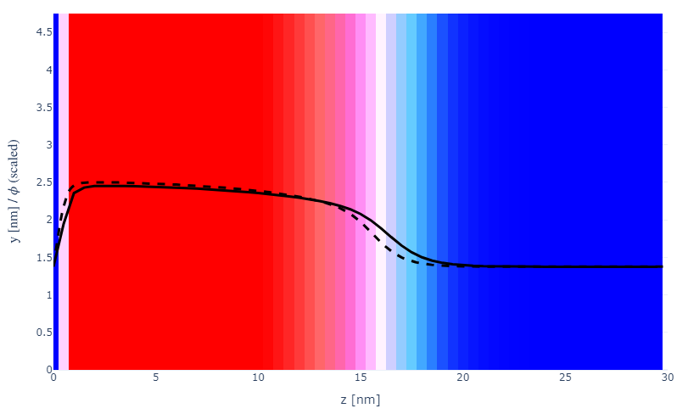
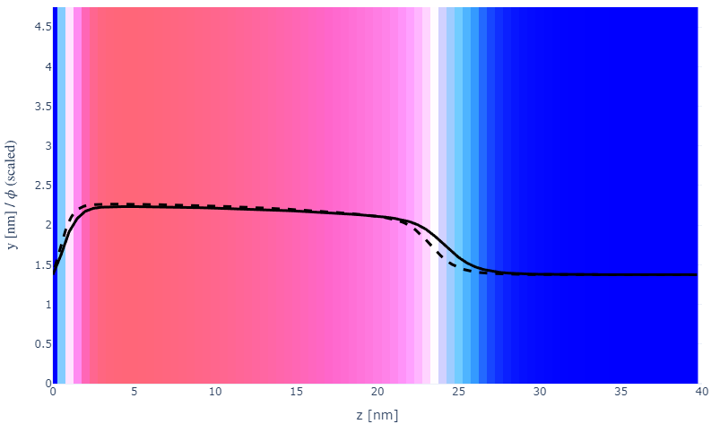
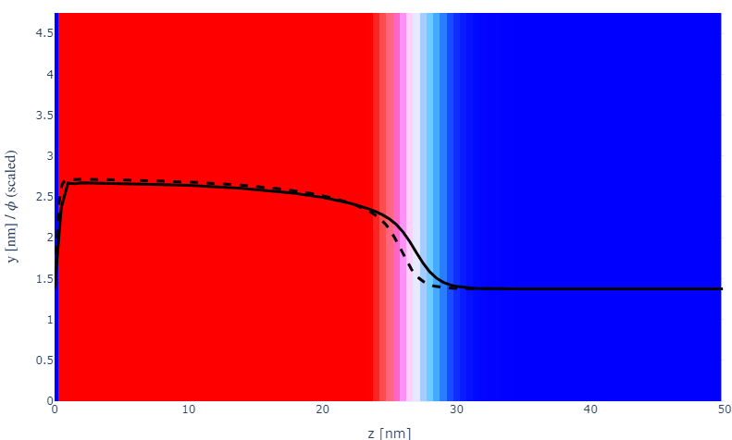
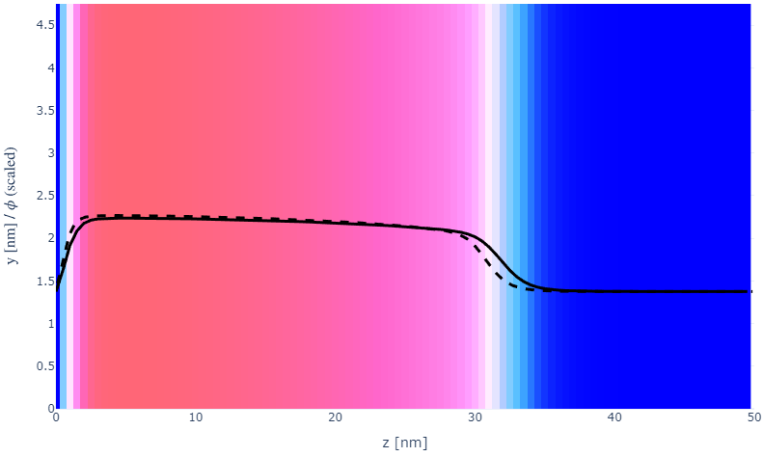
Parameter space (s, N)
a000x075
s002N050
N100
20
30
s005
N150
30
40
s010
N200
50
50

Slide 16
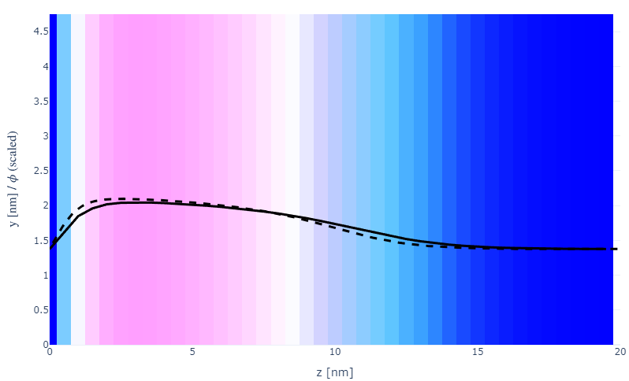
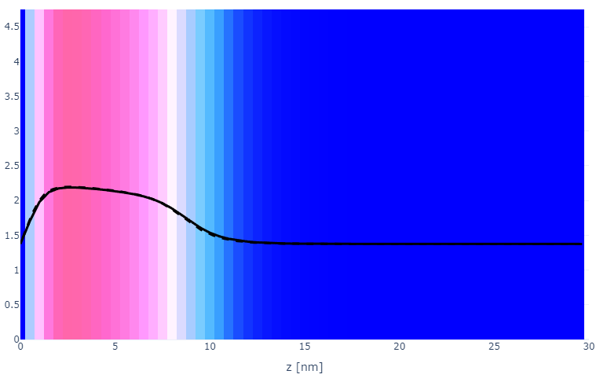
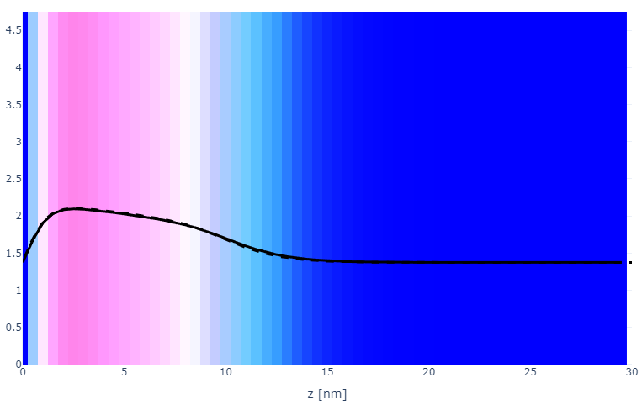
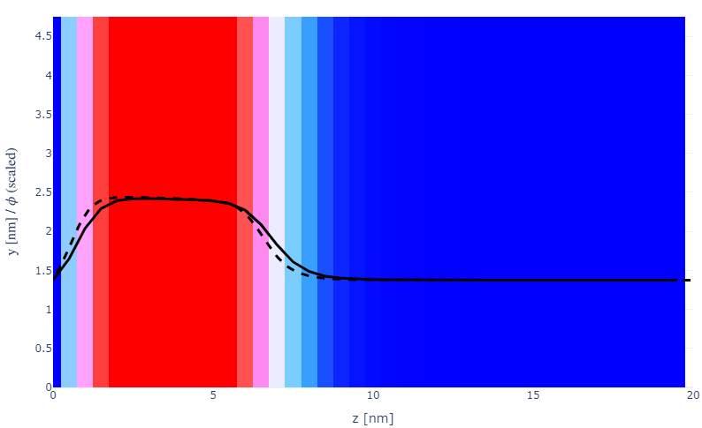
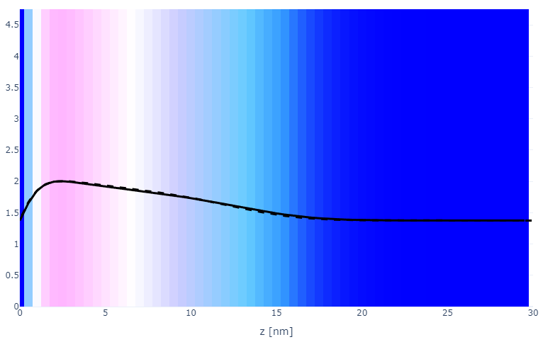
Parameter space (x, a)
a000x055s002
a010x075
20
30
x075
a020x075
20
30
x100
a030x075
20
30

Slide 17
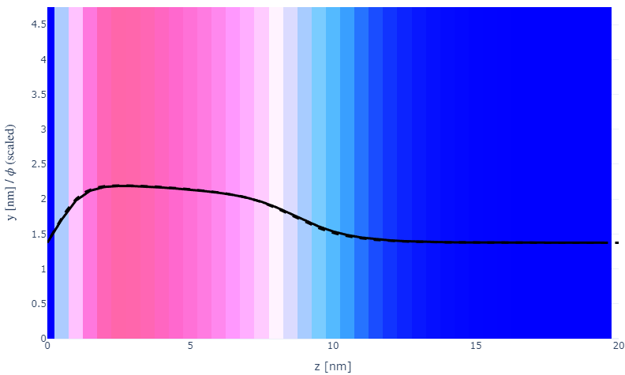
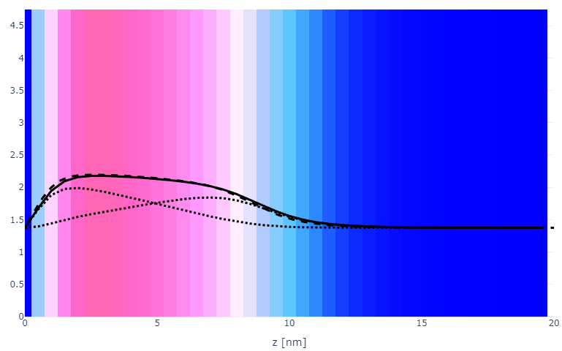
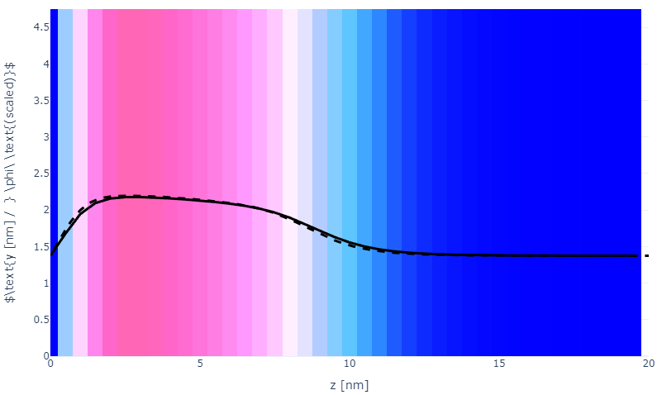

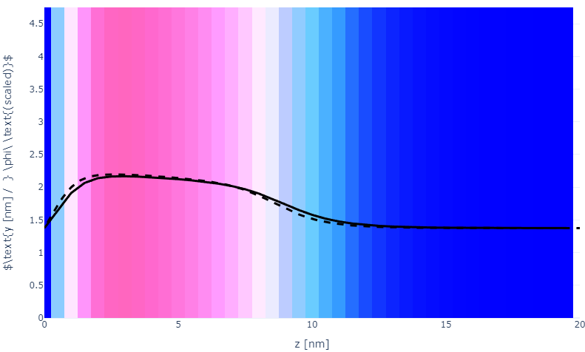

Numerical space (dz, ds, Y)
a010x075ds05
a010x075Y2
a010x075ds10
a010x075Y5
a010x075ds15
a010x075Y10

Slide 18

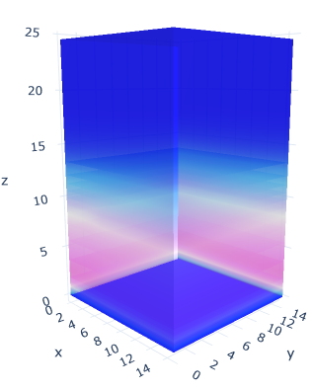
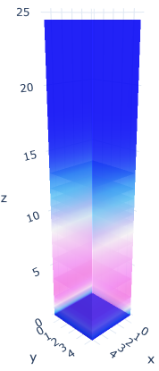
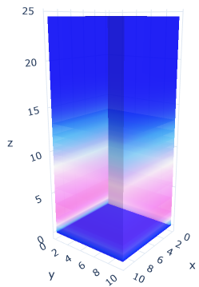
Plate size (Lx=Ly)
a020x075; Lxy = 5
Lxy = 10
Lxy = 15

Slide 19
Specifying Grafted Points

Slide 20
Strategy
2D binary array for surface sites of homogeneously grafted polymer given grafting density, simulation box size, and discretization (and assuming dx = dy)
Fullspace must be periodic on x0 = xL, y0 = yL
Halfspace must be even on xL/2 and yL/2 (overlap of boundary following REDFT00) and periodic on x0 = xL, y0 = yL.
Homogeneous spacing as determined by regular hexagon, where grafting point at centroid of hexagon
In case there are edge effects, try shifting the centroids away from the boundaries of the xy-plane (only did for fullspace)
Make sure no edge effects by comparing results of full FFT with cos FFT

Slide 21
Test conditions
Sigma = 0.05 c/nm2
Lx = 15 nm
Ly = 15 nm
dx = 0.4 nm
Cast in terms of dx (for rounding and PBC for grafting points):
Sigma = 0.0668 c/nm2
Lx = 14.80 nm
Ly = 11.20 nm
(Sigma error decrease with dx)

Slide 22
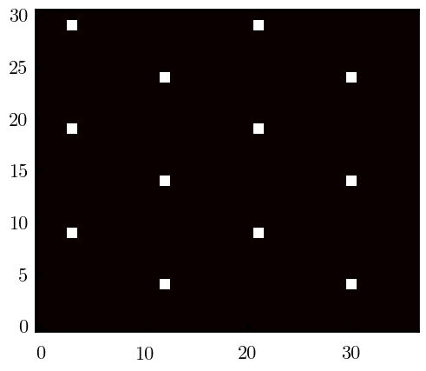
Padded PBC (Full FFT)
Hexagons drawn for illustration of hexagon approach

Slide 23
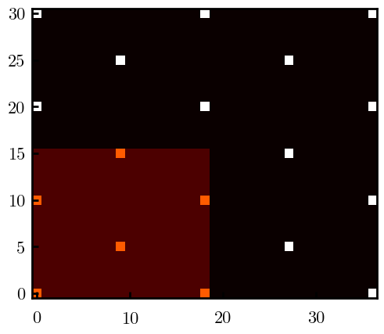
Unpadded PBC (Full/Cos FFT)

Slide 24
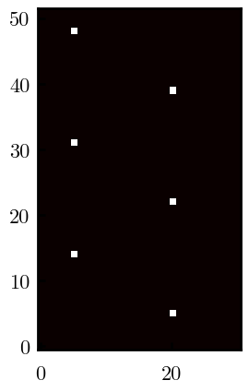





Other conditions (full and half results overlapped to show match)
s = 0.0241 (20.28%; dx=0.4), Lx, Ly = 12.40, 20.80
s = 0.0208 (4.08%; dx=0.1), Lx, Ly = 12.90, 22.30
s = 0.1332 (11%; dx=0.1), Lx, Ly = 20.50, 20.40

