Slide 1
SYSG

Slide 2
Schematic, similar to NFH but simpler like Chao, not multiblock protein

Slide 3
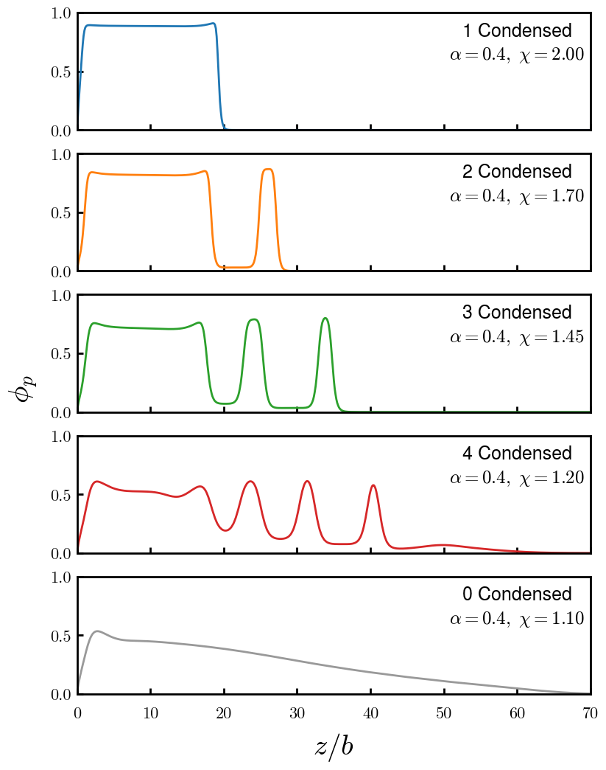
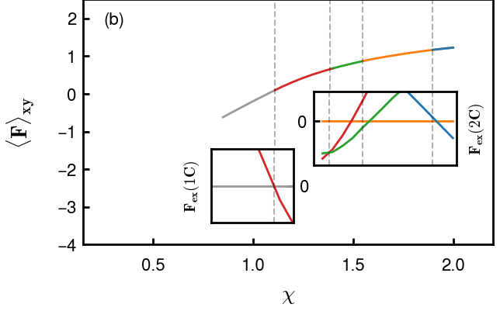
Possible brush morphologies (including +d)
Find cleaner way to portray F change and transition points

Slide 4
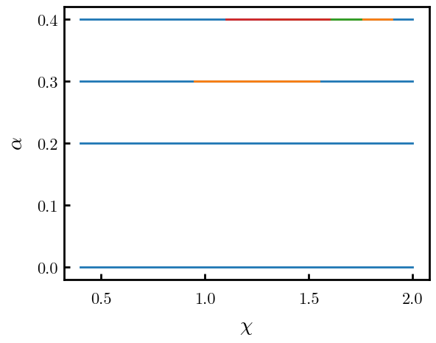
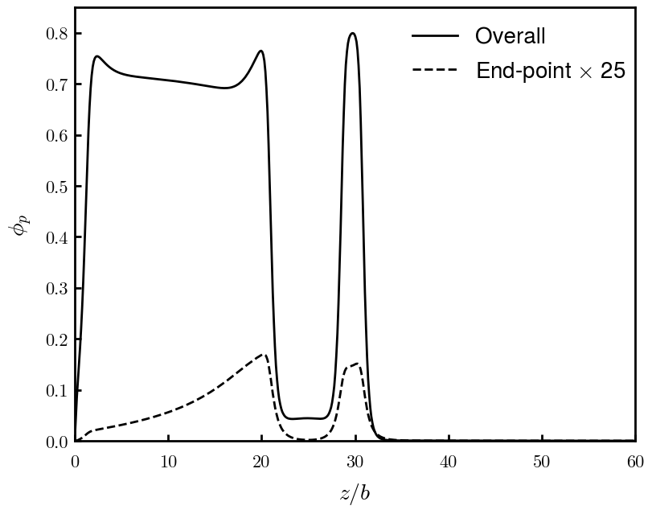
Phase diagram to highlight stability region of layers and +d regions
Explain locked-in-layer model using end-point distributions
Good one with +d? Add other blocks to show overlap, or at least which takes up the neck
Colored schematic, like NFH paper

Slide 5
Population of chains diagram (vertical, 1C includes, 2C includes, etc. d at the top)

Slide 6
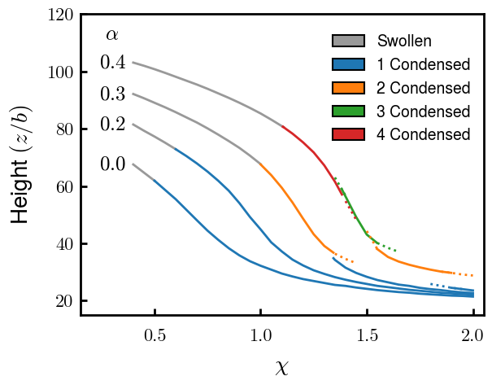
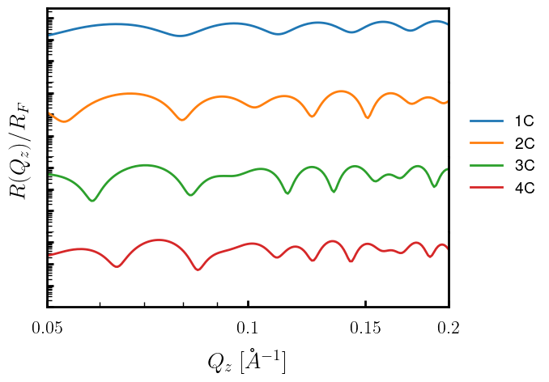
PEBs interesting bc of height response to stimuli (e.g., temp for chi, Cs for alpha)
Scaling chi available?
Signatures of each C, some way to find number of C?
Add param space (a=0.4, x = ?)
Try non-log, same limits as NFH paper

Slide 7
Force for alpha = 0.4
IS THIS NECESSARY? See if can deduce nC from reflectivity first

Slide 8
Interacting

Slide 9
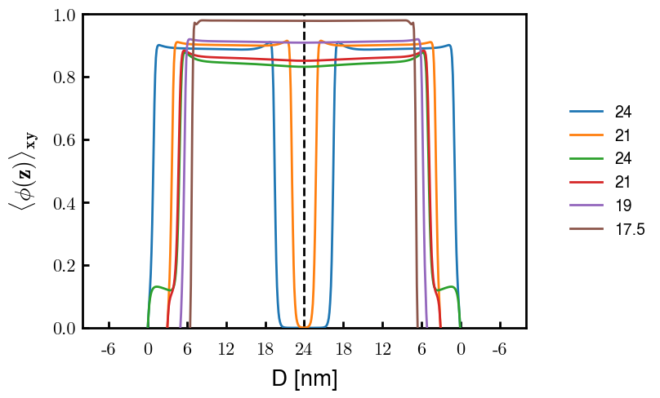
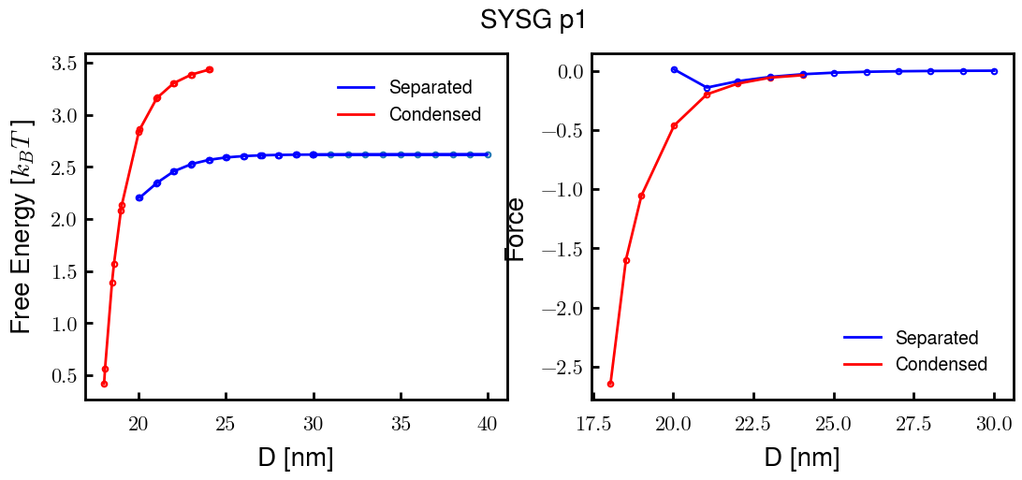
p1a4 c2.00

Slide 10
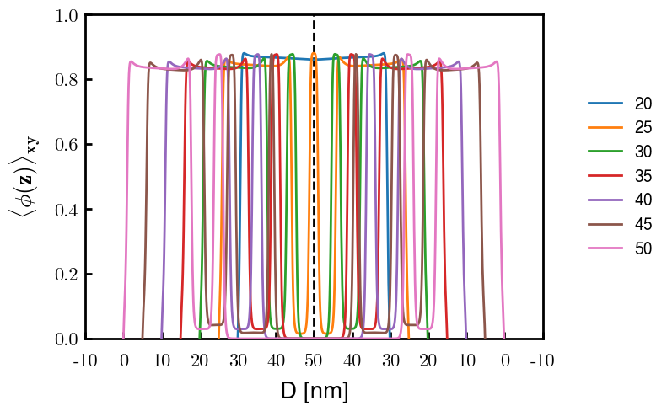
p2a4 c1.75

